Slide 1
Sugar Land Bible ChurchTx.
Do You Need to Change Your Mind About Repentance? Pt. 1
Dr Dennis Rokser
Sr. Pastor of Grace & Truth Bible Church, GA
Notes:
SO LET ME INVITE YOU TO OPEN YOUR BIBLES W ME TO EXODUS 32.
I WAS SAVED AT THE AGE OF 18 THROUGH THE WITNESS OF A FRIEND - SOME 50 PLUS YEARS AGO.
AND BEING RAISE ROMAN CATHOLIC, I HAD BEEN EXPOSED TO CHURCH TRADITION - AD INFINIUTM, AD NAUSEUM.
I’M REMINDED WHAT JC SAID ABOUT RELIGIOUS TRADITION WHEN HE REBUKED THE RELIGIOUS LEADERS OF HIS DAY BY SAYING …

Slide 2
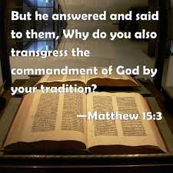
Notes:
THE BIBLE IS THE SOLE AUTHORITY FOR WHAT WE ARE TO BELIEVE AND PRACTICE.
BUT AS I GREW IN THE LORD, I BEGAN TO REALIZE THAT EVANGELICAL & FUNDAMENTAL CHURCHES ALSO HAVE MANY SACRED COWS & CHURCH ‘TRADITIONS’ – and some also VIOLATE THE WOG.
SOME WELL MEANING PEOPLE HAVE SYNCRETIZED THEIR RELIGIOUS BELIEFS WITH THE BIBLE AND THE RESULT IS UTTER CONFUSION ON A NUMBER OF ISSUES, INCLUDING CONFUSION ABOUT THE GOSPEL AND THE ANSWER TO: WHAT MUST I DO TO BE SAVED?
{CLICK}

Slide 3
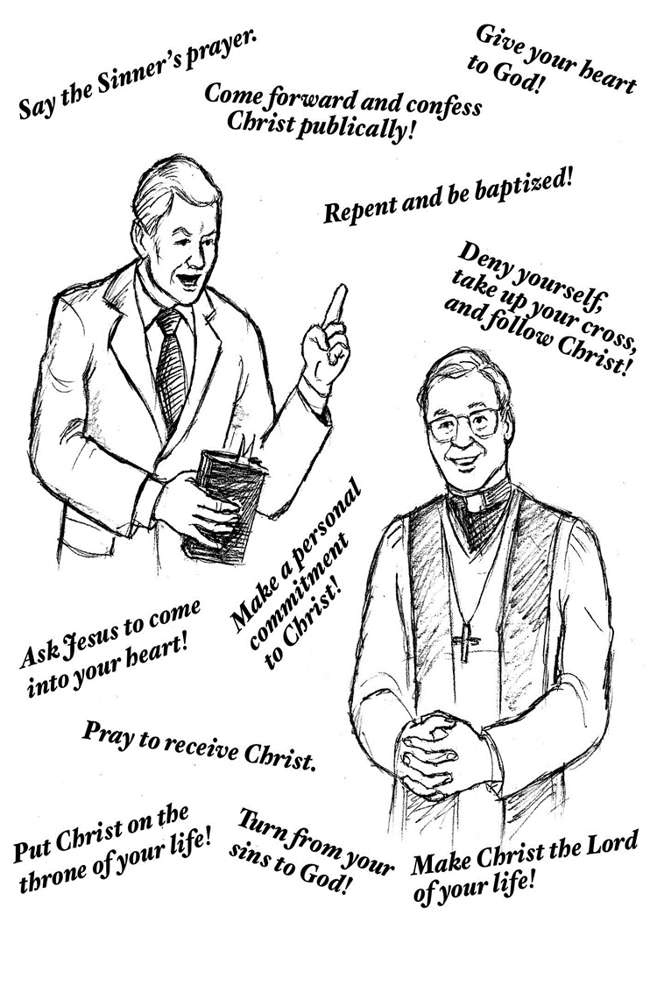
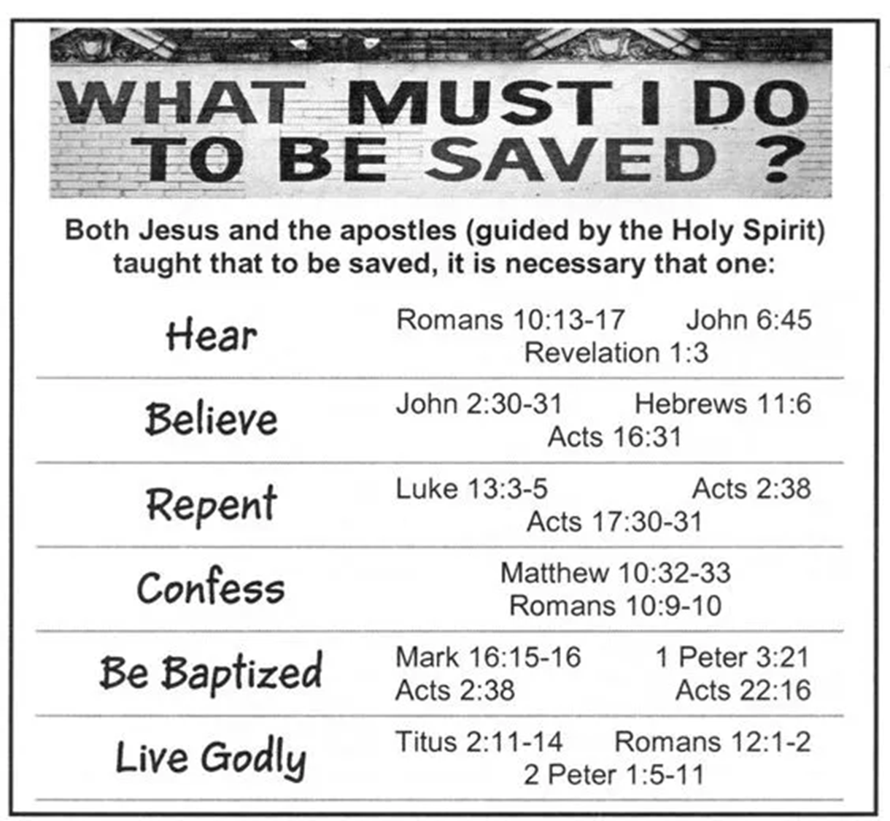
Notes:
CONFUSING MESSAGES SUCH AS ….
BTW – DO YOU REALIZE THAT EVERYONE OF THESE INVITATIONS TO SALVATION RUN CONTRARY TO THE CLEAR TEACHING OF THE SCRIPTURES?
AND THEN SOME LOVE TO COMBINE SEVERAL CONDITIONS INTO ONE PACKAGE SUCH AS …. {CLICK} GOD’S SIMPLE PLAN OF SALVATION – ONLY 6 THINGS TO DO.
ALL USING PROOF TEXTS OUT OF CONTEXT TO SUPPORT THIS ERRONEOUS AND FALSE TEACHING WHICH RUNS IN OPPOSITION TO THE GOSPEL OF GRACE.
NO WONDER THERE IS SO MUCH CONFUSION.
AND WHAT IS A MAJOR FACTOR IN THIS CONFUSION? IT IS ….

Slide 4
Notes:
https://youtu.be/gRdfX7ut8gw?si=etEzGhOVqHvHl8J5
Fiddler on the Roof
5 secs to 35 secs

Slide 5
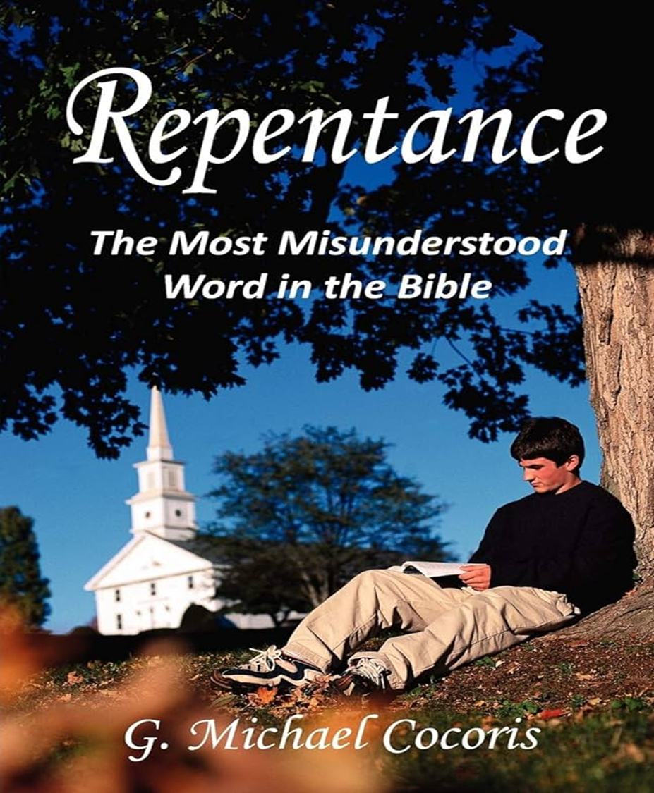
Notes:
RELIGIOUS TRADITION OFTENTIMES CONFUSES THE TRUTHS OF THE WOG. AND I SUBMIT TO YOU TODAY THAT THIS ALSO TRUE WHEN IT COMES … “REPENTANCE”.
THIS IS WHY MICHAEL COCORIS HAS WRITTEN A BOOK TITLED …
TOO MANY PEOPLE HAVE IMPOSED THEIR OWN MEANING OF THE WORDS TRANSLATED ‘REPENTANCE” IN THE BIBLE.
BUT WHAT EXACTLY IS ‘REPENTANCE” ACCORDING TO THE BIBLE AND NOT ACCORDING TO ‘TRADITION’?
MUST YOU REPENT FROM YOUR SINS TO BE SAVED ACCORDING TO THE BIBLE, AND NOT ACCORDING TO “TRADITION”?
ARE THE WORDS “REPENTANCE” AND “FAITH” SYNONOMOUS ACCORDING TO THE BIBLE, AND NOT ACCORDING TO “TRADITION”?
SO I HAVE BROKEN DOWN OUR 2 MESSAGES TODAY TO 10 IMPORTANT QUESTIONS ABOUT WHAT THE BIBLE TEACHES ABOUT … “REPENTANCE” ACCORDING TO THE BIBLE AND NOT ACCORDING TO …”TRADITION”.
SO LET’S GET STARTED. QUESTION #1 …

Slide 6
Is the subject of “repentance” a significant subject or issue in the Scriptures?
YES!
“Repent” or one of its derivatives is found in the:
King James Version – 111 x
New King James Version - 68 x
New American Standard – 71x
Notes:
The subject of repentance is a subject addressed from Genesis to Revelation.
So it should not surprise us that …

Slide 7
THE IMPORTANCE OF ‘REPENTANCE’
John the Baptist preached it. {Matt. 3:2}
Jesus Christ called sinners to it. {Luke 5:32}
The people of Ninevah did it. {Matt. 12:41}
The commissioned disciples were to preach it. {Luke 24:47}
The apostle Peter demanded it. {Acts 2:38}
The apostle Paul taught it. {Acts 20:21}
God commands all people everywhere to do it. {Acts 17:30}
The angels rejoice over it. {Luke 15:7,10}
Job concludes with it. {Job 42:6}
10. The 5 churches of Revelation 2 & 3 were instructed to do it.

Slide 8
What exactly do the words “repent” or “repentance” actually mean in the Hebrew & Greek text?
Hebrew words - OT – nacham; shub
Greek words - NT – metanoia {noun} / metanoeo {verb form}; metamellomai {KJV}
Notes:
THIS IS A VERY IMPORTANT ISSUE IN THE DEBATE OR DISCUSSION ABOUT REPENTANCE.
BECAUSE SOMETIMES WHEN PEOPLE TALK, THEY HAVE THE SAME VOCABULARY BUT NOT THE SAME DICTIONARY.
THEY USE THE SAME WORDS, BUT THEY DON’T MEAN THE SAME THINGS.
NOW LET ME 1 COMMENT ABOUT THE HEBREW WORD ‘SHUB’ BY QUOTING CHARLIE BING FROM HIS BOOK ON ‘LORDSHIP SALVATION’.

Slide 9
Dr Charles Bing writes:
The term ‘shub’ was used 1056 times in the Hebrew text. None of those occurrences is translated metanoeo in the Greek Old Testament. Not one.
This is inexplicable if the translators of the LXX felt that metanoeo was a good translation for shub.
{Lordship Salvation, pg. 68}
Notes:
AND KEEP IN MIND THAT ‘METANOIA’ {THE NOUN} OR “METANOEO” {THE VERB} WILL BE THE PRIMARY WORD TRANSLATED ‘REPENTANCE’ OR ‘REPENT’ IN THE NT.
NOW THE WORD ‘REPENT’ IS USED
NOW YOU SHOULD BE TURNED TO EX. 32. NOW KEEP IN MIND THAT THE KJV USES THE WORD ‘REPENT’ MORE THAN ANY OTHER ENGLISH TRANSLATION THAT I MENTIONED HERE.
SO SHOULD IT SURPRISE US TO READ IN EX. 32:14 …

Slide 10
KJV Exodus 32:14 And the LORD repented of the evil {disaster; calamity} which he thought to do unto his people.
NAS Exodus 32:14 So the LORD changed His mind about the harm which He said He would do to His people.
NKJ Exodus 32:14 So the LORD relented from the harm which He said He would do to His people.

Slide 11
What does “RELENT” Mean?
to change one's mind about some decided course, especially a harsh one; become more mild or amenable {British Dictionary}
Notes:
Turn next in your Bibles TO JONAH 3.

Slide 12
KJV Jonah 3:9 Who can tell if God will turn and repent {nacham / metanoeo} and turn away from his fierce anger, that we perish not?
NAS Jonah 3:9 "Who knows, God may turn and relent, and withdraw His burning anger so that we shall not perish?"
NET Jonah 3:9 Who knows? Perhaps God might be willing to change his mind and relent and turn from his fierce anger so that we might not die."
NKJ Jonah 3:9 Who can tell if God will turn and relent, and turn away from His fierce anger, so that we may not perish?
Notes:
READ VS. 1-9

Slide 13
KJV - Jonah 3:10 And God saw their works, that they turned from their evil way; and God repented {nacham / LXX - metanoeo} of the evil, that he had said that he would do unto them; and he did it not.
NAS Jonah 3:10 When God saw their deeds, that they turned from their wicked way, then God relented {nacham} concerning the calamity which He had declared He would bring upon them. And He did not do it.
NKJ Jonah 3:10 Then God saw their works, that they turned from their evil way; and God relented {nacham}from the disaster that He had said He would bring upon them, and He did not do it.

Slide 14
KJV Jonah 4:2 And he prayed unto the LORD, and said, I pray thee, O LORD, was not this my saying, when I was yet in my country? Therefore I fled before unto Tarshish: for I knew that thou art a gracious God, and merciful, slow to anger, and of great kindness, and repentest thee of the evil.
NKJ Jonah 4:2 So he prayed to the LORD, and said, "Ah, LORD, was not this what I said when I was still in my country? Therefore I fled previously to Tarshish; for I know that You are a gracious and merciful God, slow to anger and abundant in lovingkindness, One who relents {nacham / metanoeo} from doing harm.
Notes:
go next w me to Amos. Amos 7.
Its right after Billy Joel.

Slide 15
KJV Amos 7:3 The LORD repented {LXX – metanoeo} for this: It shall not be, saith the LORD.
NAS Amos 7:3 The LORD changed His mind about this. "It shall not be," said the LORD.
NET Amos 7:3 The LORD decided not to do this. "It will not happen," the LORD said.
NKJ Amos 7:3 So the LORD relented concerning this. "It shall not be," said the LORD.
NAS Amos 7:6 The LORD changed His mind {LXX – metanoeo} about this. "This too shall not be," said the Lord God.
Notes:
READ AMOS 7:1-3
READ AMOS 7:6

Slide 16
“Repent” cannot mean ‘sorrow for sin’ when it relates to God as He has no sin, but it is a CHANGE OF MIND.
When God “repented”, He changed His mind / response because man CHANGED HIS MIND or response and thus God can then bless instead of judge. (Jonah 3 & 4)
This reminds us that God is RELATIONAL and RESPONSIVE to those who seek & respond to Him.

Slide 17
“In the King James Version, the word repent occurs forty-six times in the Old Testament. Thirty-seven of these times, God is the one repenting (or not repenting). If repentance meant sorrow for sin, God would be a sinner”.
G. Michael Cocoris, Evangelism: A Biblical Approach, (Moody Press, Chicago, IL), pg. 68-69.

Slide 18
How does these words differ from the NT term for “turn” {epistrepho}? means TO TURN. Like so many words, the context determines WHO turns – to or from WHAT?
2 Cor. 3:16 Nevertheless when one {anyone} TURNS {aorist, active, subjunctive of epistrepho - to turn to, oftentimes in faith for salvation - Matt. 13:15; Mark 4:12; Luke 1:16; Acts 3:19,9:35, 11:21, 14:15, 15:19, 26:18, 20; 2 Cor. 3:16; 1 Thess. 1:9, 1 Pet. 2:25 - and who is it they choose to turn to in faith? TO THE LORD {the Lord Jesus Christ; 3x in the NT we see what they turn from - (Acts 14:15, 26:18, 1 Thess. 1:9 - from the wrong object of trust to trust THE LORD}, {And what is the result?}
the veil is taken away {present, passive, indicative of periaireo - is removed - by God; for Paul, this happened in Acts 9; 2 Cor. 5:16}.

Slide 19
How is “metanoeo {verb form} / metanoia {noun form}” different than the Greek words “metamellomai” {Matthew 27:3-5} or “lupeo”? {2 Cor. 7:8-10}
8 For even if I made you SORRY {lupeo} with my letter, I do not REGRET it {metamellomia – like Judas, Mt. 27:3; this word is NEVER used in reference to salvation / justification}; though I did regret it {metamellomia}.
For I perceive that the same epistle made you sorry {lupeo}, though only for a while. 9 Now I rejoice, not that you were made sorry {lupeo}, but that your sorrow {lupeo}
LED TO {eis – resulted in} REPENTANCE {metanoia – a change of mind}. For you were made sorry in a godly manner that you might suffer loss from us in nothing.
Notes:
Turn to 2 Cor. 7 – explain CONTEXT – then explain CONTENT
DO YOU SEE THAT SORROW IS NOT REPENTANCE; REGRET IS NOT REPENTANCE;

Slide 20
For godly sorrow PRODUCES repentance {metanoia} leading to {eis} SALVATION {2nd tense; these were believers in Christ},
not to be regretted {ametameletos – no regret or sorrow}; but the sorrow {lupeo} of the world produces death.
Always ask yourself: WHO needs to change their mind {believers? Unbelievers? Nation of Israel?} about WHAT?

Slide 22
The Greek word for “repent / repentance” (in the NT) is METANOEO / METANOIA and it means A CHANGE OF MIND (Lk. 16:30-31; 17:3-4).
It is different from the Greek word METAMELLOMAI, which means “regret” or “remorse” though translated as “repent” in the KJV in certain verses. (Matt. 27:3; 2 Cor. 7:8-10).
KJV Matthew 27:3 Then Judas, which had betrayed him, when he saw that he was condemned, repented {metamellomai} himself {NKJV – was remorseful}, and brought again the thirty pieces of silver to the chief priests and elders, saying, "I have sinned by betraying innocent blood." And they said, "What is that to us? You see to it!" 5 Then he threw down the pieces of silver in the temple and departed, and went and hanged himself.
Notes:
Comment on etymology - NICE
Comment on mixing 2 words together – HOGWASH
Why is there such a misunderstanding & mistranslation of these words?
NO PROBLEM W CLASSICAL GREEK / NO ISSUE W KOINE GREEK / LATIN VULGATE – PENANCE; PAIN, PENALTY, SUFFERING – ATTACHED A WRONG MEANING OF THE WORD METANOIA INCLUDING EMOTION, SORROW, ACTS OF CONTRITION, WORKS
TAKES FOCUS OFF JC AND PUTS THEM RIGHT ON YOU
TURN W ME TO 2 COR. 7.

Slide 23
Why are the original Hebrew and Greek words for “repentance” so often mistranslated in our English Bibles?
a. Factor #1: the apostasy of the “Church” - over time moving from salvation by grace to religious works.
b. Factor #2: the reliance on the Latin Vulgate - instead of the Koine Greek of the NT.
c. Factor #3: the tendency to force one’s theology on the text {eisegesis}
d. Factor #4: no translation team has been willing to change 100s of years of “tradition”.
Notes:
THE AVERAGE PERSON WHEN THEY HEAR THE WORD ‘REPENTANCE’ THINKS OF ‘PENANCE’ AND WHY WOULDN’T THEY, FOR BUILT INTO THE ENGLISH WORD IS THE WORD ‘PENANCE’ WHICH CARRIES THE IDEA OF SORROW FOR SIN AND A WILLINGNESS TO TURN FROM IT.
BUT ARE WE GOING TO BASE OR BELIEFS ON ‘TRADITION’ OR UPON THE WOG, STARTING IN THE ORIGINAL LANGUAGES, OR NOT?

Slide 24
Notes:
CHANGED THE BIBLE! WHY? “TRADITION”

Slide 26
6. What does “repentance” NOT mean? REPENTANCE …
a. is not necessarily connected with your “SINS” {context determines what the object of repentance is, and while sometimes believers are told to ‘repent from their sins’, unbelievers are not required to do so for salvation}
b. does not mean ‘SORROW’{though it might lead to or accompany salvation. It is important to remember that sorrow can PRECEDE repentance, ACCOMPANY repentance, or FOLLOW repentance, but sorrow is NOT repentance which requires no EMOTIONAL element involved.
c. It does not mean ‘TURNING FROM SIN’ – for did God turn from His sins when He repented? {He had none!}
d. It does not mean a CHANGE IN BEHAVIOR {though that may or may not be the fruit of it – Luke 17:3-4}
Notes:
GO NEXT W ME TO LUKE 17.

Slide 27
Luke 17:3-4
"Take heed to yourselves. If {3RD} your brother sins against you, rebuke him; and if he repents {metanoeo} , forgive him.
4 "And if {3rd} he sins against you seven times in a day,
and seven times in a day returns to you, saying,
`I repent {metanoeo},' you shall forgive him."
Notes:
THIS IS AN EXAMPLE WHERE THIS BROTHER OR BELIEVER ACTUALLY CHANGED HIS MIND AND ADMITTED TO YOU HIS SIN, AND YOU FORGAVE HIM, BUT HAS NOT YET CHANGED HIS BEHAVIOR, FOR HE DOES THE SAME THINK 7 TIMES IN THE SAME DAY.
AND WHILE HOPEFULLY HIS CHANGE OF MIND WILL LEAD HIM BY GOD’S GRACE TO A CHANGE OF BEHAVIOR FROM SIN, REPENTANCE DOES NOT MEAN OR REQUIRE A CHANGE IN BEHAVIOR.
NOW THIS IS A CONTEXT IN WHICH THE OBJECT OF REPENTANCE IS ‘SIN’ TOWARD ANOTHER BELIEVER.
BUT WE MUST BE CAREFUL NOT TO ASSUME THAT EVERY CONTEXT INVOLVES CHANGING YOUR MIND ABOUT SIN, FOR IT DOES NOT.
I SAY THIS BECAUSE SOME TRANSLATIONS IMMEDIATELY ASSUME THAT ‘REPENTANCE’ INVOLVES SIN, AND WE HAVE ALREADY OBSERVED THAT THAT MAY NOT BE THE CASE.

Slide 28
Morgan Arnold writes, “One common mistake Lordship theologians make is to conflate repentance with the fruits of repentance. The distinction between the two must be observed and interpreted appropriately.
For example, in Luke 3:8a, John the Baptist admonishes the Pharisees and Sadducees: “Therefore bear fruit in keeping with repentance.” Bing points out that subsequently, “When the people ask ‘What shall we do?’ (3:10. 12, 14a), they are asking for an expansion of the nearest thought: John’s exhortation to bear fruits worthy of repentance (3:8).” Thus, there is a marked delineation between someone changing their mind and someone changing their actions in response to the change of mind.

Slide 29
Also, in Acts 26:20, Paul uses similar language when testifying to King Agrippa concerning why the Jews seized him in the temple and was almost put to death. He shares that after his heavenly vision of Jesus, he “kept declaring both to those of Damascus first, and also at Jerusalem and then throughout all the region of Judea, and even to the Gentiles, that they should repent and turn to God, performing deeds appropriate to repentance. {Morgan Arnold}

Slide 30
Charlie Bing aptly states,
“It is a careless error to make the outward fruit of repentance the same as inner repentance itself. The fruit must be distinguished from the root, the cause from the effect.”

Slide 31
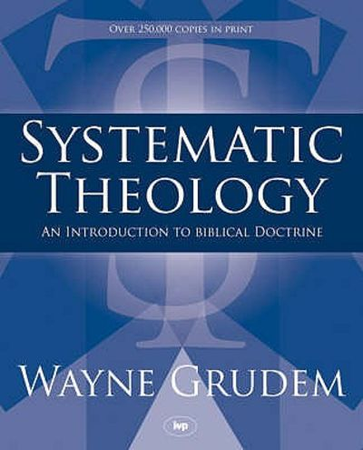
Reformed theologian, Wayne Grudem, writes in his
Systematic Theology: An Introduction to Biblical
Doctrine. He states,
“Repentance is a heartfelt sorrow for sin, a renouncing of it, and a sincere
commitment to forsake it and walk in obedience to Christ.” {pg. 713}

Slide 32
Notes:
https://youtube.com/shorts/irJVveVHmLY?si=bZXEi0z_2iYOelzT
Ray Comfort
False Alert Section starts at 10 secs
DID YOU HEAR THE GOSPEL HERE?
WAS THE SPOTLIGHT ON JC?
HOW MANY THINGS TO DO TO BE SAVED? REPLAY
AND IF YOU ONLY HAD 3 MINUTES TO LIVE, COULD YOU REPENT OF ALL YOUR SINS? MINE WOULD TAKE MORE THAN 3 MINUTES….

Slide 33
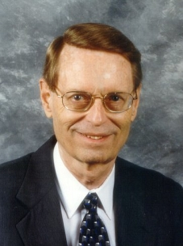
Dr Charles Ryrie states … “In both the Old and New Testaments repentance means ‘to change one’s mind’ . . .
Sorrow may well be involved in repentance, but the biblical meaning of repentance is to change one’s mind, not to be sorry.”
Ryrie continues, “Is repentance a condition for receiving eternal life? Yes, if it is repentance or changing one’s mind about Jesus Christ. No, if it means to be sorry for sin or even resolve to turn from sin, for these things will not save.” {So Great Salvation, p. 92, 99}
Notes:
REPENT FROM YOUR SINS - #1 WRONG RESPONSE TO THE GOSPEL – AROUND THE WORLD!
YOU HEAR THE PREACHER SAY … YOU MUST REPENT FROM YOUR SINS & TRUST IN X … AND THEN THEY SING … JUST AS I AM – I’M REALLY CONFUSED

Slide 34
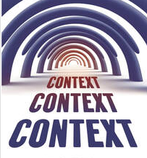
What must be considered in understanding the correct meaning or nuance of “repentance” in any passage?
The CONTEXT, CONTEXT, CONTEXT!
You must always consider “WHO is to change his/her mind and about WHAT?”
Notes:
MUST OBSERVE … WHO IS CHANGING THEIR MIND AND ABOUT WHAT IN THE CONTEXT YOU ARE READING.
FOR EXAMPLE

Slide 36
What is the relationship of “faith” and “repentance”? Are they the same thing?
Repentance and faith are closely related in many contexts, but they are NOT synonomous? NO! {Acts 20:21; Hebrews 6:1; Matt. 12:41, Jonah 3:5; Acts 10:43, 11:17-18}

Slide 37
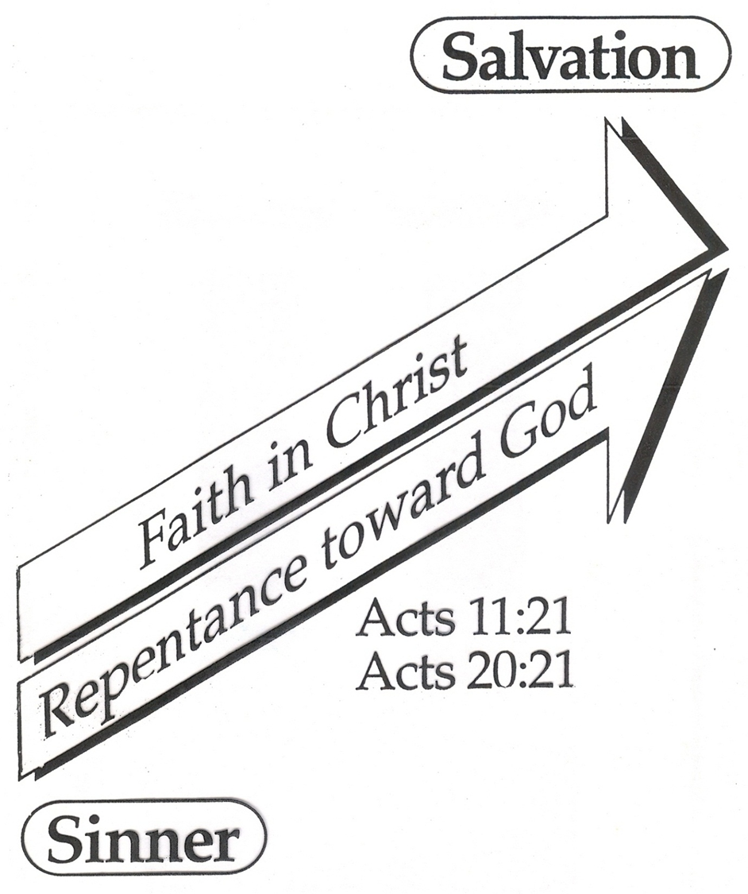
Acts 20:20-21… "how I kept back nothing that was helpful, but proclaimed it to you, and taught you publicly and from house to house, testifying to Jews, and also to Greeks, repentance toward God and faith toward our Lord Jesus Christ.
Notes:
TSKS CONSTRUCTION
GENERALLY - FAITH TOWARD GOD – REPENTANCE OF A CORRECT UNDERSTANDING OF GOD, MAN, SIN, ETC.
SPECIFICALLY – FAITH TOWARD OUR LJC

Slide 38
Notes:
* TWO CHAIR ILLUSTRATION

Slide 39
While repentance is INHERENT in BELIEVING, faith in Christ is NOT always inherent in REPENTING - depending on the context.
{Like when God repented in the OT; or when believers repent about sins in their lives, etc.}

Slide 41
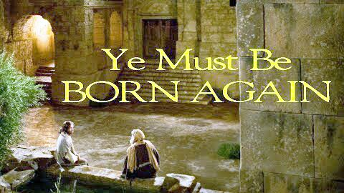
Did Jesus make “sorrow or turning from sin” a condition to be born again with Nicodemus (John 3)?

Slide 42
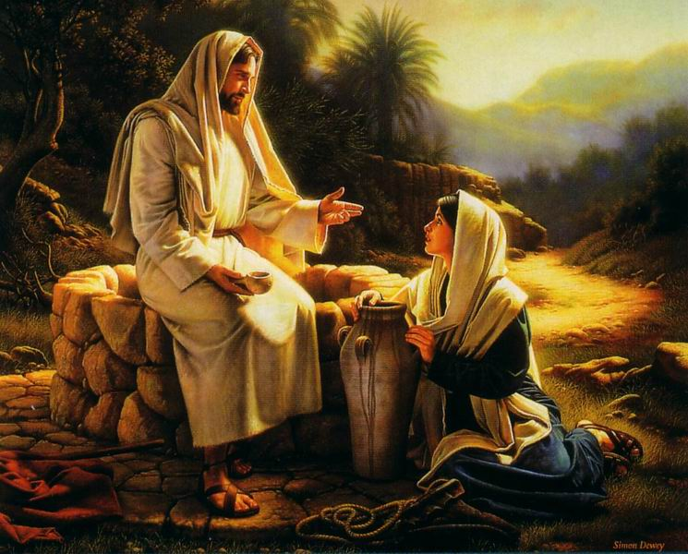
Did Jesus make “sorrow or turning from sin” (adultery) a condition of salvation with Samaritan woman at the well (John 4)?

Slide 43
Notes:
https://youtube.com/shorts/irJVveVHmLY?si=bZXEi0z_2iYOelzT
Ray Comfort
False Alert Section starts at 10 secs

Slide 45
What is the purpose of the book of John (20:30-31) and how many times is the word “repent / repentance” found in it?
The word “repent / repentance” is not found in John but “believe” is found 99x.

Slide 46
Repentance / repent found in book of …
John? 0x
Romans? 1x – 2:4 Or do you despise the riches of His goodness, forbearance, and longsuffering, not knowing that the goodness of God leads you to repentance?
Galatians? 0x

Slide 47
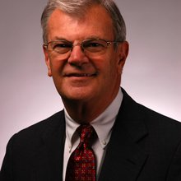
Dr. Thomas Constable writes…
“It is asserted that repentance, which is a change of mind, enters of necessity into the very act of believing on Christ, since one cannot turn to Christ from other objects of confidence without that change of mind.” Thomas Constable, The Gospel Message in “Walvoord, a Tribute” (Moody Press, Chicago, IL).
Notes:
2 CHAIR ILLUSTRATION
GO TO ACTS 10 – TELL STORY OF CORNELIUS

Slide 48
WHAT ULTIMATELY CONDEMNS A SINNER? IS IT A LACK OF HIS REPENTING OR TURNING FROM SIN? NO!
John 3:18 "He who believes in Him is not condemned; but he who does not believe is condemned already, because he has not believed in the name of the only begotten Son of God.

Slide 49
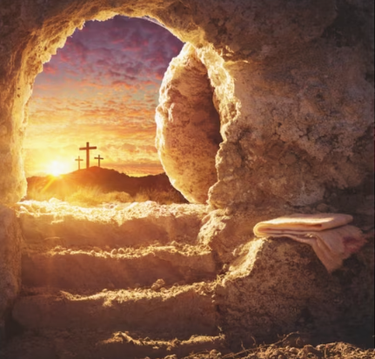
Notes:
PEOPLE ATTACH A LOT OF BAGGAGE TO THE WORD “BELIEVE” LIKE A SPENDING BILL IN CONGRESS.

Slide 50
Acts 11:14-18 `who will tell you words by which you and all your household will be saved.' 15 "And as I began to speak, the Holy Spirit fell upon them, as upon us at the beginning {Acts 2}. 16 "Then I remembered the word of the Lord, how He said, “John indeed baptized with water, but you shall be baptized with the Holy Spirit.”
17 "If therefore God gave them the same gift {of the Holy Spirit} as He gave us when we believed {aorist, active, participle of pistueo} on {epi} the Lord Jesus Christ, who was I that I could withstand God?"
18 When they heard these things they became silent; and they glorified God, saying, "Then God has also granted to the Gentiles repentance {metanoia to change their mind regarding the Gospel} to {eis – resulting in} life {eternal life}.

Slide 51
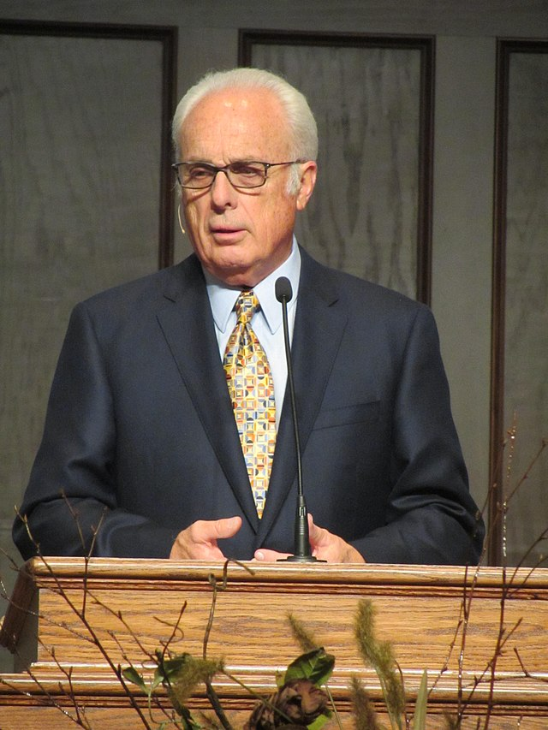
“In other words, there must be a sincere change in one’s lifestyle. One who has genuinely repented will stop doing evil and begin to live righteously. Along with a change of mind and attitude, true repentance will begin to produce a change in conduct.”
John MacArthur, Gospel According to Jesus, 166.

Slide 52
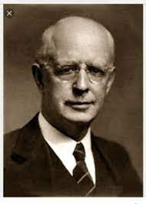
In stark contrast, Lewis Sperry Chafer writes: No unregenerate mind is prepared to deal with the problems of true Christian living. These problems anticipate the new dynamic of the imparted divine nature, and could produce nothing but hopeless discouragement when really contemplated by an unregenerate person.
Salvation: God’s Marvelous Work of Grace, pg. 48

