Slide 2
Acts 8:5-40 Philip’s Ministry
Samaria (8:5-25)
Judea (Acts 8:26-40)

Slide 3
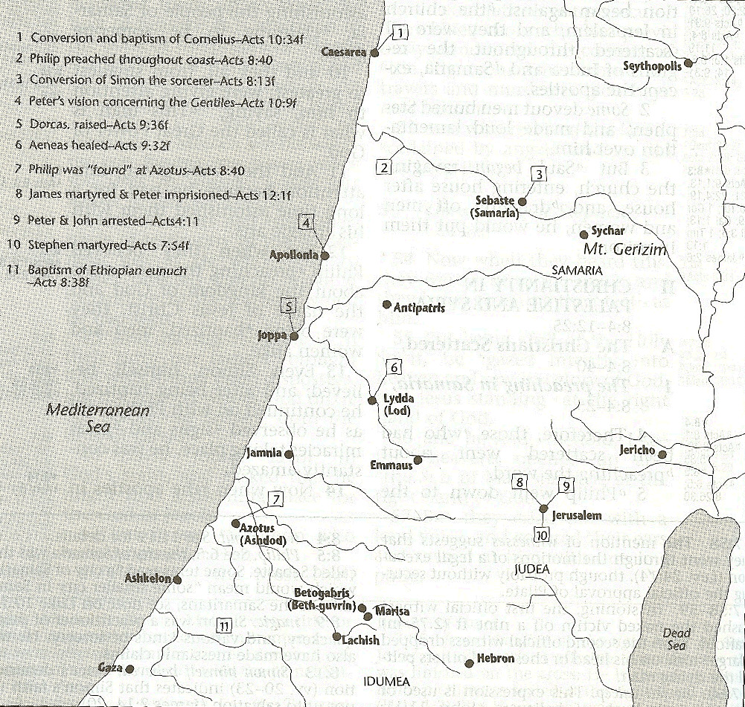

Slide 4
I. Ministry in Samaria Acts 8:5-25
Evangelization in Samaria (5-8)
Simon’s conversion (9-13)
Peter & John lay hands on the Samaritans (14-17)
Peter rebukes Simon (18-25)

Slide 5
Acts 8:9-13 Simon’s Conversion
Simon’s deception (9-11)
Samaria’s response to Philip’s preaching (12)
Simon’s response to Philip’s preaching (13)

Slide 6
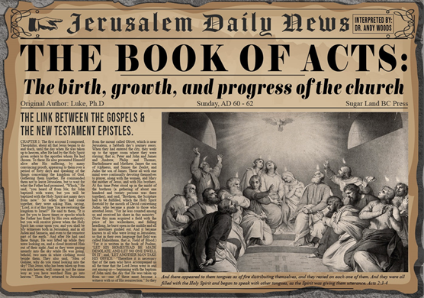
Acts 8:13 Simon’s Response to Philip’s Preaching
Faith (13a)
Baptism (13b)
Followed Philip (13c)

Slide 7
Acts 8:13 Simon’s Response to Philip’s Preaching
Faith (13a)
Baptism (13b)
Followed Philip (13c)

Slide 8
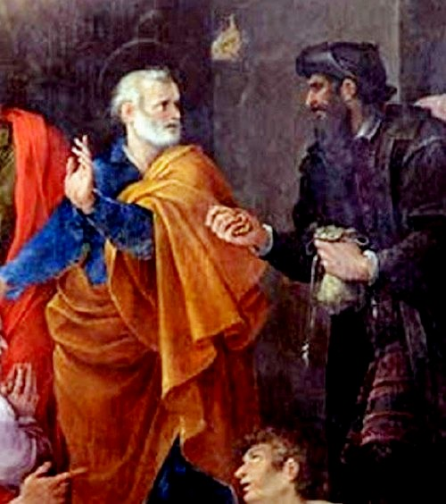
Why Simon Was Saved
Simon believed (Acts 8:12, 13)
Simon was baptized (Acts 8:12, 13)
Simon experienced remorse (Acts 8:24)
Notes:
Outline

Slide 9
Why Simon Was Saved
Simon believed (Acts 8:12, 13)
Simon was baptized (Acts 8:12, 13)
Simon experienced remorse (Acts 8:24)
Notes:
Outline

Slide 10
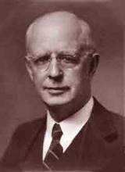
Lewis Sperry Chafer, vol. 7, Systematic Theology (Grand Rapids, MI: Kregel Publications, 1993), 265-66.
Belief – God’s One Condition for Justification
“…because upwards of 150 passages of Scripture condition salvation upon believing only (cf. John 3:16; Acts 16:31).”

Slide 11
Belief – God’s One Condition for Justification
Gen 15:6
Then he believed in the LORD; and He reckoned it to him as righteousness.
John 3:16
For God so loved the world, that He gave His only begotten Son, that whoever believes in Him shall not perish, but have eternal life.
Acts 16:30-31
"Sirs, what must I do to be saved?" They said, "Believe in the Lord Jesus, and you will be saved..."

Slide 12
Why Simon Was Saved
Simon believed (Acts 8:12, 13)
Simon was baptized (Acts 8:12, 13)
Simon experienced remorse (Acts 8:24)
Notes:
Outline

Slide 13
Why Simon Was Saved
Simon believed (Acts 8:12, 13)
Simon was baptized (Acts 8:12, 13)
Simon experienced remorse (Acts 8:24)
Notes:
Outline

Slide 14
Illegitimate Faith
Spurious faith (Luke 8:13; Jas. 2:19)
Miracle faith (John 2:23-25)
Repent (2 Pet. 3:9)
Perish (John 3:16)
Description of the Lost (Acts 8:21, 23)
Simon never received the Holy Spirit (Acts 8:17-18)
Founder of Gnosticism
Notes:
Outline

Slide 15
Answering Illegitimate Faith Arguments
Spurious faith (Luke 8:13; Jas. 2:19) – Angels
Miracle faith (John 2:23-25) – pistueō eis
Repent (2 Pet. 3:9) – Rev. 2‒3
Perish (John 3:16) – Temporal
Description of the Lost (Acts 8:21, 23) – No time for Sanctification
Simon never received the Holy Spirit (Acts 8:17-18) – Argument from silence
Founder of Gnosticism – Sola Scriptura
Notes:
Outline

Slide 16
Acts 8:13 Simon’s Response to Philip’s Preaching
Faith (13a)
Baptism (13b)
Followed Philip (13c)

Slide 17
1 Corinthians 12:13
“For by one Spirit we were all baptized into one body, whether Jews or Greeks, whether slaves or free, and we were all made to drink of one Spirit.”

Slide 18
Acts 8:13 Simon’s Response to Philip’s Preaching
Faith (13a)
Baptism (13b)
Followed Philip (13c)

Slide 19
Three Tenses of Salvation
Phase | Justification | Sanctification | Glorification
Tense | Past | Present | Future
Saved from sin’s: | Penalty | Power | Presence
Scripture | Eph 2:8-9; Titus 3:5 | Philip 2:12 | Rom 5:10
Nature | Single | Dual | Single

Slide 20
Romans 12:2
“And do not be conformed to this world, but be transformed by the renewing of your mind, so that you may prove what the will of God is, that which is good and acceptable and perfect.”

Slide 21
I. Ministry in Samaria Acts 8:5-25
Evangelization in Samaria (5-8)
Simon’s conversion (9-13)
Peter & John lay hands on the Samaritans (14-17)
Peter rebukes Simon (18-25)

Slide 22
Acts 8:14-17 Peter & John Lay Hands on the Samaritans
The concern (14)
The problem (15-16)
The solution (17)

Slide 23
Acts 8:14-17 Peter & John Lay Hands on the Samaritans
The concern (14)
The problem (15-16)
The solution (17)

Slide 25
Acts 8:14-17 Peter & John Lay Hands on the Samaritans
The concern (14)
The problem (15-16)
The solution (17)

Slide 26
Acts 8:14-17 Peter & John Lay Hands on the Samaritans
The concern (14)
The problem (15-16)
The solution (17)

Slide 27
Acts 1:5
“for John baptized with water, but you will be baptized with the Holy Spirit not many days from now.”

Slide 28
1 Corinthians 12:13
“For by one Spirit we were all baptized into one body, whether Jews or Greeks, whether slaves or free, and we were all made to drink of one Spirit.”

Slide 29
Galatians 3:28
“There is neither Jew nor Greek, there is neither slave nor free man, there is neither male nor female; for you are all one in Christ Jesus.”

Slide 30
Ephesians 2:14
“For He Himself is our peace, who made both groups into one and broke down the barrier of the dividing wall.”

Slide 32
I. Ministry in Samaria Acts 8:5-25
Evangelization in Samaria (5-8)
Simon’s conversion (9-13)
Peter & John lay hands on the Samaritans (14-17)
Peter rebukes Simon (18-25)

Slide 33
Acts 8:18-25 Peter Rebukes Simon
Simon’s request (18-19)
Peter rebukes Simon (20-23)
Simon’s response (24)
Conclusion (25)

Slide 34
Acts 8:18-25 Peter Rebukes Simon
Simon’s request (18-19)
Peter rebukes Simon (20-23)
Simon’s response (24)
Conclusion (25)

Slide 35
Acts 8:18-19 Simon’s Request
Simon’s observation (18a)
Simon’s financial offer (18b)
Simon’s ambition (19)

Slide 36
Acts 8:18-19 Simon’s Request
Simon’s observation (18a)
Simon’s financial offer (18b)
Simon’s ambition (19)

Slide 37
Acts 8:18-19 Simon’s Request
Simon’s observation (18a)
Simon’s financial offer (18b)
Simon’s ambition (19)

Slide 38
Three Tenses of Salvation
Phase | Justification | Sanctification | Glorification
Tense | Past | Present | Future
Saved from sin’s: | Penalty | Power | Presence
Scripture | Eph 2:8-9; Titus 3:5 | Philip 2:12 | Rom 5:10
Nature | Single | Dual | Single

Slide 39
Acts 8:18-19 Simon’s Request
Simon’s observation (18a)
Simon’s financial offer (18b)
Simon’s ambition (19)

Slide 40
Acts 8:18-25 Peter Rebukes Simon
Simon’s request (18-19)
Peter rebukes Simon (20-23)
Simon’s response (24)
Conclusion (25)

Slide 41
Acts 8:20-23 Peter Rebukes Simon
Simon’s consequence (20)
Simon’s heart (21)
Simon’s need: repentance (22)
Simon’s problem (23)

Slide 42
Acts 8:20-23 Peter Rebukes Simon
Simon’s consequence (20)
Simon’s heart (21)
Simon’s need: repentance (22)
Simon’s problem (23)

Slide 43
1 Corinthians 3:10-15
“¹⁰ According to the grace of God which was given to me, like a wise master builder I laid a foundation, and another is building on it. But each man must be careful how he builds on it. ¹¹ For no man can lay a foundation other than the one which is laid, which is Jesus Christ. ¹² Now if any man builds on the foundation with gold, silver, precious stones, wood, hay, straw…. ¹⁴ If any man’s work which he has built on it remains, he will receive a reward. ¹⁵ If any man’s work is burned up, he will suffer loss; but he himself will be saved, yet so as through fire.”

Slide 44
1 Corinthians 9:24-27
“²⁴ Do you not know that those who run in a race all run, but only one receives the prize? Run in such a way that you may win. ²⁵ Everyone who competes in the games exercises self-control in all things. They then do it to receive a perishable wreath, but we an imperishable. ²⁶ Therefore I run in such a way, as not without aim; I box in such a way, as not beating the air; ²⁷ but I discipline my body and make it my slave, so that, after I have preached to others, I myself will not be disqualified.”

Slide 45
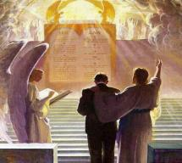
2 John 8
“Watch yourselves, that you do not lose what we have accomplished, but that you may receive a full reward.”

Slide 46
Revelation 3:11
“I am coming quickly; hold fast what you have, so that no one will take your crown.”

Slide 47
Acts 8:20-23 Peter Rebukes Simon
Simon’s consequence (20)
Simon’s heart (21)
Simon’s need: repentance (22)
Simon’s problem (23)

Slide 48
Acts 8:20-23 Peter Rebukes Simon
Simon’s consequence (20)
Simon’s heart (21)
Simon’s need: repentance (22)
Simon’s problem (23)

Slide 51
Revelation 3:19
consequences
“Those whom I love, I reprove and discipline; therefore be zealous and repent.”

Slide 52
Acts 8:20-23 Peter Rebukes Simon
Simon’s consequence (20)
Simon’s heart (21)
Simon’s need: repentance (22)
Simon’s problem (23)

Slide 53
Acts 8:18-25 Peter Rebukes Simon
Simon’s request (18-19)
Peter rebukes Simon (20-23)
Simon’s response (24)
Conclusion (25)

Slide 54
Acts 8:18-25 Peter Rebukes Simon
Simon’s request (18-19)
Peter rebukes Simon (20-23)
Simon’s response (24)
Conclusion (25)

Slide 55
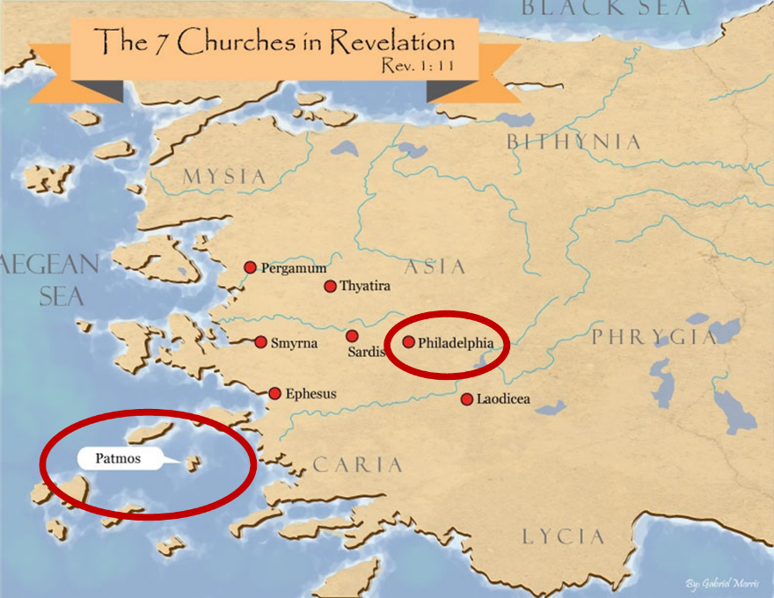

Slide 57
Acts 8:5-40 Philip’s Ministry
Samaria (8:5-25)
Judea (Acts 8:26-40)

Slide 59
II. Ministry in Judea Acts 8:26-40
Angel directs Philip (26)
Philip’s obedience (27a)
Ethiopian Eunuch’s introduction (27b-28)
Holy Spirit directs Philip (29)
Philip’s witness to the Eunuch (30-35)
Eunuch’s conversion & baptism (36-38)
Philip’s separation from the Eunuch (39)
Philip’s evangelization of the Coastal Plain (40)

Slide 60
II. Ministry in Judea Acts 8:26-40
Angel directs Philip (26)
Philip’s obedience (27a)
Ethiopian Eunuch’s introduction (27b-28)
Holy Spirit directs Philip (29)
Philip’s witness to the Eunuch (30-35)
Eunuch’s conversion & baptism (36-38)
Philip’s separation from the Eunuch (39)
Philip’s evangelization of the Coastal Plain (40)

Slide 61
Stanley D. Toussaint
Bible Knowledge Commentary, p. 374
“Though Luke gave no record of God’s commanding Philip to preach to the Samaritans (v. 5), God did sovereignly direct Philip toward Gaza . . . The highway is referred to as the desert road. The expression may refer to a desert road or a desert city. Ancient Gaza was destroyed in 93 B.C. and the city was rebuilt nearer the Mediterranean in 57 B.C. The old city was called Desert Gaza. The Greek for the angel’s command could be translated, ‘Arise and go to the south to the road . . . that goes down from Jerusalem to Gaza. This is desert.’ This reference to the road in 8:36 may imply that the road, not the city, was in a deserted area.”

Slide 62
II. Ministry in Judea Acts 8:26-40
Angel directs Philip (26)
Philip’s obedience (27a)
Ethiopian Eunuch’s introduction (27b-28)
Holy Spirit directs Philip (29)
Philip’s witness to the Eunuch (30-35)
Eunuch’s conversion & baptism (36-38)
Philip’s separation from the Eunuch (39)
Philip’s evangelization of the Coastal Plain (40)

Slide 63
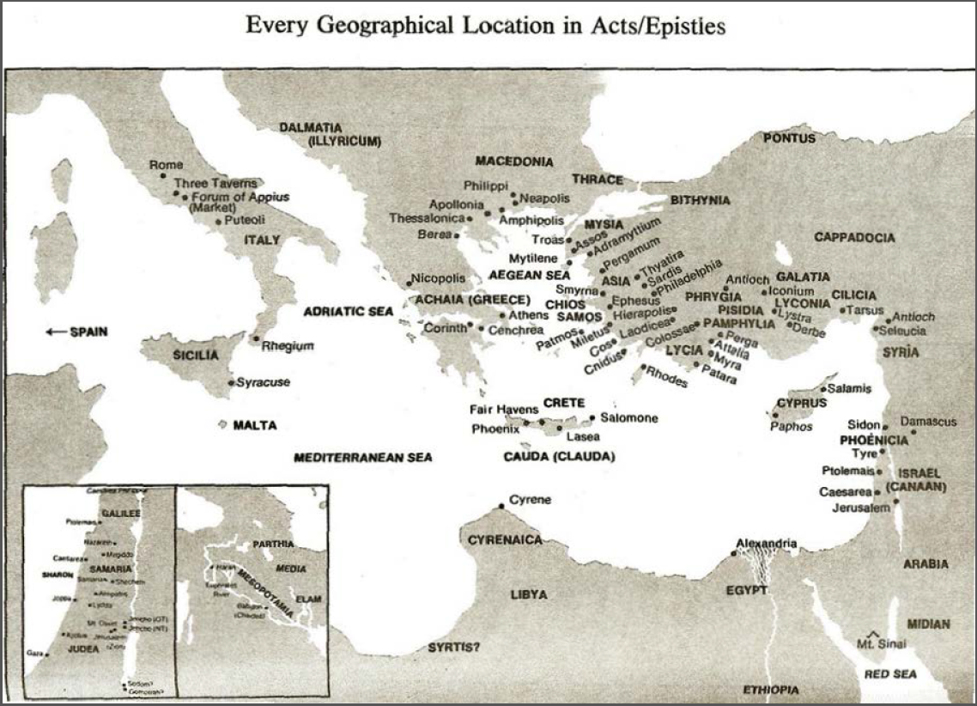

Slide 64
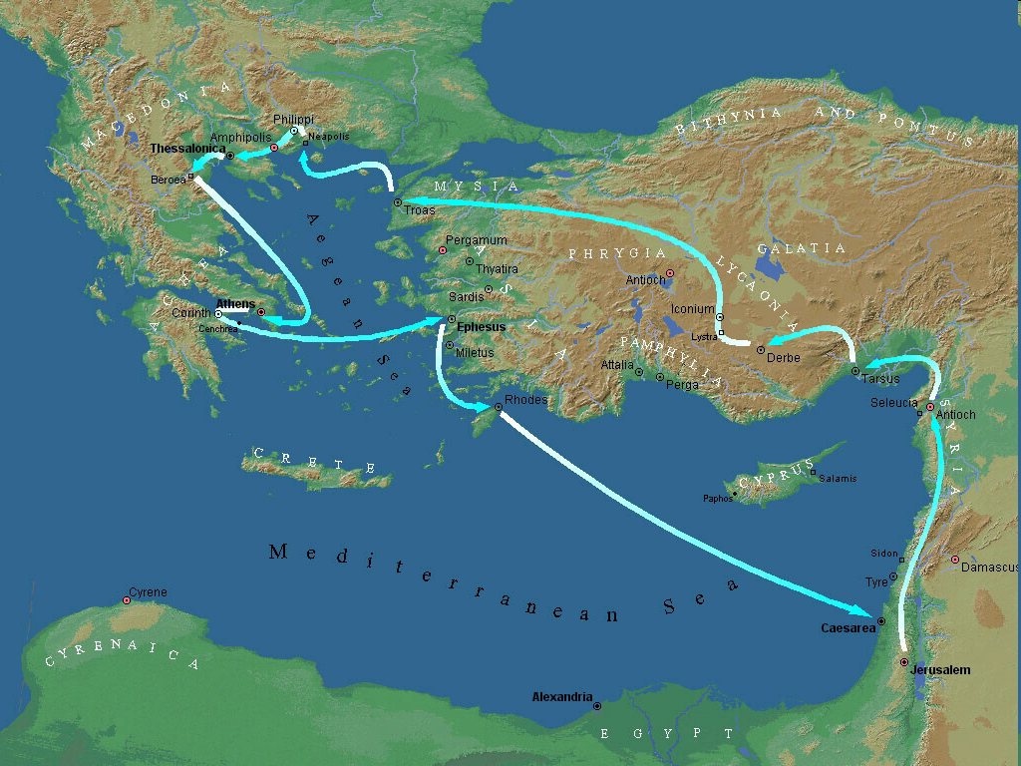
Second Missionary Journey

Slide 65
II. Ministry in Judea Acts 8:26-40
Angel directs Philip (26)
Philip’s obedience (27a)
Ethiopian Eunuch’s introduction (27b-28)
Holy Spirit directs Philip (29)
Philip’s witness to the Eunuch (30-35)
Eunuch’s conversion & baptism (36-38)
Philip’s separation from the Eunuch (39)
Philip’s evangelization of the Coastal Plain (40)

Slide 66
Dr. Arnold G. Fruchtenbaum
The Book of Acts, 200-201
“The text states that he was a eunuch. Eunuchs were often employed by oriental rulers in positions of high office. They were also male servants of female dignitaries, but only placed in such positions after having been castrated... Politically, he was a highly influential official under Candace, queen of the Ethiopians. ‘Candace’ (Kandakēs, in Greek) was not a proper name, but the title of the queen of Ethiopia, much like the word ‘Kaiser’ was the title of the king of Germany and ‘Czar’ was a title of the king of Russia.”

Slide 67
Dr. Arnold G. Fruchtenbaum
The Book of Acts, 200-201
“Because the king of Ethiopia was considered to be a child of the sun and therefore a person too sacred to be involved with secular functions of the royal court, all such duties fell to the queen mother, who had the title of ‘Candace.’ As a result, she was the real power behind the throne, and Ethiopia was a de facto matriarchy. The eunuch was in charge of her treasure, which means he held one of the highest governmental positions. His influence in Ethiopia would therefore have been very considerable.”

Slide 68
II. Ministry in Judea Acts 8:26-40
Angel directs Philip (26)
Philip’s obedience (27a)
Ethiopian Eunuch’s introduction (27b-28)
Holy Spirit directs Philip (29)
Philip’s witness to the Eunuch (30-35)
Eunuch’s conversion & baptism (36-38)
Philip’s separation from the Eunuch (39)
Philip’s evangelization of the Coastal Plain (40)

Slide 69
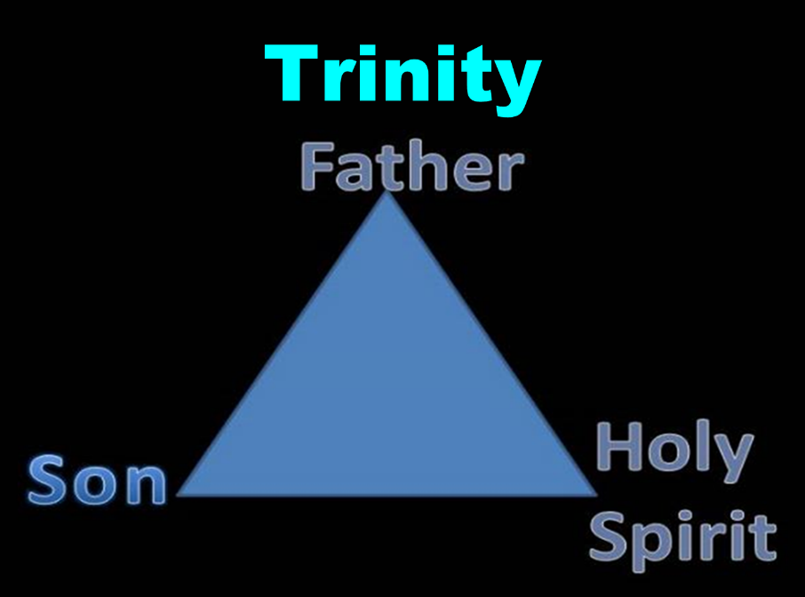

Slide 70
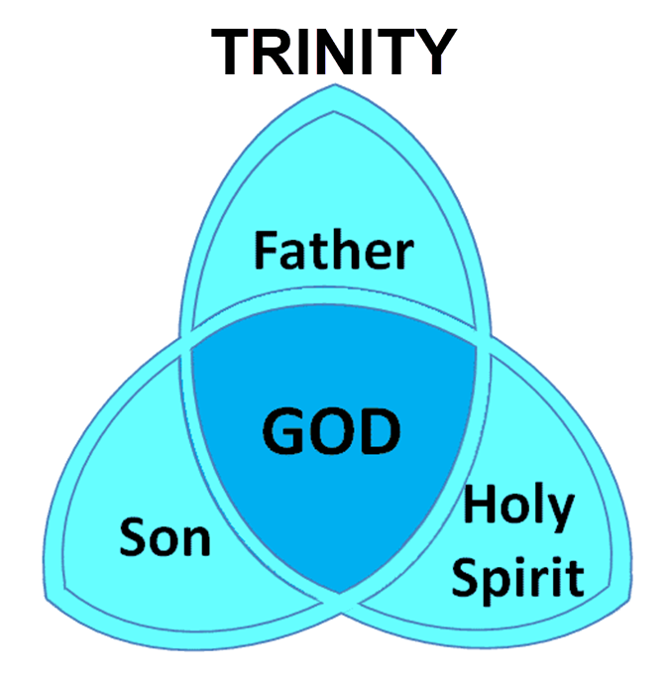

Slide 71
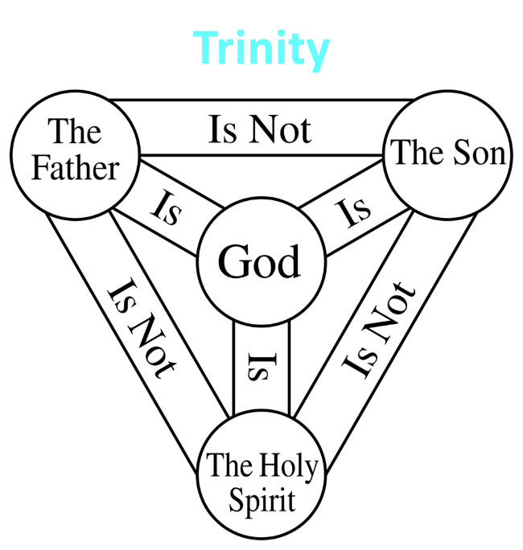

Slide 72
II. Ministry in Judea Acts 8:26-40
Angel directs Philip (26)
Philip’s obedience (27a)
Ethiopian Eunuch’s introduction (27b-28)
Holy Spirit directs Philip (29)
Philip’s witness to the Eunuch (30-35)
Eunuch’s conversion & baptism (36-38)
Philip’s separation from the Eunuch (39)
Philip’s evangelization of the Coastal Plain (40)

Slide 73
Acts 8:30-35 Philip’s Witness to the Eunuch
Philip’s question (30)
Eunuch’s answer (31)
Eunuch's reading (32-33)
Eunuch’s question (34)
Philip’s witness (35)

Slide 74
Acts 8:30-35 Philip’s Witness to the Eunuch
Philip’s question (30)
Eunuch’s answer (31)
Eunuch's reading (32-33)
Eunuch’s question (34)
Philip’s witness (35)

Slide 75
Acts 8:30-35 Philip’s Witness to the Eunuch
Philip’s question (30)
Eunuch’s answer (31)
Eunuch's reading (32-33)
Eunuch’s question (34)
Philip’s witness (35)

Slide 76
Ephesians 4:11-16
“¹¹ And He gave some as apostles, and some as prophets, and some as evangelists, and some as pastors and teachers, ¹² for the equipping of the saints for the work of service, to the building up of the body of Christ; ¹³ until we all attain to the unity of the faith, and of the knowledge of the Son of God, to a mature man, to the measure of the stature which belongs to the fullness of Christ. ¹⁴ As a result, we are no longer to be children, tossed here and there by. . .

Slide 77
Ephesians 4:11-16
“. . . waves and carried about by every wind of doctrine, by the trickery of men, by craftiness in deceitful scheming; ¹⁵ but speaking the truth in love, we are to grow up in all aspects into Him who is the head, even Christ, ¹⁶ from whom the whole body, being fitted and held together by what every joint supplies, according to the proper working of each individual part, causes the growth of the body for the building up of itself in love.”

Slide 78
Acts 8:30-35 Philip’s Witness to the Eunuch
Philip’s question (30)
Eunuch’s answer (31)
Eunuch's reading (32-33)
Eunuch’s question (34)
Philip’s witness (35)

Slide 79
Isaiah 53:3–6
³ He was despised and forsaken of men, A man of sorrows and acquainted with grief; And like one from whom men hide their face He was despised, and we did not esteem Him. ⁴ Surely our griefs He Himself bore, And our sorrows He carried; Yet we ourselves esteemed Him stricken, Smitten of God, and afflicted. ⁵ But He was pierced through for our transgressions, He was crushed for our…

Slide 80
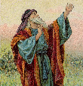
Isaiah 53:3–6
…iniquities; The chastening for our well-being fell upon Him, And by His scourging we are healed. ⁶ All of us like sheep have gone astray, Each of us has turned to his own way; But the Lord has caused the iniquity of us all To fall on Him.

Slide 81
Acts 8:30-35 Philip’s Witness to the Eunuch
Philip’s question (30)
Eunuch’s answer (31)
Eunuch's reading (32-33)
Eunuch’s question (34)
Philip’s witness (35)

Slide 82
Acts 8:30-35 Philip’s Witness to the Eunuch
Philip’s question (30)
Eunuch’s answer (31)
Eunuch's reading (32-33)
Eunuch’s question (34)
Philip’s witness (35)

Slide 83
Luke 24:27, 44
“²⁷ Then beginning with Moses and with all the prophets, He explained to them the things concerning Himself in all the Scriptures…⁴⁴ Now He said to them, ‘These are My words which I spoke to you while I was still with you, that all things which are written about Me in the Law of Moses and the Prophets and the Psalms must be fulfilled.’”

Slide 84
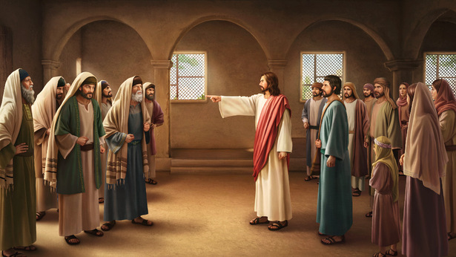
John 5:39, 46
“³⁹ You search the Scriptures because you think that in them you have eternal life; it is these that testify about Me. . .⁴⁶ For if you believed Moses, you would believe Me, for he wrote about Me.”

Slide 85
II. Ministry in Judea Acts 8:26-40
Angel directs Philip (26)
Philip’s obedience (27a)
Ethiopian Eunuch’s introduction (27b-28)
Holy Spirit directs Philip (29)
Philip’s witness to the Eunuch (30-35)
Eunuch’s conversion & baptism (36-38)
Philip’s separation from the Eunuch (39)
Philip’s evangelization of the Coastal Plain (40)

Slide 86
Sprinkling or Immersion?
Sprinkling? Other words (1 Pet. 1:12; 2 Tim. 4:6)
Immersion?
Christ’s baptism (Matt. 3:16; Mark 1:10)
Ethiopian eunuch's baptism (Acts 8:38-39)
Best symbolizes our union with Christ (Rom. 6:3)
Symbolizes a new creation (Gen. 1:6, 9; 2 Pet. 3:5; 2 Cor. 5:17)

Slide 87
II. Ministry in Judea Acts 8:26-40
Angel directs Philip (26)
Philip’s obedience (27a)
Ethiopian Eunuch’s introduction (27b-28)
Holy Spirit directs Philip (29)
Philip’s witness to the Eunuch (30-35)
Eunuch’s conversion & baptism (36-38)
Philip’s separation from the Eunuch (39)
Philip’s evangelization of the Coastal Plain (40)

Slide 88
Exemption from Death (1 Cor 15:54-56)
Enoch (Gen 5)
Elijah (2 Kings 2)
Christ (Acts 1:11; Rev 12:5)
Philip (Acts 8:39)
Paul (2 Cor 12:2, 4)
John (Rev 4:1-2)
Two witnesses (Rev 11)

Slide 89
1 Thessalonians 4:13-18
¹³ "But we do not want you to be uninformed, brethren, about those who are asleep, so that you will not grieve as do the rest who have no hope. ¹⁴ For if we believe that Jesus died and rose again, even so God will bring with Him those who have fallen asleep in Jesus. ¹⁵ For this we say to you by the word of the Lord, that we who are alive and remain until the coming of the Lord, will not precede those who have fallen asleep. ¹⁶ For the Lord Himself will . . .

Slide 90
1 Thessalonians 4:13-18
…descend from heaven with a shout, with the voice of the archangel and with the trumpet of God, and the dead in Christ will rise first. ¹⁷ Then we who are alive and remain will be caught up together with them in the clouds to meet the Lord in the air, and so we shall always be with the Lord. ¹⁸ Therefore comfort one another with these words."

Slide 92
II. Ministry in Judea Acts 8:26-40
Angel directs Philip (26)
Philip’s obedience (27a)
Ethiopian Eunuch’s introduction (27b-28)
Holy Spirit directs Philip (29)
Philip’s witness to the Eunuch (30-35)
Eunuch’s conversion & baptism (36-38)
Philip’s separation from the Eunuch (39)
Philip’s evangelization of the Coastal Plain (40)

Slide 95
Conclusion

Slide 96
Acts 8:5-40 Philip’s Ministry
Samaria (8:5-25)
Judea (Acts 8:26-40)

