Slide 1
Genesis 12‒50
Israel’s Birth & Preservation

Slide 2
GENESIS STRUCTURE
Genesis 12-50 (four people)
Abraham (12:1–25:11)
Isaac (25:12–26:35)
Jacob (27–36)
Joseph (37–50)

Slide 3
Genesis 37:2-36 Joseph Sold unto Egypt
Joseph’s coat (37:2-4)
Joseph’s dreams (37:5-11)
Joseph’s pit (37:12-24)
Joseph’s enslavement (37:25-36)

Slide 4
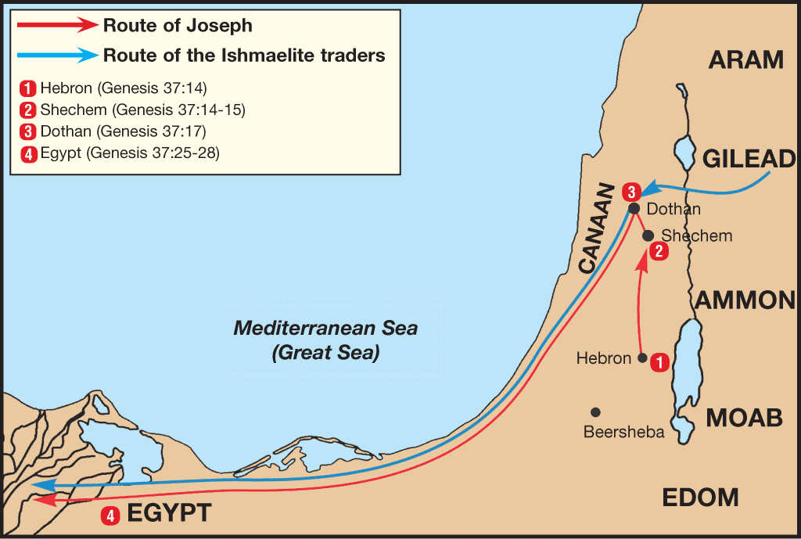

Slide 5
Genesis 38:1-30 Judah & Tamar
Tamar & Judah’s sons (38:1-11)
Tamar & Judah (38:12-26)
Tamar & Judah’s twins (38:27-30)

Slide 6
Genesis 39:1-23 Joseph in Potiphar's House
Blessing (39:1-6)
Temptation & Accusation (39:7-18)
Prison (39:19-23)

Slide 7
Genesis 40:1-23 Joseph in Prison
Imprisonment (40:1-8)
Butler’s dream (40:9-15)
Baker’s dream (40:16-19)
Fulfillment of the dreams (40:20-23)

Slide 8
Genesis 40:1-23 Joseph in Prison
Imprisonment (40:1-8)
Butler’s dream (40:9-15)
Baker’s dream (40:16-19)
Fulfillment of the dreams (40:20-23)

Slide 9
I. Genesis 40:1-8 Imprisonment
Occasion (1)
Pharoah’s anger (2)
Imprisonment of Butler & Baker (3-4)
Prisoners’ dreams (5-8)

Slide 10
I. Genesis 40:1-8 Imprisonment
Occasion (1)
Pharoah’s anger (2)
Imprisonment of Butler & Baker (3-4)
Prisoners’ dreams (5-8)

Slide 11
Genesis 40:1 Occasion
Timing (1a)
Offenders (1b)

Slide 12
Genesis 40:1 Occasion
Timing (1a)
Offenders (1b)

Slide 13
Genesis 40:1 Occasion
Timing (1a)
Offenders (1b)

Slide 14
I. Genesis 40:1-8 Imprisonment
Occasion (1)
Pharoah’s anger (2)
Imprisonment of Butler & Baker (3-4)
Prisoners’ dreams (5-8)

Slide 15
I. Genesis 40:1-8 Imprisonment
Occasion (1)
Pharoah’s anger (2)
Imprisonment of Butler & Baker (3-4)
Prisoners’ dreams (5-8)

Slide 16
Genesis 40:3-4 Occasion
Potiphar’s role (3)
Joseph’s role (4)

Slide 17
Genesis 40:3-4 Occasion
Potiphar’s role (3)
Joseph’s role (4)

Slide 18
Genesis 40:3-4 Occasion
Potiphar’s role (3)
Joseph’s role (4)

Slide 19
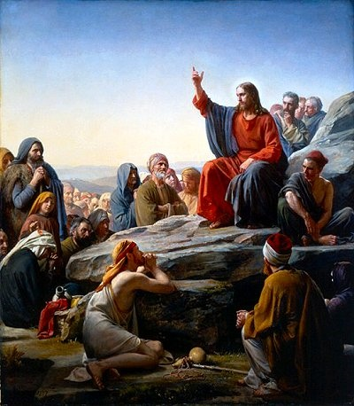
Matt 5:13, 16
“You are the light of the world. A city set on a hill cannot be hidden…Let your light shine before men in such a way that they may see your good works, and glorify your Father who is in heaven.”

Slide 20
I. Genesis 40:1-8 Imprisonment
Occasion (1)
Pharoah’s anger (2)
Imprisonment of Butler & Baker (3-4)
Prisoners’ dreams (5-8)

Slide 21
Genesis 40:5-8 Prisoners’ Dreams
Dreams (5)
Joseph’s observation (6)
Joseph’s inquiry (7)
Answer (8a)
Joseph’s offer (8b)

Slide 22
Genesis 40:5--8 Prisoners’ Dreams
Dreams (5)
Joseph’s observation (6)
Joseph’s inquiry (7)
Answer (8a)
Joseph’s offer (8b)

Slide 23
Genesis 40:5-8 Prisoners’ Dreams
Dreams (5)
Joseph’s observation (6)
Joseph’s inquiry (7)
Answer (8a)
Joseph’s offer (8b)

Slide 24
Genesis 40:5-8 Prisoners’ Dreams
Dreams (5)
Joseph’s observation (6)
Joseph’s inquiry (7)
Answer (8a)
Joseph’s offer (8b)

Slide 25
Genesis 40:5-8 Prisoners’ Dreams
Dreams (5)
Joseph’s observation (6)
Joseph’s inquiry (7)
Answer (8a)
Joseph’s offer (8b)

Slide 26
Dr. Arnold G. Fruchtenbaum
The Book of Genesis, 556-57
“By way of observation, in the Scriptures only two men function as interpreters of dreams: Joseph and Daniel. Furthermore, both served foreign monarchs who worshipped foreign gods, and both interpreted in a foreign land where they had professional interpreters: Egypt and Babylonia.”

Slide 27
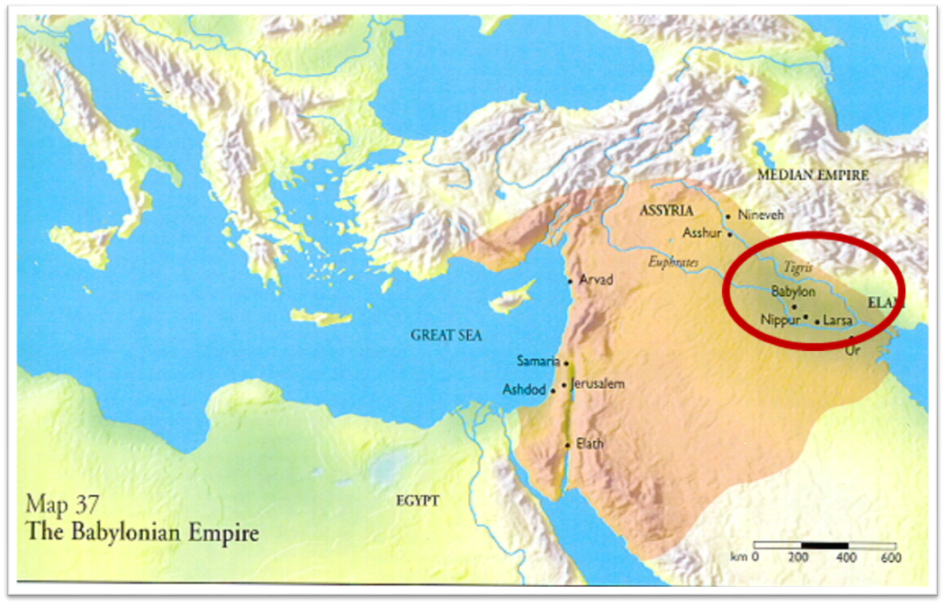

Slide 28
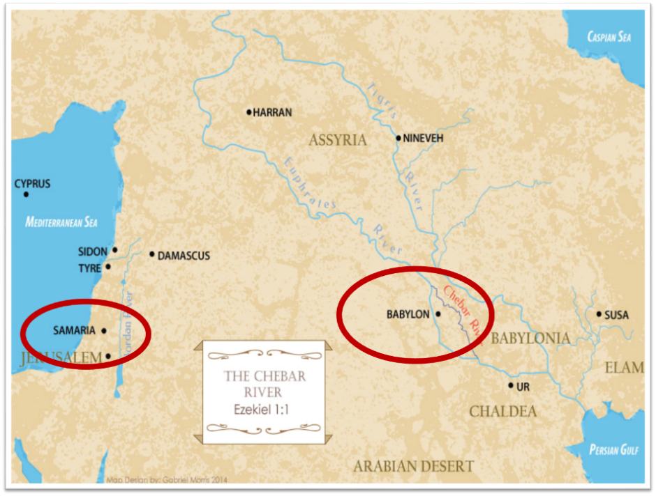

Slide 30
Genesis 40:5-8 Prisoners’ Dreams
Dreams (5)
Joseph’s observation (6)
Joseph’s inquiry (7)
Answer (8a)
Joseph’s offer (8b)

Slide 32
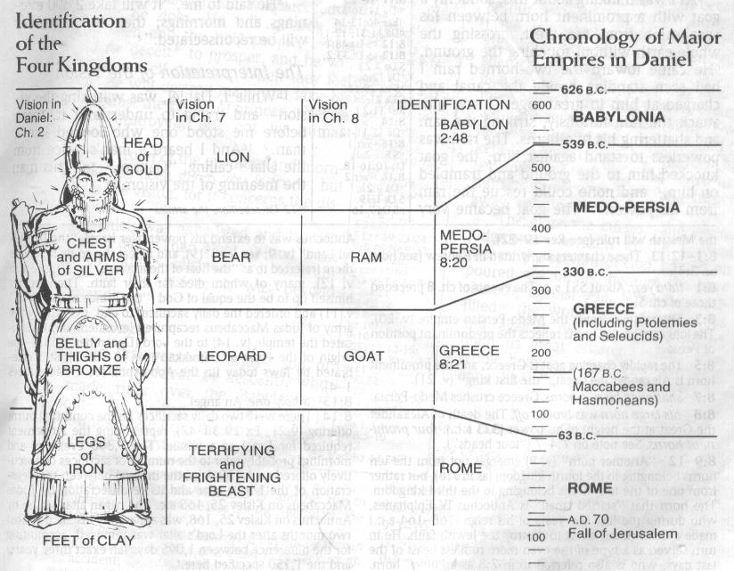

Slide 33
Genesis 40:1-23 Joseph in Prison
Imprisonment (40:1-8)
Butler’s dream (40:9-15)
Baker’s dream (40:16-19)
Fulfillment of the dreams (40:20-23)

Slide 34
II. Genesis 40:9-15 Butler’s Dream
Dream (9-11)
Joseph’s interpretation (12-13)
Joseph’s request (14-15)

Slide 35
II. Genesis 40:9-15 Butler’s Dream
Dream (9-11)
Joseph’s interpretation (12-13)
Joseph’s request (14-15)

Slide 36
Genesis 40:9-11 Dream
Vine (9)
Grapes (10)
Cup (11)

Slide 37
Genesis 40:9-11 Dream
Vine (9)
Grapes (10)
Cup (11)

Slide 38
Genesis 40:9-11 Dream
Vine (9)
Grapes (10)
Cup (11)

Slide 39
Genesis 40:9-11 Dream
Vine (9)
Grapes (10)
Cup (11)

Slide 40
Dr. Arnold G. Fruchtenbaum
The Book of Genesis, 557-58
“Genesis 40:9–15 (The Book of Genesis): In verses 10–11, the number three is prominent: the vine had three branches; three terms are used to describe the grapes of the vine (budded, blossomed, clusters of grapes); Pharaoh is mentioned three times; the word cup is used three times; and three times the first-person pronoun is used (I took, I pressed, I placed).”

Slide 41
II. Genesis 40:9-15 Butler’s Dream
Dream (9-11)
Joseph’s interpretation (12-13)
Joseph’s request (14-15)

Slide 42
Genesis 40:12-13 Joseph’s Interpretation
Time (12)
Restoration (13)

Slide 43
Genesis 40:12-13 Joseph’s Interpretation
Time (12)
Restoration (13)

Slide 44
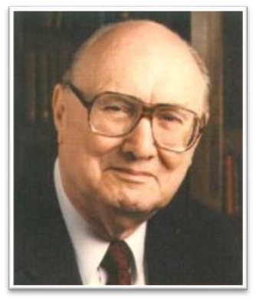
Two Rules of Interpretation
Search the immediate context
Walvoord: 26X
Search the remote context
Old Testament
Thomas: 278 / 404 verses

Slide 45
Genesis 40:12-13 Joseph’s Interpretation
Time (12)
Restoration (13)

Slide 46
Shaping and Populating (Gen 1:1-31)
Day 1 | Light
Day 2 | Water, sky
Day 3 | Land, vegetation
Day 4 | Luminaries
Day 5 | Sea animals, birds
Day 6 | Land animals, man

Slide 47
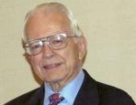
Dr. Roy B. Zuck
Basic Bible Interpretation, p. 215-16.
“﻿Usually a parable, like a sermon illustration, is teaching a single truth. When Jesus explained a number of His parables, He usually…stated one spiritual truth. For example when the man found his one lost sheep, he rejoiced, and Jesus said this illustrates the truth that there is rejoicing in heaven when a sinner repents (Luke 15:7)...He gave one simple spiritual lesson, and made no attempt to see any spiritual significance to the vineyard, the denarius, or the sixth hour, the ninth hour, or the eleventh hour, nor the vineyard foreman…To hunt for meanings in every detail in the parables is to turn them into allegories.”

Slide 48
II. Genesis 40:9-15 Butler’s Dream
Dream (9-11)
Joseph’s interpretation (12-13)
Joseph’s request (14-15)

Slide 49
Genesis 40:14-15 Joseph’s Request
Request (14)
Innocence (15)

Slide 50
Genesis 40:14-15 Joseph’s Request
Request (14)
Innocence (15)

Slide 51
2 Peter 1:19-21
“¹⁹ So we have the prophetic word made more sure, to which you do well to pay attention as to a lamp shining in a dark place, until the day dawns and the morning star arises in your hearts. ²⁰ But know this first of all, that no prophecy of Scripture is a matter of one’s own interpretation, ²¹ for no prophecy was ever made by an act of human will, but men moved by the Holy Spirit spoke from God.”

Slide 52
John 13:19; 14:29
“^{13:19} From now on I am telling you before it comes to pass, so that when it does occur, you may believe that I am He… ^{14:29} Now I have told you before it happens, so that when it happens, you may believe.”

Slide 53
What Happened to Christ’s Disciples?
Disciple | Place | Martyrdom
James the Son of Alpheus | Jerusalem | Clubbed to death
Simon the Zealot | Jerusalem | Martyred
James the Son of Zebedee | Judea (Acts 12:2) | Executed
Thaddeus | Mesopotamia | Beaten to death
Peter | Babylon, Rome | Crucified upside down
Matthew | Parthia (Tehran) | Beheaded
Notes:
109 prophecies…
Peter Stoner – SCIENCE SPEAKS, An Evaluation of Certain Christian Evidences
To fulfill just 8 prophecies =1 X 10 to the twenty-eighth power!
Can we visualize this with an illustration? Suppose we took an atheistic professor, blindfolded him and covered the state of Texas two feet deep with silver dollars. Then we put a check on one of those silver dollars and mixed them up. The odds of one person fulfilling just these eight prophecies would be the same as this atheistic professor selecting the silver dollar upon which we have placed a check, in his first try.
https://www.bereanpublishers.com/the-odds-of-eight-messianic-prophecies-coming-true/

Slide 54
What Happened to Christ’s Disciples?
Disciple | Place | Martyrdom
John | Asia Minor, Patmos, Ephesus | Fried in boiling oil
Philip | E. Turkey | Tortured & crucified
Thomas | India | Speared
Bartholomew | India | Flayed & crucified
Andrew | Ukraine, Russia, Greece | Hanged
Notes:
109 prophecies…
Peter Stoner – SCIENCE SPEAKS, An Evaluation of Certain Christian Evidences
To fulfill just 8 prophecies =1 X 10 to the twenty-eighth power!
Can we visualize this with an illustration? Suppose we took an atheistic professor, blindfolded him and covered the state of Texas two feet deep with silver dollars. Then we put a check on one of those silver dollars and mixed them up. The odds of one person fulfilling just these eight prophecies would be the same as this atheistic professor selecting the silver dollar upon which we have placed a check, in his first try.
https://www.bereanpublishers.com/the-odds-of-eight-messianic-prophecies-coming-true/

Slide 55
Genesis 40:14-15 Joseph’s Request
Request (14)
Innocence (15)

Slide 56
Genesis 40:15 Personal Innocence
Land (15a)
Dungeon (15b)

Slide 57
Genesis 40:15 Personal Innocence
Land (15a)
Dungeon (15b)

Slide 58
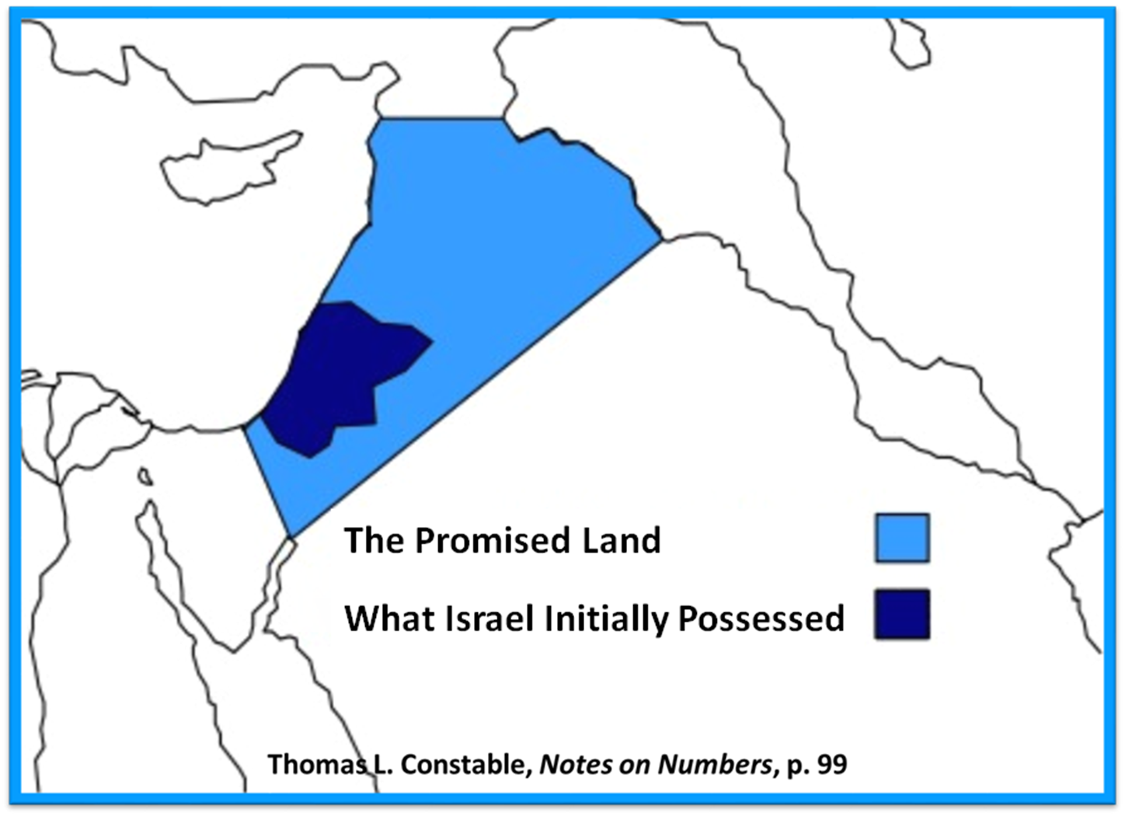

Slide 59
Genesis 40:15 Personal Innocence
Land (15a)
Dungeon (15b)

Slide 62
Genesis 40:1-23 Joseph in Prison
Imprisonment (40:1-8)
Butler’s dream (40:9-15)
Baker’s dream (40:16-19)
Fulfillment of the dreams (40:20-23)

Slide 63
III. Genesis 40:16-19 Baker’s Dream
Dream (16-17)
Joseph’s interpretation (18-19)

Slide 64
III. Genesis 40:16-19 Baker’s Dream
Dream (16-17)
Joseph’s interpretation (18-19)

Slide 65
Genesis 40:16-17 Dream
Basis for telling the dream (16a)
Dream (16b-17)

Slide 66
Genesis 40:16-17 Dream
Basis for telling the dream (16a)
Dream (16b-17)

Slide 67
Genesis 40:16-17 Dream
Basis for telling the dream (16a)
Dream (16b-17)

Slide 68
Genesis 40:16b-19 Dream
Baskets (16b)
Birds (17)

Slide 69
Genesis 40:16b-19 Dream
Baskets (16b)
Birds (17)

Slide 70
Dr. Arnold G. Fruchtenbaum
The Book of Genesis, 559
“First, in verse 16b: I also was in my dream, and, behold, three baskets of white bread were on my head. Pictorials in Egyptian tombs, where baskets of breads were carried on the head, validate the description.”

Slide 71
Genesis 40:16b-19 Dream
Baskets (16b)
Birds (17)

Slide 72
III. Genesis 40:16-19 Baker’s Dream
Dream (16-17)
Joseph’s interpretation (18-19)

Slide 73
Genesis 40:18-19 Interpretation
Baskets (18)
Birds (19)

Slide 74
Genesis 40:18-19 Interpretation
Baskets (18)
Birds (19)

Slide 75
Two Rules of Interpretation
Search the immediate context
Walvoord: 26X
Search the remote context
Old Testament
Thomas: 278 / 404 verses

Slide 76
Genesis 40:18-19 Interpretation
Baskets (18)
Birds (19)

Slide 77
Shaping and Populating (Gen 1:1-31)
Day 1 | Light
Day 2 | Water, sky
Day 3 | Land, vegetation
Day 4 | Luminaries
Day 5 | Sea animals, birds
Day 6 | Land animals, man

Slide 78
Dr. Arnold G. Fruchtenbaum
The Book of Genesis, 559
“in other words, the chief baker will be beheaded. In the Hebrew text, the wording is exactly the same here as it was in the case of the butler, but with the butler the head was “lifted up” in restoration; with the baker the head is ‘lifted up’ as punishment in the sense of being beheaded: and he shall hang you on a tree; and the birds shall eat your flesh from off you.”

Slide 79
Revelation 11:8-10
“⁸ And their dead bodies will lie in the street of the great city which mystically is called Sodom and Egypt, where also their Lord was crucified. ⁹ Those from the peoples and tribes and tongues and nations will look at their dead bodies for three and a half days, and will not permit their dead bodies to be laid in a tomb. ¹⁰ And those who dwell on the earth will rejoice over them and celebrate; and they will send gifts to one another, because these two prophets tormented those who dwell on the earth.”

Slide 80
Genesis 40:1-23 Joseph in Prison
Imprisonment (40:1-8)
Butler’s dream (40:9-15)
Baker’s dream (40:16-19)
Fulfillment of the dreams (40:20-23)

Slide 81
IV. Genesis 40:20-23 Fulfillment of the Dreams
Occasion (20)
Butler (21)
Baker (22a)
Joseph’s vindication (22b)
Joseph forgotten (23)

Slide 82
IV. Genesis 40:20-23 Fulfillment of the Dreams
Occasion (20)
Butler (21)
Baker (22a)
Joseph’s vindication (22b)
Joseph forgotten (23)

Slide 83
Genesis 40:20 Occasion
Timing (20a)
Event (20b)
Lifting (20c)

Slide 84
Genesis 40:20 Occasion
Timing (20a)
Event (20b)
Lifting (20c)

Slide 85
Genesis 40:20 Occasion
Timing (20a)
Event (20b)
Lifting (20c)

Slide 86
Genesis 40:20 Occasion
Timing (20a)
Event (20b)
Lifting (20c)

Slide 87
IV. Genesis 40:20-23 Fulfillment of the Dreams
Occasion (20)
Butler (21)
Baker (22a)
Joseph’s vindication (22b)
Joseph forgotten (23)

Slide 88
IV. Genesis 40:20-23 Fulfillment of the Dreams
Occasion (20)
Butler (21)
Baker (22a)
Joseph’s vindication (22b)
Joseph forgotten (23)

Slide 89
IV. Genesis 40:20-23 Fulfillment of the Dreams
Occasion (20)
Butler (21)
Baker (22a)
Joseph’s vindication (22b)
Joseph forgotten (23)

Slide 91
Matthew 24:1-2
“¹ Jesus came out from the temple and was going away when His disciples came up to point out the temple buildings to Him. ² And He said to them, “Do you not see all these things? Truly I say to you, not one stone here will be left upon another, which will not be torn down.”

Slide 92
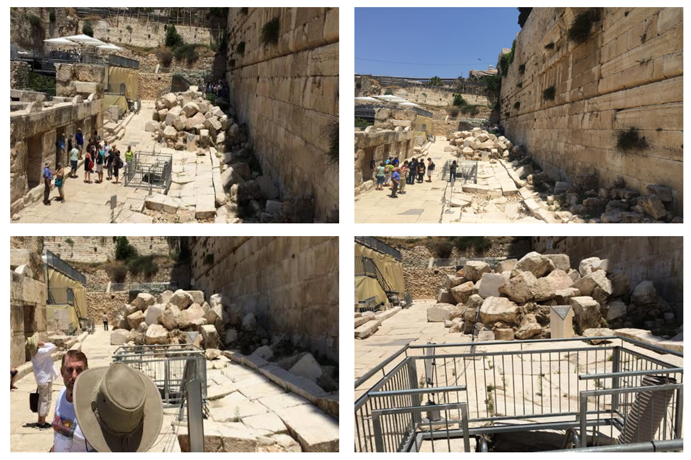

Slide 93
MATT 24 / REV 6 PARALLELS
Prediction | Birth pangs (Matt 24) | Seal judgments (Rev 6)
False Christ | 24:5 | 6:2
War | 24:6 | 6:3-4
Famine | 24:7 | 6:5-6
Death | 24:6-7 | 6:7-8
Martyrs | 24:9-13 | 6:9-11
Earthquakes | 24:7 | 6:12-17
Evangelism | 24:14 | 7:1-9

Slide 94
John 13:19; 14:29
“^{13:19} From now on I am telling you before it comes to pass, so that when it does occur, you may believe that I am He… ^{14:29} Now I have told you before it happens, so that when it happens, you may believe.”

Slide 95
IV. Genesis 40:20-23 Fulfillment of the Dreams
Occasion (20)
Butler (21)
Baker (22a)
Joseph’s vindication (22b)
Joseph forgotten (23)

Slide 96
Dr. Arnold G. Fruchtenbaum
The Book of Genesis, 560
“While on the human side this was ingratitude, on the divine side it was not yet time for Joseph’s release. Joseph had to wait two more years.”

Slide 97
John 14:16-17
¹⁶ I will ask the Father, and He will give you another Helper, that He may be with you forever; ¹⁷ that is the Spirit of truth, whom the world cannot receive, because it does not see Him or know Him, but you know Him because He abides with you and will be in you.

Slide 98
Conclusion

Slide 99
Genesis 40:1-23 Joseph in Prison
Imprisonment (40:1-8)
Butler’s dream (40:9-15)
Baker’s dream (40:16-19)
Fulfillment of the dreams (40:20-23)

Slide 100
²⁴ The Lord bless you, and keep you; ²⁵ The Lord make His face shine on you, And be gracious to you; ²⁶ The Lord lift up His countenance on you, And give you peace.
Numbers 6:24–26 (NASB95)

