Slide 1
Dr. Andy Woods
Senior Pastor – Sugar Land Bible Church
President – Chafer Theological Seminary

Slide 2
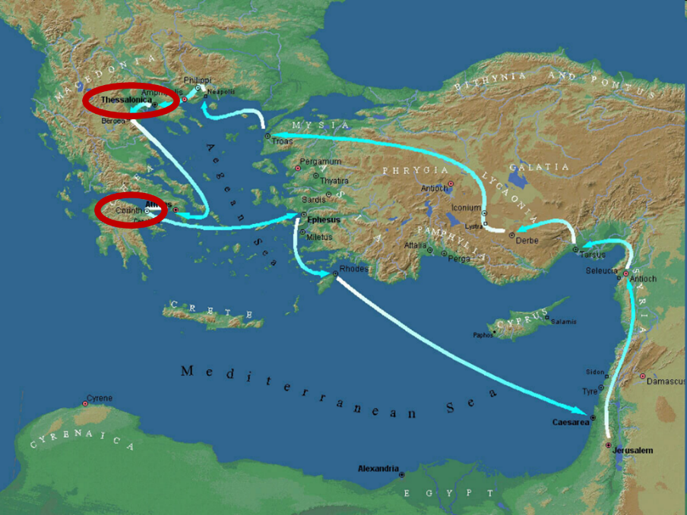

Slide 3
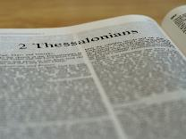
2 Thessalonians 2:1-12
Problem (2:1-2)
Prerequisites for the Day of the Lord (2:3-12)
The departure (2:3a)
Advent of the lawless one (2:3b-4)
Removal of the restrainer (2:5-7)
Destruction of the lawless one (2:8-9)
Destruction of lawless one’s followers (2:10-12)

Slide 4
2 Thessalonians 2:2
“that you not be quickly shaken from your composure or be disturbed either by a spirit or a message or a letter as if from us, to the effect that the day of the Lord [the Tribulation] has come.”

Slide 5
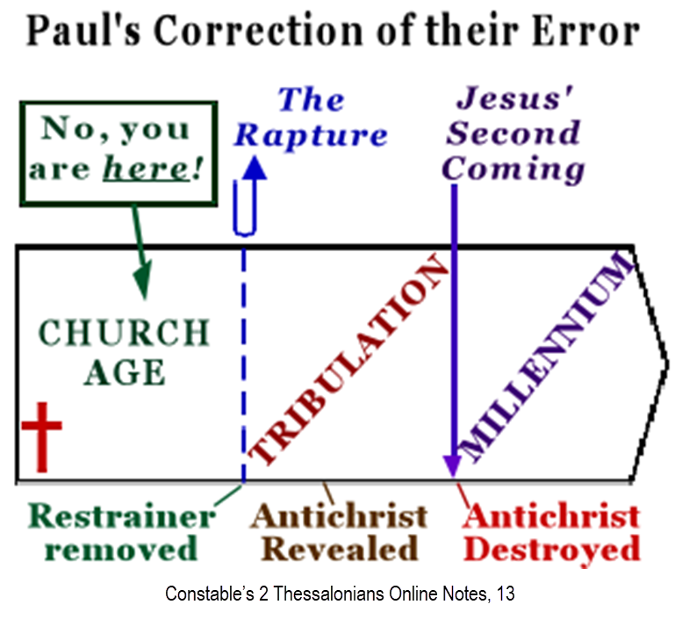

Slide 7
2 Thessalonians 2:1-12
Problem (2:1-2)
Prerequisites for the Day of the Lord (2:3-12)
The departure (2:3a)
Advent of the lawless one (2:3b-4)
Removal of the restrainer (2:5-7)
Destruction of the lawless one (2:8-9)
Destruction of lawless one’s followers (2:10-12)

Slide 8
2 Thessalonians 2:1-12
Problem (2:1-2)
Prerequisites for the Day of the Lord (2:3-12)
The departure (2:3a)
Advent of the lawless one (2:3b-4)
Removal of the restrainer (2:5-7)
Destruction of the lawless one (2:8-9)
Destruction of lawless one’s followers (2:10-12)

Slide 9
2 Thessalonians 2:1-12
Problem (2:1-2)
Prerequisites for the Day of the Lord (2:3-12)
The departure (2:3a)
Advent of the lawless one (2:3b-4)
Removal of the restrainer (2:5-7)
Destruction of the lawless one (2:8-9)
Destruction of lawless one’s followers (2:10-12)

Slide 10
2 Thessalonians 2:1-12
Problem (2:1-2)
Prerequisites for the Day of the Lord (2:3-12)
The departure (2:3a)
Advent of the lawless one (2:3b-4)
Removal of the restrainer (2:5-7)
Destruction of the lawless one (2:8-9)
Destruction of lawless one’s followers (2:10-12)

Slide 11
2 Thessalonians 2:1-12
Problem (2:1-2)
Prerequisites for the Day of the Lord (2:3-12)
The departure (2:3a)
Advent of the lawless one (2:3b-4)
Removal of the restrainer (2:5-7)
Destruction of the lawless one (2:8-9)
Destruction of lawless one’s followers (2:10-12)

Slide 12
2 Thessalonians 2:1-12
Problem (2:1-2)
Prerequisites for the Day of the Lord (2:3-12)
The departure (2:3a)
Advent of the lawless one (2:3b-4)
Removal of the restrainer (2:5-7)
Destruction of the lawless one (2:8-9)
Destruction of lawless one’s followers (2:10-12)

Slide 13
2 Thessalonians 2:10-12 Destruction of the Lawless One’s Followers
The judgment’s cause (10)
The judgment itself (11)
The judgment’s purpose (12)

Slide 14
2 Thessalonians 2:10-12 Destruction of the Lawless One’s Followers
The judgment’s cause (10)
The judgment itself (11)
The judgment’s purpose (12)

Slide 15
Romans 1:18–20
¹⁸ For the wrath of God is revealed from heaven against all ungodliness and unrighteousness of men who suppress the truth in unrighteousness, ¹⁹ because that which is known about God is evident within them; for God made it evident to them. ²⁰ For since the creation of the world His invisible attributes, His eternal power and divine nature, have been clearly seen, being understood through what has been made, so that they are without excuse.

Slide 16
Revelation 9:20-21
²⁰ “The rest of mankind, who were not killed by these plagues, did not repent of the works of their hands, so as not to worship demons, and the idols of gold and of silver and of brass and of stone and of wood, which can neither see nor hear nor walk; ²¹ and they did not repent of their murders nor of their sorceries nor of their immorality nor of their thefts.”

Slide 17
Three Tenses of Salvation
Phase | Justification | Sanctification | Glorification
Tense | Past | Present | Future
Saved from sin’s: | Penalty | Power | Presence
Scripture | Eph 2:8-9; Titus 3:5 | Philip 2:12 | Rom 5:10
Nature | Single | Dual | Single

Slide 18
2 Thessalonians 2:10-12 Destruction of the Lawless One’s Followers
The judgment’s cause (10)
The judgment itself (11)
The judgment’s purpose (12)

Slide 19
Charles Ryrie The Ryrie Study Bible, page 1489
2 Thessalonians 2:11-12 (RSBEE:NASB1995U): 2:11-12 The deluding influence comes from God; it is both a punishment and a moral result of their rejection of the truth (vv. 10, 12). These verses reflect the OT concept that God is sovereign even in the activities of the powers of evil (cf. Ex. 4:21; Josh. 11:20; 1 Kings 22:19–23; 1 Chron. 21:1; cf. 2 Sam. 24:1). The result will be that men will believe what is false, as Satan works through Antichrist.”

Slide 20
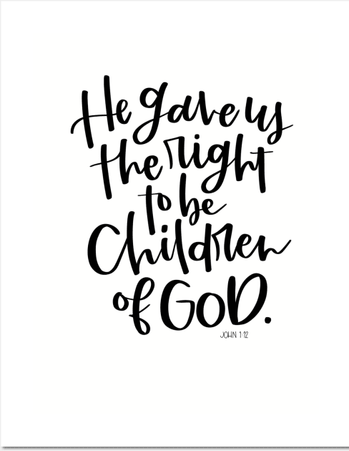
John 1:12
“But as many as received Him, to them He gave the right to become children of God, even to those who believe in His name.”

Slide 21
1st Six Seals (Revelation 6)
SEAL 1 – 6:1-2 – Advent of antichrist
SEAL 2 – 6:3-4 – War
SEAL 3 – 6:5-6 – Famine
SEAL 4 – 6:7-8 – Death
SEAL 5 – 6:9-11 – Martyrdoms
SEAL 6 – 6:12-17 – Cosmic disturbances

Slide 22
Matt 24 / Rev 6 Parallels
Prediction | Birth pangs (Matt 24) | Seal judgments (Rev 6)
1. False Christ | 24:5 | 6:2
2. War | 24:6 | 6:3-4
3. Famine | 24:7 | 6:5-6
4. Death | 24:6-7 | 6:7-8
5. Martyrs | 24:9-13 | 6:9-11
6. Earthquakes | 24:7 | 6:12-17
7. Evangelism | 24:14 | 7:1-9
©2023 ANDY WOODS MINISTRIES. ALL RIGHTS RESERVED

Slide 23
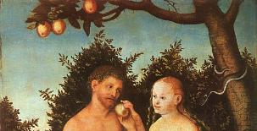
2 Thessalonians 2:9
“that is, the one whose coming is in accord with the activity of Satan, with all power and signs and false [pseudos] wonders.”

Slide 24
2 Timothy 4:3-4
³ For the time will come when they will not endure sound doctrine; but wanting to have their ears tickled, they will accumulate for themselves teachers in accordance to their own desires, ⁴ and will turn away their ears from the truth and will turn aside to myths [mythos].

Slide 25
2 Thessalonians 2:10-12 Destruction of the Lawless One’s Followers
The judgment’s cause (10)
The judgment itself (11)
The judgment’s purpose (12)

Slide 26
Acts 17:30-31
“³⁰ Therefore having overlooked the times of ignorance, God is now declaring to men that all people everywhere should repent [metanoeō], ³¹ because He has fixed a day in which He will judge the world in righteousness through a Man whom He has appointed, having furnished proof to all men by raising Him from the dead.”

Slide 27
Scripture’s Four Judgments
NAME | SHEEP AND GOAT | JUDGMENT OF THE JEWS | BEMA SEAT | GREAT WHITE THRONE
SCRIPTURE | Matt 25:31-46 | Ezek 20:33-44 | 1 Cor 3:10-15 | Rev 20:11-15
PLACE | Earth, Jerusalem | Earth, wilderness | Heaven | Earth
AUDIENCE | Gentile Tribulation survivors | Jewish Tribulation survivors | Church Age believers | All unsaved
WHEN | After Tribulation | After Tribulation | After rapture | After Millennium
PURPOSE | Saved Gentiles enter kingdom | Saved Jews enter kingdom | Reward believers | Degree of punishment in hell
EVALUATION | Treatment of Christ’s brethren | Passing under shepherd’s rod | Works taken through fire | Not in the book; judged by books

Slide 29
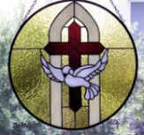
John 3:36
“The one who believes in the Son has eternal life; but the one who does not obey the Son will not see life, but the wrath of God remains on him.”

Slide 30
Thomas L. Constable “Notes on 2 Peter,” online: www.soniclight.com, accessed 21 January 2020, 12.
“Unlike other New Testament ethical lists (except Rom. 5:3-5), Peter used a literary device called ‘sorites’ (also called ‘climax’ or gradatio). Sorites (from the Gr. soros, ‘a heap’) is a set of statements that proceed, step by step, to a climactic conclusion through the force of logic or reliance upon a series of indisputable facts. Each new statement picks up the last key word or phrase of the preceding one.”

Slide 31
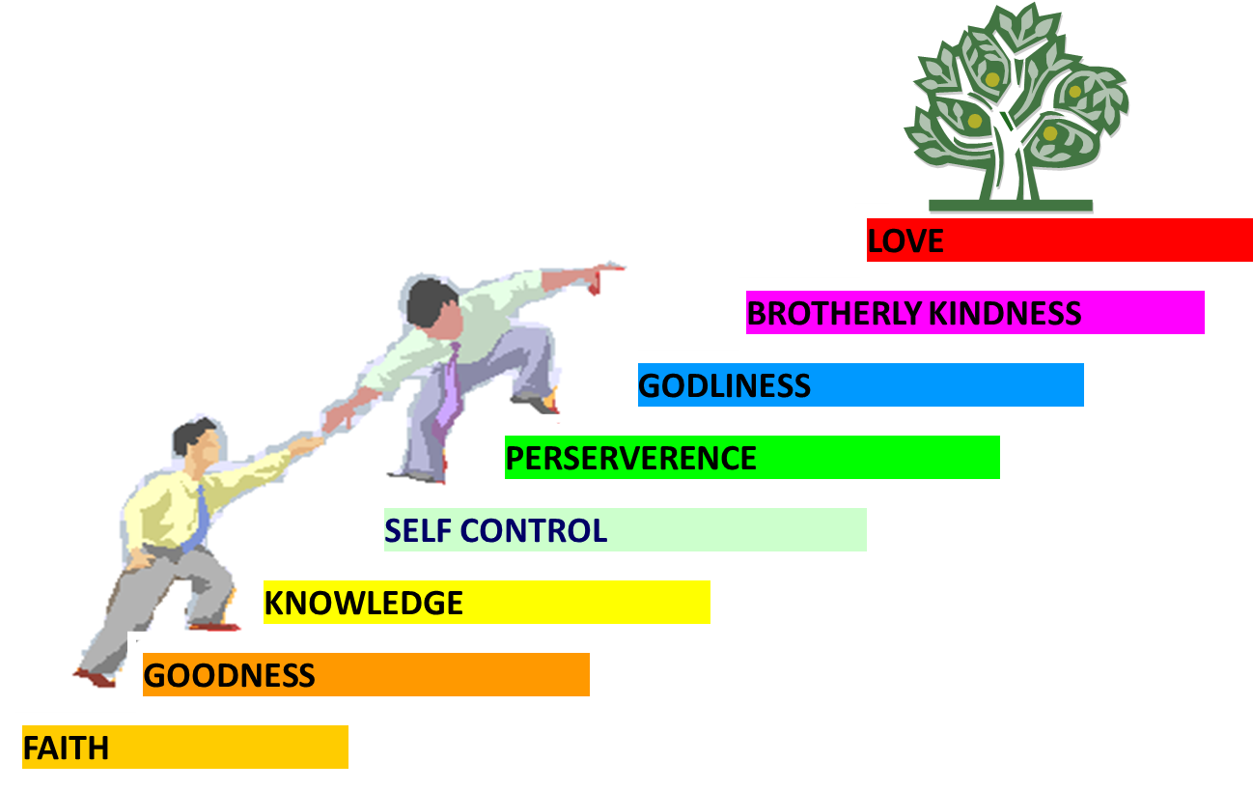
PORTRAIT OF GROWTH 1:5-7

Slide 32
2 Peter 1:5-7
⁵ Now for this very reason also, applying all diligence, in your faith supply moral excellence, and in your moral excellence, knowledge, ⁶ and in your knowledge, self-control, and in your self-control, perseverance, and in your perseverance, godliness, ⁷ and in your godliness, brotherly kindness, and in your brotherly kindness, love.

Slide 33
John 1:12
“But as many as received Him, to them He gave the right to become children of God, even to those who believe in His name.”

Slide 34
Distinctions Between 144,000 & Multitude
144,000 | MULTITUDE
Revelation 7:1-8 | Revelation 7:9-17
Numbered | Innumerable
Jews | All nations
Sealed | Slain
Sealed before the Tribulation | Converted out of the Tribulation
Hitchcock and Ice, The Truth Behind Left Behind, 77

Slide 35
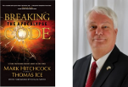
Thomas Ice
“Salvation in the Tribulation,” online: www.pre-trib.org, accessed 20 April 2024, 1.
“Second, the context of the entire passage relates to what will happen in the forthcoming Tribulation period. The context for when “they did not receive the love of the truth” in verse 10 clearly will be taking place during the Tribulation. The 2nd Thessalonians 2 passage is talking about the response of unbelievers during the Tribulation. If the passage were referring to an unbelieving response prior to the Tribulation, with a result that such a decision would impact one’s destiny during the Tribulation, then the passage would have probably been worded differently in order to convey such a message. Since it is not so configured, then there is no support for the belief that a person’s rejection of the Gospel necessarily seals his fate if he . . .

Slide 36
Thomas Ice
“Salvation in the Tribulation,” online: www.pre-trib.org, accessed 20 April 2024, 1.
…enters the Tribulation. Specific support that verses 8–12 encompass events that will transpire in the Tribulation begins in verse 8, which says, ‘And then that lawless one will be revealed . . .’ In other words, ‘then’ denotes a shift from the current Church Age into a future era: the Tribulation. Nothing in verses 8—12 takes any part of that passage out of the context of the Tribulation. All, in my opinion, would agree that verses 8–9 refer to things the Antichrist will do during the Tribulation. Verse 10 is clearly related to its preceding context and speaks of something that will take place during the Tribulation.”

Slide 37
Conclusion

Slide 38
2 Thessalonians 2:10-12 Destruction of the Lawless One’s Followers
The judgment’s cause (10)
The judgment itself (11)
The judgment’s purpose (12)

Slide 39
2 Thessalonians 2:2
“that you not be quickly shaken from your composure or be disturbed either by a spirit or a message or a letter as if from us, to the effect that the day of the Lord [the Tribulation] has come.”

Slide 40
2 Thessalonians 2:1-12
Problem (2:1-2)
Prerequisites for the Day of the Lord (2:3-12)
The departure (2:3a)
Advent of the lawless one (2:3b-4)
Removal of the restrainer (2:5-7)
Destruction of the lawless one (2:8-9)
Destruction of lawless one’s followers (2:10-12)

