Slide 2
Acts 8:5-40 Philip’s Ministry
Samaria (8:5-25)
Judea (Acts 8:26-40)

Slide 3
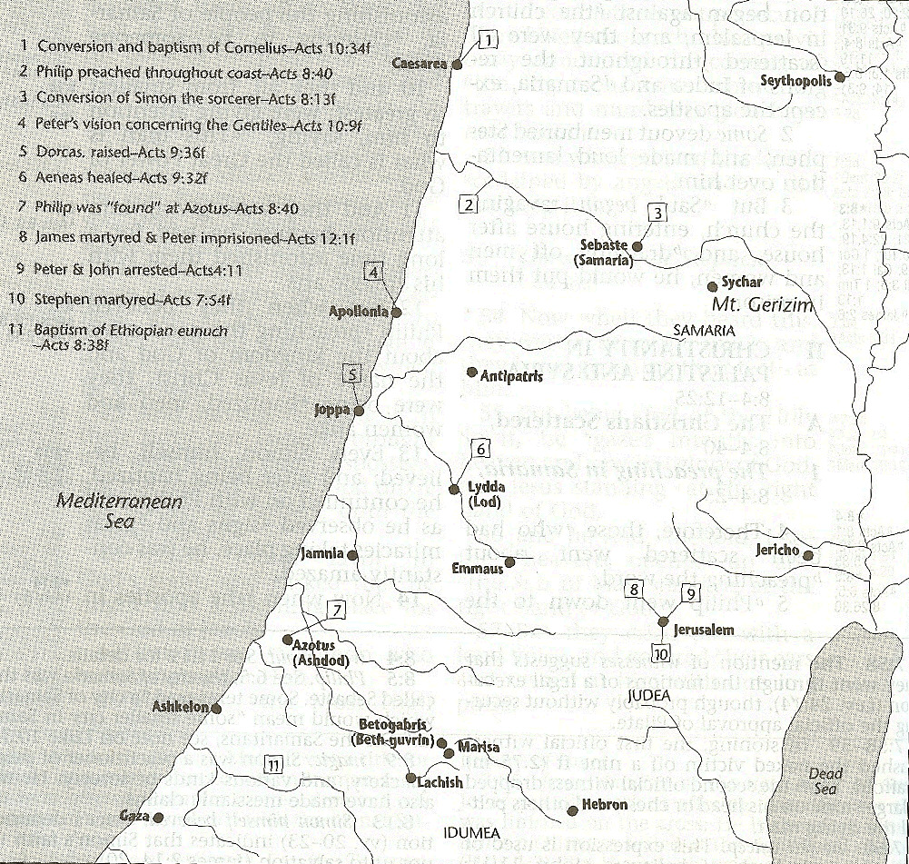

Slide 4
I. Ministry in Samaria Acts 8:5-25
Evangelization in Samaria (5-8)
Simon’s conversion (9-13)
Peter & John lay hands on the Samaritans (14-17)
Peter rebukes Simon (18-25)

Slide 5
Acts 8:9-13 Simon’s Conversion
Simon’s deception (9-11)
Samaria’s response to Philip’s preaching (12)
Simon’s response to Philip’s preaching (13)

Slide 6
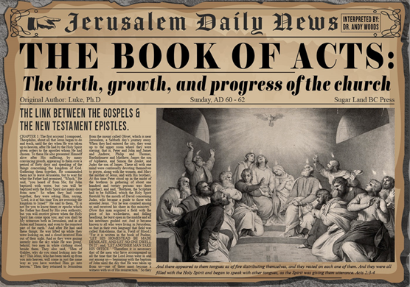
Acts 8:13 Simon’s Response to Philip’s Preaching
Faith (13a)
Baptism (13b)
Followed Philip (13c)

Slide 7
Acts 8:13 Simon’s Response to Philip’s Preaching
Faith (13a)
Baptism (13b)
Followed Philip (13c)

Slide 8
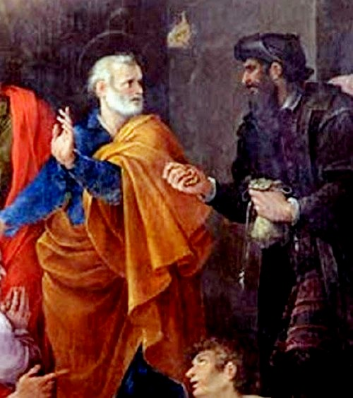
Why Simon Was Saved
Simon believed (Acts 8:12, 13)
Simon was baptized (Acts 8:12, 13)
Simon experienced remorse (Acts 8:24)
Notes:
Outline

Slide 9
Why Simon Was Saved
Simon believed (Acts 8:12, 13)
Simon was baptized (Acts 8:12, 13)
Simon experienced remorse (Acts 8:24)
Notes:
Outline

Slide 10
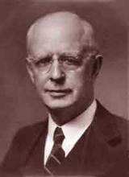
Lewis Sperry Chafer, vol. 7, Systematic Theology (Grand Rapids, MI: Kregel Publications, 1993), 265-66.
Belief-God’s One Condition for Justification
“…because upwards of 150 passages of Scripture condition salvation upon believing only (cf. John 3:16; Acts 16:31).”

Slide 11
Belief – God’s One Condition for Justification
Gen 15:6
Then he believed in the LORD; and He reckoned it to him as righteousness.
John 3:16
For God so loved the world, that He gave His only begotten Son, that whoever believes in Him shall not perish, but have eternal life.
Acts 16:30-31
"Sirs, what must I do to be saved?" They said, "Believe in the Lord Jesus, and you will be saved..."

Slide 12
Why Simon Was Saved
Simon believed (Acts 8:12, 13)
Simon was baptized (Acts 8:12, 13)
Simon experienced remorse (Acts 8:24)
Notes:
Outline

Slide 13
Why Simon Was Saved
Simon believed (Acts 8:12, 13)
Simon was baptized (Acts 8:12, 13)
Simon experienced remorse (Acts 8:24)
Notes:
Outline

Slide 14
Illegitimate Faith
Spurious faith (Luke 8:13; Jas. 2:19)
Miracle faith (John 2:23-25)
Repent (2 Pet. 3:9)
Perish (John 3:16)
Description of the Lost (Acts 8:21, 23)
Simon never received the Holy Spirit (Acts 8:17-18)
Founder of Gnosticism
Notes:
Outline

Slide 15
Illegitimate Faith
Spurious faith (Luke 8:13; Jas. 2:19)
Miracle faith (John 2:23-25)
Repent (2 Pet. 3:9)
Perish (John 3:16)
Description of the Lost (Acts 8:21, 23)
Simon never received the Holy Spirit (Acts 8:17-18)
Founder of Gnosticism
Notes:
Outline

Slide 16
William Hendriksen
“Many trusted in his name; i.e., because of the manner in which his power was displayed they accepted him as a great prophet and perhaps even as the Messiah. This, however, is not the same as saying that they surrendered their hearts to him. Not all faith is saving faith...”
William Hendriksen, A Commentary on the Gospel of John, 3d ed. (London: Banner of Truth Trust, 1964), p. 127. (1978). Bibliotheca Sacra, 135. (1978). Bibliotheca Sacra, 135.

Slide 17
Illegitimate Faith
Spurious faith (Luke 8:13; Jas. 2:19)
Miracle faith (John 2:23-25)
Repent (2 Pet. 3:9)
Perish (John 3:16)
Description of the Lost (Acts 8:21, 23)
Simon never received the Holy Spirit (Acts 8:17-18)
Founder of Gnosticism
Notes:
Outline

Slide 18
John 2:23-25
“²³ Now when He was in Jerusalem at the Passover, during the feast, many believed in (pisteuō eis) His name, observing His signs which He was doing. ²⁴ But Jesus, on His part, was not entrusting Himself to them, for He knew all men, ²⁵ and because He did not need anyone to testify concerning man, for He Himself knew what was in man.”

Slide 19
Illegitimate Faith
Spurious faith (Luke 8:13; Jas. 2:19)
Miracle faith (John 2:23-25)
Repent (2 Pet. 3:9)
Perish (John 3:16)
Description of the Lost (Acts 8:21, 23)
Simon never received the Holy Spirit (Acts 8:17-18)
Founder of Gnosticism
Notes:
Outline

Slide 20
Acts 2:38
“Peter said to them, “Repent [metanoeō], and each of you be baptized in the name of Jesus Christ for (eis) the forgiveness of your sins; and you will receive the gift of the Holy Spirit.”

Slide 21
Acts 17:30-31
“³⁰ Therefore having overlooked the times of ignorance, God is now declaring to men that all people everywhere should repent [metanoeō], ³¹ because He has fixed a day in which He will judge the world in righteousness through a Man whom He has appointed, having furnished proof to all men by raising Him from the dead.”

Slide 22
2 Peter 3:9
“The Lord is not slow about His promise, as some count slowness, but is patient toward you, not wishing for any to perish but for all to come to repentance.”

Slide 23
Illegitimate Faith
Spurious faith (Luke 8:13; Jas. 2:19)
Miracle faith (John 2:23-25)
Repent (2 Pet. 3:9)
Perish (John 3:16)
Description of the Lost (Acts 8:21, 23)
Simon never received the Holy Spirit (Acts 8:17-18)
Founder of Gnosticism
Notes:
Outline

Slide 24
Illegitimate Faith
Spurious faith (Luke 8:13; Jas. 2:19)
Miracle faith (John 2:23-25)
Repent (2 Pet. 3:9)
Perish (John 3:16)
Description of the Lost (Acts 8:21, 23)
Simon never received the Holy Spirit (Acts 8:17-18)
Founder of Gnosticism
Notes:
Outline

Slide 25
Illegitimate Faith
Spurious faith (Luke 8:13; Jas. 2:19)
Miracle faith (John 2:23-25)
Repent (2 Pet. 3:9)
Perish (John 3:16)
Description of the Lost (Acts 8:21, 23)
Simon never received the Holy Spirit (Acts 8:17-18)
Founder of Gnosticism
Notes:
Outline

Slide 26
Illegitimate Faith
Spurious faith (Luke 8:13; Jas. 2:19)
Miracle faith (John 2:23-25)
Repent (2 Pet. 3:9)
Perish (John 3:16)
Description of the Lost (Acts 8:21, 23)
Simon never received the Holy Spirit (Acts 8:17-18)
Founder of Gnosticism
Notes:
Outline

Slide 27
Henry Morris
Henry Morris Study Bible, 1646
“8:13 believed also. Simon’s ‘belief’ was evidently only a belief in the reality of signs and wonders performed by Philip (note Christ’s rebuke of this kind of belief in Jo. 4:48; also compared John 2:23–25). These wonders were greater than those which Simon was able to do with his sorceries (Greek Mageia, from which we get our word ‘magic’), and he was envious. In early Christian literature, he was called Simon Magus, and he was said to be a prominent enemy of the true faith.”

Slide 28
Answering Illegitimate Faith Arguments
Spurious faith (Luke 8:13; Jas. 2:19) – Angels
Miracle faith (John 2:23-25) – pistueō eis
Repent (2 Pet. 3:9) – Rev. 2‒3
Perish (John 3:16) – Temporal
Description of the Lost (Acts 8:21, 23) – No time for Sanctification
Simon never received the Holy Spirit (Acts 8:17-18) – Argument from silence
Founder of Gnosticism – Sola Scriptura
Notes:
Outline

Slide 29
Answering Illegitimate Faith Arguments
Spurious faith (Luke 8:13; Jas. 2:19) – Angels
Miracle faith (John 2:23-25) – pistueō eis
Repent (2 Pet. 3:9) – Rev. 2‒3
Perish (John 3:16) – Temporal
Description of the Lost (Acts 8:21, 23) – No time for Sanctification
Simon never received the Holy Spirit (Acts 8:17-18) – Argument from silence
Founder of Gnosticism – Sola Scriptura
Notes:
Outline

Slide 30
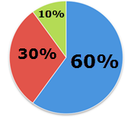

Slide 31
Answering Illegitimate Faith Arguments
Spurious faith (Luke 8:13; Jas. 2:19) – Angels
Miracle faith (John 2:23-25) – pistueō eis
Repent (2 Pet. 3:9) – Rev. 2‒3
Perish (John 3:16) – Temporal
Description of the Lost (Acts 8:21, 23) – No time for Sanctification
Simon never received the Holy Spirit (Acts 8:17-18) – Argument from silence
Founder of Gnosticism – Sola Scriptura
Notes:
Outline

Slide 32
John 2:23-25
“²³ Now when He was in Jerusalem at the Passover, during the feast, many believed in (pisteuō eis) His name, observing His signs which He was doing. ²⁴ But Jesus, on His part, was not entrusting Himself to them, for He knew all men, ²⁵ and because He did not need anyone to testify concerning man, for He Himself knew what was in man.”

Slide 33
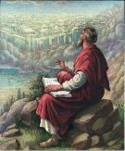
John 20:30-31
“³⁰ Therefore many other signs Jesus also performed in the presence of the disciples, which are not written in this book; ³¹ but these have been written so that you may believe (pisteuō eis) that Jesus is the Christ, the Son of God; and that believing you may have life in His name.”

Slide 34
John 15:14-15
“¹⁴ You are My friends if you do what I command you. ¹⁵ No longer do I call you slaves, for the slave does not know what his master is doing; but I have called you friends, for all things that I have heard from My Father I have made known to you.”

Slide 35
 | SALVATION | FRIENDSHIP
CONDITION | FAITH | OBEDIENCE
Scripture | John 3:16 | John 15:14
Phase of Salvation | Justification | Sanctification
Benefit | Salvation From Sin’s Penalty | Divine Insight

Slide 36
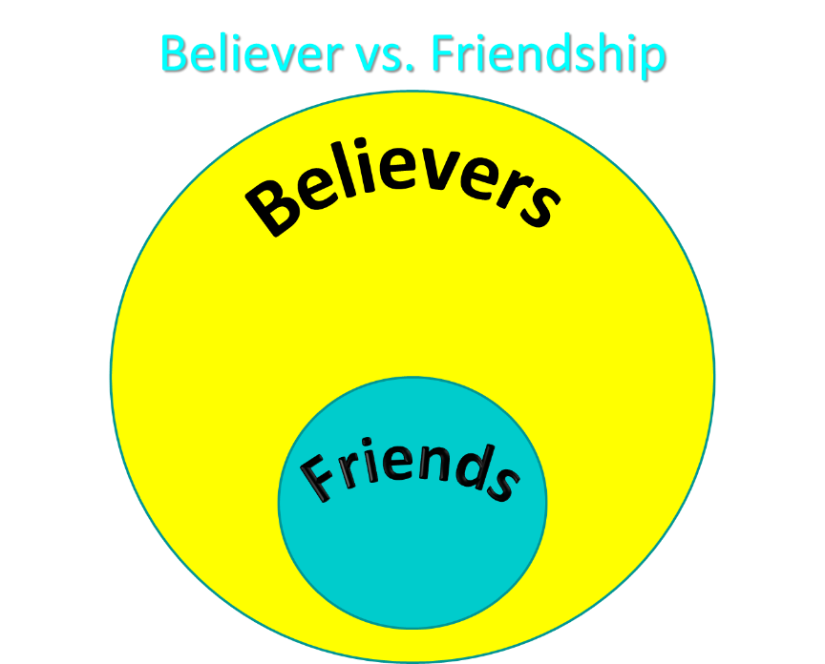

Slide 37
Answering Illegitimate Faith Arguments
Spurious faith (Luke 8:13; Jas. 2:19) – Angels
Miracle faith (John 2:23-25) – pistueō eis
Repent (2 Pet. 3:9) – Rev. 2‒3
Perish (John 3:16) – Temporal
Description of the Lost (Acts 8:21, 23) – No time for Sanctification
Simon never received the Holy Spirit (Acts 8:17-18) – Argument from silence
Founder of Gnosticism – Sola Scriptura
Notes:
Outline

Slide 39
Consequences
Rev 3:19
“Those whom I love, I reprove and discipline; therefore be zealous and repent.”

Slide 40
Answering Illegitimate Faith Arguments
Spurious faith (Luke 8:13; Jas. 2:19) – Angels
Miracle faith (John 2:23-25) – pistueō eis
Repent (2 Pet. 3:9) – Rev. 2‒3
Perish (John 3:16) – Temporal
Description of the Lost (Acts 8:21, 23) – No time for Sanctification
Simon never received the Holy Spirit (Acts 8:17-18) – Argument from silence
Founder of Gnosticism – Sola Scriptura
Notes:
Outline

Slide 41
1 Corinthians 3:10-15
“¹⁰ According to the grace of God which was given to me, like a wise master builder I laid a foundation, and another is building on it. But each man must be careful how he builds on it. ¹¹ For no man can lay a foundation other than the one which is laid, which is Jesus Christ. ¹² Now if any man builds on the foundation with gold, silver, precious stones, wood, hay, straw…. ¹⁴ If any man’s work which he has built on it remains, he will receive a reward. ¹⁵ If any man’s work is burned up, he will suffer loss; but he himself will be saved, yet so as through fire.”

Slide 42
1 Corinthians 9:24-27
“²⁴ Do you not know that those who run in a race all run, but only one receives the prize? Run in such a way that you may win. ²⁵ Everyone who competes in the games exercises self-control in all things. They then do it to receive a perishable wreath, but we an imperishable. ²⁶ Therefore I run in such a way, as not without aim; I box in such a way, as not beating the air; ²⁷ but I discipline my body and make it my slave, so that, after I have preached to others, I myself will not be disqualified.”

Slide 43
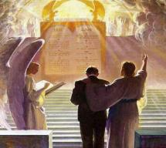
2 John 8
“Watch yourselves, that you do not lose what we have accomplished, but that you may receive a full reward.”

Slide 44
Revelation 3:11
“I am coming quickly; hold fast what you have, so that no one will take your crown.”

Slide 45
Answering Illegitimate Faith Arguments
Spurious faith (Luke 8:13; Jas. 2:19) – Angels
Miracle faith (John 2:23-25) – pistueō eis
Repent (2 Pet. 3:9) – Rev. 2‒3
Perish (John 3:16) – Temporal
Description of the Lost (Acts 8:21, 23) – No time for Sanctification
Simon never received the Holy Spirit (Acts 8:17-18) – Argument from silence
Founder of Gnosticism – Sola Scriptura
Notes:
Outline

Slide 46
Three Tenses of Salvation
Phase | Justification | Sanctification | Glorification
Tense | Past | Present | Future
Saved from sin’s: | Penalty | Power | Presence
Scripture | Eph 2:8-9; Titus 3:5 | Philip 2:12 | Rom 5:10
Nature | Single | Dual | Single

Slide 47
Romans 12:2
“And do not be conformed to this world, but be transformed by the renewing of your mind, so that you may prove what the will of God is, that which is good and acceptable and perfect.”

Slide 48
Answering Illegitimate Faith Arguments
Spurious faith (Luke 8:13; Jas. 2:19) – Angels
Miracle faith (John 2:23-25) – pistueō eis
Repent (2 Pet. 3:9) – Rev. 2‒3
Perish (John 3:16) – Temporal
Description of the Lost (Acts 8:21, 23) – No time for Sanctification
Simon never received the Holy Spirit (Acts 8:17-18) – Argument from silence
Founder of Gnosticism – Sola Scriptura
Notes:
Outline

Slide 49
Answering Illegitimate Faith Arguments
Spurious faith (Luke 8:13; Jas. 2:19) – Angels
Miracle faith (John 2:23-25) – pistueō eis
Repent (2 Pet. 3:9) – Rev. 2‒3
Perish (John 3:16) – Temporal
Description of the Lost (Acts 8:21, 23) – No time for Sanctification
Simon never received the Holy Spirit (Acts 8:17-18) – Argument from silence
Founder of Gnosticism – Sola Scriptura
Notes:
Outline

Slide 50
Christian Anti-Semitism
“First, their synagogues should be set on fire…Secondly, their homes should likewise be broken down and destroyed…Thirdly, they should be deprived of their prayer books and Talmuds…”

Slide 51
Christian Anti-Semitism
“…Fourthly, their rabbis must be forbidden under threat of death to teach any more…Fifthly, passport and traveling privileges should be absolutely forbidden to the Jews…Sixthly, they ought to be stopped from usury (charging interest on loans…”

Slide 52
Christian Anti-Semitism
“Seventhly, let the young and strong Jews and Jewesses be given the flail, the ax, the hoe, the spade, the distaff, and spindle, and let the earn their bread by the sweat of their noses…We ought to drive the rascally lazy bones out of our system...”
Martin Luther, Concerning the Jews and Their Lies, cited in Michael Brown’s Our Hands Are Stained with Blood, pp. 14-15.

Slide 53
Christian Anti-Semitism
“…Therefore away with them… To sum up, dear princes and nobles who have Jews in your domains, if this advice of mine does not suit you, then find a better one so that you and we may all be free of this insufferable devilish burden–the Jews.”
Martin Luther, Concerning the Jews and Their Lies, cited in Michael Brown’s Our Hands Are Stained with Blood, pp. 14-15.

Slide 54
Acts 8:13 Simon’s Response to Philip’s Preaching
Faith (13a)
Baptism (13b)
Followed Philip (13c)

Slide 55
Acts 8:13 Simon’s Response to Philip’s Preaching
Faith (13a)
Baptism (13b)
Followed Philip (13c)

Slide 56
Three Tenses of Salvation
Phase | Justification | Sanctification | Glorification
Tense | Past | Present | Future
Saved from sin’s: | Penalty | Power | Presence
Scripture | Eph 2:8-9; Titus 3:5 | Philip 2:12 | Rom 5:10
Nature | Single | Dual | Single

Slide 57
Romans 12:2
“And do not be conformed to this world, but be transformed by the renewing of your mind, so that you may prove what the will of God is, that which is good and acceptable and perfect.”

Slide 58
I. Ministry in Samaria Acts 8:5-25
Evangelization in Samaria (5-8)
Simon’s conversion (9-13)
Peter & John lay hands on the Samaritans (14-17)
Peter rebukes Simon (18-25)

Slide 59
Acts 8:14-17 Peter & John Lay Hands on the Samaritans
The concern (14)
The problem (15-16)
The solution (17)

Slide 60
Acts 8:14-17 Peter & John Lay Hands on the Samaritans
The concern (14)
The problem (15-16)
The solution (17)

Slide 61
Acts 8:14-17 Peter & John Lay Hands on the Samaritans
The concern (14)
The problem (15-16)
The solution (17)

Slide 62
Acts 8:14-17 Peter & John Lay Hands on the Samaritans
The concern (14)
The problem (15-16)
The solution (17)

Slide 63
Acts 1:5
“for John baptized with water, but you will be baptized with the Holy Spirit not many days from now.”

Slide 64
1 Corinthians 12:13
“For by one Spirit we were all baptized into one body, whether Jews or Greeks, whether slaves or free, and we were all made to drink of one Spirit.”

Slide 65
Galatians 3:28
“There is neither Jew nor Greek, there is neither slave nor free man, there is neither male nor female; for you are all one in Christ Jesus.”

Slide 66
Ephesians 2:14
“For He Himself is our peace, who made both groups into one and broke down the barrier of the dividing wall.”

Slide 68
I. Ministry in Samaria Acts 8:5-25
Evangelization in Samaria (5-8)
Simon’s conversion (9-13)
Peter & John lay hands on the Samaritans (14-17)
Peter rebukes Simon (18-25)

Slide 69
Acts 8:18-25 Peter Rebukes Simon
Simon’s request (18-19)
Peter rebukes Simon (20-23)
Simon’s response (24)
Conclusion (25)

Slide 70
Acts 8:18-25 Peter Rebukes Simon
Simon’s request (18-19)
Peter rebukes Simon (20-23)
Simon’s response (24)
Conclusion (25)

Slide 71
Acts 8:18-19 Simon’s Request
Simon’s observation (18a)
Simon’s financial offer (18b)
Simon’s ambition (19)

Slide 72
Acts 8:18-19 Simon’s Request
Simon’s observation (18a)
Simon’s financial offer (18b)
Simon’s ambition (19)

Slide 73
Acts 8:18-19 Simon’s Request
Simon’s observation (18a)
Simon’s financial offer (18b)
Simon’s ambition (19)

Slide 74
Three Tenses of Salvation
Phase | Justification | Sanctification | Glorification
Tense | Past | Present | Future
Saved from sin’s: | Penalty | Power | Presence
Scripture | Eph 2:8-9; Titus 3:5 | Philip 2:12 | Rom 5:10
Nature | Single | Dual | Single

Slide 75
Acts 8:18-19 Simon’s Request
Simon’s observation (18a)
Simon’s financial offer (18b)
Simon’s ambition (19)

Slide 76
Acts 8:18-25 Peter Rebukes Simon
Simon’s request (18-19)
Peter rebukes Simon (20-23)
Simon’s response (24)
Conclusion (25)

Slide 77
Acts 8:20-23 Peter Rebukes Simon
Simon’s consequence (20)
Simon’s heart (21)
Simon’s need: repentance (22)
Simon’s problem (23)

Slide 78
Acts 8:20-23 Peter Rebukes Simon
Simon’s consequence (20)
Simon’s heart (21)
Simon’s need: repentance (22)
Simon’s problem (23)

Slide 79
Acts 8:20-23 Peter Rebukes Simon
Simon’s consequence (20)
Simon’s heart (21)
Simon’s need: repentance (22)
Simon’s problem (23)

Slide 80
Acts 8:20-23 Peter Rebukes Simon
Simon’s consequence (20)
Simon’s heart (21)
Simon’s need: repentance (22)
Simon’s problem (23)

Slide 82
Acts 8:20-23 Peter Rebukes Simon
Simon’s consequence (20)
Simon’s heart (21)
Simon’s need: repentance (22)
Simon’s problem (23)

Slide 83
Acts 8:18-25 Peter Rebukes Simon
Simon’s request (18-19)
Peter rebukes Simon (20-23)
Simon’s response (24)
Conclusion (25)

Slide 84
Acts 8:18-25 Peter Rebukes Simon
Simon’s request (18-19)
Peter rebukes Simon (20-23)
Simon’s response (24)
Conclusion (25)

Slide 85
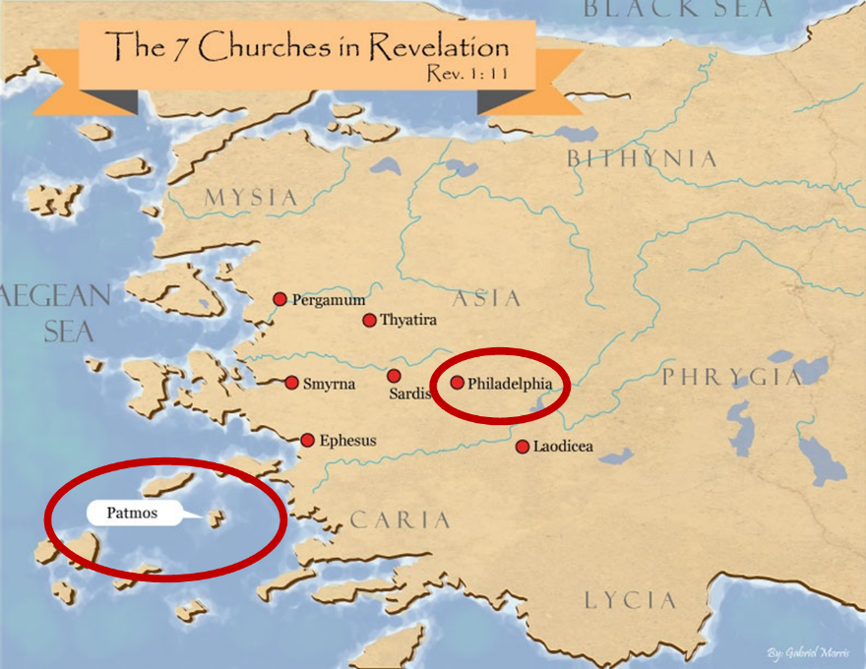

Slide 87
Acts 8:5-40 Philip’s Ministry
Samaria (8:5-25)
Judea (Acts 8:26-40)

Slide 89
II. Ministry in Judea Acts 8:26-40
Angel directs Philip (26)
Philip’s obedience (27a)
Ethiopian Eunuch’s introduction (27b-28)
Holy Spirit directs Philip (29)
Philip’s witness to the Eunuch (30-35)
Eunuch’s conversion & baptism (36-38)
Philip’s separation from the Eunuch (39)
Philip’s evangelization of the Coastal Plain (40)

Slide 90
II. Ministry in Judea Acts 8:26-40
Angel directs Philip (26)
Philip’s obedience (27a)
Ethiopian Eunuch’s introduction (27b-28)
Holy Spirit directs Philip (29)
Philip’s witness to the Eunuch (30-35)
Eunuch’s conversion & baptism (36-38)
Philip’s separation from the Eunuch (39)
Philip’s evangelization of the Coastal Plain (40)

Slide 91
Stanley D. Toussaint
Bible Knowledge Commentary, p. 374
“Though Luke gave no record of God’s commanding Philip to preach to the Samaritans (v. 5), God did sovereignly direct Philip toward Gaza . . . The highway is referred to as the desert road. The expression may refer to a desert road or a desert city. Ancient Gaza was destroyed in 93 B.C. and the city was rebuilt nearer the Mediterranean in 57 B.C. The old city was called Desert Gaza. The Greek for the angel’s command could be translated, ‘Arise and go to the south to the road . . . that goes down from Jerusalem to Gaza. This is desert.’ This reference to the road in 8:36 may imply that the road, not the city, was in a deserted area.”

Slide 92
II. Ministry in Judea Acts 8:26-40
Angel directs Philip (26)
Philip’s obedience (27a)
Ethiopian Eunuch’s introduction (27b-28)
Holy Spirit directs Philip (29)
Philip’s witness to the Eunuch (30-35)
Eunuch’s conversion & baptism (36-38)
Philip’s separation from the Eunuch (39)
Philip’s evangelization of the Coastal Plain (40)

Slide 93
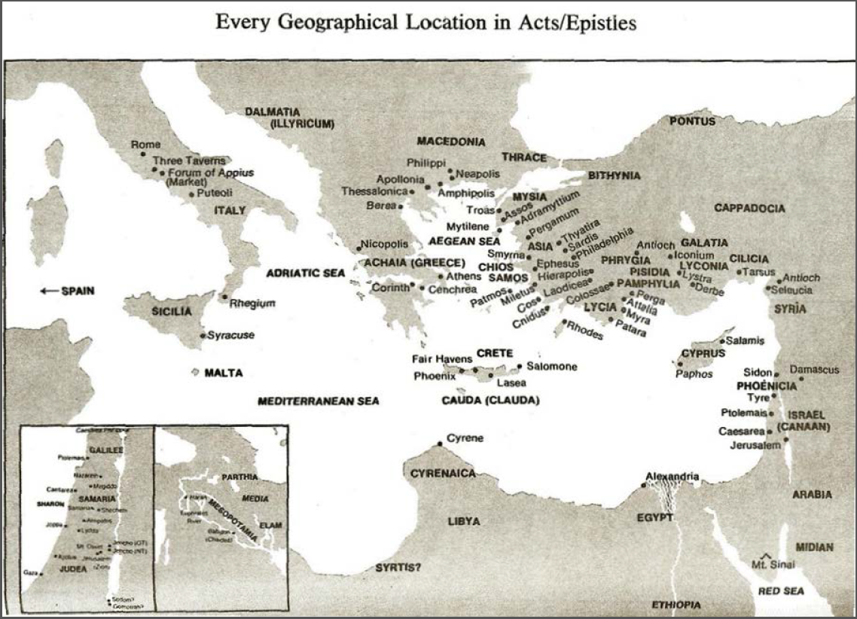

Slide 94
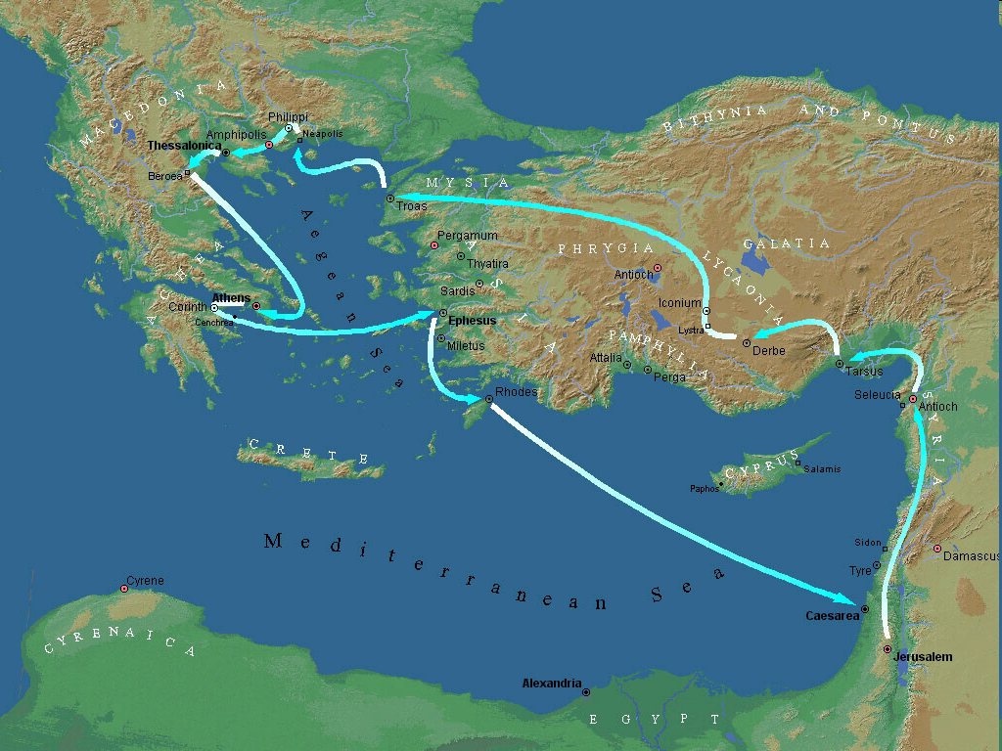
Second Missionary Journey

Slide 95
II. Ministry in Judea Acts 8:26-40
Angel directs Philip (26)
Philip’s obedience (27a)
Ethiopian Eunuch’s introduction (27b-28)
Holy Spirit directs Philip (29)
Philip’s witness to the Eunuch (30-35)
Eunuch’s conversion & baptism (36-38)
Philip’s separation from the Eunuch (39)
Philip’s evangelization of the Coastal Plain (40)

Slide 96
Dr. Arnold G. Fruchtenbaum
The Book of Acts, 200-201
“The text states that he was a eunuch. Eunuchs were often employed by oriental rulers in positions of high office. They were also male servants of female dignitaries, but only placed in such positions after having been castrated... Politically, he was a highly influential official under Candace, queen of the Ethiopians. ‘Candace’ (Kandakēs, in Greek) was not a proper name, but the title of the queen of Ethiopia, much like the word ‘Kaiser’ was the title of the king of Germany and ‘Czar’ was a title of the king of Russia.”

Slide 97
Dr. Arnold G. Fruchtenbaum
The Book of Acts, 200-201
“Because the king of Ethiopia was considered to be a child of the sun and therefore a person too sacred to be involved with secular functions of the royal court, all such duties fell to the queen mother, who had the title of ‘Candace.’ As a result, she was the real power behind the throne, and Ethiopia was a de facto matriarchy. The eunuch was in charge of her treasure, which means he held one of the highest governmental positions. His influence in Ethiopia would therefore have been very considerable.”

Slide 98
II. Ministry in Judea Acts 8:26-40
Angel directs Philip (26)
Philip’s obedience (27a)
Ethiopian Eunuch’s introduction (27b-28)
Holy Spirit directs Philip (29)
Philip’s witness to the Eunuch (30-35)
Eunuch’s conversion & baptism (36-38)
Philip’s separation from the Eunuch (39)
Philip’s evangelization of the Coastal Plain (40)

Slide 99
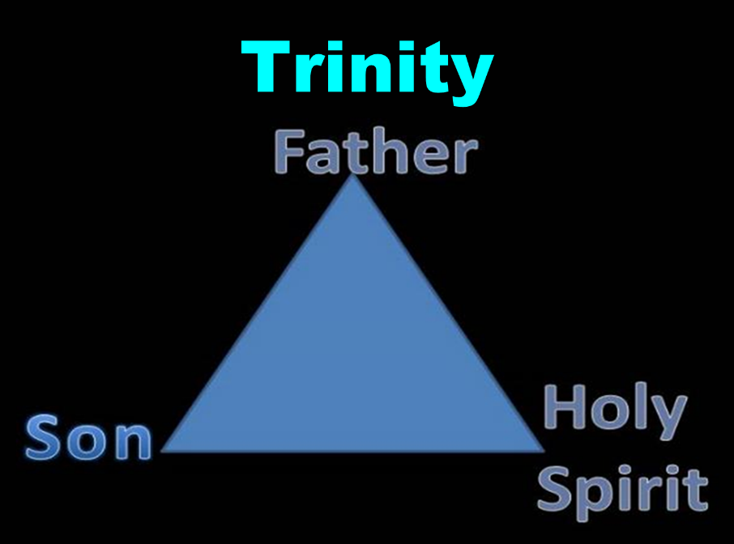

Slide 100
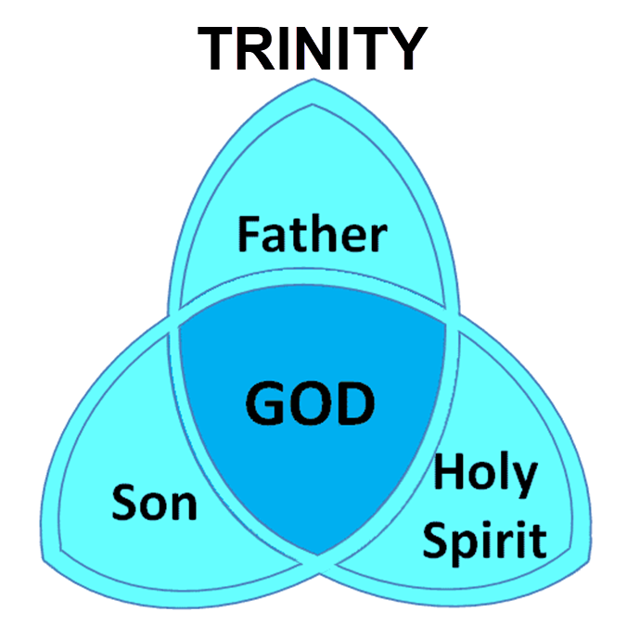

Slide 101
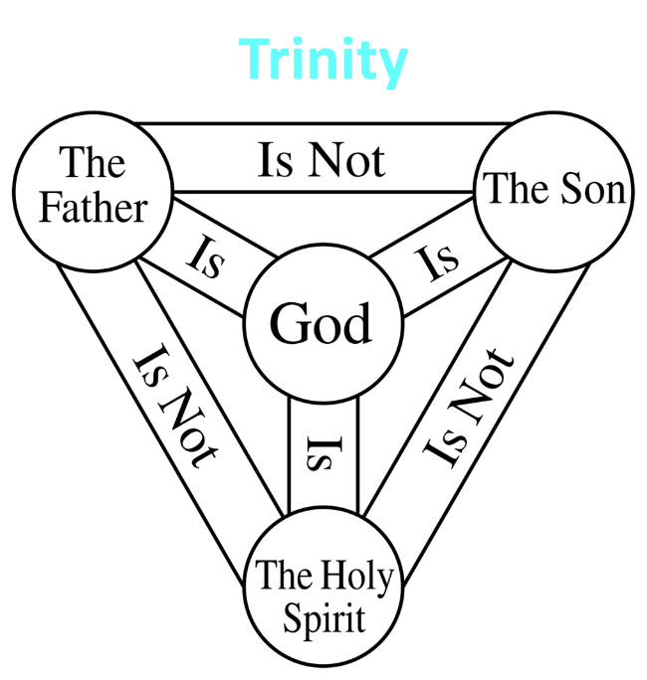

Slide 102
II. Ministry in Judea Acts 8:26-40
Angel directs Philip (26)
Philip’s obedience (27a)
Ethiopian Eunuch’s introduction (27b-28)
Holy Spirit directs Philip (29)
Philip’s witness to the Eunuch (30-35)
Eunuch’s conversion & baptism (36-38)
Philip’s separation from the Eunuch (39)
Philip’s evangelization of the Coastal Plain (40)

Slide 103
Acts 8:30-35 Philip’s Witness to the Eunuch
Philip’s question (30)
Eunuch’s answer (31)
Eunuch's reading (32-33)
Eunuch’s question (34)
Philip’s witness (35)

Slide 104
Acts 8:30-35 Philip’s Witness to the Eunuch
Philip’s question (30)
Eunuch’s answer (31)
Eunuch's reading (32-33)
Eunuch’s question (34)
Philip’s witness (35)

Slide 105
Acts 8:30-35 Philip’s Witness to the Eunuch
Philip’s question (30)
Eunuch’s answer (31)
Eunuch's reading (32-33)
Eunuch’s question (34)
Philip’s witness (35)

Slide 106
Ephesians 4:11-16
“¹¹ And He gave some as apostles, and some as prophets, and some as evangelists, and some as pastors and teachers, ¹² for the equipping of the saints for the work of service, to the building up of the body of Christ;”

Slide 107
Ephesians 4:11-16
“¹³ until we all attain to the unity of the faith, and of the knowledge of the Son of God, to a mature man, to the measure of the stature which belongs to the fullness of Christ. ¹⁴ As a result, we are no longer to be children, tossed here and there by waves and carried about by every wind of doctrine, by the trickery of men, by craftiness in deceitful scheming;”

Slide 108
Ephesians 4:11-16
“¹⁵ but speaking the truth in love, we are to grow up in all aspects into Him who is the head, even Christ, ¹⁶ from whom the whole body, being fitted and held together by what every joint supplies, according to the proper working of each individual part, causes the growth of the body for the building up of itself in love.”

Slide 109
Acts 8:30-35 Philip’s Witness to the Eunuch
Philip’s question (30)
Eunuch’s answer (31)
Eunuch's reading (32-33)
Eunuch’s question (34)
Philip’s witness (35)

Slide 110
Isaiah 53:3–6
³ He was despised and forsaken of men, A man of sorrows and acquainted with grief; And like one from whom men hide their face He was despised, and we did not esteem Him. ⁴ Surely our griefs He Himself bore, And our sorrows He carried; Yet we ourselves esteemed Him stricken, Smitten of God, and afflicted. ⁵ But He was pierced through for our transgressions, He was crushed for our…

Slide 111
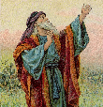
Isaiah 53:3–6
…iniquities; The chastening for our well-being fell upon Him, And by His scourging we are healed. ⁶ All of us like sheep have gone astray, Each of us has turned to his own way; But the Lord has caused the iniquity of us all To fall on Him.

Slide 112
Acts 8:30-35 Philip’s Witness to the Eunuch
Philip’s question (30)
Eunuch’s answer (31)
Eunuch's reading (32-33)
Eunuch’s question (34)
Philip’s witness (35)

Slide 113
Acts 8:30-35 Philip’s Witness to the Eunuch
Philip’s question (30)
Eunuch’s answer (31)
Eunuch's reading (32-33)
Eunuch’s question (34)
Philip’s witness (35)

Slide 114
Luke 24:27, 44
“²⁷ Then beginning with Moses and with all the prophets, He explained to them the things concerning Himself in all the Scriptures…⁴⁴ Now He said to them, ‘These are My words which I spoke to you while I was still with you, that all things which are written about Me in the Law of Moses and the Prophets and the Psalms must be fulfilled.’”

Slide 115
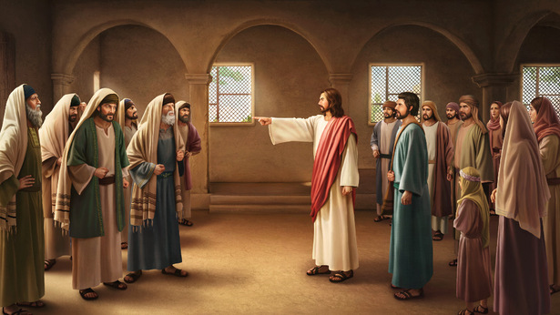
John 5:39, 46
“³⁹ You search the Scriptures because you think that in them you have eternal life; it is these that testify about Me…⁴⁶ For if you believed Moses, you would believe Me, for he wrote about Me.”

Slide 116
II. Ministry in Judea Acts 8:26-40
Angel directs Philip (26)
Philip’s obedience (27a)
Ethiopian Eunuch’s introduction (27b-28)
Holy Spirit directs Philip (29)
Philip’s witness to the Eunuch (30-35)
Eunuch’s conversion & baptism (36-38)
Philip’s separation from the Eunuch (39)
Philip’s evangelization of the Coastal Plain (40)

Slide 117
Sprinkling or Immersion?
Sprinkling? Other words (1 Pet. 1:12; 2 Tim. 4:6)
Immersion?
Christ’s baptism (Matt. 3:16; Mark 1:10)
Ethiopian eunuch's baptism (Acts 8:38-39)
Best symbolizes our union with Christ (Rom. 6:3)
Symbolizes a new creation (Gen. 1:6, 9; 2 Pet. 3:5; 2 Cor. 5:17)

Slide 118
II. Ministry in Judea Acts 8:26-40
Angel directs Philip (26)
Philip’s obedience (27a)
Ethiopian Eunuch’s introduction (27b-28)
Holy Spirit directs Philip (29)
Philip’s witness to the Eunuch (30-35)
Eunuch’s conversion & baptism (36-38)
Philip’s separation from the Eunuch (39)
Philip’s evangelization of the Coastal Plain (40)

Slide 119
Exemption from Death (1 Cor 15:54-56)
Enoch (Gen 5)
Elijah (2 Kings 2)
Christ (Acts 1:11; Rev 12:5)
Philip (Acts 8:39)
Paul (2 Cor 12:2, 4)
John (Rev 4:1-2)
Two witnesses (Rev 11)

Slide 120
1 Thessalonians 4:13-18
¹³ "But we do not want you to be uninformed, brethren, about those who are asleep, so that you will not grieve as do the rest who have no hope. ¹⁴ For if we believe that Jesus died and rose again, even so God will bring with Him those who have fallen asleep in Jesus. ¹⁵ For this we say to you by the word of the Lord, that we who are alive and remain until the coming of the Lord, will not precede those who have fallen asleep. ¹⁶ For the Lord Himself will . . .

Slide 121
1 Thessalonians 4:13-18
…descend from heaven with a shout, with the voice of the archangel and with the trumpet of God, and the dead in Christ will rise first. ¹⁷ Then we who are alive and remain will be caught up together with them in the clouds to meet the Lord in the air, and so we shall always be with the Lord. ¹⁸ Therefore comfort one another with these words."

Slide 123
II. Ministry in Judea Acts 8:26-40
Angel directs Philip (26)
Philip’s obedience (27a)
Ethiopian Eunuch’s introduction (27b-28)
Holy Spirit directs Philip (29)
Philip’s witness to the Eunuch (30-35)
Eunuch’s conversion & baptism (36-38)
Philip’s separation from the Eunuch (39)
Philip’s evangelization of the Coastal Plain (40)

Slide 126
Conclusion

Slide 127
Acts 8:5-40 Philip’s Ministry
Samaria (8:5-25)
Judea (Acts 8:26-40)

