Slide 1
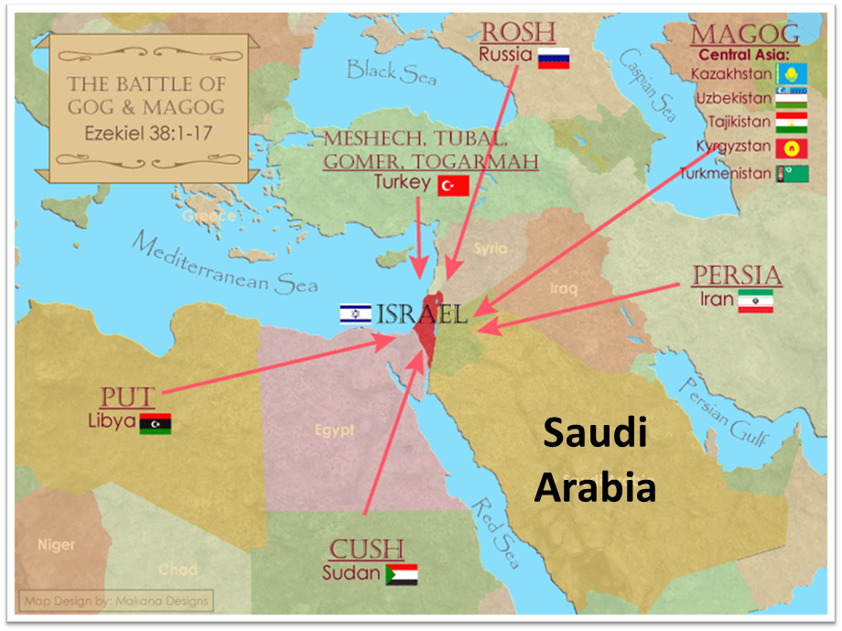
1

Slide 2
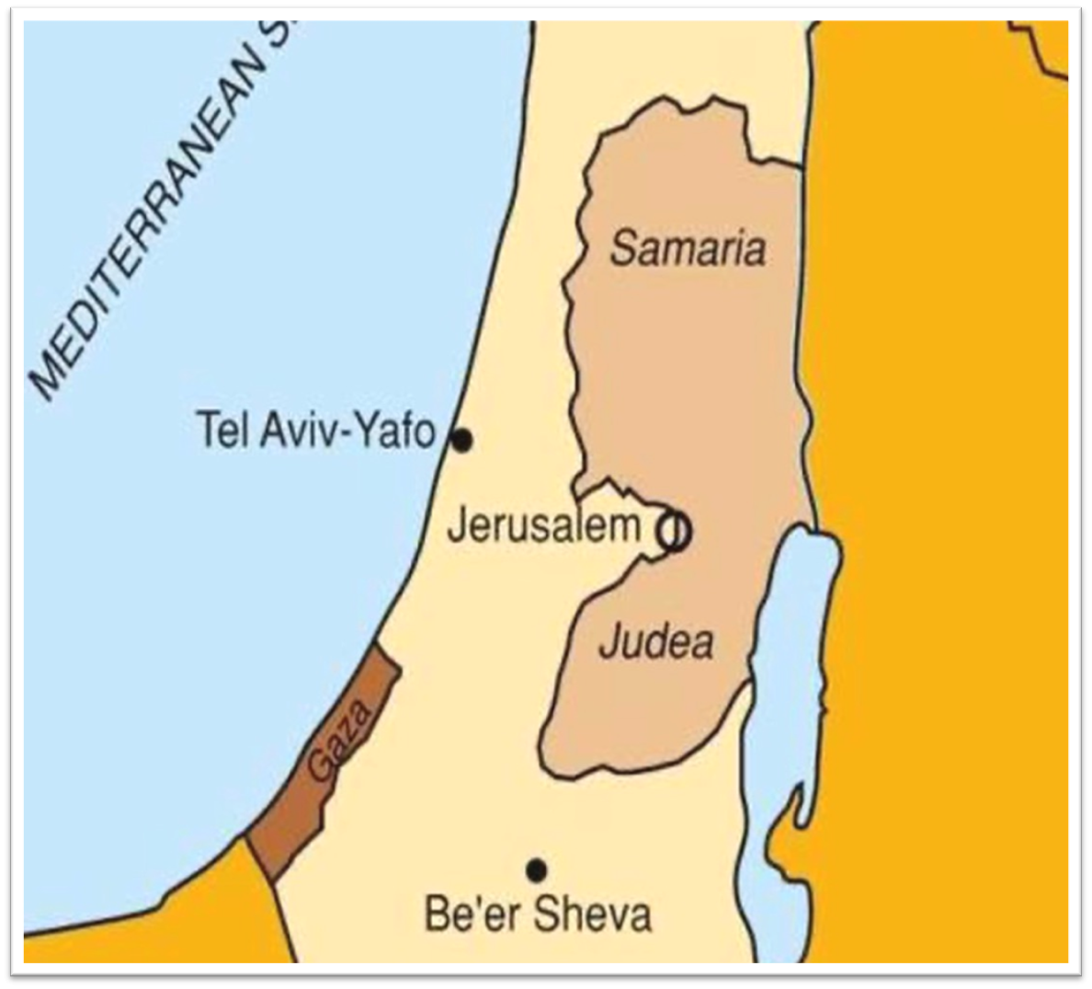

Slide 3
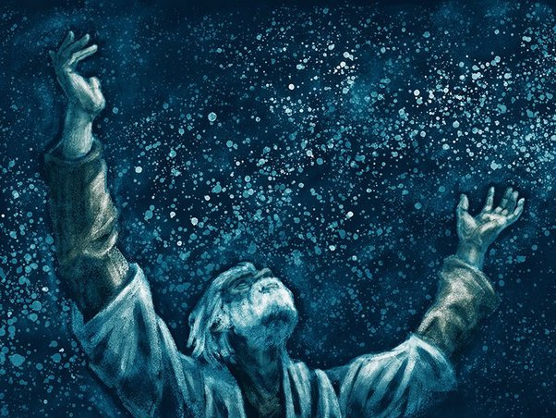
Genesis 12:3
“And I will bless those who bless you, And the one who curses you I will curse. And in you all the families of the earth will be blessed.”

Slide 4
Genesis 12‒50
Israel’s Birth & Preservation

Slide 5
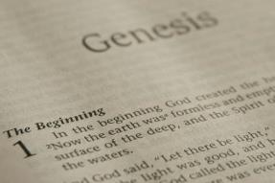
GENESIS STRUCTURE
Genesis 12-50 (four people)
Abraham (12:1–25:11)
Isaac (25:12–26:35)
Jacob (27–36)
Joseph (37–50)

Slide 6
Genesis 37:2-36 Joseph Sold unto Egypt
Joseph’s coat (37:2-4)
Joseph’s dreams (37:5-11)
Joseph’s pit (37:12-24)
Joseph’s enslavement (37:25-36)

Slide 7
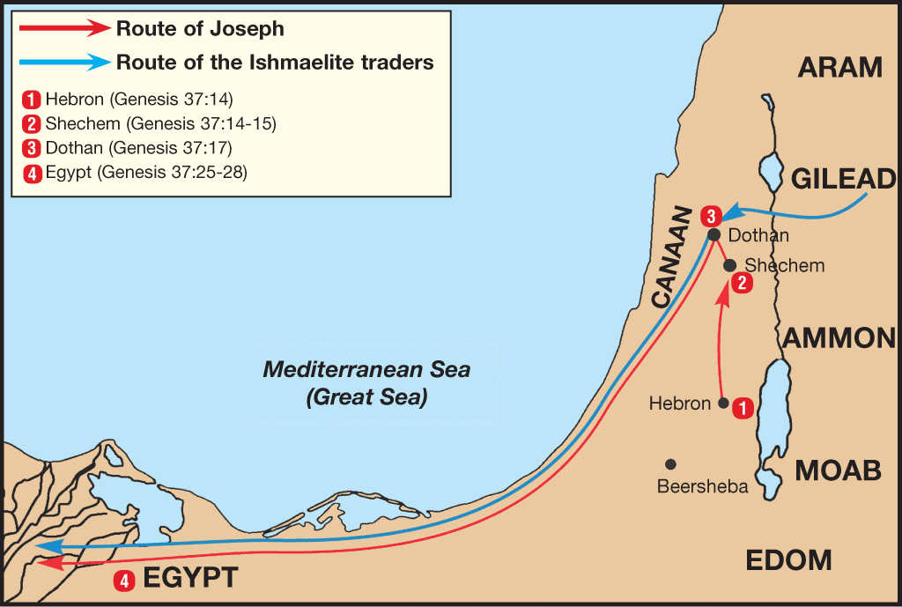

Slide 8
Genesis 38:1-30 Judah & Tamar
Tamar & Judah’s sons (38:1-11)
Tamar & Judah (38:12-26)
Tamar & Judah’s twins (38:27-30)

Slide 9
Genesis 39:1-23 Joseph in Potiphar's House
Blessing (39:1-6)
Temptation & Accusation (39:7-18)
Prison (39:19-23)

Slide 10
Genesis 39:1-23 Joseph in Potiphar's House
Blessing (39:1-6)
Temptation & Accusation (39:7-18)
Prison (39:19-23)

Slide 11
I. Genesis 39:1-6 Blessing
Purchase of Joseph (1)
Blessing of Joseph (2)
Promotion of Joseph (3-4)
Blessing to Potiphar (5)
Joseph’s control (6a)
Joseph’s attractiveness (6b)

Slide 12
Genesis 39:1-23 Joseph in Potiphar's House
Blessing (39:1-6)
Temptation & Accusation (39:7-18)
Prison (39:19-23)

Slide 13
II. Genesis 39:7-18 Temptation & Accusation
Proposition (7)
Refusal (8-9)
Persistence & refusal (10a)
Sexual harassment (11-12)
Wife’s accusations (13-18)

Slide 14
Genesis 39:1-23 Joseph in Potiphar's House
Blessing (39:1-6)
Temptation & Accusation (39:7-18)
Prison (39:19-23)

Slide 15
III. Genesis 39:19-23 Prison
Potiphar’s action (19-20)
Joseph’s blessing in prison (21-23)

Slide 16
III. Genesis 39:19-23 Prison
Potiphar’s action (19-20)
Joseph’s blessing in prison (21-23)

Slide 17
Genesis 39:19-20 Potiphar’s Action
Anger (19)
Action (20)

Slide 18
Genesis 39:19-20 Potiphar’s Action
Anger (19)
Action (20)

Slide 19
Genesis 39:19-20 Potiphar’s Action
Anger (19)
Action (20)

Slide 20
Dr. Arnold G. Fruchtenbaum
The Book of Genesis, 554
“…in verse 20, came the imprisonment: And Joseph’s master took him, and put him into the prison; this prison was where the king’s prisoners were bound; this was the royal prison. There is more than one Hebrew word for prison, and the term used here is a word that is found only in Genesis chapters 39 and 40. It is actually an Egyptian loan word, and it has the meaning of a royal prison. Potiphar was an officer of Pharaoh’s and so this was actually under his authority.”

Slide 21
III. Genesis 39:19-23 Prison
Potiphar’s action (19-20)
Joseph’s blessing in prison (21-23)

Slide 22
Genesis 39:21-23 Joseph’s Blessing in Prison
Relation to the prison keeper (21)
Joseph’s elevation (22)
Joseph’s control (23)

Slide 23
Genesis 39:21-23 Joseph’s Blessing in Prison
Relation to the prison keeper (21)
Joseph’s elevation (22)
Joseph’s control (23)

Slide 24
Genesis 39:21 Accusations
Source (21a)
Result (21b)

Slide 25
Genesis 39:21 Accusations
Source (21a)
Result (21b)

Slide 26
John 14:16-17
¹⁶ I will ask the Father, and He will give you another Helper, that He may be with you forever; ¹⁷ that is the Spirit of truth, whom the world cannot receive, because it does not see Him or know Him, but you know Him because He abides with you and will be in you.

Slide 27
Genesis 39:21 Accusations
Source (21a)
Result (21b)

Slide 28
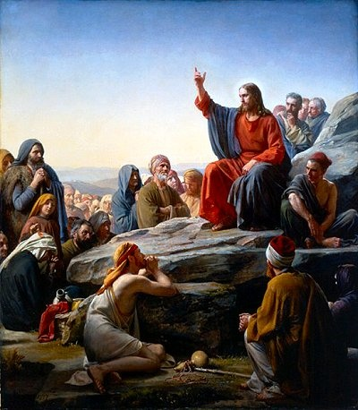
Matt 5:13, 16
“You are the light of the world. A city set on a hill cannot be hidden…Let your light shine before men in such a way that they may see your good works, and glorify your Father who is in heaven.”

Slide 29
Genesis 39:21-23 Joseph’s Blessing in Prison
Relation to the prison keeper (21)
Joseph’s elevation (22)
Joseph’s control (23)

Slide 30
Genesis 39:21-23 Joseph’s Blessing in Prison
Relation to the prison keeper (21)
Joseph’s elevation (22)
Joseph’s control (23)

Slide 31
1 John 1:9
“If we confess our sins, He is faithful and righteous to forgive us our sins and to cleanse us from all unrighteousness.”

Slide 33
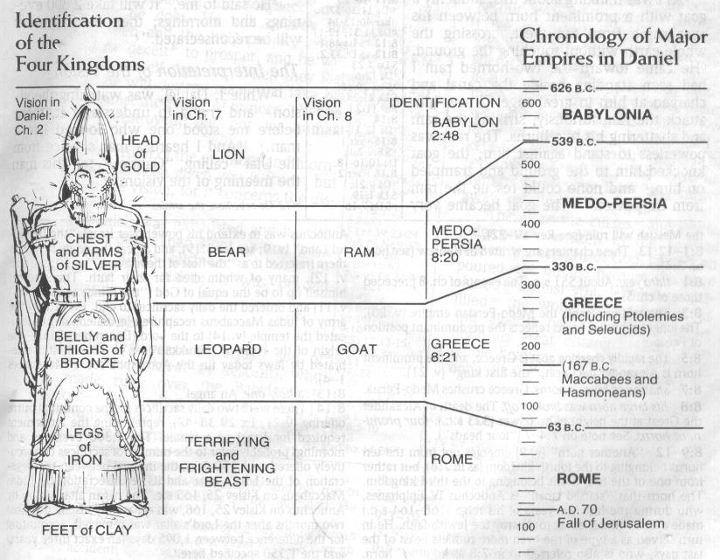

Slide 34
Conclusion

Slide 35
Genesis 39:1-23 Joseph in Potiphar's House
Blessing (39:1-6)
Temptation & Accusation (39:7-18)
Prison (39:19-23)

Slide 36
²⁴ The Lord bless you, and keep you; ²⁵ The Lord make His face shine on you, And be gracious to you; ²⁶ The Lord lift up His countenance on you, And give you peace.
Numbers 6:24–26 (NASB95)

