Slide 1
Dr. Andy Woods
Senior Pastor – Sugar Land Bible Church
President – Chafer Theological Seminary

Slide 2
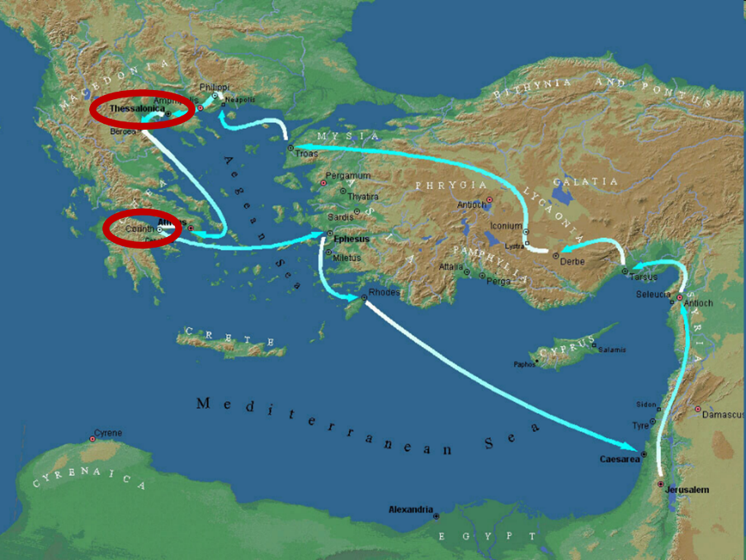

Slide 3
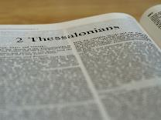
2 Thessalonians 2:1-12
Problem (2:1-2)
Prerequisites for the Day of the Lord (2:3-12)
The departure (2:3a)
Advent of the lawless one (2:3b-4)
Removal of the restrainer (2:5-7)
Destruction of the lawless one (2:8-9)
Destruction of lawless one’s followers (2:10-12)

Slide 4
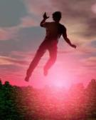
2 Thessalonians 2:2
“that you not be quickly shaken from your composure or be disturbed either by a spirit or a message or a letter as if from us, to the effect that the day of the Lord [the Tribulation] has come.”

Slide 5
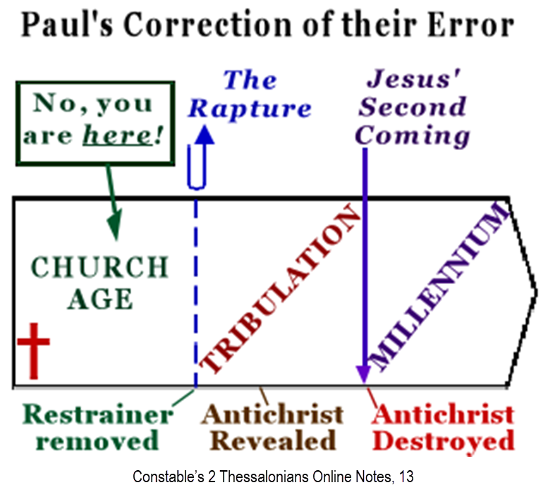

Slide 7
2 Thessalonians 2:1-12
Problem (2:1-2)
Prerequisites for the Day of the Lord (2:3-12)
The departure (2:3a)
Advent of the lawless one (2:3b-4)
Removal of the restrainer (2:5-7)
Destruction of the lawless one (2:8-9)
Destruction of lawless one’s followers (2:10-12)

Slide 8
2 Thessalonians 2:1-12
Problem (2:1-2)
Prerequisites for the Day of the Lord (2:3-12)
The departure (2:3a)
Advent of the lawless one (2:3b-4)
Removal of the restrainer (2:5-7)
Destruction of the lawless one (2:8-9)
Destruction of lawless one’s followers (2:10-12)

Slide 9
2 Thessalonians 2:1-12
Problem (2:1-2)
Prerequisites for the Day of the Lord (2:3-12)
The departure (2:3a)
Advent of the lawless one (2:3b-4)
Removal of the restrainer (2:5-7)
Destruction of the lawless one (2:8-9)
Destruction of lawless one’s followers (2:10-12)

Slide 10
2 Thessalonians 2:1-12
Problem (2:1-2)
Prerequisites for the Day of the Lord (2:3-12)
The departure (2:3a)
Advent of the lawless one (2:3b-4)
Removal of the restrainer (2:5-7)
Destruction of the lawless one (2:8-9)
Destruction of lawless one’s followers (2:10-12)

Slide 11
2 Thessalonians 2:1-12
Problem (2:1-2)
Prerequisites for the Day of the Lord (2:3-12)
The departure (2:3a)
Advent of the lawless one (2:3b-4)
Removal of the restrainer (2:5-7)
Destruction of the lawless one (2:8-9)
Destruction of lawless one’s followers (2:10-12)

Slide 12
2 Thessalonians 2:1-12
Problem (2:1-2)
Prerequisites for the Day of the Lord (2:3-12)
The departure (2:3a)
Advent of the lawless one (2:3b-4)
Removal of the restrainer (2:5-7)
Destruction of the lawless one (2:8-9)
Destruction of lawless one’s followers (2:10-12)

Slide 13
2 Thessalonians 2:10-12 Destruction of the Lawless One’s Followers
The judgment’s cause (10)
The judgment itself (11)
The judgment’s purpose (12)

Slide 14
2 Thessalonians 2:10-12 Destruction of the Lawless One’s Followers
The judgment’s cause (10)
The judgment itself (11)
The judgment’s purpose (12)

Slide 15
Matt 24 / Rev 6 Parallels
Prediction | Birth pangs (Matt 24) | Seal judgments (Rev 6)
1. False Christ | 24:5 | 6:2
2. War | 24:6 | 6:3-4
3. Famine | 24:7 | 6:5-6
4. Death | 24:6-7 | 6:7-8
5. Martyrs | 24:9-13 | 6:9-11
6. Earthquakes | 24:7 | 6:12-17
7. Evangelism | 24:14 | 7:1-9
©2023 ANDY WOODS MINISTRIES. ALL RIGHTS RESERVED

Slide 16
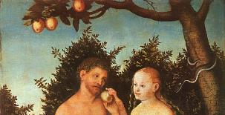
2 Thessalonians 2:9
“that is, the one whose coming is in accord with the activity of Satan, with all power and signs and false wonders.”

Slide 17
John 1:12
“But as many as received Him, to them He gave the right to become children of God, even to those who believe in His name.”

Slide 18
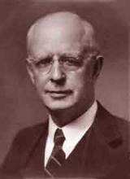
Lewis Sperry Chafer, vol. 7, Systematic Theology (Grand Rapids, MI: Kregel Publications, 1993), 265-66.
Belief-God’s One Condition for Justification
“…because upwards of 150 passages of Scripture condition salvation upon believing only (cf. John 3:16; Acts 16:31).”

Slide 19
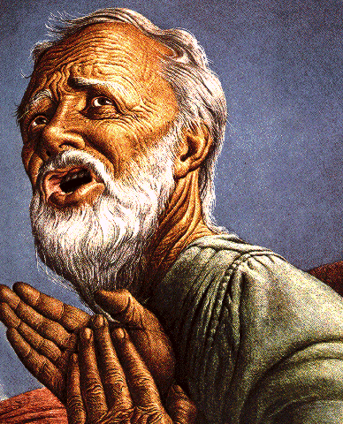
Belief – God’s One Condition for Justification
Gen 15:6
Then he believed in the LORD; and He reckoned it to him as righteousness.
John 3:16
For God so loved the world, that He gave His only begotten Son, that whoever believes in Him shall not perish, but have eternal life.
Acts 16:30-31
"Sirs, what must I do to be saved?" They said, "Believe in the Lord Jesus, and you will be saved..."

Slide 20
The Plagues of Egypt
NO. | DESCRIPTION | SCRIPTURE | IMITATION?
1. | Water to Blood | Exod. 7:14-25 | Yes
2. | Frogs | Exod. 8:1-15 | Yes
3. | Gnats | Exod. 8:16-19 | No
4. | Flies | Exod. 8:20-32 | No
5. | Disease on Cattle | Exod. 9:1-7 | No
6. | Boils | Exod. 9:8-12 | No
7. | Hail | Exod. 9:13-35 | No
8. | Locusts | Exod. 10:1-20 | No
9. | Darkness | Exod. 10:21-29 | No
10. | Death of the First Born | Exod. 12:29-36 | No

Slide 21
Romans 1:18–20
¹⁸ For the wrath of God is revealed from heaven against all ungodliness and unrighteousness of men who suppress the truth in unrighteousness, ¹⁹ because that which is known about God is evident within them; for God made it evident to them. ²⁰ For since the creation of the world His invisible attributes, His eternal power and divine nature, have been clearly seen, being understood through what has been made, so that they are without excuse.

Slide 22
Three Tenses of Salvation
Phase | Justification | Sanctification | Glorification
Tense | Past | Present | Future
Saved from sin’s: | Penalty | Power | Presence
Scripture | Eph 2:8-9; Titus 3:5 | Philip 2:12 | Rom 5:10
Nature | Single | Dual | Single

Slide 23
2 Thessalonians 2:10-12 Destruction of the Lawless One’s Followers
The judgment’s cause (10)
The judgment itself (11)
The judgment’s purpose (12)

Slide 24
Charles Ryrie The Ryrie Study Bible, page 1489
2 Thessalonians 2:11-12 (RSBEE:NASB1995U): 2:11-12 The deluding influence comes from God; it is both a punishment and a moral result of their rejection of the truth (vv. 10, 12). These verses reflect the OT concept that God is sovereign even in the activities of the powers of evil (cf. Ex. 4:21; Josh. 11:20; 1 Kings 22:19–23; 1 Chron. 21:1; cf. 2 Sam. 24:1). The result will be that men will believe what is false, as Satan works through Antichrist.”

Slide 25
1st Six Seals (Revelation 6)
SEAL 1 – 6:1-2 – Advent of antichrist
SEAL 2 – 6:3-4 – War
SEAL 3 – 6:5-6 – Famine
SEAL 4 – 6:7-8 – Death
SEAL 5 – 6:9-11 – Martyrdoms
SEAL 6 – 6:12-17 – Cosmic disturbances

Slide 26
Matt 24 / Rev 6 Parallels
Prediction | Birth pangs (Matt 24) | Seal judgments (Rev 6)
1. False Christ | 24:5 | 6:2
2. War | 24:6 | 6:3-4
3. Famine | 24:7 | 6:5-6
4. Death | 24:6-7 | 6:7-8
5. Martyrs | 24:9-13 | 6:9-11
6. Earthquakes | 24:7 | 6:12-17
7. Evangelism | 24:14 | 7:1-9
©2023 ANDY WOODS MINISTRIES. ALL RIGHTS RESERVED

Slide 27
2 Thessalonians 2:9
“that is, the one whose coming is in accord with the activity of Satan, with all power and signs and false wonders.”

Slide 28
2 Timothy 4:3-4
³ For the time will come when they will not endure sound doctrine; but wanting to have their ears tickled, they will accumulate for themselves teachers in accordance to their own desires, ⁴ and will turn away their ears from the truth and will turn aside to myths [mythos].

Slide 29
2 Thessalonians 2:10-12 Destruction of the Lawless One’s Followers
The judgment’s cause (10)
The judgment itself (11)
The judgment’s purpose (12)

Slide 30
Scripture’s Four Judgments
NAME | SHEEP AND GOAT | JUDGMENT OF THE JEWS | BEMA SEAT | GREAT WHITE THRONE
SCRIPTURE | Matt 25:31-46 | Ezek 20:33-44 | 1 Cor 3:10-15 | Rev 20:11-15
PLACE | Earth, Jerusalem | Earth, wilderness | Heaven | Earth
AUDIENCE | Gentile Tribulation survivors | Jewish Tribulation survivors | Church Age believers | All unsaved
WHEN | After Tribulation | After Tribulation | After rapture | After Millennium
PURPOSE | Saved Gentiles enter kingdom | Saved Jews enter kingdom | Reward believers | Degree of punishment in hell
EVALUATION | Treatment of Christ’s brethren | Passing under shepherd’s rod | Works taken through fire | Not in the book; judged by books

Slide 32
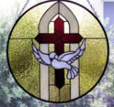
John 3:36
“The one who believes in the Son has eternal life; but the one who does not obey the Son will not see life, but the wrath of God remains on him.”

Slide 33
Distinctions Between 144,000 & Multitude
144,000 | MULTITUDE
Revelation 7:1-8 | Revelation 7:9-17
Numbered | Innumerable
Jews | All nations
Sealed | Slain
Sealed before the Tribulation | Converted out of the Tribulation
Hitchcock and Ice, The Truth Behind Left Behind, 77

Slide 34
Conclusion

Slide 35
2 Thessalonians 2:10-12 Destruction of the Lawless One’s Followers
The judgment’s cause (10)
The judgment itself (11)
The judgment’s purpose (12)

Slide 36
2 Thessalonians 2:2
“that you not be quickly shaken from your composure or be disturbed either by a spirit or a message or a letter as if from us, to the effect that the day of the Lord [the Tribulation] has come.”

Slide 37
2 Thessalonians 2:1-12
Problem (2:1-2)
Prerequisites for the Day of the Lord (2:3-12)
The departure (2:3a)
Advent of the lawless one (2:3b-4)
Removal of the restrainer (2:5-7)
Destruction of the lawless one (2:8-9)
Destruction of lawless one’s followers (2:10-12)

