Slide 1
Genesis 12‒50
Israel’s Birth & Preservation

Slide 2
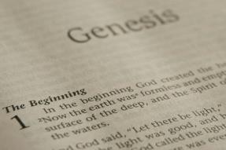
GENESIS STRUCTURE
Genesis 12-50 (four people)
Abraham (12:1–25:11)
Isaac (25:12–26:35)
Jacob (27–36)
Joseph (37–50)

Slide 3
Genesis 37:2-36 Joseph Sold unto Egypt
Joseph’s coat (37:2-4)
Joseph’s dreams (37:5-11)
Joseph’s pit (37:12-24)
Joseph’s enslavement (37:25-36)

Slide 4
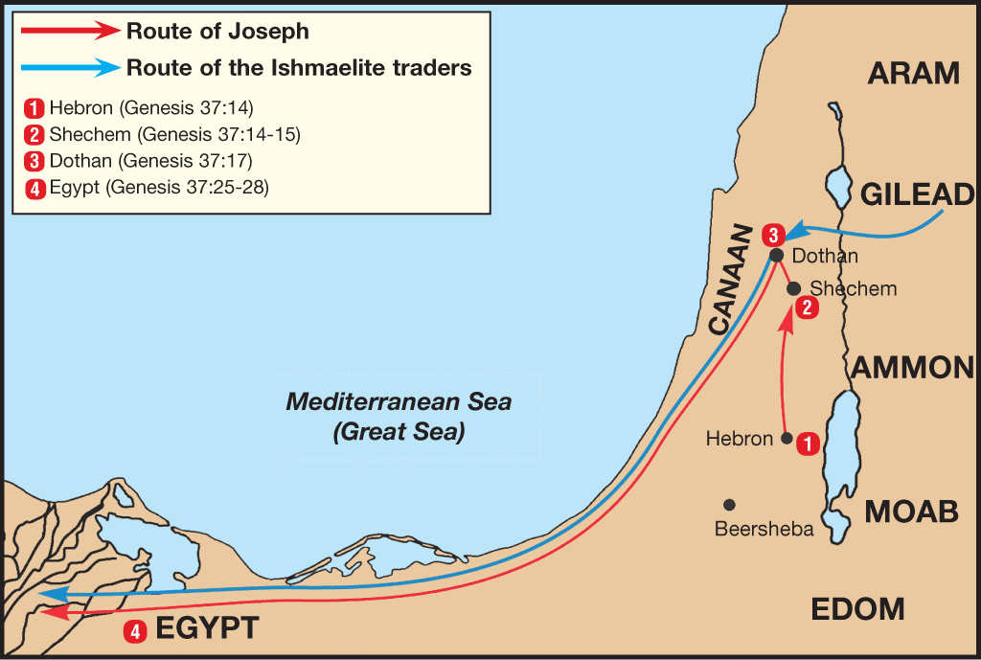

Slide 5
Genesis 38:1-30 Judah & Tamar
Tamar & Judah’s sons (38:1-11)
Tamar & Judah (38:12-26)
Tamar & Judah’s twins (38:27-30)

Slide 6
Genesis 39:1-23 Joseph in Potiphar's House
Blessing (39:1-6)
Temptation & Accusation (39:7-18)
Prison (39:19-23)

Slide 7
Genesis 39:1-23 Joseph in Potiphar's House
Blessing (39:1-6)
Temptation & Accusation (39:7-18)
Prison (39:19-23)

Slide 8
I. Genesis 39:1-6 Blessing
Purchase of Joseph (1)
Blessing of Joseph (2)
Promotion of Joseph (3-4)
Blessing to Potiphar (5)
Joseph’s control (6a)
Joseph’s attractiveness (6b)

Slide 9
Genesis 39:1-23 Joseph in Potiphar's House
Blessing (39:1-6)
Temptation & Accusation (39:7-18)
Prison (39:19-23)

Slide 10
II. Genesis 39:7-18 Temptation & Accusation
Proposition (7)
Refusal (8-9)
Persistence & refusal (10a)
Sexual harassment (11-12)
Wife’s accusations (13-18)

Slide 11
II. Genesis 39:7-18 Temptation & Accusation
Proposition (7)
Refusal (8-9)
Persistence & refusal (10a)
Sexual harassment (11-12)
Wife’s accusations (13-18)

Slide 12
II. Genesis 39:7-18 Temptation & Accusation
Proposition (7)
Refusal (8-9)
Persistence & refusal (10a)
Sexual harassment (11-12)
Wife’s accusations (13-18)

Slide 13
Genesis 39:8-9 Refusal
Refusal (8a)
Reasons (8b-9)

Slide 14
Genesis 39:8-9 Refusal
Refusal (8a)
Reasons (8b-9)

Slide 15
Genesis 39:8-9 Refusal
Refusal (8a)
Reasons (8b-9)

Slide 16
Genesis 39:8b-9 Reasons
Betrayal of Potiphar (8b-9a)
Betrayal of God (9b)

Slide 17
Genesis 39:8b-9 Reasons
Betrayal of Potiphar (8b-9a)
Betrayal of God (9b)

Slide 18
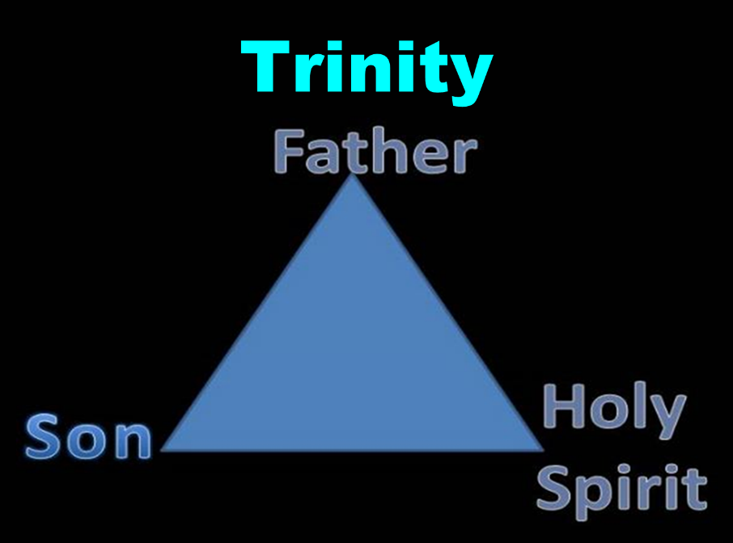

Slide 19
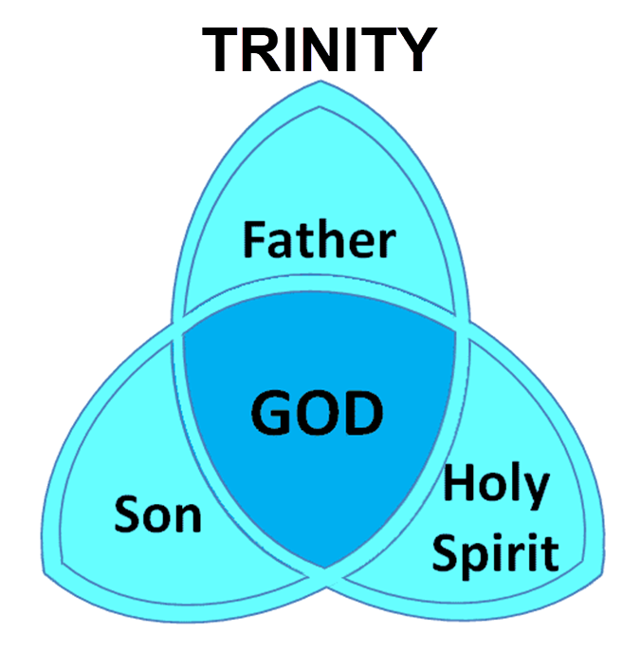

Slide 20
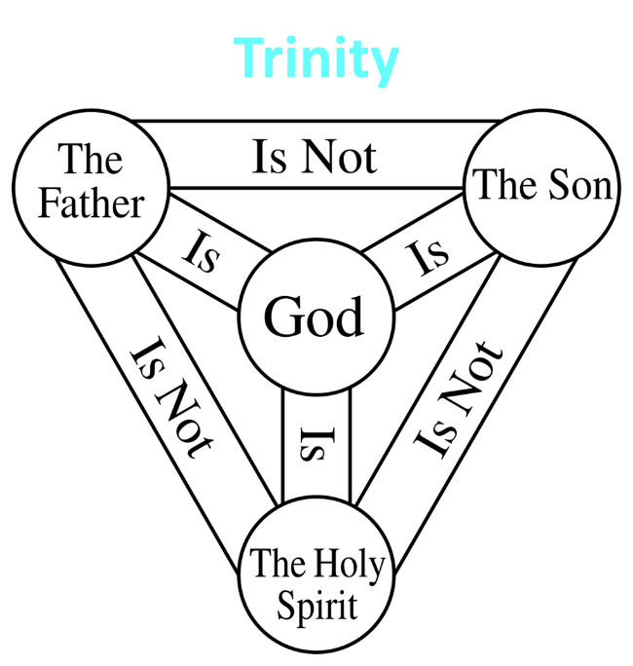

Slide 21
Genesis 39:8b-9 Reasons
Betrayal of Potiphar (8b-9a)
Betrayal of God (9b)

Slide 22
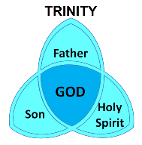
1 Corinthians 6:19
“Or do you not know that your body is a temple of the Holy Spirit who is in you, whom you have from God, and that you are not your own?”

Slide 23
Ephesians 4:30
“Do not grieve the Holy Spirit of God, by whom you were sealed for the day of redemption.”

Slide 24
John 14:16-17
¹⁶ I will ask the Father, and He will give you another Helper, that He may be with you forever; ¹⁷ that is the Spirit of truth, whom the world cannot receive, because it does not see Him or know Him, but you know Him because He abides with you and will be in you.

Slide 25
Westminster Shorter Catechism Q and A #1
Q: What is the chief end of man?
A; Man’s chief end is to gloriy God and enjoy Him forever.

Slide 26
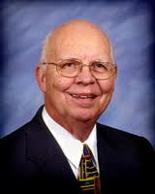
VII. Purposes of the Local Church
Glorify God (Eph 3:21)
Edify the saints (Eph 4:11-16)
Fulfill the Great Commission (Matt 28:18-20)

Slide 27
VII. Purposes of the Local Church
Glorify God (Eph 3:21)
Edify the saints (Eph 4:11-16)
Fulfill the Great Commission (Matt 28:18-20)

Slide 28
Ephesians 3:21
“to Him be the glory in the church and in Christ Jesus to all generations forever and ever. Amen.”

Slide 29
Dispensational Theology is a System of Theology
Traditional-normative dispensational theology is a system that embodies three essential, fundamental concepts called the sine qua non (lit. “without which is not”):
The consistent use of a plain, normal, literal, grammatical-historical method of interpretation;
Which reveals that the Church is distinct from Israel;
God’s overall purpose is to bring glory to Himself (Eph. 1:6, 12, 14).
Dr. Charles Ryrie, Dispensationalism, pp. 38-41

Slide 30
Dispensational Theology: Doxological Purpose
God’s ultimate purpose for the ages is to glorify Himself. Scripture is not human-centered, as though salvation were the principle point, but God-centered, because His glory is at the center.
The glory of God is the primary principle that unifies all dispensations, the program of salvation being just one of the means by which God glorifies Himself. Each successive revelation of God’s plan for the ages, as well as His dealing with the elect, non-elect, angels, and nations all manifest His glory.
Dictionary of Premillennial Theology, Charles Ryrie, p. 94

Slide 32
II. Genesis 39:7-18 Temptation & Accusation
Proposition (7)
Refusal (8-9)
Persistence & refusal (10a)
Sexual harassment (11-12)
Wife’s accusations (13-18)

Slide 33
Genesis 39:10 Persistence & Refusal
Persistence (10a)
Refusal (10b)

Slide 34
Genesis 39:10 Persistence & Refusal
Persistence (10a)
Refusal (10b)

Slide 35
Genesis 39:10 Persistence & Refusal
Persistence (10a)
Refusal (10b)

Slide 36
BOOK OF DANIEL
CHAP. & VERSE | CHRONOLOGICAL DATE | BIBLICAL DATE
1:1 | 605 | 3rd year of Jehoiakim
2:1 | 603 | 2nd year of Nebuchadnezzar
5 | Sat. night 10/12/539 (Hoehner)
7:1 | 553 | 1st year of Belshazzar
8:1 | 551 | 3rd year of Belshazzar
9:1 | 538 | 1st year of Darius
10:1 | 536 | 3rd year of Cyrus

Slide 37
Daniel’s Age
CHAP. | EVENTS | AGE
1 | Taken to Babylonian captivity | 15
2 | Interpreting Nebuchadnezzar’s 1st dream (huge image) | 17
3 | Daniel’s 3 friends cast into the fiery furnace | 19 or 20
4 | Interpreting Nebuchadnezzar’s 2nd dream (huge tree) | 45-50
5 | Interpreting handwriting of the wall at Belshazzar’s feast | Early 80’s
6 | Delivered from the den of lions | c.83
7-8 | Daniel’s visions and dreams | Mid-60’s
9 | Daniel’s seventy “sevens” prophecy | Early-80’s
10-12 | Final dreams and visions | Mid-80’s

Slide 38
II. Genesis 39:7-18 Temptation & Accusation
Proposition (7)
Refusal (8-9)
Persistence & refusal (10a)
Sexual harassment (11-12)
Wife’s accusations (13-18)

Slide 39
Genesis 39:11-12 Sexual Harassment
Circumstances (11)
Actions (12)

Slide 40
Genesis 39:11-12 Sexual Harassment
Circumstances (11)
Actions (12)

Slide 41
Genesis 39:11-12 Sexual Harassment
Circumstances (11)
Actions (12)

Slide 42
Genesis 39:12 Actions
Potiphar’s Wife (12a)
Joseph (12b)

Slide 43
Genesis 39:12 Actions
Potiphar’s Wife (12a)
Joseph (12b)

Slide 44
Genesis 39:12 Actions
Potiphar’s Wife (12a)
Joseph (12b)

Slide 45
II. Genesis 39:7-18 Temptation & Accusation
Proposition (7)
Refusal (8-9)
Persistence & refusal (10a)
Sexual harassment (11-12)
Wife’s accusations (13-18)

Slide 46
Genesis 39:13-18 Wife’s Accusations
Evidence (13)
Accusations (14-18)

Slide 47
Genesis 39:13-18 Wife’s Accusations
Evidence (13)
Accusations (14-18)

Slide 48
Genesis 39:13-18 Wife’s Accusations
Evidence (13)
Accusations (14-18)

Slide 49
Genesis 39:14-18 Accusations
To the servants (14-15)
To Potiphar (16-18)

Slide 50
Genesis 39:14-18 Accusations
To the servants (14-15)
To Potiphar (16-18)

Slide 51
Genesis 39:14-18 Accusations
To the servants (14-15)
To Potiphar (16-18)

Slide 52
Genesis 39:1-23 Joseph in Potiphar's House
Blessing (39:1-6)
Temptation & Accusation (39:7-18)
Prison (39:19-23)

Slide 53
III. Genesis 39:19-23 Prison
Potiphar’s action (19-20)
Joseph’s blessing in prison (21-23)

Slide 54
III. Genesis 39:19-23 Prison
Potiphar’s action (19-20)
Joseph’s blessing in prison (21-23)

Slide 55
Genesis 39:19-20 Potiphar’s Action
Anger (19)
Action (20)

Slide 56
Genesis 39:19-20 Potiphar’s Action
Anger (19)
Action (20)

Slide 57
Genesis 39:19-20 Potiphar’s Action
Anger (19)
Action (20)

Slide 58
Dr. Arnold G. Fruchtenbaum
The Book of Genesis, 554
“…in verse 20, came the imprisonment: And Joseph’s master took him, and put him into the prison; this prison was where the king’s prisoners were bound; this was the royal prison. There is more than one Hebrew word for prison, and the term used here is a word that is found only in Genesis chapters 39 and 40. It is actually an Egyptian loan word, and it has the meaning of a royal prison. Potiphar was an officer of Pharaoh’s and so this was actually under his authority.”

Slide 59
III. Genesis 39:19-23 Prison
Potiphar’s action (19-20)
Joseph’s blessing in prison (21-23)

Slide 60
Genesis 39:21-23 Joseph’s Blessing in Prison
Relation to the prison keeper (21)
Joseph’s elevation (22)
Joseph’s control (23)

Slide 61
Genesis 39:21-23 Joseph’s Blessing in Prison
Relation to the prison keeper (21)
Joseph’s elevation (22)
Joseph’s control (23)

Slide 62
Genesis 39:21 Accusations
Source (21a)
Result (21b)

Slide 63
Genesis 39:21 Accusations
Source (21a)
Result (21b)

Slide 64
Genesis 39:21 Accusations
Source (21a)
Result (21b)

Slide 65
Genesis 39:21-23 Joseph’s Blessing in Prison
Relation to the prison keeper (21)
Joseph’s elevation (22)
Joseph’s control (23)

Slide 66
Genesis 39:21-23 Joseph’s Blessing in Prison
Relation to the prison keeper (21)
Joseph’s elevation (22)
Joseph’s control (23)

Slide 67
Conclusion

Slide 68
Genesis 39:1-23 Joseph in Potiphar's House
Blessing (39:1-6)
Temptation & Accusation (39:7-18)
Prison (39:19-23)

Slide 69
²⁴ The Lord bless you, and keep you; ²⁵ The Lord make His face shine on you, And be gracious to you; ²⁶ The Lord lift up His countenance on you, And give you peace.
Numbers 6:24–26 (NASB95)

