Slide 1
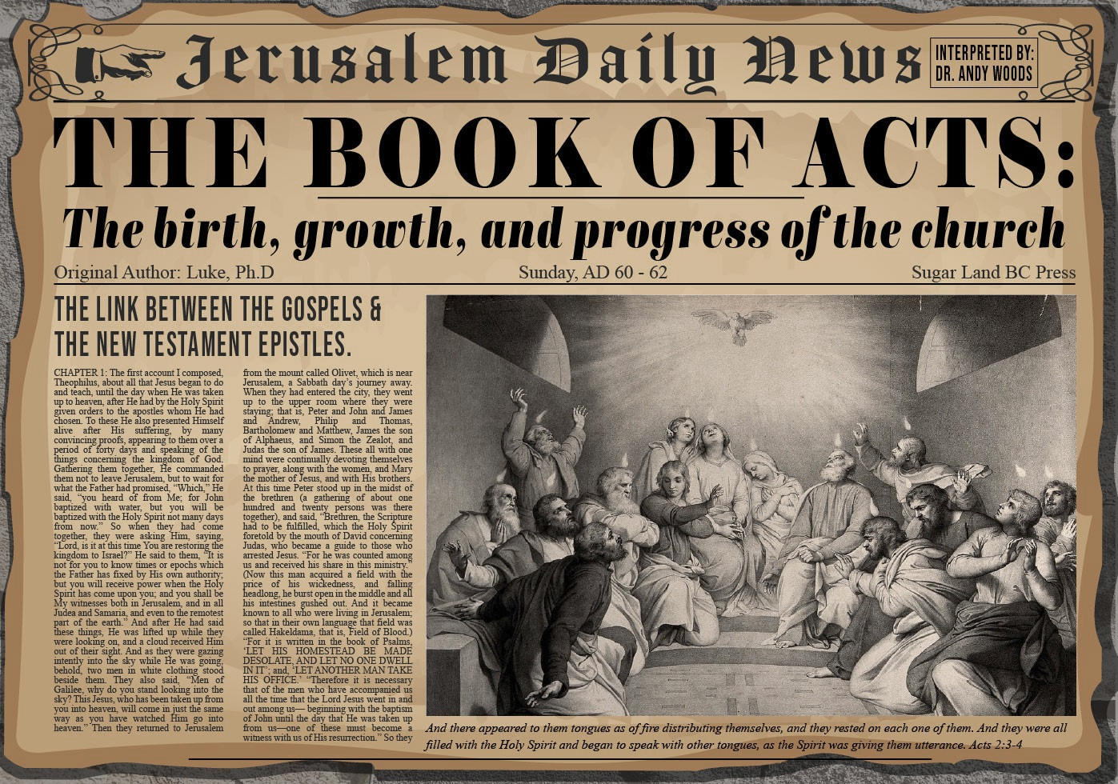


Slide 2
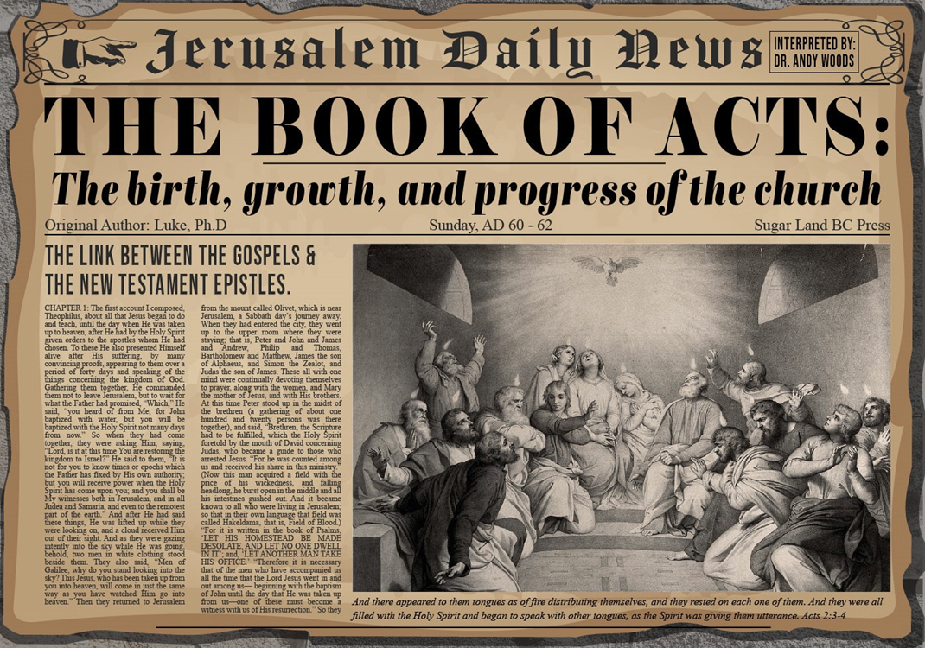
Acts 8:5-40
Philip’s Ministry
  Samaria (8:5-25)
  Judea (Acts 8:6-40)

Slide 3
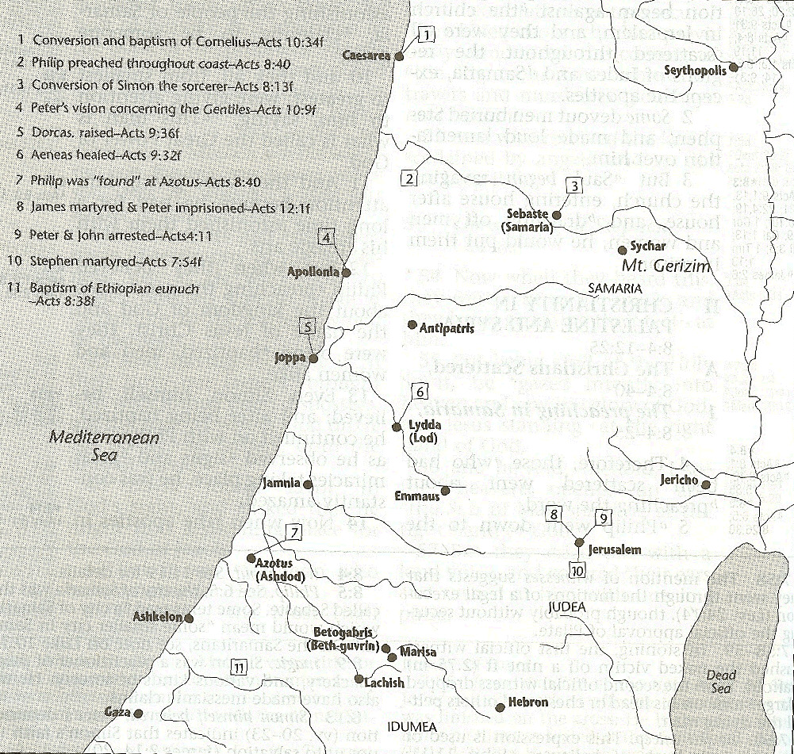



Slide 4
Acts 8:5-40
Philip’s Ministry
  Samaria (8:5-25)
  Judea (Acts 8:6-40)

Slide 6
I. Ministry in Samaria
Acts 8:5-25
  Evangelization in Samaria (5-8)
  Simon’s conversion (9-13)
  Peter & John lay hands on the Samaritans (14-17)
  Peter rebukes Simon (18-25)

Slide 7
I. Ministry in Samaria
Acts 8:5-25
  Evangelization in Samaria (5-8)
  Simon’s conversion (9-13)
  Peter & John lay hands on the Samaritans (14-17)
  Peter rebukes Simon (18-25)

Slide 8
Acts 8:5-8
Evangelization of Samaria
      Philip’s preaching (5)
      Samaritans’ response (6a)
      Authenticating signs (6b-7)
      Result: joy (8)

Slide 9
Acts 8:5-8
Evangelization of Samaria
      Philip’s preaching (5)
      Samaritans’ response (6a)
      Authenticating signs (6b-7)
      Result: joy (8)

Slide 11
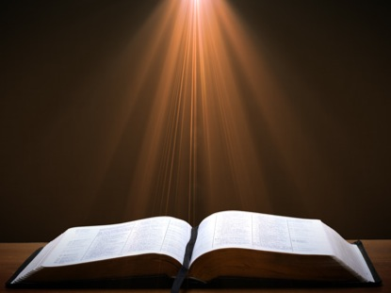
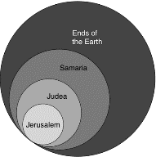
Acts 1:8
“but you will receive power when the Holy Spirit has come upon you; and you shall be My witnesses both in Jerusalem, and in all Judea and Samaria, and even to the remotest part of the earth.”

Slide 12
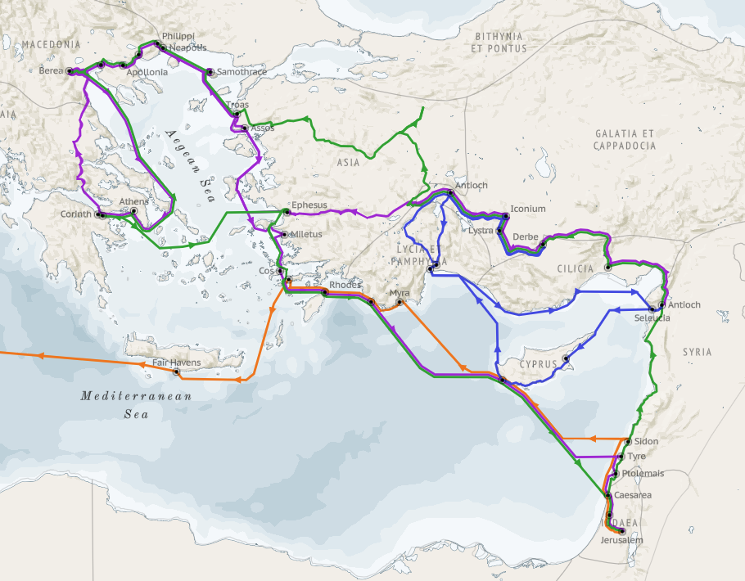
Structure (Acts 1:8)
  Jerusalem (Acts 1–7)
  Judea and Samaria (Acts 8–12)
  Remotest part of the earth (Acts 13–28)
  1st missionary journey (Acts 13–14)
  Jerusalem council (Acts 15:1-35)
  2nd missionary journey (Acts 15:36 –18:22)
  3rd missionary journey (Acts 18:23–21:17)
  Trip to Rome (Acts 21:18–28:31)

Slide 13
Acts 8:5-8
Evangelization of Samaria
      Philip’s preaching (5)
      Samaritans’ response (6a)
      Authenticating signs (6b-7)
      Result: joy (8)

Slide 14
Acts 8:5-8
Evangelization of Samaria
      Philip’s preaching (5)
      Samaritans’ response (6a)
      Authenticating signs (6b-7)
      Result: joy (8)

Slide 15

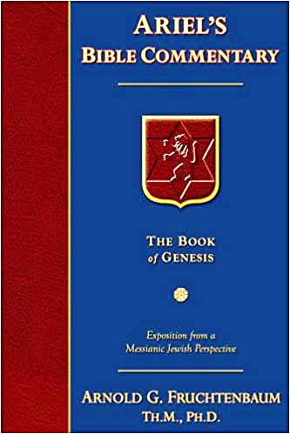
Dr. Arnold G. Fruchtenbaum
The Book of Acts, 129
“Verse 12 provides evidence of apostolic authority. The account of the second persecution of the church begins by describing the apostolic signs (v. 12a). Again it is important to note that in the book of Acts, only the apostles and the apostolic [de]legates, who were appointed by the apostles by the laying on of hands, were able to perform miracles, signs, and wonders (e.g. Acts 6:8).[113] This fact has come out four times before (Acts 2:43; 3:6-7; 4:22, 33), and now it is repeated once again in this verse.”

Slide 16
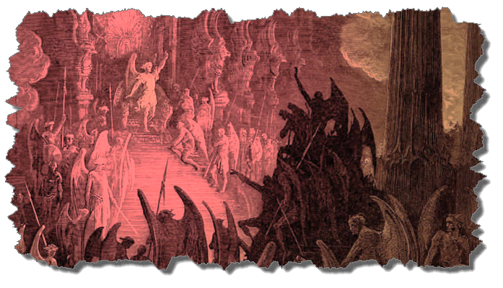
Not all Physical Infirmities are
Attributable to Satan/Demon
  Matt 8:5-13
  Matt 9:19-20, 27-30
  Matt 12:9-14
  Matt 14:35-36

Slide 17
Acts 8:5-8
Evangelization of Samaria
      Philip’s preaching (5)
      Samaritans’ response (6a)
      Authenticating signs (6b-7)
      Result: joy (8)

Slide 18
I. Ministry in Samaria
Acts 8:5-25
  Evangelization in Samaria (5-8)
  Simon’s conversion (9-13)
  Peter & John lay hands on the Samaritans (14-17)
  Peter rebukes Simon (18-25)

Slide 19
Acts 8:9-13
Simon’s Conversion
      Simon’s deception (9-11)
      Samaria’s response to Philip’s preaching (12)
      Simon’s response to Philip’s preaching (13)

Slide 20
Acts 8:9-13
Simon’s Conversion
      Simon’s deception (9-11)
      Samaria’s response to Philip’s preaching (12)
      Simon’s response to Philip’s preaching (13)

Slide 21
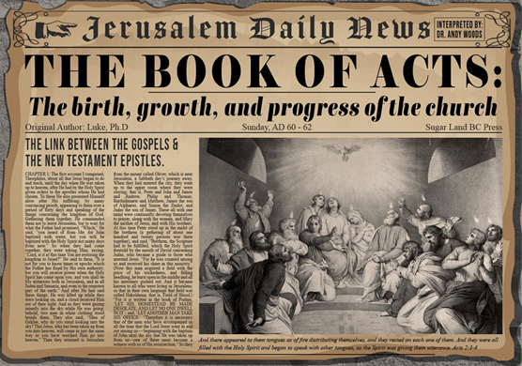
Acts 8:9-11
Simon’s Deception
      The deceiver (9)
      The deceived (10)
      The deception (11)

Slide 22
Acts 8:9-11
Simon’s Deception
      The deceiver (9)
      The deceived (10)
      The deception (11)

Slide 23
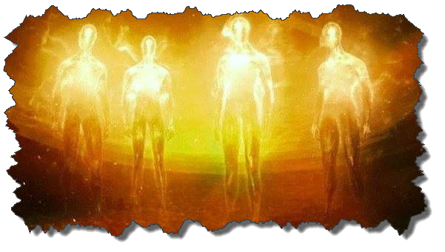

Satanic/Demonic Miracles
Exod. 7–8
Deut. 13:1-3
Job 1:12-19; 2:7-8
1 Sam. 28?
Matt. 7:21-23; 24:24
Luke 4:5
Acts 8:9; 16:16
Gal. 1:6-9
2 Thess. 2:9
Rev. 13:3, 13, 15; 16:13-14

Slide 24
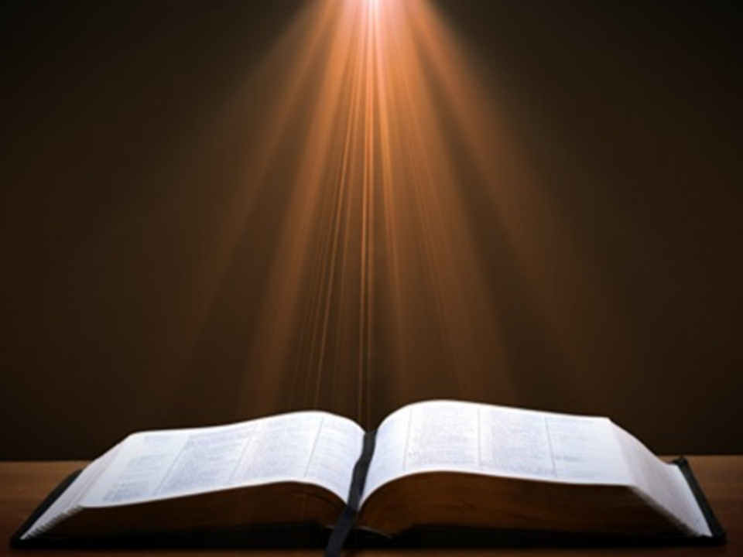

1 John 4:1
“Beloved, do not believe every spirit, but test the spirits to see whether they are from God, because many false prophets have gone out into the world.”

Slide 25
Acts 8:9-11
Simon’s Deception
      The deceiver (9)
      The deceived (10)
      The deception (11)

Slide 26

Revelation 13:16-18
¹⁶ And he causes all, the small and the great, and the rich and the poor, and the free men and the slaves, to be given a mark on their right hand or on their forehead, ¹⁷ and he provides that no one will be able to buy or to sell, except the one who has the mark, either the name of the beast or the number of his name. ¹⁸ Here is wisdom. Let him who has understanding calculate the number of the beast, for the number is that of a man; and his number is six hundred and sixty-six.

Slide 27
Acts 8:9-11
Simon’s Deception
      The deceiver (9)
      The deceived (10)
      The deception (11)

Slide 28
Acts 8:9-13
Simon’s Conversion
      Simon’s deception (9-11)
      Samaria’s response to Philip’s preaching (12)
      Simon’s response to Philip’s preaching (13)

Slide 29
Acts 8:12
Simon’s Deception
      Faith (12a)
      Content (12b-c)
      Response of faith: baptism (12d)

Slide 30
Acts 8:12
Simon’s Deception
      Faith (12a)
      Content (12b-c)
      Response of faith: baptism (12d)

Slide 31
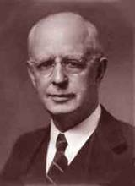
Lewis Sperry Chafer, vol. 7, Systematic Theology
(Grand Rapids, MI: Kregel Publications, 1993), 265-66.
Belief-God’s One Condition for Justification
“…because upwards of 150 passages of Scripture condition salvation upon believing only (cf. John 3:16; Acts 16:31).”

Slide 32
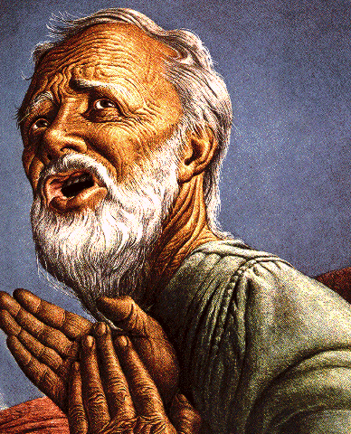
Belief – God’s One Condition for Justification
Gen 15:6
Then he believed in the LORD; and He reckoned it to him as righteousness.
John 3:16
For God so loved the world, that He gave His only begotten Son, that whoever believes in Him shall not perish, but have eternal life.
Acts 16:30-31
"Sirs, what must I do to be saved?" They said, "Believe in the Lord Jesus, and you will be saved..."

Slide 33
Acts 8:12
Simon’s Deception
      Faith (12a)
      Content (12b-c)
      Response of faith: baptism (12d)

Slide 34
Acts 8:12b-c
Content
      Hebrew kingdom (12b)
      Hebrew messiah (12c)

Slide 35
Acts 8:12b-c
Content
      Hebrew kingdom (12b)
      Hebrew messiah (12c)

Slide 36
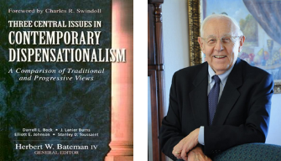
Stanley D. Toussaint
“Israel and the Church of a Traditional Dispensationalist,” in Three Central Issues in Contemporary Dispensationalism, ed. Herbert W. Bateman (Grand Rapids: Kregel, 1999), 242.
“[T]he word Kingdom does not occur in Acts 2. . . . It is difficult to explain why Luke does not use the term if the kingdom is being inaugurated. He employs it forty-five times in the gospel and uses it two more times in Acts 1. . . . [O]ne would expect Luke to use the word if such a startling thing as the inauguration of the kingdom had taken place. The fact that Luke uses kingdom only eight times in Acts after such heavy usage in his gospel implies that the kingdom had not begun but was in fact, postponed.”

Slide 37
ISRAEL'S JUDGMENTS
Division of the kingdom in 931 B.C. (1 Kgs. 12)
Assyrian judgment in 722 B.C. (2 Kgs. 17)
Babylonian captivity in 586 B.C. (2 Kgs. 25)
Rome Diaspora in A.D. 70 (Luke 19:41-44)

Slide 38

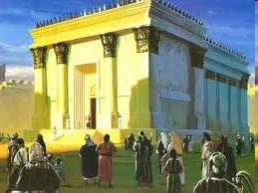
Israel’s Four Temples
Solomon’s pre-exilic temple (Kings and Chronicles)
Zerubbabel’s post exilic temple (Ezra 1-6; John 2:20)
Antichrist's temple (Dan 9:27; Matt 24:15; 2 Thess 2:4; Rev 11:1-2)
Millennial temple (Ezek 40-48)

Slide 40
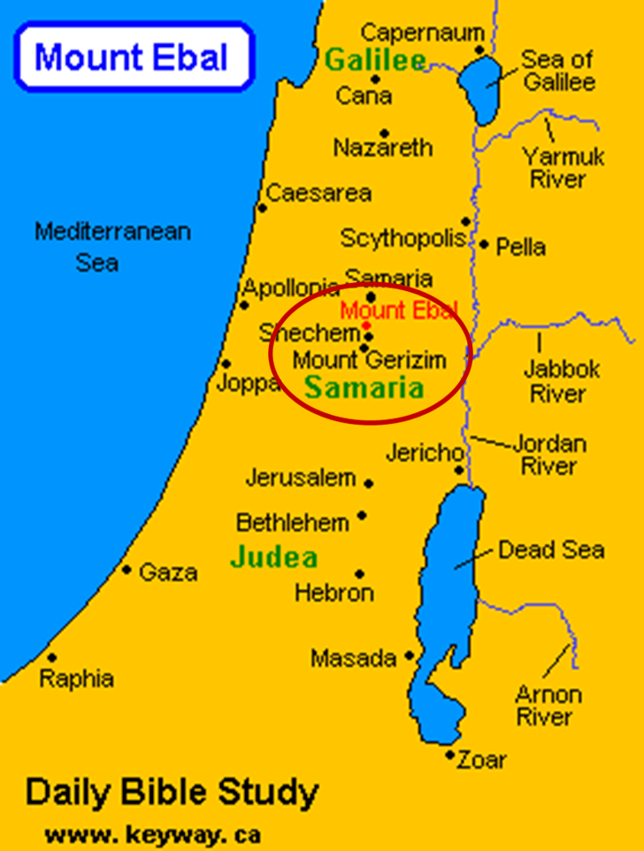

Slide 41

Isaiah 2:1-4
¹ “The word which Isaiah the son of Amoz saw concerning Judah and Jerusalem.² Now it will come about that In the last days The mountain of the house of the Lord Will be established as the chief of the mountains, And will be raised above the hills; And all the nations will stream to it.³ And many peoples will come and say, “Come, let us go up to the mountain of the Lord, To the house of the God of Jacob; That He may teach us concerning His ways And that we may . . .

Slide 42

Isaiah 2:1-4
. . . walk in His paths.” For the law will go forth from Zion And the word of the Lord from Jerusalem.⁴ And He will judge between the nations, And will render decisions for many peoples; And they will hammer their swords into plowshares and their spears into pruning hooks. Nation will not lift up sword against nation, And never again will they learn war.”

Slide 43

Zechariah 14:16-18
“¹⁶ Then it will come about that any who are left of all the nations that went against Jerusalem will go up from year to year to worship the King, the Lord of hosts, and to celebrate the Feast of Booths. ¹⁷ And it will be that whichever of the families of the earth does not go up to Jerusalem to worship the King, the Lord of hosts, there will be no rain on them. ¹⁸ If the family of Egypt does not go up or enter, then no rain will fall on them; it will be the plague with which the Lord smites the nations who do not go up to celebrate the Feast of Booths.”

Slide 44

Revelation 20:7-9
“⁷ When the thousand years are completed, Satan will be released from his prison, ⁸ and will come out to deceive the nations which are in the four corners of the earth, Gog and Magog, to gather them together for the war; the number of them is like the sand of the seashore. ⁹ And they came up on the broad plain of the earth and surrounded the camp of the saints and the beloved city, and fire came down from heaven and devoured them.

Slide 45
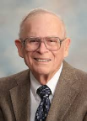
Robert Thomas
Four Views on the Book of Revelation, page 207.
“At the end of the Millennium that city will be Satan’s prime objective with his rebel army, because Israel will be a leader among the nations.”

Slide 46
Acts 8:12b-c
Content
      Hebrew kingdom (12b)
      Hebrew messiah (12c)

Slide 47
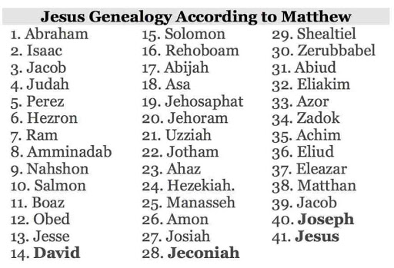

Slide 48
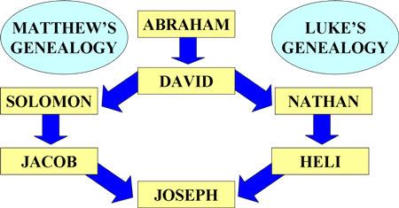
To Circumvent Jeconiah’s Curse

Slide 49
Acts 8:12
Simon’s Deception
      Faith (12a)
      Content (12b-c)
      Response of faith: baptism (12d)

Slide 50
Acts 8:9-13
Simon’s Conversion
      Simon’s deception (9-11)
      Samaria’s response to Philip’s preaching (12)
      Simon’s response to Philip’s preaching (13)

Slide 51
Acts 8:13
Simon’s Response to Philip’s Preaching
      Faith (13a)
      Baptism (13b)
      Followed Philip (13c)

Slide 52
Acts 8:13
Simon’s Response to Philip’s Preaching
      Faith (13a)
      Baptism (13b)
      Followed Philip (13c)

Slide 53
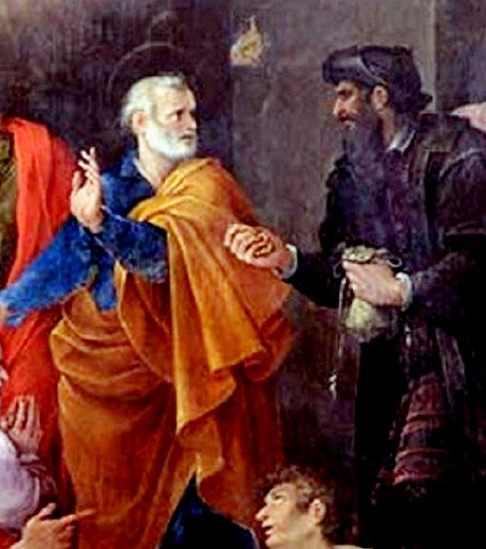
Why Simon Was Saved
Simon believed (Acts 8:12, 13)
Simon was baptized (Acts 8:12, 13)
Simon experienced remorse (Acts 8:24)
Notes:
Outline

Slide 54
Why Simon Was Saved
Simon believed (Acts 8:12, 13)
Simon was baptized (Acts 8:12, 13)
Simon experienced remorse (Acts 8:24)
Notes:
Outline

Slide 55
Lewis Sperry Chafer, vol. 7, Systematic Theology
(Grand Rapids, MI: Kregel Publications, 1993), 265-66.
Belief-God’s One Condition for Justification
“…because upwards of 150 passages of Scripture condition salvation upon believing only (cf. John 3:16; Acts 16:31).”

Slide 56
Belief – God’s One Condition for Justification
Gen 15:6
Then he believed in the LORD; and He reckoned it to him as righteousness.
John 3:16
For God so loved the world, that He gave His only begotten Son, that whoever believes in Him shall not perish, but have eternal life.
Acts 16:30-31
"Sirs, what must I do to be saved?" They said, "Believe in the Lord Jesus, and you will be saved..."

Slide 57
Why Simon Was Saved
Simon believed (Acts 8:12, 13)
Simon was baptized (Acts 8:12, 13)
Simon experienced remorse (Acts 8:24)
Notes:
Outline

Slide 58
Why Simon Was Saved
Simon believed (Acts 8:12, 13)
Simon was baptized (Acts 8:12, 13)
Simon experienced remorse (Acts 8:24)
Notes:
Outline

Slide 59
Illegitimate Faith
Spurious faith (Luke 8:13; Jas. 2:19)
Miracle faith (John 2:23-25)
Repent (2 Pet. 3:9)
Perish (John 3:16)
Description of the Lost (Acts 8:21, 23)
Simon never received the Holy Spirit (Acts 8:17-18)
Founder of Gnosticism
Notes:
Outline

Slide 60
Illegitimate Faith
Spurious faith (Luke 8:13; Jas. 2:19)
Miracle faith (John 2:23-25)
Repent (2 Pet. 3:9)
Perish (John 3:16)
Description of the Lost (Acts 8:21, 23)
Simon never received the Holy Spirit (Acts 8:17-18)
Founder of Gnosticism
Notes:
Outline

Slide 61

William Hendriksen
“Many trusted in his name; i.e., because of the manner in which his power was displayed they accepted him as a great prophet and perhaps even as the Messiah. This, however, is not the same as saying that they surrendered their hearts to him. Not all faith is saving faith...”
William Hendriksen, A Commentary on the Gospel of John, 3d ed. (London: Banner of Truth Trust, 1964), p. 127. (1978). Bibliotheca Sacra, 135. (1978). Bibliotheca Sacra, 135.

Slide 62
Illegitimate Faith
Spurious faith (Luke 8:13; Jas. 2:19)
Miracle faith (John 2:23-25)
Repent (2 Pet. 3:9)
Perish (John 3:16)
Description of the Lost (Acts 8:21, 23)
Simon never received the Holy Spirit (Acts 8:17-18)
Founder of Gnosticism
Notes:
Outline

Slide 63

John 2:23-25
“²³ Now when He was in Jerusalem at the Passover, during the feast, many believed in (pisteuō eis) His name, observing His signs which He was doing. ²⁴ But Jesus, on His part, was not entrusting Himself to them, for He knew all men, ²⁵ and because He did not need anyone to testify concerning man, for He Himself knew what was in man.”

Slide 64
Illegitimate Faith
Spurious faith (Luke 8:13; Jas. 2:19)
Miracle faith (John 2:23-25)
Repent (2 Pet. 3:9)
Perish (John 3:16)
Description of the Lost (Acts 8:21, 23)
Simon never received the Holy Spirit (Acts 8:17-18)
Founder of Gnosticism
Notes:
Outline

Slide 65

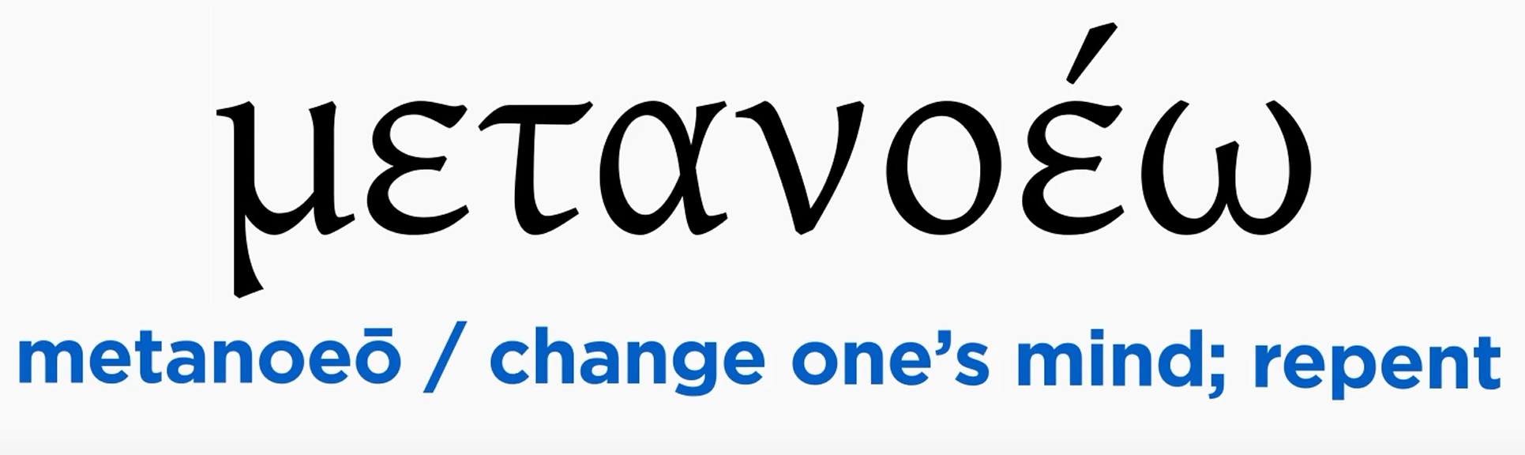
Acts 2:38
“Peter said to them, “Repent [metanoeō], and each of you be baptized in the name of Jesus Christ for (eis) the forgiveness of your sins; and you will receive the gift of the Holy Spirit.”

Slide 66

Acts 17:30-31
“³⁰ Therefore having overlooked the times of ignorance, God is now declaring to men that all people everywhere should repent [metanoeō], ³¹ because He has fixed a day in which He will judge the world in righteousness through a Man whom He has appointed, having furnished proof to all men by raising Him from the dead.”

Slide 67


2 Peter 3:9
“The Lord is not slow about His promise, as some count slowness, but is patient toward you, not wishing for any to perish but for all to come to repentance.”

Slide 68
Illegitimate Faith
Spurious faith (Luke 8:13; Jas. 2:19)
Miracle faith (John 2:23-25)
Repent (2 Pet. 3:9)
Perish (John 3:16)
Description of the Lost (Acts 8:21, 23)
Simon never received the Holy Spirit (Acts 8:17-18)
Founder of Gnosticism
Notes:
Outline

Slide 69
Illegitimate Faith
Spurious faith (Luke 8:13; Jas. 2:19)
Miracle faith (John 2:23-25)
Repent (2 Pet. 3:9)
Perish (John 3:16)
Description of the Lost (Acts 8:21, 23)
Simon never received the Holy Spirit (Acts 8:17-18)
Founder of Gnosticism
Notes:
Outline

Slide 70
Illegitimate Faith
Spurious faith (Luke 8:13; Jas. 2:19)
Miracle faith (John 2:23-25)
Repent (2 Pet. 3:9)
Perish (John 3:16)
Description of the Lost (Acts 8:21, 23)
Simon never received the Holy Spirit (Acts 8:17-18)
Founder of Gnosticism
Notes:
Outline

Slide 71
Illegitimate Faith
Spurious faith (Luke 8:13; Jas. 2:19)
Miracle faith (John 2:23-25)
Repent (2 Pet. 3:9)
Perish (John 3:16)
Description of the Lost (Acts 8:21, 23)
Simon never received the Holy Spirit (Acts 8:17-18)
Founder of Gnosticism
Notes:
Outline

Slide 72
Answering Illegitimate Faith Arguments
Spurious faith (Luke 8:13; Jas. 2:19) – Angels
Miracle faith (John 2:23-25) – pistueō eis
Repent (2 Pet. 3:9) – Rev. 2‒3
Perish (John 3:16) – Temporal
Description of the Lost (Acts 8:21, 23) – No time for Sanctification
Simon never received the Holy Spirit (Acts 8:17-18) – Argument from silence
Founder of Gnosticism – Sola Scriptura
Notes:
Outline

Slide 73
Answering Illegitimate Faith Arguments
Spurious faith (Luke 8:13; Jas. 2:19) – Angels
Miracle faith (John 2:23-25) – pistueō eis
Repent (2 Pet. 3:9) – Rev. 2‒3
Perish (John 3:16) – Temporal
Description of the Lost (Acts 8:21, 23) – No time for Sanctification
Simon never received the Holy Spirit (Acts 8:17-18) – Argument from silence
Founder of Gnosticism – Sola Scriptura
Notes:
Outline

Slide 74
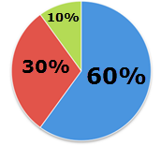

Slide 75
Answering Illegitimate Faith Arguments
Spurious faith (Luke 8:13; Jas. 2:19) – Angels
Miracle faith (John 2:23-25) – pistueō eis
Repent (2 Pet. 3:9) – Rev. 2‒3
Perish (John 3:16) – Temporal
Description of the Lost (Acts 8:21, 23) – No time for Sanctification
Simon never received the Holy Spirit (Acts 8:17-18) – Argument from silence
Founder of Gnosticism – Sola Scriptura
Notes:
Outline

Slide 76
John 2:23-25
“²³ Now when He was in Jerusalem at the Passover, during the feast, many believed in (pisteuō eis) His name, observing His signs which He was doing. ²⁴ But Jesus, on His part, was not entrusting Himself to them, for He knew all men, ²⁵ and because He did not need anyone to testify concerning man, for He Himself knew what was in man.”

Slide 77
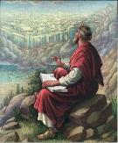
John 20:30-31
“³⁰ Therefore many other signs Jesus also performed in the presence of the disciples, which are not written in this book; ³¹ but these have been written so that you may believe (pisteuō eis) that Jesus is the Christ, the Son of God; and that believing you may have life in His name.”

Slide 78

John 15:14-15
“¹⁴ You are My friends if you do what I command you. ¹⁵ No longer do I call you slaves, for the slave does not know what his master is doing; but I have called you friends, for all things that I have heard from My Father I have made known to you.”

Slide 79
 | SALVATION | FRIENDSHIP
CONDITION | FAITH | OBEDIENCE
Scripture | John 3:16 | John 15:14
Phase of Salvation | Justification | Sanctification
Benefit | Salvation From Sin’s Penalty | Divine Insight

Slide 80
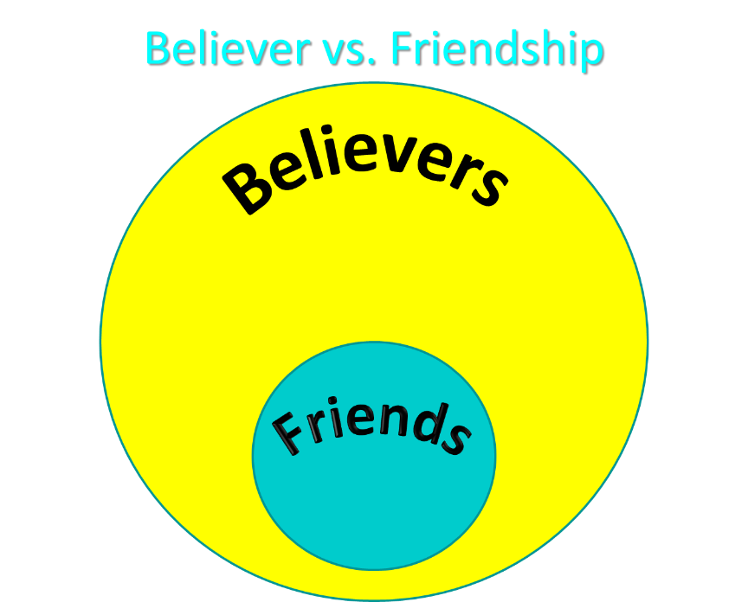

Slide 81
Answering Illegitimate Faith Arguments
Spurious faith (Luke 8:13; Jas. 2:19) – Angels
Miracle faith (John 2:23-25) – pistueō eis
Repent (2 Pet. 3:9) – Rev. 2‒3
Perish (John 3:16) – Temporal
Description of the Lost (Acts 8:21, 23) – No time for Sanctification
Simon never received the Holy Spirit (Acts 8:17-18) – Argument from silence
Founder of Gnosticism – Sola Scriptura
Notes:
Outline

Slide 82
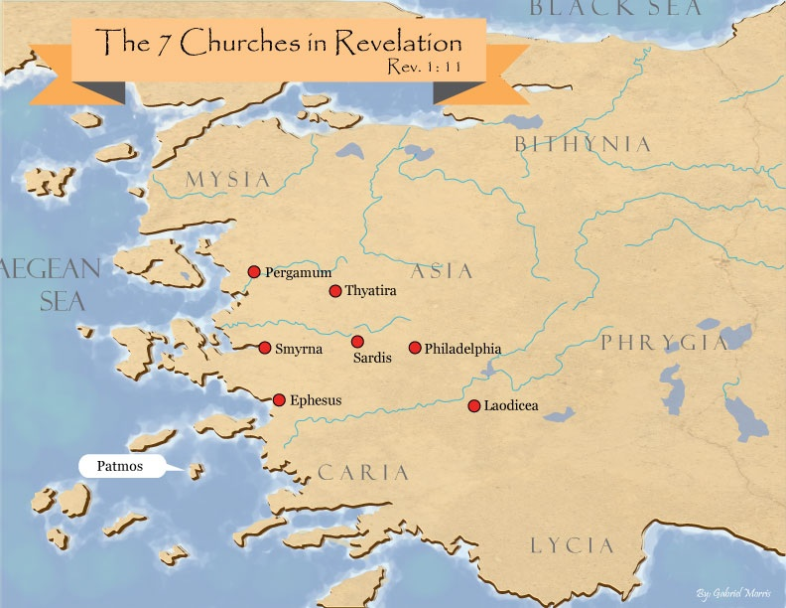
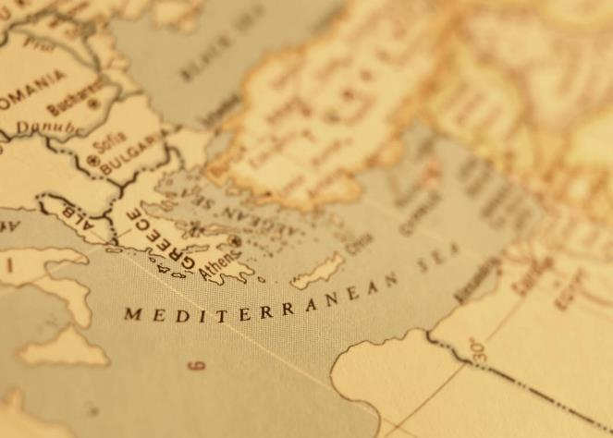

Slide 83
Answering Illegitimate Faith Arguments
Spurious faith (Luke 8:13; Jas. 2:19) – Angels
Miracle faith (John 2:23-25) – pistueō eis
Repent (2 Pet. 3:9) – Rev. 2‒3
Perish (John 3:16) – Temporal
Description of the Lost (Acts 8:21, 23) – No time for Sanctification
Simon never received the Holy Spirit (Acts 8:17-18) – Argument from silence
Founder of Gnosticism – Sola Scriptura
Notes:
Outline

Slide 84
1 Corinthians 3:10-15
“¹⁰ According to the grace of God which was given to me, like a wise master builder I laid a foundation, and another is building on it. But each man must be careful how he builds on it. ¹¹ For no man can lay a foundation other than the one which is laid, which is Jesus Christ. ¹² Now if any man builds on the foundation with gold, silver, precious stones, wood, hay, straw…. ¹⁴ If any man’s work which he has built on it remains, he will receive a reward. ¹⁵ If any man’s work is burned up, he will suffer loss; but he himself will be saved, yet so as through fire.”

Slide 85
1 Corinthians 9:24-27
“²⁴ Do you not know that those who run in a race all run, but only one receives the prize? Run in such a way that you may win. ²⁵ Everyone who competes in the games exercises self-control in all things. They then do it to receive a perishable wreath, but we an imperishable. ²⁶ Therefore I run in such a way, as not without aim; I box in such a way, as not beating the air; ²⁷ but I discipline my body and make it my slave, so that, after I have preached to others, I myself will not be disqualified.”

Slide 86
Answering Illegitimate Faith Arguments
Spurious faith (Luke 8:13; Jas. 2:19) – Angels
Miracle faith (John 2:23-25) – pistueō eis
Repent (2 Pet. 3:9) – Rev. 2‒3
Perish (John 3:16) – Temporal
Description of the Lost (Acts 8:21, 23) – No time for Sanctification
Simon never received the Holy Spirit (Acts 8:17-18) – Argument from silence
Founder of Gnosticism – Sola Scriptura
Notes:
Outline

Slide 87
Three Tenses of Salvation
Phase | Justification | Sanctification | Glorification
Tense | Past | Present | Future
Saved from sin’s: | Penalty | Power | Presence
Scripture | Eph 2:8-9; Titus 3:5 | Philip 2:12 | Rom 5:10
Nature | Single | Dual | Single

Slide 88
Answering Illegitimate Faith Arguments
Spurious faith (Luke 8:13; Jas. 2:19) – Angels
Miracle faith (John 2:23-25) – pistueō eis
Repent (2 Pet. 3:9) – Rev. 2‒3
Perish (John 3:16) – Temporal
Description of the Lost (Acts 8:21, 23) – No time for Sanctification
Simon never received the Holy Spirit (Acts 8:17-18) – Argument from silence
Founder of Gnosticism – Sola Scriptura
Notes:
Outline

Slide 89
Answering Illegitimate Faith Arguments
Spurious faith (Luke 8:13; Jas. 2:19) – Angels
Miracle faith (John 2:23-25) – pistueō eis
Repent (2 Pet. 3:9) – Rev. 2‒3
Perish (John 3:16) – Temporal
Description of the Lost (Acts 8:21, 23) – No time for Sanctification
Simon never received the Holy Spirit (Acts 8:17-18) – Argument from silence
Founder of Gnosticism – Sola Scriptura
Notes:
Outline

Slide 90
Christian Anti-Semitism
  “First, their synagogues should be set on fire…Secondly, their homes should likewise be broken down and destroyed…Thirdly, they should be deprived of their prayer books and Talmuds…”

Slide 91
Christian Anti-Semitism
  “…Fourthly, their rabbis must be forbidden under threat of death to teach any more…Fifthly, passport and traveling privileges should be absolutely forbidden to the Jews…Sixthly, they ought to be stopped from usury (charging interest on loans…”

Slide 92
Christian Anti-Semitism
“Seventhly, let the young and strong Jews and Jewesses be given the flail, the ax, the hoe, the spade, the distaff, and spindle, and let the earn their bread by the sweat of their noses…We ought to drive the rascally lazy bones out of our system...”
Martin Luther, Concerning the Jews and Their Lies, cited in Michael Brown’s Our Hands Are Stained with Blood, pp. 14-15.

Slide 93
Christian Anti-Semitism
“…Therefore away with them… To sum up, dear princes and nobles who have Jews in your domains, if this advice of mine does not suit you, then find a better one so that you and we may all be free of this insufferable devilish burden–the Jews.”
Martin Luther, Concerning the Jews and Their Lies, cited in Michael Brown’s Our Hands Are Stained with Blood, pp. 14-15.

Slide 94
Acts 8:13
Simon’s Response to Philip’s Preaching
      Faith (13a)
      Baptism (13b)
      Followed Philip (13c)

Slide 95
Acts 8:13
Simon’s Response to Philip’s Preaching
      Faith (13a)
      Baptism (13b)
      Followed Philip (13c)

Slide 96
Three Tenses of Salvation
Phase | Justification | Sanctification | Glorification
Tense | Past | Present | Future
Saved from sin’s: | Penalty | Power | Presence
Scripture | Eph 2:8-9; Titus 3:5 | Philip 2:12 | Rom 5:10
Nature | Single | Dual | Single

Slide 97
I. Ministry in Samaria
Acts 8:5-25
  Evangelization in Samaria (5-8)
  Simon’s conversion (9-13)
  Peter & John lay hands on the Samaritans (14-17)
  Peter rebukes Simon (18-25)

Slide 98
Acts 8:14-17
Peter & John Lay Hands on the Samaritans
      The concern (14)
      The problem (15-16)
      The solution (17)

Slide 99
Acts 8:14-17
Peter & John Lay Hands on the Samaritans
      The concern (14)
      The problem (15-16)
      The solution (17)

Slide 100
Acts 8:14-17
Peter & John Lay Hands on the Samaritans
      The concern (14)
      The problem (15-16)
      The solution (17)

Slide 101
Acts 8:14-17
Peter & John Lay Hands on the Samaritans
      The concern (14)
      The problem (15-16)
      The solution (17)

Slide 102


Acts 1:5
“for John baptized with water, but you will be baptized with the Holy Spirit not many days from now.”

Slide 103
1 Corinthians 12:13
“For by one Spirit we were all baptized into one body, whether Jews or Greeks, whether slaves or free, and we were all made to drink of one Spirit.”

Slide 104


Galatians 3:28
“There is neither Jew nor Greek, there is neither slave nor free man, there is neither male nor female; for you are all one in Christ Jesus.”

Slide 105
Ephesians 2:14
“For He Himself is our peace, who made both groups into one and broke down the barrier of the dividing wall.”

Slide 106


Slide 107
I. Ministry in Samaria
Acts 8:5-25
  Evangelization in Samaria (5-8)
  Simon’s conversion (9-13)
  Peter & John lay hands on the Samaritans (14-17)
  Peter rebukes Simon (18-25)

Slide 108
Acts 8:18-25
Peter Rebukes Simon
      Simon’s request (18-19)
      Peter rebukes Simon (20-23)
      Simon’s response (24)
      Conclusion (25)

Slide 109
Acts 8:18-25
Peter Rebukes Simon
      Simon’s request (18-19)
      Peter rebukes Simon (20-23)
      Simon’s response (24)
      Conclusion (25)

Slide 110
Acts 8:18-19
Simon’s Request
      Simon’s observation (18a)
      Simon’s financial offer (18b)
      Simon’s ambition (19)

Slide 111
Acts 8:18-19
Simon’s Request
      Simon’s observation (18a)
      Simon’s financial offer (18b)
      Simon’s ambition (19)

Slide 112
Acts 8:18-19
Simon’s Request
      Simon’s observation (18a)
      Simon’s financial offer (18b)
      Simon’s ambition (19)

Slide 113
Three Tenses of Salvation
Phase | Justification | Sanctification | Glorification
Tense | Past | Present | Future
Saved from sin’s: | Penalty | Power | Presence
Scripture | Eph 2:8-9; Titus 3:5 | Philip 2:12 | Rom 5:10
Nature | Single | Dual | Single

Slide 114
Acts 8:18-19
Simon’s Request
      Simon’s observation (18a)
      Simon’s financial offer (18b)
      Simon’s ambition (19)

Slide 115
Acts 8:18-25
Peter Rebukes Simon
      Simon’s request (18-19)
      Peter rebukes Simon (20-23)
      Simon’s response (24)
      Conclusion (25)

Slide 116
Acts 8:20-23
Peter Rebukes Simon
      Simon’s consequence (20)
      Simon’s heart (21)
      Simon’s need: repentance (22)
      Simon’s problem (23)

Slide 117
Acts 8:20-23
Peter Rebukes Simon
      Simon’s consequence (20)
      Simon’s heart (21)
      Simon’s need: repentance (22)
      Simon’s problem (23)

Slide 118
Acts 8:20-23
Peter Rebukes Simon
      Simon’s consequence (20)
      Simon’s heart (21)
      Simon’s need: repentance (22)
      Simon’s problem (23)

Slide 119
Acts 8:20-23
Peter Rebukes Simon
      Simon’s consequence (20)
      Simon’s heart (21)
      Simon’s need: repentance (22)
      Simon’s problem (23)

Slide 121
Acts 8:20-23
Peter Rebukes Simon
      Simon’s consequence (20)
      Simon’s heart (21)
      Simon’s need: repentance (22)
      Simon’s problem (23)

Slide 122
Acts 8:18-25
Peter Rebukes Simon
      Simon’s request (18-19)
      Peter rebukes Simon (20-23)
      Simon’s response (24)
      Conclusion (25)

Slide 123
Acts 8:18-25
Peter Rebukes Simon
      Simon’s request (18-19)
      Peter rebukes Simon (20-23)
      Simon’s response (24)
      Conclusion (25)

Slide 124
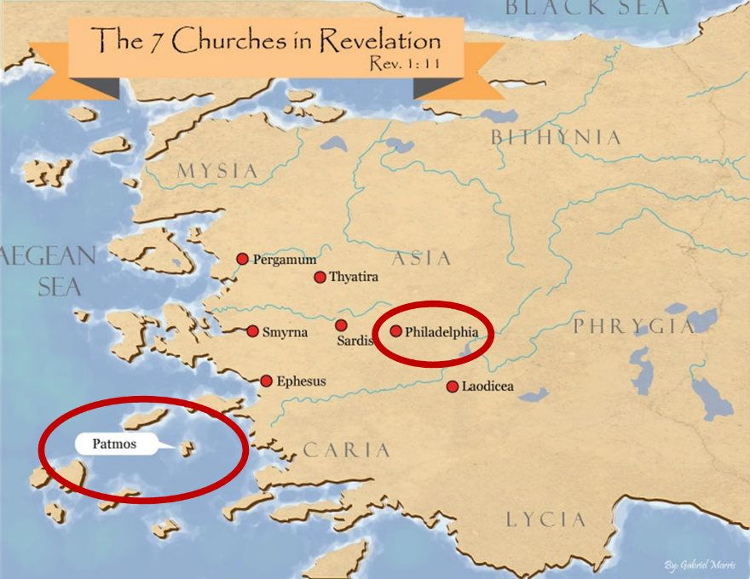

Slide 126
Acts 8:5-40
Philip’s Ministry
  Samaria (8:5-25)
  Judea (Acts 8:6-40)

Slide 128
II. Ministry in Judea
Acts 8:26-40
  Angel directs Philip (26)
  Philip’s obedience (27a)
  Ethiopian Eunuch’s introduction (27b-28)
  Holy Spirit directs Philip (29)
  Philip’s witness to the Eunuch (30-35)
  Eunuch’s conversion & baptism (36-38)
  Philip’s separation from the Eunuch (39)
  Philip’s evangelization of the Coastal Plain (40)

Slide 129
II. Ministry in Judea
Acts 8:26-40
  Angel directs Philip (26)
  Philip’s obedience (27a)
  Ethiopian Eunuch’s introduction (27b-28)
  Holy Spirit directs Philip (29)
  Philip’s witness to the Eunuch (30-35)
  Eunuch’s conversion & baptism (36-38)
  Philip’s separation from the Eunuch (39)
  Philip’s evangelization of the Coastal Plain (40)

Slide 130
Stanley D. Toussaint
Bible Knowledge Commentary, p. 374
“Though Luke gave no record of God’s commanding Philip to preach to the Samaritans (v. 5), God did sovereignly direct Philip toward Gaza . . . The highway is referred to as the desert road. The expression may refer to a desert road or a desert city. Ancient Gaza was destroyed in 93 B.C. and the city was rebuilt nearer the Mediterranean in 57 B.C. The old city was called Desert Gaza. The Greek for the angel’s command could be translated, ‘Arise and go to the south to the road . . . that goes down from Jerusalem to Gaza. This is desert.’ This reference to the road in 8:36 may imply that the road, not the city, was in a deserted area.”

Slide 131
II. Ministry in Judea
Acts 8:26-40
  Angel directs Philip (26)
  Philip’s obedience (27a)
  Ethiopian Eunuch’s introduction (27b-28)
  Holy Spirit directs Philip (29)
  Philip’s witness to the Eunuch (30-35)
  Eunuch’s conversion & baptism (36-38)
  Philip’s separation from the Eunuch (39)
  Philip’s evangelization of the Coastal Plain (40)

Slide 132
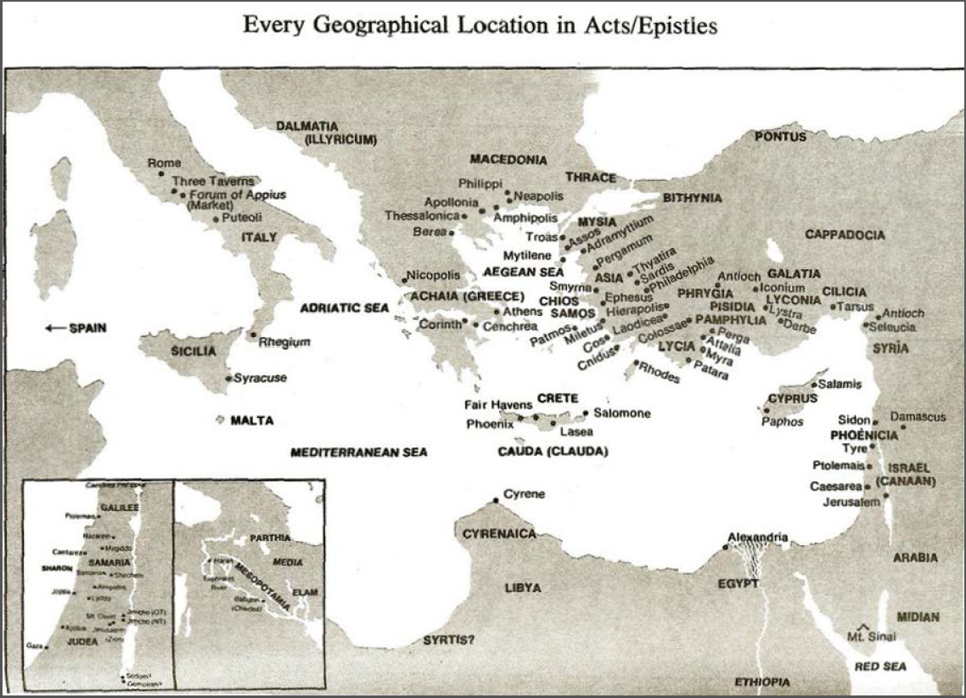

Slide 133
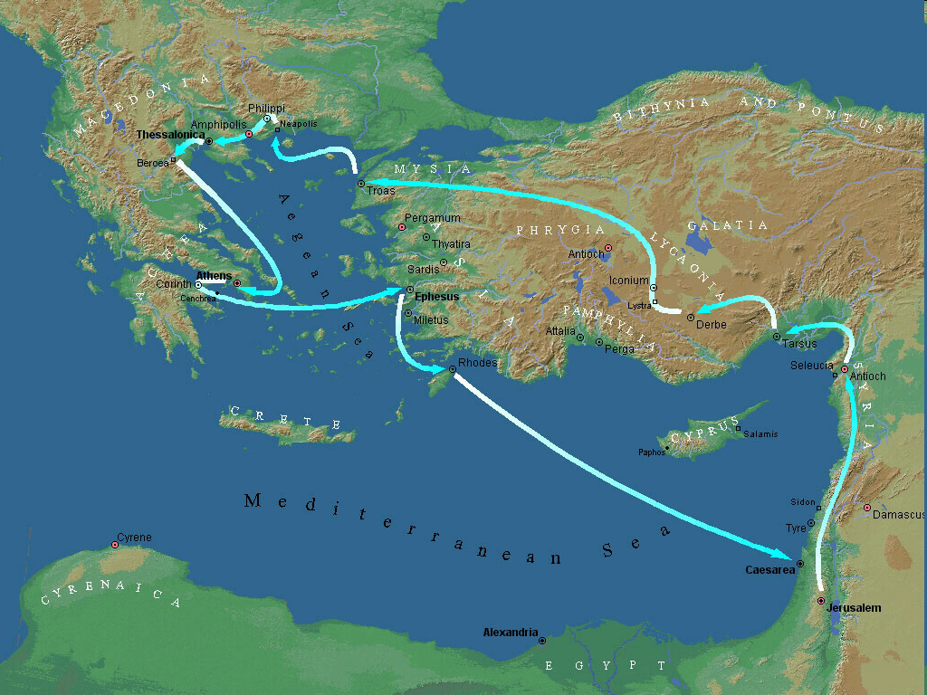
Second Missionary Journey

Slide 134
II. Ministry in Judea
Acts 8:26-40
  Angel directs Philip (26)
  Philip’s obedience (27a)
  Ethiopian Eunuch’s introduction (27b-28)
  Holy Spirit directs Philip (29)
  Philip’s witness to the Eunuch (30-35)
  Eunuch’s conversion & baptism (36-38)
  Philip’s separation from the Eunuch (39)
  Philip’s evangelization of the Coastal Plain (40)

Slide 135
Dr. Arnold G. Fruchtenbaum
The Book of Acts, 200-201
“The text states that he was a eunuch. Eunuchs were often employed by oriental rulers in positions of high office. They were also male servants of female dignitaries, but only placed in such positions after having been castrated... Politically, he was a highly influential official under Candace, queen of the Ethiopians. ‘Candace’ (Kandakēs, in Greek) was not a proper name, but the title of the queen of Ethiopia, much like the word ‘Kaiser’ was the title of the king of Germany and ‘Czar’ was a title of the king of Russia.”

Slide 136
Dr. Arnold G. Fruchtenbaum
The Book of Acts, 200-201
“Because the king of Ethiopia was considered to be a child of the sun and therefore a person too sacred to be involved with secular functions of the royal court, all such duties fell to the queen mother, who had the title of ‘Candace.’ As a result, she was the real power behind the throne, and Ethiopia was a de facto matriarchy. The eunuch was in charge of her treasure, which means he held one of the highest governmental positions. His influence in Ethiopia would therefore have been very considerable.”

Slide 137
II. Ministry in Judea
Acts 8:26-40
  Angel directs Philip (26)
  Philip’s obedience (27a)
  Ethiopian Eunuch’s introduction (27b-28)
  Holy Spirit directs Philip (29)
  Philip’s witness to the Eunuch (30-35)
  Eunuch’s conversion & baptism (36-38)
  Philip’s separation from the Eunuch (39)
  Philip’s evangelization of the Coastal Plain (40)

Slide 138
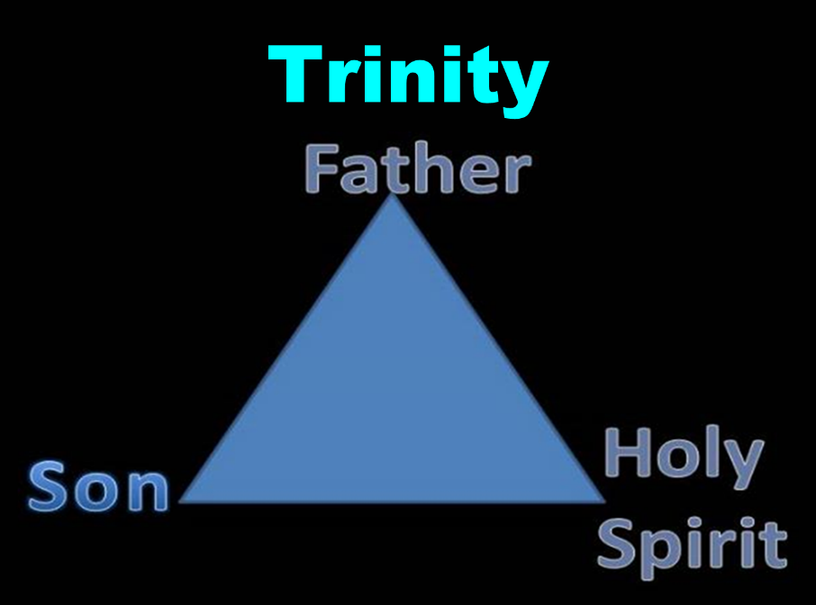

Slide 139
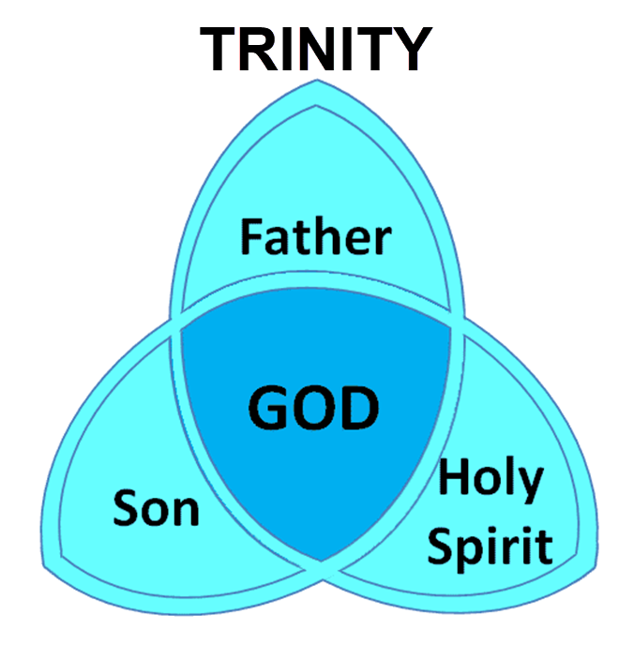

Slide 140
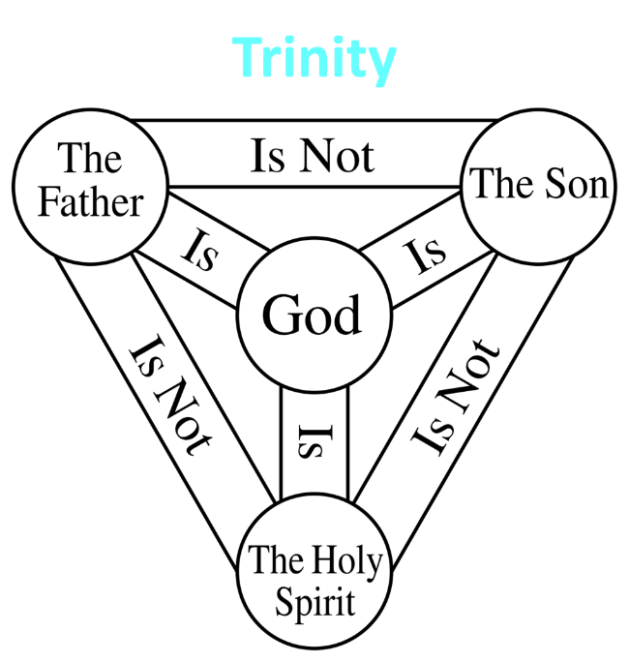

Slide 141
II. Ministry in Judea
Acts 8:26-40
  Angel directs Philip (26)
  Philip’s obedience (27a)
  Ethiopian Eunuch’s introduction (27b-28)
  Holy Spirit directs Philip (29)
  Philip’s witness to the Eunuch (30-35)
  Eunuch’s conversion & baptism (36-38)
  Philip’s separation from the Eunuch (39)
  Philip’s evangelization of the Coastal Plain (40)

Slide 142
Acts 8:30-35
Philip’s Witness to the Eunuch
      Philip’s question (30)
      Eunuch’s answer (31)
      Eunuch's reading (32-33)
      Eunuch’s question (34)
      Philip’s witness (35)

Slide 143
Acts 8:30-35
Philip’s Witness to the Eunuch
      Philip’s question (30)
      Eunuch’s answer (31)
      Eunuch's reading (32-33)
      Eunuch’s question (34)
      Philip’s witness (35)

Slide 144
Acts 8:30-35
Philip’s Witness to the Eunuch
      Philip’s question (30)
      Eunuch’s answer (31)
      Eunuch's reading (32-33)
      Eunuch’s question (34)
      Philip’s witness (35)

Slide 145

Ephesians 4:11-16
“¹¹ And He gave some as apostles, and some as prophets, and some as evangelists, and some as pastors and teachers, ¹² for the equipping of the saints for the work of service, to the building up of the body of Christ;”

Slide 146
Ephesians 4:11-16
“¹³ until we all attain to the unity of the faith, and of the knowledge of the Son of God, to a mature man, to the measure of the stature which belongs to the fullness of Christ. ¹⁴ As a result, we are no longer to be children, tossed here and there by waves and carried about by every wind of doctrine, by the trickery of men, by craftiness in deceitful scheming;”

Slide 147
Ephesians 4:11-16
“¹⁵ but speaking the truth in love, we are to grow up in all aspects into Him who is the head, even Christ, ¹⁶ from whom the whole body, being fitted and held together by what every joint supplies, according to the proper working of each individual part, causes the growth of the body for the building up of itself in love.”

Slide 148
Acts 8:30-35
Philip’s Witness to the Eunuch
      Philip’s question (30)
      Eunuch’s answer (31)
      Eunuch's reading (32-33)
      Eunuch’s question (34)
      Philip’s witness (35)

Slide 149
Isaiah 53:3–6
³ He was despised and forsaken of men, A man of sorrows and acquainted with grief; And like one from whom men hide their face He was despised, and we did not esteem Him. ⁴ Surely our griefs He Himself bore, And our sorrows He carried; Yet we ourselves esteemed Him stricken, Smitten of God, and afflicted. ⁵ But He was pierced through for our transgressions, He was crushed for our…

Slide 150
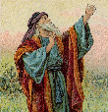
Isaiah 53:3–6
…iniquities; The chastening for our well-being fell upon Him, And by His scourging we are healed. ⁶ All of us like sheep have gone astray, Each of us has turned to his own way; But the Lord has caused the iniquity of us all To fall on Him.

Slide 151
Acts 8:30-35
Philip’s Witness to the Eunuch
      Philip’s question (30)
      Eunuch’s answer (31)
      Eunuch's reading (32-33)
      Eunuch’s question (34)
      Philip’s witness (35)

Slide 152
Acts 8:30-35
Philip’s Witness to the Eunuch
      Philip’s question (30)
      Eunuch’s answer (31)
      Eunuch's reading (32-33)
      Eunuch’s question (34)
      Philip’s witness (35)

Slide 153
Luke 24:27, 44
“²⁷ Then beginning with Moses and with all the prophets, He explained to them the things concerning Himself in all the Scriptures…⁴⁴ Now He said to them, ‘These are My words which I spoke to you while I was still with you, that all things which are written about Me in the Law of Moses and the Prophets and the Psalms must be fulfilled.’”

Slide 154
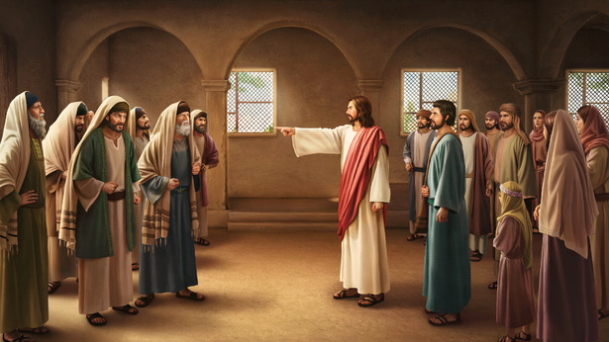
John 5:39, 46
“³⁹ You search the Scriptures because you think that in them you have eternal life; it is these that testify about Me…⁴⁶ For if you believed Moses, you would believe Me, for he wrote about Me.”

Slide 155
II. Ministry in Judea
Acts 8:26-40
  Angel directs Philip (26)
  Philip’s obedience (27a)
  Ethiopian Eunuch’s introduction (27b-28)
  Holy Spirit directs Philip (29)
  Philip’s witness to the Eunuch (30-35)
  Eunuch’s conversion & baptism (36-38)
  Philip’s separation from the Eunuch (39)
  Philip’s evangelization of the Coastal Plain (40)

Slide 156
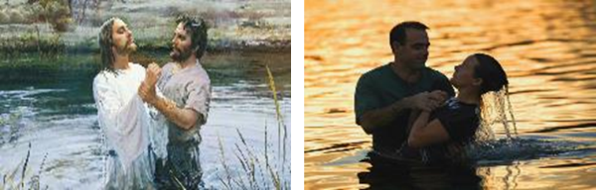
Sprinkling or Immersion?
Sprinkling? Other words (1 Pet. 1:12; 2 Tim. 4:6)
Immersion?
  Christ’s baptism (Matt. 3:16; Mark 1:10)
  Ethiopian eunuch's baptism (Acts 8:38-39)
  Best symbolizes our union with Christ (Rom. 6:3)
  Symbolizes a new creation (Gen. 1:6, 9; 2 Pet. 3:5; 2 Cor. 5:17)

Slide 157
II. Ministry in Judea
Acts 8:26-40
  Angel directs Philip (26)
  Philip’s obedience (27a)
  Ethiopian Eunuch’s introduction (27b-28)
  Holy Spirit directs Philip (29)
  Philip’s witness to the Eunuch (30-35)
  Eunuch’s conversion & baptism (36-38)
  Philip’s separation from the Eunuch (39)
  Philip’s evangelization of the Coastal Plain (40)

Slide 158
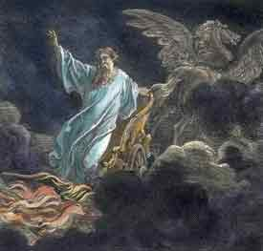
Exemption from Death
(1 Cor 15:54-56)
Enoch (Gen 5)
Elijah (2 Kings 2)
Christ (Acts 1:11; Rev 12:5)
Philip (Acts 8:39)
Paul (2 Cor 12:2, 4)
John (Rev 4:1-2)
Two witnesses (Rev 11)

Slide 159
1 Thessalonians 4:13-18
¹³ "But we do not want you to be uninformed, brethren, about those who are asleep, so that you will not grieve as do the rest who have no hope. ¹⁴ For if we believe that Jesus died and rose again, even so God will bring with Him those who have fallen asleep in Jesus. ¹⁵ For this we say to you by the word of the Lord, that we who are alive and remain until the coming of the Lord, will not precede those who have fallen asleep. ¹⁶ For the Lord Himself will . . .

Slide 160
1 Thessalonians 4:13-18
…descend from heaven with a shout, with the voice of the archangel and with the trumpet of God, and the dead in Christ will rise first. ¹⁷ Then we who are alive and remain will be caught up together with them in the clouds to meet the Lord in the air, and so we shall always be with the Lord. ¹⁸ Therefore comfort one another with these words."

Slide 162
II. Ministry in Judea
Acts 8:26-40
  Angel directs Philip (26)
  Philip’s obedience (27a)
  Ethiopian Eunuch’s introduction (27b-28)
  Holy Spirit directs Philip (29)
  Philip’s witness to the Eunuch (30-35)
  Eunuch’s conversion & baptism (36-38)
  Philip’s separation from the Eunuch (39)
  Philip’s evangelization of the Coastal Plain (40)

Slide 165
Conclusion

Slide 166
Acts 8:5-40
Philip’s Ministry
  Samaria (8:5-25)
  Judea (Acts 8:6-40)

