Slide 1
Happy Resurrection Day. he is risen!

Slide 2
The centrality of Christianity: Christ’s resurrection

Slide 3
Resurrection? No thanks.
“we’re not going to use the words ‘calvary,’ ‘resurrection’ or the phrase ‘the blood of Jesus.’ We won’t use language that will immediately make someone feel like an outsider.”
Source: https://relevantmagazine.com/faith/church/steven-furtick-facing-backlash-because-elevation-church-wont-use-words-like-resurrection-on-easter-invites/, accessed March 27, 2024

Slide 4
Resurrection? You mean, Love.
“Without equivocation or hesitation, I fully and completely admit that I deny the resurrection of Christ. I deny the resurrection of Christ every time I do not serve at the feet of the oppressed, each day that I turn my back on the poor; I deny the resurrection of Christ when I close my ears to the cries of the downtrodden and lend my support to an unjust and corrupt system.
Source: https://www.youtube.com/watch?v=6T8FVaI9Bc0, accessed March 27, 2024

Slide 5
Resurrection? You mean, Love.
“I affirm that resurrection…when I stand up for those who are forced to live on their knees, when I speak for those who have had their tongues torn out, when I cry for those who have no more tears left to shed.”
Source: https://www.youtube.com/watch?v=6T8FVaI9Bc0, accessed March 27, 2024

Slide 6
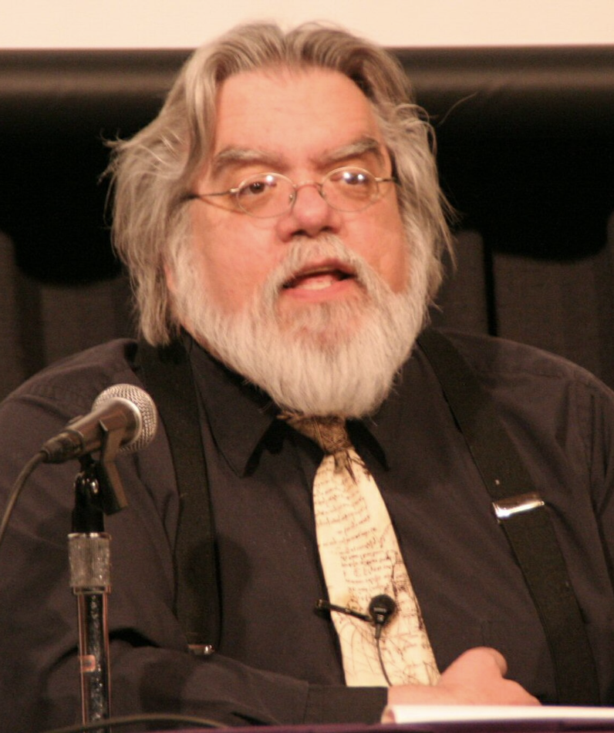
Resurrection? Implicit Absurdity!
“…there is ‘implicit absurdity’ in the ‘notion that Jesus is still alive, after two thousand years, in the personal, individual-consciousness mode intended by evangelical apologists.’”
Source: https://www.amazon.com/Empty-Tomb-Jesus-Beyond-Grave-ebook/dp/B002IC05LC/ref=sr_1_19?sr=8-19, accessed March 27, 2024

Slide 7
Outline: Christ’s Resurrection is…
The grounds for justification (Rom 4:23-25)
The highest Christian attainment (Phil 3:7-11)
The measure of God’s power in us (Eph 1:18-20)
The wellspring of all Christian living (Col 3:1-10)
Without, there is no Christianity (1 Cor 15:1-19)
Outline adapted from Weston, Henry G. “The Resurrection Of The Lord Jesus The Central Fact In Christianity.” Bibliotheca Sacra 57, no. 228 (1900).

Slide 8
Outline: Christ’s Resurrection is…
The grounds for justification (Rom 4:23-25)
The highest Christian attainment (Phil 3:7-11)
The measure of God’s power in us (Eph 1:18-20)
The wellspring of all Christian living (Col 3:1-10)
Without, there is no Christianity (1 Cor 15:1-19)
Outline adapted from Weston, Henry G. “The Resurrection Of The Lord Jesus The Central Fact In Christianity.” Bibliotheca Sacra 57, no. 228 (1900).

Slide 9
Romans 4:23-25
“Now not for his sake only was it written that it was credited to him, but for our sake also, to whom it will be credited, as those who believe in Him who raised Jesus our Lord from the dead, He who was delivered over because of our transgressions, and was raised because of our justification.”

Slide 10
“The experience of the world has proved that man cannot, by any act of his, attain righteousness. He is under law, and by law righteousness is impossible. All human history, a history which makes one shudder to read, attests this. It is attested by the painful struggles, so ineffectual, of every soul that has felt its own moral condition and has striven to change it. Such a struggle ends always in absolute despair. Its dying shriek is, ‘O wretched man that I am, who shall deliver me from the body of this death?’ Unless God interpose, there is no deliverance.”
Weston, Henry G. “The Resurrection Of The Lord Jesus The Central Fact In Christianity.” Bibliotheca Sacra 57, no. 228 (1900).

Slide 11
Isaiah 64:6
For all of us have become like one who is unclean, And all our righteous deeds are like a filthy garment…

Slide 12
Romans 4:23-25
“Now not for his sake only was it written that it was credited to him, but for our sake also, to whom it will be credited, as those who believe in Him who raised Jesus our Lord from the dead, He who was delivered over because of our transgressions, and was raised because of our justification.”

Slide 13
Outline: Christ’s Resurrection is…
The grounds for justification (Rom 4:23-25)
The highest Christian attainment (Phil 3:7-11)
The measure of God’s power in us (Eph 1:18-20)
The wellspring of all Christian living (Col 3:1-10)
Without, there is no Christianity (1 Cor 15:1-19)
Outline adapted from Weston, Henry G. “The Resurrection Of The Lord Jesus The Central Fact In Christianity.” Bibliotheca Sacra 57, no. 228 (1900).

Slide 14
Philippians 3:7-10
7 “But whatever things were gain to me, those things I have counted as loss for the sake of Christ.
8 More than that, I count all things to be loss in view of the surpassing value of knowing Christ Jesus my Lord, for whom I have suffered the loss of all things, and count them but rubbish so that I may gain Christ,
9 and may be found in Him, not having a righteousness of my own derived from the Law, but that which is through faith in Christ, the righteousness which comes from God on the basis of faith,
10 that I may know Him and the power of His resurrection and the fellowship of His sufferings, being conformed to His death;
11 in order that I may attain to the resurrection from the dead.”

Slide 15
Philippians 3:7-10
7 “But whatever things were gain to me, those things I have counted as loss for the sake of Christ.
8 More than that, I count all things to be loss in view of the surpassing value of knowing Christ Jesus my Lord, for whom I have suffered the loss of all things, and count them but rubbish so that I may gain Christ,
9 and may be found in Him, not having a righteousness of my own derived from the Law, but that which is through faith in Christ, the righteousness which comes from God on the basis of faith,
10 that I may know Him and the power of His resurrection and the fellowship of His sufferings, being conformed to His death;
11 in order that I may attain to the resurrection from the dead.”

Slide 16
Philippians 3:7-10
7 “But whatever things were gain to me, those things I have counted as loss for the sake of Christ.
8 More than that, I count all things to be loss in view of the surpassing value of knowing Christ Jesus my Lord, for whom I have suffered the loss of all things, and count them but rubbish so that I may gain Christ,
9 and may be found in Him, not having a righteousness of my own derived from the Law, but that which is through faith in Christ, the righteousness which comes from God on the basis of faith,
10 that I may know Him and the power of His resurrection and the fellowship of His sufferings, being conformed to His death;
11 in order that I may attain to the resurrection from the dead.”

Slide 17
Philippians 3:11 -
Resurrected, ἐξανάστασις
“This compound word literally means out-resurrection. It denotes however a partial resurrection. It means a partial resurrection out from among other corpses, literally an “out-resurrection.” But why did Paul say he wanted somehow, to attain to the (out-) resurrection from the dead? Did he doubt he would be raised from the dead? Hardly. Perhaps he was using this word to refer to the Rapture, thus expressing the hope that the Lord would return during his lifetime.”
Robert P. Lightner, “Philippians,” in The Bible Knowledge Commentary: An Exposition of the Scriptures, ed. J. F. Walvoord and R. B. Zuck, vol. 2 (Wheaton, IL: Victor Books, 1985), 661.

Slide 18
Philippians 3:11 -
Resurrected, ἐξανάστασις
“This compound word literally means out-resurrection. It denotes however a partial resurrection. It means a partial resurrection out from among other corpses, literally an “out-resurrection.” But why did Paul say he wanted somehow, to attain to the (out-) resurrection from the dead? Did he doubt he would be raised from the dead? Hardly. Perhaps he was using this word to refer to the Rapture, thus expressing the hope that the Lord would return during his lifetime.”
Robert P. Lightner, “Philippians,” in The Bible Knowledge Commentary: An Exposition of the Scriptures, ed. J. F. Walvoord and R. B. Zuck, vol. 2 (Wheaton, IL: Victor Books, 1985), 661.

Slide 19
1 Thessalonians 4:17
“Then we who are alive and remain will be caught up together with them in the clouds to meet the Lord in the air, and so we shall always be with the Lord.”

Slide 20
Outline: Christ’s Resurrection is…
The grounds for justification (Rom 4:23-25)
The highest Christian attainment (Phil 3:7-11)
The measure of God’s power in us (Eph 1:18-20)
The wellspring of all Christian living (Col 3:1-10)
Without, there is no Christianity (1 Cor 15:1-19)
Outline adapted from Weston, Henry G. “The Resurrection Of The Lord Jesus The Central Fact In Christianity.” Bibliotheca Sacra 57, no. 228 (1900).

Slide 21
Ephesians 1:18-20
18 I pray that the eyes of your heart may be enlightened, so that you will know what is the hope of His calling, what are the riches of the glory of His inheritance in the saints,
19 and what is the surpassing greatness of His power toward us who believe. These are in accordance with the working of the strength of His might
20 which He brought about in Christ, when He raised Him from the dead and seated Him at His right hand in the heavenly places…

Slide 22
Ephesians 1:18-20
18 I pray that the eyes of your heart may be enlightened, so that you will know what is the hope of His calling, what are the riches of the glory of His inheritance in the saints,
19 and what is the surpassing greatness of His power toward us who believe. These are in accordance with the working of the strength of His might
20 which He brought about in Christ, when He raised Him from the dead and seated Him at His right hand in the heavenly places…

Slide 23
Ephesians 1:18-20
18 I pray that the eyes of your heart may be enlightened, so that you will know what is the hope of His calling, what are the riches of the glory of His inheritance in the saints,
19 and what is the surpassing greatness of His power toward us who believe. These are in accordance with the working of the strength of His might
20 which He brought about in Christ, when He raised Him from the dead and seated Him at His right hand in the heavenly places…

Slide 24
Ephesians 1:18-20
18 I pray that the eyes of your heart may be enlightened, so that you will know what is the hope of His calling, what are the riches of the glory of His inheritance in the saints,
19 and what is the surpassing greatness of His power toward us who believe. These are in accordance with the working of the strength of His might
20 which He brought about in Christ, when He raised Him from the dead and seated Him at His right hand in the heavenly places…

Slide 25
Ephesians 1:18-20
18 I pray that the eyes of your heart may be enlightened, so that you will know what is the hope of His calling, what are the riches of the glory of His inheritance in the saints,
19 and what is the surpassing greatness of His power toward us who believe. These are in accordance with the working of the strength of His might
20 which He brought about in Christ, when He raised Him from the dead and seated Him at His right hand in the heavenly places...

Slide 26
Ephesians 1:18-20
18 I pray that the eyes of your heart may be enlightened, so that you will know what is the hope of His calling, what are the riches of the glory of His inheritance in the saints,
19 and what is the surpassing greatness of His power toward us who believe. These are in accordance with the working of the strength of His might
20 which He brought about in Christ, when He raised Him from the dead and seated Him at His right hand in the heavenly places…

Slide 27
Ephesians 1:18-20
The hope of His calling…
The riches of the glory of His inheritance in the saints…
The surpassing greatness of His power toward us who believe.

Slide 28
Ephesians 1:18-20
18 I pray that the eyes of your heart may be enlightened, so that you will know what is the hope of His calling, what are the riches of the glory of His inheritance in the saints,
19 and what is the surpassing greatness of His power toward us who believe. These are in accordance with the working of the strength of His might
20 which He brought about in Christ, when He raised Him from the dead and seated Him at His right hand in the heavenly places…

Slide 29
Outline: Christ’s Resurrection is…
The grounds for justification (Rom 4:23-25)
The highest Christian attainment (Phil 3:7-11)
The measure of God’s power in us (Eph 1:18-20)
The wellspring of all Christian living (Col 3:1-10)
Without, there is no Christianity (1 Cor 15:1-19)
Outline adapted from Weston, Henry G. “The Resurrection Of The Lord Jesus The Central Fact In Christianity.” Bibliotheca Sacra 57, no. 228 (1900).

Slide 30
Colossians 3:1-4
1 “Therefore if you have been raised up with Christ, keep seeking the things above, where Christ is, seated at the right hand of God.
2 Set your mind on the things above, not on the things that are on earth.
3 For you have died and your life is hidden with Christ in God.
4 When Christ, who is our life, is revealed, then you also will be revealed with Him in glory.”

Slide 31
Romans 6:8-11
8 Now if we have died with Christ, we believe that we shall also live with Him,
9 knowing that Christ, having been raised from the dead, is never to die again; death no longer is master over Him.
10 For the death that He died, He died to sin once for all; but the life that He lives, He lives to God.
11 Even so consider yourselves to be dead to sin, but alive to God in Christ Jesus.

Slide 32
Romans 6:8-11
8 Now if we have died with Christ, we believe that we shall also live with Him,
9 knowing that Christ, having been raised from the dead, is never to die again; death no longer is master over Him.
10 For the death that He died, He died to sin once for all; but the life that He lives, He lives to God.
11 Even so consider yourselves to be dead to sin, but alive to God in Christ Jesus.

Slide 33
Outline: Christ’s Resurrection is…
The grounds for justification (Rom 4:23-25)
The highest Christian attainment (Phil 3:7-11)
The measure of God’s power in us (Eph 1:18-20)
The wellspring of all Christian living (Col 3:1-10)
Without, there is no Christianity (1 Cor 15:1-19)
Outline adapted from Weston, Henry G. “The Resurrection Of The Lord Jesus The Central Fact In Christianity.” Bibliotheca Sacra 57, no. 228 (1900).

Slide 34
1 Corinthians 15:12-14
12 “Now if Christ is preached, that He has been raised from the dead, how do some among you say that there is no resurrection of the dead?
13 But if there is no resurrection of the dead, not even Christ has been raised;
14 and if Christ has not been raised, then our preaching is vain, your faith also is vain.”

Slide 35
1 Cor 15 - Without Christ’s resurrection…
No gospel – 15:1
No sanctification – 15:1b
No salvation – 15:2
No historical evidence or apostolic witness – 15:5-8
Christ’s body? – 15:12-13
Our Preaching/teaching pointless – 15:14a
Your faith worthless, pointless, futile – 15:14b
Those dead in Christ, are still dead 15:18
No hope - 15:19a
We are to be most pitied – 15:19b

Slide 36
H.P Liddon, 1829-1890
“Faith and resurrection is the very keystone of the arch of Christian faith, and , when it is removed, all must inevitably crumble into ruin.”
McDowell, Josh. “Evidence for Christianity: Historical Evidence for the Christian Faith.” Nashville, TN: Thomas Nelson, Inc., 2006, 249

Slide 37
Douglas Groothius
“The various New Testament letters and the book of Revelation would melt into nothingness without the resurrected Jesus.”
McDowell, Josh. “Evidence for Christianity: Historical Evidence for the Christian Faith.” Nashville, TN: Thomas Nelson, Inc., 2006, 249

Slide 38
John 10:17-18
17 “For this reason the Father loves Me, because I lay down My life so that I may take it again.
18 No one has taken it away from Me, but I lay it down on My own initiative. I have authority to lay it down, and I have authority to take it up again. This commandment I received from My Father.”

Slide 39
Outline: Christ’s Resurrection is…
The grounds for justification (Rom 4:23-25)
The highest Christian attainment (Phil 3:7-11)
The measure of God’s power in us (Eph 1:18-20)
The wellspring of all Christian living (Col 3:1-10)
Without, there is no Christianity (1 Cor 15:1-19)
Outline adapted from Weston, Henry G. “The Resurrection Of The Lord Jesus The Central Fact In Christianity.” Bibliotheca Sacra 57, no. 228 (1900).

Slide 40
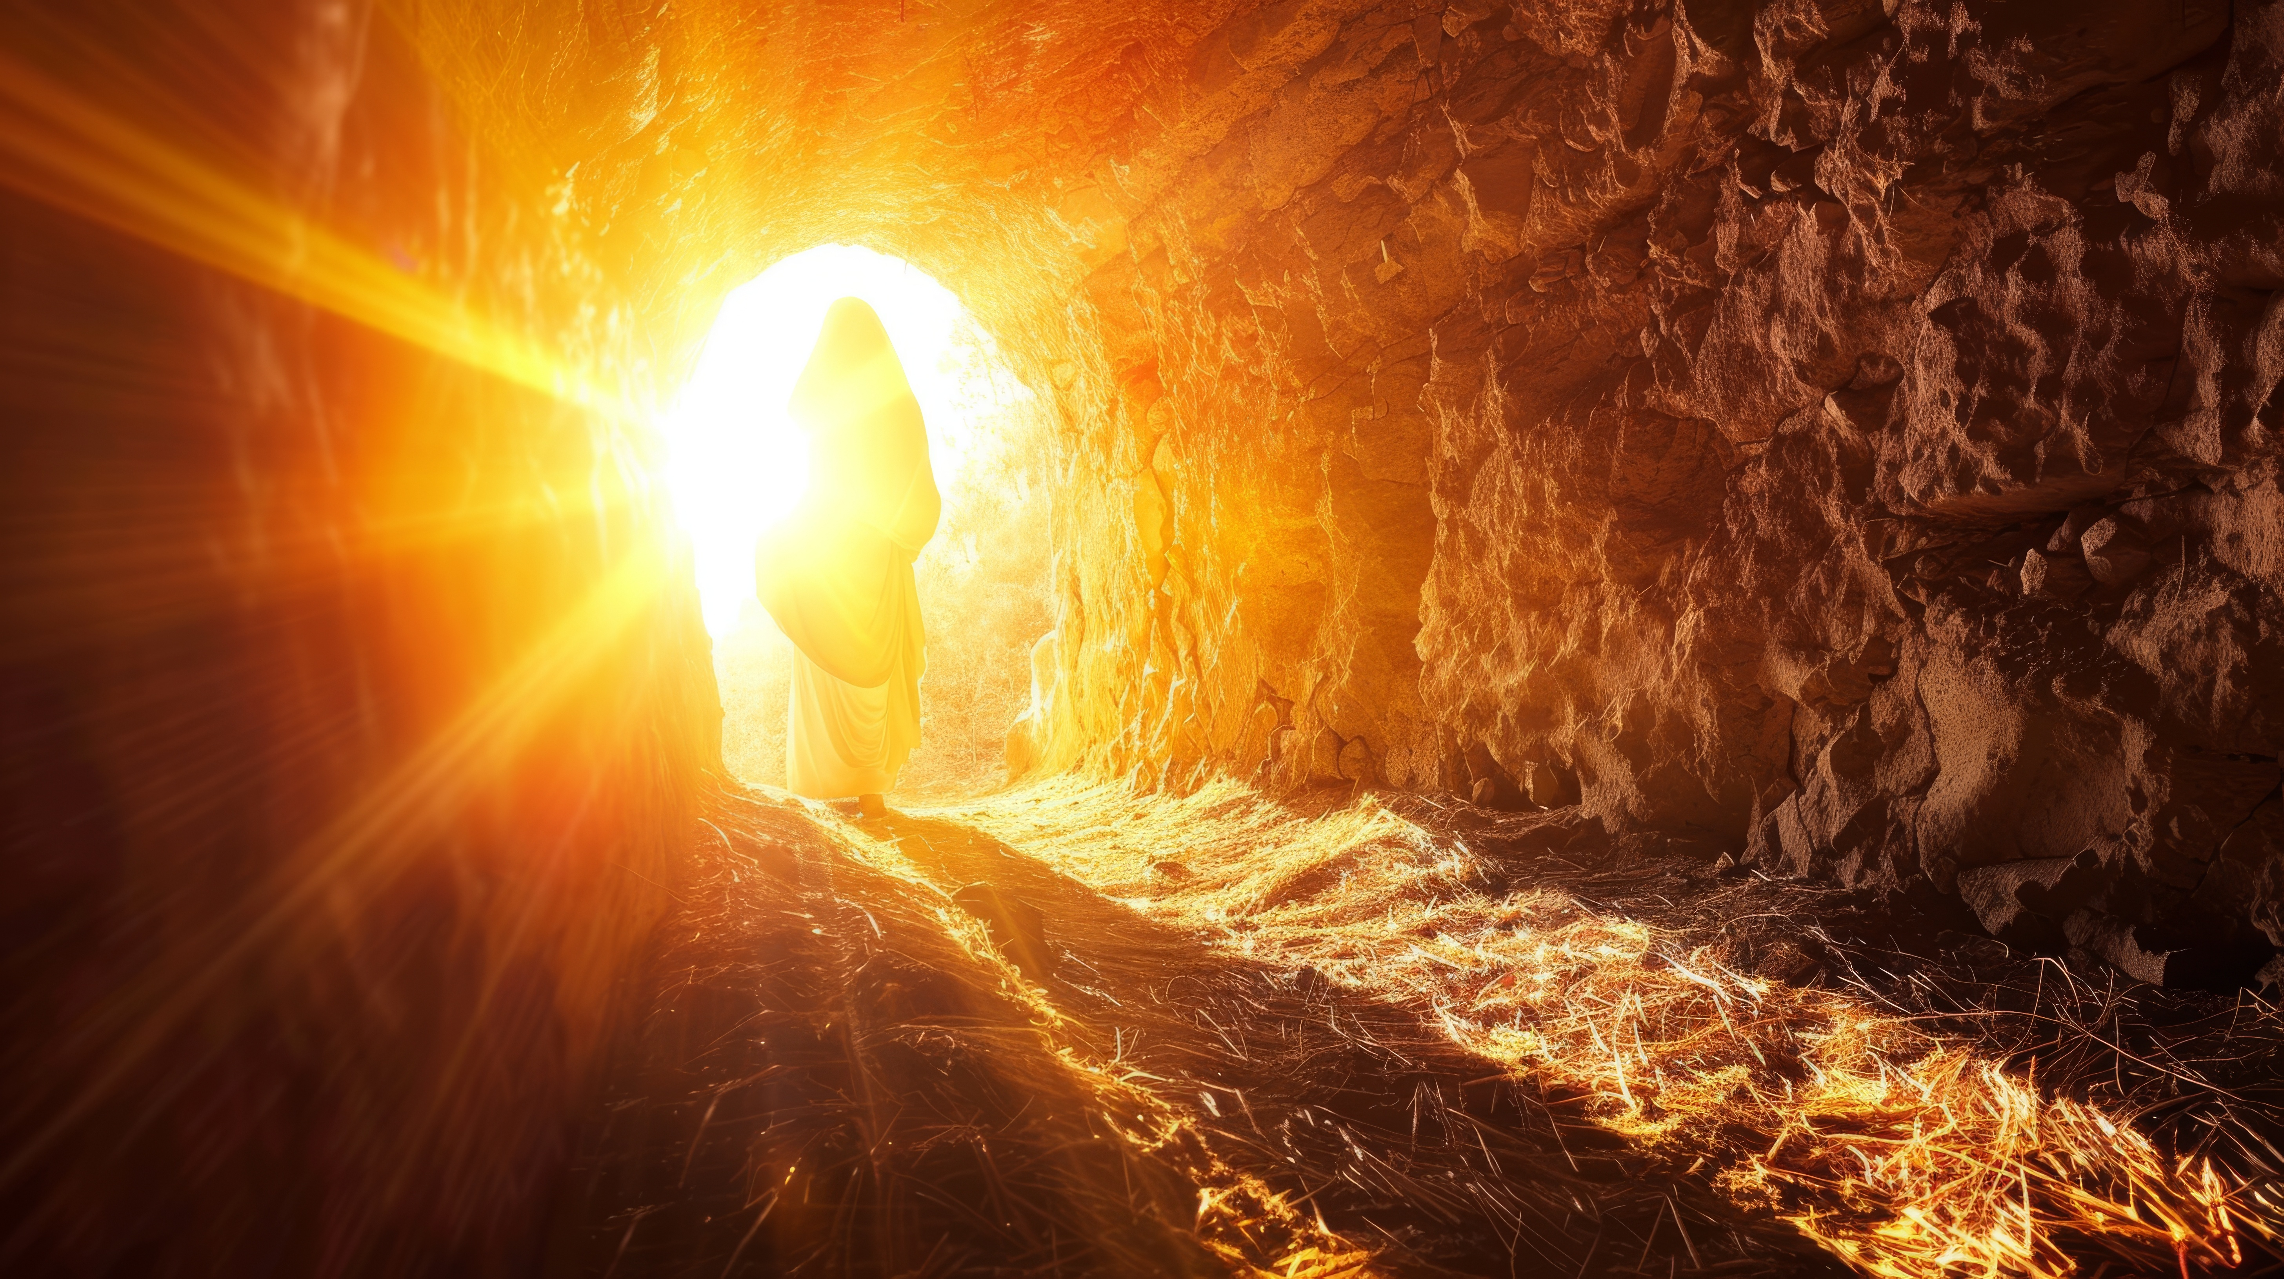
he is risen!

