Slide 1
Law and Grace: An Overview Jim McGowan, Th.D. Sugar Land Bible Church 03-31-2024
…but grace and truth were realized through Jesus Christ - John 1:17
For the Law was given through Moses…
Special thanks to Dr. Vern Peterman for access to his insights and resources.

Slide 2
Session 42 Outline
Review
Purpose, Aim, and Objective
Session 41
The Gospel of Substitution & the Gospel of the Kingdom – Part 2
Contrasts and Comparisons
Concluding Observations

Slide 3
OUR PURPOSE, AIM AND OBJECTIVE
Law and Grace
…is to Compare and Contrast Law and Grace so as to properly understand these two important themes and how they are related to the life of the New Testament Believer.

Slide 4
C. I. Scofield, D. D.
The Grace of God, The Fundamentals Vol. 3, Chapter VII, p. 98
We have, most of us, been reared and now live under the influence of Galatianism. Protestant theology, alas, is for the most part, thoroughly Galatianized, in that neither law nor grace are given their distinct and separated places, as in the counsels of God, but are mingled together in one incoherent system.
The law is no longer, as in the Divine intent, a ministration of death (2 Cor. 3:7), of cursing (Gal. 3:10), of conviction (Rom. 3:19), because we are taught that we must try to keep it, and that by Divine help we may.
Nor, on the other hand, does grace bring us blessed deliverance from the dominion of sin, for we are kept under the law as a rule of life despite the plain declaration, “Sin shall not have dominion over you: for ye are not under the law, but under grace” (Rom. 6:14). (emphasis mine)

Slide 5
William R. Newell
Romans Verse-by-Verse (p. 274).
Grand Rapids, MI: Christian Classics Ethereal Library.
It is because Reformed theology has kept us Gentiles under the Law,—if not as a means of righteousness, then as “a rule of life,” that all the trouble has arisen. The Law is no more a rule of life than it is a means of righteousness. Walking in the Spirit has now taken the place of walking by ordinances. God has another principle under which He has put his saints: “Ye are not under law, but, under grace! (Rom. 6:14)” (italics mine)
PDF Download Here: https://archive.org/details/Romans_Verse_By_Verse-NewellWR

Slide 6
Henry Ironside
The Continual Burnt Offering: Daily Meditations on the Word of God (p. 265). Neptune, NJ: Loizeaux Brothers.
In Romans 7 we have a man renewed by the Spirit of God, but struggling under law, hoping thereby to subdue or find deliverance from the power of the old Adamic nature. In chapter 8 we have God’s way of deliverance through the death and resurrection of Christ with which the believer is identified before God. The chapter begins with “no condemnation” and ends with “no separation.” All who are in Christ Jesus are accepted in the Beloved and as free from every charge of guilt as He is Himself. He paid our penalty on the cross. Now we are linked up with Him in resurrection, not under law but under grace.

Slide 7
Matthew’s 3-Fold Purpose
Law and Grace: Review - Matthew
To explain:
that Jesus in whom they had believed was the long-awaited Jewish Messiah
why the kingdom had been postponed despite the fact that the king had arrived
the interim program of God during the kingdom’s absence

Slide 8
Matthew and the Kingdom
Law and Grace: Review - Matthew
 | offered
 | rejected
 | postponed Interim program
 | ultimately accepted

Slide 9
Matthew’s Message
Law and Grace: Review - Matthew
Jesus is the predicted Jewish king who ushered in an interim program by building the sons of the kingdom into the Church in between Israel’s past rejection and future acceptance of her king.

Slide 10
Session 42 Outline
Review
Purpose, Aim, and Objective
Session 41
The Gospel of Substitution & the Gospel of the Kingdom – Part 2
Contrasts and Comparisons
Concluding Observations

Slide 11
THE GOSPEL
Law & Grace: Review: The Gospel of Substitution & The Gospel of the Kingdom – Part 1
The word that is translated ‘gospel’ in the New Testament is a compound word that literally means ‘good message’ but is most often translated ‘good news’ in our English Bibles.
We find the word ‘gospel’ only in the New Testament, but the word pair ‘good news’ is found in both the Old and the New Testaments, often in telling about a spiritual truth.

Slide 12
GOOD NEW ABOUT WHAT?
Law & Grace: Review: The Gospel of Substitution & The Gospel of the Kingdom – Part 1
“Our English word gospel means “good story” or “good news.” But the word gospel must be further defined by answering one more question: good news about what? Even the New Testament uses the word gospel to mean various types of good news, so one has to describe what good news is in view.”
Ryrie, C. C. (1997). So Great Salvation: What It Means to Believe in Jesus Christ (p. 36). Moody Press.

Slide 13
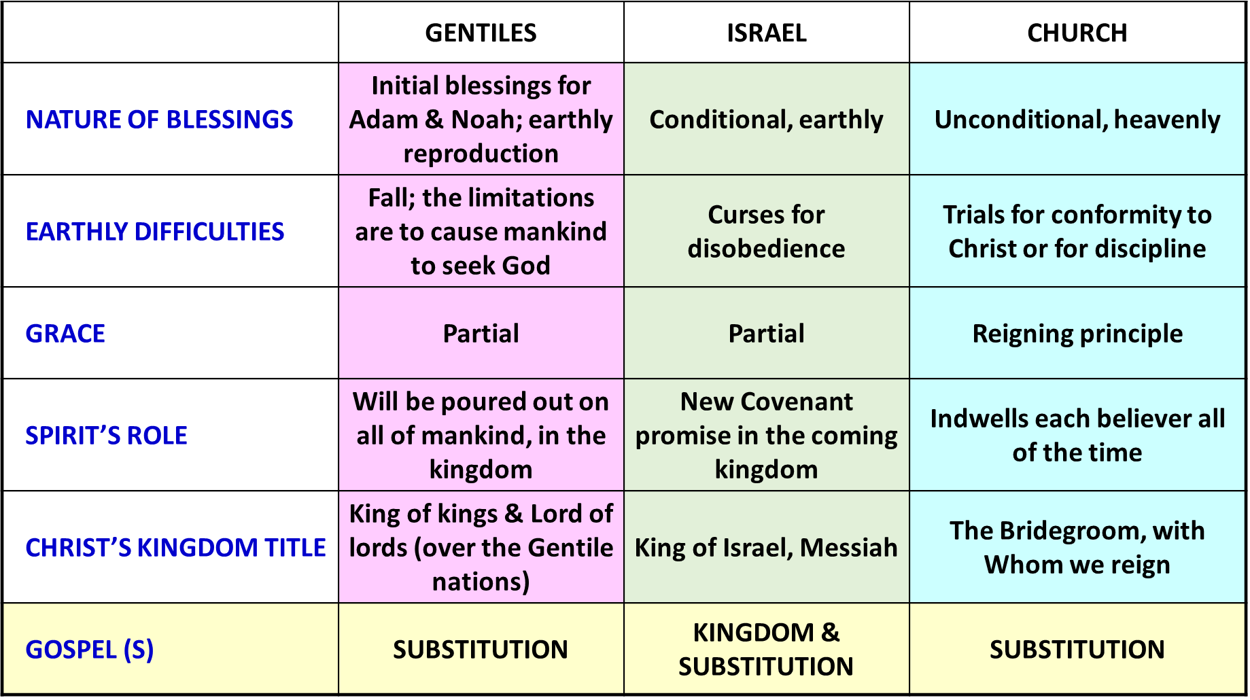
THE GOSPEL
Law & Grace: Review: The Gospel of Substitution & The Gospel of the Kingdom – Part 1

Slide 14
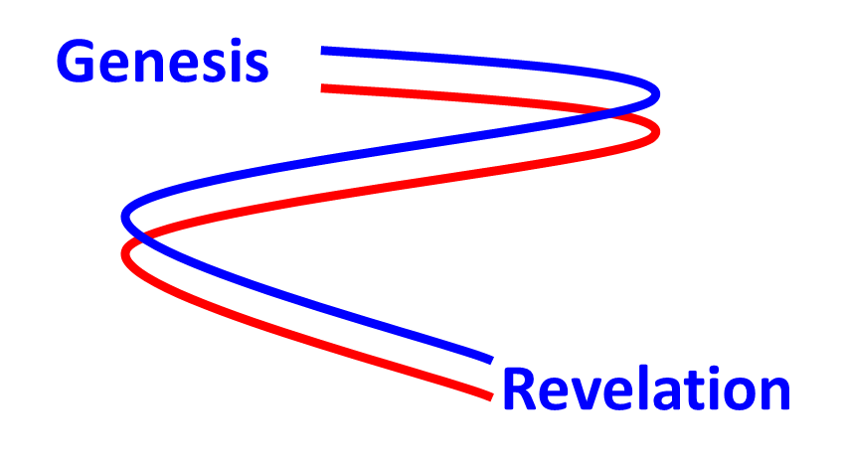
TWO GOSPELS THAT SPAN FROM GENESIS TO REVELATION
Law & Grace: Review: The Gospel of Substitution & The Gospel of the Kingdom – Part 1
The two gospels that begin in the book of Genesis continue as two threads on into the book of Revelation.
1

Slide 15
Law & Grace: Review: The Gospel of Substitution & The Gospel of the Kingdom – Part 1
TWO GOSPELS THAT SPAN FROM GENESIS TO REVELATION
The Gospel of Substitution is that Christ died in the place of every single human being for all of time.
The Gospel of the Kingdom is that Christ will reign over Israel and the entire earth for 1000 years.

Slide 16
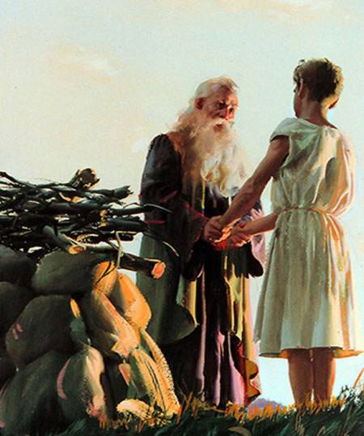
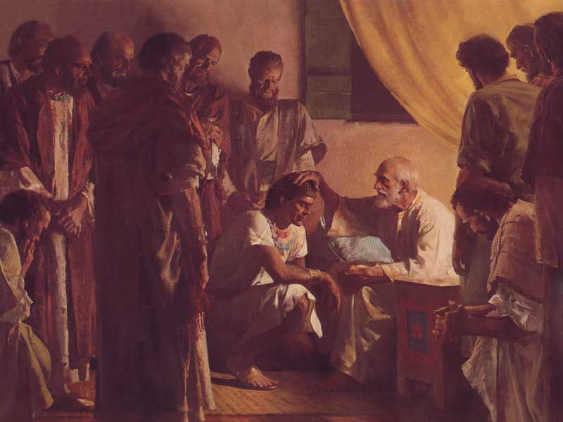
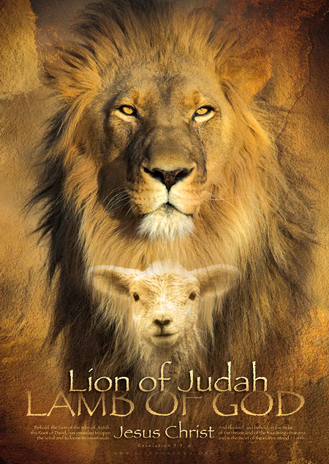
Law & Grace: Review: The Gospel of Substitution & The Gospel of the Kingdom – Part 1
"Judah… your father's sons shall bow down to you… "

Slide 17
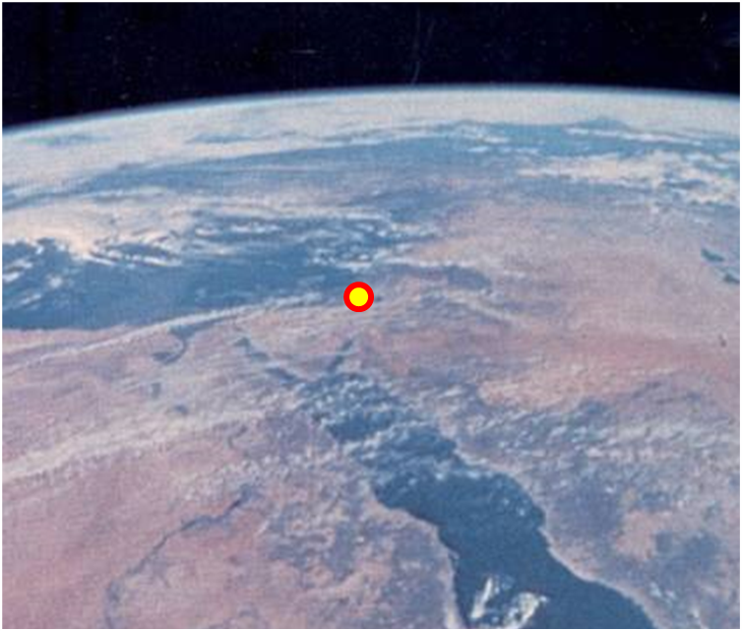
Law & Grace: Review: The Gospel of Substitution & The Gospel of the Kingdom – Part 1
WHAT DO YOU THINK OF CHRIST?
The key question of the ‘Gospel of the Kingdom’ is, “Do you believe that Jesus is the Christ, that is, Israel’s promised Messiah?”, and that question is of first priority for Israel.

Slide 18
Law & Grace: Review: The Gospel of Substitution & The Gospel of the Kingdom – Part 1
WHAT DO YOU THINK OF CHRIST?
The key question of the ‘Gospel of Substitution’ is, “Do you believe God regarding Jesus Christ’s death for your sins, His burial, and His resurrection?”
The questions about Christ are different.

Slide 19
Session 42 Outline
Review
Purpose, Aim, and Objective
Session 41
The Gospel of Substitution & the Gospel of the Kingdom – Part 2
Contrasts and Comparisons
Concluding Observations

Slide 20
Law & Grace: The Gospel of Substitution & The Gospel of the Kingdom – Part 2

Slide 21
Law & Grace: The Gospel of Substitution & The Gospel of the Kingdom – Part 2

Slide 22
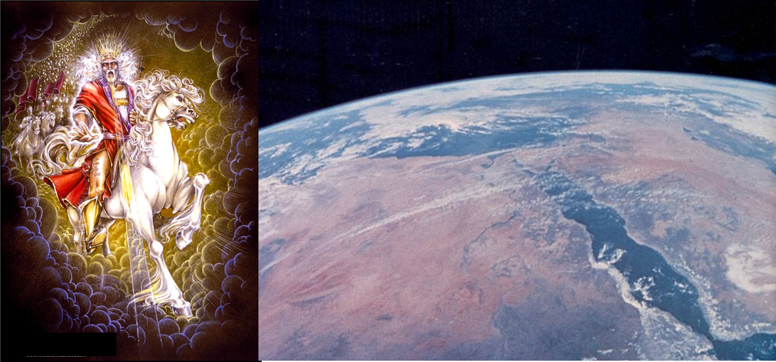
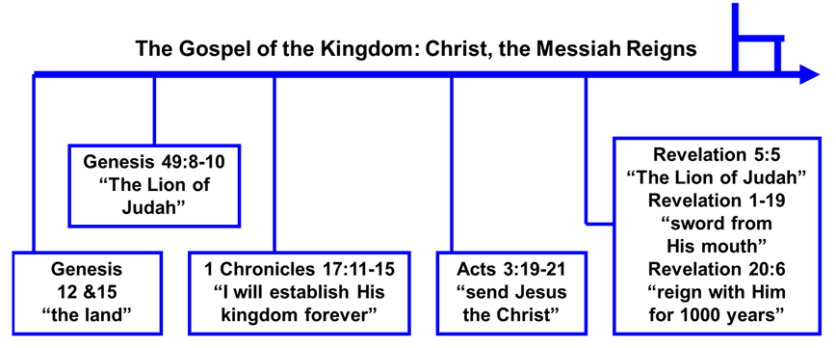
Law & Grace: The Gospel of Substitution & The Gospel of the Kingdom – Part 2

Slide 23
Law & Grace: The Gospel of Substitution & The Gospel of the Kingdom – Part 2

Slide 24
Genesis 3:15
“seed of the woman”
¹⁵ And I will put enmity Between you and the woman, And between your seed and her seed; He [Christ, the Seed] shall bruise you [Satan] on the head, And you [Satan] shall bruise him [Christ, the Seed] on the heel.”

Slide 25
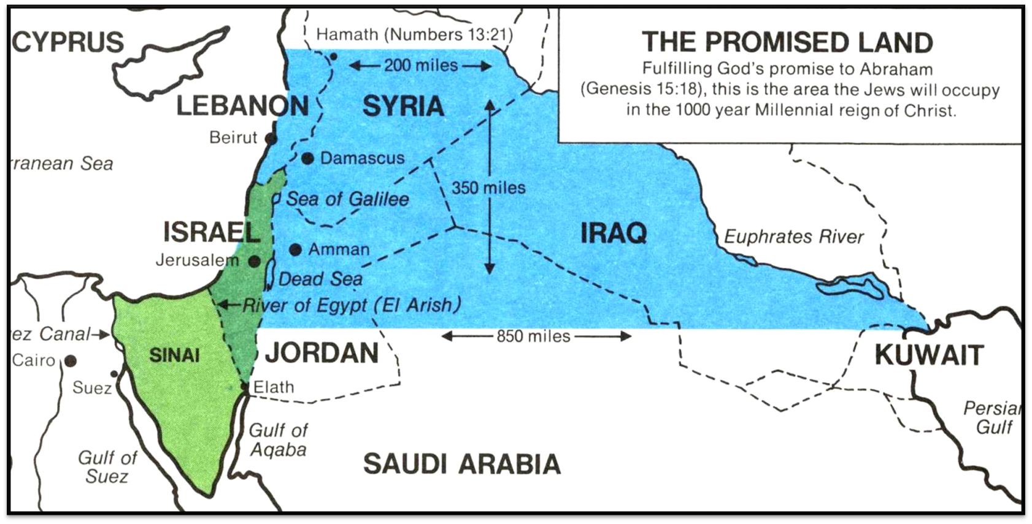
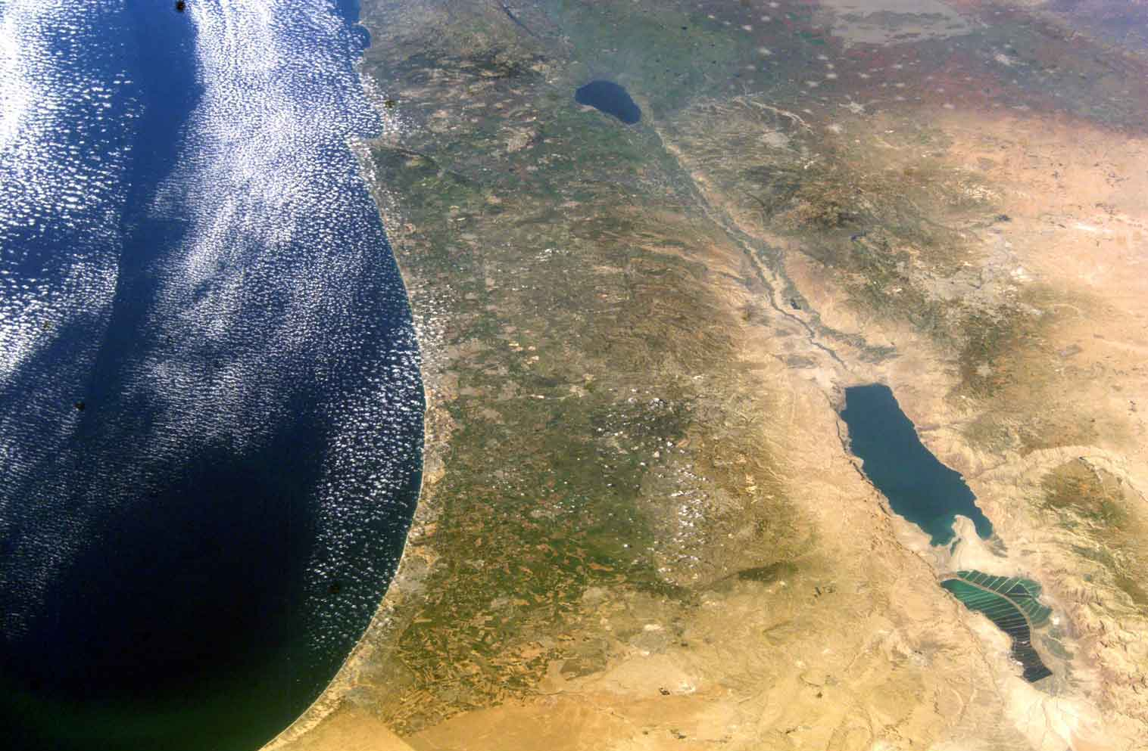
Law & Grace: The Gospel of Substitution & The Gospel of the Kingdom – Part 2

Slide 26
Law & Grace: The Gospel of Substitution & The Gospel of the Kingdom – Part 2

Slide 27
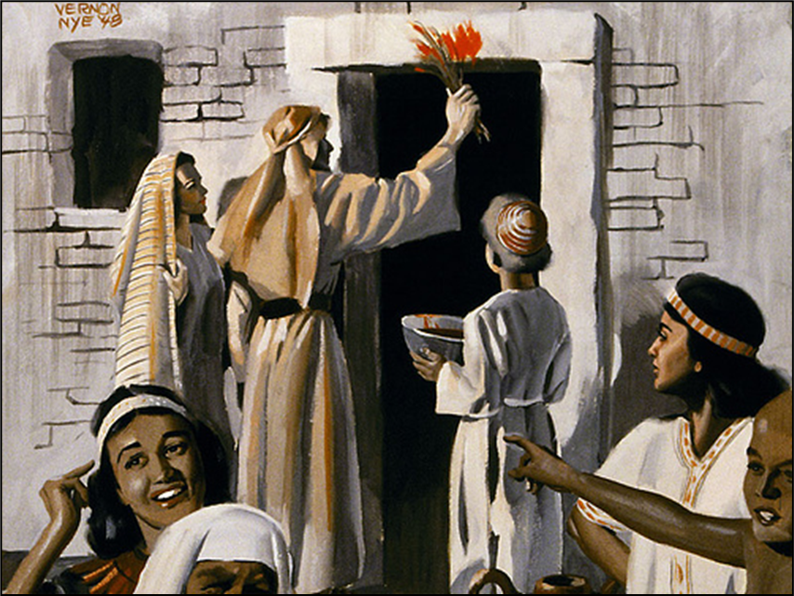
Law & Grace: The Gospel of Substitution & The Gospel of the Kingdom – Part 2

Slide 28
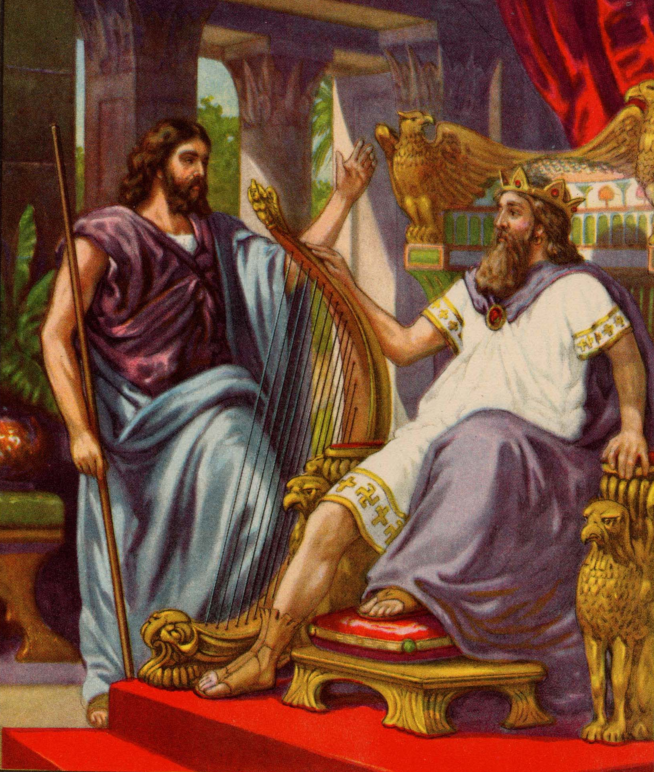
Law & Grace: The Gospel of Substitution & The Gospel of the Kingdom – Part 2

Slide 29
Law & Grace: The Gospel of Substitution & The Gospel of the Kingdom – Part 2

Slide 30
Law & Grace: The Gospel of Substitution & The Gospel of the Kingdom – Part 2

Slide 31
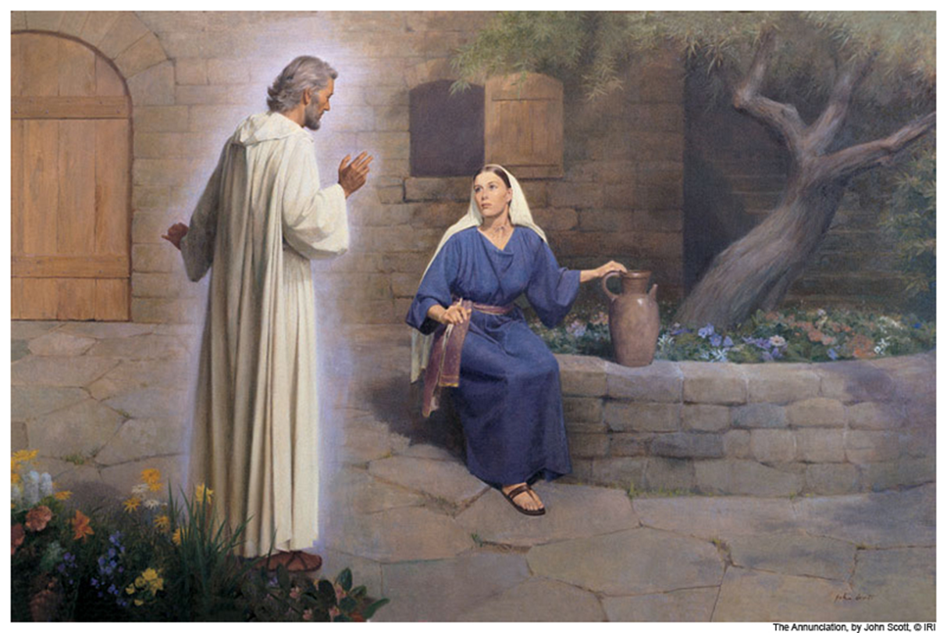
Law & Grace: The Gospel of Substitution & The Gospel of the Kingdom – Part 2

Slide 32
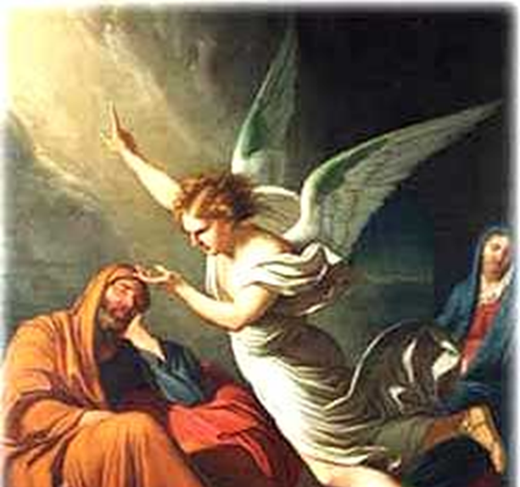
Law & Grace: The Gospel of Substitution & The Gospel of the Kingdom – Part 2

Slide 33
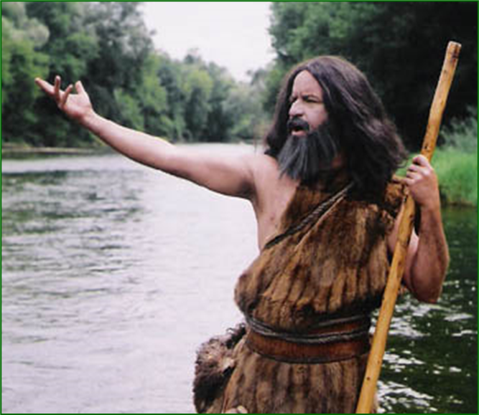
Law & Grace: The Gospel of Substitution & The Gospel of the Kingdom – Part 2

Slide 34
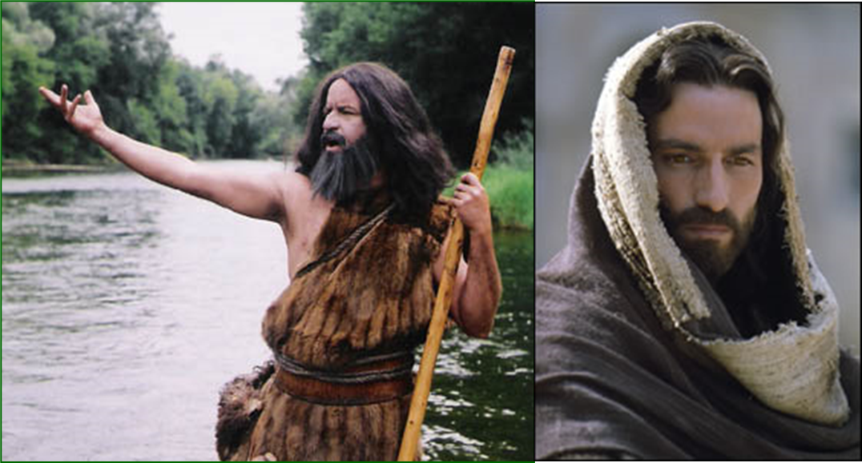
Law & Grace: The Gospel of Substitution & The Gospel of the Kingdom – Part 2

Slide 35
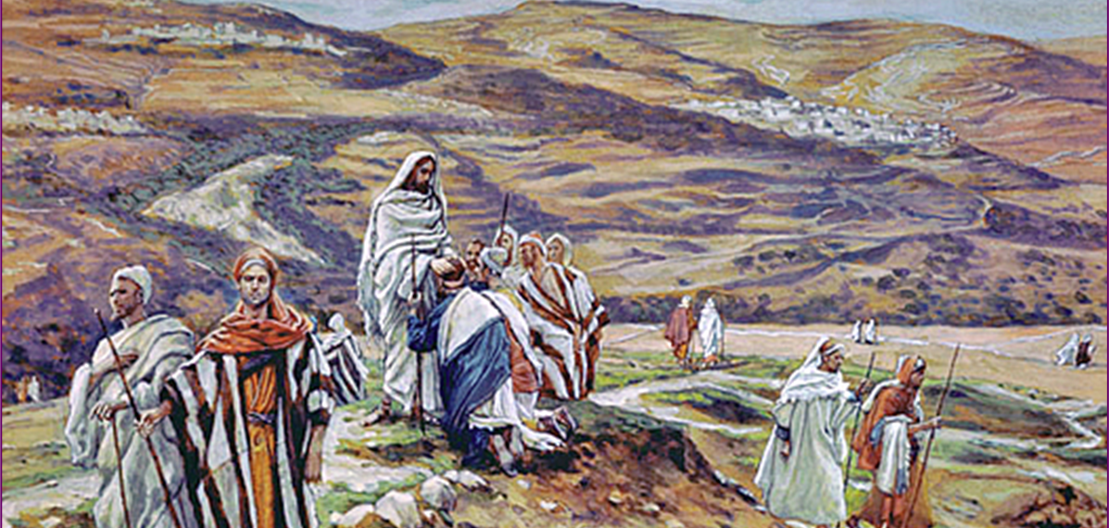
Law & Grace: The Gospel of Substitution & The Gospel of the Kingdom – Part 2

Slide 36
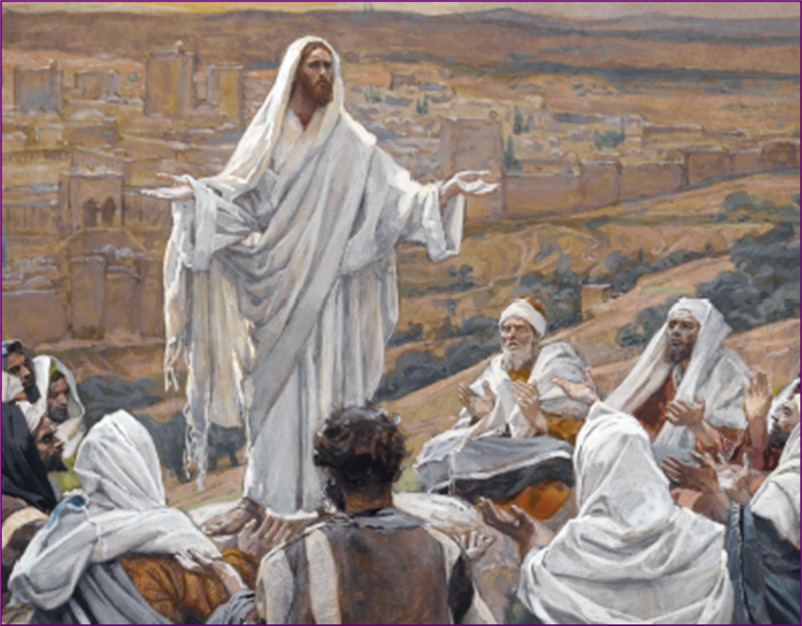
Law & Grace: The Gospel of Substitution & The Gospel of the Kingdom – Part 2

Slide 37
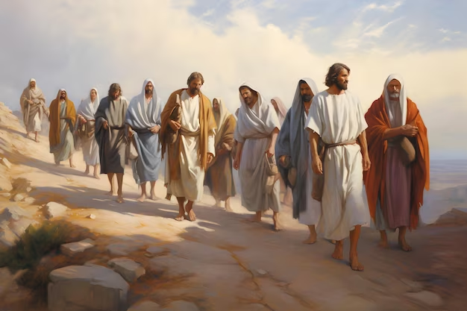
Law & Grace: The Gospel of Substitution & The Gospel of the Kingdom – Part 2
The Gospel of Substitution
In Matthew, Jesus presented that He would die, then be buried, and raised:
Matthew 12:40
Matthew 16:21, one year before
Matthew 17:23
Matthew 20:19

Slide 38
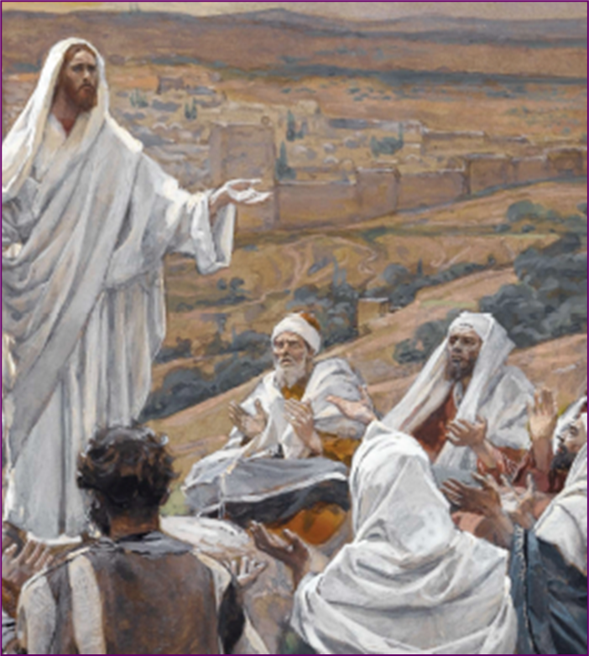
Luke 9:43-45
the gospel of substitution
⁴³ …He said to His disciples, ⁴⁴ "Let these words sink into your ears; for the Son of Man is going to be delivered into the hands of men.“ ⁴⁵ But they did not understand this statement, and it was concealed from them so that they would not perceive it; and they were afraid to ask Him about this statement.

Slide 39
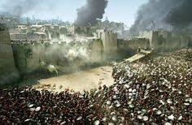
Luke 19:41-44
rejection of the gospel of the kingdom
⁴¹ When He approached Jerusalem, He saw the city and wept over it, ⁴² saying, "If you had known in this day, even you, the things which make for peace! But now they have been hidden from your eyes. ⁴³ For the days will come upon you when your enemies will throw up a barricade against you, and surround you and hem you in on every side, ⁴⁴ and they will level you to the ground and your children within you, and they will not leave in you one stone upon another, because you did not recognize the time of your visitation."

Slide 40
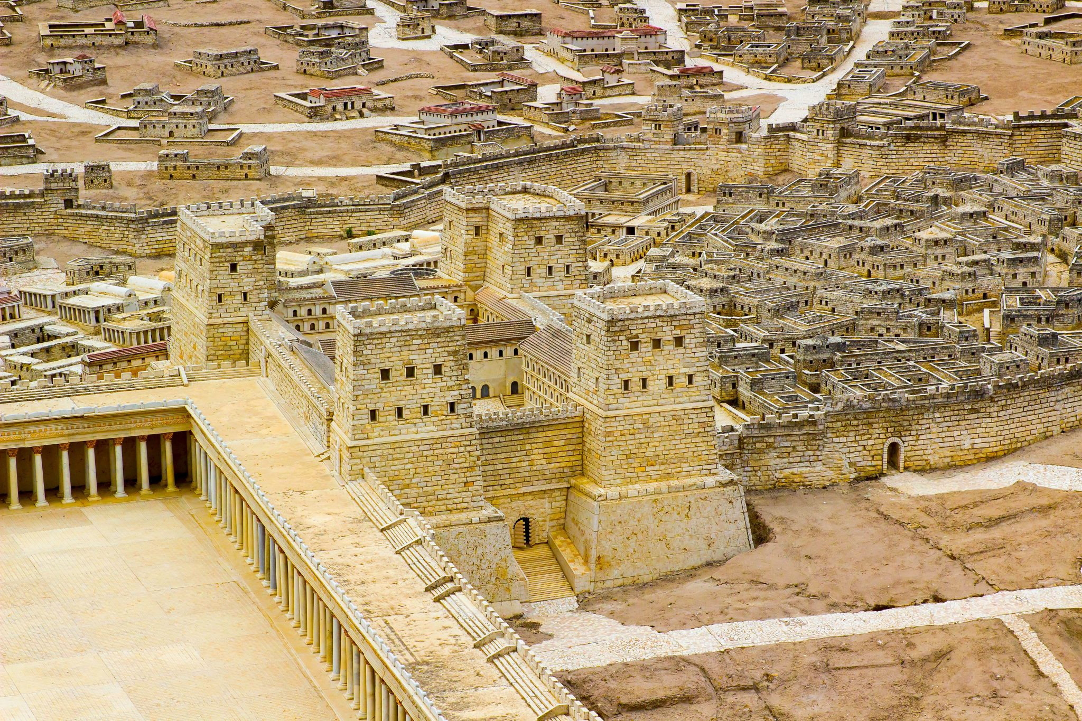
Law & Grace: The Gospel of Substitution & The Gospel of the Kingdom – Part 2
The Fortress of Antonia
The Antonia Fortress was strategically located on the northeastern corner of the Temple Mount and overlooked the Temple courts.
Its primary purpose was to provide a military garrison for the Roman troops stationed in Jerusalem to maintain order and quell any potential uprisings during religious festivals.

Slide 41
Law & Grace: The Gospel of Substitution & The Gospel of the Kingdom – Part 2
The Gospel of the Kingdom was to be presented to Israel
Israel’s response to the ‘Gospel of the Kingdom’, that Christ was indeed the King of Israel and to be received by Israel, would determine the outcome:
If Israel’s response to Jesus as their Messiah had been favorable, then the kingdom would have begun soon.
But they rejected Jesus as their Messiah so, the beginning of the kingdom was…

Slide 42
Matthew 23:37-39
rejection of the gospel of the kingdom
³⁷ Jerusalem, Jerusalem, who kills the prophets and stones those who are sent to her! How often I wanted to gather your children together, the way a hen gathers her chicks under her wings⁺, and you were unwilling. ³⁸ "Behold, your house is being left to you desolate! ³⁹ For I say to you, from now on you will not see Me until you say, 'Blessed is He who comes in the name of the Lord!'"
⁺ The Psalms picture God taking Israel ‘under His wings’ for protection. (cf. 17:8, 36:7, et al)

Slide 43
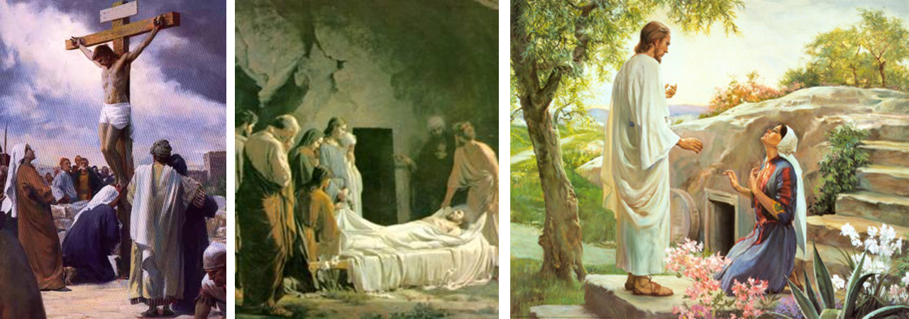
Law & Grace: The Gospel of Substitution & The Gospel of the Kingdom – Part 2

Slide 44
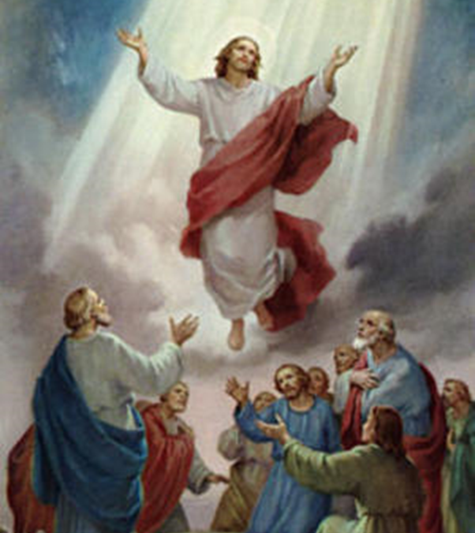
Law & Grace: The Gospel of Substitution & The Gospel of the Kingdom – Part 2

Slide 45
Law & Grace: The Gospel of Substitution & The Gospel of the Kingdom – Part 2
Two Charts
1
2

Slide 46
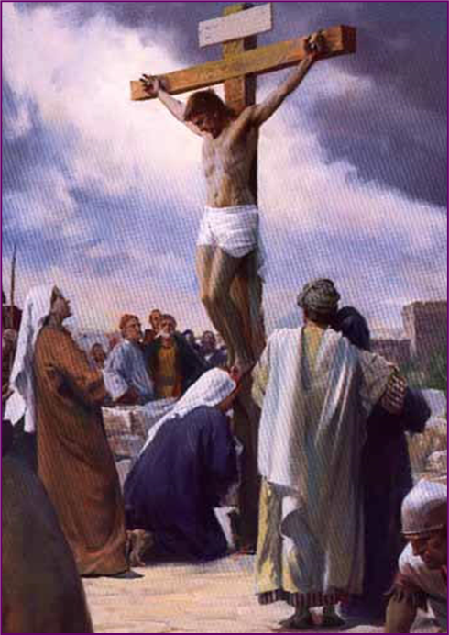
Law & Grace: The Gospel of Substitution & The Gospel of the Kingdom – Part 2
Acts 3:18, 19, “Christ would suffer”

Slide 47
Acts 3:17-21
“¹⁷ And now, brethren, I know that you acted in ignorance, just as your rulers did also. ¹⁸ But the things which God announced beforehand by the mouth of all the prophets, that His Christ would suffer, He has thus fulfilled. ¹⁹ Therefore repent and return, so that your sins may be wiped away, in order that times of refreshing may come from the presence of the Lord; ²⁰ and that He may send Jesus, the Christ appointed for you, ²¹ whom heaven must receive until the period of restoration of all things about which God spoke by the mouth of His holy prophets from ancient time.”

Slide 48
Law & Grace: The Gospel of Substitution & The Gospel of the Kingdom – Part 2
Acts 3:19-21 “send Jesus the Christ”

Slide 49
Acts 3:17-21
“¹⁷ And now, brethren, I know that you acted in ignorance, just as your rulers did also. ¹⁸ But the things which God announced beforehand by the mouth of all the prophets, that His Christ would suffer, He has thus fulfilled. ¹⁹ Therefore repent and return, so that your sins may be wiped away, in order that times of refreshing may come from the presence of the Lord; ²⁰ and that He may send Jesus, the Christ appointed for you, ²¹ whom heaven must receive until the period of restoration of all things about which God spoke by the mouth of His holy prophets from ancient time.”

Slide 50
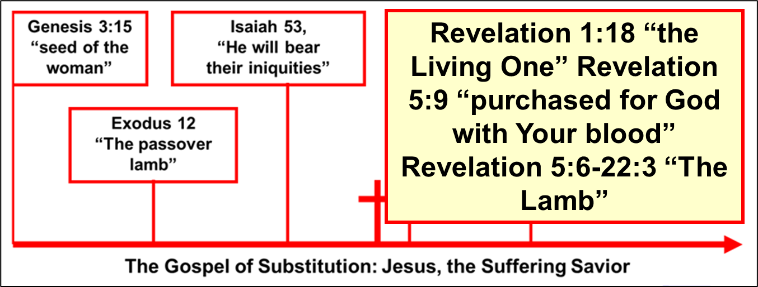
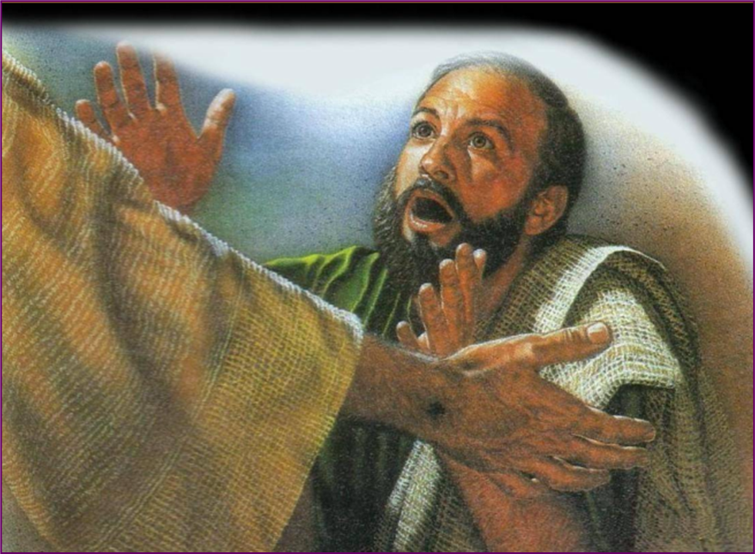
Law & Grace: The Gospel of Substitution & The Gospel of the Kingdom – Part 2

Slide 51
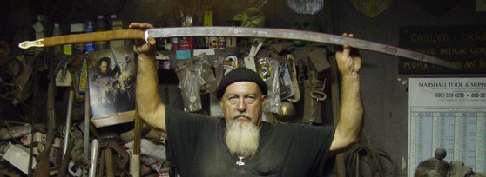
Law & Grace: The Gospel of Substitution & The Gospel of the Kingdom – Part 2

Slide 52
Session 42 Outline
Review
Purpose, Aim, and Objective
Session 41
The Gospel of Substitution & the Gospel of the Kingdom – Part 2
Contrasts and Comparisons
Concluding Observations

Slide 53
Law & Grace: The Gospel of Substitution & The Gospel of the Kingdom – Part 2
Two Charts
1
2

Slide 54
Law and Grace: An Overview Jim McGowan, Th.D. Sugar Land Bible Church 03-31-2024
…but grace and truth were realized through Jesus Christ - John 1:17
For the Law was given through Moses…
Special thanks to Dr. Vern Peterman for access to his insights and resources.

