Slide 1
Jim McGowan, Th.D. Sugar Land Bible Church

Slide 2
Introductory Comments

Slide 3
THE FIVE SOLAS The Essentials of the Historic Christian Faith

Slide 4
Basic Definitions
ORTHODOX DOCTRINE – Orthodox means “correct teaching” and generally refers to the essentials of the historic Christian faith.
CULT – A deviation from orthodoxy (correct teaching).
HERESY – A denial of orthodoxy (correct teaching). “Heresy,” refers to false teachings that are destructive because they overturn the basic elements which make up the historic Christian faith, substituting in their place doctrines which distort or contradict the teachings found in the Bible.
ABERRANT – a doctrine that does not overtly deny basic biblical theology but is dangerously inconsistent with orthodoxy (correct teaching). A group may be orthodox in its central theology while at the same time maintain teachings and practices that are clearly at odds with essential Christian theology.

Slide 5
What is Calvinism?
Calvinism can for all intents and purposes can be divided up into 3 general categories:
“HFHE” – Hyper / False / High / Extreme Calvinism
“Normal” Calvinism also known as “Reformed Theology.”
“Moderate” Calvinism

Slide 6
What is Calvinism?
All forms of Calvinism takes their name from John Calvin (1509–1564). Today the term “Calvinism” is essentially synonymous with “Reformed Theology.”
All branches of Calvinism hold to the “Five Points of Calvinism”, with the exception of Moderate Calvinism, which alters various points.
The “Five Points of Calvinism” originated at the *Synod of Dort (1619), 55 years after the death of John Calvin!
* Synod – Church or Ecclesiastical Council

Slide 7
Notes:
Dead - held captive and blind - unable to respond to God. – But death in the Bible always means a separation.
Election guarantees salvation – but clearly, election alone does not result in salvation of people – they must hear about the death, burial, and resurrection of Christ and exercise faith in those facts to be saved.
Christ only died for the elect – but - the death of Christ pays for all the sins of all people. But not one individual has his own account settled until he believes
God’s grace is irresistible, so the unbeliever’s will is overwhelmed – but grace can be resisted…
A true believer will persist without failure in good works – but – the bible commands good works of the believer.

Slide 8
What is HFHE Calvinism?

Slide 9
What is HFHE Calvinism ?
HFHE Calvinism denies any universal command to believe because they say, Christ purchased faith for the elect, thus removing the one condition of salvation for them.
HFHE Calvinism denies any need for faith or a universal call of the gospel because ultimately unbelief is not a condemnatory sin.
HFHE Calvinism teaches that even if the elect do not believe, they will still be saved since Christ died for their unbelief.
HFHE Calvinism teaches “Double Predestination” that God actively decrees damnation of some and salvation for some. Man has no say and no part in this decree.

Slide 10
What is HFHE Calvinism ?
“There were no missionary societies among the Particular Baptists and no real missionary interest either. When Carey advocated whether the command given to the apostles to teach all nations was not obligatory on all succeeding ministers at a ministers' meeting, one Dr. Ryland shouted, "Young man, sit down: when God pleases to covert the heathen, He will do it without your aid or mine."
“Father of modern missions."
https://www.wholesomewords.org/missions/bcarey1.html - accessed on 03-22-2024

Slide 11
Is HFHE Calvinism Biblical?

Slide 12
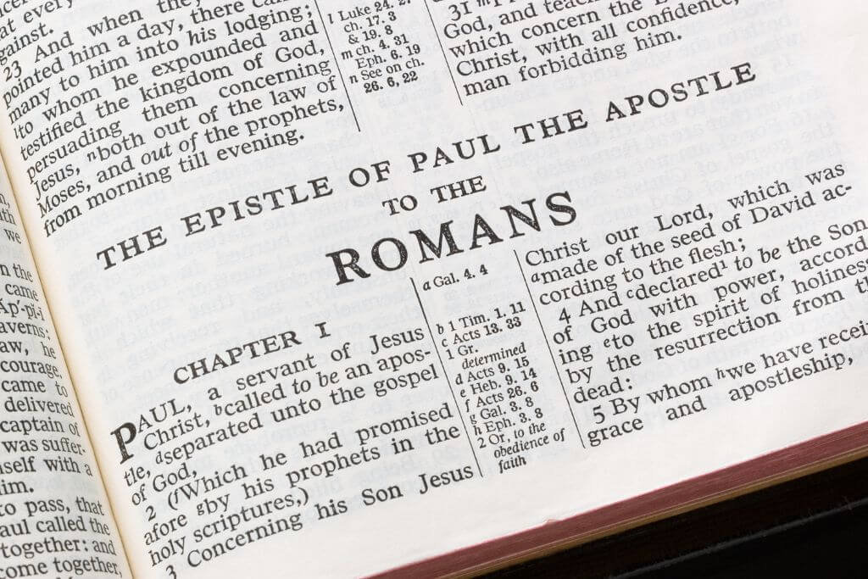
Is HFHE Calvinism biblical? Two Important Themes in the Book of Romans.
The first theme is the ‘righteousness of God’.
The second theme is that of ‘the wrath of God’.

Slide 13
Is HFHE Calvinism biblical? Two Important Themes in the Book of Romans.
The first theme is the ‘righteousness of God’.
It is the biblical facts regarding the gospel message itself that reveals God's righteousness (Romans 1:16-17).

Slide 14
Is HFHE Calvinism biblical? Two Important Themes in the Book of Romans.
The first theme is the ‘righteousness of God’.
It is the biblical facts within the gospel message that once believed, makes a man righteous before God (Romans 4-5). Biblical Facts + Faith in the Facts = Results in righteous standing before God.

Slide 15
GOD’S PROMISES TRAIN

Slide 16
William R. Newell
Justification, or declaring-righteous, therefore, is the reckoning by God to a believing sinner of the whole value of the infinite work of Christ on the cross; and, further, His connecting this believing sinner with the Risen Christ in glory, giving him the same acceptance before Himself as has Christ: so that the believer is now “the righteousness of God in Him” (Christ).
Newell, W. R. (n.d.). Romans Verse-by-Verse (p. 111). Christian Classics Ethereal Library.

Slide 17
Is HFHE Calvinism biblical? Two Important Themes in the Book of Romans.
The first theme is the ‘righteousness of God’.
It is “Jesus Christ” the central figure of the gospel message, Whose transferred righteousness, enables a man to walk in righteousness (Romans 6-7).

Slide 18
Romans 6:11, 13
¹¹ Even so consider yourselves to be dead to sin, but alive to God in Christ Jesus.…¹³ and do not go on presenting the members of your body to sin as instruments of unrighteousness; but present yourselves to God…and your members as instruments of righteousness to God.

Slide 19
Romans 7:4
Therefore, my brethren, you also were made to die to the Law through the body of Christ, so that you might be joined to another, to Him who was raised from the dead, in order that we might bear fruit for God.

Slide 20
Is HFHE Calvinism biblical? Two Important Themes in the Book of Romans.
The first theme is the ‘righteousness of God’.
It is an understanding of the biblical facts concerning the gospel message that encourages man to live in a righteous manner (Romans 12).

Slide 21
Romans 12:1
¹ Therefore I urge you, brethren, by the mercies of God, to present your bodies a living and holy sacrifice, acceptable to God, which is your spiritual service of worship. ² And do not be conformed to this world, but be transformed by the renewing of your mind, so that you may prove what the will of God is, that which is good and acceptable and perfect.

Slide 22
Is HFHE Calvinism biblical? Two Important Themes in the Book of Romans.
The second theme is that of ‘ the wrath of God’.
God's wrath has been revealed—and is being revealed—against all sinful actions (Romans 1:18).

Slide 23
Is HFHE Calvinism biblical? Two Important Themes in the Book of Romans.
The second theme is that of ‘ the wrath of God’.
Mankind knows about God, but rejects God in their thinking and in their actions (Romans 1:21-22).

Slide 24
Albert Camus Atheist, Leftist, Libertarian, Socialist November 7, 1913 – January 4, 1960
Camus was anti-Christianity and was committed to ‘individual moral freedom and responsibility’. His philosophy was that ‘Life’ is void of meaning and man's inability to know that meaning if it were to exist — is something that man should embrace!

Slide 25
Is HFHE Calvinism biblical? Two Important Themes in the Book of Romans.
The second theme is that of ‘ the wrath of God’.
The wrath of God, therefore, is the giving over of man to live his life as he chooses* (Romans 1:24, 26, 28), which apart from God leads to destruction (Romans 1:28-32).
* Camus’ ‘individual moral freedom and responsibility’!

Slide 26
Romans 1:24, 26, 28
²⁴ Therefore God gave them over in the lusts of their hearts to impurity, so that their bodies would be dishonored among them…. ²⁶ For this reason God gave them over to degrading passions; for their women exchanged the natural function for that which is unnatural,… ²⁸ And just as they did not see fit to acknowledge God any longer, God gave them over to a depraved mind, to do those things which are not proper,

Slide 27
Is HFHE Calvinism biblical? Two Important Themes in the Book of Romans.
The second theme is that of ‘ the wrath of God’.
The wrath of God, therefore, is the giving over of man to live his life as he chooses (Romans 1:24, 26, 28), which apart from God leads to destruction (Romans 1:28-32).
* Camus’ ‘individual moral freedom and responsibility’!

Slide 28
Romans 1:29–32
²⁹ being filled with all unrighteousness, wickedness, greed, evil; full of envy, murder, strife, deceit, malice; they are gossips, ³⁰ slanderers, haters of God, insolent, arrogant, boastful, inventors of evil, disobedient to parents, ³¹ without understanding, untrustworthy, unloving, unmerciful; ³² and although they know the ordinance of God, that those who practice such things are worthy of death, they not only do the same, but also give hearty approval to those who practice them.

Slide 29
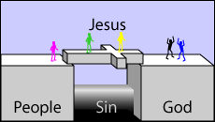
Is HFHE Calvinism biblical? Two Important Themes in the Book of Romans.
The second theme is that of ‘ the wrath of God’.
Man rejects the God of the universe, and God, in turn, gives man over to his evil desires. Man’s self-destructive path ultimately hardens him in sin and only a personal intervention from God can alter that path.

Slide 30
Is HFHE Calvinism biblical? Two Important Themes in the Book of Romans.
HFHE teaches that Romans 9:22 shows that God has made certain vessels for His wrath. But this is not the point of the verse.

Slide 31
Romans 9:22
²² What if God, although willing to demonstrate His wrath and to make His power known, endured with much patience vessels of wrath prepared for destruction?

Slide 32
Is HFHE Calvinism biblical? Two Important Themes in the Book of Romans.
Romans 9:22 is actually teaching that mankind, already under God's wrath, fitted itself for destruction.

Slide 33
Is HFHE Calvinism biblical? Two Important Themes in the Book of Romans.
It is not said that God so fitted them. On the contrary, it is God who endures these vessels—who have prepared themselves for destruction because they would not leave their sin and turn to God.
These vessels never learned to “regard that the patience of our Lord is salvation” (cf. 2 Pet. 3:15; Rom. 9:23) and they became vessels of wrath.

Slide 34
2 Pet. 3:14-15
¹⁴ “Therefore, beloved, since you look for these things, be diligent to be found by Him in peace, spotless and blameless, ¹⁵ and regard the patience of our Lord as salvation; just as also our beloved brother Paul, according to the wisdom given him, wrote to you,…”

Slide 35
Romans 9:22-23
²² What if God, although willing to demonstrate His wrath and to make His power known, endured with much patience vessels of wrath prepared for destruction? ²³ And He did so to make known the riches of His glory upon vessels of mercy, which He prepared beforehand for glory,

Slide 36
Is HFHE Calvinism biblical? Two Important Themes in the Book of Romans.
Notice that God elects certain people beforehand for His glory. In other words, before the foundation of the world God ordained that those who would become His children through faith in Christ, would glorify Him! (see Ephesians 1:4).

Slide 37
Ephesians 1:3-5a
³ “Blessed be the God and Father of our Lord Jesus Christ, who has blessed us with every spiritual blessing in the heavenly places in Christ, ⁴ just as He chose us in Him (Christ) before the foundation of the world, that we would be holy and blameless before Him. In love ⁵ He predestined us to adoption as sons through Jesus Christ…”

Slide 38
Is HFHE Calvinism biblical? Two Important Themes in the Book of Romans.
It does not say that God chose people to damnation or predestined people to wrath. The Bible never speaks about a double predestination where God elects or predestinates some to hell, others to heaven.

Slide 39
Ezekiel 18:23, 32
²³ “Do I have any pleasure in the death of the wicked,” declares the Lord GOD, “rather than that he should turn from his ways and live?... ³² “For I have no pleasure in the death of anyone who dies,” declares the Lord GOD. “Therefore, repent and live.”
Ezekiel 33:11
“Say to them, ‘As I live!’ declares the Lord GOD, ‘I take no pleasure in the death of the wicked, but rather that the wicked turn from his way and live…’

Slide 40
Is HFHE Calvinism biblical? Two Important Themes in the Book of Romans.
Unbelievers are under God's wrath because they willfully reject God.
Believers have the righteousness of God because God has chosen them to be His children, but election alone does not save.

Slide 41
Charles Ryrie Basic Theology: A Popular Systematic Guide to Understanding Biblical Truth (p. 363). Chicago, IL: Moody Press.
To be sure, election assures that those chosen will be saved, but it alone does not save them. People are saved through faith in the substitutionary death of Christ. And, of course, they must learn about the death of Christ somehow in order to have content to their faith. Thus election, the death of Christ, testimony of His death, and personal faith are all necessary in the salvation of an individual. Election alone does not save.

Slide 42
Concluding Comments

Slide 43
Is HFHE Calvinism biblical? HFHE Calvinism Affects Sharing the Gospel
HFHE Calvinism does not believe Christ died for all.
When sharing the gospel to the lost, those who hold to HFHE Calvinism, cannot tell the sinner, “Christ died for you”. They say that only God knows who the elect are so the sinner cannot be told Christ died for him and paid his debt of sin.

Slide 44
Is HFHE Calvinism biblical? HFHE Calvinism Affects Sharing the Gospel
“As a reformed Christian, this writer believes that [Christian] counselors must not tell any unsaved counselee that Christ died for him, for they cannot say that. No man knows except Christ himself who are his elect for whom he died.” Dr. Jay Adams, Competent to Counsel, page 70.

Slide 45
Is HFHE Calvinism biblical? HFHE Calvinism Affects Sharing the Gospel

Slide 46
Is HFHE Calvinism biblical?

Slide 47
References
https://en.wikipedia.org/wiki/Hyper-Calvinism
https://www.gotquestions.org/double-predestination.html
http://www.middletownbiblechurch.org/doctrine/4whom18.htm
Lightner, R. P. (1998). The Death Christ Died: A Biblical Case for Unlimited Atonement. Grand Rapids, MI: Kregel Publications.
Enns, P. P. (1989). The Moody Handbook of Theology. Chicago, IL: Moody Press.

