Slide 1
Genesis 12‒50
Israel’s Birth & Preservation

Slide 2
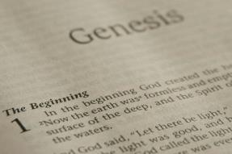
GENESIS STRUCTURE
Genesis 12-50 (four people)
Abraham (12:1–25:11)
Isaac (25:12–26:35)
Jacob (27–36)
Joseph (37–50)

Slide 3
Genesis 37:2-36 Joseph Sold unto Egypt
Joseph’s coat (37:2-4)
Joseph’s dreams (37:5-11)
Joseph’s pit (37:12-24)
Joseph’s enslavement (37:25-36)

Slide 4
Genesis 38:1-30 Judah & Tamar
Tamar & Judah’s sons (38:1-11)
Tamar & Judah (38:12-26)
Tamar & Judah’s twins (38:27-30)

Slide 5
Genesis 39:1-23 Joseph in Potiphar's House
Blessing (39:1-6)
Temptation & Accusation (39:7-18)
Prison (39:19-23)

Slide 6
Genesis 39:1-23 Joseph in Potiphar's House
Blessing (39:1-6)
Temptation & Accusation (39:7-18)
Prison (39:19-23)

Slide 7
I. Genesis 39:1-6 Blessing
Purchase of Joseph (1)
Blessing of Joseph (2)
Promotion of Joseph (3-4)
Blessing to Potiphar (5)
Joseph’s control (6a)
Joseph’s attractiveness (6b)

Slide 8
I. Genesis 39:1-6 Blessing
Purchase of Joseph (1)
Blessing of Joseph (2)
Promotion of Joseph (3-4)
Blessing to Potiphar (5)
Joseph’s control (6a)
Joseph’s attractiveness (6b)

Slide 9
Genesis 39:1 Purchase of Joseph
Journey (1a)
Buyer (1b)

Slide 10
Genesis 39:1 Purchase of Joseph
Journey (1a)
Buyer (1b)

Slide 12
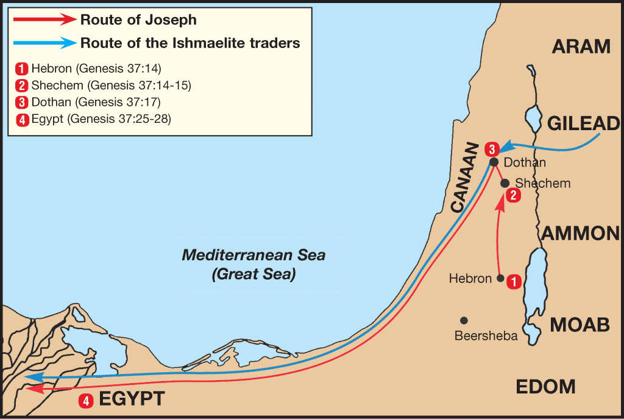

Slide 13
Genesis 39:1 Purchase of Joseph
Journey (1a)
Buyer (1b)

Slide 14
Genesis 12‒25 Abraham’s Early Journeys
Unconditional promises (Gen. 12:1-3) From Haran to Canaan (Gen. 12:4-5) In Canaan (Gen. 12:6-9) In Egypt (Gen. 12:10-20) Abram and Lot Separate (Gen. 13:1-13) Reaffirmation of Abram’s promises (Gen. 13:14-18) Abram Rescues Lot (14:1-24) Abrahamic Covenant (15:1-21) Hagar & Ishmael (16:1-16) Circumcision (Gen. 17:1-27) | Sodom & Gomorrah (Gen. 18‒19) Abraham & Abimelech (Gen. 20) Isaac’s birth (Gen. 21:1-7) Ishmael’s expulsion (21:8-21) Abraham & Abimelech’s covenant (21:22-34) Abraham sacrifices Isaac (22) Sarah’s death (23) Isaac’s marriage (24) Abraham & Keturah (25:1-6) Abraham’s death (25:7-11)

Slide 15
Dr. Arnold G. Fruchtenbaum
The Book of Genesis, 537
“There is an interchange of terminology between the Ishmaelites and Midianites, and those two nationalities were often connected together (Judg. 8:22–26). They were allies, and Midianites were eventually absorbed by the Ishmaelites.”

Slide 16
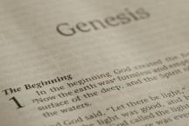
Beginning Themes
Universe Life Man Marriage Evil Clothing | Religion Salvation Language Government Nations Israel
Morris, Genesis Record, 18-20

Slide 17
I. Genesis 39:1-6 Blessing
Purchase of Joseph (1)
Blessing of Joseph (2)
Promotion of Joseph (3-4)
Blessing to Potiphar (5)
Joseph’s control (6a)
Joseph’s attractiveness (6b)

Slide 18
Genesis 39:2 Joseph’s Blessing
Source (2a)
Result (2b)
Place (2c)

Slide 19
Genesis 39:2 Joseph’s Blessing
Source (2a)
Result (2b)
Place (2c)

Slide 20
John 14:16-17
¹⁶ I will ask the Father, and He will give you another Helper, that He may be with you forever; ¹⁷ that is the Spirit of truth, whom the world cannot receive, because it does not see Him or know Him, but you know Him because He abides with you and will be in you.

Slide 21
Genesis 39:2 Joseph’s Blessing
Source (2a)
Result (2b)
Place (2c)

Slide 22
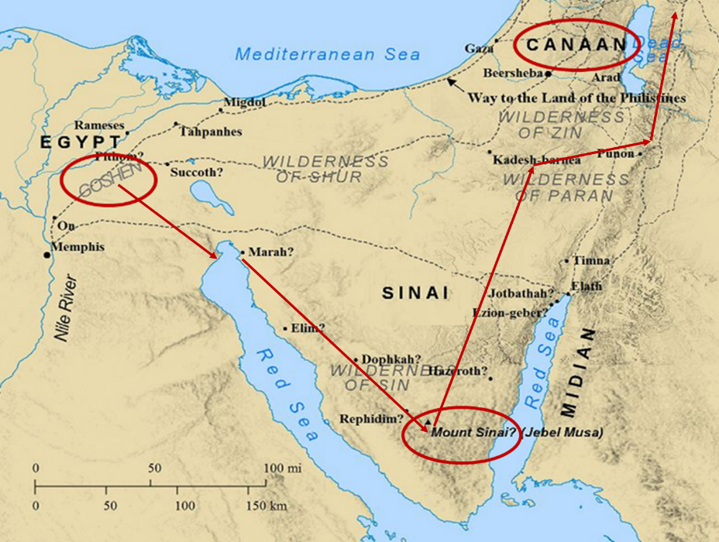

Slide 23
Genesis 39:2 Joseph’s Blessing
Source (2a)
Result (2b)
Place (2c)

Slide 24
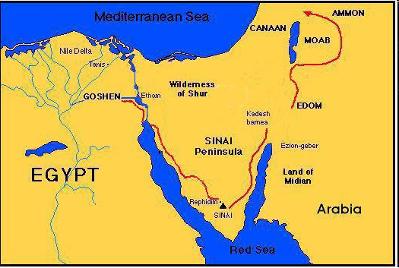

Slide 25
I. Genesis 39:1-6 Blessing
Purchase of Joseph (1)
Blessing of Joseph (2)
Promotion of Joseph (3-4)
Blessing to Potiphar (5)
Joseph’s control (6a)
Joseph’s attractiveness (6b)

Slide 26
Genesis 39:3-4 Joseph’s Promotion
Potiphar’s observation (3)
Potiphar’s promotion (4)

Slide 27
Genesis 39:3-4 Joseph’s Promotion
Potiphar’s observation (3)
Potiphar’s promotion (4)

Slide 28
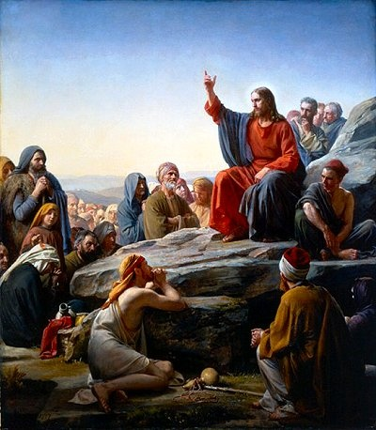
Matt 5:13, 16
“You are the light of the world. A city set on a hill cannot be hidden…Let your light shine before men in such a way that they may see your good works, and glorify your Father who is in heaven.”

Slide 29
Genesis 39:3-4 Joseph’s Promotion
Potiphar’s observation (3)
Potiphar’s promotion (4)

Slide 30
I. Genesis 39:1-6 Blessing
Purchase of Joseph (1)
Blessing of Joseph (2)
Promotion of Joseph (3-4)
Blessing to Potiphar (5)
Joseph’s control (6a)
Joseph’s attractiveness (6b)

Slide 31
8 New Promises Genesis 12:1-3
Land (Gen. 12:1b)
Great nation (Gen. 12:2a)
Personal blessing (Gen. 12:2b)
Great name (Gen. 12:2c)
Blessing to others (Gen. 12:2d)
Blessing to blessers (Gen. 12:3a)
Cursing to cursers (Gen. 12:3b)
Blessing to the world (Gen. 12:3c)

Slide 32
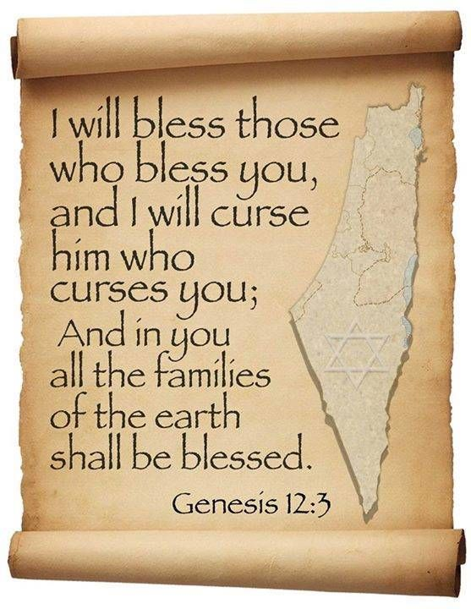
Genesis 12:3
“And I will bless those who bless you, And the one who curses you I will curse. And in you all the families of the earth will be blessed.”

Slide 33
I. Genesis 39:1-6 Blessing
Purchase of Joseph (1)
Blessing of Joseph (2)
Promotion of Joseph (3-4)
Blessing to Potiphar (5)
Joseph’s control (6a)
Joseph’s attractiveness (6b)

Slide 34
I. Genesis 39:1-6 Blessing
Purchase of Joseph (1)
Blessing of Joseph (2)
Promotion of Joseph (3-4)
Blessing to Potiphar (5)
Joseph’s control (6a)
Joseph’s attractiveness (6b)

Slide 35
2 Cor. 4:16
“Therefore, we do not lose heart, but though our outer man is decaying, yet our inner man is being renewed day by day.”

Slide 36
Genesis 39:1-23 Joseph in Potiphar's House
Blessing (39:1-6)
Temptation & Accusation (39:7-18)
Prison (39:19-23)

Slide 37
II. Genesis 39:7-18 Temptation & Accusation
Proposition (7)
Refusal (8-9)
Persistence & refusal (10a)
Sexual harassment (11-12)
Wife’s accusations (13-18)

Slide 38
II. Genesis 39:7-18 Temptation & Accusation
Proposition (7)
Refusal (8-9)
Persistence & refusal (10a)
Sexual harassment (11-12)
Wife’s accusations (13-18)

Slide 39
II. Genesis 39:7-18 Temptation & Accusation
Proposition (7)
Refusal (8-9)
Persistence & refusal (10a)
Sexual harassment (11-12)
Wife’s accusations (13-18)

Slide 40
Genesis 39:8-9 Refusal
Refusal (8a)
Reasons (8b-9)

Slide 41
Genesis 39:8-9 Refusal
Refusal (8a)
Reasons (8b-9)

Slide 42
Genesis 39:8-9 Refusal
Refusal (8a)
Reasons (8b-9)

Slide 43
Genesis 39:8b-9 Reasons
Betrayal of Potiphar (8b-9a)
Betrayal of God (9b)

Slide 44
Genesis 39:8b-9 Reasons
Betrayal of Potiphar (8b-9a)
Betrayal of God (9b)

Slide 45
Genesis 39:8b-9 Reasons
Betrayal of Potiphar (8b-9a)
Betrayal of God (9b)

Slide 46
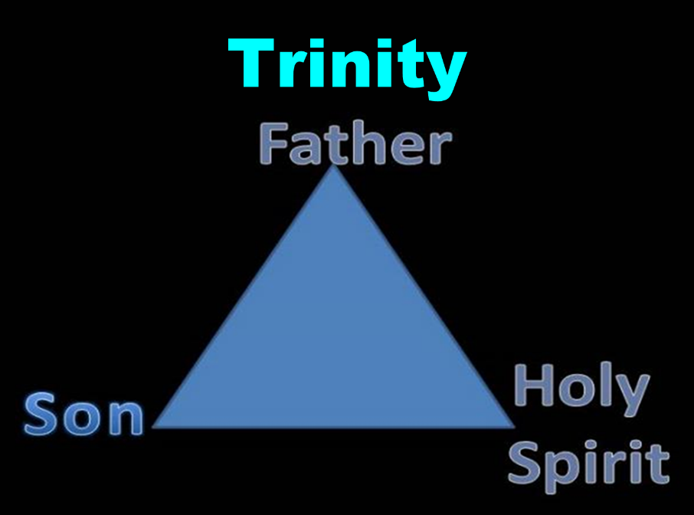

Slide 47
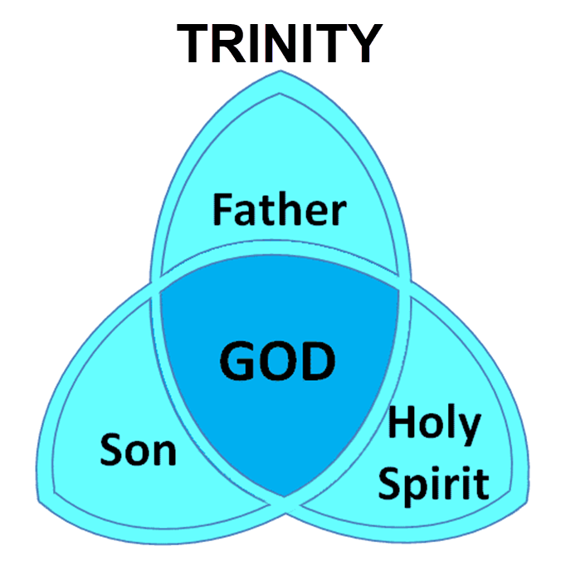

Slide 48
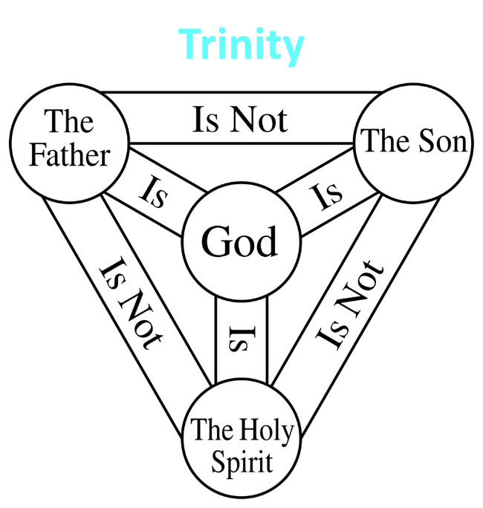

Slide 49
Genesis 39:8b-9 Reasons
Betrayal of Potiphar (8b-9a)
Betrayal of God (9b)

Slide 50
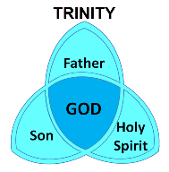
1 Corinthians 6:19
“Or do you not know that your body is a temple of the Holy Spirit who is in you, whom you have from God, and that you are not your own?”

Slide 51
Ephesians 4:30
“Do not grieve the Holy Spirit of God, by whom you were sealed for the day of redemption.”

Slide 52
Westminster Shorter Catechism Q and A #1
Q: What is the chief end of man?
A; Man’s chief end is to gloriy God and enjoy Him forever.

Slide 53
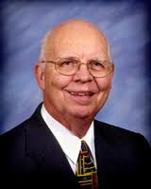
VII. Purposes of the Local Church
Glorify God (Eph 3:21)
Edify the saints (Eph 4:11-16)
Fulfill the Great Commission (Matt 28:18-20)

Slide 54
VII. Purposes of the Local Church
Glorify God (Eph 3:21)
Edify the saints (Eph 4:11-16)
Fulfill the Great Commission (Matt 28:18-20)

Slide 55
Dispensational Theology is a System of Theology
Traditional-normative dispensational theology is a system that embodies three essential, fundamental concepts called the sine qua non (lit. “without which is not”):
The consistent use of a plain, normal, literal, grammatical-historical method of interpretation;
Which reveals that the Church is distinct from Israel;
God’s overall purpose is to bring glory to Himself (Eph. 1:6, 12, 14).
Dr. Charles Ryrie, Dispensationalism, pp. 38-41

Slide 56
Dispensational Theology: Doxological Purpose
God’s ultimate purpose for the ages is to glorify Himself. Scripture is not human-centered, as though salvation were the principle point, but God-centered, because His glory is at the center.
The glory of God is the primary principle that unifies all dispensations, the program of salvation being just one of the means by which God glorifies Himself. Each successive revelation of God’s plan for the ages, as well as His dealing with the elect, non-elect, angels, and nations all manifest His glory.
Dictionary of Premillennial Theology, Charles Ryrie, p. 94

Slide 58
Ephesians 3:21
“to Him be the glory in the church and in Christ Jesus to all generations forever and ever. Amen.”

Slide 59
II. Genesis 39:7-18 Temptation & Accusation
Proposition (7)
Refusal (8-9)
Persistence & refusal (10a)
Sexual harassment (11-12)
Wife’s accusations (13-18)

Slide 60
Genesis 39:10 Persistence & Refusal
Persistence (10a)
Refusal (10b)

Slide 61
Genesis 39:10 Persistence & Refusal
Persistence (10a)
Refusal (10b)

Slide 62
Genesis 39:10 Persistence & Refusal
Persistence (10a)
Refusal (10b)

Slide 63
II. Genesis 39:7-18 Temptation & Accusation
Proposition (7)
Refusal (8-9)
Persistence & refusal (10a)
Sexual harassment (11-12)
Wife’s accusations (13-18)

Slide 64
Genesis 39:11-12 Sexual Harassment
Circumstances (11)
Actions (12)

Slide 65
Genesis 39:11-12 Sexual Harassment
Circumstances (11)
Actions (12)

Slide 66
Genesis 39:11-12 Sexual Harassment
Circumstances (11)
Actions (12)

Slide 67
Genesis 39:12 Actions
Potiphar’s Wife (12a)
Joseph (12b)

Slide 68
Genesis 39:12 Actions
Potiphar’s Wife (12a)
Joseph (12b)

Slide 69
Genesis 39:12 Actions
Potiphar’s Wife (12a)
Joseph (12b)

Slide 70
II. Genesis 39:7-18 Temptation & Accusation
Proposition (7)
Refusal (8-9)
Persistence & refusal (10a)
Sexual harassment (11-12)
Wife’s accusations (13-18)

Slide 71
Genesis 39:13-18 Wife’s Accusations
Evidence (13)
Accusations (14-18)

Slide 72
Genesis 39:13-18 Wife’s Accusations
Evidence (13)
Accusations (14-18)

Slide 73
Genesis 39:13-18 Wife’s Accusations
Evidence (13)
Accusations (14-18)

Slide 74
Genesis 39:14-18 Accusations
To the servants (14-15)
To Potiphar (16-18)

Slide 75
Genesis 39:14-18 Accusations
To the servants (14-15)
To Potiphar (16-18)

Slide 76
Genesis 39:14-18 Accusations
To the servants (14-15)
To Potiphar (16-18)

Slide 77
Genesis 39:1-23 Joseph in Potiphar's House
Blessing (39:1-6)
Temptation & Accusation (39:7-18)
Prison (39:19-23)

Slide 78
III. Genesis 39:19-23 Prison
Potiphar’s action (19-20)
Joseph’s blessing in prison (21-23)

Slide 79
III. Genesis 39:19-23 Prison
Potiphar’s action (19-20)
Joseph’s blessing in prison (21-23)

Slide 80
Genesis 39:19-20 Potiphar’s Action
Anger (19)
Action (20)

Slide 81
Genesis 39:19-20 Potiphar’s Action
Anger (19)
Action (20)

Slide 82
Genesis 39:19-20 Potiphar’s Action
Anger (19)
Action (20)

Slide 83
Dr. Arnold G. Fruchtenbaum
The Book of Genesis, 554
“…in verse 20, came the imprisonment: And Joseph’s master took him, and put him into the prison; this prison was where the king’s prisoners were bound; this was the royal prison. There is more than one Hebrew word for prison, and the term used here is a word that is found only in Genesis chapters 39 and 40. It is actually an Egyptian loan word, and it has the meaning of a royal prison. Potiphar was an officer of Pharaoh’s and so this was actually under his authority.”

Slide 84
III. Genesis 39:19-23 Prison
Potiphar’s action (19-20)
Joseph’s blessing in prison (21-23)

Slide 85
Genesis 39:21-23 Joseph’s Blessing in Prison
Relation to the prison keeper (21)
Joseph’s elevation (22)
Joseph’s control (23)

Slide 86
Genesis 39:21-23 Joseph’s Blessing in Prison
Relation to the prison keeper (21)
Joseph’s elevation (22)
Joseph’s control (23)

Slide 87
Genesis 39:21 Accusations
Source (21a)
Result (21b)

Slide 88
Genesis 39:21 Accusations
Source (21a)
Result (21b)

Slide 89
Genesis 39:21 Accusations
Source (21a)
Result (21b)

Slide 90
Genesis 39:21-23 Joseph’s Blessing in Prison
Relation to the prison keeper (21)
Joseph’s elevation (22)
Joseph’s control (23)

Slide 91
Genesis 39:21-23 Joseph’s Blessing in Prison
Relation to the prison keeper (21)
Joseph’s elevation (22)
Joseph’s control (23)

Slide 92
Conclusion

Slide 93
Genesis 39:1-23 Joseph in Potiphar's House
Blessing (39:1-6)
Temptation & Accusation (39:7-18)
Prison (39:19-23)

Slide 94
²⁴ The Lord bless you, and keep you; ²⁵ The Lord make His face shine on you, And be gracious to you; ²⁶ The Lord lift up His countenance on you, And give you peace.
Numbers 6:24–26 (NASB95)

