Slide 1
Dr. Andy Woods
Senior Pastor – Sugar Land Bible Church
President – Chafer Theological Seminary

Slide 2
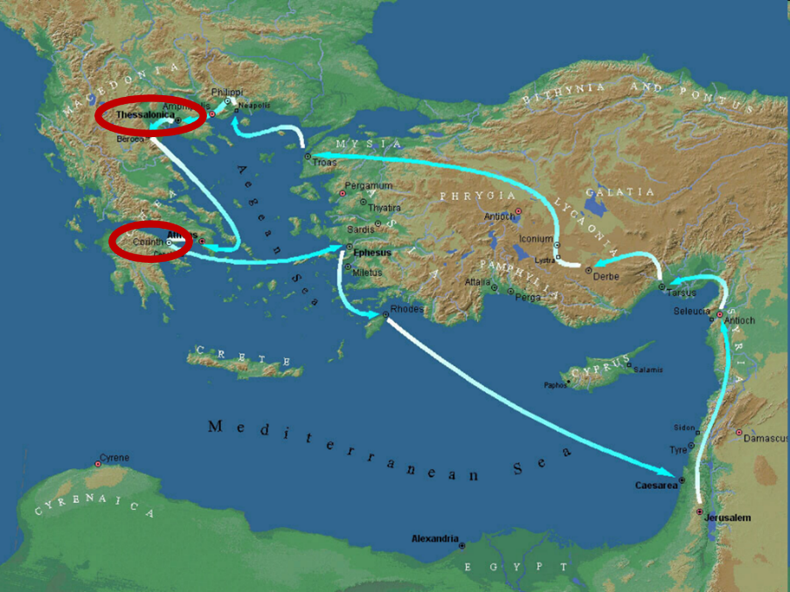

Slide 3
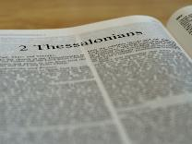
2 Thessalonians 2:1-12
Problem (2:1-2)
Prerequisites for the Day of the Lord (2:3-12)
The departure (2:3a)
Advent of the lawless one (2:3b-4)
Removal of the restrainer (2:5-7)
Destruction of the lawless one (2:8-9)
Destruction of lawless one’s followers (2:10-12)

Slide 4
2 Thessalonians 2:2
“that you not be quickly shaken from your composure or be disturbed either by a spirit or a message or a letter as if from us, to the effect that the day of the Lord [the Tribulation] has come.”

Slide 5
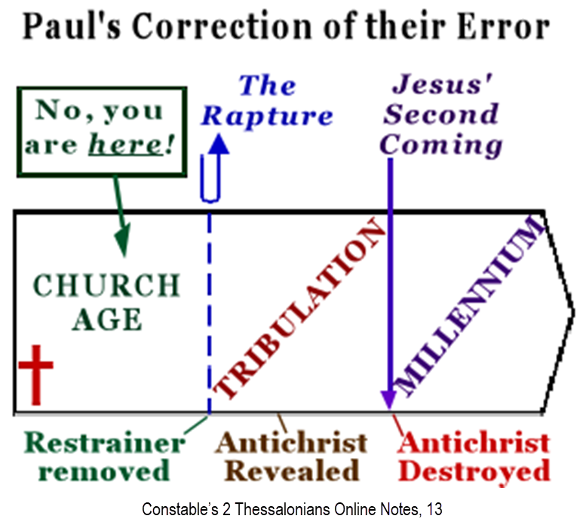

Slide 7
2 Thessalonians 2:1-12
Problem (2:1-2)
Prerequisites for the Day of the Lord (2:3-12)
The departure (2:3a)
Advent of the lawless one (2:3b-4)
Removal of the restrainer (2:5-7)
Destruction of the lawless one (2:8-9)
Destruction of lawless one’s followers (2:10-12)

Slide 8
2 Thessalonians 2:1-12
Problem (2:1-2)
Prerequisites for the Day of the Lord (2:3-12)
The departure (2:3a)
Advent of the lawless one (2:3b-4)
Removal of the restrainer (2:5-7)
Destruction of the lawless one (2:8-9)
Destruction of lawless one’s followers (2:10-12)

Slide 9
2 Thessalonians 2:1-12
Problem (2:1-2)
Prerequisites for the Day of the Lord (2:3-12)
The departure (2:3a)
Advent of the lawless one (2:3b-4)
Removal of the restrainer (2:5-7)
Destruction of the lawless one (2:8-9)
Destruction of lawless one’s followers (2:10-12)

Slide 10
2 Thessalonians 2:1-12
Problem (2:1-2)
Prerequisites for the Day of the Lord (2:3-12)
The departure (2:3a)
Advent of the lawless one (2:3b-4)
Removal of the restrainer (2:5-7)
Destruction of the lawless one (2:8-9)
Destruction of lawless one’s followers (2:10-12)

Slide 11
2 Thessalonians 2:1-12
Problem (2:1-2)
Prerequisites for the Day of the Lord (2:3-12)
The departure (2:3a)
Advent of the lawless one (2:3b-4)
Removal of the restrainer (2:5-7)
Destruction of the lawless one (2:8-9)
Destruction of lawless one’s followers (2:10-12)

Slide 12
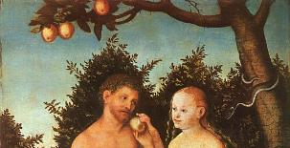
2 Thessalonians 2:9
“that is, the one whose coming is in accord with the activity of Satan, with all power and signs and false wonders.”

Slide 13
Antichrist’s Satanic Miracles (2 Thessalonians 2:9)
MIRACLE | GREEK | CHRIST’S MINISTRY
Powers | Dynamis | Matt. 11:20
Signs | Sēmeion | John 20:30
Wonders | Teras | Acts 2:22

Slide 14
How Satan Imitates God and the Antichrist Imitates Jesus Christ
NO. | CATEGORY | JESUS CHRIST | ANTICHRIST
1. | World prepared in advance | Gal. 4:4 | 2 Thess. 2:7
2. | Revealed at the proper time | Gal. 4:4 | 2 Thess. 2:6
3. | Claim of deity | John 14:9 | 2 Thess. 2:4
4. | Heralded by a forerunner | John 1:23 | Rev. 13:12
5. | Forerunner comes in the Spirit and power of Elijah | Luke 1:17 | 1 Kgs. 8:37-38; Rev. 13:13
6. | Empowered by a higher source | 1 Cor. 6:14 | Rev. 13:4
7. | Member of a Trinity | Phil. 1:2; Acts 5:3-4; John 14:9 | Rev. 16:13; 20:10
8. | Head of a Church | Eph. 5:23 | Rev. 2:9; 3:9
9. | Miracle worker | Acts 2:22 | 2 Thess. 2:9
10. | Resurrection from the dead | 1 Cor. 15:3-6 | Rev. 13:3, 12, 14
11. | Given a throne | Rev. 3:21 | Rev. 13:2

Slide 15
How Satan Imitates God and the Antichrist Imitates Jesus Christ
NO. | CATEGORY | JESUS CHRIST | ANTICHRIST
12. | Ruling a political kingdom | Isa. 9:6-7 | Rev. 13:5
13. | Ushering in world peace | Isa. 9:6-7 | Rev. 6:1-4
14. | Activity in the Temple | Luke 2:41-50 | 2 Thess. 2:4
15. | Putting an end to animal sacrifices | Heb. 9:26-29 | Dan. 9:27
16. | Length of ministry | Over 3 years | Rev. 13:5
17. | Sealing ministry | Eph. 4:30 | Rev. 13:16-17
18. | Presentation to Israel as her Messiah | John 1:11 | John 5:43
19. | Covenant with Israel | Gen. 15:18 | Dan. 9:27
20. | Reception of worship | Zech. 14:16 | 2 Thess. 2:4
21. | Establishing Jerusalem as the center of worldwide worship | Zech. 14:17 | 2 Thess. 2:4

Slide 16
1 John 2:18
“Children, it is the last hour; and just as you heard that antichrist is coming, even now many antichrists have appeared; from this we know that it is the last hour.”

Slide 17
1 John 4:3
“and every spirit that does not confess Jesus is not from God; this is the spirit of the antichrist, of which you have heard that it is coming, and now it is already in the world.”

Slide 18
2 Thessalonians 2:6-7
⁶And you know what restrains [τὸ κατέχον; neuter] him now, so that in his time he will be revealed. ⁷For the mystery of lawlessness is already at work; only he who now restrains [ὁ κατέχων; masculine] will do so until he is taken out of the way.

Slide 19
Test the Spirits
Deut. 13:1-5
Isa. 8:19-20
Acts 17:11
Gal. 1:8-9
1 Thess. 5:20-21
1 John 4:1
Rev. 2:2

Slide 20
Test the Spirits
Deut. 13:1-5
Isa. 8:19-20
Acts 17:11
Gal. 1:8-9
1 Thess. 5:20-21
1 John 4:1
Rev. 2:2

Slide 21
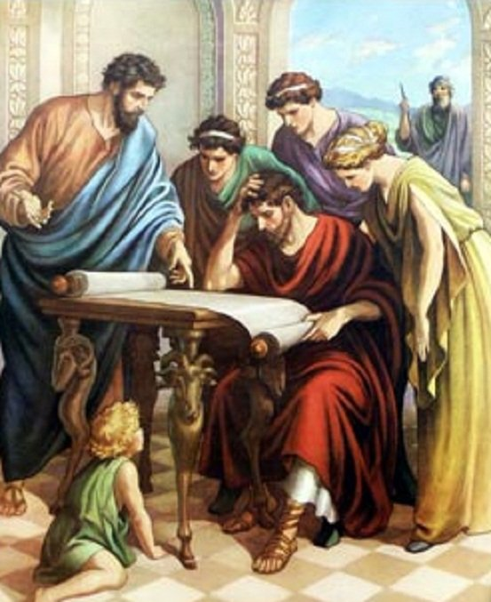
Acts 17:11
“Now these were more noble-minded than those in Thessalonica, for they received the word with great eagerness, examining the Scriptures daily to see whether these things were so.”

Slide 22
Test the Spirits
Deut. 13:1-5
Isa. 8:19-20
Acts 17:11
Gal. 1:8-9
1 Thess. 5:20-21
1 John 4:1
Rev. 2:2

Slide 23
Galatians 1:6–9
⁶ I am amazed that you are so quickly deserting Him who called you by the grace of Christ, for a different gospel; ⁷ which is really not another; only there are some who are disturbing you and want to distort the gospel of Christ. ⁸ But even if we, or an angel from heaven, should preach to you a gospel contrary to what we have preached to you, he is to be accursed! ⁹ As we have said before, so I say again now, if any man is preaching to you a gospel contrary to what you received, he is to be accursed!

Slide 24
Test the Spirits
Deut. 13:1-5
Isa. 8:19-20
Acts 17:11
Gal. 1:8-9
1 Thess. 5:20-21
1 John 4:1
Rev. 2:2

Slide 25
Test the Spirits
Deut. 13:1-5
Isa. 8:19-20
Acts 17:11
Gal. 1:8-9
1 Thess. 5:20-21
1 John 4:1
Rev. 2:2

Slide 26
1 John 4:1
“Beloved, do not believe every spirit, but test the spirits to see whether they are from God, because many false prophets have gone out into the world.”

Slide 27
Test the Spirits
Deut. 13:1-5
Isa. 8:19-20
Acts 17:11
Gal. 1:8-9
1 Thess. 5:20-21
1 John 4:1
Rev. 2:2

Slide 28
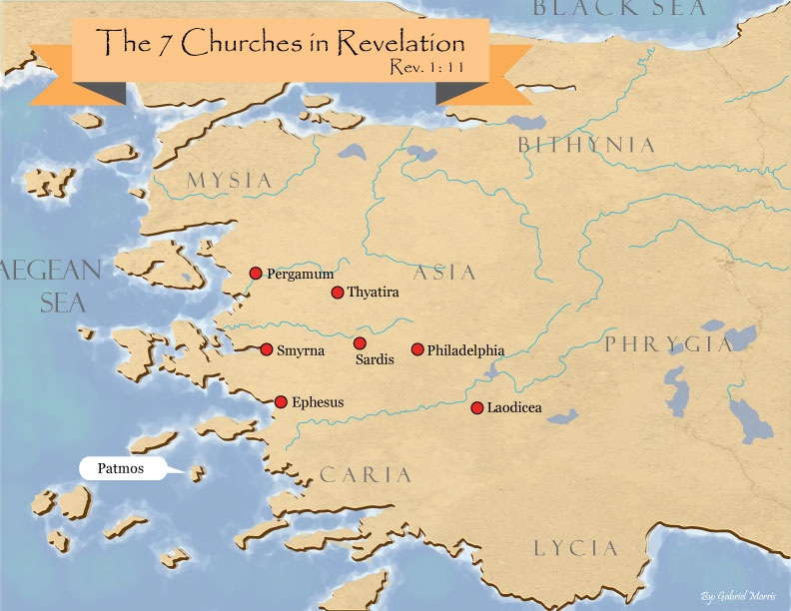

Slide 29
Revelation 2:2
‘I know your deeds and your toil and perseverance, and that you cannot tolerate evil men, and you put to the test [peirázō] those who call themselves apostles, and they are not, and you found them to be false;

Slide 30
Jude 3
“Beloved, while I was making every effort to write you about our common salvation, I felt the necessity to write to you appealing that you contend earnestly for the faith that was once for all time handed down to the saints.”

Slide 31
Limits of Orthodoxy
Deut 13:1-5;
Prov 30:6;
Acts 17:11;
Gal. 1:6-9;
1 Thess 5:21;
2 Pet 3:16;
Rev 2:2; 22:18-19

Slide 32
Limits of Orthodoxy
Deut 13:1-5;
Prov 30:6;
Acts 17:11;
Gal. 1:6-9;
1 Thess 5:21;
2 Pet 3:16;
Rev 2:2; 22:18-19

Slide 33
Acts 17:11
“Now these were more noble-minded than those in Thessalonica, for they received the word with great eagerness, examining the Scriptures daily to see whether these things were so.”

Slide 34
Limits of Orthodoxy
Deut 13:1-5;
Prov 30:6;
Acts 17:11;
Gal. 1:6-9;
1 Thess 5:21;
2 Pet 3:16;
Rev 2:2; 22:18-19

Slide 35
Galatians 1:6–9
⁶ I am amazed that you are so quickly deserting Him who called you by the grace of Christ, for a different gospel; ⁷ which is really not another; only there are some who are disturbing you and want to distort the gospel of Christ. ⁸ But even if we, or an angel from heaven, should preach to you a gospel contrary to what we have preached to you, he is to be accursed! ⁹ As we have said before, so I say again now, if any man is preaching to you a gospel contrary to what you received, he is to be accursed!

Slide 36
Limits of Orthodoxy
Deut 13:1-5;
Prov 30:6;
Acts 17:11;
Gal. 1:6-9;
1 Thess 5:21;
2 Pet 3:16;
Rev 2:2; 22:18-19

Slide 37
Limits of Orthodoxy
Deut 13:1-5;
Prov 30:6;
Acts 17:11;
Gal. 1:6-9;
1 Thess 5:21;
2 Pet 3:16;
Rev 2:2; 22:18-19

Slide 38
2 Peter 3:16-17
“¹⁶ as also in all his letters, speaking in them of these things, in which are some things hard to understand, which the untaught and unstable distort, as they do also the rest of the Scriptures, to their own destruction. ¹⁷ You therefore, beloved, knowing this beforehand, be on your guard so that you are not carried away by the error of unprincipled men and fall from your own steadfastness.”

Slide 39
Limits of Orthodoxy
Deut 13:1-5;
Prov 30:6;
Acts 17:11;
Gal. 1:6-9;
1 Thess 5:21;
2 Pet 3:16;
Rev 2:2; 22:18-19

Slide 40
Revelation 2:2
‘I know your deeds and your toil and perseverance, and that you cannot tolerate evil men, and you put to the test [peirázō] those who call themselves apostles, and they are not, and you found them to be false;

Slide 42
Revelation 22:17-19
“¹⁷ The Spirit and the bride say, ‘Come.’ And let the one who hears say, ‘Come.’ And let the one who is thirsty come; let the one who desires, take the water of life without cost.¹⁸ I testify to everyone who hears the words of the prophecy of this book: if anyone adds to them, God will add to him the plagues which are written in this book; ¹⁹ and if anyone takes away from the words of the book of this prophecy, God will take away his part [meros] from the tree of life and from the holy city, which are written in this book.”

Slide 43
Conclusion

Slide 44
2 Thessalonians 2:1-12
Problem (2:1-2)
Prerequisites for the Day of the Lord (2:3-12)
The departure (2:3a)
Advent of the lawless one (2:3b-4)
Removal of the restrainer (2:5-7)
Destruction of the lawless one (2:8-9)
Destruction of lawless one’s followers (2:10-12)

