Slide 1
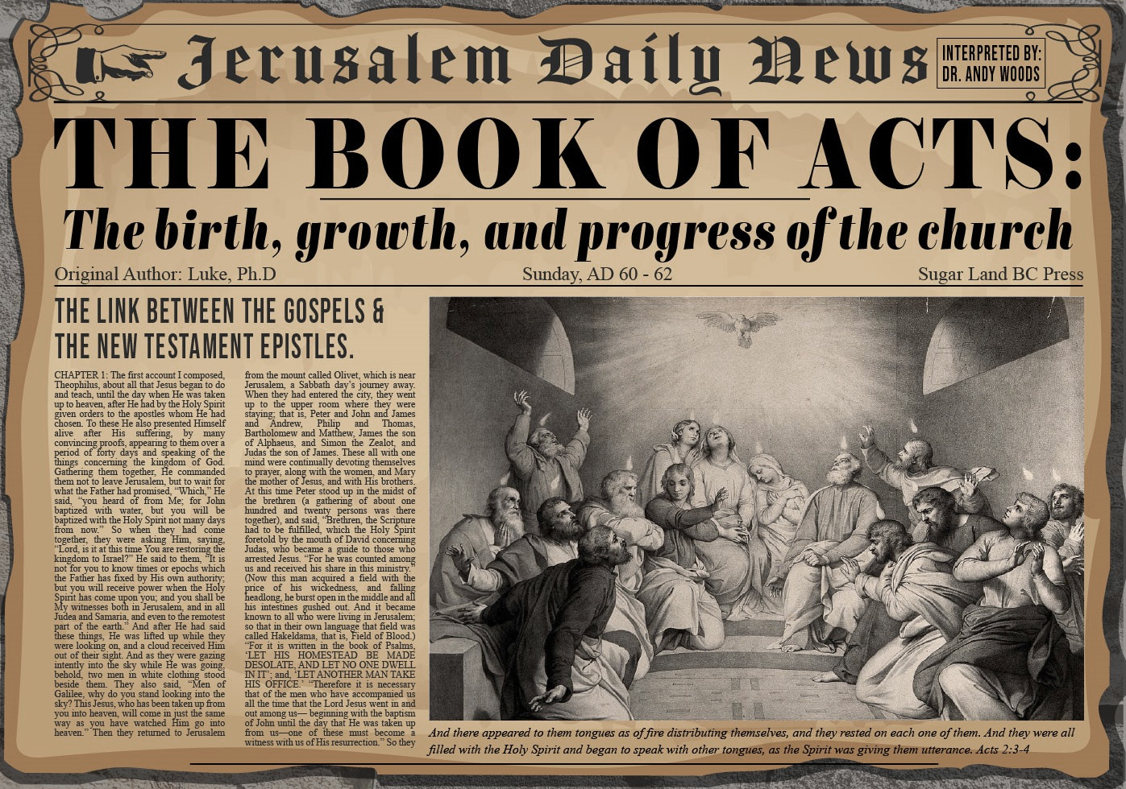

Slide 2
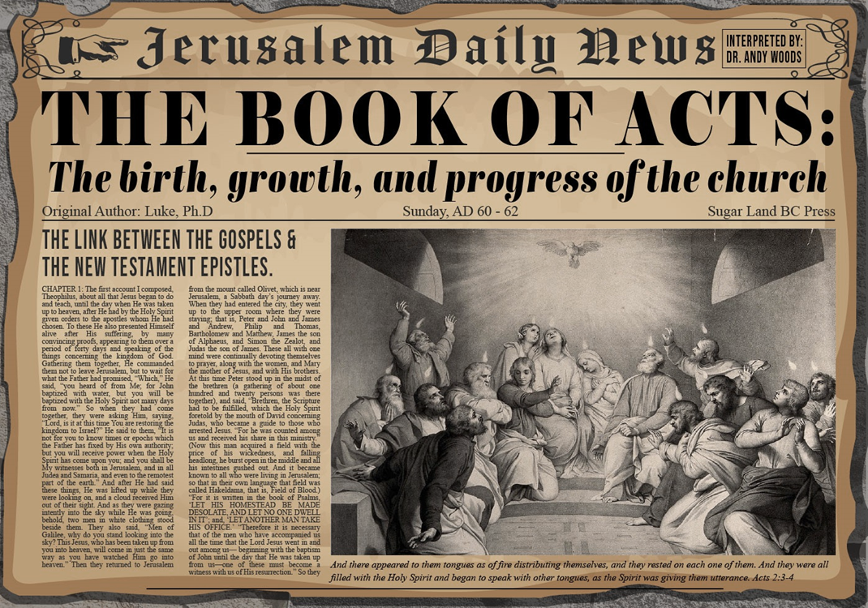
Acts 6:8‒8:4 Stephen
Stephen’s Arrest (6:8‒7:1)
Stephen’s Defense (Acts 7:2-53)
Stephen’s Stoning (7:54-60)
Third Persecution (Acts 8:1-4)

Slide 3
IV. Third Persecution Acts 8:1-4
Saul’s role in Stephen’s execution (1a)
Third persecution against the Church (1b)
Result of the persecution: scattering (1c)
Stephen’s burial (2)
Saul’s persecution of the Church (3)
Ministry of those Dispersed (4)

Slide 4
IV. Third Persecution Acts 8:1-4
Saul’s role in Stephen’s execution (1a)
Third persecution against the Church (1b)
Result of the persecution: scattering (1c)
Stephen’s burial (2)
Saul’s persecution of the Church (3)
Ministry of those Dispersed (4)

Slide 5
IV. Third Persecution Acts 8:1-4
Saul’s role in Stephen’s execution (1a)
Third persecution against the Church (1b)
Result of the persecution: scattering (1c)
Stephen’s burial (2)
Saul’s persecution of the Church (3)
Ministry of those Dispersed (4)

Slide 6
Acts 2:47
“praising God and having favor with all the people. And the Lord was adding to their number day by day those who were being saved.” (NASB)
“praising God and having favor with all the people. And the Lord added to the church daily those who were being saved.” (NKJV)

Slide 7
IV. Third Persecution Acts 8:1-4
Saul’s role in Stephen’s execution (1a)
Third persecution against the Church (1b)
Result of the persecution: scattering (1c)
Stephen’s burial (2)
Saul’s persecution of the Church (3)
Ministry of those Dispersed (4)

Slide 8
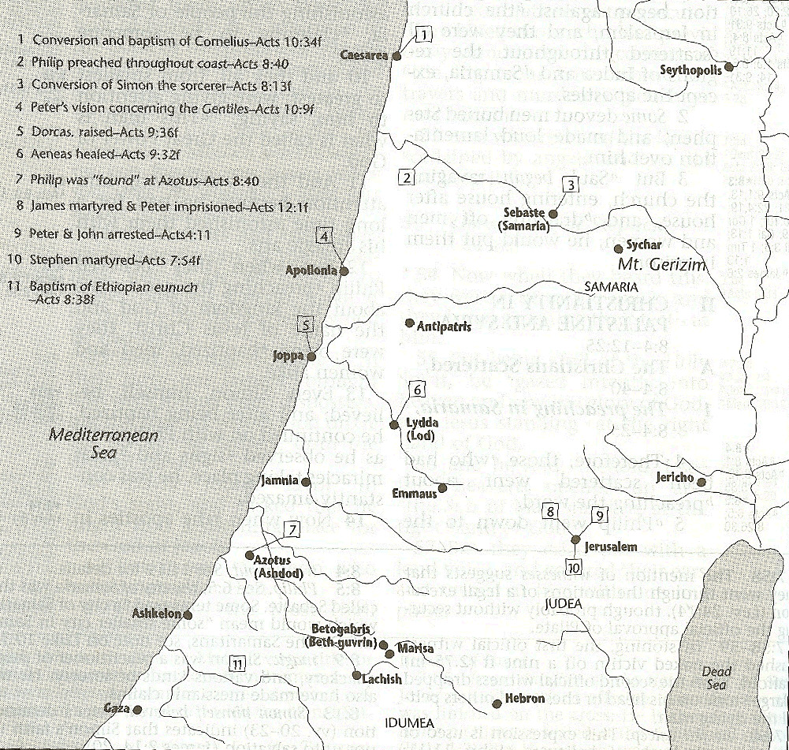

Slide 9
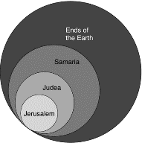
Acts 1:8
“but you will receive power when the Holy Spirit has come upon you; and you shall be My witnesses both in Jerusalem, and in all Judea and Samaria, and even to the remotest part of the earth.”

Slide 10
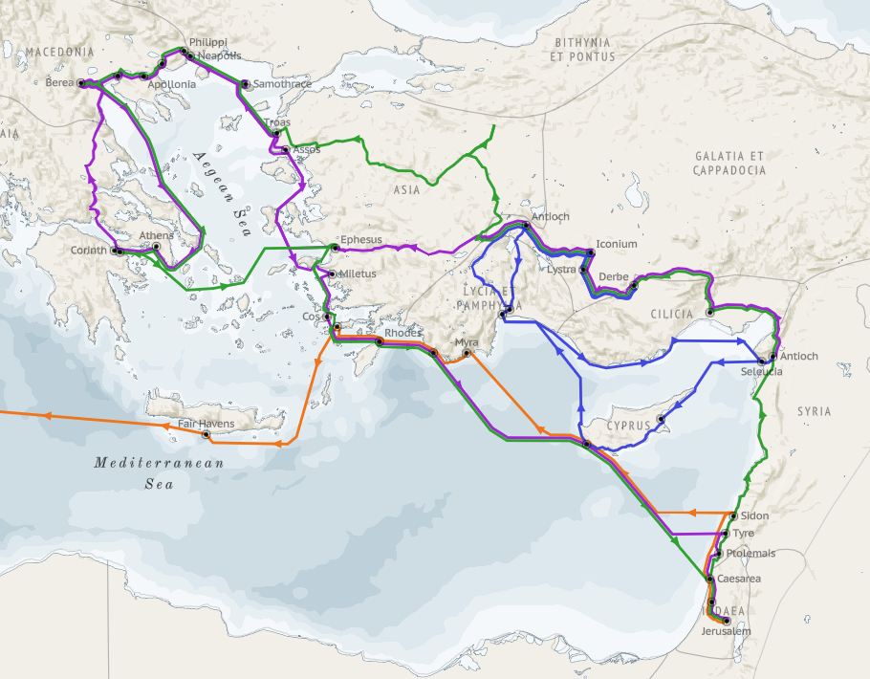
Structure (Acts 1:8)
Jerusalem (Acts 1–7)
Judea and Samaria (Acts 8–12)
Remotest part of the earth (Acts 13–28)
1st missionary journey (Acts 13–14)
Jerusalem council (Acts 15:1-35)
2nd missionary journey (Acts 15:36 –18:22)
3rd missionary journey (Acts 18:23–21:17)
Trip to Rome (Acts 21:18–28:31)

Slide 11
Structure (Acts 1:8)
Jerusalem (Acts 1–7)
Judea and Samaria (Acts 8–12)
Remotest part of the earth (Acts 13–28)
1st missionary journey (Acts 13–14)
Jerusalem council (Acts 15:1-35)
2nd missionary journey (Acts 15:36 –18:22)
3rd missionary journey (Acts 18:23–21:17)
Trip to Rome (Acts 21:18–28:31)

Slide 12
Acts 8:3-4; 11:19
“³ But Saul began ravaging the church, entering house after house, and dragging off men and women, he would put them in prison. ⁴ Therefore, those who had been scattered went about preaching the word…¹⁹ So then those who were scattered because of the persecution that occurred in connection with Stephen made their way to Phoenicia and Cyprus and Antioch, speaking the word to no one except to Jews alone.”

Slide 13
Eusebius (A.D. 260-340), Ecclesiastical History, 3.5.3
"But the people of the church in Jerusalem had been commanded by a revelation, vouchsafed to approved men there before the war, to leave the city and to dwell in a certain town of Perea called Pella. And when those that believed in Christ had come thither from Jerusalem, then, as if the royal city of the Jews and the whole land of Judea were entirely destitute of holy men, the judgment of God at length overtook those who had committed such outrages against Christ and his apostles, and totally destroyed that generation of impious men."
Epiphanius (De pond. et mens. 15) also records this flight of the Christians to Pella.)

Slide 14
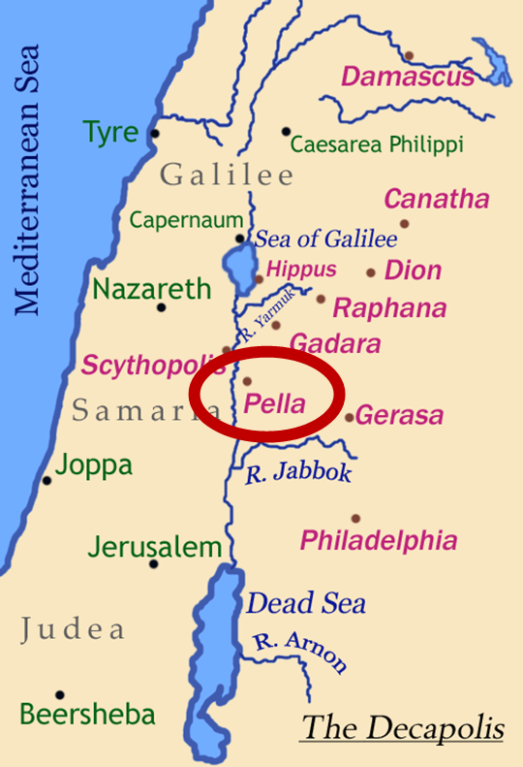
Pella
Pella was a town situated beyond the Jordan, in the north of Perea, within the dominions of Herod Agrippa II. The surrounding population was chiefly Gentile. See Pliny V. 18, and Josephus, B. J. III. 3. 3, and I. 4. 8.

Slide 15
James 1:1
“James, a bond-servant of God and of the Lord Jesus Christ, To the twelve tribes who are dispersed abroad: Greetings.”

Slide 16
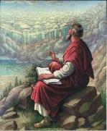
1 Peter 1:1
“To those who reside as aliens, scattered [diaspora] throughout Pontus, Galatia, Cappadocia, Asia, and Bithynia, who are chosen.”

Slide 17
IV. Third Persecution Acts 8:1-4
Saul’s role in Stephen’s execution (1a)
Third persecution against the Church (1b)
Result of the persecution: scattering (1c)
Stephen’s burial (2)
Saul’s persecution of the Church (3)
Ministry of those Dispersed (4)

Slide 18
1 Thessalonians 4:13-18
¹³ "But we do not want you to be uninformed, brethren, about those who are asleep, so that you will not grieve as do the rest who have no hope. ¹⁴ For if we believe that Jesus died and rose again, even so God will bring with Him those who have fallen asleep in Jesus. ¹⁵ For this we say to you by the word of the Lord, that we who are alive and remain until the coming of the Lord, will not precede those who have fallen asleep. ¹⁶ For the Lord Himself will descend from . . .

Slide 19
1 Thessalonians 4:13-18
. . .heaven with a shout, with the voice of the archangel and with the trumpet of God, and the dead in Christ will rise first. ¹⁷ Then we who are alive and remain will be caught up together with them in the clouds to meet the Lord in the air, and so we shall always be with the Lord. ¹⁸ Therefore comfort one another with these words."

Slide 20
IV. Third Persecution Acts 8:1-4
Saul’s role in Stephen’s execution (1a)
Third persecution against the Church (1b)
Result of the persecution: scattering (1c)
Stephen’s burial (2)
Saul’s persecution of the Church (3)
Ministry of those Dispersed (4)

Slide 21
From Peter to Paul
Reference | Center | Person | Place | Outreach
Acts 1–12 | Jerusalem | Peter | Jerusalem, Judea, Samaria | Jewish
Acts 13–28 | Antioch | Paul | Uttermost parts | Gentiles

Slide 22
From Peter to Paul
Peter | Paul
Heals a man lame from birth (3:1-11) | Heals a man lame from birth (14:8-18)
Heals by shadow (5:15-16) | Heals by handkerchief (19:11-12)
Success is a cause of jealousy (5:17) | Success is a cause of jealousy (13:45)
Confronts a sorcerer (8:9-24) | Confronts a sorcerer (13:6-11)
Raises Dorcas (9:36-41) | Raises Eutychus (20:9-12)
Jailed and miraculously freed (12:3-19) | Jailed and miraculously freed (16:25-34)

Slide 23
2 John 9-11
“⁷ For many deceivers have gone out into the world, those who do not acknowledge Jesus Christ as coming in the flesh. This is the deceiver and the antichrist. ⁸ Watch yourselves, that you do not lose what we have accomplished, but that you may receive a full reward. ⁹ Anyone who goes too far and does not abide in the teaching of Christ, does not have God; the one who abides in the teaching, he has both the Father and the Son. ¹⁰ If anyone comes to you and does not bring this teaching, do not receive him into your house, and do not give him a greeting; ¹¹ for the one who gives him a greeting participates in his evil deeds.”

Slide 24
IV. Third Persecution Acts 8:1-4
Saul’s role in Stephen’s execution (1a)
Third persecution against the Church (1b)
Result of the persecution: scattering (1c)
Stephen’s burial (2)
Saul’s persecution of the Church (3)
Ministry of those Dispersed (4)

Slide 25
Acts 8:3-4; 11:19
“³ But Saul began ravaging the church, entering house after house, and dragging off men and women, he would put them in prison. ⁴ Therefore, those who had been scattered went about preaching the word…¹⁹ So then those who were scattered because of the persecution that occurred in connection with Stephen made their way to Phoenicia and Cyprus and Antioch, speaking the word to no one except to Jews alone.”

Slide 26
Conclusion

Slide 27
Acts 6:8‒8:4 Stephen
Stephen’s Arrest (6:8‒7:1)
Stephen’s Defense (Acts 7:2-53)
Stephen’s Stoning (7:54-60)
Third Persecution (Acts 8:1-4)

Slide 28
IV. Third Persecution Acts 8:1-4
Saul’s role in Stephen’s execution (1a)
Third persecution against the Church (1b)
Result of the persecution: scattering (1c)
Stephen’s burial (2)
Saul’s persecution of the Church (3)
Ministry of those Dispersed (4)

