Slide 1
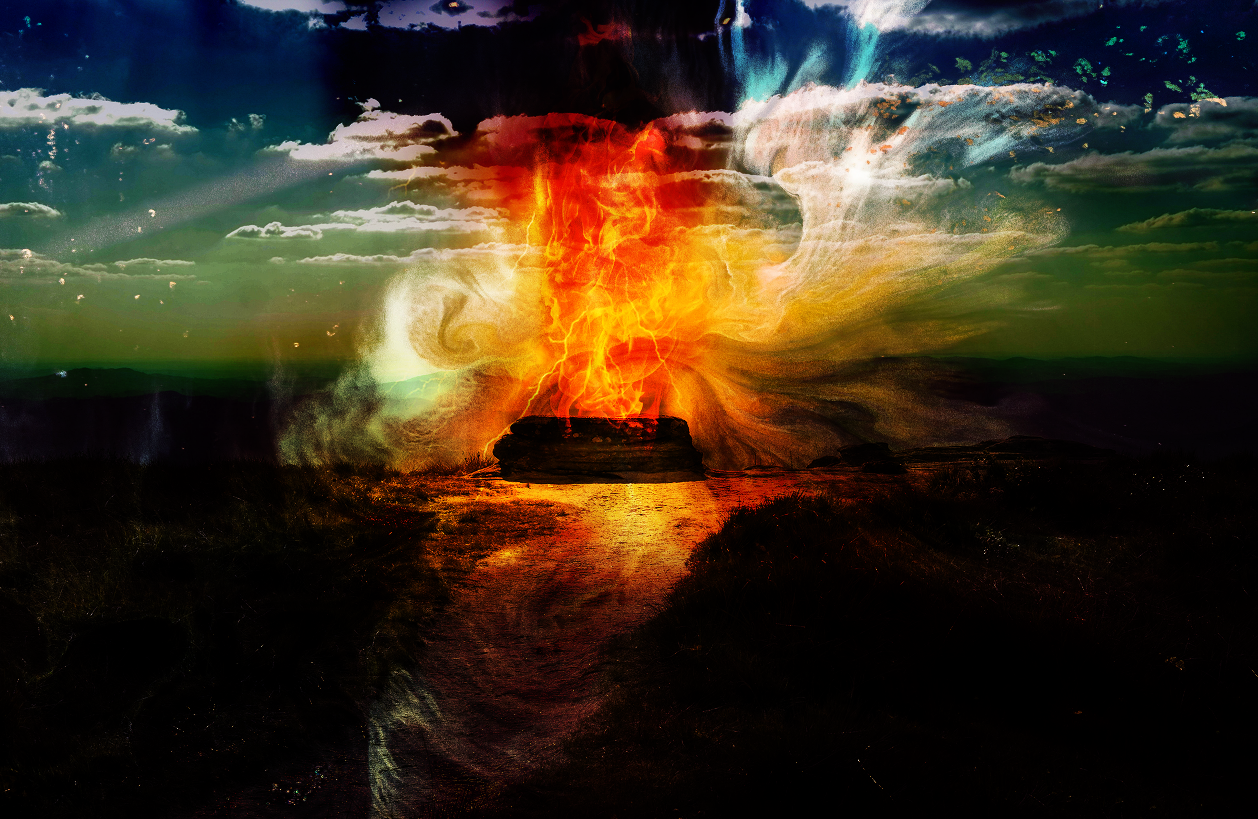

Paul J. Scharf, M.Div.
Church Ministries Representative
foi.org/scharf pscharf@foi.org
Elijah: When You’re
Ready To Serve

Slide 2


Slide 3

Alyssa Ruddell
Field Ministries Representative
Houston, TX

Slide 4

Our mission is focused:
The Friends of Israel is a
worldwide evangelical ministry
proclaiming Biblical truth
about Israel and the Messiah,
while bringing physical and spiritual comfort to the Jewish people.

Slide 5
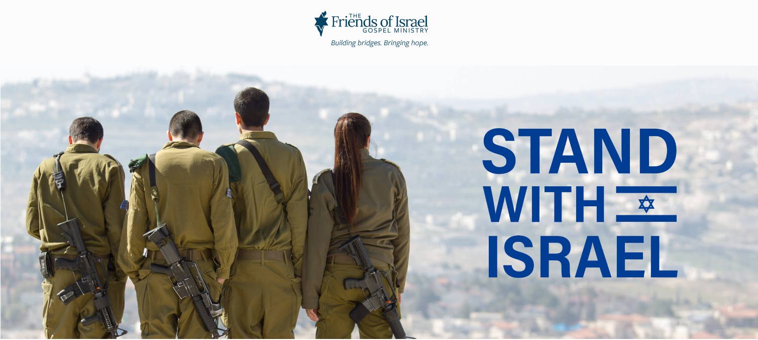
FOI.ORG/STANDWITHISRAEL

Slide 6
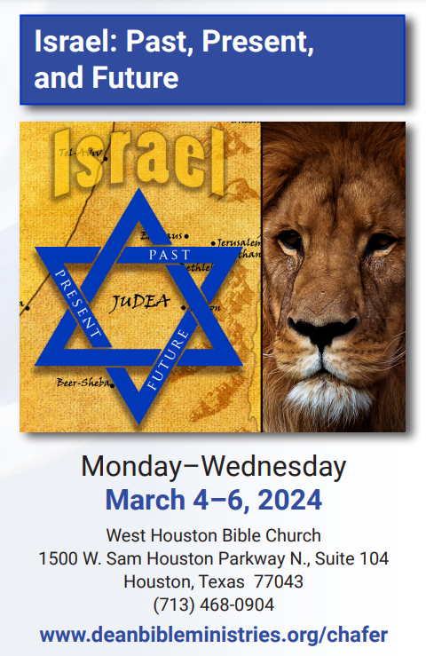


Slide 7
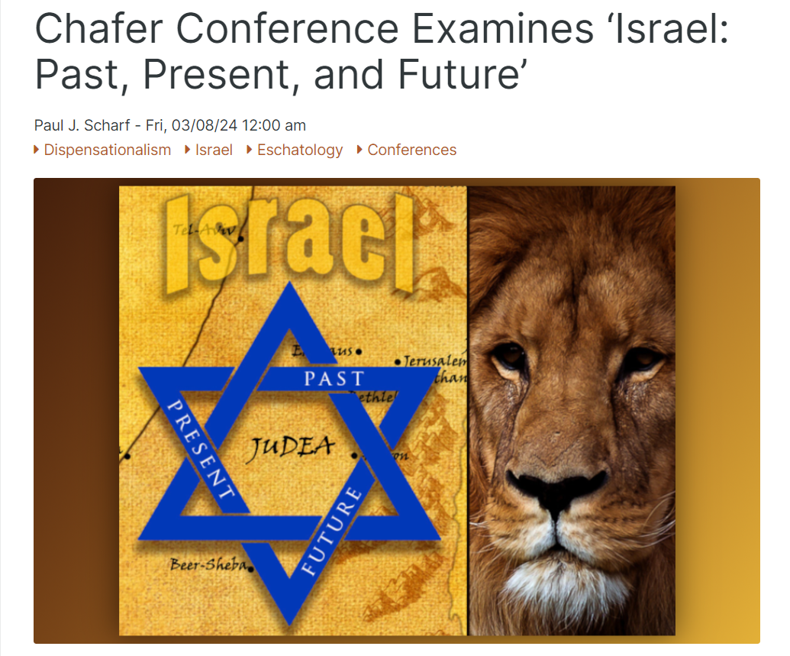
sharperiron.org

Slide 8
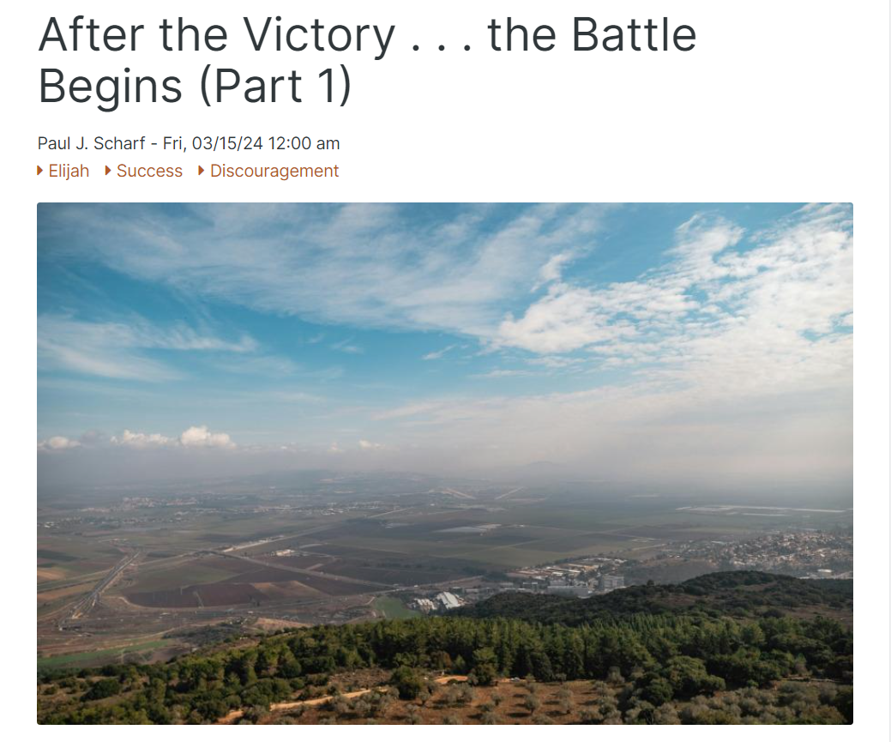
sharperiron.org

Slide 9

RAPTUREREADY.COM

Slide 10
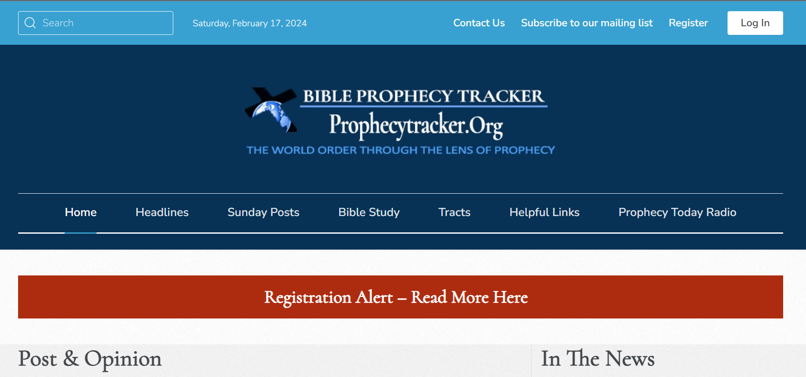
PROPHECYTRACKER.ORG

Slide 11
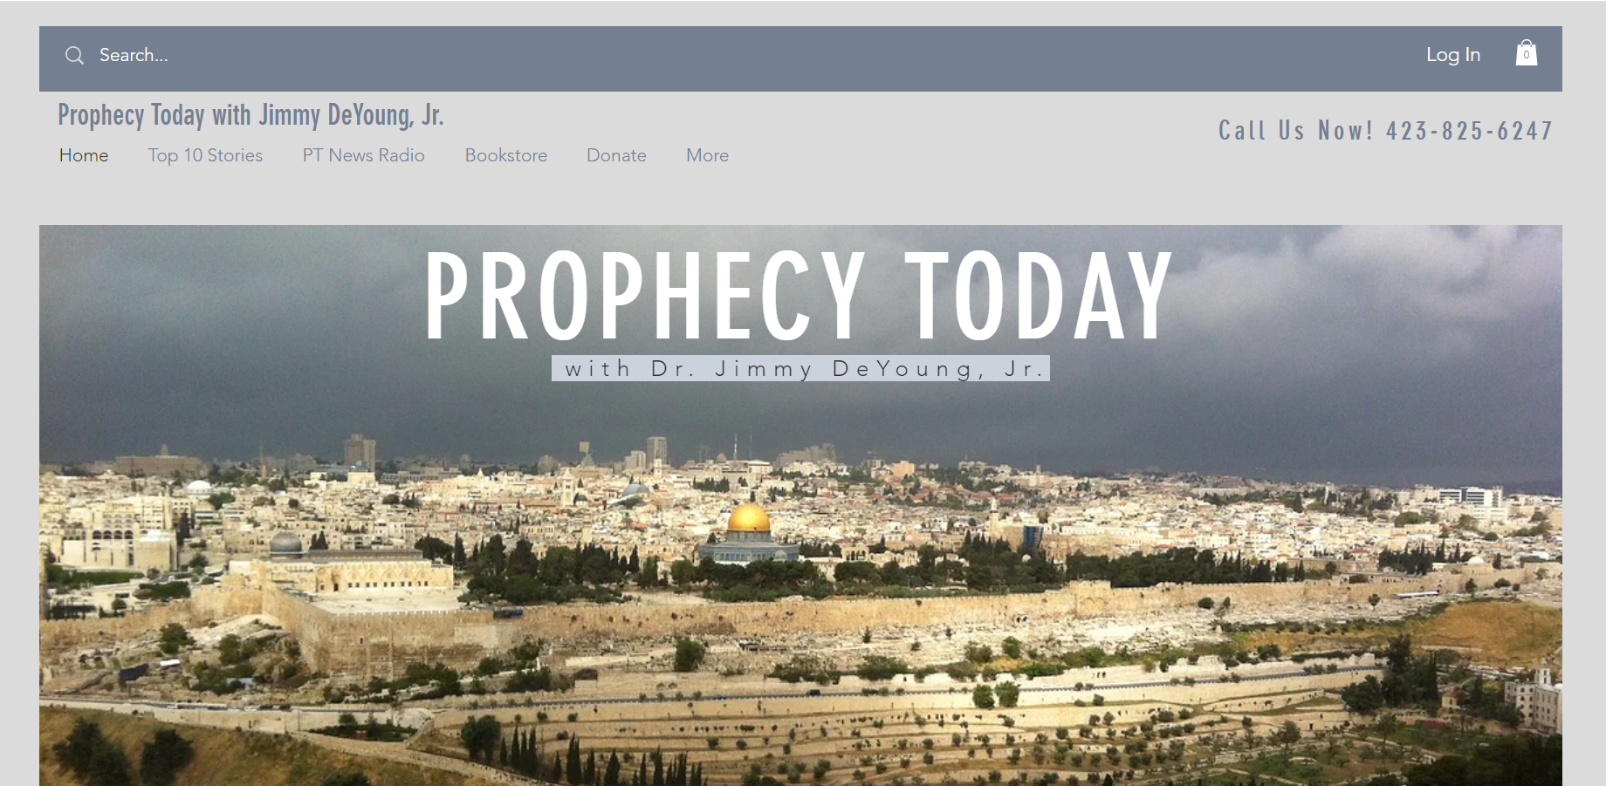
PROPHECYTODAY.COM

Slide 12

KHCB.ORG

Slide 13
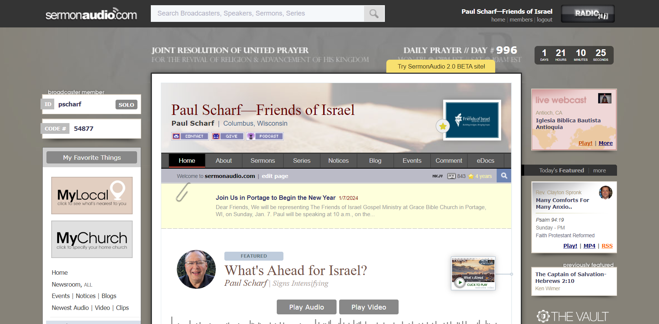
SERMONAUDIO.COM/PSCHARF

Slide 14


Thursday,
March 21,
11 a.m.
SERMONAUDIO.COM/UNITEDPRAYER

Slide 15

Search for
SCHARF
in the ChurchOne App
and
“Select Broadcaster”
INSTALL OUR APP

Slide 16
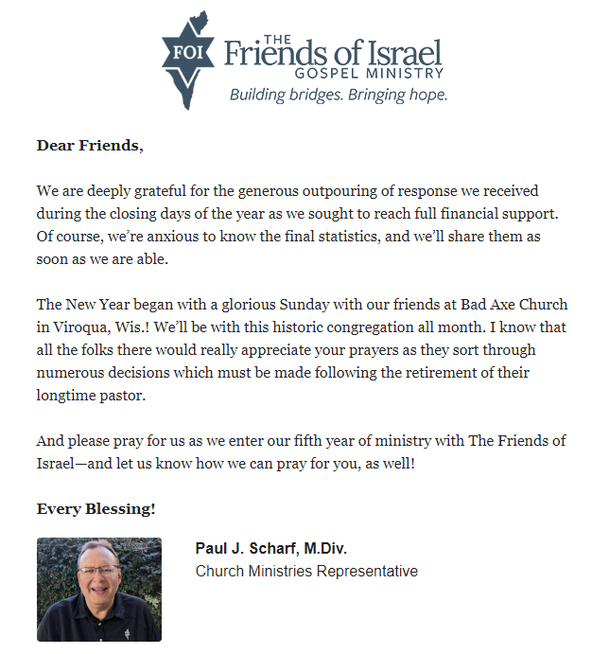
Sign up for
Weekly
E-newsletter

Slide 17

BAPTISTBULLETIN.ORG

Slide 18


Slide 19
Paul J. Scharf, M.Div.
Church Ministries Representative
foi.org/scharf pscharf@foi.org
Elijah: When You’re
Ready To Serve

Slide 20


Slide 21
Elijah

Slide 22
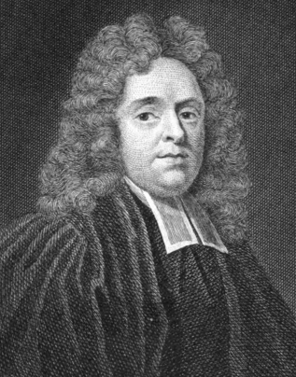
… Elijah drops (so to speak)
out of the clouds, as if, like Melchisedek, he were without father, without mother, and without descent, which made
some of the Jews
Matthew Henry
Commentary on the Whole Bible, p. 517
Matthew Henry’s Commentary on the Whole Bible, Vol. 2, Joshua to Esther (Peabody, MA: Hendrickson Publishers, 1991)

Slide 23
fancy that he was an angel
sent from heaven; but the apostle
has assured us that he was a man
subject to like passions
as we are....
Matthew Henry
Commentary on the Whole Bible, p. 517
Matthew Henry’s Commentary on the Whole Bible, Vol. 2, Joshua to Esther (Peabody, MA: Hendrickson Publishers, 1991)

Slide 24
  “Elijah was a man
  with a nature like ours,
  and he prayed earnestly
  that it would not rain;
James 5:17, NKJV

Slide 25
  and it did not rain
  on the land
  for three years
  and six months.
James 5:17, NKJV

Slide 26

  And he prayed again,
  and the heaven gave rain,
  and the earth
  produced its fruit.”
James 5:18, NKJV

Slide 27
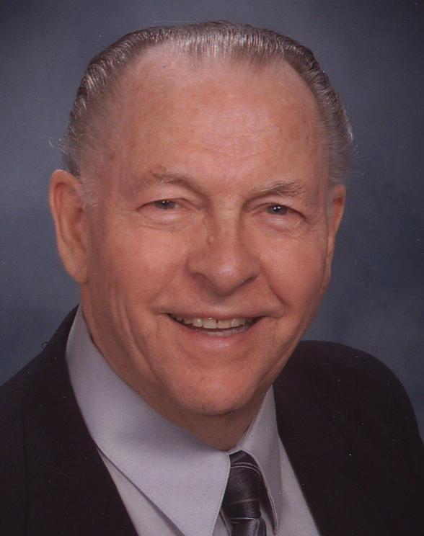
Like a meteor suddenly flashing
across the darkened sky,
Elijah appears on the scene
without genealogy,
Dr. John C. Whitcomb
Israel: From Conquest to Exile, p. 386
(Winona Lake, IN: BMH Books, 1989)

Slide 28
without historical background,
and without warning.
Dr. John C. Whitcomb
Israel: From Conquest to Exile, p. 386
(Winona Lake, IN: BMH Books, 1989)

Slide 29
One thunderous judgment
from heaven through his lips
and he disappeared without a trace.
Dr. John C. Whitcomb
Israel: From Conquest to Exile, p. 386
(Winona Lake, IN: BMH Books, 1989)

Slide 30
  “A hairy man wearing
  a leather belt....”
2 Kings 2:8, NKJV

Slide 31
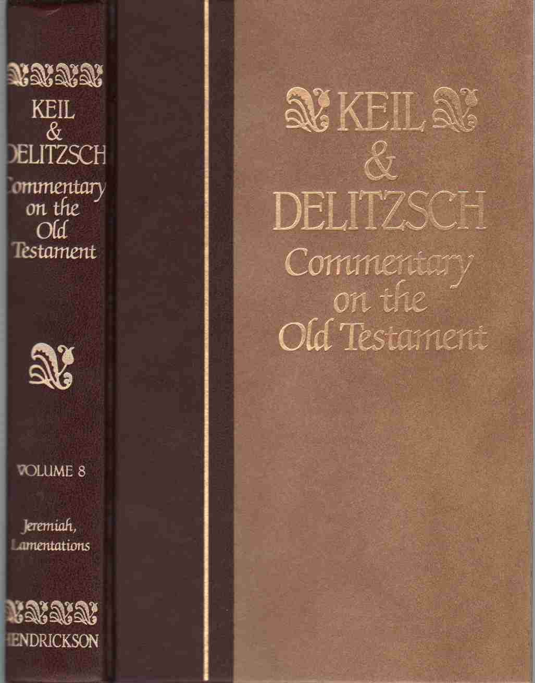
… the Lord God raised up the most powerful of all the prophets,
namely Elijah the Tishbite,
who by his deeds attested his name … whose God is Jehovah.
C.F. Keil and F. Delitzsch
Biblical Commentary on the OT, p. 229
The Books of the Kings (Grand Rapids, MI: William B. Eerdmans Publishing Co., 1950)

Slide 32
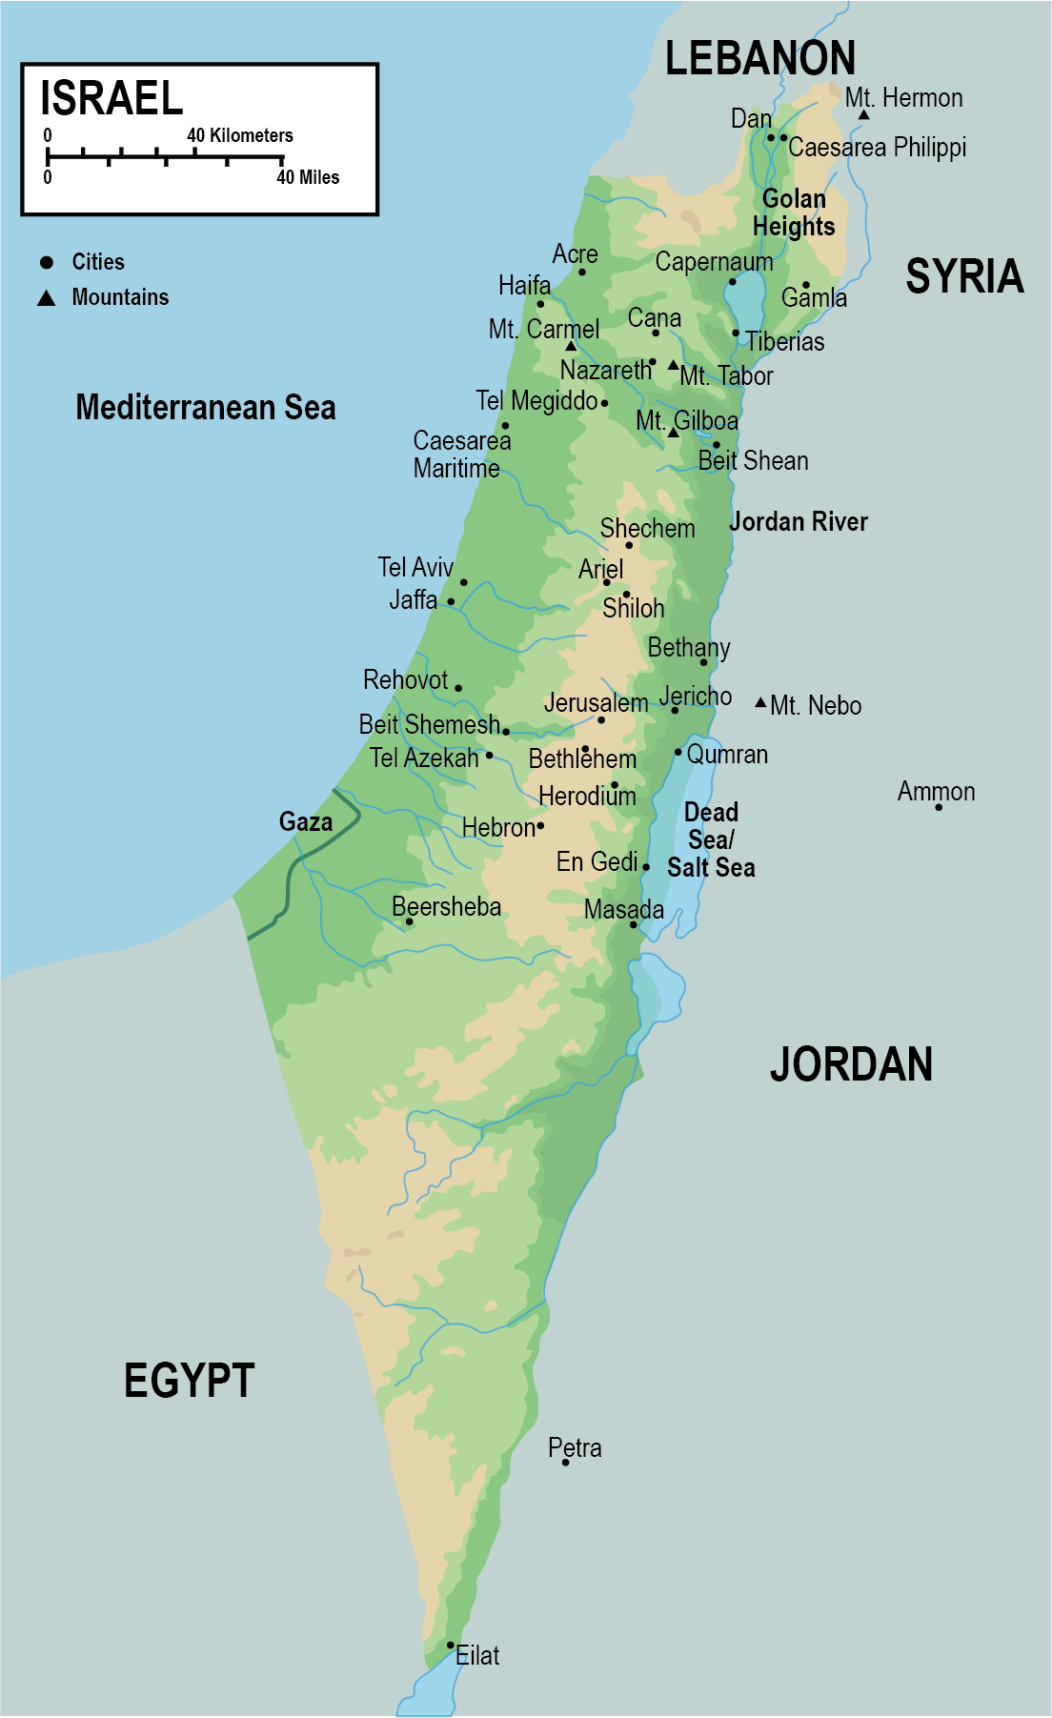

Slide 33
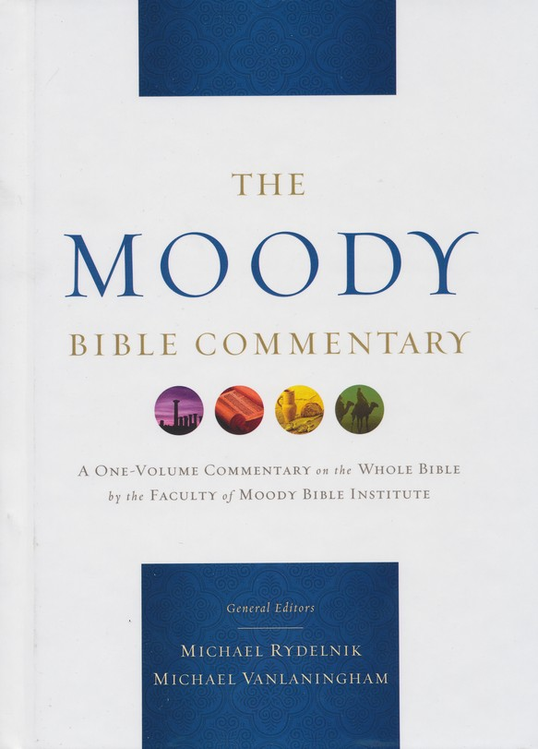
Gilead was east of the Jordan River across from the Jezreel Valley
(cf. Dt 34:1), but the exact location
of Tishbi cannot be identified
with any certainty.
The Moody Bible Commentary
“1 Kings,” Harry E. Shields, p. 507
(Chicago: Moody Publishers, 2014)

Slide 34
A Two-Phase Ministry

Slide 35
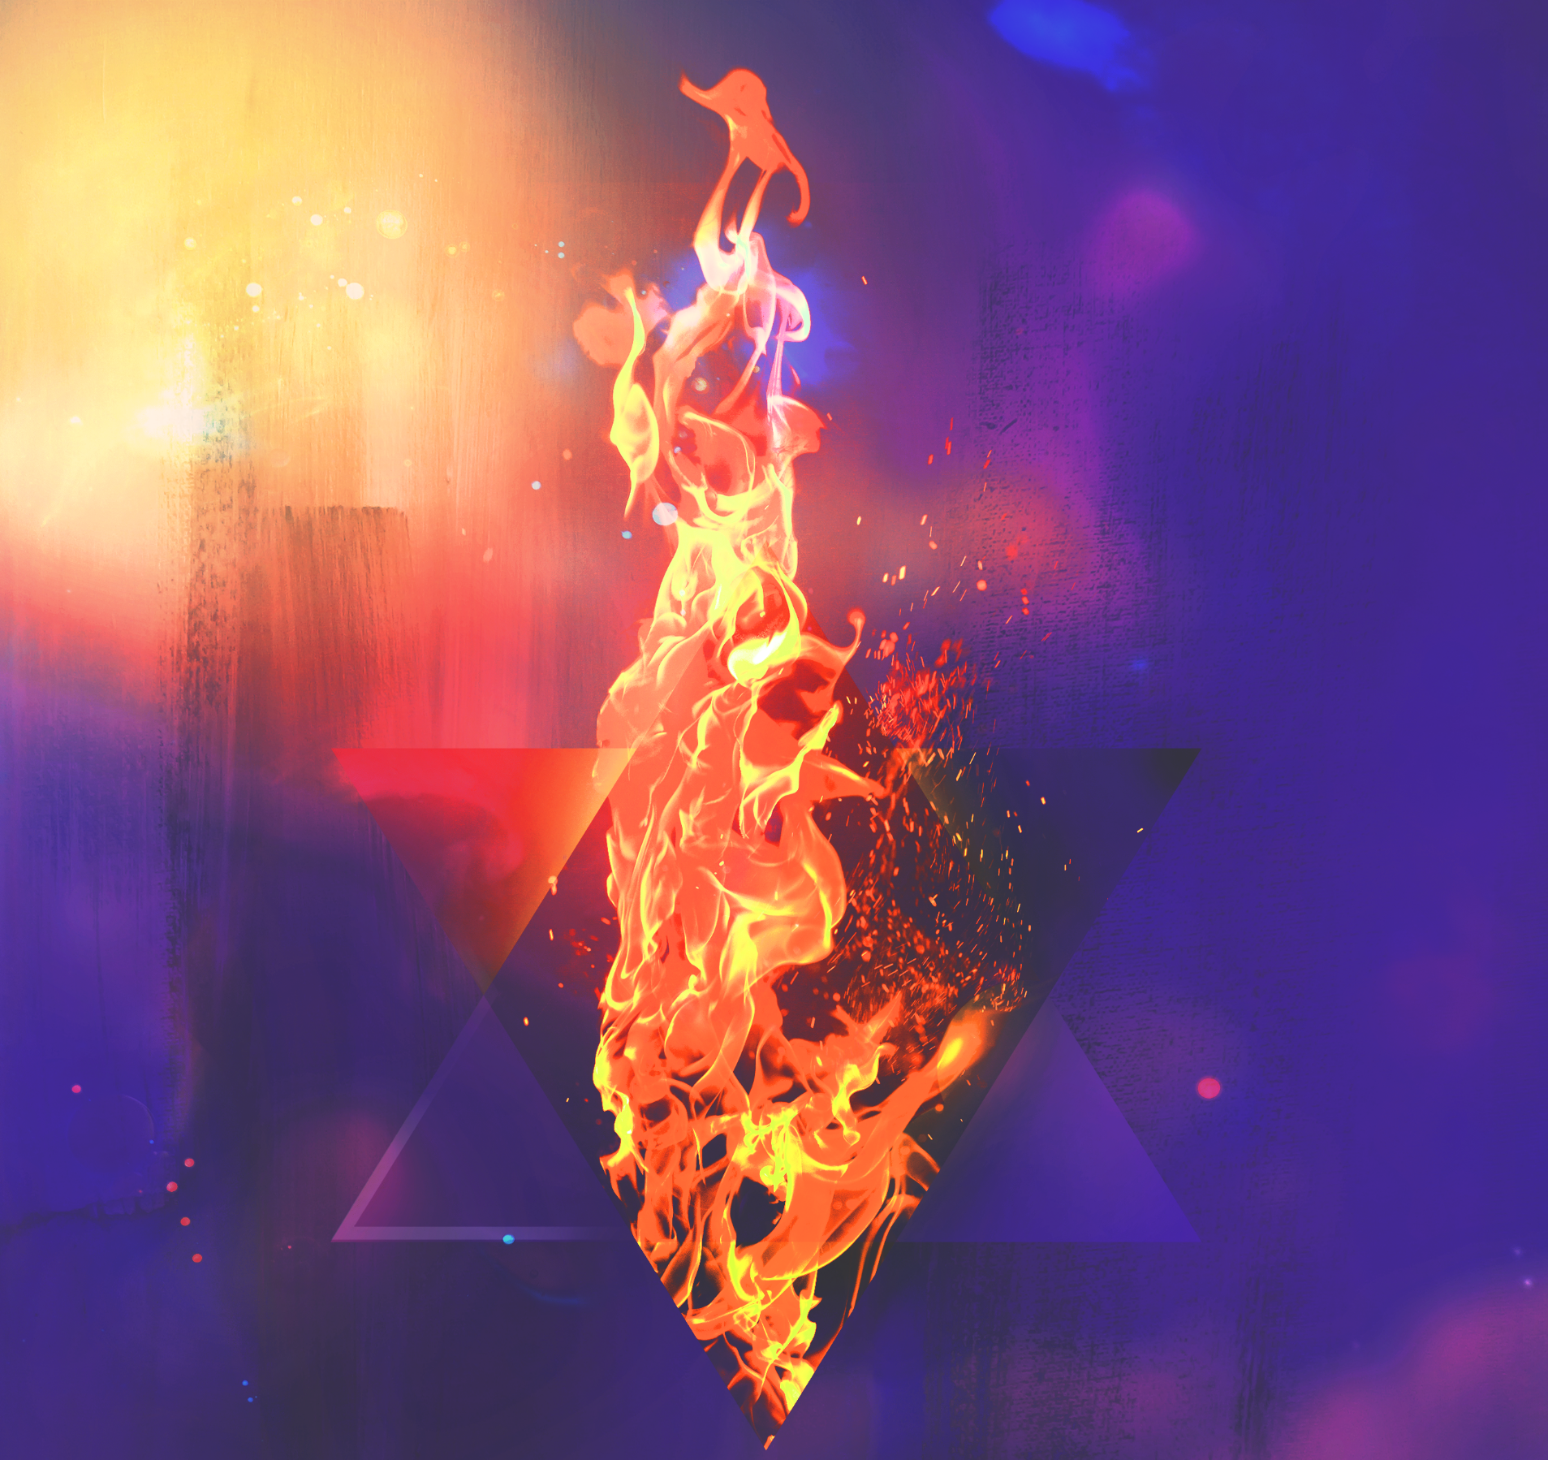
A Two-Phase Ministry
Prophet to Israel

Slide 36
The Setting of 1 Kings 17-19
Division
of the Kingdom
Ahab’s
Reign
Elijah’s
Ministry
Jonah’s
Ministry
931 B.C.
874
853
859
852
784-760 B.C.
Dates based on John C. Whitcomb, Old Testament Kings and Prophets Study-Graph

Slide 37
A Two-Phase Ministry
Prophet to Israel

Slide 38
A Two-Phase Ministry
Prophet to Israel
Prophesied to return

Slide 39
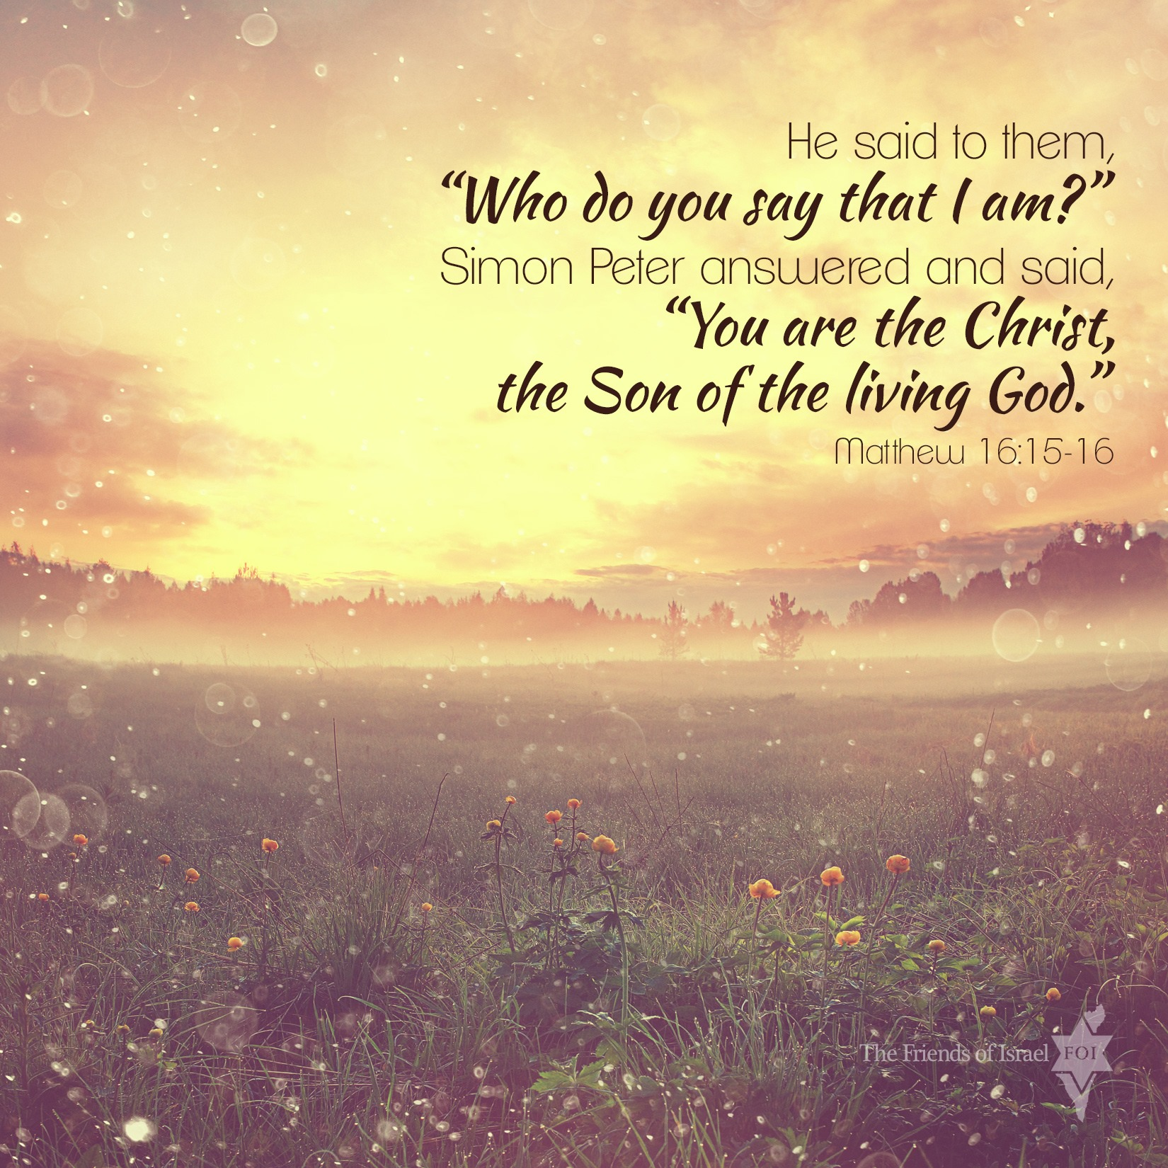

Slide 40

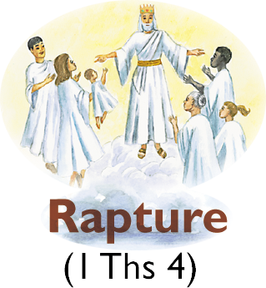
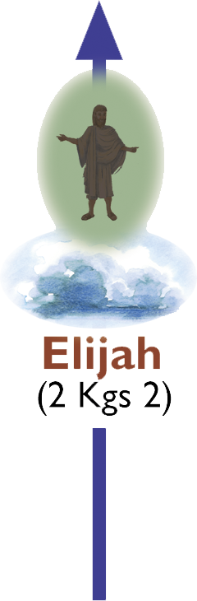
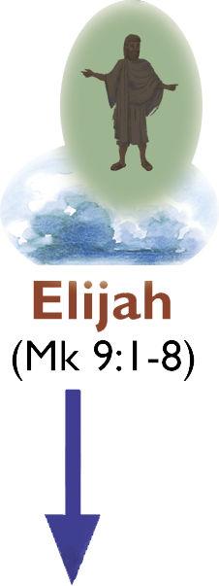

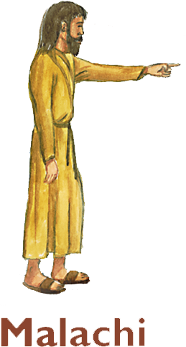
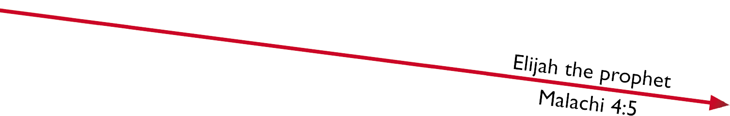

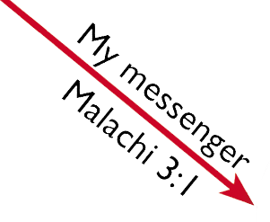
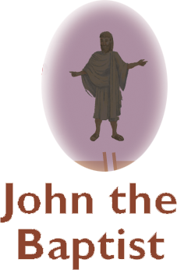
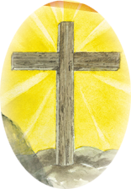
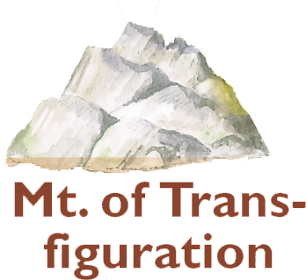
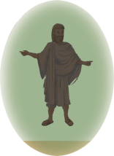
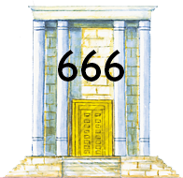
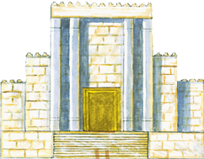








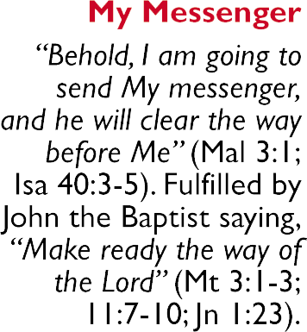
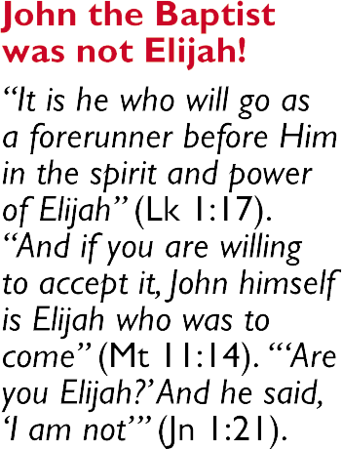
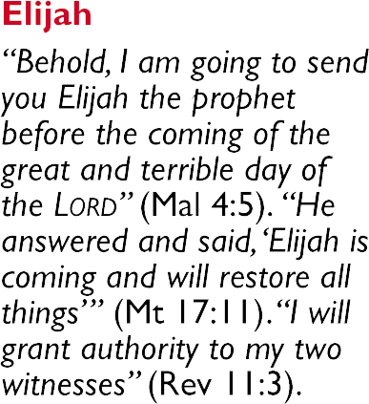

Slide 41
  “Behold, I will send you
  Elijah the prophet
  Before the coming
  of the great and dreadful day of the LORD.”
Malachi 4:5, NKJV

Slide 42
ISRAEL’S 70TH WEEK and CHRIST’S SECOND COMING
(The Church confronted by Christ at the Judgment Seat. Marriage Supper of the Lamb.)
Satan
cast down
Antichrist (Little Horn)
Killed by the King of the North
Abomination of Desolations
144,000 Witnesses
The Second Coming
Two Witnesses in Jerusalem
Resurrection & Rapture of the true Church
Little Horn conquers 10 western Kings
His deadly wound healed
Armageddon
ABYSS
©2006 Dr. John C. Whitcomb

Slide 43
  “These have power
  to shut heaven, so that
  no rain falls in the days
  of their prophecy….”
Revelation 11:6, NKJV

Slide 44
A Two-Phase Ministry

Slide 45
A Two-Phase Ministry
30 NT references

Slide 46
Ahab

Slide 47
  “Ahab did more to provoke
  the LORD God of Israel
  to anger than all the kings
  of Israel who were
  before him.”
1 Kings 16:33, NKJV

Slide 48
  “But there was no one like Ahab who sold himself
  to do wickedness in the sight of the LORD, because Jezebel his wife stirred him up.”
1 Kings 21:25, NKJV

Slide 49
Jezebel

Slide 50
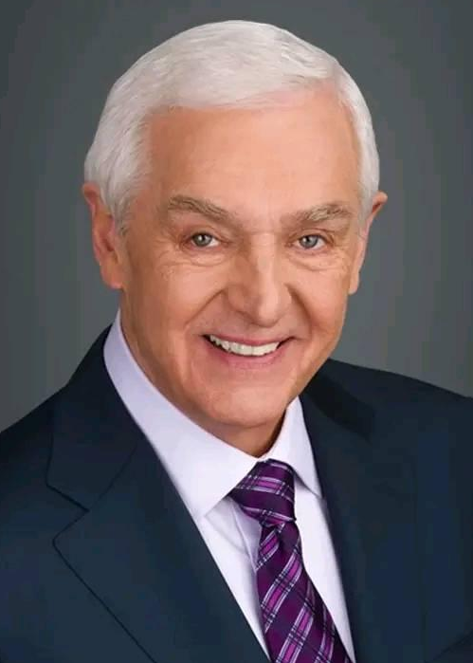
She persuaded Ahab to build
a temple and altar to Baal in Samaria, where Ahab was.
She supported 850 prophets
of her immoral cult....
The Jeremiah Study Bible
NKJV, “The Wicked Jezebel,” p. 466
David Jeremiah (Franklin, TN: Worthy Publishing, 2013)

Slide 51
  “This is the word of the LORD, which He spoke by His servant Elijah the Tishbite, saying … dogs shall eat the flesh
  of Jezebel.”
2 Kings 9:36, NKJV

Slide 52
Baal worshipers believed that their god made rain and was responsible
for fertility throughout the land.
If a drought occurred, Baal worshipers believed that their god
The Moody Bible Commentary
“1 Kings,” Harry E. Shields, p. 507
(Chicago: Moody Publishers, 2014)

Slide 53
was residing in the place of the dead
and needed to be brought back to life.
The Moody Bible Commentary
“1 Kings,” Harry E. Shields, p. 507
(Chicago: Moody Publishers, 2014)

Slide 54
  “… if you do not obey Me …
  I will make your heavens
  like iron and your earth
  like bronze.”
Leviticus 26:18-19, NKJV

Slide 55
  “… lest the Lord’s anger
  be aroused against you,
  and He shut up the heavens
  so that there be no rain, and the land yield no produce,
Deuteronomy 11:17, NKJV

Slide 56
  and you perish quickly
  from the good land
  which the LORD
  is giving you.”
Deuteronomy 11:17, NKJV

Slide 57
  “The LORD will change
  the rain of your land
  to powder and dust….”
Deuteronomy 28:24, NKJV

Slide 58
The king was left to stagger
for three more years under the colossal
judgment of an unrelieved drought,
six months of it having been
experienced already....
Dr. John C. Whitcomb
Israel: From Conquest to Exile, p. 386
With John J. Davis (Winona Lake, IN: BMH Books, 1989)

Slide 59
  “… it did not rain
  on the land
  for three years
  and six months.”
James 5:17b, NKJV

Slide 60
In Israel’s agricultural economy,
this meant famine,
followed by pestilence,
then death.
The Jeremiah Study Bible
NKJV, Note on 1 Kings 17:1, p. 466
David Jeremiah (Franklin, TN: Worthy Publishing, 2013)

Slide 62
Elijah would suffer from the drought just like everyone else.

Slide 63
  “… in the days of Elijah,
  when the heaven was shut up three years and six months, and there was a great famine throughout all the land….”
Luke 4:25, NKJV

Slide 64
  “You prepare a table
  before me
  in the presence
  of my enemies.”
Psalm 23:5a, NKJV

Slide 65
Cherith

Slide 66
Source: Jeremiah Study Bible, p. 469

Slide 67
Jezreel to Cherith
= 15 miles
Source: The Expositor’s Bible Commentary (Vol. 4), p. 138

Slide 69
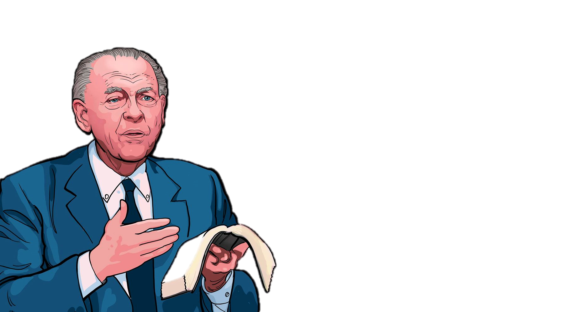
Providence
The indirect and mediate employment by God
of natural laws
and events and people
to accomplish His will.
Dr. John C. Whitcomb
John C. Whitcomb, Biblical Miracles, cassette 1, side 1, Middletown Bible Church, Middletown, CT, April 2001.

Slide 71
Notice a pattern that develops
in Elijah’s relationship with God:

Slide 72
Notice a pattern that develops
in Elijah’s relationship with God:
Direction

Slide 73
Notice a pattern that develops
in Elijah’s relationship with God:
Direction
Obedience

Slide 74
Notice a pattern that develops
in Elijah’s relationship with God:
Direction
Obedience
Testing

Slide 75


Slide 76
When the brook dries up
is the true test of a person’s faith.
God wanted Elijah to trust in Him
rather than in His provision.
The Jeremiah Study Bible
NKJV, Note on 1 Kings 17:7, p. 466
David Jeremiah (Franklin, TN: Worthy Publishing, 2013)

Slide 77
Zarephath

Slide 78
Source: Jeremiah Study Bible, p. 469

Slide 79
Cherith to Zarephath
= 80 miles
Source: The Bible Knowledge Commentary: Old Testament, p. 524

Slide 80
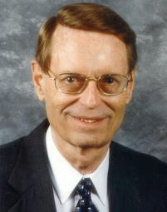
Zarephath. A town on the Mediterranean coast between Tyre
and Sidon, the home of Jezebel
and the heart of Baal worship.
Ryrie Study Bible
KJV, Expanded Edition, Note on 1 Kings 17:9, p. 567
(Chicago: Moody Publishers, 1994).

Slide 82
Sidon … was a Gentile region
outside of Israel
in the very center
of Baal worship.
The Moody Bible Commentary
“1 Kings,” Harry E. Shields, p. 508
(Chicago: Moody Publishers, 2014)

Slide 83
Sign Miracle
A direct and immediate intervention of God
into the physical world
to publicly demonstrate His power or to authenticate
His messengers.
Dr. John C. Whitcomb
Adapted from John C. Whitcomb, Biblical Miracles, cassette 1, side 1, Middletown Bible Church, Middletown, CT, April 2001.

Slide 84
Four Periods of Biblical Miracles

Slide 85
Four Periods of Biblical Miracles
Moses at the Exodus

Slide 86
Four Periods of Biblical Miracles
Moses at the Exodus
Elijah/Elisha

Slide 87
Four Periods of Biblical Miracles

Slide 88
Four Periods of Biblical Miracles
Jesus and the Apostles (Heb. 2:3-4)

Slide 89
Four Periods of Biblical Miracles
Jesus and the Apostles (Heb. 2:3-4)
Millennial Kingdom
(Isa. 35:5-7; Heb. 6:5)

Slide 90
Miracles in 1 Kings 17
v. 1 – Stopping the Rain
vv. 2, 8 – Spiritual Revelation
v. 6 – Sustained by Ravens
vv. 14-16 – Supernatural Resources
v. 22 – Son Resuscitated

Slide 91
Death

Slide 92
Carmel

Slide 93

Mount Carmel is part of a range
of fertile, forested hills …
about fifteen miles long on the west border of the land allotted
to the tribe of Asher....
Evangelical Study Bible
Note on 1 Kings 18:19, p. 587
(Nashville: Thomas Nelson, 2023).

Slide 95
Because it is at the entrance
of the Jezreel Valley (Esdraelon)
and has an elevation of 1,724 feet,
it commands an excellent view
of the shoreline.
Evangelical Study Bible
Note on 1 Kings 18:19, p. 587
(Nashville: Thomas Nelson, 2023).

Slide 96
The Canaanites built sanctuaries
(“high places”) for pagan deities
on this mountain.
Evangelical Study Bible
Note on 1 Kings 18:19, p. 587
(Nashville: Thomas Nelson, 2023).

Slide 97
… nothing can be quite so dangerous
to the spiritual vitality of a church
or nation as the presence
and prominence
Dr. John C. Whitcomb
Israel: From Conquest to Exile, p. 390
(Winona Lake, IN: BMH Books, 1989)

Slide 98
of those who profess to know God
but by their works deny Him
(Titus 1:16).
Dr. John C. Whitcomb
Israel: From Conquest to Exile, p. 390
(Winona Lake, IN: BMH Books, 1989)

Slide 99
The twelve stones were a practical declaration on the part of the prophet
that the division of the nation into two kingdoms was at variance with the
divine calling of Israel....
C.F. Keil and F. Delitzsch
Biblical Commentary on the OT, p. 248
The Books of the Kings (Grand Rapids, MI: William B. Eerdmans Publishing Co., 1950)

Slide 100
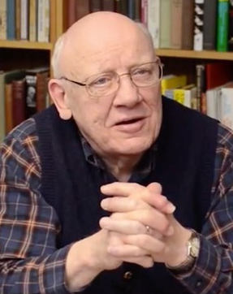
By using twelve stones,
he reaffirmed the spiritual unity
of God’s people in spite
of their political division.
Warren W. Wiersbe
The BE Commentary: OT History, p. 473
The Bible Exposition Commentary: OT History (Colorado Springs, CO: Cook Communications Ministries, 2003)

Slide 101
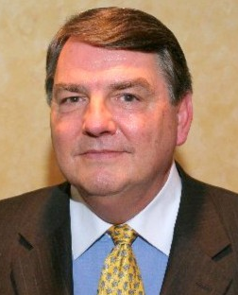
Like me, I’m sure you have one or two “God moments” that stand out
in your life above all others.
I call these “Aha!” or “Wow!”
Dr. Woodrow Kroll
Back to the Bible, May 2010
BacktotheBible.org

Slide 102
moments in time that not only
serve as memorial stones
of God’s extraordinary goodness
towards you, but also spur you on
Dr. Woodrow Kroll
Back to the Bible, May 2010
BacktotheBible.org

Slide 103
to contend for the plans and purposes
God has yet to fulfill in your life.
Dr. Woodrow Kroll
Back to the Bible, May 2010
BacktotheBible.org

Slide 104
  “For our God
  is a consuming fire.”
Hebrews 12:29, NKJV

Slide 105
Jezreel

Slide 106
Source: ESV Study Bible, p. 636

Slide 107
Mount Carmel to Jezreel
= 25 miles
Source: The Bible Knowledge Commentary: Old Testament, p. 527

Slide 109

Ahab … went to Jezreel,
where he had a palace (21:1)
and where Jezebel
was staying (19:1-2).
ESV Study Bible
Note on 1 Kings 18:45-46, p. 635
(Wheaton, IL: Crossway, 2008)

Slide 110
The fact that Elijah also went to Jezreel suggests that he thought his war
with Baal worship was over,
which turned out to be a misjudgment.
ESV Study Bible
Note on 1 Kings 18:45-46, p. 635
(Wheaton, IL: Crossway, 2008)

Slide 112
  Elijah had faithfully testified
  of the prophetic vision entrusted to him.

Slide 113
  Elijah had faithfully testified
  of the prophetic vision entrusted to him.
  He also trusted God through times of great testing.

Slide 114
  Elijah had faithfully testified
  of the prophetic vision entrusted to him.
  He also trusted God through times of great testing.
  God had sustained His servant through both
  natural providences and supernatural miracles.

Slide 115
  Elijah had faithfully testified
  of the prophetic vision entrusted to him.
  He also trusted God through times of great testing.
  God had sustained His servant through both
  natural providences and supernatural miracles.
  Now God vindicated His servant
  with a great victory on Mount Carmel.

Slide 117
After the victory
on the mountaintop …

Slide 118
After the victory
on the mountaintop …
came the descent
into the valley.

Slide 120
Sometimes it is
after the victory …

Slide 121
Sometimes it is
after the victory …
that the real
battle begins.

Slide 122
Paul J. Scharf, M.Div.
Church Ministries Representative
foi.org/scharf pscharf@foi.org
Elijah: When You’re
Ready To Serve

Slide 124
Paul J. Scharf, M.Div.
Church Ministries Representative
foi.org/scharf pscharf@foi.org
Elijah: When You’re
Ready To Quit

Slide 125
How quickly we can move
from the mountaintop of triumph
to the valley of testing!
Warren W. Wiersbe
The BE Commentary: OT History, p. 475
The Bible Exposition Commentary: OT History (Colorado Springs, CO: Cook Communications Ministries, 2003)

Slide 126
We need to humble ourselves
before the Lord and get ready
for the trials that usually follow
the victories.
Warren W. Wiersbe
The BE Commentary: OT History, p. 475
The Bible Exposition Commentary: OT History (Colorado Springs, CO: Cook Communications Ministries, 2003)

Slide 127
  “Elijah was a man
  with a nature like ours,
  and he prayed earnestly
  that it would not rain;
James 5:17, NKJV

Slide 128
  and it did not rain
  on the land
  for three years
  and six months.
James 5:17, NKJV

Slide 129
  And he prayed again,
  and the heaven gave rain,
  and the earth
  produced its fruit.”
James 5:18, NKJV

Slide 131
Since we have the same
sin nature as Elijah,
we are susceptible to the
same temptations he faced,
and are prone to the same sins.

Slide 133
  The Lord Jesus
  never quit!

Slide 134
  “… He steadfastly
  set His face
  to go to Jerusalem.”
Luke 9:51, NKJV

Slide 135
  “Therefore I have set
  My face like a flint,
  And I know that
  I will not be ashamed.”
Isaiah 50:7b, NKJV

Slide 136
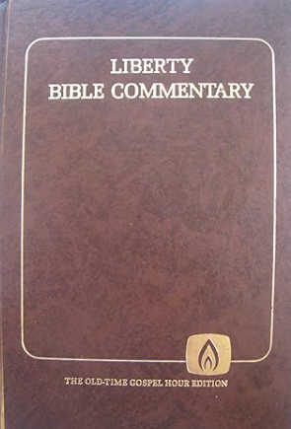
At a time when prospects
for a nationwide spiritual revival
were the greatest, the prophet himself spoiled them by fleeing
in discouragement
Liberty Bible Commentary: OT
“1 Kings,” Harvey Hartman, pp. 686-687
(Lynchburg, VA: Old-Time Gospel Hour, 1982)

Slide 137
and abandoning the nation
without spiritual leadership.
Instead, he sought only
to protect himself.
Liberty Bible Commentary: OT
“1 Kings,” Harvey Hartman, pp. 686-687
(Lynchburg, VA: Old-Time Gospel Hour, 1982)

Slide 138
Victory now becomes defeat
as Elijah retreats,
both physically and mentally,
and ultimately arrives
ESV Study Bible
Note on 1 Kings 19:1-21, p. 636
(Wheaton, IL: Crossway, 2008)

Slide 139
not at Mount Carmel
but at another mountain
to confront not Baal
but the Lord himself....
ESV Study Bible
Note on 1 Kings 19:1-21, p. 636
(Wheaton, IL: Crossway, 2008)

Slide 141
On Mount Carmel,
Elijah experienced
one of the greatest
spiritual victories recorded
in all of Holy Scripture.

Slide 143
Elijah would have great experiences on three mountains:

Slide 144
Elijah would have great experiences on three mountains:
Mount Carmel

Slide 145
Elijah would have great experiences on three mountains:
Mount Carmel
Mount Horeb

Slide 146
Elijah would have great experiences on three mountains:
Mount Carmel
Mount Horeb
Mount of Transfiguration

Slide 147
He that stood undaunted in the midst
of the terrors both of heaven and earth trembles at the impotent menaces
of a proud passionate woman.
Matthew Henry
Commentary on the Whole Bible, p. 529
Matthew Henry’s Commentary on the Whole Bible, Vol. 2, Joshua to Esther (Peabody, MA: Hendrickson Publishers, 1991)

Slide 148
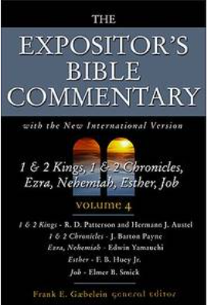
… Elijah had played
into Jezebel’s hand....
What she desired was that Elijah
and his God be discredited
before the new converts....
Expositor’s Bible Commentary
“1 Kings,” Patterson and Austel, p. 148
The Expositor’s Bible Commentary; Vol. 4, 1 Kings—Job; Frank E. Gaebelein, General Editor; Richard D. Patterson and Hermann J. Austel (Grand Rapids: Zondervan, 1988)

Slide 149
Just when God needed him the most,
the divinely trained prophet
was to prove a notable failure.
Expositor’s Bible Commentary
“1 Kings,” Patterson and Austel, p. 148
The Expositor’s Bible Commentary; Vol. 4, 1 Kings—Job; Frank E. Gaebelein, General Editor; Richard D. Patterson and Hermann J. Austel (Grand Rapids: Zondervan, 1988)

Slide 151
  Elijah was spiritually exhausted (19:3-4a)

Slide 152
The resistance of one person
(Jezebel) has turned massive victory
into overwhelming defeat,
in Elijah’s mind.
ESV Study Bible
Note on 1 Kings 19:10, p. 636
(Wheaton, IL: Crossway, 2008)

Slide 153
Beersheba

Slide 154
  “And when he saw that,
  he arose and ran for his life, and went to Beersheba,
  which belongs to Judah,
  and left his servant there.”
1 Kings 19:3, NKJV

Slide 156
Mount Carmel to Beersheba
= 120 miles
Source: ESV Study Bible, p. 636

Slide 158
Perhaps Elijah had come
to expect the spiritual high
of extraordinary events.
Evangelical Study Bible
Note on 1 Kings 19:3-4, p. 589
(Nashville: Thomas Nelson, 2023).

Slide 159
… Elijah had come to bask in the glow
of the spectacular. He may have fully expected that because of what had been accomplished at Mount Carmel,
Expositor’s Bible Commentary
“1 Kings,” Patterson and Austel, p. 148
The Expositor’s Bible Commentary; Vol. 4, 1 Kings—Job; Frank E. Gaebelein, General Editor; Richard D. Patterson and Hermann J. Austel (Grand Rapids: Zondervan, 1988)

Slide 160
Jezebel would capitulate
and pagan worship would come
to an end in Israel—
all through his influence!
Expositor’s Bible Commentary
“1 Kings,” Patterson and Austel, p. 148
The Expositor’s Bible Commentary; Vol. 4, 1 Kings—Job; Frank E. Gaebelein, General Editor; Richard D. Patterson and Hermann J. Austel (Grand Rapids: Zondervan, 1988)

Slide 161
For a moment, Elijah forgot
all that God had done
and acted in fear
rather than faith.
The Jeremiah Study Bible
NKJV, Note on 1 King 19:2, 3, p. 469
David Jeremiah (Franklin, TN: Worthy Publishing, 2013)

Slide 162


Slide 163
Wilderness

Slide 165
“a day’s journey into the wilderness” = 15 miles
Source: The Bible Knowledge Commentary: Old Testament, p. 528

Slide 167
  “… we were burdened
  beyond measure,
  above strength,
  so that we despaired
  even of life.”
2 Corinthians 1:8, NKJV

Slide 168
  Elijah was spiritually exhausted (19:3-4a)

Slide 169
  Elijah was spiritually exhausted (19:3-4a)
  Elijah was physically exhausted (18:46; 19:3-4)

Slide 170
  Elijah was spiritually exhausted (19:3-4a)
  Elijah was physically exhausted (18:46; 19:3-4)
    He needed rest (19:5a; 6b)

Slide 171
  Elijah was spiritually exhausted (19:3-4a)
  Elijah was physically exhausted (18:46; 19:3-4)
    He needed rest (19:5a; 6b)
    He needed food (19:5b-8a)

Slide 172
Mt. Horeb

Slide 173
Source: The Bible Knowledge Commentary: Old Testament, p. 528

Slide 174
Mount Carmel to Beersheba
= 120 miles
Source: ESV Study Bible, p. 636

Slide 176
Mount Carmel to Beersheba
= 120 miles
Source: ESV Study Bible, p. 636

Slide 177
Mount Carmel to Beersheba
= 120 miles
Beersheba to Mount Horeb
= 250 miles
Source: ESV Study Bible, p. 636

Slide 179
  “For He knows our frame;
  He remembers
  that we are dust.”
Psalm 103:14, NKJV

Slide 180
The Cave

Slide 182
Mount Horeb = Mount Sinai
Ex. 3:1, 12; 19:3, 18, 20

Slide 183
Mount Horeb = Mount Sinai
Ex. 3:1, 12; 19:3, 18, 20
This cave (vv. 9, 13) may be the same as “the cleft of the rock” (Ex. 33:21-22)

Slide 184
40: The Number of Testing

Slide 185
40: The Number of Testing
Moses—40 days at Sinai
(Ex. 24:18; 34:28)

Slide 186
40: The Number of Testing
Moses—40 days at Sinai
(Ex. 24:18; 34:28)
Israel—40 years wandering
(Num. 14:33-34; 32:13)

Slide 187
40: The Number of Testing

Slide 188
40: The Number of Testing
Elijah—40 days to Horeb
(1 Kings 19:8)

Slide 189
40: The Number of Testing
Elijah—40 days to Horeb
(1 Kings 19:8)
Jonah—40 days to repent
(Jon. 3:4)

Slide 190
40: The Number of Testing

Slide 191
40: The Number of Testing
Jesus—temptation/proof
(Matt. 4:1-2/Acts 1:3)

Slide 192
  Elijah was spiritually exhausted (19:3-4a)
  Elijah was physically exhausted (18:46; 19:3-4)
    He needed rest (19:5a; 6b)
    He needed food (19:5b-8a)

Slide 193
  Elijah was spiritually exhausted (19:3-4a)
  Elijah was physically exhausted (18:46; 19:3-4)
    He needed rest (19:5a; 6b)
    He needed food (19:5b-8a)
Elijah felt isolated (19:10, 14)

Slide 194
… perhaps this was the same cave,
or cleft of a rock, in which Moses
was hidden when the Lord passed
by before him and proclaimed
his name, Exod. 33:22.
Matthew Henry
Commentary on the Whole Bible, p. 529
Matthew Henry’s Commentary on the Whole Bible, Vol. 2, Joshua to Esther (Peabody, MA: Hendrickson Publishers, 1991)

Slide 195
… Elijah was in a cave (19:9),
probably an allusion to the
“cleft of the rock” in which Moses
found himself in Ex. 33:22.
The Moody Bible Commentary
“1 Kings,” Harry E. Shields, p. 511
(Chicago: Moody Publishers, 2014)

Slide 196
God was said to “pass by” both Moses
(cf. Ex. 33:22) and Elijah
(1 Kings 19:11), the same word
in both passages, and both received
a vision of God....
The Moody Bible Commentary
“1 Kings,” Harry E. Shields, p. 511
(Chicago: Moody Publishers, 2014)

Slide 198
Exodus 33:22 –
“pass by” (two times)
= same word as 1 Kings 19:11

Slide 199
  Elijah was spiritually exhausted (19:3-4a)
  Elijah was physically exhausted (18:46; 19:3-4)
    He needed rest (19:5a; 6b)
    He needed food (19:5b-8a)
Elijah felt isolated (19:10, 14)

Slide 200
  Elijah was spiritually exhausted (19:3-4a)
  Elijah was physically exhausted (18:46; 19:3-4)
    He needed rest (19:5a; 6b)
    He needed food (19:5b-8a)
Elijah felt isolated (19:10, 14)
Elijah had become prideful (19:4b)

Slide 201
  “It is enough!
  Now, LORD, take my life,
  for I am no better
  than my fathers!”
1 Kings 19:4b, NKJV

Slide 202
Elijah was sure that his
courageous ministry on Mount Carmel would bring the nation to its knees.
Warren W. Wiersbe
The BE Commentary: OT History, p. 477
The Bible Exposition Commentary: OT History (Colorado Springs, CO: Cook Communications Ministries, 2003)

Slide 203
Perhaps he was also hoping
that Ahab and Jezebel would repent
and turn from Baal to Jehovah.
Warren W. Wiersbe
The BE Commentary: OT History, p. 477
The Bible Exposition Commentary: OT History (Colorado Springs, CO: Cook Communications Ministries, 2003)

Slide 204
His expectations weren’t fulfilled,
so he considered himself a failure.
Warren W. Wiersbe
The BE Commentary: OT History, p. 477
The Bible Exposition Commentary: OT History (Colorado Springs, CO: Cook Communications Ministries, 2003)

Slide 205
He has always claimed
to “stand before the LORD”
(… 17:1; 18:15); but here
on Mount Horeb, in spite
ESV Study Bible
Note on 1 Kings 19:13-14, p. 637
(Wheaton, IL: Crossway, 2008)

Slide 206
of the command of 19:11
… he apparently stays
in the cave
until the storm is over.
ESV Study Bible
Note on 1 Kings 19:13-14, p. 637
(Wheaton, IL: Crossway, 2008)

Slide 207
… what was he doing hiding
in a cave located hundreds of miles
from his appointed place of ministry?
Warren W. Wiersbe
The BE Commentary: OT History, p. 478
The Bible Exposition Commentary: OT History (Colorado Springs, CO: Cook Communications Ministries, 2003)

Slide 210
How did you get
where you are?

Slide 212
  Have you
  succumbed
  to the
  Elijah Syndrome?

Slide 214
  The Elijah Syndrome is a combination of physical and spiritual fatigue, resulting in despair.

Slide 215
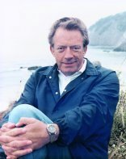
Despair is a greater sin
than any of the sins
that led up to it.
Dr. Dave Breese
ChristianDestiny.org

Slide 216
  “Yes, we had the sentence
  of death in ourselves,
  that we should not trust
  in ourselves, but in God
  who raises the dead....”
2 Corinthians 1:9, NKJV

Slide 217
… the situation is never as grim
as it appears. Elijah’s perspective
had been skewed by his exhaustion:
he believed he was all alone
in his misery.
The Jeremiah Study Bible
NKJV, “The Weary Warrior,” p. 470
David Jeremiah (Franklin, TN: Worthy Publishing, 2013)

Slide 218
  “Or do you not know
  what the Scripture says
  of Elijah, how he pleads
  with God against Israel….”
Romans 11:2b, NKJV

Slide 220
  What did
  Elijah really need?

Slide 221
Miracles in 1 Kings 19
vv. 5-6 – Supply by an Angel
vv. 7-8 – Stamina in Abundance
vv. 9, 13 – Supernatural Announcement
vv. 11-12 – Sovereign Appearance

Slide 223
Even more than a display
of God’s power
through sign miracles,
what Elijah truly needed
was revelation from God.

Slide 225
We possess the
completed canon—
which is greater
than the miracles
that Elijah witnessed.

Slide 226
  “And behold,
  there appeared to them
  Moses and Elijah,
  talking with him.”
Matthew 17:3, ESV

Slide 227
  “… we have
  the prophetic word
  more fully confirmed,
  to which you will do well
  to pay attention….”
2 Peter 1:19, ESV

Slide 228
God was calling Elijah
to stop weeping over the past
and running away from the present.
It was time for him to start preparing others for the future.
Warren W. Wiersbe
The BE Commentary: OT History, p. 481
The Bible Exposition Commentary: OT History (Colorado Springs, CO: Cook Communications Ministries, 2003)

Slide 229
  “Even so then,
  at this present time
  there is a remnant
  according to the election
  of grace.”
Romans 11:5, NKJV

Slide 230
Elisha

Slide 231
Elisha was living
in Abel Meholah (19:16)
Source: The Bible Knowledge Commentary: Old Testament, p. 523

Slide 233
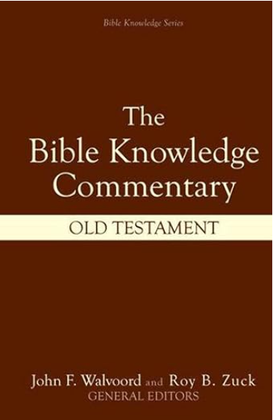
Through these three men
God would complete the purge
of Baal worship that
Elijah had begun.
Bible Knowledge Commentary
“1 Kings,” Thomas L. Constable, p. 529
Old Testament (Wheaton, IL: Victor Books—Scripture Press Publications, 1985)

Slide 234
Were it not for the insight into his feelings of fear and discouragement given in this chapter, one might not believe that Elijah was indeed “a man just like us” (James 5:17).
Bible Knowledge Commentary
“1 Kings,” Thomas L. Constable, p. 529
Old Testament (Wheaton, IL: Victor Books—Scripture Press Publications, 1985)

Slide 236
Not only was Elijah not alone,
he was not even essential
to God’s ongoing work,
but found out that he was expendable and replaceable.

Slide 238
  What do
  we do now?

Slide 239
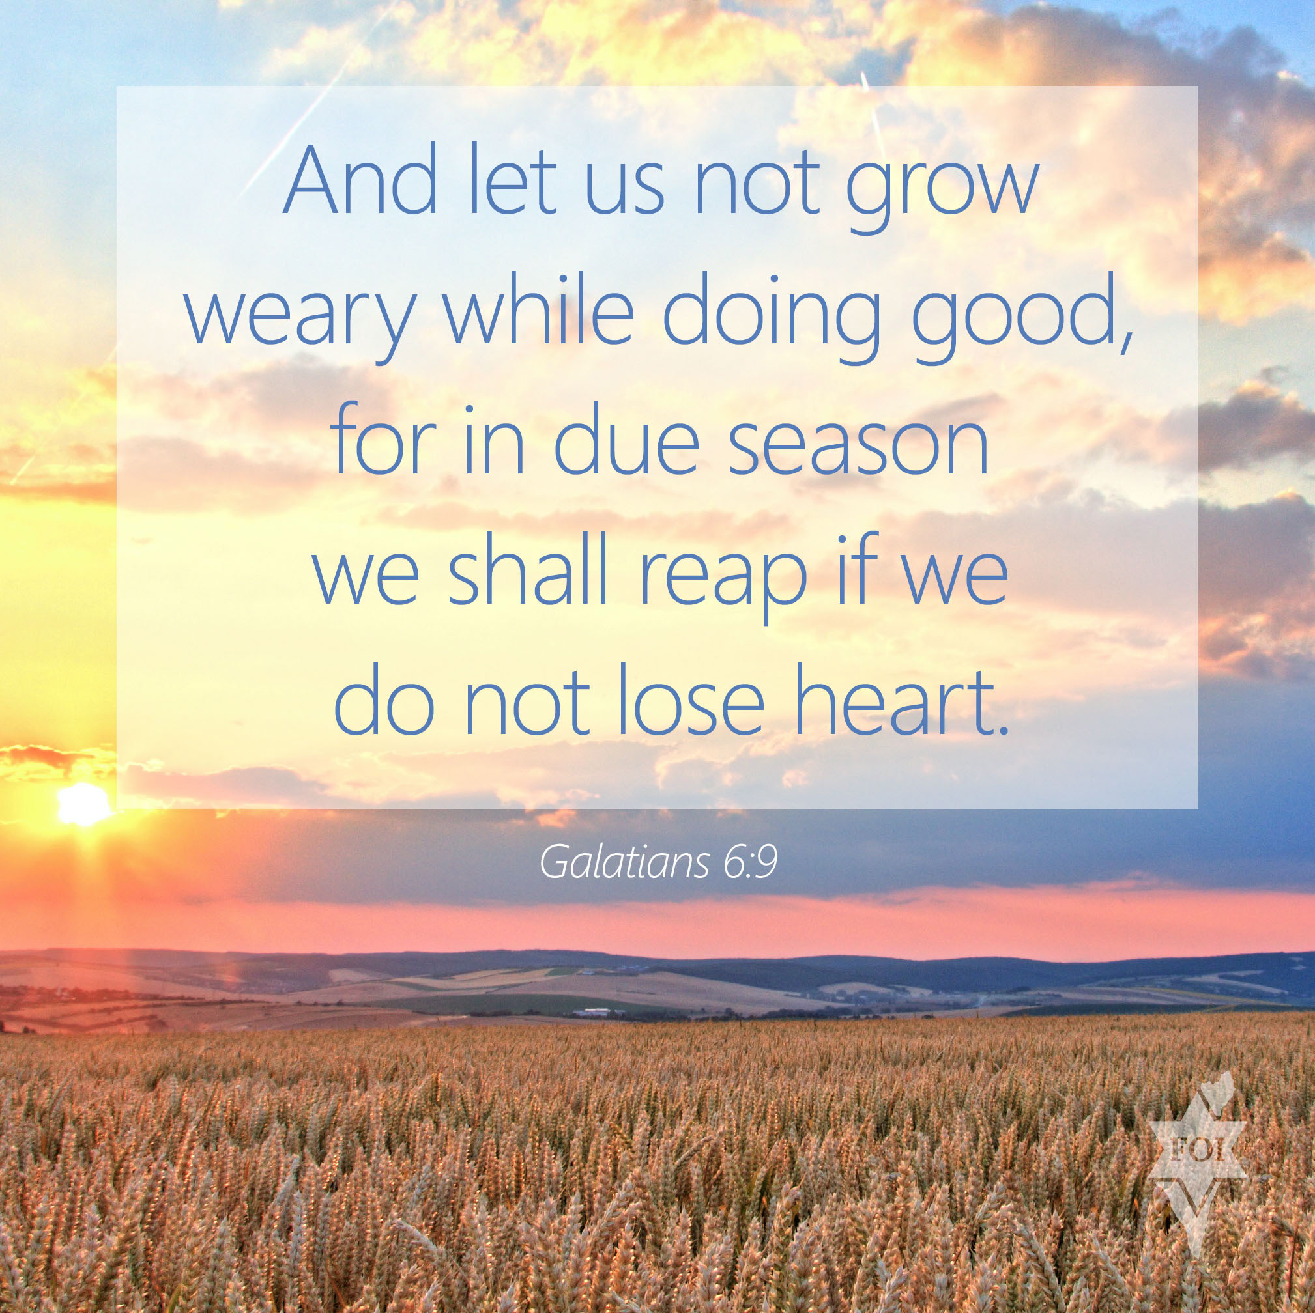

Slide 241
Before you quit:

Slide 242
Before you quit:
Get some sleep (v. 5)

Slide 243
Before you quit:
Get some sleep (v. 5)
Gain some strength (v. 6)

Slide 244
Before you quit:
Get some sleep (v. 5)
Gain some strength (v. 6)
Grow in the Scriptures

Slide 245
Before you quit:
Get some sleep (v. 5)
Gain some strength (v. 6)
Grow in the Scriptures
Go to the Savior

Slide 246
  “For God is not unjust
  to forget your work
  and labor of love
  which you have shown
  toward His name....”
Hebrews 6:10, NKJV

Slide 247
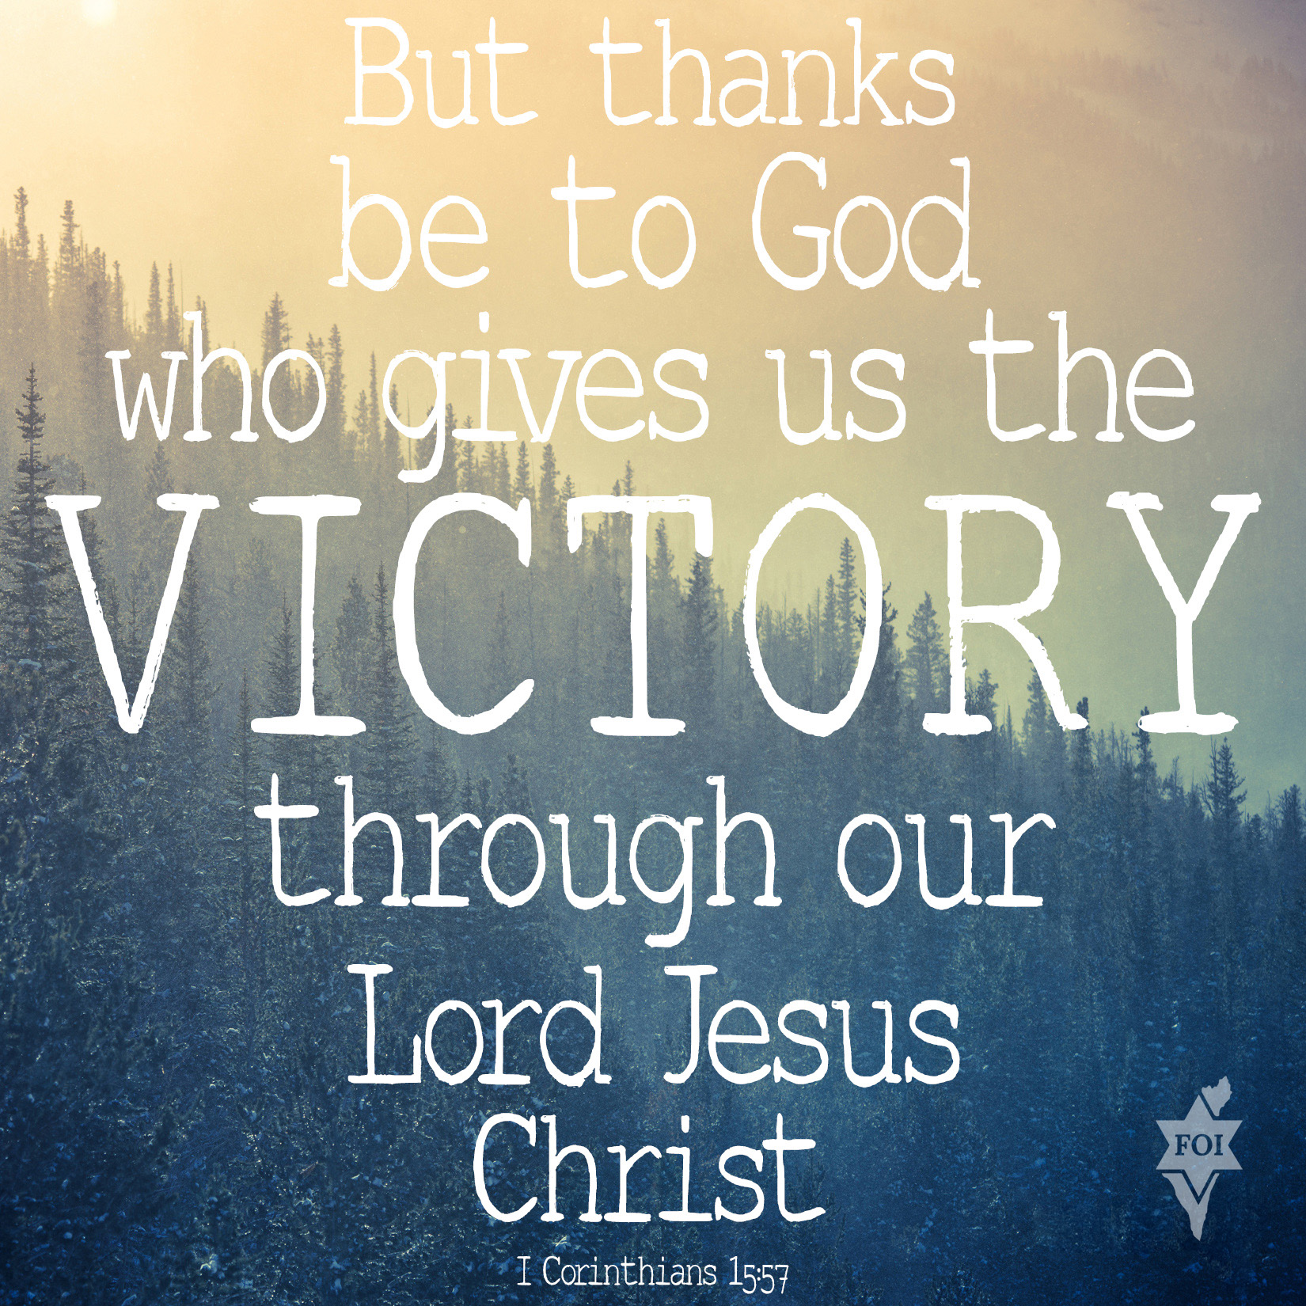

Slide 248
Paul J. Scharf, M.Div.
Church Ministries Representative
foi.org/scharf pscharf@foi.org
Elijah: When You’re
Ready To Quit

