Slide 1
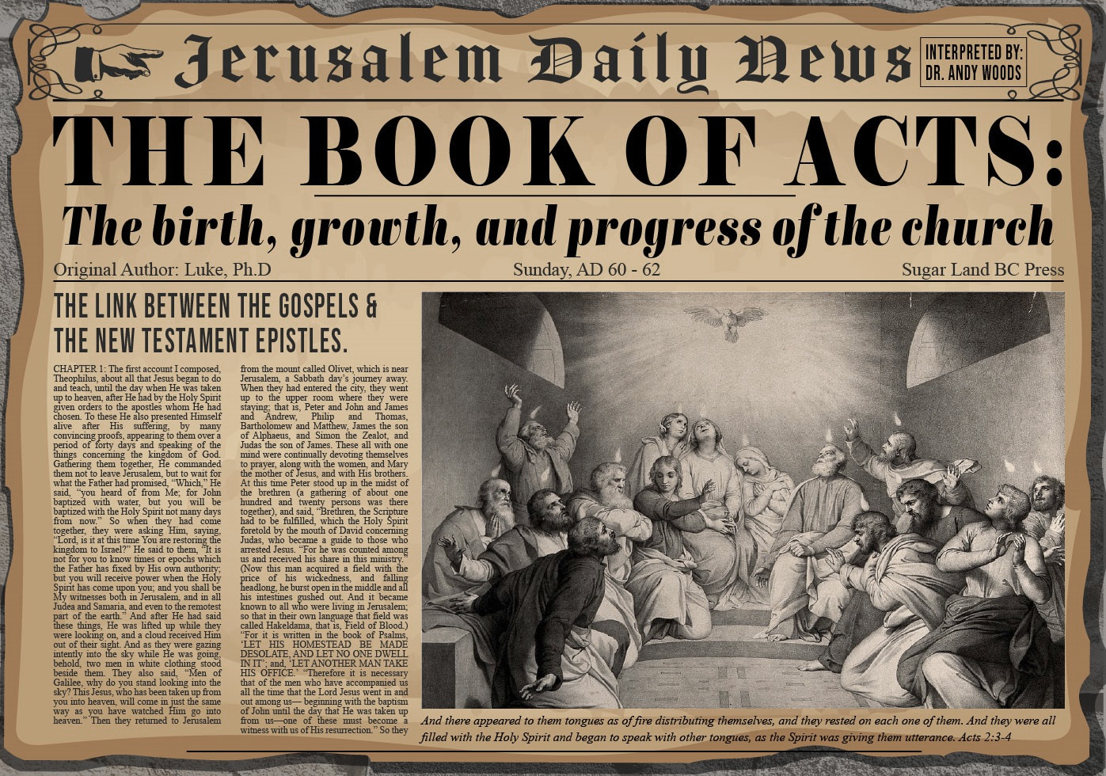

Slide 2
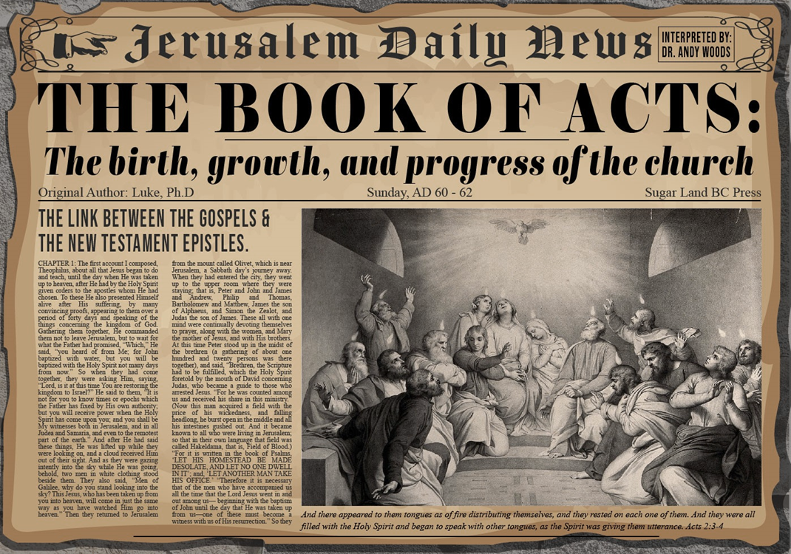
Acts 6:8‒8:4 Stephen
Stephen’s Arrest (6:8‒7:1)
Stephen’s Defense (Acts 7:2-53)
Stephen’s Stoning (7:54-60)
Third Persecution (Acts 8:1-4)

Slide 3
Acts 6:8‒8:4 Stephen
Stephen’s Arrest (6:8‒7:1)
Stephen’s Defense (Acts 7:2-53)
Stephen’s Stoning (7:54-60)
Third Persecution (Acts 8:1-4)

Slide 4
Acts 7 – Stephen’s Speech
1. 7:2-5 | Abraham’s partial obedience
2. 7:6-38 | Israel’s initial rejections and later acceptances
3. 7:39-41 | Israel’s early rebellion against Moses
4. 7:42-45 | Israel reinterpreted Moses’ teachings though a polytheistic framework
5. 7:46-50 | Neither the Tabernacle nor Temple were intended as permanent habitations of God
6. 7:51-53 | Current generation imitating these same rebellions

Slide 5
Acts 6:8‒8:4 Stephen
Stephen’s Arrest (6:8‒7:1)
Stephen’s Defense (Acts 7:2-53)
Stephen’s Stoning (7:54-60)
Third Persecution (Acts 8:1-4)

Slide 6
III. Stephen’s Stoning Acts 7:54-60
Audience's reaction (54)
Stephen’s dying vision (55-56)
Stephen’s death (57-60)

Slide 7
III. Stephen’s Stoning Acts 7:54-60
Audience's reaction (54)
Stephen’s dying vision (55-56)
Stephen’s death (57-60)

Slide 8
John 16:7–11
⁷ “But I tell you the truth, it is to your advantage that I go away; for if I do not go away, the Helper will not come to you; but if I go, I will send Him to you. ⁸ “And He, when He comes, will convict the world concerning sin and righteousness and judgment; ⁹ concerning sin, because they do not believe in Me; ¹⁰ and concerning righteousness, because I go to the Father and you no longer see Me; ¹¹ and concerning judgment, because the ruler of this world has been judged.

Slide 9
III. Stephen’s Stoning Acts 7:54-60
Audience's reaction (54)
Stephen’s dying vision (55-56)
Stephen’s death (57-60)

Slide 10
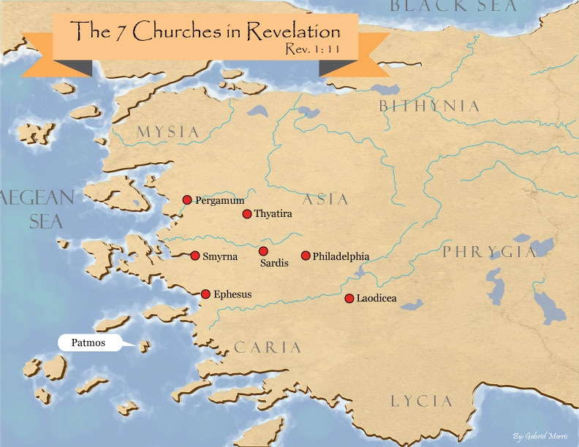

Slide 11
Revelation 3:21
Promise to the Overcomers
“He who overcomes, I will grant to him to sit down with Me on My throne, as I also overcame and sat down with My Father on His throne.”

Slide 12
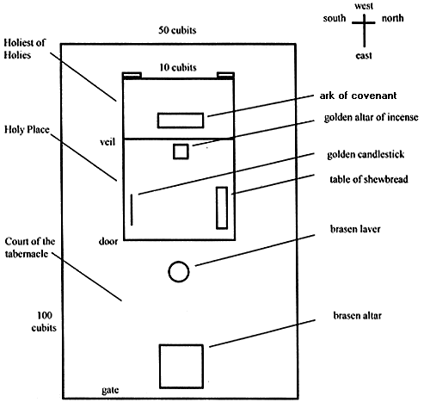
Tabernacle Diagram

Slide 13
III. Stephen’s Stoning Acts 7:54-60
Audience's reaction (54)
Stephen’s dying vision (55-56)
Stephen’s death (57-60)

Slide 14
Acts 7:57-60 Stephen’s Death
Mob response (57)
Stephen’s stoning (58)
Stephen’s response (59)
Stephen’s death (60)

Slide 15
Acts 7:57-60 Stephen’s Death
Mob response (57)
Stephen’s stoning (58)
Stephen’s response (59)
Stephen’s death (60)

Slide 16
Acts 7:57-60 Stephen’s Death
Mob response (57)
Stephen’s stoning (58)
Stephen’s response (59)
Stephen’s death (60)

Slide 17
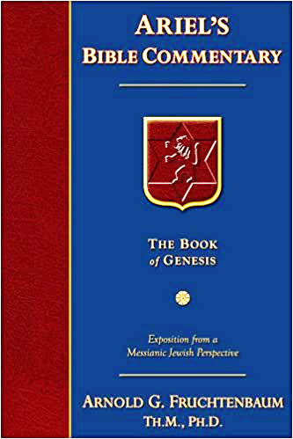
Dr. Arnold G. Fruchtenbaum
The Book of Acts, 176-77
“A second explanation is that this event may have occurred in A.D. 36. In that year, Vitellus became the new imperial legate of the Province of Syria, which included Judea. He deposed Pontius Pilate from his procuratorship in A.D. 36. Pilate’s successor, Marullus, did not arrive until A.D. 38. So there may have been a hiatus or a break between the deposing of Pilate and the arrival of the new procurator. It could very well be that the stoning of Stephen occurred during this time, which would have left the Sanhedrin without tight Roman oversight. A third explanation is that this was a mob scene, and mobs do not regard the rules of law.”

Slide 18
From Peter to Paul
Reference | Center | Person | Place | Outreach
Acts 1–12 | Jerusalem | Peter | Jerusalem, Judea, Samaria | Jewish
Acts 13–28 | Antioch | Paul | Uttermost parts | Gentiles

Slide 19
From Peter to Paul
Peter | Paul
Heals a man lame from birth (3:1-11) | Heals a man lame from birth (14:8-18)
Heals by shadow (5:15-16) | Heals by handkerchief (19:11-12)
Success is a cause of jealousy (5:17) | Success is a cause of jealousy (13:45)
Confronts a sorcerer (8:9-24) | Confronts a sorcerer (13:6-11)
Raises Dorcas (9:36-41) | Raises Eutychus (20:9-12)
Jailed and miraculously freed (12:3-19) | Jailed and miraculously freed (16:25-34)

Slide 20
Acts 7:57-60 Stephen’s Death
Mob response (57)
Stephen’s stoning (58)
Stephen’s response (59)
Stephen’s death (60)

Slide 21
Acts 7:57-60 Stephen’s Death
Mob response (57)
Stephen’s stoning (58)
Stephen’s response (59)
Stephen’s death (60)

Slide 22
Acts 7:60 Stephen’s Death
Kneeling (60a)
Cried out (60b)
Fell asleep (60c)

Slide 23
Acts 7:60 Stephen’s Death
Kneeling (60a)
Cried out (60b)
Fell asleep (60c)

Slide 24
Acts 7:60 Stephen’s Death
Kneeling (60a)
Cried out (60b)
Fell asleep (60c)

Slide 25
Acts 7:60 Stephen’s Death
Kneeling (60a)
Cried out (60b)
Fell asleep (60c)

Slide 26
1 Thessalonians 4:13-18
¹³ "But we do not want you to be uninformed, brethren, about those who are asleep, so that you will not grieve as do the rest who have no hope. ¹⁴ For if we believe that Jesus died and rose again, even so God will bring with Him those who have fallen asleep in Jesus. ¹⁵ For this we say to you by the word of the Lord, that we who are alive and remain until the coming of the Lord, will not precede . . .

Slide 27
1 Thessalonians 4:13-18
… those who have fallen asleep. ¹⁶ For the Lord Himself descend from heaven with a shout, with the voice of the archangel and with the trumpet of God, and the dead in Christ will rise first. ¹⁷ Then we who are alive and remain will be caught up together with them in the clouds to meet the Lord in the air, and so we shall always be with the Lord. ¹⁸ Therefore comfort one another with these words."

Slide 28
Conclusion

Slide 29
Acts 6:8‒8:4 Stephen
Stephen’s Arrest (6:8‒7:1)
Stephen’s Defense (Acts 7:2-53)
Stephen’s Stoning (7:54-60)
Third Persecution (Acts 8:1-4)

Slide 30
III. Stephen’s Stoning Acts 7:54-60
Audience's reaction (54)
Stephen’s dying vision (55-56)
Stephen’s death (57-60)

