Slide 1


Dr. Andy Woods
Senior Pastor – Sugar Land Bible Church
President – Chafer Theological Seminary

Slide 2
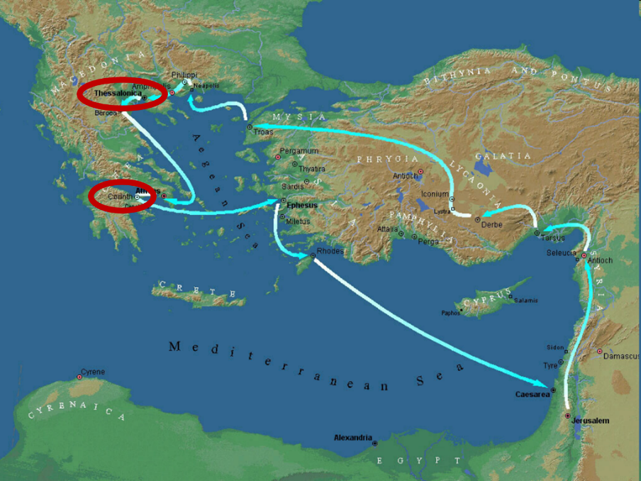

Slide 3
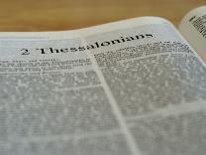
2 Thessalonians 2:1-12
Problem (2:1-2)
Prerequisites for the Day of the Lord (2:3-12)
  The departure (2:3a)
  Advent of the lawless one (2:3b-4)
  Removal of the restrainer (2:5-7)
  Destruction of the lawless one (2:8-9)
  Destruction of lawless one’s followers (2:10-12)

Slide 4


2 Thessalonians 2:2
“that you not be quickly shaken from your composure or be disturbed either by a spirit or a message or a letter as if from us, to the effect that the day of the Lord [the Tribulation] has come.”

Slide 5
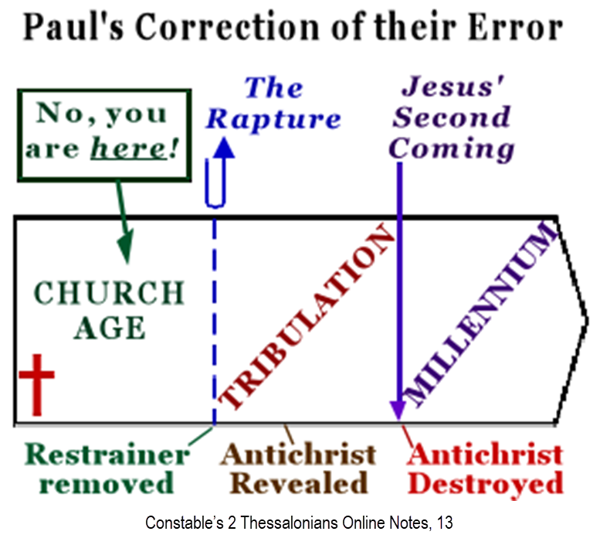

Slide 6
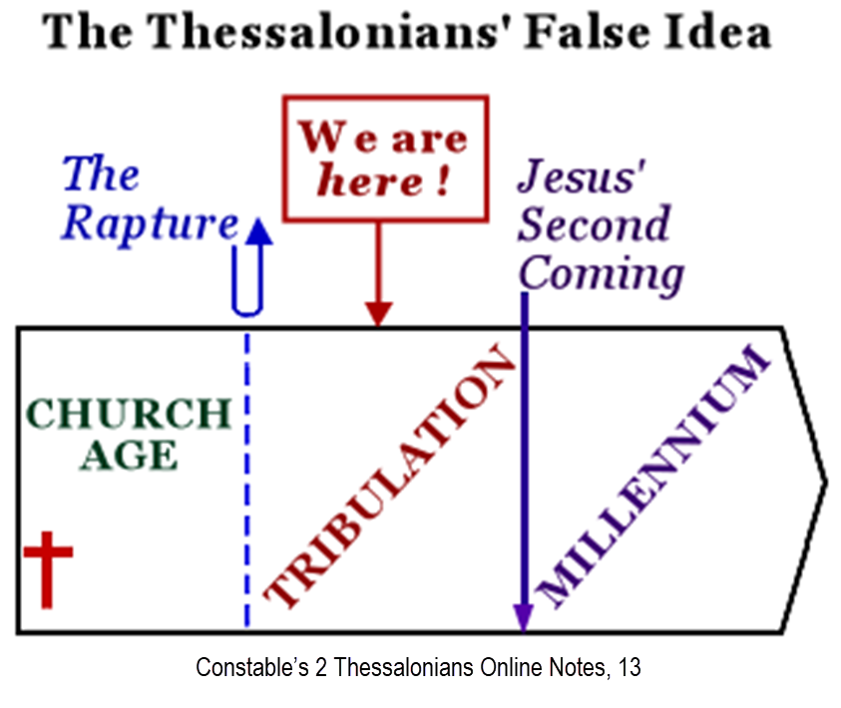

Slide 7
2 Thessalonians 2:1-12
Problem (2:1-2)
Prerequisites for the Day of the Lord (2:3-12)
  The departure (2:3a)
  Advent of the lawless one (2:3b-4)
  Removal of the restrainer (2:5-7)
  Destruction of the lawless one (2:8-9)
  Destruction of lawless one’s followers (2:10-12)

Slide 8
2 Thessalonians 2:1-12
Problem (2:1-2)
Prerequisites for the Day of the Lord (2:3-12)
  The departure (2:3a)
  Advent of the lawless one (2:3b-4)
  Removal of the restrainer (2:5-7)
  Destruction of the lawless one (2:8-9)
  Destruction of lawless one’s followers (2:10-12)

Slide 9
2 Thessalonians 2:1-12
Problem (2:1-2)
Prerequisites for the Day of the Lord (2:3-12)
  The departure (2:3a)
  Advent of the lawless one (2:3b-4)
  Removal of the restrainer (2:5-7)
  Destruction of the lawless one (2:8-9)
  Destruction of lawless one’s followers (2:10-12)

Slide 10
2 Thessalonians 2:1-12
Problem (2:1-2)
Prerequisites for the Day of the Lord (2:3-12)
  The departure (2:3a)
  Advent of the lawless one (2:3b-4)
  Removal of the restrainer (2:5-7)
  Destruction of the lawless one (2:8-9)
  Destruction of lawless one’s followers (2:10-12)

Slide 11
2 Thessalonians 2:1-12
Problem (2:1-2)
Prerequisites for the Day of the Lord (2:3-12)
  The departure (2:3a)
  Advent of the lawless one (2:3b-4)
  Removal of the restrainer (2:5-7)
  Destruction of the lawless one (2:8-9)
  Destruction of lawless one’s followers (2:10-12)

Slide 12


2 Thessalonians 2:9
“that is, the one whose coming is in accord with the activity of Satan, with all power and signs and false wonders.”

Slide 13
Antichrist’s Satanic Miracles (2 Thessalonians 2:9)
MIRACLE | GREEK | CHRIST’S MINISTRY
Powers | Dynamis | Matt. 11:20
Signs | Sēmeion | John 20:30
Wonders | Teras | Acts 2:22

Slide 14
How Satan Imitates God and the Antichrist Imitates Jesus Christ
NO. | CATEGORY | JESUS CHRIST | ANTICHRIST
1. | World prepared in advance | Gal. 4:4 | 2 Thess. 2:7
2. | Revealed at the proper time | Gal. 4:4 | 2 Thess. 2:6
3. | Claim of deity | John 14:9 | 2 Thess. 2:4
4. | Heralded by a forerunner | John 1:23 | Rev. 13:12
5. | Forerunner comes in the Spirit and power of Elijah | Luke 1:17 | 1 Kgs. 8:37-38; Rev. 13:13
6. | Empowered by a higher source | 1 Cor. 6:14 | Rev. 13:4
7. | Member of a Trinity | Phil. 1:2; Acts 5:3-4; John 14:9 | Rev. 16:13; 20:10
8. | Head of a Church | Eph. 5:23 | Rev. 2:9; 3:9
9. | Miracle worker | Acts 2:22 | 2 Thess. 2:9
10. | Resurrection from the dead | 1 Cor. 15:3-6 | Rev. 13:3, 12, 14
11. | Given a throne | Rev. 3:21 | Rev. 13:2

Slide 15
How Satan Imitates God and the Antichrist Imitates Jesus Christ
NO. | CATEGORY | JESUS CHRIST | ANTICHRIST
12. | Ruling a political kingdom | Isa. 9:6-7 | Rev. 13:5
13. | Ushering in world peace | Isa. 9:6-7 | Rev. 6:1-4
14. | Activity in the Temple | Luke 2:41-50 | 2 Thess. 2:4
15. | Putting an end to animal sacrifices | Heb. 9:26-29 | Dan. 9:27
16. | Length of ministry | Over 3 years | Rev. 13:5
17. | Sealing ministry | Eph. 4:30 | Rev. 13:16-17
18. | Presentation to Israel as her Messiah | John 1:11 | John 5:43
19. | Covenant with Israel | Gen. 15:18 | Dan. 9:27
20. | Reception of worship | Zech. 14:16 | 2 Thess. 2:4
21. | Establishing Jerusalem as the center of worldwide worship | Zech. 14:17 | 2 Thess. 2:4

Slide 16
ISRAEL’S FOUR TEMPLES
Solomon’s pre-exilic temple (Kings and Chronicles)
Zerubbabel’s post exilic temple (Ezra 1-6; John 2:20)
Antichrist's temple (Dan. 9:27; Matt. 24:15; 2 Thess. 2:4; Rev. 11:1-2)
Millennial temple (Ezek. 40-48)

Slide 17
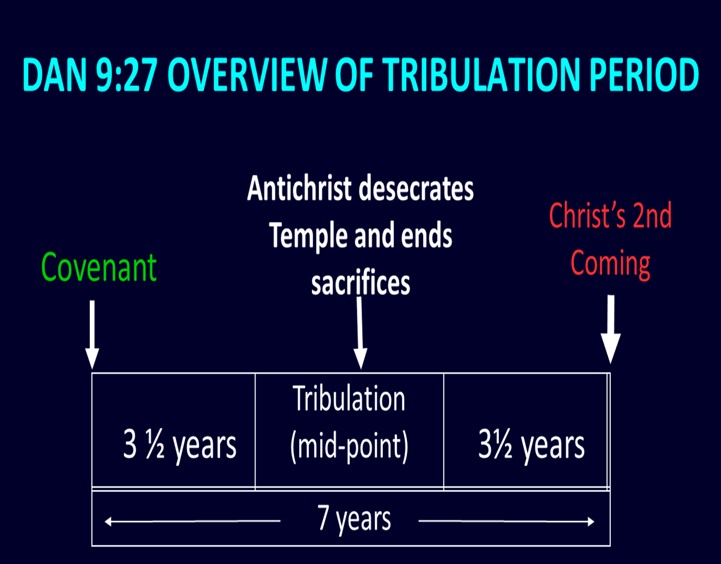

Slide 18

Daniel 9:27
“And he will make a firm covenant with the many for one week, but in the middle of the week he will put a stop to sacrifice and grain offering; and on the wing of abominations will come one who makes desolate, even until a complete destruction, one that is decreed, is poured out on the one who makes desolate.”

Slide 19
How Satan Imitates God and the Antichrist Imitates Jesus Christ
NO. | CATEGORY | JESUS CHRIST | ANTICHRIST
12. | Ruling a political kingdom | Isa. 9:6-7 | Rev. 13:5
13. | Ushering in world peace | Isa. 9:6-7 | Rev. 6:1-4
14. | Activity in the Temple | Luke 2:41-50 | 2 Thess. 2:4
15. | Putting an end to animal sacrifices | Heb. 9:26-29 | Dan. 9:27
16. | Length of ministry | Over 3 years | Rev. 13:5
17. | Sealing ministry | Eph. 4:30 | Rev. 13:16-17
18. | Presentation to Israel as her Messiah | John 1:11 | John 5:43
19. | Covenant with Israel | Gen. 15:18 | Dan. 9:27
20. | Reception of worship | Zech. 14:16 | 2 Thess. 2:4
21. | Establishing Jerusalem as the center of worldwide worship | Zech. 14:17 | 2 Thess. 2:4

Slide 20
Daniel 9:27
“And he will make a firm covenant with the many for one week, but in the middle of the week he will put a stop to sacrifice and grain offering; and on the wing of abominations will come one who makes desolate, even until a complete destruction, one that is decreed, is poured out on the one who makes desolate.”

Slide 21
How Satan Imitates God and the Antichrist Imitates Jesus Christ
NO. | CATEGORY | JESUS CHRIST | ANTICHRIST
12. | Ruling a political kingdom | Isa. 9:6-7 | Rev. 13:5
13. | Ushering in world peace | Isa. 9:6-7 | Rev. 6:1-4
14. | Activity in the Temple | Luke 2:41-50 | 2 Thess. 2:4
15. | Putting an end to animal sacrifices | Heb. 9:26-29 | Dan. 9:27
16. | Length of ministry | Over 3 years | Rev. 13:5
17. | Sealing ministry | Eph. 4:30 | Rev. 13:16-17
18. | Presentation to Israel as her Messiah | John 1:11 | John 5:43
19. | Covenant with Israel | Gen. 15:18 | Dan. 9:27
20. | Reception of worship | Zech. 14:16 | 2 Thess. 2:4
21. | Establishing Jerusalem as the center of worldwide worship | Zech. 14:17 | 2 Thess. 2:4

Slide 22

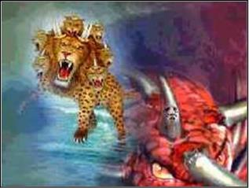
Revelation 13:5
“There was given to him a mouth speaking arrogant words and blasphemies, and authority to act for forty-two months was given to him.”

Slide 23


Daniel 7:25
“He will speak out against the Most High and wear down the saints of the Highest One, and he will intend to make alterations in times and in law; and they will be given into his hand for a time, times, and half a time.”

Slide 25
How Satan Imitates God and the Antichrist Imitates Jesus Christ
NO. | CATEGORY | JESUS CHRIST | ANTICHRIST
12. | Ruling a political kingdom | Isa. 9:6-7 | Rev. 13:5
13. | Ushering in world peace | Isa. 9:6-7 | Rev. 6:1-4
14. | Activity in the Temple | Luke 2:41-50 | 2 Thess. 2:4
15. | Putting an end to animal sacrifices | Heb. 9:26-29 | Dan. 9:27
16. | Length of ministry | Over 3 years | Rev. 13:5
17. | Sealing ministry | Eph. 4:30 | Rev. 13:16-17
18. | Presentation to Israel as her Messiah | John 1:11 | John 5:43
19. | Covenant with Israel | Gen. 15:18 | Dan. 9:27
20. | Reception of worship | Zech. 14:16 | 2 Thess. 2:4
21. | Establishing Jerusalem as the center of worldwide worship | Zech. 14:17 | 2 Thess. 2:4

Slide 26
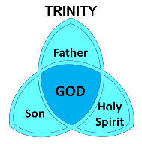
Ephesians 4:30
“Do not grieve the Holy Spirit of God, by whom you were sealed for the day of redemption.”

Slide 27

Revelation 13:16-18
¹⁶ And he causes all, the small and the great, and the rich and the poor, and the free men and the slaves, to be given a mark on their right hand or on their forehead, ¹⁷ and he provides that no one will be able to buy or to sell, except the one who has the mark, either the name of the beast or the number of his name. ¹⁸ Here is wisdom. Let him who has understanding calculate the number of the beast, for the number is that of a man; and his number is six hundred and sixty-six.

Slide 28
How Satan Imitates God and the Antichrist Imitates Jesus Christ
NO. | CATEGORY | JESUS CHRIST | ANTICHRIST
12. | Ruling a political kingdom | Isa. 9:6-7 | Rev. 13:5
13. | Ushering in world peace | Isa. 9:6-7 | Rev. 6:1-4
14. | Activity in the Temple | Luke 2:41-50 | 2 Thess. 2:4
15. | Putting an end to animal sacrifices | Heb. 9:26-29 | Dan. 9:27
16. | Length of ministry | Over 3 years | Rev. 13:5
17. | Sealing ministry | Eph. 4:30 | Rev. 13:16-17
18. | Presentation to Israel as her Messiah | John 1:11 | John 5:43
19. | Covenant with Israel | Gen. 15:18 | Dan. 9:27
20. | Reception of worship | Zech. 14:16 | 2 Thess. 2:4
21. | Establishing Jerusalem as the center of worldwide worship | Zech. 14:17 | 2 Thess. 2:4

Slide 30
Daniel 9:27
“And he will make a firm covenant with the many for one week, but in the middle of the week he will put a stop to sacrifice and grain offering; and on the wing of abominations will come one who makes desolate, even until a complete destruction, one that is decreed, is poured out on the one who makes desolate.”

Slide 31
How Satan Imitates God and the Antichrist Imitates Jesus Christ
NO. | CATEGORY | JESUS CHRIST | ANTICHRIST
12. | Ruling a political kingdom | Isa. 9:6-7 | Rev. 13:5
13. | Ushering in world peace | Isa. 9:6-7 | Rev. 6:1-4
14. | Activity in the Temple | Luke 2:41-50 | 2 Thess. 2:4
15. | Putting an end to animal sacrifices | Heb. 9:26-29 | Dan. 9:27
16. | Length of ministry | Over 3 years | Rev. 13:5
17. | Sealing ministry | Eph. 4:30 | Rev. 13:16-17
18. | Presentation to Israel as her Messiah | John 1:11 | John 5:43
19. | Covenant with Israel | Gen. 15:18 | Dan. 9:27
20. | Reception of worship | Zech. 14:16 | 2 Thess. 2:4
21. | Establishing Jerusalem as the center of worldwide worship | Zech. 14:17 | 2 Thess. 2:4

Slide 32

Genesis 15:18-21
¹⁸ On that day the Lord made a covenant with Abram, saying, “To your descendants I have given this land, From the river of Egypt as far as the great river, the river Euphrates: ¹⁹ the Kenite and the Kenizzite and the Kadmonite ²⁰ and the Hittite and the Perizzite and the Rephaim ²¹ and the Amorite and the Canaanite and the Girgashite and the Jebusite.”

Slide 33


Slide 34
Daniel 9:27
“And he will make a firm covenant with the many for one week, but in the middle of the week he will put a stop to sacrifice and grain offering; and on the wing of abominations will come one who makes desolate, even until a complete destruction, one that is decreed, is poured out on the one who makes desolate.”

Slide 35


Slide 36
How Satan Imitates God and the Antichrist Imitates Jesus Christ
NO. | CATEGORY | JESUS CHRIST | ANTICHRIST
12. | Ruling a political kingdom | Isa. 9:6-7 | Rev. 13:5
13. | Ushering in world peace | Isa. 9:6-7 | Rev. 6:1-4
14. | Activity in the Temple | Luke 2:41-50 | 2 Thess. 2:4
15. | Putting an end to animal sacrifices | Heb. 9:26-29 | Dan. 9:27
16. | Length of ministry | Over 3 years | Rev. 13:5
17. | Sealing ministry | Eph. 4:30 | Rev. 13:16-17
18. | Presentation to Israel as her Messiah | John 1:11 | John 5:43
19. | Covenant with Israel | Gen. 15:18 | Dan. 9:27
20. | Reception of worship | Zech. 14:16 | 2 Thess. 2:4
21. | Establishing Jerusalem as the center of worldwide worship | Zech. 14:17 | 2 Thess. 2:4

Slide 37

Zechariah 14:16-18
“¹⁶ Then it will come about that any who are left of all the nations that went against Jerusalem will go up from year to year to worship the King, the Lord of hosts, and to celebrate the Feast of Booths. ¹⁷ And it will be that whichever of the families of the earth does not go up to Jerusalem to worship the King, the Lord of hosts, there will be no rain on them. ¹⁸ If the family of Egypt does not go up or enter, then no rain will fall on them; it will be the plague with which the Lord smites the nations who do not go up to celebrate the Feast of Booths.”

Slide 38
How Satan Imitates God and the Antichrist Imitates Jesus Christ
NO. | CATEGORY | JESUS CHRIST | ANTICHRIST
12. | Ruling a political kingdom | Isa. 9:6-7 | Rev. 13:5
13. | Ushering in world peace | Isa. 9:6-7 | Rev. 6:1-4
14. | Activity in the Temple | Luke 2:41-50 | 2 Thess. 2:4
15. | Putting an end to animal sacrifices | Heb. 9:26-29 | Dan. 9:27
16. | Length of ministry | Over 3 years | Rev. 13:5
17. | Sealing ministry | Eph. 4:30 | Rev. 13:16-17
18. | Presentation to Israel as her Messiah | John 1:11 | John 5:43
19. | Covenant with Israel | Gen. 15:18 | Dan. 9:27
20. | Reception of worship | Zech. 14:16 | 2 Thess. 2:4
21. | Establishing Jerusalem as the center of worldwide worship | Zech. 14:17 | 2 Thess. 2:4

Slide 39

Isaiah 2:1-4
¹ “The word which Isaiah the son of Amoz saw concerning Judah and Jerusalem.² Now it will come about that In the last days The mountain of the house of the Lord Will be established as the chief of the mountains, And will be raised above the hills; And all the nations will stream to it.³ And many peoples will come and say, “Come, let us go up to the mountain of the Lord, To the house of the God of Jacob; . . .

Slide 40

Isaiah 2:1-4
. . .That He may teach us concerning His ways And that we may walk in His paths.” For the law will go forth from Zion And the word of the Lord from Jerusalem.⁴ And He will judge between the nations, And will render decisions for many peoples; And they will hammer their swords into plowshares and their spears into pruning hooks. Nation will not lift up sword against nation, And never again will they learn war.”

Slide 41
Zechariah 14:16-18
“¹⁶ Then it will come about that any who are left of all the nations that went against Jerusalem will go up from year to year to worship the King, the Lord of hosts, and to celebrate the Feast of Booths. ¹⁷ And it will be that whichever of the families of the earth does not go up to Jerusalem to worship the King, the Lord of hosts, there will be no rain on them. ¹⁸ If the family of Egypt does not go up or enter, then no rain will fall on them; it will be the plague with which the Lord smites the nations who do not go up to celebrate the Feast of Booths.”

Slide 42

Revelation 20:7-9
“⁷ When the thousand years are completed [teleō], Satan will be released from his prison, ⁸ and will come out to deceive the nations which are in the four corners of the earth, Gog and Magog, to gather them together for the war; the number of them is like the sand of the seashore. ⁹ And they came up on the broad plain of the earth and surrounded the camp of the saints and the beloved city, and fire came down from heaven and devoured them.”

Slide 43
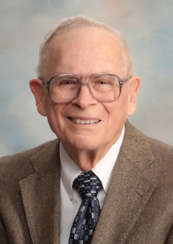
Robert Thomas
Four Views on the Book of Revelation, page 207.
“At the end of the Millennium that city will be Satan’s prime objective with his rebel army, because Israel will be a leader among the nations.”

Slide 44

Test the Spirits
Deut. 13:1-5
Isa. 8:19-20
Acts 17:11
Gal. 1:8-9
1 Thess. 5:20-21
1 John 4:1
Rev. 2:2

Slide 45
Test the Spirits
Deut. 13:1-5
Isa. 8:19-20
Acts 17:11
Gal. 1:8-9
1 Thess. 5:20-21
1 John 4:1
Rev. 2:2

Slide 46
Galatians 1:6–9
⁶ I am amazed that you are so quickly deserting Him who called you by the grace of Christ, for a different gospel; ⁷ which is really not another; only there are some who are disturbing you and want to distort the gospel of Christ. ⁸ But even if we, or an angel from heaven, should preach to you a gospel contrary to what we have preached to you, he is to be accursed! ⁹ As we have said before, so I say again now, if any man is preaching to you a gospel contrary to what you received, he is to be accursed!

Slide 47
Test the Spirits
Deut. 13:1-5
Isa. 8:19-20
Acts 17:11
Gal. 1:8-9
1 Thess. 5:20-21
1 John 4:1
Rev. 2:2

Slide 48
Test the Spirits
Deut. 13:1-5
Isa. 8:19-20
Acts 17:11
Gal. 1:8-9
1 Thess. 5:20-21
1 John 4:1
Rev. 2:2

Slide 49


1 John 4:1
“Beloved, do not believe every spirit, but test the spirits to see whether they are from God, because many false prophets have gone out into the world.”

Slide 50
Test the Spirits
Deut. 13:1-5
Isa. 8:19-20
Acts 17:11
Gal. 1:8-9
1 Thess. 5:20-21
1 John 4:1
Rev. 2:2

Slide 51



Slide 52


Revelation 2:2
‘I know your deeds and your toil and perseverance, and that you cannot tolerate evil men, and you put to the test [peirázō] those who call themselves apostles, and they are not, and you found them to be false;

Slide 53

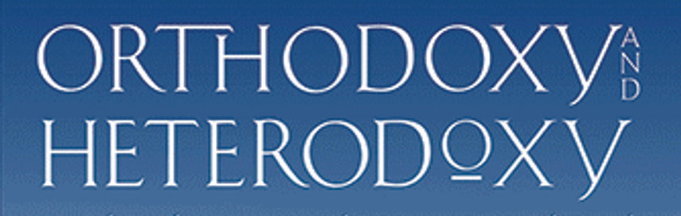
Limits of Orthodoxy
Deut 13:1-5;
Prov 30:6;
Acts 17:11;
Gal. 1:6-9;
1 Thess 5:21;
2 Pet 3:16;
Rev 2:2; 22:18-19

Slide 54
Limits of Orthodoxy
Deut 13:1-5;
Prov 30:6;
Acts 17:11;
Gal. 1:6-9;
1 Thess 5:21;
2 Pet 3:16;
Rev 2:2; 22:18-19

Slide 55
Galatians 1:6–9
⁶ I am amazed that you are so quickly deserting Him who called you by the grace of Christ, for a different gospel; ⁷ which is really not another; only there are some who are disturbing you and want to distort the gospel of Christ. ⁸ But even if we, or an angel from heaven, should preach to you a gospel contrary to what we have preached to you, he is to be accursed! ⁹ As we have said before, so I say again now, if any man is preaching to you a gospel contrary to what you received, he is to be accursed!

Slide 56
Limits of Orthodoxy
Deut 13:1-5;
Prov 30:6;
Acts 17:11;
Gal. 1:6-9;
1 Thess 5:21;
2 Pet 3:16;
Rev 2:2; 22:18-19

Slide 57
Limits of Orthodoxy
Deut 13:1-5;
Prov 30:6;
Acts 17:11;
Gal. 1:6-9;
1 Thess 5:21;
2 Pet 3:16;
Rev 2:2; 22:18-19

Slide 58

2 Peter 3:16-17
“¹⁶ as also in all his letters, speaking in them of these things, in which are some things hard to understand, which the untaught and unstable distort, as they do also the rest of the Scriptures, to their own destruction. ¹⁷ You therefore, beloved, knowing this beforehand, be on your guard so that you are not carried away by the error of unprincipled men and fall from your own steadfastness.”

Slide 59
Limits of Orthodoxy
Deut 13:1-5;
Prov 30:6;
Acts 17:11;
Gal. 1:6-9;
1 Thess 5:21;
2 Pet 3:16;
Rev 2:2; 22:18-19

Slide 60
Revelation 2:2
‘I know your deeds and your toil and perseverance, and that you cannot tolerate evil men, and you put to the test [peirázō] those who call themselves apostles, and they are not, and you found them to be false;

Slide 62
Revelation 22:17-19
“¹⁷ The Spirit and the bride say, ‘Come.’ And let the one who hears say, ‘Come.’ And let the one who is thirsty come; let the one who desires, take the water of life without cost.¹⁸ I testify to everyone who hears the words of the prophecy of this book: if anyone adds to them, God will add to him the plagues which are written in this book; ¹⁹ and if anyone takes away from the words of the book of this prophecy, God will take away his part [meros] from the tree of life and from the holy city, which are written in this book.”

Slide 63
Conclusion

Slide 64
2 Thessalonians 2:1-12
Problem (2:1-2)
Prerequisites for the Day of the Lord (2:3-12)
  The departure (2:3a)
  Advent of the lawless one (2:3b-4)
  Removal of the restrainer (2:5-7)
  Destruction of the lawless one (2:8-9)
  Destruction of lawless one’s followers (2:10-12)

