Slide 1
Genesis 12‒50
Israel’s Birth & Preservation

Slide 2
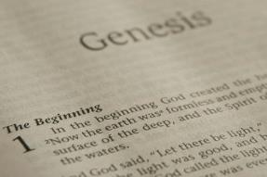
GENESIS STRUCTURE
Genesis 12-50 (four people)
Abraham (12:1–25:11)
Isaac (25:12–26:35)
Jacob (27–36)
Joseph (37–50)

Slide 3
Genesis 37:2-36 Joseph Sold unto Egypt
Joseph’s coat (37:2-4)
Joseph’s dreams (37:5-11)
Joseph’s pit (37:12-24)
Joseph’s enslavement (37:25-36)

Slide 4
Genesis 38:1-30 Judah & Tamar
Tamar & Judah’s sons (38:1-11)
Tamar & Judah (38:12-26)
Tamar & Judah’s twins (38:27-30)

Slide 5
III. Genesis 38:27-30 Twins of Tamar & Judah
Birth of the twins (27)
Scarlet thread (28)
Reversal of the birth order (29-30)

Slide 6
III. Genesis 38:27-30 Twins of Tamar & Judah
Birth of the twins (27)
Scarlet thread (28)
Reversal of the birth order (29-30)

Slide 7
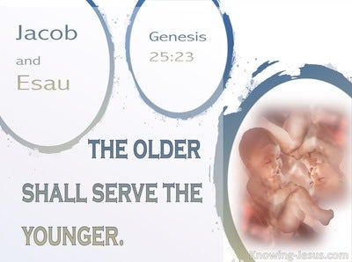
Genesis 25:23
“The Lord said to her, ‘Two nations are in your womb; And two peoples will be separated from your body; And one people shall be stronger than the other; And the older shall serve the younger.’”

Slide 8
Luke 19:42-44
^{“42} saying, ‘If you had known in this day, even you, the things which make for peace! But now they have been hidden from your eyes. ⁴³ For the days will come upon you when your enemies will throw up a barricade against you, and surround you and hem you in on every side, ⁴⁴ and they will level you to the ground and your children within you, and they will not leave in you one stone upon another, because you did not recognize the time of your visitation.’”

Slide 9
III. Genesis 38:27-30 Twins of Tamar & Judah
Birth of the twins (27)
Scarlet thread (28)
Reversal of the birth order (29-30)

Slide 10
III. Genesis 38:27-30 Twins of Tamar & Judah
Birth of the twins (27)
Scarlet thread (28)
Reversal of the birth order (29-30)

Slide 11
Genesis 38:29-30 Reversal of the Birth Order
Perez’ birth (29)
Zerah’s birth (30)

Slide 12
Genesis 38:29-30 Reversal of the Birth Order
Perez’ birth (29)
Zerah’s birth (30)

Slide 13
Cain Murders Abel (Genesis 4:3-8)
4:3-5a
Messianic line through Abel (Gen 3:21; Heb 11:4) contrary to Eve’s false expectation (4:1)
Begins selection of younger over older pattern (Abel over Cain, Seth over Cain, Shem over Japheth, Isaac over Ishmael, Jacob over Esau, Judah and Joseph over their brothers, and Ephraim over Manasseh)

Slide 14
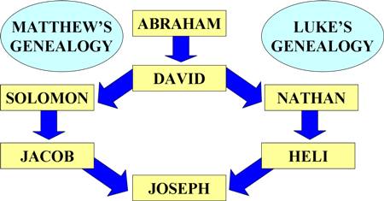
To Circumvent Jeconiah’s Curse

Slide 15
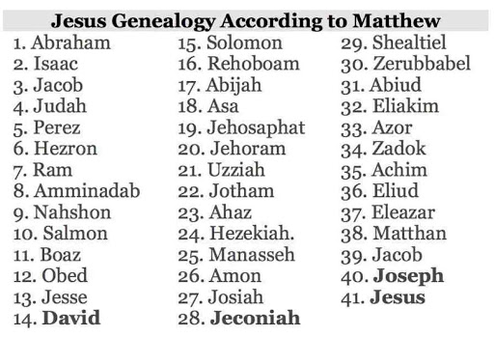

Slide 17
Genesis 38:29-30 Reversal of the Birth Order
Perez’ birth (29)
Zerah’s birth (30)

Slide 18
Genesis 38:1-30 Concluding Observations
Interruption of the Joseph account
Why the Egyptian sojourn was necessary
Problem of Canaanite intermarriage
Problem of Canaanite immorality
Problem of famine in Canaan
Messianic lineage
Origin of Levirate Marriage
Sexual temptation: Judah vs. Joseph

Slide 19
Genesis 38:1-30 Concluding Observations
Interruption of the Joseph account
Why the Egyptian sojourn was necessary
Problem of Canaanite intermarriage
Problem of Canaanite immorality
Problem of famine in Canaan
Messianic lineage
Origin of Levirate Marriage
Sexual temptation: Judah vs. Joseph

Slide 20
Genesis 38:1-30 Concluding Observations
Interruption of the Joseph account
Why the Egyptian sojourn was necessary
Problem of Canaanite intermarriage
Problem of Canaanite immorality
Problem of famine in Canaan
Messianic lineage
Origin of Levirate Marriage
Sexual temptation: Judah vs. Joseph

Slide 22
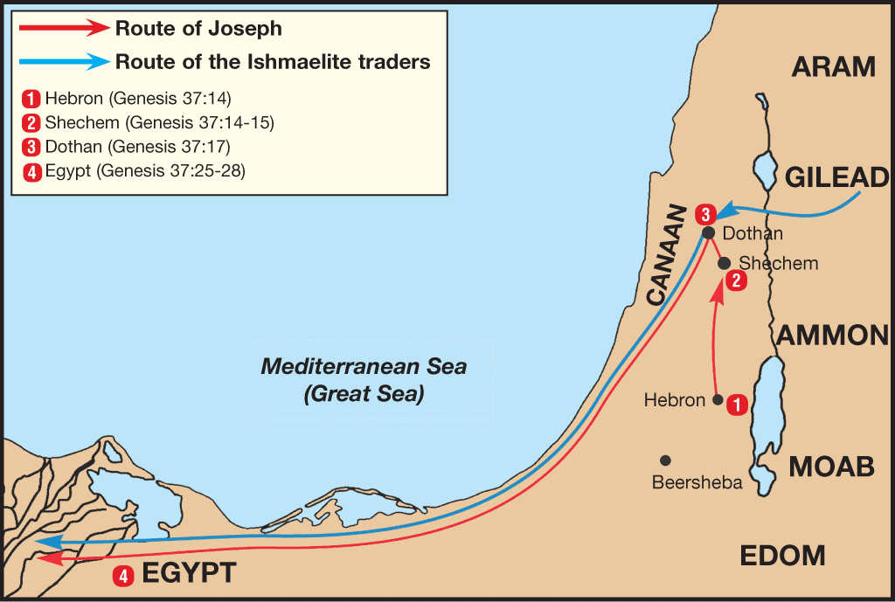

Slide 23
Genesis 38:1-30 Concluding Observations
Interruption of the Joseph account
Why the Egyptian sojourn was necessary
Problem of Canaanite intermarriage
Problem of Canaanite immorality
Problem of famine in Canaan
Messianic lineage
Origin of Levirate Marriage
Sexual temptation: Judah vs. Joseph

Slide 24
Genesis 38:1-30 Concluding Observations
Interruption of the Joseph account
Why the Egyptian sojourn was necessary
Problem of Canaanite intermarriage
Problem of Canaanite immorality
Problem of famine in Canaan
Messianic lineage
Origin of Levirate Marriage
Sexual temptation: Judah vs. Joseph

Slide 25
Genesis 38:1-30 Concluding Observations
Interruption of the Joseph account
Why the Egyptian sojourn was necessary
Problem of Canaanite intermarriage
Problem of Canaanite immorality
Problem of famine in Canaan
Messianic lineage
Origin of Levirate Marriage
Sexual temptation: Judah vs. Joseph

Slide 26
God’s Provision for His People (Phil. 4:19)
Exodus 16
1 Kings 17:2-6
Psalm 37:25
Matthew 6:25-34

Slide 27
God’s Provision for His People (Phil. 4:19)
Exodus 16
1 Kings 17:2-6
Psalm 37:25
Matthew 6:25-34

Slide 28
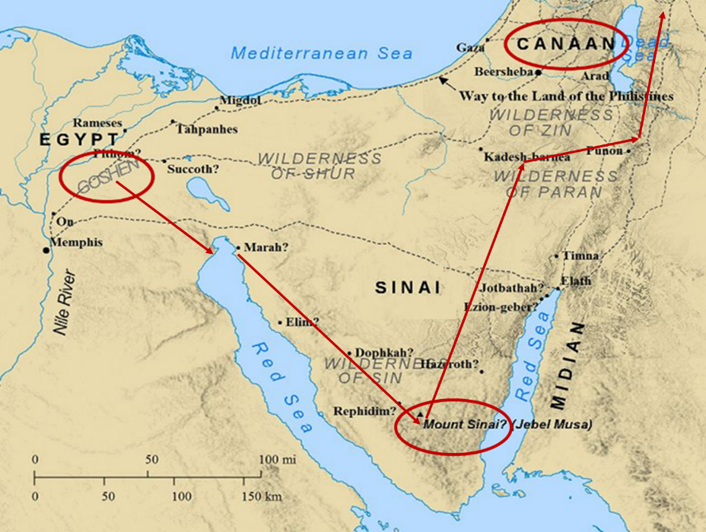

Slide 29
God’s Provision for His People (Phil. 4:19)
Exodus 16
1 Kings 17:2-6
Psalm 37:25
Matthew 6:25-34

Slide 30
Genesis 38:1-30 Concluding Observations
Interruption of the Joseph account
Why the Egyptian sojourn was necessary
Problem of Canaanite intermarriage
Problem of Canaanite immorality
Problem of famine in Canaan
Messianic lineage
Origin of Levirate Marriage
Sexual temptation: Judah vs. Joseph

Slide 32
Genesis 38:1-30 Concluding Observations
Interruption of the Joseph account
Why the Egyptian sojourn was necessary
Problem of Canaanite intermarriage
Problem of Canaanite immorality
Problem of famine in Canaan
Messianic lineage
Origin of Levirate Marriage
Sexual temptation: Judah vs. Joseph

Slide 34
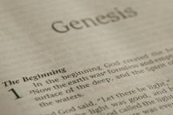
Beginning Themes
Universe Life Man Marriage Evil Clothing | Religion Salvation Language Government Nations Israel
Morris, Genesis Record, 18-20

Slide 35
Genesis 38:1-30 Concluding Observations
Interruption of the Joseph account
Why the Egyptian sojourn was necessary
Problem of Canaanite intermarriage
Problem of Canaanite immorality
Problem of famine in Canaan
Messianic lineage
Origin of Levirate Marriage
Sexual temptation: Judah vs. Joseph

Slide 36
Conclusion

Slide 37
Genesis 38:1-30 Judah & Tamar
Tamar & Judah’s sons (38:1-11)
Tamar & Judah (38:12-26)
Tamar & Judah’s twins (38:27-30)

Slide 38
²⁴ The Lord bless you, and keep you; ²⁵ The Lord make His face shine on you, And be gracious to you; ²⁶ The Lord lift up His countenance on you, And give you peace.
Numbers 6:24–26 (NASB95)

