Slide 1


Dr. Andy Woods
Senior Pastor – Sugar Land Bible Church
President – Chafer Theological Seminary

Slide 2
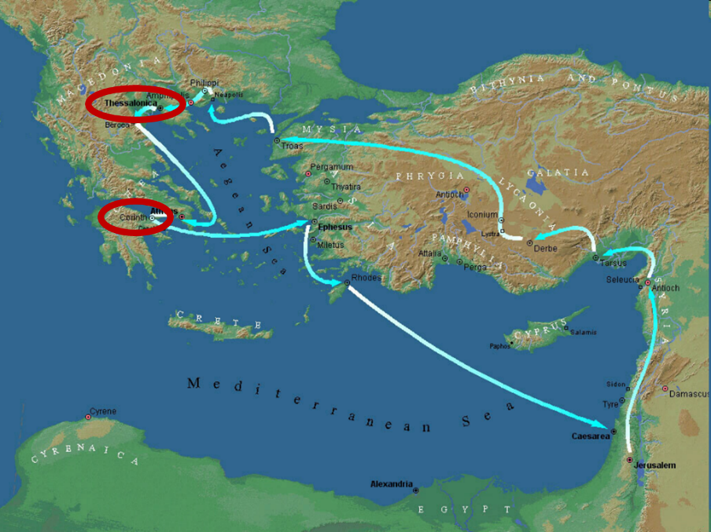

Slide 3
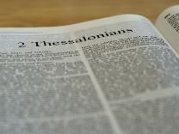
2 Thessalonians 2:1-12
Problem (2:1-2)
Prerequisites for the Day of the Lord (2:3-12)
  The departure (2:3a)
  Advent of the lawless one (2:3b-4)
  Removal of the restrainer (2:5-7)
  Destruction of the lawless one (2:8-9)
  Destruction of lawless one’s followers (2:10-12)

Slide 4


2 Thessalonians 2:2
“that you not be quickly shaken from your composure or be disturbed either by a spirit or a message or a letter as if from us, to the effect that the day of the Lord [the Tribulation] has come.”

Slide 5
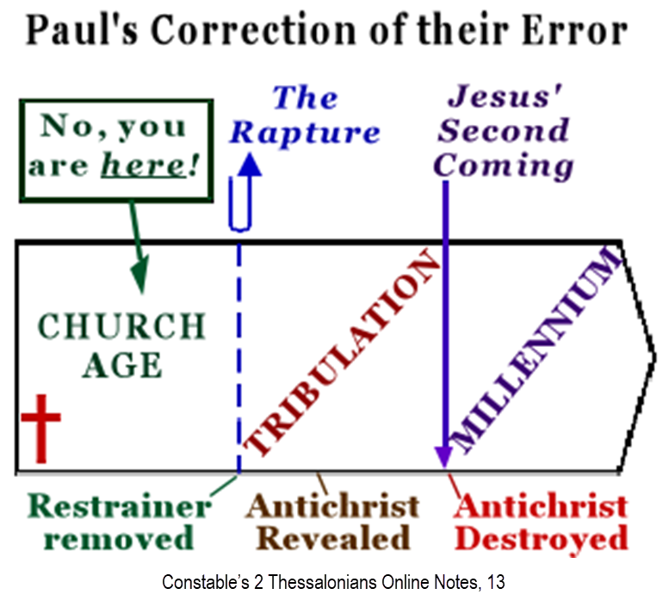

Slide 6
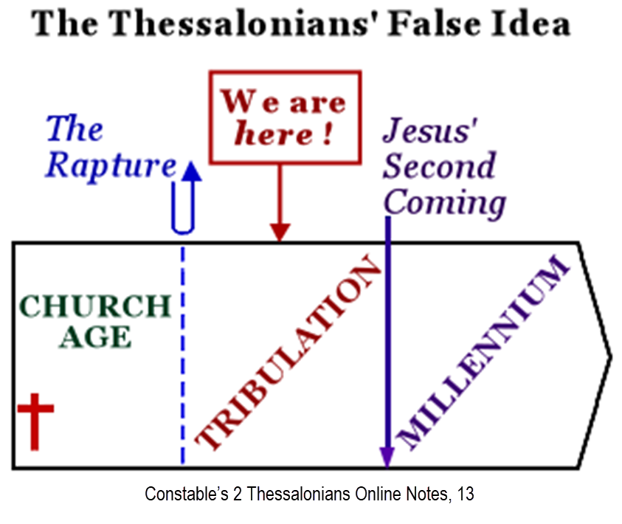

Slide 7
2 Thessalonians 2:1-12
Problem (2:1-2)
Prerequisites for the Day of the Lord (2:3-12)
  The departure (2:3a)
  Advent of the lawless one (2:3b-4)
  Removal of the restrainer (2:5-7)
  Destruction of the lawless one (2:8-9)
  Destruction of lawless one’s followers (2:10-12)

Slide 8
2 Thessalonians 2:1-12
Problem (2:1-2)
Prerequisites for the Day of the Lord (2:3-12)
  The departure (2:3a)
  Advent of the lawless one (2:3b-4)
  Removal of the restrainer (2:5-7)
  Destruction of the lawless one (2:8-9)
  Destruction of lawless one’s followers (2:10-12)

Slide 9
2 Thessalonians 2:1-12
Problem (2:1-2)
Prerequisites for the Day of the Lord (2:3-12)
  The departure (2:3a)
  Advent of the lawless one (2:3b-4)
  Removal of the restrainer (2:5-7)
  Destruction of the lawless one (2:8-9)
  Destruction of lawless one’s followers (2:10-12)

Slide 10
2 Thessalonians 2:1-12
Problem (2:1-2)
Prerequisites for the Day of the Lord (2:3-12)
  The departure (2:3a)
  Advent of the lawless one (2:3b-4)
  Removal of the restrainer (2:5-7)
  Destruction of the lawless one (2:8-9)
  Destruction of lawless one’s followers (2:10-12)

Slide 11
2 Thessalonians 2:1-12
Problem (2:1-2)
Prerequisites for the Day of the Lord (2:3-12)
  The departure (2:3a)
  Advent of the lawless one (2:3b-4)
  Removal of the restrainer (2:5-7)
  Destruction of the lawless one (2:8-9)
  Destruction of lawless one’s followers (2:10-12)

Slide 12


2 Thessalonians 2:9
“that is, the one whose coming is in accord with the activity of Satan, with all power and signs and false wonders.”

Slide 13
Antichrist’s Satanic Miracles (2 Thessalonians 2:9)
MIRACLE | GREEK | CHRIST’S MINISTRY
Powers | Dynamis | Matt. 11:20
Signs | Sēmeion | John 20:30
Wonders | Teras | Acts 2:22

Slide 14
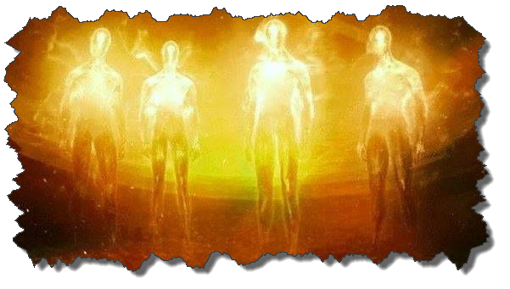

Satanic/Demonic Miracles
Exod. 7–8
Deut. 13:1-3
Job 1:12-19; 2:7-8
1 Sam. 28?
Matt. 7:21-23; 24:24
Luke 4:5
Acts 8:9; 16:16
Gal. 1:6-9
2 Thess. 2:9
Rev. 13:3, 13, 15; 16:13-14

Slide 15
How Satan Imitates God and the Antichrist Imitates Jesus Christ
NO. | CATEGORY | JESUS CHRIST | ANTICHRIST
1. | World prepared in advance | Gal. 4:4 | 2 Thess. 2:7
2. | Revealed at the proper time | Gal. 4:4 | 2 Thess. 2:6
3. | Claim of deity | John 14:9 | 2 Thess. 2:4
4. | Heralded by a forerunner | John 1:23 | Rev. 13:12
5. | Forerunner comes in the Spirit and power of Elijah | Luke 1:17 | 1 Kgs. 8:37-38; Rev. 13:13
6. | Empowered by a higher source | 1 Cor. 6:14 | Rev. 13:4
7. | Member of a Trinity | Phil. 1:2; Acts 5:3-4; John 14:9 | Rev. 16:13; 20:10
8. | Head of a Church | Eph. 5:23 | Rev. 2:9; 3:9
9. | Miracle worker | Acts 2:22 | 2 Thess. 2:9
10. | Resurrection from the dead | 1 Cor. 15:3-6 | Rev. 13:3, 12, 14
11. | Given a throne | Rev. 3:21 | Rev. 13:2

Slide 16
How Satan Imitates God and the Antichrist Imitates Jesus Christ
NO. | CATEGORY | JESUS CHRIST | ANTICHRIST
1. | World prepared in advance | Gal. 4:4 | 2 Thess. 2:7
2. | Revealed at the proper time | Gal. 4:4 | 2 Thess. 2:6
3. | Claim of deity | John 14:9 | 2 Thess. 2:4
4. | Heralded by a forerunner | John 1:23 | Rev. 13:12
5. | Forerunner comes in the Spirit and power of Elijah | Luke 1:17 | 1 Kgs. 8:37-38; Rev. 13:13
6. | Empowered by a higher source | 1 Cor. 6:14 | Rev. 13:4
7. | Member of a Trinity | Phil. 1:2; Acts 5:3-4; John 14:9 | Rev. 16:13; 20:10
8. | Head of a Church | Eph. 5:23 | Rev. 2:9; 3:9
9. | Miracle worker | Acts 2:22 | 2 Thess. 2:9
10. | Resurrection from the dead | 1 Cor. 15:3-6 | Rev. 13:3, 12, 14
11. | Given a throne | Rev. 3:21 | Rev. 13:2

Slide 17

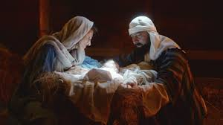
Galatians 4:4
“But when the fullness of the time came, God sent forth His Son, born of a woman, born under the Law.”

Slide 18
How Satan Imitates God and the Antichrist Imitates Jesus Christ
NO. | CATEGORY | JESUS CHRIST | ANTICHRIST
1. | World prepared in advance | Gal. 4:4 | 2 Thess. 2:7
2. | Revealed at the proper time | Gal. 4:4 | 2 Thess. 2:6
3. | Claim of deity | John 14:9 | 2 Thess. 2:4
4. | Heralded by a forerunner | John 1:23 | Rev. 13:12
5. | Forerunner comes in the Spirit and power of Elijah | Luke 1:17 | 1 Kgs. 8:37-38; Rev. 13:13
6. | Empowered by a higher source | 1 Cor. 6:14 | Rev. 13:4
7. | Member of a Trinity | Phil. 1:2; Acts 5:3-4; John 14:9 | Rev. 16:13; 20:10
8. | Head of a Church | Eph. 5:23 | Rev. 2:9; 3:9
9. | Miracle worker | Acts 2:22 | 2 Thess. 2:9
10. | Resurrection from the dead | 1 Cor. 15:3-6 | Rev. 13:3, 12, 14
11. | Given a throne | Rev. 3:21 | Rev. 13:2

Slide 19
Galatians 4:4
“But when the fullness of the time came, God sent forth His Son, born of a woman, born under the Law.”

Slide 20


2 Thessalonians 2:6-7
⁶And you know what restrains [τὸ κατέχον; neuter] him now, so that in his time he will be revealed. ⁷For the mystery of lawlessness is already at work; only he who now restrains [ὁ κατέχων; masculine] will do so until he is taken out of the way.

Slide 21

Messiah must present Himself to Israel on March 30, A.D. 33 (Daniel 9:25)

Slide 22

Luke 19:42-44
^{“42} saying, ‘If you had known in this day, even you, the things which make for peace! But now they have been hidden from your eyes. ⁴³ For the days will come upon you when your enemies will throw up a barricade against you, and surround you and hem you in on every side, ⁴⁴ and they will level you to the ground and your children within you, and they will not leave in you one stone upon another, because you did not recognize the time of your visitation.’”

Slide 23
How Satan Imitates God and the Antichrist Imitates Jesus Christ
NO. | CATEGORY | JESUS CHRIST | ANTICHRIST
1. | World prepared in advance | Gal. 4:4 | 2 Thess. 2:7
2. | Revealed at the proper time | Gal. 4:4 | 2 Thess. 2:6
3. | Claim of deity | John 14:9 | 2 Thess. 2:4
4. | Heralded by a forerunner | John 1:23 | Rev. 13:12
5. | Forerunner comes in the Spirit and power of Elijah | Luke 1:17 | 1 Kgs. 8:37-38; Rev. 13:13
6. | Empowered by a higher source | 1 Cor. 6:14 | Rev. 13:4
7. | Member of a Trinity | Phil. 1:2; Acts 5:3-4; John 14:9 | Rev. 16:13; 20:10
8. | Head of a Church | Eph. 5:23 | Rev. 2:9; 3:9
9. | Miracle worker | Acts 2:22 | 2 Thess. 2:9
10. | Resurrection from the dead | 1 Cor. 15:3-6 | Rev. 13:3, 12, 14
11. | Given a throne | Rev. 3:21 | Rev. 13:2

Slide 24
How Satan Imitates God and the Antichrist Imitates Jesus Christ
NO. | CATEGORY | JESUS CHRIST | ANTICHRIST
1. | World prepared in advance | Gal. 4:4 | 2 Thess. 2:7
2. | Revealed at the proper time | Gal. 4:4 | 2 Thess. 2:6
3. | Claim of deity | John 14:9 | 2 Thess. 2:4
4. | Heralded by a forerunner | John 1:23 | Rev. 13:12
5. | Forerunner comes in the Spirit and power of Elijah | Luke 1:17 | 1 Kgs. 8:37-38; Rev. 13:13
6. | Empowered by a higher source | 1 Cor. 6:14 | Rev. 13:4
7. | Member of a Trinity | Phil. 1:2; Acts 5:3-4; John 14:9 | Rev. 16:13; 20:10
8. | Head of a Church | Eph. 5:23 | Rev. 2:9; 3:9
9. | Miracle worker | Acts 2:22 | 2 Thess. 2:9
10. | Resurrection from the dead | 1 Cor. 15:3-6 | Rev. 13:3, 12, 14
11. | Given a throne | Rev. 3:21 | Rev. 13:2

Slide 25
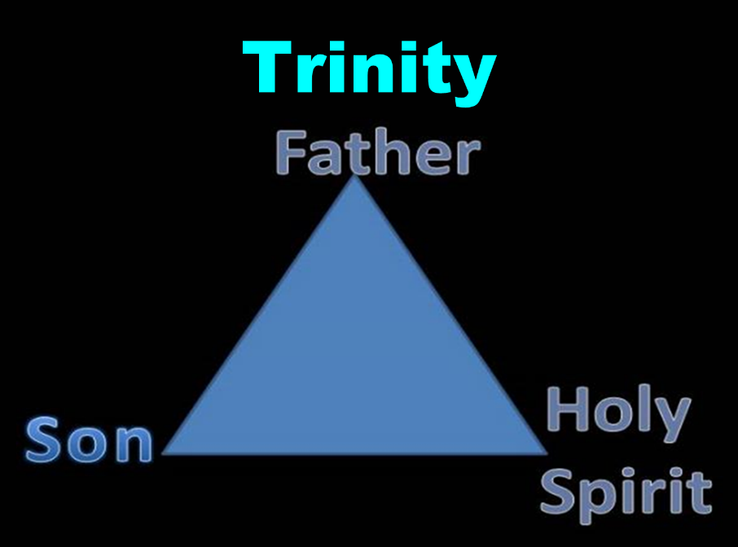

Slide 26


Slide 27
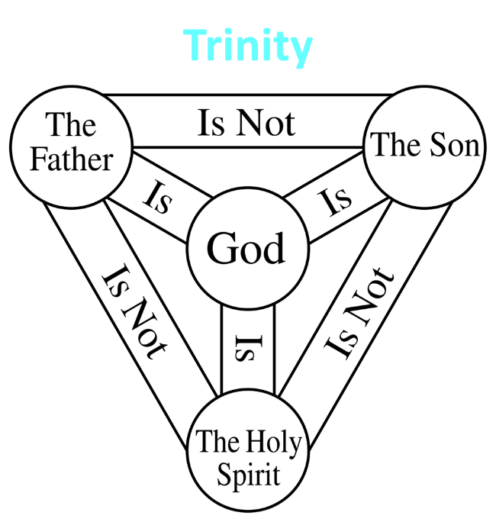

Slide 28

Revelation 20:10
“And the devil who deceived them was thrown into the lake of fire and brimstone, where the beast and the false prophet are also; and they will be tormented day and night forever (aiōn) and ever (aiōn).”

Slide 29
How Satan Imitates God and the Antichrist Imitates Jesus Christ
NO. | CATEGORY | JESUS CHRIST | ANTICHRIST
1. | World prepared in advance | Gal. 4:4 | 2 Thess. 2:7
2. | Revealed at the proper time | Gal. 4:4 | 2 Thess. 2:6
3. | Claim of deity | John 14:9 | 2 Thess. 2:4
4. | Heralded by a forerunner | John 1:23 | Rev. 13:12
5. | Forerunner comes in the Spirit and power of Elijah | Luke 1:17 | 1 Kgs. 8:37-38; Rev. 13:13
6. | Empowered by a higher source | 1 Cor. 6:14 | Rev. 13:4
7. | Member of a Trinity | Phil. 1:2; Acts 5:3-4; John 14:9 | Rev. 16:13; 20:10
8. | Head of a Church | Eph. 5:23 | Rev. 2:9; 3:9
9. | Miracle worker | Acts 2:22 | 2 Thess. 2:9
10. | Resurrection from the dead | 1 Cor. 15:3-6 | Rev. 13:3, 12, 14
11. | Given a throne | Rev. 3:21 | Rev. 13:2

Slide 30


Slide 31
How Satan Imitates God and the Antichrist Imitates Jesus Christ
NO. | CATEGORY | JESUS CHRIST | ANTICHRIST
1. | World prepared in advance | Gal. 4:4 | 2 Thess. 2:7
2. | Revealed at the proper time | Gal. 4:4 | 2 Thess. 2:6
3. | Claim of deity | John 14:9 | 2 Thess. 2:4
4. | Heralded by a forerunner | John 1:23 | Rev. 13:12
5. | Forerunner comes in the Spirit and power of Elijah | Luke 1:17 | 1 Kgs. 8:37-38; Rev. 13:13
6. | Empowered by a higher source | 1 Cor. 6:14 | Rev. 13:4
7. | Member of a Trinity | Phil. 1:2; Acts 5:3-4; John 14:9 | Rev. 16:13; 20:10
8. | Head of a Church | Eph. 5:23 | Rev. 2:9; 3:9
9. | Miracle worker | Acts 2:22 | 2 Thess. 2:9
10. | Resurrection from the dead | 1 Cor. 15:3-6 | Rev. 13:3, 12, 14
11. | Given a throne | Rev. 3:21 | Rev. 13:2

Slide 32

Acts 2:22
“Men of Israel, listen to these words: Jesus the Nazarene, a man attested to you by God with miracles [dynamis] and wonders [teras] and signs [sēmeion] which God performed through Him in your midst, just as you yourselves know.”

Slide 33


John 20:30-31
“³⁰ Therefore many other signs [sēmeion] Jesus also performed in the presence of the disciples, which are not written in this book; ³¹ but these have been written so that you may believe (pisteuō eis) that Jesus is the Christ, the Son of God; and that believing you may have life in His name.”

Slide 34
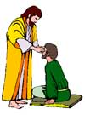
“SEVEN SIGNS” in Gospel of John
1. Changing Water into Wine | 2:11
2. Healing official’s son | 4:46-54
3. Healing an invalid at the Pool of Bethesda | 5:1-18
4. Feeding the 5,000 | 6:5-14
5. Walking on water | 6:16-21
6. Healing a blind man | 9:1-7
7. Raising dead Lazarus | 11:1-45

Slide 35
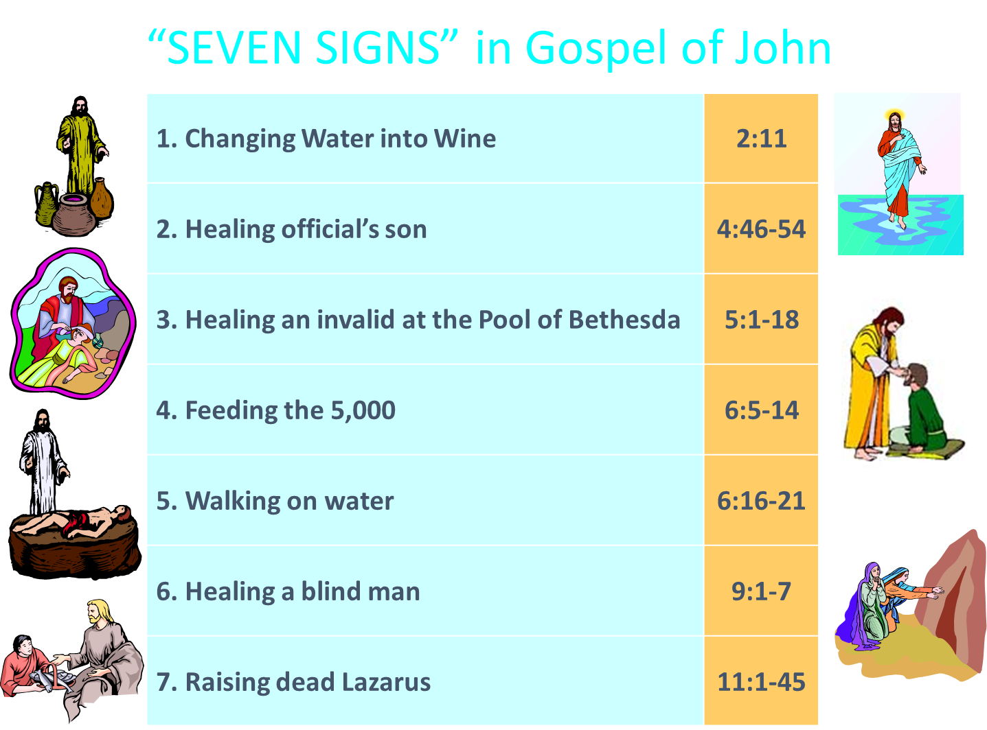
John 3:2
“[Nicodemus came to Jesus by night and said to Him, “Rabbi, we know that You have come from God as a teacher; for no one can do these signs [sēmeion] that You do unless God is with him.”

Slide 36
2 Thessalonians 2:9
“that is, the one whose coming is in accord with the activity of Satan, with all power and signs and false wonders.”

Slide 37
How Satan Imitates God and the Antichrist Imitates Jesus Christ
NO. | CATEGORY | JESUS CHRIST | ANTICHRIST
1. | World prepared in advance | Gal. 4:4 | 2 Thess. 2:7
2. | Revealed at the proper time | Gal. 4:4 | 2 Thess. 2:6
3. | Claim of deity | John 14:9 | 2 Thess. 2:4
4. | Heralded by a forerunner | John 1:23 | Rev. 13:12
5. | Forerunner comes in the Spirit and power of Elijah | Luke 1:17 | 1 Kgs. 8:37-38; Rev. 13:13
6. | Empowered by a higher source | 1 Cor. 6:14 | Rev. 13:4
7. | Member of a Trinity | Phil. 1:2; Acts 5:3-4; John 14:9 | Rev. 16:13; 20:10
8. | Head of a Church | Eph. 5:23 | Rev. 2:9; 3:9
9. | Miracle worker | Acts 2:22 | 2 Thess. 2:9
10. | Resurrection from the dead | 1 Cor. 15:3-6 | Rev. 13:3, 12, 14
11. | Given a throne | Rev. 3:21 | Rev. 13:2

Slide 38
How Satan Imitates God and the Antichrist Imitates Jesus Christ
NO. | CATEGORY | JESUS CHRIST | ANTICHRIST
1. | World prepared in advance | Gal. 4:4 | 2 Thess. 2:7
2. | Revealed at the proper time | Gal. 4:4 | 2 Thess. 2:6
3. | Claim of deity | John 14:9 | 2 Thess. 2:4
4. | Heralded by a forerunner | John 1:23 | Rev. 13:12
5. | Forerunner comes in the Spirit and power of Elijah | Luke 1:17 | 1 Kgs. 8:37-38; Rev. 13:13
6. | Empowered by a higher source | 1 Cor. 6:14 | Rev. 13:4
7. | Member of a Trinity | Phil. 1:2; Acts 5:3-4; John 14:9 | Rev. 16:13; 20:10
8. | Head of a Church | Eph. 5:23 | Rev. 2:9; 3:9
9. | Miracle worker | Acts 2:22 | 2 Thess. 2:9
10. | Resurrection from the dead | 1 Cor. 15:3-6 | Rev. 13:3, 12, 14
11. | Given a throne | Rev. 3:21 | Rev. 13:2

Slide 39

Rev 3:21
promise to the overcomers
“He who overcomes, I will grant to him to sit down with Me on My throne, as I also overcame and sat down with My Father on His throne.”

Slide 40
How Satan Imitates God and the Antichrist Imitates Jesus Christ
NO. | CATEGORY | JESUS CHRIST | ANTICHRIST
12. | Ruling a political kingdom | Isa. 9:6-7 | Rev. 13:5
13. | Ushering in world peace | Isa. 9:6-7 | Rev. 6:1-4
14. | Activity in the Temple | Luke 2:41-50 | 2 Thess. 2:4
15. | Putting an end to animal sacrifices | Heb. 9:26-29 | Dan. 9:27
16. | Length of ministry | Over 3 years | Rev. 13:5
17. | Sealing ministry | Eph. 4:30 | Rev. 13:16-17
18. | Presentation to Israel as her Messiah | John 1:11 | John 5:43
19. | Covenant with Israel | Gen. 15:18 | Dan. 9:27
20. | Reception of worship | Zech. 14:16 | 2 Thess. 2:4
21. | Establishing Jerusalem as the center of worldwide worship | Zech. 14:17 | 2 Thess. 2:4

Slide 41
How Satan Imitates God and the Antichrist Imitates Jesus Christ
NO. | CATEGORY | JESUS CHRIST | ANTICHRIST
12. | Ruling a political kingdom | Isa. 9:6-7 | Rev. 13:5
13. | Ushering in world peace | Isa. 9:6-7 | Rev. 6:1-4
14. | Activity in the Temple | Luke 2:41-50 | 2 Thess. 2:4
15. | Putting an end to animal sacrifices | Heb. 9:26-29 | Dan. 9:27
16. | Length of ministry | Over 3 years | Rev. 13:5
17. | Sealing ministry | Eph. 4:30 | Rev. 13:16-17
18. | Presentation to Israel as her Messiah | John 1:11 | John 5:43
19. | Covenant with Israel | Gen. 15:18 | Dan. 9:27
20. | Reception of worship | Zech. 14:16 | 2 Thess. 2:4
21. | Establishing Jerusalem as the center of worldwide worship | Zech. 14:17 | 2 Thess. 2:4

Slide 42

Isaiah 9:6-7
^{6 “}For a child will be born to us, a son will be given to us; And the government will rest on His shoulders; And His name will be called Wonderful Counselor, Mighty God, Eternal Father, Prince of Peace.⁷ There will be no end to the increase of His government or of peace, The zeal of the Lord of hosts will accomplish this. On the throne of David and over his kingdom, To establish it and to uphold it with justice and righteousness From then on and forevermore.”

Slide 43

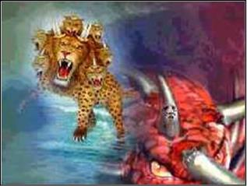
Revelation 13:5
“There was given to him a mouth speaking arrogant words and blasphemies, and authority to act for forty-two months was given to him.”

Slide 44
How Satan Imitates God and the Antichrist Imitates Jesus Christ
NO. | CATEGORY | JESUS CHRIST | ANTICHRIST
12. | Ruling a political kingdom | Isa. 9:6-7 | Rev. 13:5
13. | Ushering in world peace | Isa. 9:6-7 | Rev. 6:1-4
14. | Activity in the Temple | Luke 2:41-50 | 2 Thess. 2:4
15. | Putting an end to animal sacrifices | Heb. 9:26-29 | Dan. 9:27
16. | Length of ministry | Over 3 years | Rev. 13:5
17. | Sealing ministry | Eph. 4:30 | Rev. 13:16-17
18. | Presentation to Israel as her Messiah | John 1:11 | John 5:43
19. | Covenant with Israel | Gen. 15:18 | Dan. 9:27
20. | Reception of worship | Zech. 14:16 | 2 Thess. 2:4
21. | Establishing Jerusalem as the center of worldwide worship | Zech. 14:17 | 2 Thess. 2:4

Slide 45

1st Six Seals (Revelation 6)
SEAL 1 – 6:1-2 – Advent of antichrist
SEAL 2 – 6:3-4 – War
SEAL 3 – 6:5-6 – Famine
SEAL 4 – 6:7-8 – Death
SEAL 5 – 6:9-11 – Martyrdoms
SEAL 6 – 6:12-17 – Cosmic disturbances

Slide 46
Isaiah 9:6-7
^{6 “}For a child will be born to us, a son will be given to us; And the government will rest on His shoulders; And His name will be called Wonderful Counselor, Mighty God, Eternal Father, Prince of Peace.⁷ There will be no end to the increase of His government or of peace, The zeal of the Lord of hosts will accomplish this. On the throne of David and over his kingdom, To establish it and to uphold it with justice and righteousness From then on and forevermore.”

Slide 47
How Satan Imitates God and the Antichrist Imitates Jesus Christ
NO. | CATEGORY | JESUS CHRIST | ANTICHRIST
12. | Ruling a political kingdom | Isa. 9:6-7 | Rev. 13:5
13. | Ushering in world peace | Isa. 9:6-7 | Rev. 6:1-4
14. | Activity in the Temple | Luke 2:41-50 | 2 Thess. 2:4
15. | Putting an end to animal sacrifices | Heb. 9:26-29 | Dan. 9:27
16. | Length of ministry | Over 3 years | Rev. 13:5
17. | Sealing ministry | Eph. 4:30 | Rev. 13:16-17
18. | Presentation to Israel as her Messiah | John 1:11 | John 5:43
19. | Covenant with Israel | Gen. 15:18 | Dan. 9:27
20. | Reception of worship | Zech. 14:16 | 2 Thess. 2:4
21. | Establishing Jerusalem as the center of worldwide worship | Zech. 14:17 | 2 Thess. 2:4

Slide 48

Daniel 9:27
“And he will make a firm covenant with the many for one week, but in the middle of the week he will put a stop to sacrifice and grain offering; and on the wing of abominations will come one who makes desolate, even until a complete destruction, one that is decreed, is poured out on the one who makes desolate.”

Slide 49
How Satan Imitates God and the Antichrist Imitates Jesus Christ
NO. | CATEGORY | JESUS CHRIST | ANTICHRIST
12. | Ruling a political kingdom | Isa. 9:6-7 | Rev. 13:5
13. | Ushering in world peace | Isa. 9:6-7 | Rev. 6:1-4
14. | Activity in the Temple | Luke 2:41-50 | 2 Thess. 2:4
15. | Putting an end to animal sacrifices | Heb. 9:26-29 | Dan. 9:27
16. | Length of ministry | Over 3 years | Rev. 13:5
17. | Sealing ministry | Eph. 4:30 | Rev. 13:16-17
18. | Presentation to Israel as her Messiah | John 1:11 | John 5:43
19. | Covenant with Israel | Gen. 15:18 | Dan. 9:27
20. | Reception of worship | Zech. 14:16 | 2 Thess. 2:4
21. | Establishing Jerusalem as the center of worldwide worship | Zech. 14:17 | 2 Thess. 2:4

Slide 50
Daniel 9:27
“And he will make a firm covenant with the many for one week, but in the middle of the week he will put a stop to sacrifice and grain offering; and on the wing of abominations will come one who makes desolate, even until a complete destruction, one that is decreed, is poured out on the one who makes desolate.”

Slide 51
How Satan Imitates God and the Antichrist Imitates Jesus Christ
NO. | CATEGORY | JESUS CHRIST | ANTICHRIST
12. | Ruling a political kingdom | Isa. 9:6-7 | Rev. 13:5
13. | Ushering in world peace | Isa. 9:6-7 | Rev. 6:1-4
14. | Activity in the Temple | Luke 2:41-50 | 2 Thess. 2:4
15. | Putting an end to animal sacrifices | Heb. 9:26-29 | Dan. 9:27
16. | Length of ministry | Over 3 years | Rev. 13:5
17. | Sealing ministry | Eph. 4:30 | Rev. 13:16-17
18. | Presentation to Israel as her Messiah | John 1:11 | John 5:43
19. | Covenant with Israel | Gen. 15:18 | Dan. 9:27
20. | Reception of worship | Zech. 14:16 | 2 Thess. 2:4
21. | Establishing Jerusalem as the center of worldwide worship | Zech. 14:17 | 2 Thess. 2:4

Slide 52
Revelation 13:5
“There was given to him a mouth speaking arrogant words and blasphemies, and authority to act for forty-two months was given to him.”

Slide 53


Daniel 7:25
“He will speak out against the Most High and wear down the saints of the Highest One, and he will intend to make alterations in times and in law; and they will be given into his hand for a time, times, and half a time.”

Slide 54
How Satan Imitates God and the Antichrist Imitates Jesus Christ
NO. | CATEGORY | JESUS CHRIST | ANTICHRIST
12. | Ruling a political kingdom | Isa. 9:6-7 | Rev. 13:5
13. | Ushering in world peace | Isa. 9:6-7 | Rev. 6:1-4
14. | Activity in the Temple | Luke 2:41-50 | 2 Thess. 2:4
15. | Putting an end to animal sacrifices | Heb. 9:26-29 | Dan. 9:27
16. | Length of ministry | Over 3 years | Rev. 13:5
17. | Sealing ministry | Eph. 4:30 | Rev. 13:16-17
18. | Presentation to Israel as her Messiah | John 1:11 | John 5:43
19. | Covenant with Israel | Gen. 15:18 | Dan. 9:27
20. | Reception of worship | Zech. 14:16 | 2 Thess. 2:4
21. | Establishing Jerusalem as the center of worldwide worship | Zech. 14:17 | 2 Thess. 2:4

Slide 55
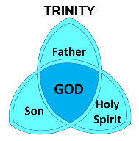
Ephesians 4:30
“Do not grieve the Holy Spirit of God, by whom you were sealed for the day of redemption.”

Slide 56

Revelation 13:16-18
¹⁶ And he causes all, the small and the great, and the rich and the poor, and the free men and the slaves, to be given a mark on their right hand or on their forehead, ¹⁷ and he provides that no one will be able to buy or to sell, except the one who has the mark, either the name of the beast or the number of his name. ¹⁸ Here is wisdom. Let him who has understanding calculate the number of the beast, for the number is that of a man; and his number is six hundred and sixty-six.
56

Slide 57
How Satan Imitates God and the Antichrist Imitates Jesus Christ
NO. | CATEGORY | JESUS CHRIST | ANTICHRIST
12. | Ruling a political kingdom | Isa. 9:6-7 | Rev. 13:5
13. | Ushering in world peace | Isa. 9:6-7 | Rev. 6:1-4
14. | Activity in the Temple | Luke 2:41-50 | 2 Thess. 2:4
15. | Putting an end to animal sacrifices | Heb. 9:26-29 | Dan. 9:27
16. | Length of ministry | Over 3 years | Rev. 13:5
17. | Sealing ministry | Eph. 4:30 | Rev. 13:16-17
18. | Presentation to Israel as her Messiah | John 1:11 | John 5:43
19. | Covenant with Israel | Gen. 15:18 | Dan. 9:27
20. | Reception of worship | Zech. 14:16 | 2 Thess. 2:4
21. | Establishing Jerusalem as the center of worldwide worship | Zech. 14:17 | 2 Thess. 2:4

Slide 58
How Satan Imitates God and the Antichrist Imitates Jesus Christ
NO. | CATEGORY | JESUS CHRIST | ANTICHRIST
12. | Ruling a political kingdom | Isa. 9:6-7 | Rev. 13:5
13. | Ushering in world peace | Isa. 9:6-7 | Rev. 6:1-4
14. | Activity in the Temple | Luke 2:41-50 | 2 Thess. 2:4
15. | Putting an end to animal sacrifices | Heb. 9:26-29 | Dan. 9:27
16. | Length of ministry | Over 3 years | Rev. 13:5
17. | Sealing ministry | Eph. 4:30 | Rev. 13:16-17
18. | Presentation to Israel as her Messiah | John 1:11 | John 5:43
19. | Covenant with Israel | Gen. 15:18 | Dan. 9:27
20. | Reception of worship | Zech. 14:16 | 2 Thess. 2:4
21. | Establishing Jerusalem as the center of worldwide worship | Zech. 14:17 | 2 Thess. 2:4

Slide 59
Daniel 9:27
“And he will make a firm covenant with the many for one week, but in the middle of the week he will put a stop to sacrifice and grain offering; and on the wing of abominations will come one who makes desolate, even until a complete destruction, one that is decreed, is poured out on the one who makes desolate.”

Slide 60
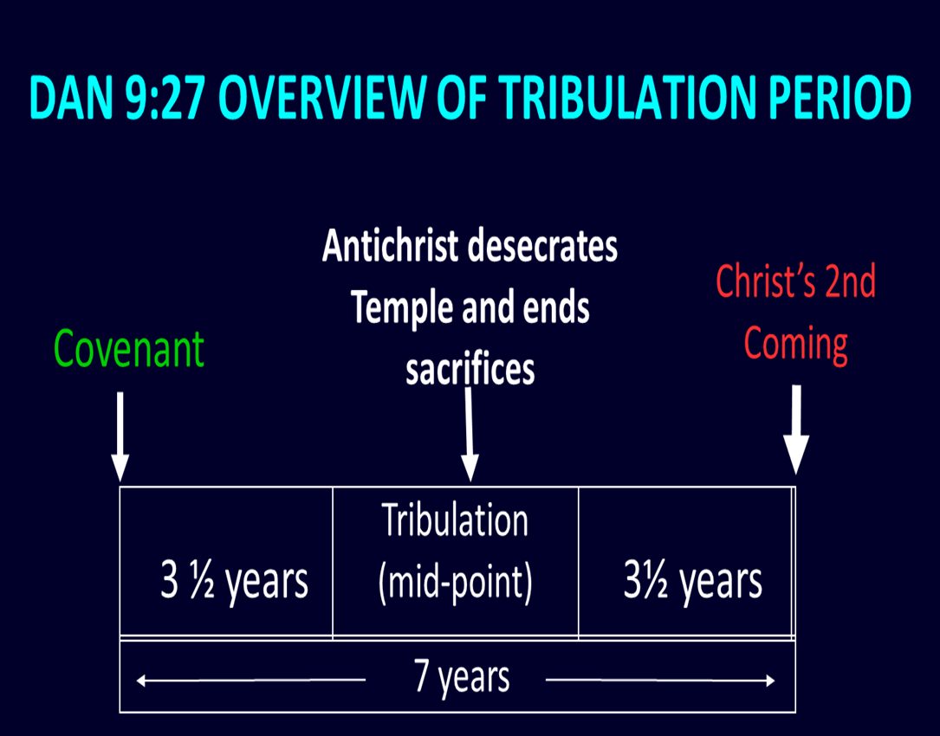
60

Slide 61
How Satan Imitates God and the Antichrist Imitates Jesus Christ
NO. | CATEGORY | JESUS CHRIST | ANTICHRIST
12. | Ruling a political kingdom | Isa. 9:6-7 | Rev. 13:5
13. | Ushering in world peace | Isa. 9:6-7 | Rev. 6:1-4
14. | Activity in the Temple | Luke 2:41-50 | 2 Thess. 2:4
15. | Putting an end to animal sacrifices | Heb. 9:26-29 | Dan. 9:27
16. | Length of ministry | Over 3 years | Rev. 13:5
17. | Sealing ministry | Eph. 4:30 | Rev. 13:16-17
18. | Presentation to Israel as her Messiah | John 1:11 | John 5:43
19. | Covenant with Israel | Gen. 15:18 | Dan. 9:27
20. | Reception of worship | Zech. 14:16 | 2 Thess. 2:4
21. | Establishing Jerusalem as the center of worldwide worship | Zech. 14:17 | 2 Thess. 2:4

Slide 62

Isaiah 2:1-4
¹ “The word which Isaiah the son of Amoz saw concerning Judah and Jerusalem.² Now it will come about that In the last days The mountain of the house of the Lord Will be established as the chief of the mountains, And will be raised above the hills; And all the nations will stream to it.³ And many peoples will come and say, “Come, let us go up to the mountain of the Lord, To the house of the God of Jacob; . . .

Slide 63

Isaiah 2:1-4
. . .That He may teach us concerning His ways And that we may walk in His paths.” For the law will go forth from Zion And the word of the Lord from Jerusalem.⁴ And He will judge between the nations, And will render decisions for many peoples; And they will hammer their swords into plowshares and their spears into pruning hooks. Nation will not lift up sword against nation, And never again will they learn war.”

Slide 64

Zechariah 14:16-18
“¹⁶ Then it will come about that any who are left of all the nations that went against Jerusalem will go up from year to year to worship the King, the Lord of hosts, and to celebrate the Feast of Booths. ¹⁷ And it will be that whichever of the families of the earth does not go up to Jerusalem to worship the King, the Lord of hosts, there will be no rain on them. ¹⁸ If the family of Egypt does not go up or enter, then no rain will fall on them; it will be the plague with which the Lord smites the nations who do not go up to celebrate the Feast of Booths.”

Slide 65
How Satan Imitates God and the Antichrist Imitates Jesus Christ
NO. | CATEGORY | JESUS CHRIST | ANTICHRIST
12. | Ruling a political kingdom | Isa. 9:6-7 | Rev. 13:5
13. | Ushering in world peace | Isa. 9:6-7 | Rev. 6:1-4
14. | Activity in the Temple | Luke 2:41-50 | 2 Thess. 2:4
15. | Putting an end to animal sacrifices | Heb. 9:26-29 | Dan. 9:27
16. | Length of ministry | Over 3 years | Rev. 13:5
17. | Sealing ministry | Eph. 4:30 | Rev. 13:16-17
18. | Presentation to Israel as her Messiah | John 1:11 | John 5:43
19. | Covenant with Israel | Gen. 15:18 | Dan. 9:27
20. | Reception of worship | Zech. 14:16 | 2 Thess. 2:4
21. | Establishing Jerusalem as the center of worldwide worship | Zech. 14:17 | 2 Thess. 2:4

Slide 66
Isaiah 2:1-4
¹ “The word which Isaiah the son of Amoz saw concerning Judah and Jerusalem.² Now it will come about that In the last days The mountain of the house of the Lord Will be established as the chief of the mountains, And will be raised above the hills; And all the nations will stream to it.³ And many peoples will come and say, “Come, let us go up to the mountain of the Lord, To the house of the God of Jacob; . . .

Slide 67
Isaiah 2:1-4
. . .That He may teach us concerning His ways And that we may walk in His paths.” For the law will go forth from Zion And the word of the Lord from Jerusalem.⁴ And He will judge between the nations, And will render decisions for many peoples; And they will hammer their swords into plowshares and their spears into pruning hooks. Nation will not lift up sword against nation, And never again will they learn war.”

Slide 68
Zechariah 14:16-18
“¹⁶ Then it will come about that any who are left of all the nations that went against Jerusalem will go up from year to year to worship the King, the Lord of hosts, and to celebrate the Feast of Booths. ¹⁷ And it will be that whichever of the families of the earth does not go up to Jerusalem to worship the King, the Lord of hosts, there will be no rain on them. ¹⁸ If the family of Egypt does not go up or enter, then no rain will fall on them; it will be the plague with which the Lord smites the nations who do not go up to celebrate the Feast of Booths.”

Slide 69

Test the Spirits
Deut. 13:1-5
Isa. 8:19-20
Acts 17:11
Gal. 1:8-9
1 Thess. 5:20-21
1 John 4:1
Rev. 2:2

Slide 70
Test the Spirits
Deut. 13:1-5
Isa. 8:19-20
Acts 17:11
Gal. 1:8-9
1 Thess. 5:20-21
1 John 4:1
Rev. 2:2

Slide 71
Galatians 1:6–9
⁶ I am amazed that you are so quickly deserting Him who called you by the grace of Christ, for a different gospel; ⁷ which is really not another; only there are some who are disturbing you and want to distort the gospel of Christ. ⁸ But even if we, or an angel from heaven, should preach to you a gospel contrary to what we have preached to you, he is to be accursed! ⁹ As we have said before, so I say again now, if any man is preaching to you a gospel contrary to what you received, he is to be accursed!

Slide 72
Test the Spirits
Deut. 13:1-5
Isa. 8:19-20
Acts 17:11
Gal. 1:8-9
1 Thess. 5:20-21
1 John 4:1
Rev. 2:2

Slide 73
Test the Spirits
Deut. 13:1-5
Isa. 8:19-20
Acts 17:11
Gal. 1:8-9
1 Thess. 5:20-21
1 John 4:1
Rev. 2:2

Slide 74

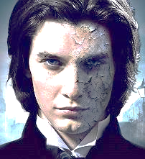
1 John 4:1
“Beloved, do not believe every spirit, but test the spirits to see whether they are from God, because many false prophets have gone out into the world.”

Slide 75
Test the Spirits
Deut. 13:1-5
Isa. 8:19-20
Acts 17:11
Gal. 1:8-9
1 Thess. 5:20-21
1 John 4:1
Rev. 2:2

Slide 76

Revelation 2:2
‘I know your deeds and your toil and perseverance, and that you cannot tolerate evil men, and you put to the test [peirázō] those who call themselves apostles, and they are not, and you found them to be false;

Slide 77

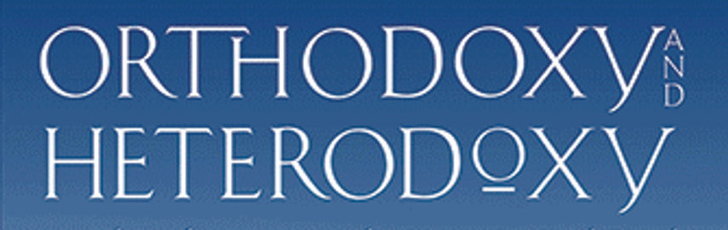
Limits of Orthodoxy
Deut 13:1-5;
Prov 30:6;
Acts 17:11;
Gal. 1:6-9;
1 Thess 5:21;
2 Pet 3:16;
Rev 2:2; 22:18-19

Slide 78
Limits of Orthodoxy
Deut 13:1-5;
Prov 30:6;
Acts 17:11;
Gal. 1:6-9;
1 Thess 5:21;
2 Pet 3:16;
Rev 2:2; 22:18-19

Slide 79
Galatians 1:6–9
⁶ I am amazed that you are so quickly deserting Him who called you by the grace of Christ, for a different gospel; ⁷ which is really not another; only there are some who are disturbing you and want to distort the gospel of Christ. ⁸ But even if we, or an angel from heaven, should preach to you a gospel contrary to what we have preached to you, he is to be accursed! ⁹ As we have said before, so I say again now, if any man is preaching to you a gospel contrary to what you received, he is to be accursed!

Slide 80
Limits of Orthodoxy
Deut 13:1-5;
Prov 30:6;
Acts 17:11;
Gal. 1:6-9;
1 Thess 5:21;
2 Pet 3:16;
Rev 2:2; 22:18-19

Slide 81
Limits of Orthodoxy
Deut 13:1-5;
Prov 30:6;
Acts 17:11;
Gal. 1:6-9;
1 Thess 5:21;
2 Pet 3:16;
Rev 2:2; 22:18-19

Slide 82

2 Peter 3:16-17
“as also in all his letters, speaking in them of these things, in which are some things hard to understand, which the untaught and unstable distort, as they do also the rest of the Scriptures, to their own destruction. ¹⁷ You therefore, beloved, knowing this beforehand, be on your guard so that you are not carried away by the error of unprincipled men and fall from your own steadfastness.”

Slide 83
Limits of Orthodoxy
Deut 13:1-5;
Prov 30:6;
Acts 17:11;
Gal. 1:6-9;
1 Thess 5:21;
2 Pet 3:16;
Rev 2:2; 22:18-19

Slide 84
Limits of Orthodoxy
Deut 13:1-5;
Prov 30:6;
Acts 17:11;
Gal. 1:6-9;
1 Thess 5:21;
2 Pet 3:16;
Rev 2:2; 22:18-19

Slide 85
Revelation 2:2
‘I know your deeds and your toil and perseverance, and that you cannot tolerate evil men, and you put to the test [peirázō] those who call themselves apostles, and they are not, and you found them to be false;

Slide 86
Revelation 22:17-19
“¹⁷ The Spirit and the bride say, ‘Come.’ And let the one who hears say, ‘Come.’ And let the one who is thirsty come; let the one who desires, take the water of life without cost.¹⁸ I testify to everyone who hears the words of the prophecy of this book: if anyone adds to them, God will add to him the plagues which are written in this book; ¹⁹ and if anyone takes away from the words of the book of this prophecy, God will take away his part [meros] from the tree of life and from the holy city, which are written in this book.”

Slide 87
Conclusion

Slide 88
2 Thessalonians 2:1-12
Problem (2:1-2)
Prerequisites for the Day of the Lord (2:3-12)
  The departure (2:3a)
  Advent of the lawless one (2:3b-4)
  Removal of the restrainer (2:5-7)
  Destruction of the lawless one (2:8-9)
  Destruction of lawless one’s followers (2:10-12)

