Slide 1
Genesis 12‒50
Israel’s Birth & Preservation

Slide 2
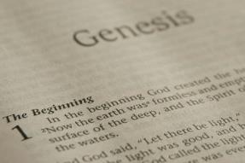
GENESIS STRUCTURE
Genesis 12-50 (four people)
Abraham (12:1–25:11)
Isaac (25:12–26:35)
Jacob (27–36)
Joseph (37–50)

Slide 3
Genesis 37:2-36 Joseph Sold unto Egypt
Joseph’s coat (37:2-4)
Joseph’s dreams (37:5-11)
Joseph’s pit (37:12-24)
Joseph’s enslavement (37:25-36)

Slide 4
Genesis 38:1-30 Judah & Tamar
Tamar & Judah’s sons (38:1-11)
Tamar & Judah (38:12-26)
Tamar & Judah’s twins (38:27-30)

Slide 5
Genesis 38:1-30 Judah & Tamar
Tamar & Judah’s sons (38:1-11)
Tamar & Judah (38:12-26)
Tamar & Judah’s twins (38:27-30)

Slide 6
II. Genesis 38:12-26 Tamar & Judah
Occasion (12-14)
Incest (15-18)
Tamar’s departure (19)
Judah’s attempted payment (20-23)
Judah’s revelation (24-26)

Slide 7
II. Genesis 38:12-26 Tamar & Judah
Occasion (12-14)
Incest (15-18)
Tamar’s departure (19)
Judah’s attempted payment (20-23)
Judah’s revelation (24-26)

Slide 8
Genesis 38:12-14 Occasion
Death of Judah’s wife (12a)
Judah goes to Timnah (12b)
Message comes to Tamar (13)
Tamar’s plan (14)

Slide 9
Genesis 38:12-14 Occasion
Death of Judah’s wife (12a)
Judah goes to Timnah (12b)
Message comes to Tamar (13)
Tamar’s plan (14)

Slide 10
Genesis 38:12-14 Occasion
Death of Judah’s wife (12a)
Judah goes to Timnah (12b)
Message comes to Tamar (13)
Tamar’s plan (14)

Slide 11
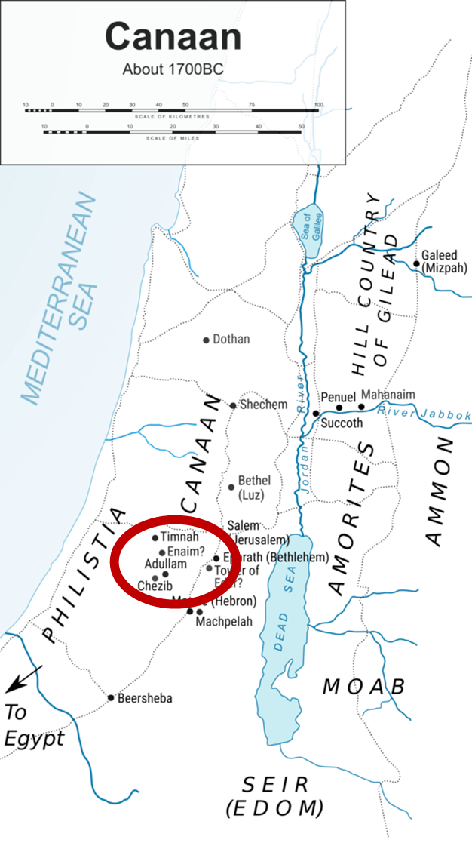

Slide 12
Genesis 38:12-14 Occasion
Death of Judah’s wife (12a)
Judah goes to Timnah (12b)
Message comes to Tamar (13)
Tamar’s plan (14)

Slide 13
Genesis 38:12-14 Occasion
Death of Judah’s wife (12a)
Judah goes to Timnah (12b)
Message comes to Tamar (13)
Tamar’s plan (14)

Slide 14
Genesis 38:14 Tamar’s Plan
Disguise (14a)
Position (14b)
Reason (14c)

Slide 15
Genesis 38:14 Tamar’s Plan
Disguise (14a)
Position (14b)
Reason (14c)

Slide 16
Genesis 38:14 Tamar’s Plan
Disguise (14a)
Position (14b)
Reason (14c)

Slide 18
Genesis 38:14 Tamar’s Plan
Disguise (14a)
Position (14b)
Reason (14c)

Slide 19
II. Genesis 38:12-26 Tamar & Judah
Occasion (12-14)
Incest (15-18)
Tamar’s departure (19)
Judah’s attempted payment (20-23)
Judah’s revelation (24-26)

Slide 20
Genesis 38:15-18 Incest of Judah & Tamar
Deception (15)
Bargaining (16-18b)
Incest (18c)

Slide 21
Genesis 38:15-18 Incest of Judah & Tamar
Deception (15)
Bargaining (16-18b)
Incest (18c)

Slide 22
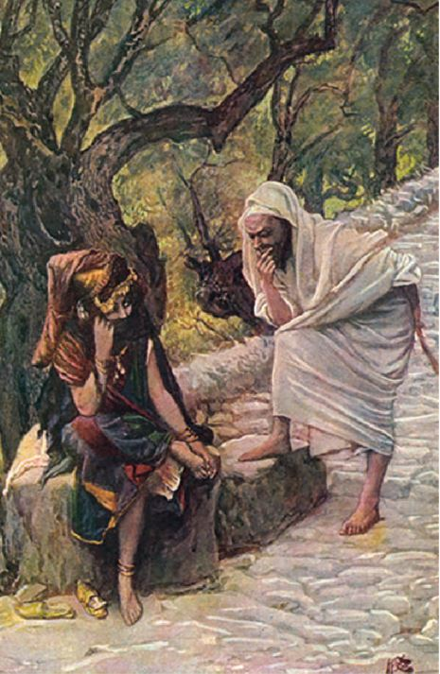
Dr. Arnold G. Fruchtenbaum
The Book of Genesis, 543
“Therefore, Judah, who had earlier deceived Jacob, initiating the selling of Joseph, now is himself deceived.”

Slide 23
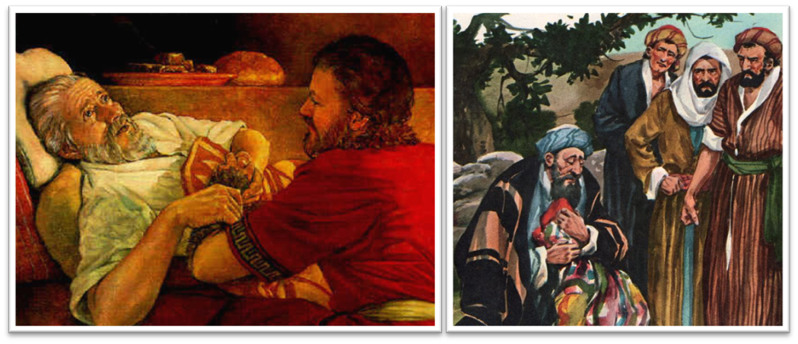
Dr. Arnold G. Fruchtenbaum
The Book of Genesis, 537
“Here again, there is a form of retribution: Jacob deceived Isaac with goatskins (27:16), now Jacob was being deceived with goat’s blood. Furthermore, Jacob deceived Isaac with Esau’s clothes (27:15); now Jacob was deceived by the use of Joseph’s clothes.”

Slide 24
Dr. Arnold G. Fruchtenbaum
The Book of Genesis, 445
“Now the deceiver is deceived, although the motivations differ from good to bad. This is divine retribution in four ways. First, Isaac’s blindness equals the darkness of Jacob’s wedding night, and neither could see well as a result. Second, this Jacob is deceived by being presented the older for the younger, the reversal of Isaac’s presentation of Jacob for Esau. Third, Isaac thought Jacob was Esau and Jacob thought Leah was Rachel. Fourth, Jacob pretended to be his older brother, while Leah pretended to be her younger sister.”

Slide 25
Genesis 38:15-18 Incest of Judah & Tamar
Deception (15)
Bargaining (16-18b)
Incest (18c)

Slide 26
Genesis 38:16-18b Bargaining
Judah’s solicitation (16a)
Tamar’s request (16b)
Judah’s offer (17a)
Tamar’s request for a pledge (17b)
Judah’s request for specificity (18a)
Tamar’s clarification (18b)

Slide 27
Genesis 38:16-18b Bargaining
Judah’s solicitation (16a)
Tamar’s request (16b)
Judah’s offer (17a)
Tamar’s request for a pledge (17b)
Judah’s request for specificity (18a)
Tamar’s clarification (18b)

Slide 28
Genesis 38:16-18b Bargaining
Judah’s solicitation (16a)
Tamar’s request (16b)
Judah’s offer (17a)
Tamar’s request for a pledge (17b)
Judah’s request for specificity (18a)
Tamar’s clarification (18b)

Slide 29
Genesis 38:16-18b Bargaining
Judah’s solicitation (16a)
Tamar’s request (16b)
Judah’s offer (17a)
Tamar’s request for a pledge (17b)
Judah’s request for specificity (18a)
Tamar’s clarification (18b)

Slide 30
Genesis 38:16-18b Bargaining
Judah’s solicitation (16a)
Tamar’s request (16b)
Judah’s offer (17a)
Tamar’s request for a pledge (17b)
Judah’s request for specificity (18a)
Tamar’s clarification (18b)

Slide 31
Genesis 38:16-18b Bargaining
Judah’s solicitation (16a)
Tamar’s request (16b)
Judah’s offer (17a)
Tamar’s request for a pledge (17b)
Judah’s request for specificity (18a)
Tamar’s clarification (18b)

Slide 32
Genesis 38:16-18b Bargaining
Judah’s solicitation (16a)
Tamar’s request (16b)
Judah’s offer (17a)
Tamar’s request for a pledge (17b)
Judah’s request for specificity (18a)
Tamar’s clarification (18b)

Slide 33
Genesis 38:15-18 Incest of Judah & Tamar
Deception (15)
Bargaining (16-18b)
Incest (18c)

Slide 35
II. Genesis 38:12-26 Tamar & Judah
Occasion (12-14)
Incest (15-18)
Tamar’s departure (19)
Judah’s attempted payment (20-23)
Judah’s revelation (24-26)

Slide 36
II. Genesis 38:12-26 Tamar & Judah
Occasion (12-14)
Incest (15-18)
Tamar’s departure (19)
Judah’s attempted payment (20-23)
Judah’s revelation (24-26)

Slide 37
Genesis 38:20-23 Judah’s Attempted Payment
Search (20)
Problem (21)
Report to Judah (22)
Judah’s decision (23)

Slide 38
Genesis 38:20-23 Judah’s Attempted Payment
Search (20)
Problem (21)
Report to Judah (22)
Judah’s decision (23)

Slide 39
Genesis 38:20-23 Judah’s Attempted Payment
Search (20)
Problem (21)
Report to Judah (22)
Judah’s decision (23)

Slide 40
Genesis 38:20-23 Judah’s Attempted Payment
Search (20)
Problem (21)
Report to Judah (22)
Judah’s decision (23)

Slide 41
Genesis 38:20-23 Judah’s Attempted Payment
Search (20)
Problem (21)
Report to Judah (22)
Judah’s decision (23)

Slide 42
II. Genesis 38:12-26 Tamar & Judah
Occasion (12-14)
Incest (15-18)
Tamar’s departure (19)
Judah’s attempted payment (20-23)
Judah’s revelation (24-26)

Slide 43
Genesis 38:24-26 Judah’s Revelation
Report to Judah (24a)
Judah’s verdict (24b)
Tamar’s defense (25)
Judah’s admission (26)

Slide 44
Genesis 38:24-26 Judah’s Revelation
Report to Judah (24a)
Judah’s verdict (24b)
Tamar’s defense (25)
Judah’s admission (26)

Slide 45
Genesis 38:24-26 Judah’s Revelation
Report to Judah (24a)
Judah’s verdict (24b)
Tamar’s defense (25)
Judah’s admission (26)

Slide 46
Genesis 38:24-26 Judah’s Revelation
Report to Judah (24a)
Judah’s verdict (24b)
Tamar’s defense (25)
Judah’s admission (26)

Slide 47
Genesis 38:24-26 Judah’s Revelation
Report to Judah (24a)
Judah’s verdict (24b)
Tamar’s defense (25)
Judah’s admission (26)

Slide 48
Genesis 38:1-30 Judah & Tamar
Tamar & Judah’s sons (38:1-11)
Tamar & Judah (38:12-26)
Tamar & Judah’s twins (38:27-30)

Slide 49
III. Genesis 38:27-30 Twins of Tamar & Judah
Birth of the twins (27)
Scarlet thread (28)
Reversal of the birth order (29-30)

Slide 50
III. Genesis 38:27-30 Twins of Tamar & Judah
Birth of the twins (27)
Scarlet thread (28)
Reversal of the birth order (29-30)

Slide 51
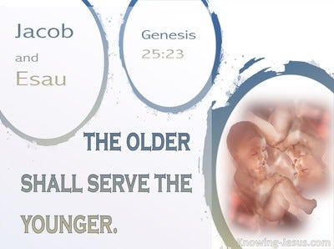
Genesis 25:23
“The Lord said to her, ‘Two nations are in your womb; And two peoples will be separated from your body; And one people shall be stronger than the other; And the older shall serve the younger.’”

Slide 52
Luke 19:42-44
^{“42} saying, ‘If you had known in this day, even you, the things which make for peace! But now they have been hidden from your eyes. ⁴³ For the days will come upon you when your enemies will throw up a barricade against you, and surround you and hem you in on every side, ⁴⁴ and they will level you to the ground and your children within you, and they will not leave in you one stone upon another, because you did not recognize the time of your visitation.’”

Slide 53
III. Genesis 38:27-30 Twins of Tamar & Judah
Birth of the twins (27)
Scarlet thread (28)
Reversal of the birth order (29-30)

Slide 54
III. Genesis 38:27-30 Twins of Tamar & Judah
Birth of the twins (27)
Scarlet thread (28)
Reversal of the birth order (29-30)

Slide 55
Genesis 38:29-30 Reversal of the Birth Order
Perez’ birth (29)
Zerah’s birth (30)

Slide 56
Genesis 38:29-30 Reversal of the Birth Order
Perez’ birth (29)
Zerah’s birth (30)

Slide 57
Cain Murders Abel (Genesis 4:3-8)
4:3-5a
Messianic line through Abel (Gen 3:21; Heb 11:4) contrary to Eve’s false expectation (4:1)
Begins selection of younger over older pattern (Abel over Cain, Seth over Cain, Shem over Japheth, Isaac over Ishmael, Jacob over Esau, Judah and Joseph over their brothers, and Ephraim over Manasseh)

Slide 58
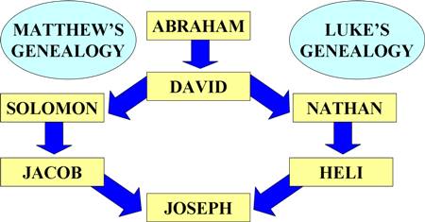
To Circumvent Jeconiah’s Curse

Slide 59
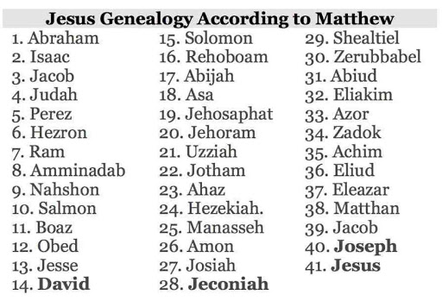

Slide 60
Genesis 38:29-30 Reversal of the Birth Order
Perez’ birth (29)
Zerah’s birth (30)

Slide 61
Genesis 38:1-30 Concluding Observations
Interruption of the Joseph account
Why the Egyptian sojourn was necessary
Problem of Canaanite intermarriage
Problem of Canaanite immorality
Problem of famine in Canaan
Messianic lineage
Origin of Levirate Marriage
Sexual temptation: Judah vs. Joseph

Slide 62
Genesis 38:1-30 Concluding Observations
Interruption of the Joseph account
Why the Egyptian sojourn was necessary
Problem of Canaanite intermarriage
Problem of Canaanite immorality
Problem of famine in Canaan
Messianic lineage
Origin of Levirate Marriage
Sexual temptation: Judah vs. Joseph

Slide 63
Genesis 38:1-30 Concluding Observations
Interruption of the Joseph account
Why the Egyptian sojourn was necessary
Problem of Canaanite intermarriage
Problem of Canaanite immorality
Problem of famine in Canaan
Messianic lineage
Origin of Levirate Marriage
Sexual temptation: Judah vs. Joseph

Slide 65
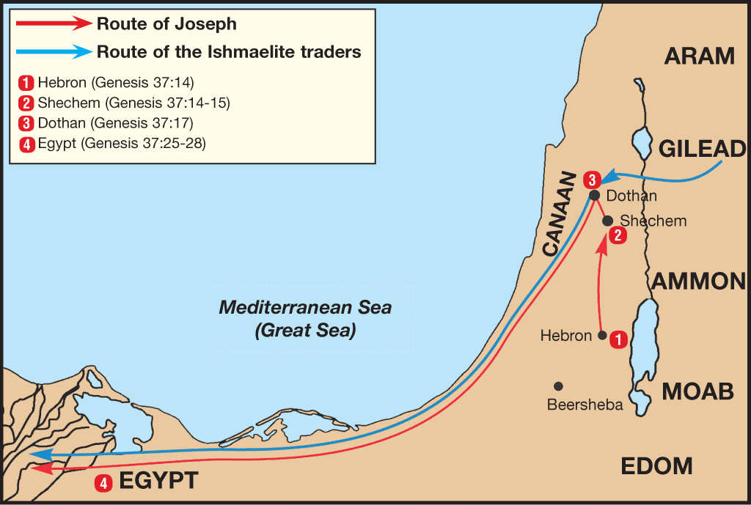

Slide 66
Genesis 38:1-30 Concluding Observations
Interruption of the Joseph account
Why the Egyptian sojourn was necessary
Problem of Canaanite intermarriage
Problem of Canaanite immorality
Problem of famine in Canaan
Messianic lineage
Origin of Levirate Marriage
Sexual temptation: Judah vs. Joseph

Slide 67
Genesis 38:1-30 Concluding Observations
Interruption of the Joseph account
Why the Egyptian sojourn was necessary
Problem of Canaanite intermarriage
Problem of Canaanite immorality
Problem of famine in Canaan
Messianic lineage
Origin of Levirate Marriage
Sexual temptation: Judah vs. Joseph

Slide 68
Genesis 38:1-30 Concluding Observations
Interruption of the Joseph account
Why the Egyptian sojourn was necessary
Problem of Canaanite intermarriage
Problem of Canaanite immorality
Problem of famine in Canaan
Messianic lineage
Origin of Levirate Marriage
Sexual temptation: Judah vs. Joseph

Slide 69
Genesis 38:1-30 Concluding Observations
Interruption of the Joseph account
Why the Egyptian sojourn was necessary
Problem of Canaanite intermarriage
Problem of Canaanite immorality
Problem of famine in Canaan
Messianic lineage
Origin of Levirate Marriage
Sexual temptation: Judah vs. Joseph

Slide 71
Genesis 38:1-30 Concluding Observations
Interruption of the Joseph account
Why the Egyptian sojourn was necessary
Problem of Canaanite intermarriage
Problem of Canaanite immorality
Problem of famine in Canaan
Messianic lineage
Origin of Levirate Marriage
Sexual temptation: Judah vs. Joseph

Slide 72
Genesis 38:1-30 Concluding Observations
Interruption of the Joseph account
Why the Egyptian sojourn was necessary
Problem of Canaanite intermarriage
Problem of Canaanite immorality
Problem of famine in Canaan
Messianic lineage
Origin of Levirate Marriage
Sexual temptation: Judah vs. Joseph

Slide 73
Conclusion

Slide 74
Genesis 38:1-30 Judah & Tamar
Tamar & Judah’s sons (38:1-11)
Tamar & Judah (38:12-26)
Tamar & Judah’s twins (38:27-30)

Slide 75
²⁴ The Lord bless you, and keep you; ²⁵ The Lord make His face shine on you, And be gracious to you; ²⁶ The Lord lift up His countenance on you, And give you peace.
Numbers 6:24–26 (NASB95)

