Slide 2
Acts 6:8‒8:4 Stephen
Stephen’s Arrest (6:8‒7:1)
Stephen’s Defense (Acts 7:2-53)
Stephen’s Stoning (7:54-60)
Third Persecution (Acts 8:1-4)

Slide 3
Acts 7 – Stephen’s Speech
1. 7:2-5 | Abraham’s partial obedience
2. 7:6-38 | Israel’s initial rejections and later acceptances
3. 7:39-41 | Israel’s early rebellion against Moses
4. 7:42-45 | Israel reinterpreted Moses’ teachings though a polytheistic framework
5. 7:46-50 | Neither the Tabernacle nor Temple were intended as permanent habitations of God
6. 7:51-53 | Current generation imitating these same rebellions

Slide 4
2 Samuel 7:12-16
¹² “When your days are complete and you lie down with your fathers, I will raise up your descendant after you, who will come forth from you, and I will establish his kingdom. ¹³ He shall build a house for My name, and I will establish the throne of his kingdom forever. ¹⁴ I will be a father to him and he will be a son to Me; when he commits iniquity, I will correct him with the rod of men and the strokes of the sons of men, ¹⁵ but My lovingkindness shall not depart . . .

Slide 5
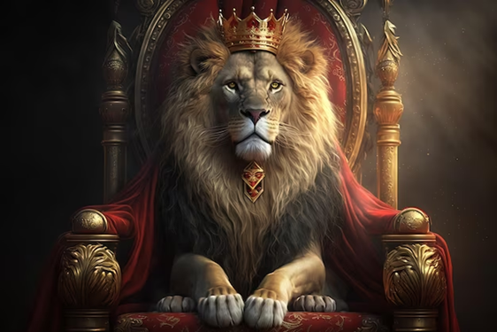
2 Samuel 7:12-16
. . .from him, as I took it away from Saul, whom I removed from before you. ¹⁶ Your house and your kingdom shall endure before Me forever; your throne shall be established forever.” ¹⁷ In accordance with all these words and all this vision, so Nathan spoke to David.”

Slide 6
ISRAEL’S FOUR TEMPLES
Solomon’s pre-exilic temple (Kings and Chronicles)
Zerubbabel’s post exilic temple (Ezra 1-6; John 2:20)
Antichrist's temple (Dan. 9:27; Matt. 24:15; 2 Thess. 2:4; Rev. 11:1-2)
Millennial temple (Ezek. 40-48)

Slide 7
ISRAEL’S FOUR TEMPLES
Solomon’s pre-exilic temple (Kings and Chronicles)
Zerubbabel’s post exilic temple (Ezra 1-6; John 2:20)
Antichrist's temple (Dan. 9:27; Matt. 24:15; 2 Thess. 2:4; Rev. 11:1-2)
Millennial temple (Ezek. 40-48)

Slide 8
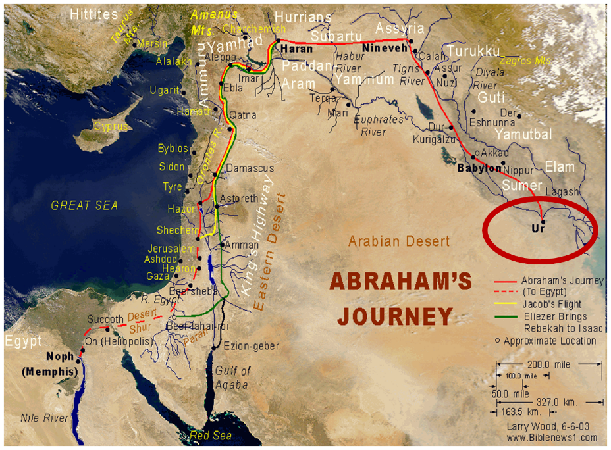

Slide 12
Matthew 24:1-2
“¹ Jesus came out from the temple and was going away when His disciples came up to point out the temple buildings to Him. ² And He said to them, “Do you not see all these things? Truly I say to you, not one stone here will be left upon another, which will not be torn down.”

Slide 13
Luke 19:42-44
^{“42} saying, ‘If you had known in this day, even you, the things which make for peace! But now they have been hidden from your eyes. ⁴³ For the days will come upon you when your enemies will throw up a barricade against you, and surround you and hem you in on every side, ⁴⁴ and they will level you to the ground and your children within you, and they will not leave in you one stone upon another, because you did not recognize the time of your visitation.’”

Slide 14
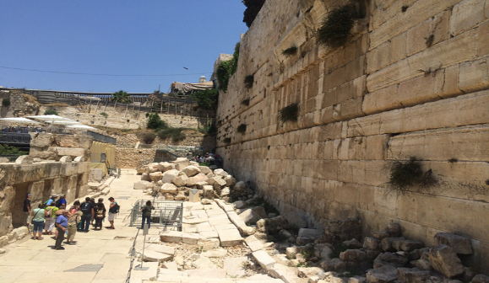
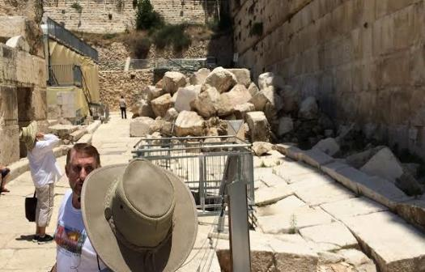
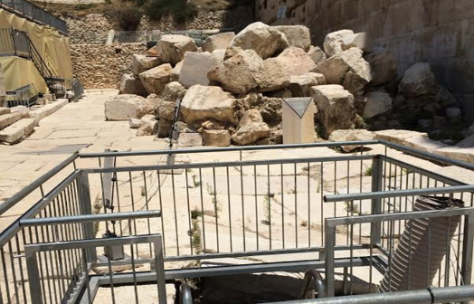

Slide 15
1 Samuel 16:13-14
“¹³ Then Samuel took the horn of oil and anointed him in the midst of his brothers; and the Spirit of the Lord came mightily upon David from that day forward. And Samuel arose and went to Ramah. ¹⁴ Now the Spirit of the Lord departed from Saul, and an evil spirit from the Lord terrorized him.”

Slide 16
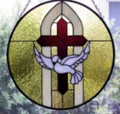
John 14:16-17
¹⁶ I will ask the Father, and He will give you another Helper, that He may be with you forever; ¹⁷ that is the Spirit of truth, whom the world cannot receive, because it does not see Him or know Him, but you know Him because He abides with you and will be in you.

Slide 17
WORK OF THE SPIRIT IN THE OT
 | OT/GOSPELS/ACTS 1 | ACTS 2/TODAY
External vs. Internal | Upon (1 Sam. 16:13) | Within (John 14:17)
Reception of all of the Spirit at the moment of salvation? | Subsequent to salvation (Exod 31:3) | At moment of salvation (Rom 8:9)
How long is the indwelling? | Temporary indwelling (1 Sam 16:14; Ps 51:11) | Permanent indwelling (John 14:16)
Who is indwelt? | Selective indwelling (Joel 2:28) | Universal indwelling (1 Cor 12:13)

Slide 18
Acts 7 – Stephen’s Speech
1. 7:2-5 | Abraham’s partial obedience
2. 7:6-38 | Israel’s initial rejections and later acceptances
3. 7:39-41 | Israel’s early rebellion against Moses
4. 7:42-45 | Israel reinterpreted Moses’ teachings though a polytheistic framework
5. 7:46-50 | Neither the Tabernacle nor Temple were intended as permanent habitations of God
6. 7:51-53 | Current generation imitating these same rebellions

Slide 19
6. Current Generation Imitating These Rebellions Acts 7:51-53
Resisting the Spirit (51)
Prophet Killers (52)
Law Breakers (53)

Slide 20
6. Current Generation Imitating These Rebellions Acts 7:51-53
Resisting the Spirit (51)
Prophet Killers (52)
Law Breakers (53)

Slide 21
Running TULIP Through the Grid of Scripture
Total Depravity
Unconditional Election
Limited Atonement
Irresistible Grace
Perseverance of the Saints

Slide 22
Running TULIP Through the Grid of Scripture
Total Depravity
Unconditional Election
Limited Atonement
Irresistible Grace
Perseverance of the Saints

Slide 23
David N. Steele & Curtis C. Thomas
The “efficacious call of the Spirit or irresistible grace” is “the special inward call of the Spirit [that] never fails to result in the conversion of those to whom it is made. This special call is not made to all sinners what is issued to the elect only.”
David N. Steele, Curtis C. Thomas, and S. Lance Quinn, The Five Points of Calvinism, 2nd ed. (Phillipsburg, NJ: Presbyterian and Reformed Publishing, 1963), 52-53.

Slide 24
Genesis 6:1-3
“¹ Now it came about, when men began to multiply on the face of the land, and daughters were born to them, ² that the sons of God saw that the daughters of men were beautiful; and they took wives for themselves, whomever they chose. ³ Then the Lord said, “My Spirit shall not strive with man forever, because he also is flesh; nevertheless his days shall be one hundred and twenty years.”

Slide 25
Zechariah 12:10
“I will pour out on the house of David and on the inhabitants of Jerusalem, the Spirit of grace and of supplication, so that they will look on Me whom they have pierced; and they will mourn for Him, as one mourns for an only son, and they will weep bitterly over Him like the bitter weeping over a firstborn.”

Slide 26
6. Current Generation Imitating These Rebellions Acts 7:51-53
Resisting the Spirit (51)
Prophet Killers (52)
Law Breakers (53)

Slide 27
Luke 24:27, 44
“²⁷ Then beginning with Moses and with all the prophets, He explained to them the things concerning Himself in all the Scriptures…⁴⁴ Now He said to them, ‘These are My words which I spoke to you while I was still with you, that all things which are written about Me in the Law of Moses and the Prophets and the Psalms must be fulfilled.’”

Slide 28
6. Current Generation Imitating These Rebellions Acts 7:51-53
Resisting the Spirit (51)
Prophet Killers (52)
Law Breakers (53)

Slide 30
John 5:39, 46
“³⁹ You search the Scriptures because you think that in them you have eternal life; it is these that testify about Me…⁴⁶ For if you believed Moses, you would believe Me, for he wrote about Me.”

Slide 31
Acts 6:8‒8:4 Stephen
Stephen’s Arrest (6:8‒7:1)
Stephen’s Defense (Acts 7:2-53)
Stephen’s Stoning (7:54-60)
Third Persecution (Acts 8:1-4)

Slide 32
III. Stephen’s Stoning Acts 7:54-60
Audience's reaction (54)
Stephen’s dying vision (55-56)
Stephen’s death (57-60)

Slide 33
III. Stephen’s Stoning Acts 7:54-60
Audience's reaction (54)
Stephen’s dying vision (55-56)
Stephen’s death (57-60)

Slide 34
John 16:7–11
⁷ “But I tell you the truth, it is to your advantage that I go away; for if I do not go away, the Helper will not come to you; but if I go, I will send Him to you. ⁸ “And He, when He comes, will convict the world concerning sin and righteousness and judgment; ⁹ concerning sin, because they do not believe in Me; ¹⁰ and concerning righteousness, because I go to the Father and you no longer see Me; ¹¹ and concerning judgment, because the ruler of this world has been judged.

Slide 35
III. Stephen’s Stoning Acts 7:54-60
Audience's reaction (54)
Stephen’s dying vision (55-56)
Stephen’s death (57-60)

Slide 36
Revelation 3:21
Promise to the Overcomers
“He who overcomes, I will grant to him to sit down with Me on My throne, as I also overcame and sat down with My Father on His throne.”

Slide 38
III. Stephen’s Stoning Acts 7:54-60
Audience's reaction (54)
Stephen’s dying vision (55-56)
Stephen’s death (57-60)

Slide 39
Acts 7:57-60 Stephen’s Death
Mob response (57)
Stephen’s stoning (58)
Stephen’s response (59)
Stephen’s death (60)

Slide 40
Acts 7:57-60 Stephen’s Death
Mob response (57)
Stephen’s stoning (58)
Stephen’s response (59)
Stephen’s death (60)

Slide 41
Acts 7:57-60 Stephen’s Death
Mob response (57)
Stephen’s stoning (58)
Stephen’s response (59)
Stephen’s death (60)

Slide 42
Dr. Arnold G. Fruchtenbaum
The Book of Acts, 176-77
“A second explanation is that this event may have occurred in A.D. 36. In that year, Vitellus became the new imperial legate of the Province of Syria, which included Judea. He deposed Pontius Pilate from his procuratorship in A.D. 36. Pilate’s successor, Marullus, did not arrive until A.D. 38. So there may have been a hiatus or a break between the deposing of Pilate and the arrival of the new procurator. It could very well be that the stoning of Stephen occurred during this time, which would have left the Sanhedrin without tight Roman oversight. A third explanation is that this was a mob scene, and mobs do not regard the rules of law.”

Slide 43
From Peter to Paul
Reference | Center | Person | Place | Outreach
Acts 1–12 | Jerusalem | Peter | Jerusalem, Judea, Samaria | Jewish
Acts 13–28 | Antioch | Paul | Uttermost parts | Gentiles

Slide 44
From Peter to Paul
Peter | Paul
Heals a man lame from birth (3:1-11) | Heals a man lame from birth (14:8-18)
Heals by shadow (5:15-16) | Heals by handkerchief (19:11-12)
Success is a cause of jealousy (5:17) | Success is a cause of jealousy (13:45)
Confronts a sorcerer (8:9-24) | Confronts a sorcerer (13:6-11)
Raises Dorcas (9:36-41) | Raises Eutychus (20:9-12)
Jailed and miraculously freed (12:3-19) | Jailed and miraculously freed (16:25-34)

Slide 45
Acts 7:57-60 Stephen’s Death
Mob response (57)
Stephen’s stoning (58)
Stephen’s response (59)
Stephen’s death (60)

Slide 46
Acts 7:57-60 Stephen’s Death
Mob response (57)
Stephen’s stoning (58)
Stephen’s response (59)
Stephen’s death (60)

Slide 47
Acts 7:60 Stephen’s Death
Kneeling (60a)
Cried out (60b)
Fell asleep (60c)

Slide 48
Acts 7:60 Stephen’s Death
Kneeling (60a)
Cried out (60b)
Fell asleep (60c)

Slide 49
Acts 7:60 Stephen’s Death
Kneeling (60a)
Cried out (60b)
Fell asleep (60c)

Slide 50
Acts 7:60 Stephen’s Death
Kneeling (60a)
Cried out (60b)
Fell asleep (60c)

Slide 51
1 Thessalonians 4:13-18
¹³ "But we do not want you to be uninformed, brethren, about those who are asleep, so that you will not grieve as do the rest who have no hope. ¹⁴ For if we believe that Jesus died and rose again, even so God will bring with Him those who have fallen asleep in Jesus. ¹⁵ For this we say to you by the word of the Lord, that we who are alive and remain until the coming of the Lord, will not precede . . .

Slide 52
1 Thessalonians 4:13-18
… those who have fallen asleep. ¹⁶ For the Lord Himself descend from heaven with a shout, with the voice of the archangel and with the trumpet of God, and the dead in Christ will rise first. ¹⁷ Then we who are alive and remain will be caught up together with them in the clouds to meet the Lord in the air, and so we shall always be with the Lord. ¹⁸ Therefore comfort one another with these words."

Slide 53
Conclusion

Slide 54
Acts 6:8‒8:4 Stephen
Stephen’s Arrest (6:8‒7:1)
Stephen’s Defense (Acts 7:2-53)
Stephen’s Stoning (7:54-60)
Third Persecution (Acts 8:1-4)

Slide 55
Acts 7 – Stephen’s Speech
1. 7:2-5 | Abraham’s partial obedience
2. 7:6-38 | Israel’s initial rejections and later acceptances
3. 7:39-41 | Israel’s early rebellion against Moses
4. 7:42-45 | Israel reinterpreted Moses’ teachings though a polytheistic framework
5. 7:46-50 | Neither the Tabernacle nor Temple were intended as permanent habitations of God
6. 7:51-53 | Current generation imitating these same rebellions

