Slide 1

FROM FLOOD TO FIRE
2 Peter 3:3-15
Andrew Marshall Woods, Th.M., JD., PhD.
Sr. Pastor, Sugar Land Bible Church
President – Chafer Theological Seminary

Slide 2
Overview 2 Peter 3:3-15
Heresy of the false teachers (v3-4)
Motive of the false teachers (v3-4)
Peter’s rebuttal (v5-10)
Application (v11-15)

Slide 3
Overview 2 Peter 3:3-15
Heresy of the false teachers (v3-4)
Motive of the false teachers (v3-4)
Peter’s rebuttal (v5-10)
Application (v11-15)

Slide 4

Doctrine of False Teachers V.3-4
Deny 2nd coming
  Scoffing
  Future tense

Slide 5
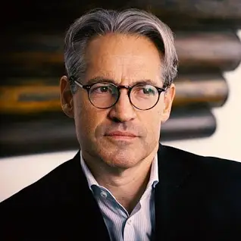
Eric Metaxas
The Eric Metaxas Show on TBN which aired on January 9, 20024. Eric Metaxas interviewed author Benjamin Thomas about his book “Revelation Riddle: Kingdom Age of the Saints, End Times for the New World Order.” The video is titled "Dangerous END TIMES Doctrines & The Spiritual Battle Against The Deep State.”
“[rescue Rapture Doctrine]…they think Jesus is going to rescue them. On the other hand there are a lot of people l've met that they're almost psyched to see the world go to hell. They're almost psyched to see everything get worse, like haha judgment is coming, instead of being moved by compassion to help those who might be helped. They're kind of glad to see it go downhill…and a lot of people who have this rescue Rapture rescue mentality…they're kind of like we we're happy to see America go down the tubes…and they're not even slightly patriotic thinking what can I do to help my nation stand for God's principles…I'm just about Jesus.”

Slide 6


Slide 7
Eric Metaxas
The Eric Metaxas Show on TBN which aired on January 9, 20024. Eric Metaxas interviewed author Benjamin Thomas about his book “Revelation Riddle: Kingdom Age of the Saints, End Times for the New World Order.” The video is titled "Dangerous END TIMES Doctrines & The Spiritual Battle Against The Deep State.”
“Let's call it what it is folks. It’s bad Theology. And by the way I want to be very clear. I say this in all my speeches. Bad theology to be clear is from the pit of Hell. It's Satan's theology. It's not like all B minus theology. It's from the pit of Hell.”

Slide 8
Overview 2 Peter 3:3-15
Heresy of the false teachers (v3-4)
Motive of the false teachers (v3-4)
Peter’s rebuttal (v5-10)
Application (v11-15)

Slide 9
Motive of False Teachers V.3-4
Deny 2nd coming
  Lust & denial of judgment
  Uniformitarianism; naturalism

Slide 10
Motive of False Teachers V.3-4
Deny 2nd coming
  Lust & denial of judgment
  Uniformitarianism; naturalism

Slide 11

Matthew 24:46-50
^{“46} Blessed is that slave whom his master finds so doing when he comes. ⁴⁷ Truly I say to you that he will put him in charge of all his possessions. ⁴⁸ But if that evil slave says in his heart, ‘My master is not coming for a long time,’ ⁴⁹ and he begins to beat his fellow slaves, and he eats and drinks with those habitually drunk; ⁵⁰ then the master of that slave will come on a day that he does not expect, and at an hour that he does not know.”

Slide 12
Motive of False Teachers V.3-4
Deny 2nd coming
  Lust & denial of judgment
  Uniformitarianism; naturalism

Slide 13
Uniformitarianism Defined
https://www.britannica.com/science/uniformitarianism
“Uniformitarianism, in geology, the doctrine suggesting that Earth’s geologic processes acted in the same manner and with essentially the same intensity in the past as they do in the present and that such uniformity is sufficient to account for all geologic change. This principle is fundamental to geologic thinking and underlies the whole development of the science of geology... When William Whewell, a University of Cambridge scholar, introduced the term in 1832, the prevailing view (called catastrophism) was that Earth had originated through supernatural means and had been affected by a series of . . .

Slide 14
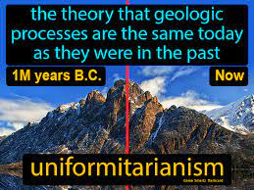
Uniformitarianism Defined
https://www.britannica.com/science/uniformitarianism
“. . . catastrophic events such as the biblical Flood. In contrast to catastrophism, uniformitarianism postulates that phenomena displayed in rocks may be entirely accounted for by geologic processes that continue to operate—in other words, the present is the key to the past.”

Slide 15

Colossians 2:8
“See to it that no one takes you captive through philosophy and empty deception, according to the tradition of men, according to the elementary principles of the world, rather than according to Christ.”

Slide 16
Overview 2 Peter 3:3-15
Heresy of the false teachers (v3-4)
Motive of the false teachers (v3-4)
Peter’s rebuttal (v5-10)
Application (v11-15)

Slide 17
Peter’s Rebuttal V.5-10
Arguments from:
History (5-7)
Scripture (8)
God’s character (9)
Divine promise (10)

Slide 18
Peter’s Rebuttal V.5-10
Arguments from:
History (5-7)
Scripture (8)
God’s character (9)
Divine promise (10)

Slide 19

History V. 5-7
Creation (5)
Flood (6-7)
  God will judge again via fire

Slide 20
History V. 5-7
Creation (5)
Flood (6-7)
  God will judge again via fire

Slide 21

Genesis 1:1-3
¹ In the beginning God created the heavens and the earth. ² The earth was formless and void, and darkness was over the surface of the deep, and the Spirit of God was moving over the surface of the waters. ³ Then God said, “Let there be light”; and there was light.

Slide 22

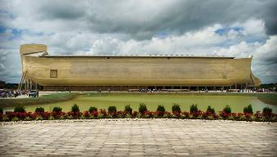
2 Peter 3:5 (KJV)
“For this they willingly are ignorant of [thelō], that by the word of God the heavens were of old, and the earth standing out of the water and in the water.”

Slide 23
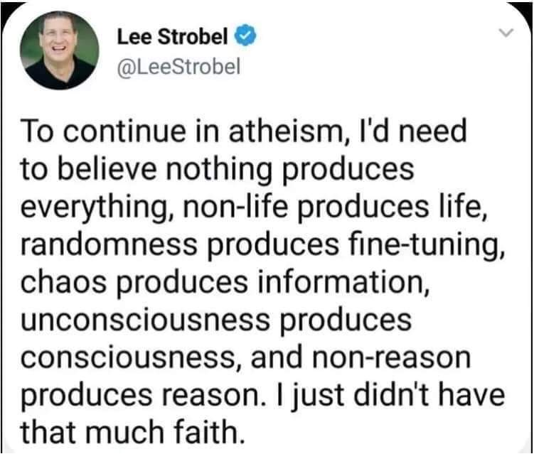

Slide 24
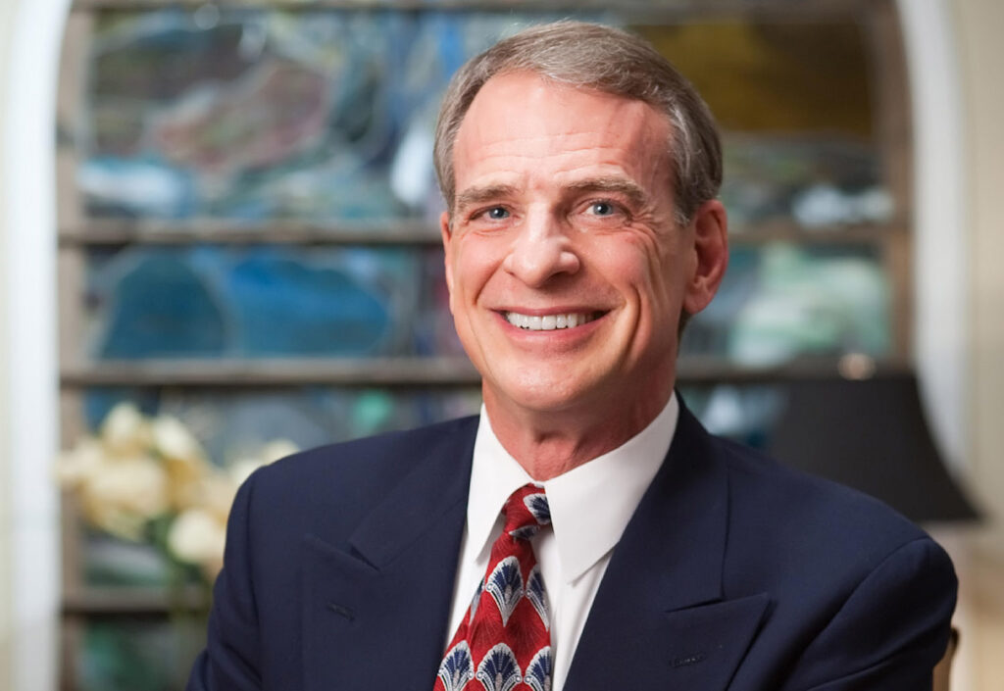
William Lane Craig
“See William Lane Craig, "Dr. Craig on Collins vs Dawkins on Design of Universe," January 20, 2013, https://www.reasonablefaith.org/media/reasonable-faith-podcast/dr.-craig-on-collins-vs-dawkins-on-design-of-universe/.”.
“…I've seen a comparable statistic that says that over 50% of evangelical pastors think that the world is less than ten thousand years old. Now, when you think about that … that is just hugely embarrassing; that over half of our ministers really believe that the universe is only around ten thousand years old. This is just scientifically nonsense, and yet this is the view that the majority of our pastors hold. It's really quite shocking when you think about it.”

Slide 25
History V. 5-7
Creation (5)
Flood (6-7)
  God will judge again via fire

Slide 26
Genesis 7:19-23
They rose greatly on the earth, and all the high mountains under the entire heaven were covered…Every living thing that moved on the earth perished—birds, livestock, wild animals, all the creatures that swarm over the earth, and all mankind. Everything on dry land that had the breath of life in its nostrils died. Every living thing on the face of the earth was wiped out; men and animals and the creatures that move along the ground and the birds of the air were wiped from the earth. Only Noah was left, and those with him in the ark.”

Slide 27

H.C. Leupold
Exposition of Genesis (Grand Rapids: Baker, 1942), vol. 1, p. 301-302.
“… ‘all the high mountains under all the heavens.’ One of these expressions alone would almost necessitate the impression that the author intends to convey the idea of the absolute universality of the Flood…Yet since ‘all’ is known to be used in a relative sense, the writer removes all ambiguity by adding the phrase ‘under all the heavens.’ A double ‘all’ (kol) cannot allow for so relative a sense. It almost constitutes a Hebrew superlative. So we believe that the text disposes of the question of the universality of the flood. By way of objection to this interpretation, those who believe in a limited flood…urge the . . .

Slide 28
H.C. Leupold
Exposition of Genesis (Grand Rapids: Baker, 1942), vol. 1, p. 301-302.
. . . fact that kol is used in a relative sense, as is clearly the case in passages such as Genesis 41:57; Exodus 9:25, 10:15; Deuteronomy 2:25; and 1 Kings 10:24. However, we still insist that this fact could overthrow a single kol, never a double kol, as our verse has it.”

Slide 29

Matthew 24:36-39
³⁶ “But of that day and hour no one knows, not even the angels of heaven, nor the Son, but the Father alone. ³⁷ For the coming of the Son of Man will be just like the days of Noah. ³⁸ For as in those days before the flood they were eating and drinking, marrying and giving in marriage, until the day that Noah entered the ark, ³⁹ and they did not understand until the flood came and took them all away; so will the coming of the Son of Man be.”

Slide 30

Dr. Henry Morris
The Revelation Record, 14
“The Book of Revelation is the sequel to the Book of Genesis, the two books together bounding all history and bounding all of God’s revelations to mankind. They constitute the alpha and omega of God’s written Word, the Book of Beginnings, and the Book of Unveilings.”

Slide 31
Uniformitarianism is not Biblicism
Era | Scripture | Distinctives
1. Creation | Gen. 1-2 | No death
2. Fall | Gen. 3-6 | Death, painful pregnancy & toil, long life spans, no human government
3. Flood | Gen. 7-10 | Shorter life spans, one language, no nations, human government
4. Babel | Gen. 11-present | No global government, multiple languages, nations, ethnicities

Slide 32
Uniformitarianism is not Biblicism
Era | Scripture | Distinctives
5. Antichrist | Rapture to 2nd Advent | Global government, restrainer removed
6. Kingdom | Rev. 20:1-10 | Long life spans, kingdom conditions, reality of death, renovated earth
7. Eternal State | Rev. 21-22 | No death, new earth

Slide 33
Peter’s Rebuttal V.5-10
Arguments from:
History (5-7)
Scripture (8)
God’s character (9)
Divine promise (10)

Slide 34
Scripture V. 8
God’s timing is not the same as ours

Slide 35

Romans 8:29-30
²⁹ For those whom He foreknew, He also predestined to become conformed to the image of His Son, so that He would be the firstborn among many brethren; ³⁰ and these whom He predestined, He also called; and these whom He called, He also justified; and these whom He justified, He also glorified.

Slide 36
Peter’s Rebuttal V.5-10
Arguments from:
History (5-7)
Scripture (8)
God’s character (9)
Divine promise (10)

Slide 37

2 Peter 3:9
“The Lord is not slow about His promise, as some count slowness, but is patient toward you, not wishing for any to perish but for all to come to repentance.”

Slide 38
God’s Character
V. 9
Delay ≠ no 2nd Coming
Delay = patience

Slide 39
Genesis 6:1-4
“¹ Now it came about, when men began to multiply on the face of the land, and daughters were born to them, ² that the sons of God saw that the daughters of men were beautiful; and they took wives for themselves, whomever they chose. ³ Then the Lord said, ‘My Spirit shall not strive with man forever, because he also is flesh; nevertheless his days shall be one hundred and . . .

Slide 40
Genesis 6:1-4
. . . twenty years.’ ⁴ The Nephilim were on the earth in those days, and also afterward, when the sons of God came in to the daughters of men, and they bore children to them. Those were the mighty men who were of old, men of renown.”

Slide 41
1 Peter 3:19-20
“¹⁹ in which also He went and made proclamation the spirits now in prison, ²⁰ who once were disobedient, when the patience of God kept waiting in the days of Noah, during the construction of the ark, in which a few, that is, eight persons, were brought safely through the water.”

Slide 42
Peter’s Rebuttal V.5-10
Arguments from:
History (5-7)
Scripture (8)
God’s character (9)
Divine promise (10)

Slide 43
God’s Promise V. 10
Despite delay,
  the day will come:
Like a thief
According to God’s promise

Slide 44
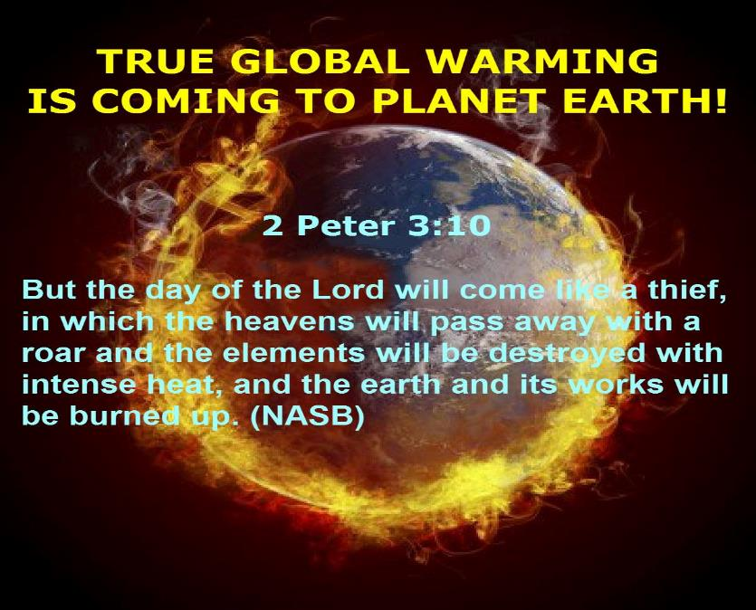

Slide 45


2 Corintians 4:18
“…while we look not at the things which are seen, but at the things which are not seen; for the things which are seen are temporal, but the things which are not seen are eternal.”

Slide 46
Overview 2 Peter 3:3-15
Heresy of the false teachers (v3-4)
Motive of the false teachers (v3-4)
Peter’s rebuttal (v5-10)
Application (v11-15)

Slide 47

2 Peter 3:10-11
“¹⁰ But the day of the Lord will come like a thief, in which the heavens will pass away with a roar and the elements will be destroyed with intense heat, and the earth and its works will be burned up. ¹¹ Since all these things are to be destroyed in this way, what sort of people ought you to be in holy conduct and godliness.”

Slide 48
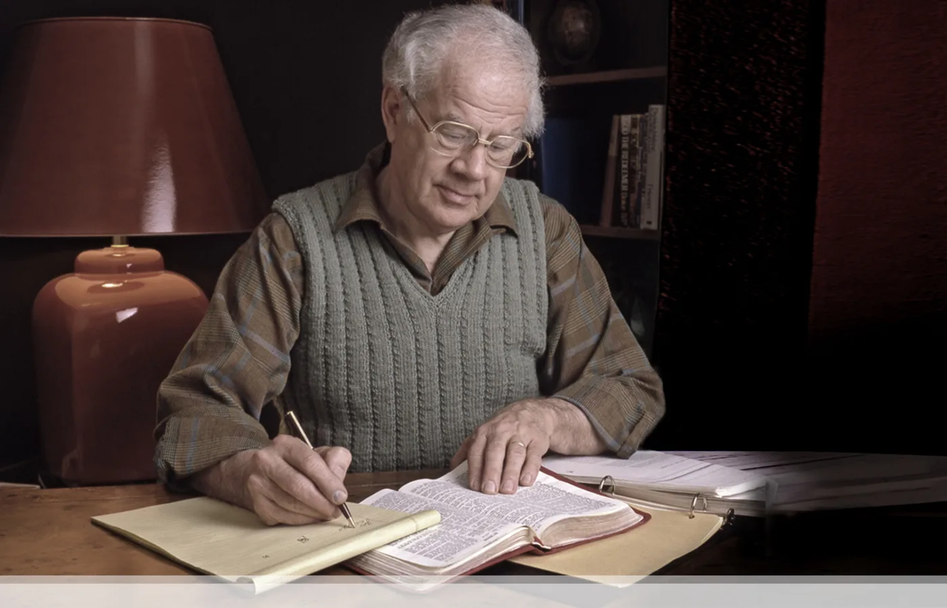

J. Dwight Pentecost
Prophecy For Today, Page 20
“A short time ago, I took occasion to go through the New Testament to mark each reference to the coming of the Lord Jesus Christ and to observe the use made of that teaching about His coming. I was struck a new with the fact that almost without exception, when the coming of Christ is mentioned in the New Testament, it is followed by an exhortation to godliness and holy living.”

Slide 49
Application V. 11-15
Holy Living (11b, 14)
Evangelism (12)
Hope (13)
Patience (15)

Slide 50
Application V. 11-15
Holy Living (11b, 14)
Evangelism (12)
Hope (13)
Patience (15)

Slide 51
Application V. 11-15
Holy Living (11b, 14)
Evangelism (12)
Hope (13)
Patience (15)

Slide 52
2 Peter 3:12
“looking for and hastening [speudō] the coming of the day of God, because of which the heavens will be destroyed by burning, and the elements will melt with intense heat!.”

Slide 53
2 Peter 3:9
“The Lord is not slow about His promise, as some count slowness, but is patient toward you, not wishing for any to perish but for all to come to repentance.”

Slide 54
Application V. 11-15
Holy Living (11b, 14)
Evangelism (12)
Hope (13)
Patience (15)

Slide 55
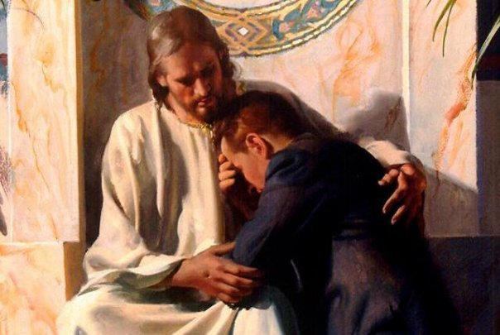
Revelation 21:4
“and He will wipe away every tear from their eyes; and there will no longer be any death; there will no longer be any mourning, or crying, or pain; the first things have passed away.”

Slide 56
Application V. 11-15
Holy Living (11b, 14)
Evangelism (12)
Hope (13)
Patience (15)

Slide 57
2 Peter 3:9
“The Lord is not slow about His promise, as some count slowness, but is patient toward you, not wishing for any to perish but for all to come to repentance.”

Slide 58
CONCLUSION

Slide 59
Overview 2 Peter 3:3-15
Heresy of the false teachers (v3-4)
Motive of the false teachers (v3-4)
Peter’s rebuttal (v5-10)
Application (v11-15)

