Slide 1


Genesis 12‒50
Israel’s Birth & Preservation

Slide 2

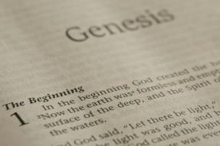
GENESIS STRUCTURE
  Genesis 12-50 (four people)
    Abraham (12:1–25:11)
    Isaac (25:12–26:35)
    Jacob (27–36)
    Joseph (37–50)

Slide 3
Genesis 37:2-36
Joseph Sold unto Egypt
  Joseph’s coat (37:2-4)
  Joseph’s dreams (37:5-11)
  Joseph’s pit (37:12-24)
  Joseph’s enslavement (37:25-36)

Slide 4
Genesis 38:1-30
Judah & Tamar
  Tamar & Judah’s sons (38:1-11)
  Tamar & Judah (38:12-26)
  Tamar & Judah’s twins (38:27-30)

Slide 5
Genesis 38:1-30
Judah & Tamar
  Tamar & Judah’s sons (38:1-11)
  Tamar & Judah (38:12-26)
  Tamar & Judah’s twins (38:27-30)

Slide 6
I. Genesis 38:1-11
Tamar & Judah’s Sons
    Judah’s separation (1)
    Judah’s wife (2)
    Judah’s sons (3-5)
    Tamar’s marriages (6-10)
    Tamar’s widowhood (11)

Slide 7
I. Genesis 38:1-11
Tamar & Judah’s Sons
    Judah’s separation (1)
    Judah’s wife (2)
    Judah’s sons (3-5)
    Tamar’s marriages (6-10)
    Tamar’s widowhood (11)

Slide 8
Genesis 38:1
Judah’s Separation
      Timing (1a)
      Event (1b)

Slide 9
Genesis 38:1
Judah’s Separation
      Timing (1a)
      Event (1b)

Slide 10
Genesis 38:1
Judah’s Separation
      Timing (1a)
      Event (1b)

Slide 11
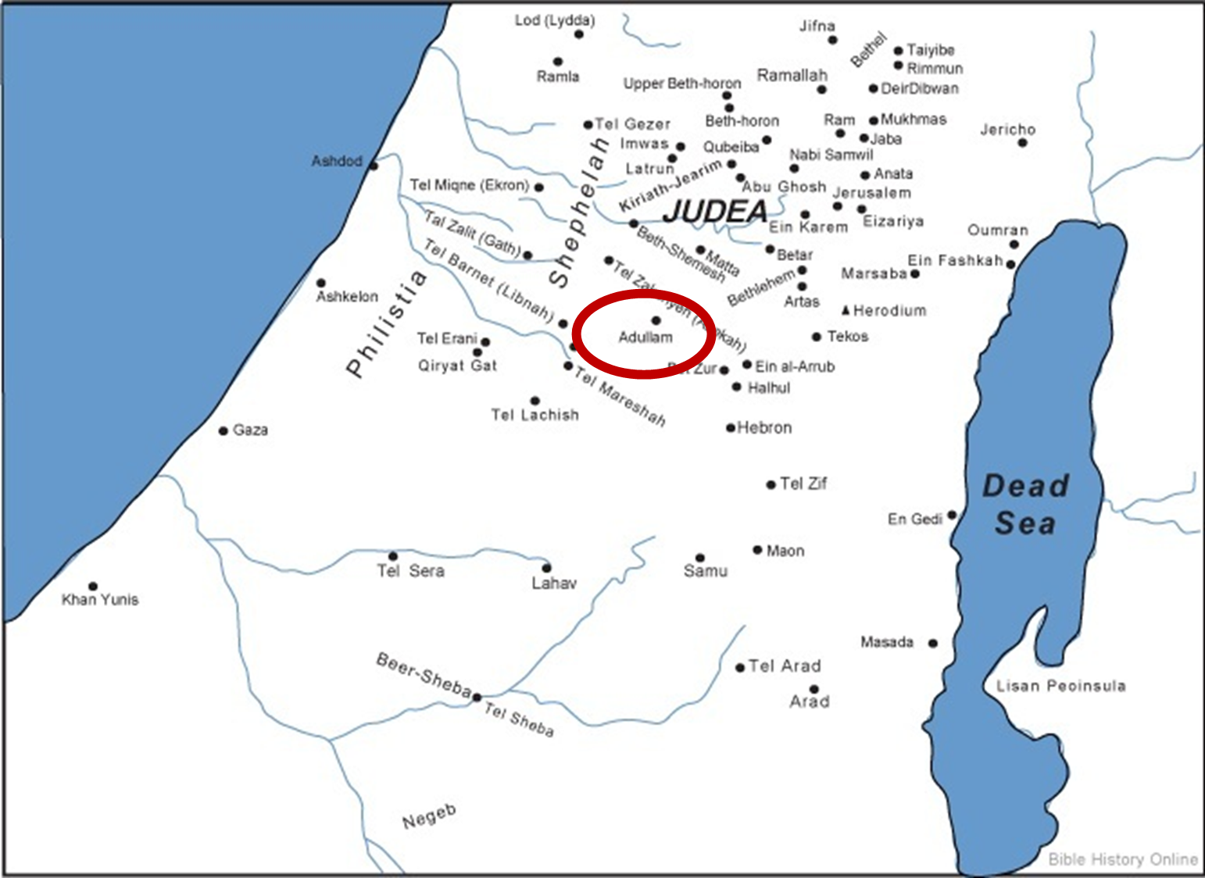

Slide 12
I. Genesis 38:1-11
Tamar & Judah’s Sons
    Judah’s separation (1)
    Judah’s wife (2)
    Judah’s sons (3-5)
    Tamar’s marriages (6-10)
    Tamar’s widowhood (11)

Slide 13
Messiah must be from the tribe of Judah
Genesis 49:10
Revelation 5:5

Slide 14

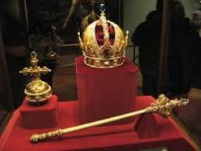
Genesis 49:10
“The scepter shall not depart from Judah, Nor the ruler’s staff from between his feet, Until Shiloh comes, And to him shall be the obedience of the peoples.”

Slide 15

Revelation 5:5
“and one of the elders said to me, “Stop weeping; behold, the Lion that is from the tribe of Judah, the Root of David, has overcome so as to open the book and its seven seals.”

Slide 16
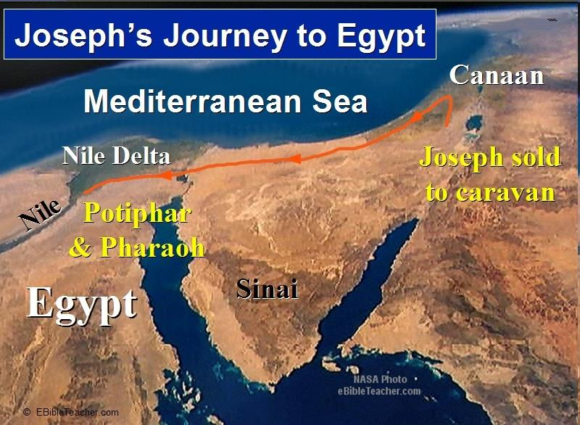

Slide 17
I. Genesis 38:1-11
Tamar & Judah’s Sons
    Judah’s separation (1)
    Judah’s wife (2)
    Judah’s sons (3-5)
    Tamar’s marriages (6-10)
    Tamar’s widowhood (11)

Slide 18
Genesis 38:3-5
Judah’s Sons
      Er (3)
      Onan (4)
      Shelah (5)

Slide 19
Genesis 38:3-5
Judah’s Sons
      Er (3)
      Onan (4)
      Shelah (5)

Slide 20
Genesis 38:3-5
Judah’s Sons
      Er (3)
      Onan (4)
      Shelah (5)

Slide 21
Genesis 38:3-5
Judah’s Sons
      Er (3)
      Onan (4)
      Shelah (5)

Slide 22
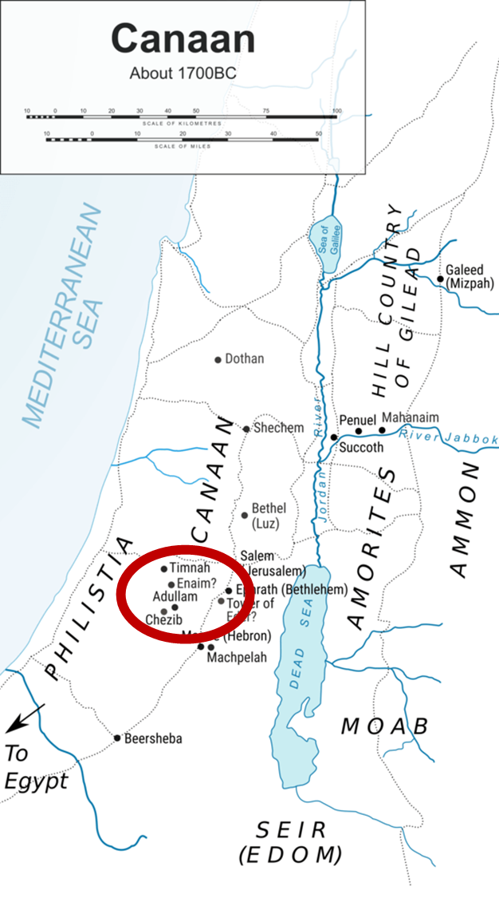

Slide 23
I. Genesis 38:1-11
Tamar & Judah’s Sons
    Judah’s separation (1)
    Judah’s wife (2)
    Judah’s sons (3-5)
    Tamar’s marriages (6-10)
    Tamar’s widowhood (11)

Slide 24
Genesis 38:6-10
Tamar’s Marriages
      To Er (6-7)
      To Onan (8-10)

Slide 25
Genesis 38:6-10
Tamar’s Marriages
      To Er (6-7)
      To Onan (8-10)

Slide 26
Genesis 38:6-7
To Er
      Marriage (6)
      Death (7)

Slide 27
Genesis 38:6-7
To Er
      Marriage (6)
      Death (7)

Slide 28
Genesis 38:6-7
To Er
      Marriage (6)
      Death (7)

Slide 29
Genesis 38:6-10
Tamar’s Marriages
      To Er (6-7)
      To Onan (8-10)

Slide 30
Genesis 38:8-10
To Onan
      Marriage (8)
      Onan’s sin (9)
      Death (10)

Slide 31
Genesis 38:8-10
To Onan
      Marriage (8)
      Onan’s sin (9)
      Death (10)

Slide 32
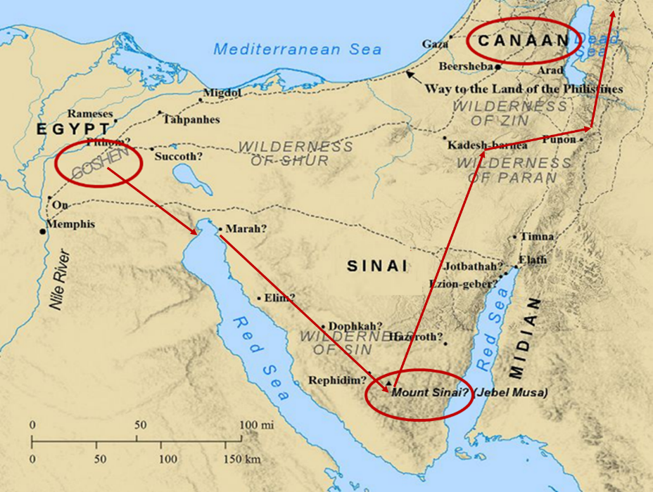

Slide 33
Genesis 38:8-10
To Onan
      Marriage (8)
      Onan’s sin (9)
      Death (10)

Slide 34


Dr. Arnold G. Fruchtenbaum
The Book of Genesis, 540
“Verse 9 describes Onan’s sin: And Onan knew that the seed would not be his; he knew whatever child he had would be the legal child of his dead brother: and it came to pass, when he went in unto his brother’s wife, meaning he had sexual intercourse with her, that he spilled it on the ground, meaning he ejaculated on the ground. From this account came the term ‘onanism,’ and it is usually a euphemism for masturbation, and so people have used this passage to teach that masturbation itself is a sin. However, in fact, this was not masturbation but coitus interruptus, meaning that he withdrew himself before ejaculation and spilled the semen on the ground.”

Slide 35
Dr. Arnold G. Fruchtenbaum
The Book of Genesis, 540
“His problem was that he was not willing to fulfill the obligation he had to his brother: lest he should give seed to his brother. This was the sin; he did not want to honor his dead brother, so he obviously had a hatred for his brother. He was willing to take Tamar for sexual gratification, but he was not willing to take the responsibility to fulfill his obligation. This was not just a one-time act; the way it is phrased means he regularly spilled the seed on the ground.”

Slide 36
Genesis 38:8-10
To Onan
      Marriage (8)
      Onan’s sin (9)
      Death (10)

Slide 37
I. Genesis 38:1-11
Tamar & Judah’s Sons
    Judah’s separation (1)
    Judah’s wife (2)
    Judah’s sons (3-5)
    Tamar’s marriages (6-10)
    Tamar’s widowhood (11)

Slide 38
Genesis 38:11
Tamar’s Widowhood
      Judah’s instructions (11a)
      Tamar’s obedience (11b)

Slide 39
Genesis 38:11
Tamar’s Widowhood
      Judah’s instructions (11a)
      Tamar’s obedience (11b)

Slide 40
Genesis 38:11
Tamar’s Widowhood
      Judah’s instructions (11a)
      Tamar’s obedience (11b)

Slide 41
Genesis 38:1-30
Judah & Tamar
  Tamar & Judah’s sons (38:1-11)
  Tamar & Judah (38:12-26)
  Tamar & Judah’s twins (38:27-30)

Slide 42
II. Genesis 38:12-26
Tamar & Judah
    Occasion (12-14)
    Incest (15-18)
    Tamar’s departure (19)
    Judah’s attempted payment (20-23)
    Judah’s revelation (24-26)

Slide 43
II. Genesis 38:12-26
Tamar & Judah
    Occasion (12-14)
    Incest (15-18)
    Tamar’s departure (19)
    Judah’s attempted payment (20-23)
    Judah’s revelation (24-26)

Slide 44
Genesis 38:12-14
Occasion
      Death of Judah’s wife (12a)
      Judah goes to Timnah (12b)
      Message comes to Tamar (13)
      Tamar’s plan (14)

Slide 45
Genesis 38:12-14
Occasion
      Death of Judah’s wife (12a)
      Judah goes to Timnah (12b)
      Message comes to Tamar (13)
      Tamar’s plan (14)

Slide 46
Genesis 38:12-14
Occasion
      Death of Judah’s wife (12a)
      Judah goes to Timnah (12b)
      Message comes to Tamar (13)
      Tamar’s plan (14)

Slide 48
Genesis 38:12-14
Occasion
      Death of Judah’s wife (12a)
      Judah goes to Timnah (12b)
      Message comes to Tamar (13)
      Tamar’s plan (14)

Slide 49
Genesis 38:12-14
Occasion
      Death of Judah’s wife (12a)
      Judah goes to Timnah (12b)
      Message comes to Tamar (13)
      Tamar’s plan (14)

Slide 50
Genesis 38:14
Tamar’s Plan
      Disguise (14a)
      Position (14b)
      Reason (14c)

Slide 51
Genesis 38:14
Tamar’s Plan
      Disguise (14a)
      Position (14b)
      Reason (14c)

Slide 52
Genesis 38:14
Tamar’s Plan
      Disguise (14a)
      Position (14b)
      Reason (14c)

Slide 54
Genesis 38:14
Tamar’s Plan
      Disguise (14a)
      Position (14b)
      Reason (14c)

Slide 55
II. Genesis 38:12-26
Tamar & Judah
    Occasion (12-14)
    Incest (15-18)
    Tamar’s departure (19)
    Judah’s attempted payment (20-23)
    Judah’s revelation (24-26)

Slide 56
Genesis 38:15-18
Incest of Judah & Tamar
      Deception (15)
      Bargaining (16-18b)
      Incest (18c)

Slide 57
Genesis 38:15-18
Incest of Judah & Tamar
      Deception (15)
      Bargaining (16-18b)
      Incest (18c)

Slide 58
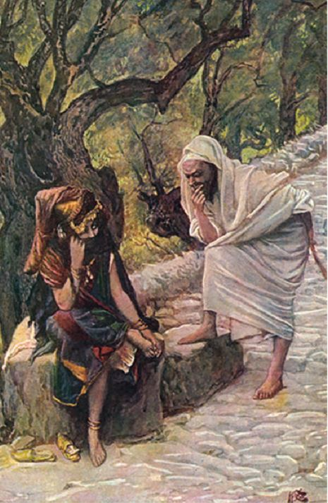
Dr. Arnold G. Fruchtenbaum
The Book of Genesis, 543
“Therefore, Judah, who had earlier deceived Jacob, initiating the selling of Joseph, now is himself deceived.”

Slide 59
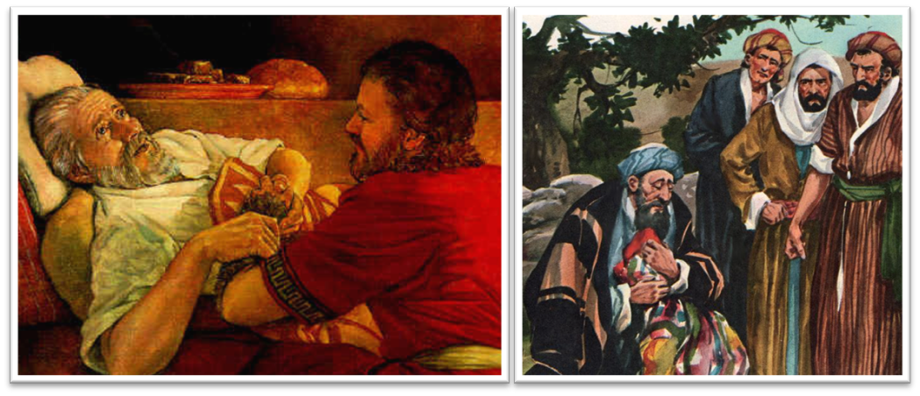
Dr. Arnold G. Fruchtenbaum
The Book of Genesis, 537
“Here again, there is a form of retribution: Jacob deceived Isaac with goatskins (27:16), now Jacob was being deceived with goat’s blood. Furthermore, Jacob deceived Isaac with Esau’s clothes (27:15); now Jacob was deceived by the use of Joseph’s clothes.”

Slide 60
Dr. Arnold G. Fruchtenbaum
The Book of Genesis, 445
“Now the deceiver is deceived, although the motivations differ from good to bad. This is divine retribution in four ways. First, Isaac’s blindness equals the darkness of Jacob’s wedding night, and neither could see well as a result. Second, this Jacob is deceived by being presented the older for the younger, the reversal of Isaac’s presentation of Jacob for Esau. Third, Isaac thought Jacob was Esau and Jacob thought Leah was Rachel. Fourth, Jacob pretended to be his older brother, while Leah pretended to be her younger sister.”

Slide 61
Genesis 38:15-18
Incest of Judah & Tamar
      Deception (15)
      Bargaining (16-18b)
      Incest (18c)

Slide 62
Genesis 38:16-18b
Bargaining
      Judah’s solicitation (16a)
      Tamar’s request (16b)
      Judah’s offer (17a)
      Tamar’s request for a pledge (17b)
      Judah’s request for specificity (18a)
      Tamar’s clarification (18b)

Slide 63
Genesis 38:16-18b
Bargaining
      Judah’s solicitation (16a)
      Tamar’s request (16b)
      Judah’s offer (17a)
      Tamar’s request for a pledge (17b)
      Judah’s request for specificity (18a)
      Tamar’s clarification (18b)

Slide 64
Genesis 38:16-18b
Bargaining
      Judah’s solicitation (16a)
      Tamar’s request (16b)
      Judah’s offer (17a)
      Tamar’s request for a pledge (17b)
      Judah’s request for specificity (18a)
      Tamar’s clarification (18b)

Slide 65
Genesis 38:16-18b
Bargaining
      Judah’s solicitation (16a)
      Tamar’s request (16b)
      Judah’s offer (17a)
      Tamar’s request for a pledge (17b)
      Judah’s request for specificity (18a)
      Tamar’s clarification (18b)

Slide 66
Genesis 38:16-18b
Bargaining
      Judah’s solicitation (16a)
      Tamar’s request (16b)
      Judah’s offer (17a)
      Tamar’s request for a pledge (17b)
      Judah’s request for specificity (18a)
      Tamar’s clarification (18b)

Slide 67
Genesis 38:16-18b
Bargaining
      Judah’s solicitation (16a)
      Tamar’s request (16b)
      Judah’s offer (17a)
      Tamar’s request for a pledge (17b)
      Judah’s request for specificity (18a)
      Tamar’s clarification (18b)

Slide 68
Genesis 38:16-18b
Bargaining
      Judah’s solicitation (16a)
      Tamar’s request (16b)
      Judah’s offer (17a)
      Tamar’s request for a pledge (17b)
      Judah’s request for specificity (18a)
      Tamar’s clarification (18b)

Slide 69
Genesis 38:15-18
Incest of Judah & Tamar
      Deception (15)
      Bargaining (16-18b)
      Incest (18c)

Slide 70
II. Genesis 38:12-26
Tamar & Judah
    Occasion (12-14)
    Incest (15-18)
    Tamar’s departure (19)
    Judah’s attempted payment (20-23)
    Judah’s revelation (24-26)

Slide 71
II. Genesis 38:12-26
Tamar & Judah
    Occasion (12-14)
    Incest (15-18)
    Tamar’s departure (19)
    Judah’s attempted payment (20-23)
    Judah’s revelation (24-26)

Slide 72
Genesis 38:20-23
Judah’s Attempted Payment
      Search (20)
      Problem (21)
      Report to Judah (22)
      Judah’s decision (23)

Slide 73
Genesis 38:20-23
Judah’s Attempted Payment
      Search (20)
      Problem (21)
      Report to Judah (22)
      Judah’s decision (23)

Slide 74
Genesis 38:20-23
Judah’s Attempted Payment
      Search (20)
      Problem (21)
      Report to Judah (22)
      Judah’s decision (23)

Slide 75
Genesis 38:20-23
Judah’s Attempted Payment
      Search (20)
      Problem (21)
      Report to Judah (22)
      Judah’s decision (23)

Slide 76
Genesis 38:20-23
Judah’s Attempted Payment
      Search (20)
      Problem (21)
      Report to Judah (22)
      Judah’s decision (23)

Slide 77
II. Genesis 38:12-26
Tamar & Judah
    Occasion (12-14)
    Incest (15-18)
    Tamar’s departure (19)
    Judah’s attempted payment (20-23)
    Judah’s revelation (24-26)

Slide 78
Genesis 38:24-26
Judah’s Revelation
      Report to Judah (24a)
      Judah’s verdict (24b)
      Tamar’s defense (25)
      Judah’s admission (26)

Slide 79
Genesis 38:24-26
Judah’s Revelation
      Report to Judah (24a)
      Judah’s verdict (24b)
      Tamar’s defense (25)
      Judah’s admission (26)

Slide 80
Genesis 38:24-26
Judah’s Revelation
      Report to Judah (24a)
      Judah’s verdict (24b)
      Tamar’s defense (25)
      Judah’s admission (26)

Slide 81
Genesis 38:24-26
Judah’s Revelation
      Report to Judah (24a)
      Judah’s verdict (24b)
      Tamar’s defense (25)
      Judah’s admission (26)

Slide 82
Genesis 38:24-26
Judah’s Revelation
      Report to Judah (24a)
      Judah’s verdict (24b)
      Tamar’s defense (25)
      Judah’s admission (26)

Slide 83
Genesis 38:1-30
Judah & Tamar
  Tamar & Judah’s sons (38:1-11)
  Tamar & Judah (38:12-26)
  Tamar & Judah’s twins (38:27-30)

Slide 84
III. Genesis 38:27-30
Twins of Tamar & Judah
    Birth of the twins (27)
    Scarlet thread (28)
    Reversal of the birth order (29-30)

Slide 85
III. Genesis 38:27-30
Twins of Tamar & Judah
    Birth of the twins (27)
    Scarlet thread (28)
    Reversal of the birth order (29-30)

Slide 86

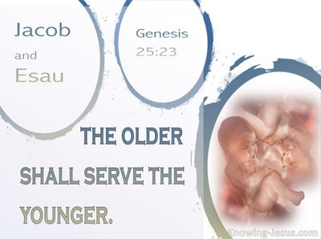
Genesis 25:23
“The Lord said to her, ‘Two nations are in your womb; And two peoples will be separated from your body; And one people shall be stronger than the other; And the older shall serve the younger.’”

Slide 87

Luke 19:42-44
^{“42} saying, ‘If you had known in this day, even you, the things which make for peace! But now they have been hidden from your eyes. ⁴³ For the days will come upon you when your enemies will throw up a barricade against you, and surround you and hem you in on every side, ⁴⁴ and they will level you to the ground and your children within you, and they will not leave in you one stone upon another, because you did not recognize the time of your visitation.’”

Slide 88
III. Genesis 38:27-30
Twins of Tamar & Judah
    Birth of the twins (27)
    Scarlet thread (28)
    Reversal of the birth order (29-30)

Slide 89
III. Genesis 38:27-30
Twins of Tamar & Judah
    Birth of the twins (27)
    Scarlet thread (28)
    Reversal of the birth order (29-30)

Slide 90
Genesis 38:29-30
Reversal of the Birth Order
      Perez’ birth (29)
      Zerah’s birth (30)

Slide 91
Genesis 38:29-30
Reversal of the Birth Order
      Perez’ birth (29)
      Zerah’s birth (30)

Slide 92

Cain Murders Abel
(Genesis 4:3-8)
  4:3-5a
  Messianic line through Abel (Gen 3:21; Heb 11:4) contrary to Eve’s false expectation (4:1)
  Begins selection of younger over older pattern (Abel over Cain, Seth over Cain, Shem over Japheth, Isaac over Ishmael, Jacob over Esau, Judah and Joseph over their brothers, and Ephraim over Manasseh)

Slide 93
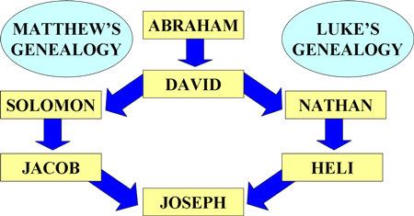
To Circumvent Jeconiah’s Curse

Slide 94
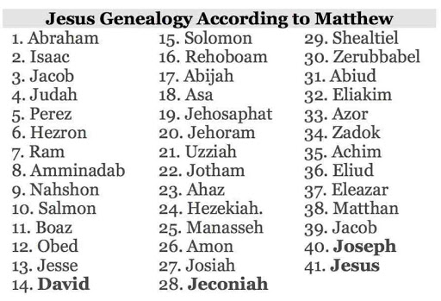

Slide 95
Genesis 38:29-30
Reversal of the Birth Order
      Perez’ birth (29)
      Zerah’s birth (30)

Slide 96
Genesis 38:1-30
Concluding Observations
  Interruption of the Joseph account
  Why the Egyptian sojourn was necessary
  Problem of Canaanite intermarriage
  Problem of Canaanite immorality
  Problem of famine in Canaan
  Messianic lineage
  Origin of Levirate Marriage
  Sexual temptation: Judah vs. Joseph

Slide 97
Genesis 38:1-30
Concluding Observations
  Interruption of the Joseph account
  Why the Egyptian sojourn was necessary
  Problem of Canaanite intermarriage
  Problem of Canaanite immorality
  Problem of famine in Canaan
  Messianic lineage
  Origin of Levirate Marriage
  Sexual temptation: Judah vs. Joseph

Slide 98
Genesis 38:1-30
Concluding Observations
  Interruption of the Joseph account
  Why the Egyptian sojourn was necessary
  Problem of Canaanite intermarriage
  Problem of Canaanite immorality
  Problem of famine in Canaan
  Messianic lineage
  Origin of Levirate Marriage
  Sexual temptation: Judah vs. Joseph

Slide 100
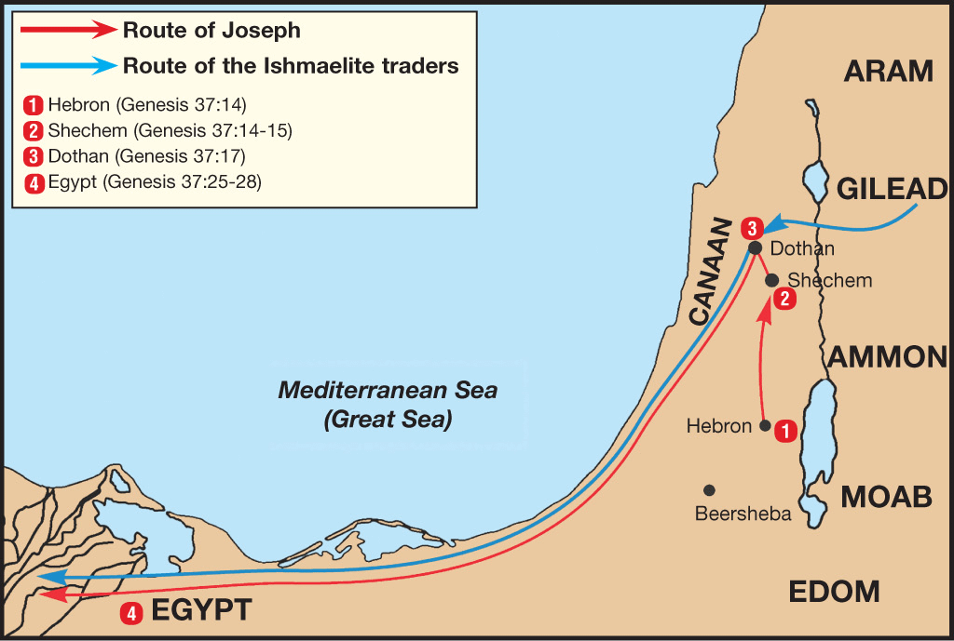

Slide 101
Genesis 38:1-30
Concluding Observations
  Interruption of the Joseph account
  Why the Egyptian sojourn was necessary
  Problem of Canaanite intermarriage
  Problem of Canaanite immorality
  Problem of famine in Canaan
  Messianic lineage
  Origin of Levirate Marriage
  Sexual temptation: Judah vs. Joseph

Slide 102
Genesis 38:1-30
Concluding Observations
  Interruption of the Joseph account
  Why the Egyptian sojourn was necessary
  Problem of Canaanite intermarriage
  Problem of Canaanite immorality
  Problem of famine in Canaan
  Messianic lineage
  Origin of Levirate Marriage
  Sexual temptation: Judah vs. Joseph

Slide 103
Genesis 38:1-30
Concluding Observations
  Interruption of the Joseph account
  Why the Egyptian sojourn was necessary
  Problem of Canaanite intermarriage
  Problem of Canaanite immorality
  Problem of famine in Canaan
  Messianic lineage
  Origin of Levirate Marriage
  Sexual temptation: Judah vs. Joseph

Slide 104
Genesis 38:1-30
Concluding Observations
  Interruption of the Joseph account
  Why the Egyptian sojourn was necessary
  Problem of Canaanite intermarriage
  Problem of Canaanite immorality
  Problem of famine in Canaan
  Messianic lineage
  Origin of Levirate Marriage
  Sexual temptation: Judah vs. Joseph

Slide 106
Genesis 38:1-30
Concluding Observations
  Interruption of the Joseph account
  Why the Egyptian sojourn was necessary
  Problem of Canaanite intermarriage
  Problem of Canaanite immorality
  Problem of famine in Canaan
  Messianic lineage
  Origin of Levirate Marriage
  Sexual temptation: Judah vs. Joseph

Slide 107
Genesis 38:1-30
Concluding Observations
  Interruption of the Joseph account
  Why the Egyptian sojourn was necessary
  Problem of Canaanite intermarriage
  Problem of Canaanite immorality
  Problem of famine in Canaan
  Messianic lineage
  Origin of Levirate Marriage
  Sexual temptation: Judah vs. Joseph

Slide 108
Conclusion

Slide 109
Genesis 38:1-30
Judah & Tamar
  Tamar & Judah’s sons (38:1-11)
  Tamar & Judah (38:12-26)
  Tamar & Judah’s twins (38:27-30)

Slide 110
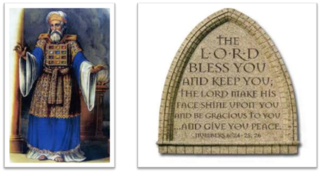
²⁴ The Lord bless you, and keep you; ²⁵ The Lord make His face shine on you, And be gracious to you; ²⁶ The Lord lift up His countenance on you, And give you peace.
Numbers 6:24–26 (NASB95)

