Slide 1


Dr. Andy Woods
Senior Pastor – Sugar Land Bible Church
President – Chafer Theological Seminary

Slide 2
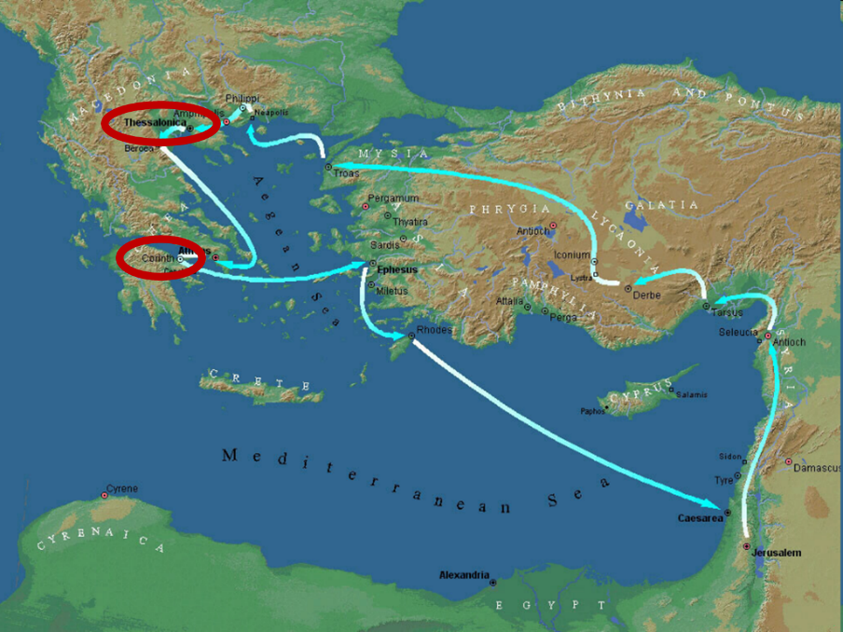

Slide 3
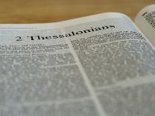
2 Thessalonians 2:1-12
Problem (2:1-2)
Prerequisites for the Day of the Lord (2:3-12)
  The departure (2:3a)
  Advent of the lawless one (2:3b-4)
  Removal of the restrainer (2:5-7)
  Destruction of the lawless one (2:8-9)
  Destruction of lawless one’s followers (2:10-12)

Slide 4


2 Thessalonians 2:2
“that you not be quickly shaken from your composure or be disturbed either by a spirit or a message or a letter as if from us, to the effect that the day of the Lord [the Tribulation] has come.”

Slide 5
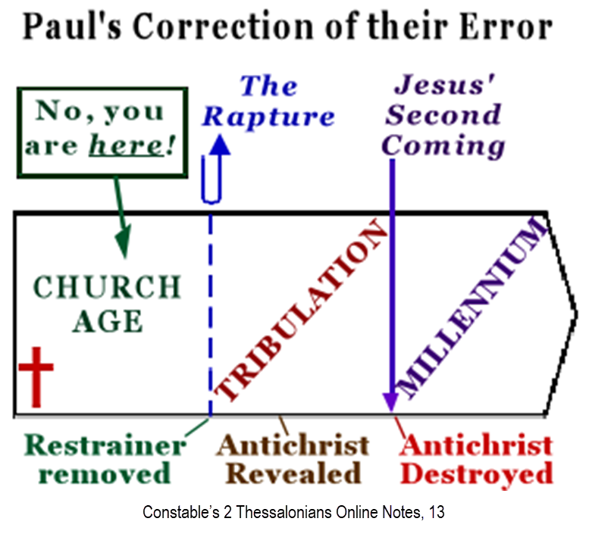

Slide 6
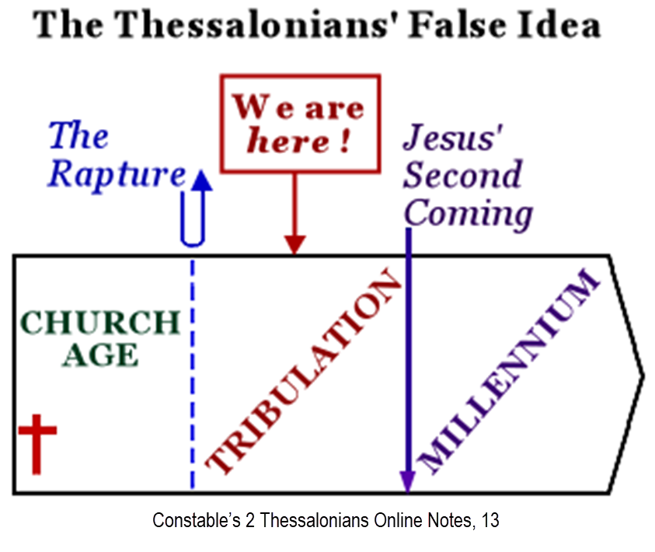

Slide 7
2 Thessalonians 2:1-12
Problem (2:1-2)
Prerequisites for the Day of the Lord (2:3-12)
  The departure (2:3a)
  Advent of the lawless one (2:3b-4)
  Removal of the restrainer (2:5-7)
  Destruction of the lawless one (2:8-9)
  Destruction of lawless one’s followers (2:10-12)

Slide 8
2 Thessalonians 2:1-12
Problem (2:1-2)
Prerequisites for the Day of the Lord (2:3-12)
  The departure (2:3a)
  Advent of the lawless one (2:3b-4)
  Removal of the restrainer (2:5-7)
  Destruction of the lawless one (2:8-9)
  Destruction of lawless one’s followers (2:10-12)

Slide 9
2 Thessalonians 2:1-12
Problem (2:1-2)
Prerequisites for the Day of the Lord (2:3-12)
  The departure (2:3a)
  Advent of the lawless one (2:3b-4)
  Removal of the restrainer (2:5-7)
  Destruction of the lawless one (2:8-9)
  Destruction of lawless one’s followers (2:10-12)

Slide 10
2 Thessalonians 2:1-12
Problem (2:1-2)
Prerequisites for the Day of the Lord (2:3-12)
  The departure (2:3a)
  Advent of the lawless one (2:3b-4)
  Removal of the restrainer (2:5-7)
  Destruction of the lawless one (2:8-9)
  Destruction of lawless one’s followers (2:10-12)

Slide 11
2 Thessalonians 2:1-12
Problem (2:1-2)
Prerequisites for the Day of the Lord (2:3-12)
  The departure (2:3a)
  Advent of the lawless one (2:3b-4)
  Removal of the restrainer (2:5-7)
  Destruction of the lawless one (2:8-9)
  Destruction of lawless one’s followers (2:10-12)

Slide 12

Isaiah 11:4
But with righteousness He will judge the poor, And decide with fairness for the afflicted of the earth; And He will strike the earth with the rod of His mouth, And with the breath of His lips He will slay the wicked.

Slide 13
Revelation 19:15
From His mouth comes a sharp sword, so that with it He may strike down the nations, and He will rule them with a rod of iron; and He treads the wine press of the fierce wrath of God, the Almighty.

Slide 14
Hebrew 4:12
For the word of God is living and active and sharper than any two-edged sword, and piercing as far as the division of soul and spirit, of both joints and marrow, and able to judge the thoughts and intentions of the heart.

Slide 15


2 Thessalonians 2:9
“that is, the one whose coming is in accord with the activity of Satan, with all power and signs and false wonders.”

Slide 16

Genesis 1:1-3
“¹ In the beginning God created the heavens and the earth. ² The earth was formless and void, and darkness was over the surface of the deep, and the Spirit of God was moving over the surface of the waters. ³ Then God said, ‘Let there be light’; and there was light.”

Slide 17

Refutation of Man’s Philosophies
(Gen 1:1)
Atheism – God created (Ps. 14:1)
Pantheism – God is transcendent over creation
Polytheism – One God created (Deut. 6:4; Isa 43:11; 44:6; 45:5)
Materialism – Matter began
Dualism – God alone created (Ezek. 28:13, 15)
Humanism – God rather than man created
Naturalism – God created
Morris, Genesis Record, 38

Slide 18


Slide 19
Ezekiel 28:13, 15
“¹³ You were in Eden, the garden of God; Every precious stone was your covering: The ruby, the topaz and the diamond; The beryl, the onyx and the jasper; The lapis lazuli, the turquoise and the emerald; And the gold, the workmanship of your settings and sockets, Was in you. On the day that you were created They were prepared… ¹⁵ You were blameless in your ways From the day you were created Until unrighteousness was found in you.”

Slide 20
2 Thessalonians 2:9
“that is, the one whose coming is in accord with the activity of Satan, with all power and signs and false wonders.”

Slide 21
Antichrist’s Satanic Miracles (2 Thessalonians 2:9)
MIRACLE | GREEK | CHRIST’S MINISTRY
Powers | Dynamis | Matt. 11:20
Signs | Sēmeion | John 20:30
Wonders | Teras | Acts 2:22

Slide 22
Antichrist’s Satanic Miracles (2 Thessalonians 2:9)
MIRACLE | GREEK | CHRIST’S MINISTRY
Powers | Dynamis | Matt. 11:20
Signs | Sēmeion | John 20:30
Wonders | Teras | Acts 2:22

Slide 23

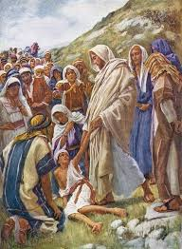
Matthew 11:20
“Then He began to denounce the cities in which most of His miracles [dynamis] were done, because they did not repent.”

Slide 24
Acts 2:22
“Men of Israel, listen to these words: Jesus the Nazarene, a man attested to you by God with miracles [dynamis] and wonders [teras] and signs [sēmeion] which God performed through Him in your midst, just as you yourselves know.”

Slide 25
Antichrist’s Satanic Miracles (2 Thessalonians 2:9)
MIRACLE | GREEK | CHRIST’S MINISTRY
Powers | Dynamis | Matt. 11:20
Signs | Sēmeion | John 20:30
Wonders | Teras | Acts 2:22

Slide 26


John 20:30-31
“³⁰ Therefore many other signs [sēmeion] Jesus also performed in the presence of the disciples, which are not written in this book; ³¹ but these have been written so that you may believe (pisteuō eis) that Jesus is the Christ, the Son of God; and that believing you may have life in His name.”

Slide 27
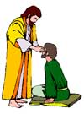
“SEVEN SIGNS” in Gospel of John
1. Changing Water into Wine | 2:11
2. Healing official’s son | 4:46-54
3. Healing an invalid at the Pool of Bethesda | 5:1-18
4. Feeding the 5,000 | 6:5-14
5. Walking on water | 6:16-21
6. Healing a blind man | 9:1-7
7. Raising dead Lazarus | 11:1-45

Slide 28
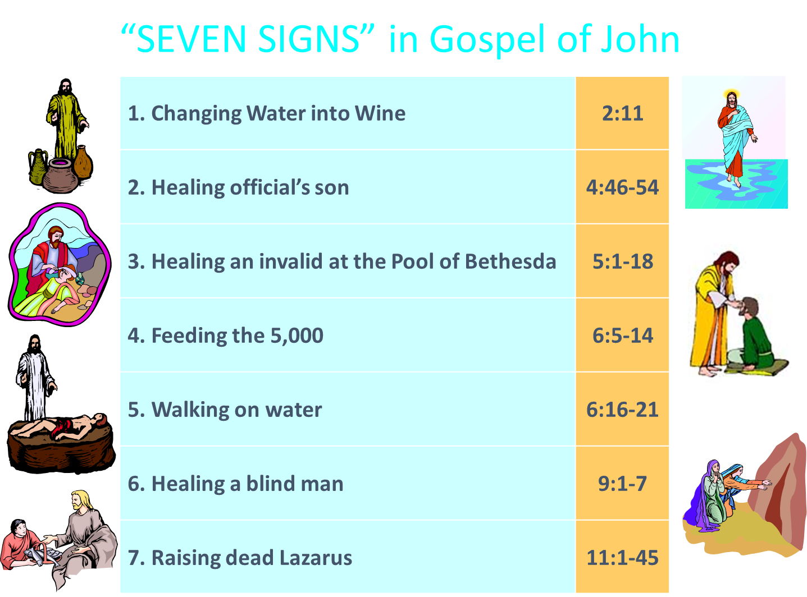
John 3:2
“this man came to Jesus by night and said to Him, “Rabbi, we know that You have come from God as a teacher; for no one can do these signs [sēmeion] that You do unless God is with him.”

Slide 29
Acts 2:22
“Men of Israel, listen to these words: Jesus the Nazarene, a man attested to you by God with miracles and wonders [teras] and signs [sēmeion] which God performed through Him in your midst, just as you yourselves know.”

Slide 30
Antichrist’s Satanic Miracles (2 Thessalonians 2:9)
MIRACLE | GREEK | CHRIST’S MINISTRY
Powers | Dynamis | Matt. 11:20
Signs | Sēmeion | John 20:30
Wonders | Teras | Acts 2:22

Slide 31
Acts 2:22
“Men of Israel, listen to these words: Jesus the Nazarene, a man attested to you by God with miracles and wonders [teras] and signs [sēmeion] which God performed through Him in your midst, just as you yourselves know.”

Slide 32
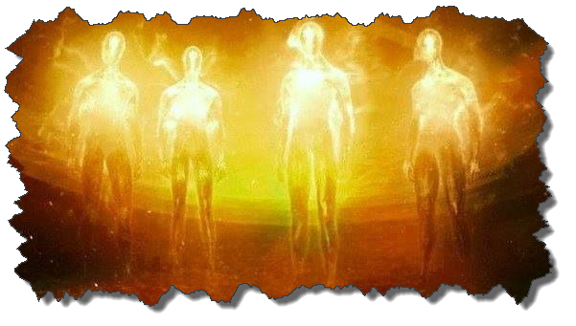

Satanic/Demonic Miracles
Exod. 7–8
Deut. 13:1-3
Job 1:12-19; 2:7-8
1 Sam. 28?
Matt. 7:21-23; 24:24
Luke 4:5
Acts 8:9; 16:16
Gal. 1:6-9
2 Thess. 2:9
Rev. 13:3, 13, 15; 16:13-14

Slide 33
Satanic/Demonic Miracles
Exod. 7–8
Deut. 13:1-3
Job 1:12-19; 2:7-8
1 Sam. 28?
Matt. 7:21-23; 24:24
Luke 4:5
Acts 8:9; 16:16
Gal. 1:6-9
2 Thess. 2:9
Rev. 13:3, 13, 15; 16:13-14

Slide 34
The Plagues of Egypt
NO. | DESCRIPTION | SCRIPTURE | IMITATION?
1. | Water to Blood | Exod. 7:14-25 | Yes
2. | Frogs | Exod. 8:1-15 | Yes
3. | Gnats | Exod. 8:16-19 | No
4. | Flies | Exod. 8:20-32 | No
5. | Disease on Cattle | Exod. 9:1-7 | No
6. | Boils | Exod. 9:8-12 | No
7. | Hail | Exod. 9:13-35 | No
8. | Locusts | Exod. 10:1-20 | No
9. | Darkness | Exod. 10:21-29 | No
10. | Death of the First Born | Exod. 12:29-36 | No

Slide 35
Satanic/Demonic Miracles
Exod. 7–8
Deut. 13:1-3
Job 1:12-19; 2:7-8
1 Sam. 28?
Matt. 7:21-23; 24:24
Luke 4:5
Acts 8:9; 16:16
Gal. 1:6-9
2 Thess. 2:9
Rev. 13:3, 13, 15; 16:13-14

Slide 36
Satanic/Demonic Miracles
Exod. 7–8
Deut. 13:1-3
Job 1:12-19; 2:7-8
1 Sam. 28?
Matt. 7:21-23; 24:24
Luke 4:5
Acts 8:9; 16:16
Gal. 1:6-9
2 Thess. 2:9
Rev. 13:3, 13, 15; 16:13-14

Slide 37
Galatians 1:6–9
⁶ I am amazed that you are so quickly deserting Him who called you by the grace of Christ, for a different gospel; ⁷ which is really not another; only there are some who are disturbing you and want to distort the gospel of Christ. ⁸ But even if we, or an angel from heaven, should preach to you a gospel contrary to what we have preached to you, he is to be accursed! ⁹ As we have said before, so I say again now, if any man is preaching to you a gospel contrary to what you received, he is to be accursed!

Slide 38
Satanic/Demonic Miracles
Exod. 7–8
Deut. 13:1-3
Job 1:12-19; 2:7-8
1 Sam. 28?
Matt. 7:21-23; 24:24
Luke 4:5
Acts 8:9; 16:16
Gal. 1:6-9
2 Thess. 2:9
Rev. 13:3, 13, 15; 16:13-14

Slide 39
2 Thessalonians 2:9
“that is, the one whose coming is in accord with the activity of Satan, with all power and signs and false wonders.”

Slide 40
Satanic/Demonic Miracles
Exod. 7–8
Deut. 13:1-3
Job 1:12-19; 2:7-8
1 Sam. 28?
Matt. 7:21-23; 24:24
Luke 4:5
Acts 8:9; 16:16
Gal. 1:6-9
2 Thess. 2:9
Rev. 13:3, 13, 15; 16:13-14

Slide 41
Conclusion

Slide 42
2 Thessalonians 2:1-12
Problem (2:1-2)
Prerequisites for the Day of the Lord (2:3-12)
  The departure (2:3a)
  Advent of the lawless one (2:3b-4)
  Removal of the restrainer (2:5-7)
  Destruction of the lawless one (2:8-9)
  Destruction of lawless one’s followers (2:10-12)

