Slide 1


Dr. Andy Woods
Senior Pastor – Sugar Land Bible Church
President – Chafer Theological Seminary

Slide 2
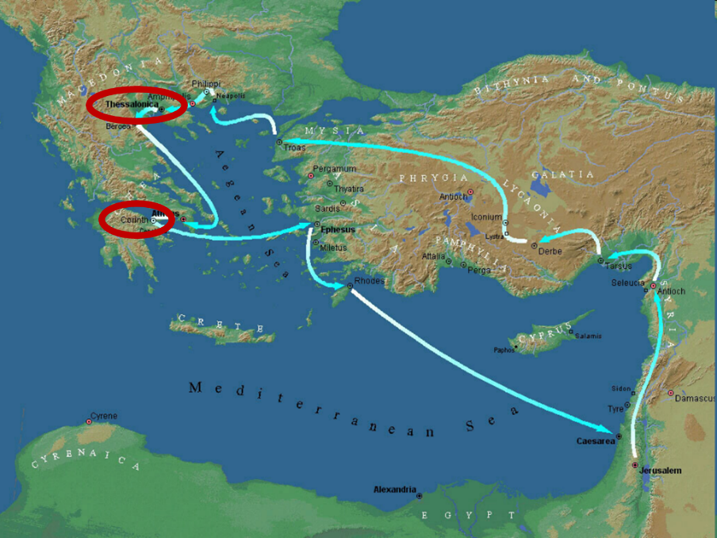

Slide 3
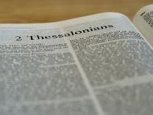
2 Thessalonians 2:1-12
Problem (2:1-2)
Prerequisites for the Day of the Lord (2:3-12)
  The departure (2:3a)
  Advent of the lawless one (2:3b-4)
  Removal of the restrainer (2:5-7)
  Destruction of the lawless one (2:8-9)
  Destruction of lawless one’s followers (2:10-12)

Slide 4


2 Thessalonians 2:2
“that you not be quickly shaken from your composure or be disturbed either by a spirit or a message or a letter as if from us, to the effect that the day of the Lord [the Tribulation] has come.”

Slide 5
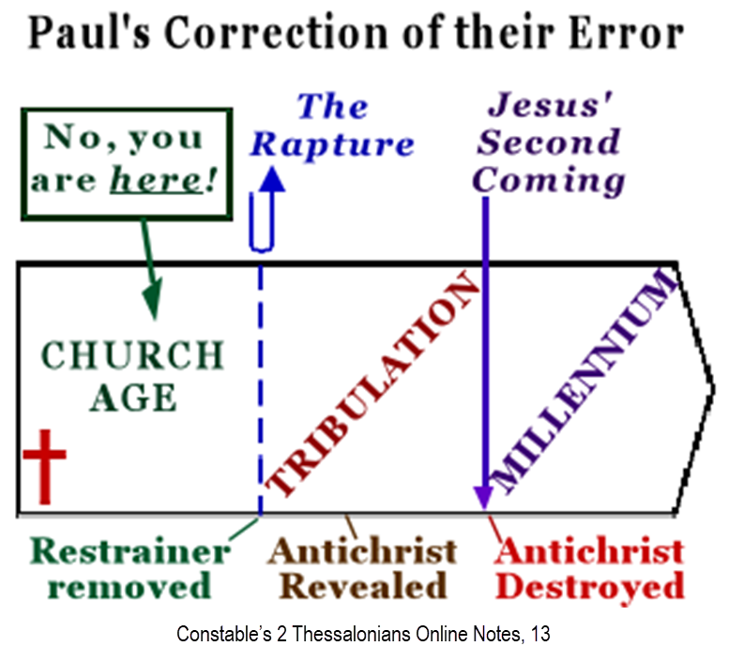

Slide 6
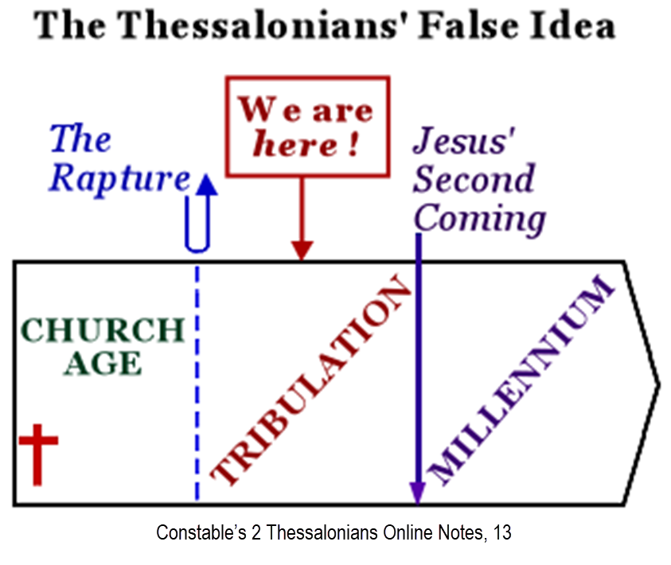

Slide 7
2 Thessalonians 2:1-12
Problem (2:1-2)
Prerequisites for the Day of the Lord (2:3-12)
  The departure (2:3a)
  Advent of the lawless one (2:3b-4)
  Removal of the restrainer (2:5-7)
  Destruction of the lawless one (2:8-9)
  Destruction of lawless one’s followers (2:10-12)

Slide 8
2 Thessalonians 2:1-12
Problem (2:1-2)
Prerequisites for the Day of the Lord (2:3-12)
  The departure (2:3a)
  Advent of the lawless one (2:3b-4)
  Removal of the restrainer (2:5-7)
  Destruction of the lawless one (2:8-9)
  Destruction of lawless one’s followers (2:10-12)

Slide 9
2 Thessalonians 2:1-12
Problem (2:1-2)
Prerequisites for the Day of the Lord (2:3-12)
  The departure (2:3a)
  Advent of the lawless one (2:3b-4)
  Removal of the restrainer (2:5-7)
  Destruction of the lawless one (2:8-9)
  Destruction of lawless one’s followers (2:10-12)

Slide 10
2 Thessalonians 2:1-12
Problem (2:1-2)
Prerequisites for the Day of the Lord (2:3-12)
  The departure (2:3a)
  Advent of the lawless one (2:3b-4)
  Removal of the restrainer (2:5-7)
  Destruction of the lawless one (2:8-9)
  Destruction of lawless one’s followers (2:10-12)

Slide 11


2 Thessalonians 2:6-7
⁶And you know what restrains [τὸ κατέχον; neuter] him now, so that in his time he will be revealed. ⁷For the mystery of lawlessness is already at work; only he who now restrains [ὁ κατέχων; masculine] will do so until he is taken out of the way.

Slide 12

Restrainer? (2:6-7)
Rome?
Satan?
Government?
Michael?
Spirit?

Slide 13
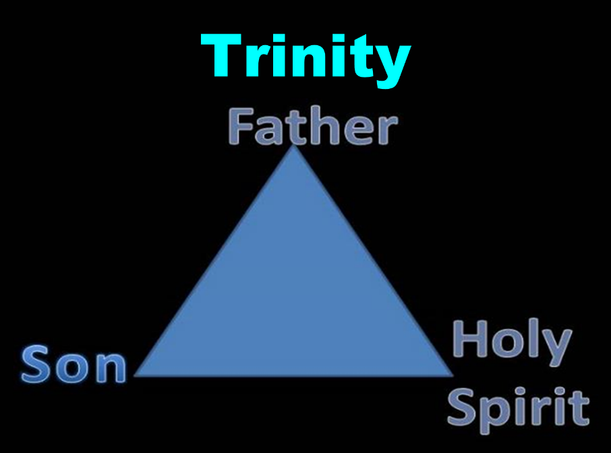

Slide 14


Slide 15
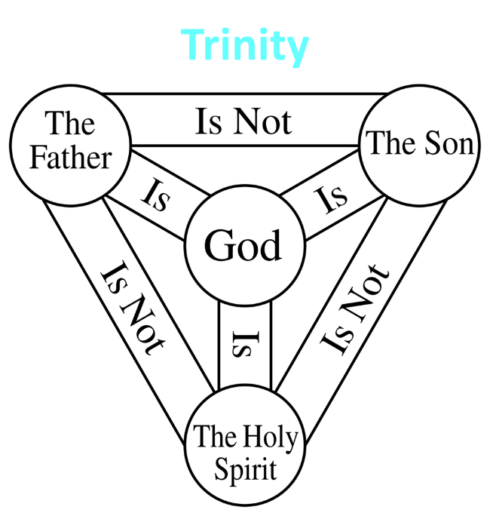

Slide 16

3 Reasons Why the Restrainer is the Holy Spirit
(2 Thessalonians 2:6-7)
The Holy Spirit is omnipotent (2 Thess. 2:9)
The Holy Spirit is active in the world (Gen. 6:3; John 16:7-11)
The Holy Spirit view handles well the switch in gender from the neuter (vs. 6) to the masculine (vs. 7)

Slide 17

Romans 8:5-6
^{5 “}For those who are according to the flesh set their minds on the things of the flesh, but those who are according to the Spirit, the things of the Spirit. ⁶ For the mind set on the flesh is death, but the mind set on the Spirit is life and peace.”

Slide 18

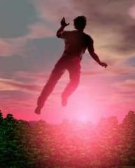
2 Thessalonians 2:5
“Do you not remember that while I was still with you, I was telling you these things?”

Slide 19
Restrainer Must First be Removed
Restrainer holds back the Antichrist (2 Thess 2:6-7)
Restrainer = the omnipotent Holy Spirit (2 Thess 2:9)
Holy Spirit permanently indwells all Christians (John 14:16; Rom 8:9)
Sprit indwelt Christians must first be removed prior to the Antichrist's advent

Slide 20
Remaining Questions
Will the Holy Spirit be active during the Tribulation period? – YES
Should believers be politically active today? – YES
Can we identify the Antichrist today? – NO
Has Satan selected an Antichrist for every generation? – YES
Will an Antichrist one day arise? – YES

Slide 21

Ezekiel 28:13–15
¹³ “You were in Eden, the garden of God; Every precious stone was your covering: The ruby, the topaz and the diamond; The beryl, the onyx and the jasper; The lapis lazuli, the turquoise and the emerald; And the gold, the workmanship of your settings and sockets, Was in you. On the day that you were created They were prepared….¹⁵ “You were blameless in your ways From the day you were created Until unrighteousness was found in you.

Slide 22
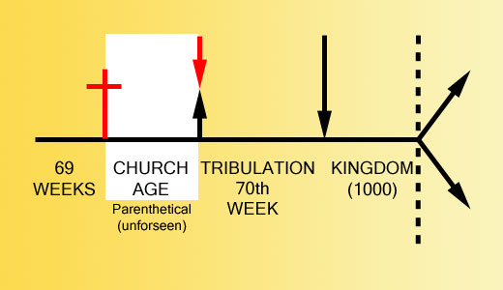

Slide 23


2 Thessalonians 2:3, 7
“…the man of lawlessness is revealed, the son of destruction…For the mystery of lawlessness is already at work; only he who now restrains will do so until he is taken out of the way.”

Slide 24
1 John 4:3
“and every spirit that does not confess Jesus is not from God; this is the spirit of the antichrist, of which you have heard that it is coming, and now it is already in the world.”

Slide 25
1 John 2:18
“Children, it is the last hour; and just as you heard that antichrist is coming, even now many antichrists have appeared; from this we know that it is the last hour.”

Slide 26
Remaining Questions
Will the Holy Spirit be active during the Tribulation period? – YES
Should believers be politically active today? – YES
Can we identify the Antichrist today? – NO
Has Satan selected an Antichrist for every generation? – YES
Will an Antichrist one day arise? – YES

Slide 27

Revelation 13:16-18
¹⁶ And he causes all, the small and the great, and the rich and the poor, and the free men and the slaves, to be given a mark on their right hand or on their forehead, ¹⁷ and he provides that no one will be able to buy or to sell, except the one who has the mark, either the name of the beast or the number of his name. ¹⁸ Here is wisdom. Let him who has understanding calculate the number of the beast, for the number is that of a man; and his number is six hundred and sixty-six.

Slide 28
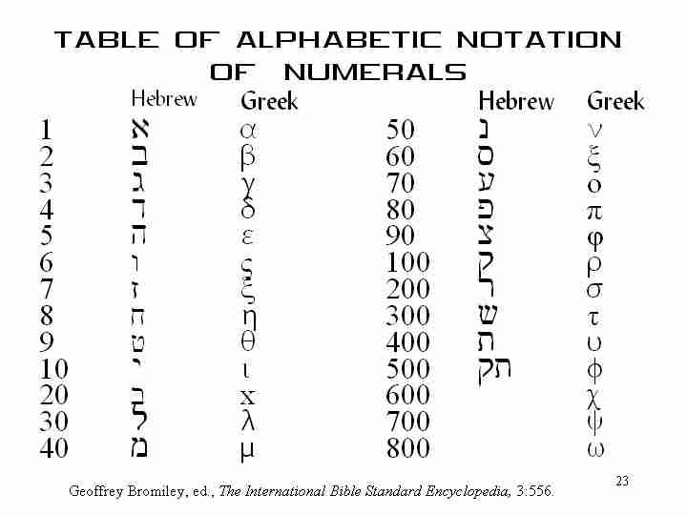

Slide 29
2 Thessalonians 2:1-12
Problem (2:1-2)
Prerequisites for the Day of the Lord (2:3-12)
  The departure (2:3a)
  Advent of the lawless one (2:3b-4)
  Removal of the restrainer (2:5-7)
  Destruction of the lawless one (2:8-9)
  Destruction of lawless one’s followers (2:10-12)

Slide 30

Daniel 9:27
And he will make a firm covenant with the many for one week, but in the middle of the week he will put a stop to sacrifice and grain offering; and on the wing of abominations will come one who makes desolate, even until a complete destruction, one that is decreed, is poured out on the one who makes desolate.
30

Slide 31
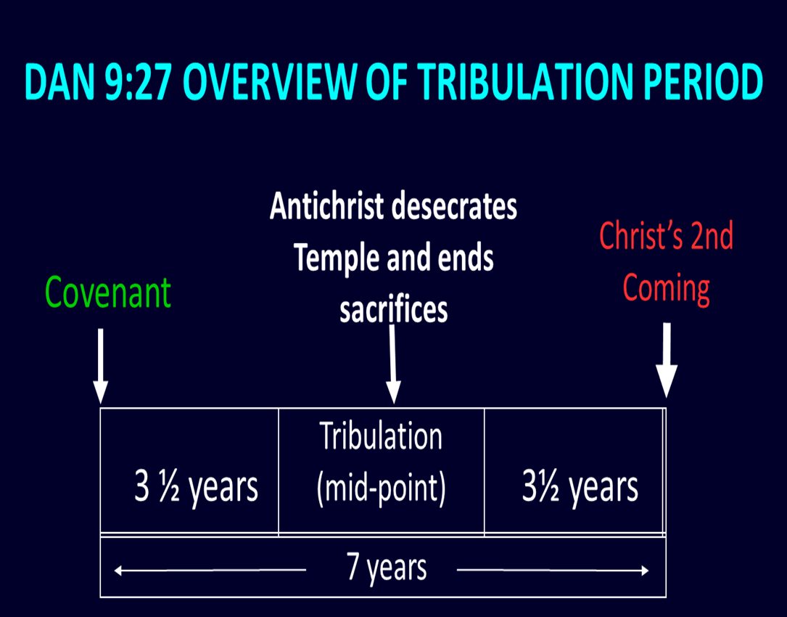

Slide 32

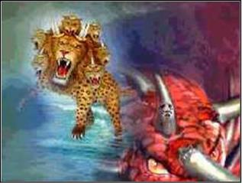
Revelation 13:5
“There was given to him a mouth speaking arrogant words and blasphemies, and authority to act for forty-two months was given to him.”

Slide 33

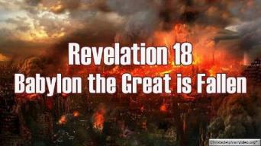
Revelation 18:8
“For this reason in one day her plagues will come, pestilence and mourning and famine, and she will be burned up with fire; for the Lord God who judges her is strong.

Slide 34
Revelation 18:10
“standing at a distance because of the fear of her torment, saying, ‘Woe, woe, the great city, Babylon, the strong city! For in one hour your judgment has come.”

Slide 35

Isaiah 9:6-7
⁶ For a child will be born to us, a son will be given to us; And the government will rest on His shoulders; And His name will be called Wonderful Counselor, Mighty God, Eternal Father, Prince of Peace.⁷ There will be no end to the increase of His government or of peace, On the throne of David and over his kingdom, To establish it and to uphold it with justice and righteousness From then on and forevermore. The zeal of the Lord of hosts will accomplish this.

Slide 36
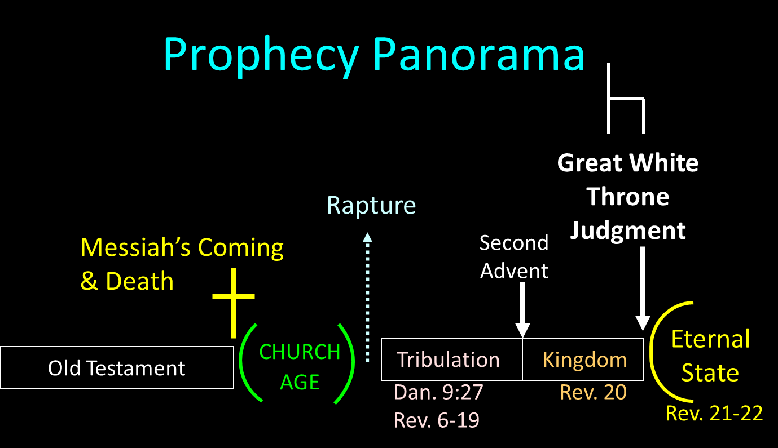

Slide 37
Isaiah 11:4
But with righteousness He will judge the poor, And decide with fairness for the afflicted of the earth; And He will strike the earth with the rod of His mouth, And with the breath of His lips He will slay the wicked.

Slide 38
Revelation 19:15
From His mouth comes a sharp sword, so that with it He may strike down the nations, and He will rule them with a rod of iron; and He treads the wine press of the fierce wrath of God, the Almighty.

Slide 39
Hebrew 4:12
For the word of God is living and active and sharper than any two-edged sword, and piercing as far as the division of soul and spirit, of both joints and marrow, and able to judge the thoughts and intentions of the heart.

Slide 40

2 Thessalonians 2:9
“that is, the one whose coming is in accord with the activity of Satan, with all power and signs and false wonders.”

Slide 41
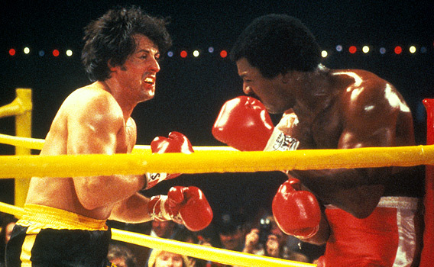

Slide 42

Ezekiel 28:13, 15
“¹³ You were in Eden, the garden of God; Every precious stone was your covering: The ruby, the topaz and the diamond; The beryl, the onyx and the jasper; The lapis lazuli, the turquoise and the emerald; And the gold, the workmanship of your settings and sockets, Was in you. On the day that you were created They were prepared… ¹⁵ You were blameless in your ways From the day you were created Until unrighteousness was found in you.”

Slide 43
Antichrist’s Satanic Miracles (2 Thessalonians 2:9)
MIRACLE | GREEK | CHRIST’S MINISTRY
Powers | Dynamis | Matt. 11:20
Signs | Sēmeion | John 20:30
Wonders | Teras | Acts 2:22

Slide 44
Antichrist’s Satanic Miracles (2 Thessalonians 2:9)
MIRACLE | GREEK | CHRIST’S MINISTRY
Powers | Dynamis | Matt. 11:20
Signs | Sēmeion | John 20:30
Wonders | Teras | Acts 2:22

Slide 45

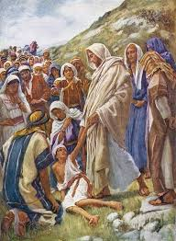
Matthew 11:20
Then He began to denounce the cities in which most of His miracles [dynamis] were done, because they did not repent.

Slide 46
Acts 2:22
“Men of Israel, listen to these words: Jesus the Nazarene, a man attested to you by God with miracles [dynamis] and wonders [teras] and signs [sēmeion] which God performed through Him in your midst, just as you yourselves know.”

Slide 47
Antichrist’s Satanic Miracles (2 Thessalonians 2:9)
MIRACLE | GREEK | CHRIST’S MINISTRY
Powers | Dynamis | Matt. 11:20
Signs | Sēmeion | John 20:30
Wonders | Teras | Acts 2:22

Slide 48

John 20:30-31
“³⁰ Therefore many other signs [sēmeion] Jesus also performed in the presence of the disciples, which are not written in this book; ³¹ but these have been written so that you may believe (pisteuō eis) that Jesus is the Christ, the Son of God; and that believing you may have life in His name.”

Slide 49
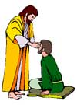
“SEVEN SIGNS” in Gospel of John
1. Changing Water into Wine | 2:11
2. Healing official’s son | 4:46-54
3. Healing an invalid at the Pool of Bethesda | 5:1-18
4. Feeding the 5,000 | 6:5-14
5. Walking on water | 6:16-21
6. Healing a blind man | 9:1-7
7. Raising dead Lazarus | 11:1-45

Slide 50
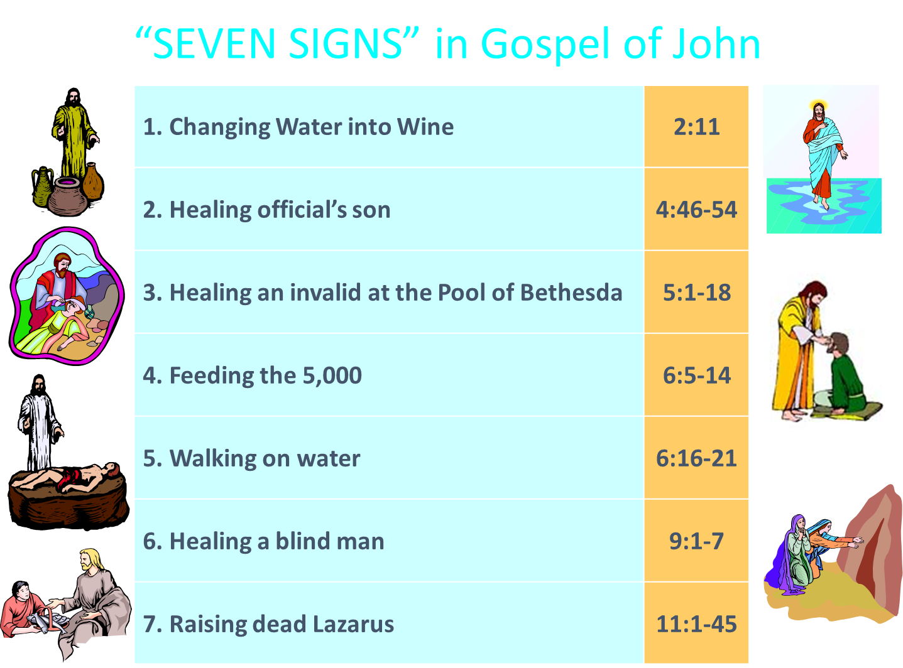
John 3:2
“this man came to Jesus by night and said to Him, “Rabbi, we know that You have come from God as a teacher; for no one can do these signs [sēmeion] that You do unless God is with him.”

Slide 51
Acts 2:22
“Men of Israel, listen to these words: Jesus the Nazarene, a man attested to you by God with miracles and wonders [teras] and signs [sēmeion] which God performed through Him in your midst, just as you yourselves know.”

Slide 52
Antichrist’s Satanic Miracles (2 Thessalonians 2:9)
MIRACLE | GREEK | CHRIST’S MINISTRY
Powers | Dynamis | Matt. 11:20
Signs | Sēmeion | John 20:30
Wonders | Teras | Acts 2:22

Slide 53
Acts 2:22
“Men of Israel, listen to these words: Jesus the Nazarene, a man attested to you by God with miracles and wonders [teras] and signs [sēmeion] which God performed through Him in your midst, just as you yourselves know.”

Slide 54
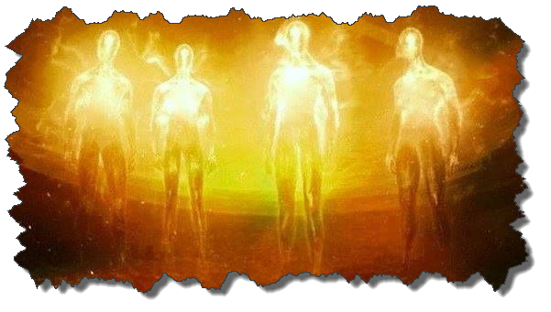

Satanic/Demonic Miracles
Exod. 7–8
Deut. 13:1-3
Job 1:12-19; 2:7-8
1 Sam. 28?
Matt. 7:21-23; 24:24
Acts 8:9; 16:16
Gal. 1:6-9
2 Thess. 2:9
Rev. 13:3, 13, 15; 16:13-14

Slide 55
Satanic/Demonic Miracles
Exod. 7–8
Deut. 13:1-3
Job 1:12-19; 2:7-8
1 Sam. 28?
Matt. 7:21-23; 24:24
Acts 8:9; 16:16
Gal. 1:6-9
2 Thess. 2:9
Rev. 13:3, 13, 15; 16:13-14

Slide 56
The Plagues of Egypt
NO. | DESCRIPTION | SCRIPTURE | IMITATION?
1. | Water to Blood | Exod. 7:14-25 | Yes
2. | Frogs | Exod. 8:1-15 | Yes
3. | Gnats | Exod. 8:16-19 | No
4. | Flies | Exod. 8:20-32 | No
5. | Disease on Cattle | Exod. 9:1-7 | No
6. | Boils | Exod. 9:8-12 | No
7. | Hail | Exod. 9:13-35 | No
8. | Locusts | Exod. 10:1-20 | No
9. | Darkness | Exod. 10:21-29 | No
10. | Death of the First Born | Exod. 12:29-36 | No

Slide 57
Satanic/Demonic Miracles
Exod. 7–8
Deut. 13:1-3
Job 1:12-19; 2:7-8
1 Sam. 28?
Matt. 7:21-23; 24:24
Acts 8:9; 16:16
Gal. 1:6-9
2 Thess. 2:9
Rev. 13:3, 13, 15; 16:13-14

Slide 58
Satanic/Demonic Miracles
Exod. 7–8
Deut. 13:1-3
Job 1:12-19; 2:7-8
1 Sam. 28?
Matt. 7:21-23; 24:24
Acts 8:9; 16:16
Gal. 1:6-9
2 Thess. 2:9
Rev. 13:3, 13, 15; 16:13-14

Slide 59
Galatians 1:6–9
⁶ I am amazed that you are so quickly deserting Him who called you by the grace of Christ, for a different gospel; ⁷ which is really not another; only there are some who are disturbing you and want to distort the gospel of Christ. ⁸ But even if we, or an angel from heaven, should preach to you a gospel contrary to what we have preached to you, he is to be accursed! ⁹ As we have said before, so I say again now, if any man is preaching to you a gospel contrary to what you received, he is to be accursed!

Slide 60
Satanic/Demonic Miracles
Exod. 7–8
Deut. 13:1-3
Job 1:12-19; 2:7-8
1 Sam. 28?
Matt. 7:21-23; 24:24
Acts 8:9; 16:16
Gal. 1:6-9
2 Thess. 2:9
Rev. 13:3, 13, 15; 16:13-14

Slide 61
2 Thessalonians 2:9
“that is, the one whose coming is in accord with the activity of Satan, with all power and signs and false wonders.”

Slide 62
Satanic/Demonic Miracles
Exod. 7–8
Deut. 13:1-3
Job 1:12-19; 2:7-8
1 Sam. 28?
Matt. 7:21-23; 24:24
Acts 8:9; 16:16
Gal. 1:6-9
2 Thess. 2:9
Rev. 13:3, 13, 15; 16:13-14

Slide 63
Conclusion

Slide 64
2 Thessalonians 2:1-12
Problem (2:1-2)
Prerequisites for the Day of the Lord (2:3-12)
  The departure (2:3a)
  Advent of the lawless one (2:3b-4)
  Removal of the restrainer (2:5-7)
  Destruction of the lawless one (2:8-9)
  Destruction of lawless one’s followers (2:10-12)

