Slide 2
From Peter to Paul
Reference | Center | Person | Place | Outreach
Acts 1–12 | Jerusalem | Peter | Jerusalem, Judea, Samaria | Jewish
Acts 13–28 | Antioch | Paul | Uttermost parts | Gentiles

Slide 3
From Peter to Paul
Peter | Paul
Heals a man lame from birth (3:1-11) | Heals a man lame from birth (14:8-18)
Heals by shadow (5:15-16) | Heals by handkerchief (19:11-12)
Success is a cause of jealousy (5:17) | Success is a cause of jealousy (13:45)
Confronts a sorcerer (8:9-24) | Confronts a sorcerer (13:6-11)
Raises Dorcas (9:36-41) | Raises Eutychus (20:9-12)
Jailed and miraculously freed (12:3-19) | Jailed and miraculously freed (16:25-34)

Slide 4
Acts 6:8‒8:4 Stephen
Stephen’s Arrest (6:8‒7:1)
Stephen’s Defense (Acts 7:2-53)
Stephen’s Stoning (7:54-60)
Third Persecution (Acts 8:1-4)

Slide 5
II. Stephen’s Arrest Acts 6:8-15
Description of Stephen (8)
Disputations against Stephen (9-10)
Conspiracy against Stephen (11)
Arrest of Stephen (12)
Charges against Stephen (13-14)
Face of Stephen (15)
Opportunity of Stephen (7:1)

Slide 6
Acts 6:8‒8:4 Stephen
Stephen’s Arrest (6:8‒7:1)
Stephen’s Defense (Acts 7:2-53)
Stephen’s Stoning (7:54-60)
Third Persecution (Acts 8:1-4)

Slide 7
Acts 7 – Stephen’s Speech
1. 7:2-5 | Abraham’s partial obedience
2. 7:6-38 | Israel’s initial rejections and later acceptances
3. 7:39-41 | Israel’s early rebellion against Moses
4. 7:42-45 | Israel reinterpreted Moses’ teachings though a polytheistic framework
5. 7:46-50 | Neither the Tabernacle nor Temple were intended as permanent habitations of God
6. 7:51-53 | Current generation imitating these same rebellions

Slide 8
Acts 7 – Stephen’s Speech
1. 7:2-5 | Abraham’s partial obedience
2. 7:6-38 | Israel’s initial rejections and later acceptances
3. 7:39-41 | Israel’s early rebellion against Moses
4. 7:42-45 | Israel reinterpreted Moses’ teachings though a polytheistic framework
5. 7:46-50 | Neither the Tabernacle nor Temple were intended as permanent habitations of God
6. 7:51-53 | Current generation imitating these same rebellions

Slide 9
Acts 7 – Stephen’s Speech
1. 7:2-5 | Abraham’s partial obedience
2. 7:6-38 | Israel’s initial rejections and later acceptances
3. 7:39-41 | Israel’s early rebellion against Moses
4. 7:42-45 | Israel reinterpreted Moses’ teachings though a polytheistic framework
5. 7:46-50 | Neither the Tabernacle nor Temple were intended as permanent habitations of God
6. 7:51-53 | Current generation imitating these same rebellions

Slide 10
2. Israel’s Initial Rejections & Later Acceptances Acts 7:6-38
Example of Joseph (6-16)
Example of Moses (17-38)

Slide 11
2. Israel’s Initial Rejections & Later Acceptances Acts 7:6-38
Example of Joseph (6-16)
Example of Moses (17-38)

Slide 12
2. Israel’s Initial Rejections & Later Acceptances Acts 7:6-38
Example of Joseph (6-16)
Example of Moses (17-38)

Slide 13
Genesis 15:16
“Then in the fourth generation they will return here, for the wrongdoing of the Amorite is not yet complete.”

Slide 14
THREE PHASES OF MOSES’ 120 YEAR LIFE
LIFE PHASE | SCRIPTURE | YEARS | AGE | ACTIVITY
Natural Training | Acts 7:23 | 1526–1486 B.C. | 1-40 | Egyptian Education
Spiritual Training | Exod. 7:7 | 1486–1446 B.C. | 40-80 | Midian Shepherding
Ministry | Deut. 31:2; 34:7; Acts 7:36 | 1446–1406 B.C. | 80-120 | Exodus, Law, Wilderness Preservation, Pentateuch Authorship

Slide 16
THREE PHASES OF MOSES’ 120 YEAR LIFE
LIFE PHASE | SCRIPTURE | YEARS | AGE | ACTIVITY
Natural Training | Acts 7:23 | 1526–1486 B.C. | 1-40 | Egyptian Education
Spiritual Training | Exod. 7:7 | 1486–1446 B.C. | 40-80 | Midian Shepherding
Ministry | Deut. 31:2; 34:7; Acts 7:36 | 1446–1406 B.C. | 80-120 | Exodus, Law, Wilderness Preservation, Pentateuch Authorship

Slide 18
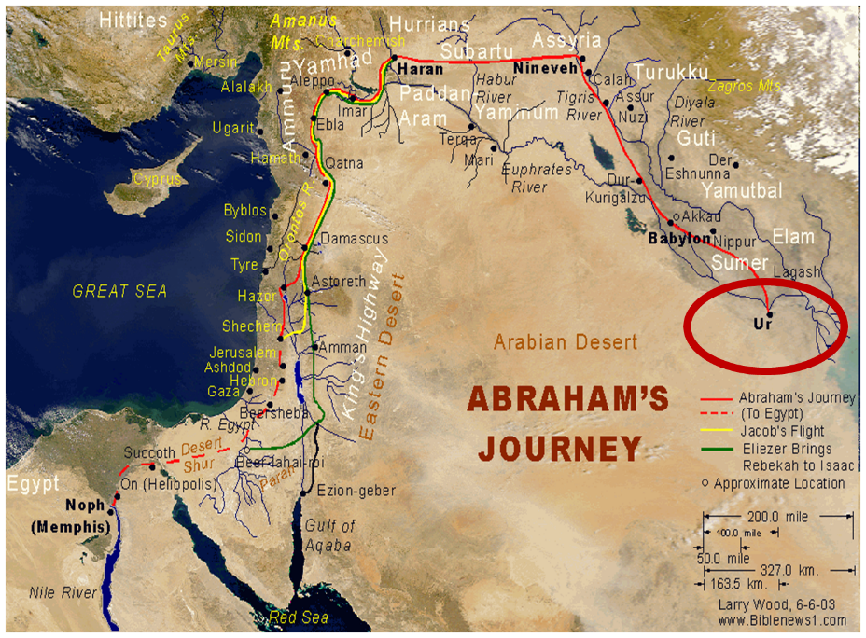

Slide 20
THREE PHASES OF MOSES’ 120 YEAR LIFE
LIFE PHASE | SCRIPTURE | YEARS | AGE | ACTIVITY
Natural Training | Acts 7:23 | 1526–1486 B.C. | 1-40 | Egyptian Education
Spiritual Training | Exod. 7:7 | 1486–1446 B.C. | 40-80 | Midian Shepherding
Ministry | Deut. 31:2; 34:7; Acts 7:36 | 1446–1406 B.C. | 80-120 | Exodus, Law, Wilderness Preservation, Pentateuch Authorship

Slide 21
Matthew 16:18
“I also say to you that you are Peter, and upon this rock I WILL build [oikodomeō] My church; and the gates of Hades WILL NOT overpower it.”

Slide 22
Ephesians 2:14
“For He Himself is our peace, who made both groups into one and broke down the barrier of the dividing wall.”

Slide 23
Ephesians 3:3-6
“³ that by revelation there was made known to me the mystery, as I wrote before in brief. ⁴ By referring to this, when you read you can understand my insight into the mystery of Christ, ⁵ which in other generations was not made known to the sons of men, as it has now been revealed to His holy apostles and prophets in the Spirit; ⁶ to be specific, that the Gentiles are fellow heirs and fellow members of the body, and fellow partakers of the promise in Christ Jesus through the gospel.”

Slide 24
Ephesians 3:9
“and to bring to light what is the administration of the mystery which for ages has been hidden in God who created all things.”

Slide 28
Acts 7 – Stephen’s Speech
1. 7:2-5 | Abraham’s partial obedience
2. 7:6-38 | Israel’s initial rejections and later acceptances
3. 7:39-41 | Israel’s early rebellion against Moses
4. 7:42-45 | Israel reinterpreted Moses’ teachings though a polytheistic framework
5. 7:46-50 | Neither the Tabernacle nor Temple were intended as permanent habitations of God
6. 7:51-53 | Current generation imitating these same rebellions

Slide 30
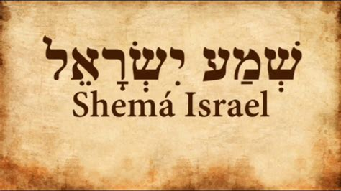
Deuteronomy 6:4-7
“⁴ Hear, Israel! The Lord is our God, the Lord is one!... ⁶ These words, which I am commanding you today, shall be on your heart. ⁷ You shall teach them diligently to your sons and shall talk of them when you sit in your house and when you walk by the way and when you lie down and when you rise up.”

Slide 31
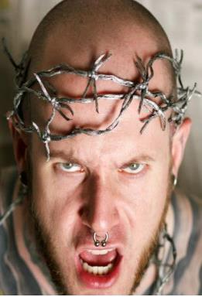
APOSTASY CAN HAPPEN QUICKLY
Galatians 1:6
“I marvel that you are turning away so soon from Him who called you in the grace of Christ, to a different gospel.” (Italics mine)
Exodus 32:8
“They have turned aside quickly out of the way which I have commanded them” (Italics mine; see also Exod 24:18).

Slide 32
Acts 7 – Stephen’s Speech
1. 7:2-5 | Abraham’s partial obedience
2. 7:6-38 | Israel’s initial rejections and later acceptances
3. 7:39-41 | Israel’s early rebellion against Moses
4. 7:42-45 | Israel reinterpreted Moses’ teachings though a polytheistic framework
5. 7:46-50 | Neither the Tabernacle nor Temple were intended as permanent habitations of God
6. 7:51-53 | Current generation imitating these same rebellions

Slide 33
Genesis 1:1-3
“¹ In the beginning God created the heavens and the earth. ² The earth was formless and void, and darkness was over the surface of the deep, and the Spirit of God was moving over the surface of the waters. ³ Then God said, ‘Let there be light’; and there was light.”

Slide 34
Genesis 1:14
Then God said, “Let there be lights in the expanse of the heavens to separate the day from the night, and let them be for signs and for seasons and for days and years.”

Slide 35
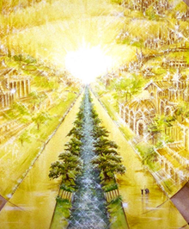
Eternal State is Future
No Satan (Rev 20:10)
No sea (Rev 21:1)
No death, crying, or pain (Rev 21:4)
No Sun (Rev 22:5)
No Moon (Rev 21:23)
No temple (Rev. 21:22)
No night (Rev 21:25)
No evil (Rev 21:27)
No curse (Rev 22:3)

Slide 36
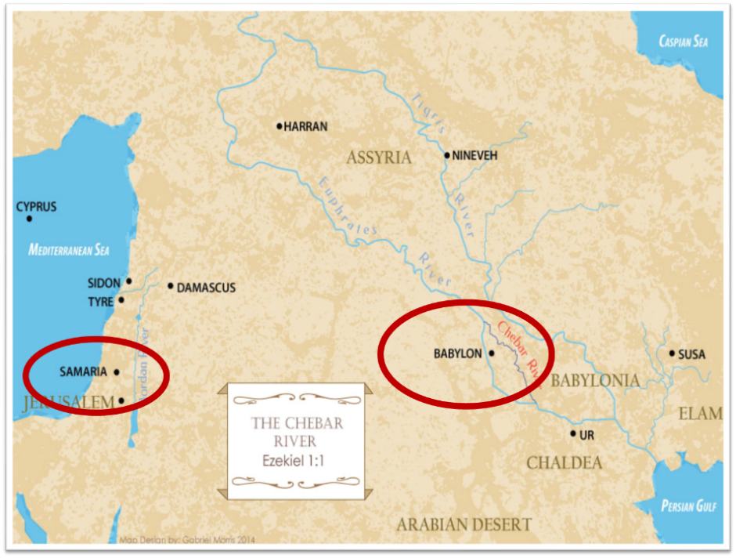

Slide 37
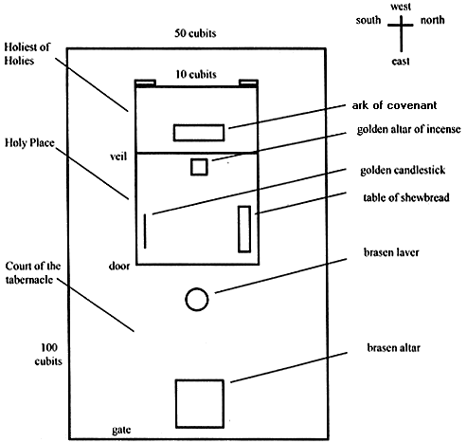
Tabernacle Diagram

Slide 38
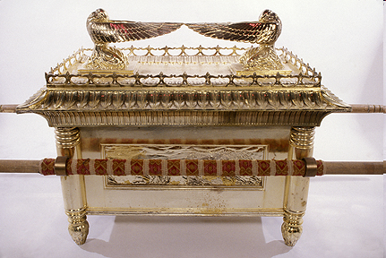
Ark of the Covenant

Slide 40
Matthew 5:21-22
“²¹ “You have heard that the ancients were told, ‘You shall not commit murder’ and ‘Whoever commits murder shall be liable to the court.’ ²² But I say to you that everyone who is angry with his brother shall be guilty before the court; and whoever says to his brother, ‘You good-for-nothing,’ shall be guilty before the supreme court; and whoever says, ‘You fool,’ shall be guilty enough to go into the fiery hell.””

Slide 41
Matthew 5:27-28
“²⁷ You have heard that it was said, ‘You shall not commit adultery’; ²⁸ but I say to you that everyone who looks at a woman with lust for her has already committed adultery with her in his heart.”

Slide 42
Acts 7 – Stephen’s Speech
1. 7:2-5 | Abraham’s partial obedience
2. 7:6-38 | Israel’s initial rejections and later acceptances
3. 7:39-41 | Israel’s early rebellion against Moses
4. 7:42-45 | Israel reinterpreted Moses’ teachings though a polytheistic framework
5. 7:46-50 | Neither the Tabernacle nor Temple were intended as permanent habitations of God
6. 7:51-53 | Current generation imitating these same rebellions

Slide 43
2 Samuel 7:12-16
¹² “When your days are complete and you lie down with your fathers, I will raise up your descendant after you, who will come forth from you, and I will establish his kingdom. ¹³ He shall build a house for My name, and I will establish the throne of his kingdom forever. ¹⁴ I will be a father to him and he will be a son to Me; when he commits iniquity, I will correct him with the rod of men and the strokes of the sons of men, ¹⁵ but My lovingkindness shall not depart . . .

Slide 44
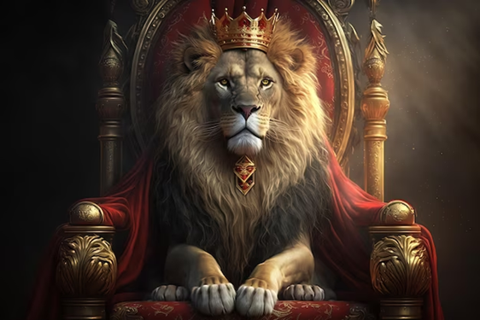
2 Samuel 7:12-16
. . .from him, as I took it away from Saul, whom I removed from before you. ¹⁶ Your house and your kingdom shall endure before Me forever; your throne shall be established forever.” ¹⁷ In accordance with all these words and all this vision, so Nathan spoke to David.”

Slide 45
ISRAEL’S FOUR TEMPLES
Solomon’s pre-exilic temple (Kings and Chronicles)
Zerubbabel’s post exilic temple (Ezra 1-6; John 2:20)
Antichrist's temple (Dan. 9:27; Matt. 24:15; 2 Thess. 2:4; Rev. 11:1-2)
Millennial temple (Ezek. 40-48)

Slide 50
Matthew 24:1-2
“¹ Jesus came out from the temple and was going away when His disciples came up to point out the temple buildings to Him. ² And He said to them, “Do you not see all these things? Truly I say to you, not one stone here will be left upon another, which will not be torn down.”

Slide 51
Luke 19:42-44
^{“42} saying, ‘If you had known in this day, even you, the things which make for peace! But now they have been hidden from your eyes. ⁴³ For the days will come upon you when your enemies will throw up a barricade against you, and surround you and hem you in on every side, ⁴⁴ and they will level you to the ground and your children within you, and they will not leave in you one stone upon another, because you did not recognize the time of your visitation.’”

Slide 52
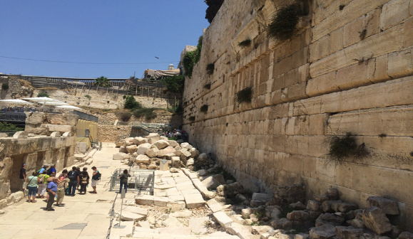

Slide 53
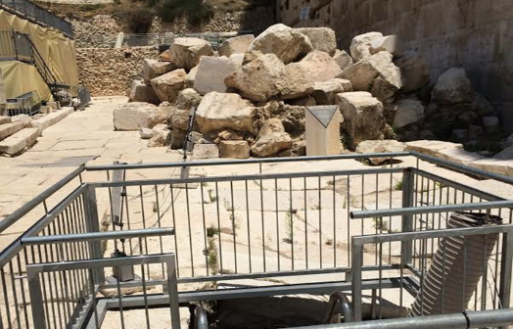

Slide 54
1 Samuel 16:13-14
“¹³ Then Samuel took the horn of oil and anointed him in the midst of his brothers; and the Spirit of the Lord came mightily upon David from that day forward. And Samuel arose and went to Ramah. ¹⁴ Now the Spirit of the Lord departed from Saul, and an evil spirit from the Lord terrorized him.”

Slide 55
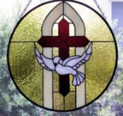
John 14:16-17
¹⁶ I will ask the Father, and He will give you another Helper, that He may be with you forever; ¹⁷ that is the Spirit of truth, whom the world cannot receive, because it does not see Him or know Him, but you know Him because He abides with you and will be in you.

Slide 56
WORK OF THE SPIRIT IN THE OT
 | OT/GOSPELS/ACTS 1 | ACTS 2/TODAY
External vs. Internal | Upon (1 Sam. 16:13) | Within (John 14:17)
Reception of all of the Spirit at the moment of salvation? | Subsequent to salvation (Exod 31:3) | At moment of salvation (Rom 8:9)
How long is the indwelling? | Temporary indwelling (1 Sam 16:14; Ps 51:11) | Permanent indwelling (John 14:16)
Who is indwelt? | Selective indwelling (Joel 2:28) | Universal indwelling (1 Cor 12:13)

Slide 57
Acts 7 – Stephen’s Speech
1. 7:2-5 | Abraham’s partial obedience
2. 7:6-38 | Israel’s initial rejections and later acceptances
3. 7:39-41 | Israel’s early rebellion against Moses
4. 7:42-45 | Israel reinterpreted Moses’ teachings though a polytheistic framework
5. 7:46-50 | Neither the Tabernacle nor Temple were intended as permanent habitations of God
6. 7:51-53 | Current generation imitating these same rebellions

Slide 58
6. Current Generation Imitating These Rebellions Acts 7:51-53
Resisting the Spirit (51)
Prophet Killers (52)
Law Breakers (53)

Slide 59
6. Current Generation Imitating These Rebellions Acts 7:51-53
Resisting the Spirit (51)
Prophet Killers (52)
Law Breakers (53)

Slide 60
Genesis 6:1-3
“¹ Now it came about, when men began to multiply on the face of the land, and daughters were born to them, ² that the sons of God saw that the daughters of men were beautiful; and they took wives for themselves, whomever they chose. ³ Then the Lord said, “My Spirit shall not strive with man forever, because he also is flesh; nevertheless his days shall be one hundred and twenty years.”

Slide 61
Zechariah 12:10
“I will pour out on the house of David and on the inhabitants of Jerusalem, the Spirit of grace and of supplication, so that they will look on Me whom they have pierced; and they will mourn for Him, as one mourns for an only son, and they will weep bitterly over Him like the bitter weeping over a firstborn.”

Slide 62
6. Current Generation Imitating These Rebellions Acts 7:51-53
Resisting the Spirit (51)
Prophet Killers (52)
Law Breakers (53)

Slide 63
Luke 24:27, 44
“²⁷ Then beginning with Moses and with all the prophets, He explained to them the things concerning Himself in all the Scriptures…⁴⁴ Now He said to them, ‘These are My words which I spoke to you while I was still with you, that all things which are written about Me in the Law of Moses and the Prophets and the Psalms must be fulfilled.’”

Slide 64
6. Current Generation Imitating These Rebellions Acts 7:51-53
Resisting the Spirit (51)
Prophet Killers (52)
Law Breakers (53)

Slide 65
John 5:39, 46
“³⁹ You search the Scriptures because you think that in them you have eternal life; it is these that testify about Me…⁴⁶ For if you believed Moses, you would believe Me, for he wrote about Me.”

Slide 66
Acts 6:8‒8:4 Stephen
Stephen’s Arrest (6:8‒7:1)
Stephen’s Defense (Acts 7:2-53)
Stephen’s Stoning (7:54-60)
Third Persecution (Acts 8:1-4)

Slide 67
III. Stephen’s Stoning Acts 7:54-60
Audience's reaction (54)
Stephen’s dying vision (55-56)
Stephen’s death (57-60)

Slide 68
III. Stephen’s Stoning Acts 7:54-60
Audience's reaction (54)
Stephen’s dying vision (55-56)
Stephen’s death (57-60)

Slide 69
John 16:7–11
⁷ “But I tell you the truth, it is to your advantage that I go away; for if I do not go away, the Helper will not come to you; but if I go, I will send Him to you. ⁸ “And He, when He comes, will convict the world concerning sin and righteousness and judgment; ⁹ concerning sin, because they do not believe in Me; ¹⁰ and concerning righteousness, because I go to the Father and you no longer see Me; ¹¹ and concerning judgment, because the ruler of this world has been judged.

Slide 70
III. Stephen’s Stoning Acts 7:54-60
Audience's reaction (54)
Stephen’s dying vision (55-56)
Stephen’s death (57-60)

Slide 71
Revelation 3:21
Promise to the Overcomers
“He who overcomes, I will grant to him to sit down with Me on My throne, as I also overcame and sat down with My Father on His throne.”

Slide 73
III. Stephen’s Stoning Acts 7:54-60
Audience's reaction (54)
Stephen’s dying vision (55-56)
Stephen’s death (57-60)

Slide 74
Acts 7:57-60 Stephen’s Death
Mob response (57)
Stephen’s stoning (58)
Stephen’s response (59)
Stephen’s death (60)

Slide 75
Acts 7:57-60 Stephen’s Death
Mob response (57)
Stephen’s stoning (58)
Stephen’s response (59)
Stephen’s death (60)

Slide 76
Acts 7:57-60 Stephen’s Death
Mob response (57)
Stephen’s stoning (58)
Stephen’s response (59)
Stephen’s death (60)

Slide 77
Dr. Arnold G. Fruchtenbaum
The Book of Acts, 176-77
“A second explanation is that this event may have occurred in A.D. 36. In that year, Vitellus became the new imperial legate of the Province of Syria, which included Judea. He deposed Pontius Pilate from his procuratorship in A.D. 36. Pilate’s successor, Marullus, did not arrive until A.D. 38. So there may have been a hiatus or a break between the deposing of Pilate and the arrival of the new procurator. It could very well be that the stoning of Stephen occurred during this time, which would have left the Sanhedrin without tight Roman oversight. A third explanation is that this was a mob scene, and mobs do not regard the rules of law.”

Slide 78
From Peter to Paul
Reference | Center | Person | Place | Outreach
Acts 1–12 | Jerusalem | Peter | Jerusalem, Judea, Samaria | Jewish
Acts 13–28 | Antioch | Paul | Uttermost parts | Gentiles

Slide 79
From Peter to Paul
Peter | Paul
Heals a man lame from birth (3:1-11) | Heals a man lame from birth (14:8-18)
Heals by shadow (5:15-16) | Heals by handkerchief (19:11-12)
Success is a cause of jealousy (5:17) | Success is a cause of jealousy (13:45)
Confronts a sorcerer (8:9-24) | Confronts a sorcerer (13:6-11)
Raises Dorcas (9:36-41) | Raises Eutychus (20:9-12)
Jailed and miraculously freed (12:3-19) | Jailed and miraculously freed (16:25-34)

Slide 80
Acts 7:57-60 Stephen’s Death
Mob response (57)
Stephen’s stoning (58)
Stephen’s response (59)
Stephen’s death (60)

Slide 81
Acts 7:57-60 Stephen’s Death
Mob response (57)
Stephen’s stoning (58)
Stephen’s response (59)
Stephen’s death (60)

Slide 82
Acts 7:60 Stephen’s Death
Kneeling (60a)
Cried out (60b)
Fell asleep (60c)

Slide 83
Acts 7:60 Stephen’s Death
Kneeling (60a)
Cried out (60b)
Fell asleep (60c)

Slide 84
Acts 7:60 Stephen’s Death
Kneeling (60a)
Cried out (60b)
Fell asleep (60c)

Slide 85
Acts 7:60 Stephen’s Death
Kneeling (60a)
Cried out (60b)
Fell asleep (60c)

Slide 86
1 Thessalonians 4:13-18
¹³ "But we do not want you to be uninformed, brethren, about those who are asleep, so that you will not grieve as do the rest who have no hope. ¹⁴ For if we believe that Jesus died and rose again, even so God will bring with Him those who have fallen asleep in Jesus. ¹⁵ For this we say to you by the word of the Lord, that we who are alive and remain until the coming of the Lord, will not precede . . .

Slide 87
1 Thessalonians 4:13-18
… those who have fallen asleep. ¹⁶ For the Lord Himself descend from heaven with a shout, with the voice of the archangel and with the trumpet of God, and the dead in Christ will rise first. ¹⁷ Then we who are alive and remain will be caught up together with them in the clouds to meet the Lord in the air, and so we shall always be with the Lord. ¹⁸ Therefore comfort one another with these words."

Slide 88
Conclusion

Slide 89
Acts 6:8‒8:4 Stephen
Stephen’s Arrest (6:8‒7:1)
Stephen’s Defense (Acts 7:2-53)
Stephen’s Stoning (7:54-60)
Third Persecution (Acts 8:1-4)

Slide 90
Acts 7 – Stephen’s Speech
1. 7:2-5 | Abraham’s partial obedience
2. 7:6-38 | Israel’s initial rejections and later acceptances
3. 7:39-41 | Israel’s early rebellion against Moses
4. 7:42-45 | Israel reinterpreted Moses’ teachings though a polytheistic framework
5. 7:46-50 | Neither the Tabernacle nor Temple were intended as permanent habitations of God
6. 7:51-53 | Current generation imitating these same rebellions

