Slide 1
THE BELIEVER’S RESPONSE AFTER OCTOBER 7, 2023
OLIVIER MELNICK
SHALOM IN MESIAH MINISTREIS

Slide 2
Slide Tite
REDEEMING THE PAST
• Have Christians missed the mark in
making the Jewish people jealous?
Romans 11:11 I say then, they did not stumble so as to fall, did they? May it never be! But by their transgression salvation has come to the Gentiles, to make them jealous.

Slide 3
CHRISTIANS SHOULDN’T IGNORE
THE “CHRISTIAN BAGGAGE”
WHEN THEY SPEAK TO JEWISH PEOPLE

Slide 4
CHRISTIANS SHOULDN’T IGNORE
THE “CHRISTIAN BAGGAGE”
WHEN THEY SPEAK TO JEWISH PEOPLE

Slide 5
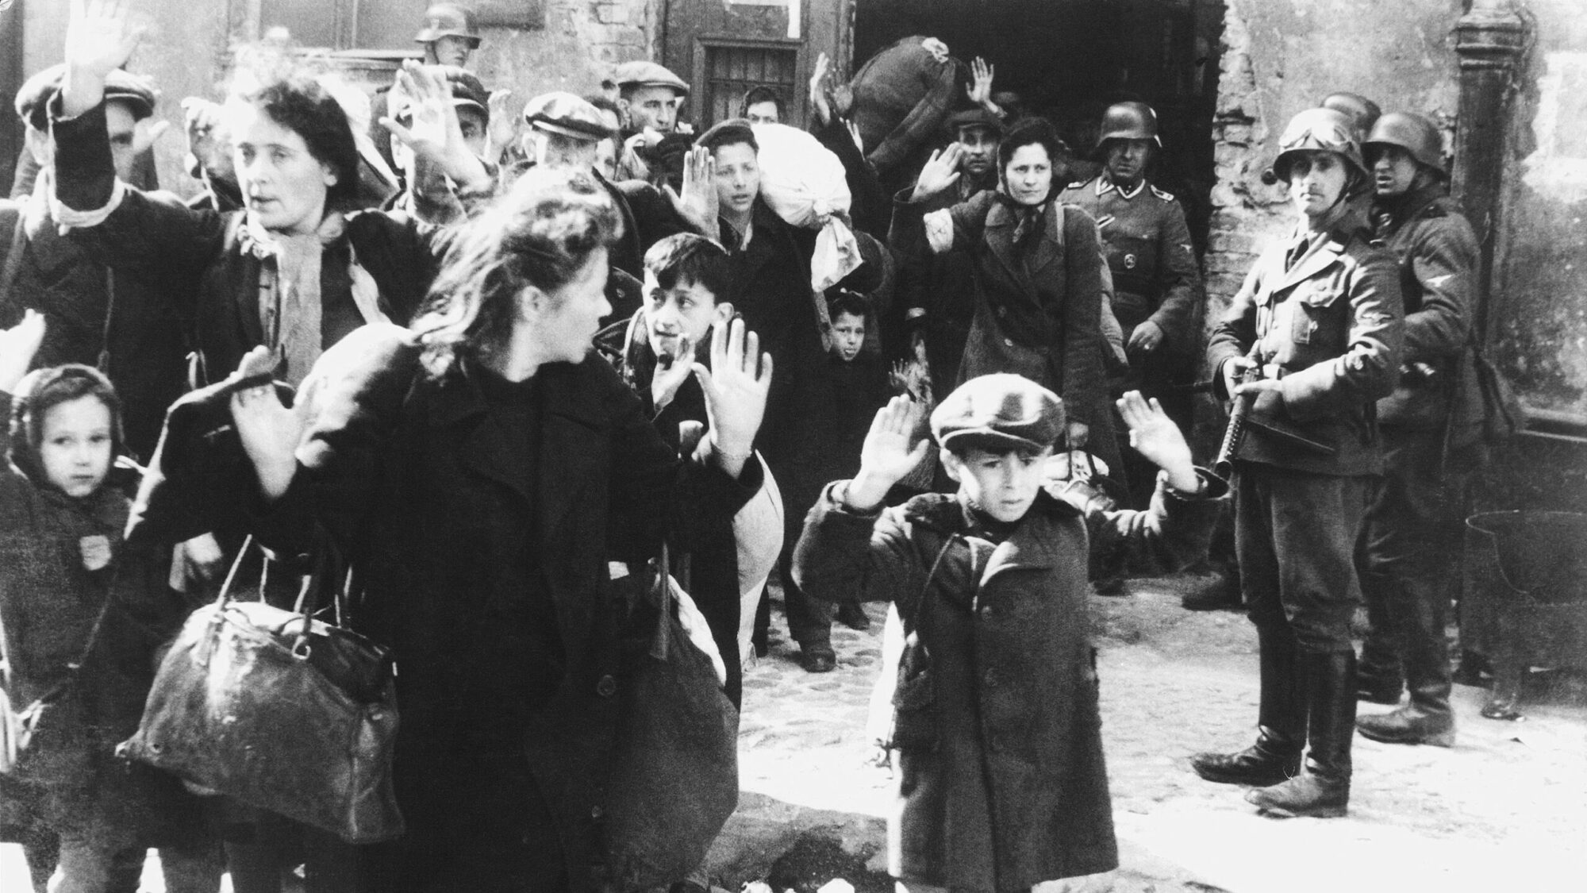
Slide Tite
REDEEMING THE PAST
WORLD WAR TWO AND THE HOLOCAUST

Slide 6
Slide Tite
REDEEMING THE PAST
Luke 10:30-33 Yeshua replied and said, “A man was going down from Jerusalem to Jericho, and fell among robbers, and they stripped him and beat him, and went away leaving him half dead. ³¹ And by chance a priest was going down on that road, and when he saw him, he passed by on the other side. ³² Likewise a Levite also, when he came to the place and saw him, passed by on the other side. ³³ But a Samaritan, who was on a journey, came upon him; and when he saw him, he felt compassion.

Slide 7
Slide Tite
REDEEMING THE PAST

Slide 8
Slide Tite
REDEEMING THE PAST
WHO WERE THE BYSTANDERS?
• They were not the rescuers
• They were not the victims
• They were not the direct perpetrators
A BYSTANDER WHO DOES NOTHING ONLY FACILITATES THE WORK
OF A PERPETRATOR.

Slide 9
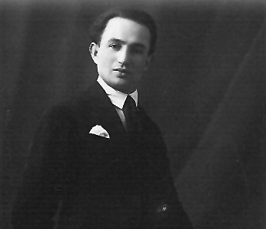
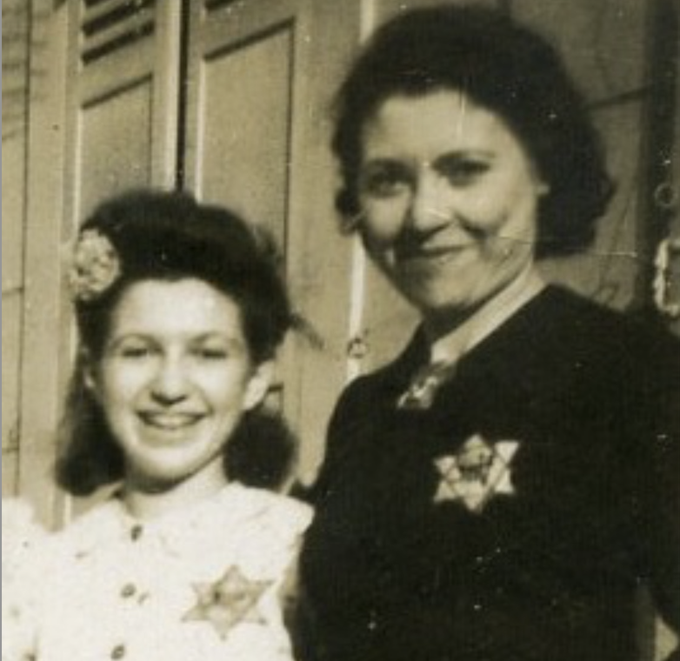
Slide Tite
REDEEMING THE PAST
WHO WERE THE BYSTANDERS?
Summer of 1942, Paris, France
Maurice Weinzveig
Evelyn and Berthe Weinzveig

Slide 10
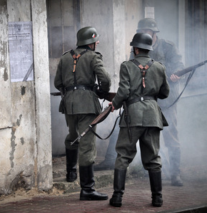
Slide Tite
REDEEMING THE PAST
WHO WERE THE BYSTANDERS?
Summer of 1942, Paris, France
Gestapo officers came to get Maurice at his home.
Maurice complied, promising to his family that he’d be back soon.
He disappeared in the smokestacks of Auschwitz and never returned.

Slide 11
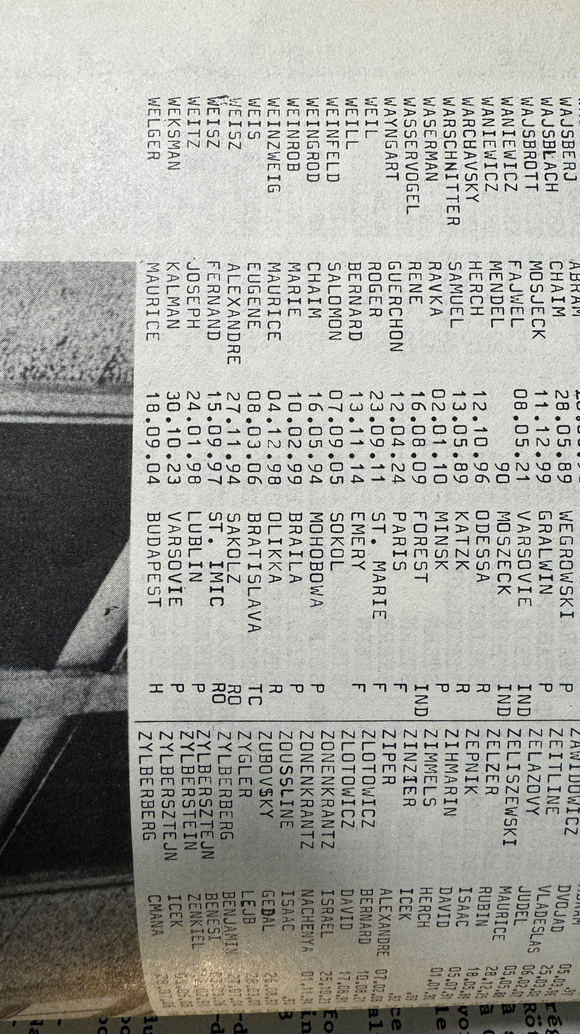
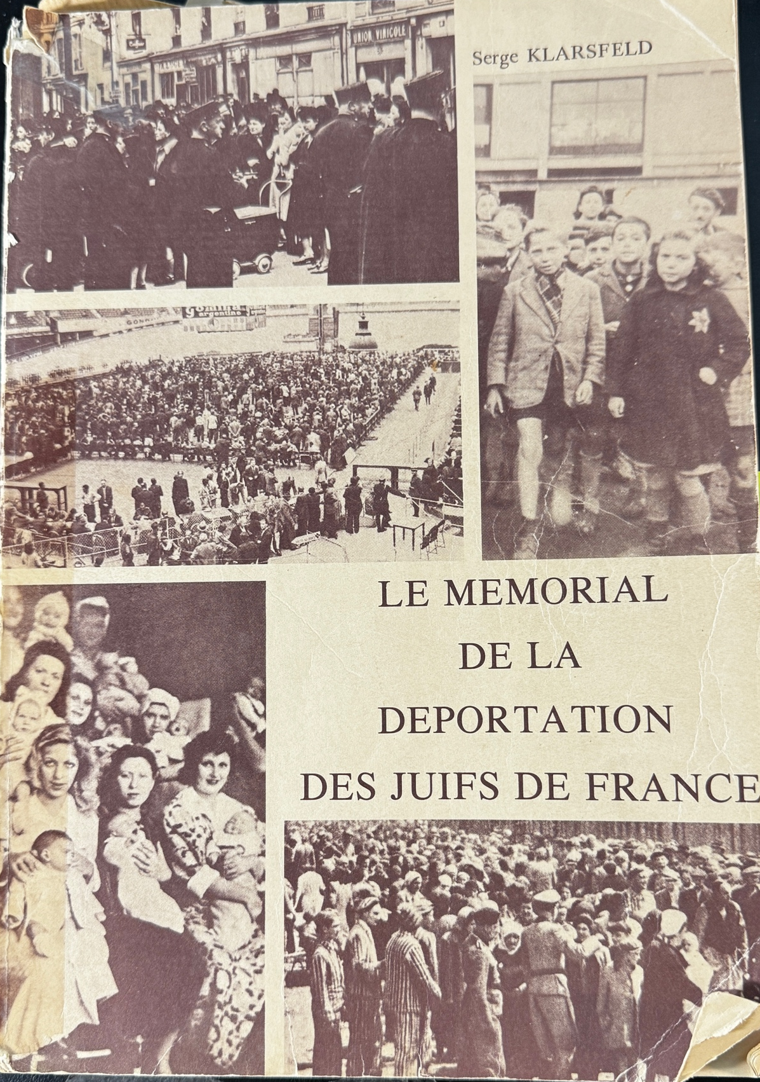
Slide Tite
REDEEMING THE PAST
WHO WERE THE BYSTANDERS?

Slide 12
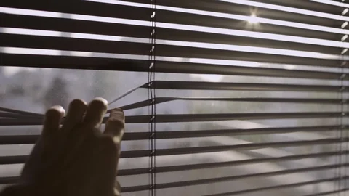
Slide Tite
REDEEMING THE PAST
WHO WERE THE BYSTANDERS?
Summer of 1942, Paris, France

Slide 13
Slide Tite
REDEEMING THE PAST
POSSIBLE REASONS TO BE
A BYSTANDER
• Fear
• Feeling powerless
• Protecting family
• Greed
• Hatred of Jews

Slide 14
Slide Tite
DO NOT BE A BYSTANDER!

Slide 15
Slide Tite
LOOKING AT THE PRESENT
CURRENT EVENTS AND THE
GLOBAL RISE OF ANTISEMITISM
WHAT CHANGED ON
OCTOBER 7, 2023?

Slide 16
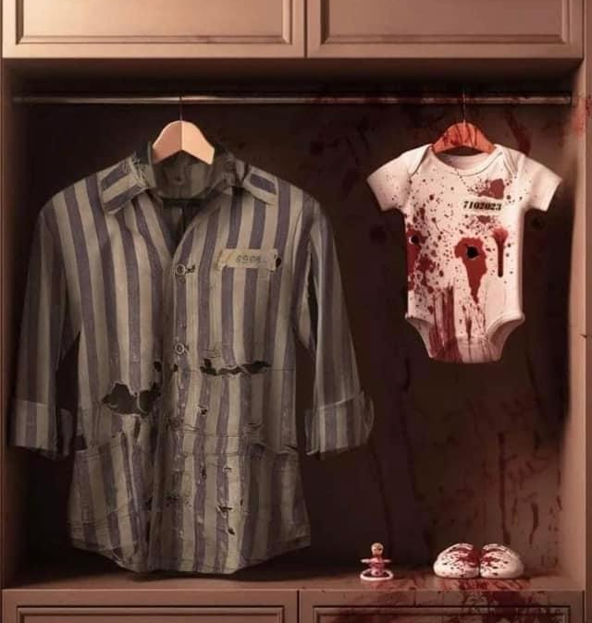
Slide Tite
LOOKING AT THE PRESENT
CURRENT EVENTS AND THE GLOBAL RISE OF ANTISEMITISM
HAMAS/ ISRAEL 2023 HEAVIEST JEWISH DEATH TOLL SINCE THE HOLOCAUST!

Slide 17
Slide Tite
LOOKING AT THE PRESENT
HAMAS’ POGROM UNLEASHED ANTISEMITISM
ON A GLOBAL SCALE

Slide 18
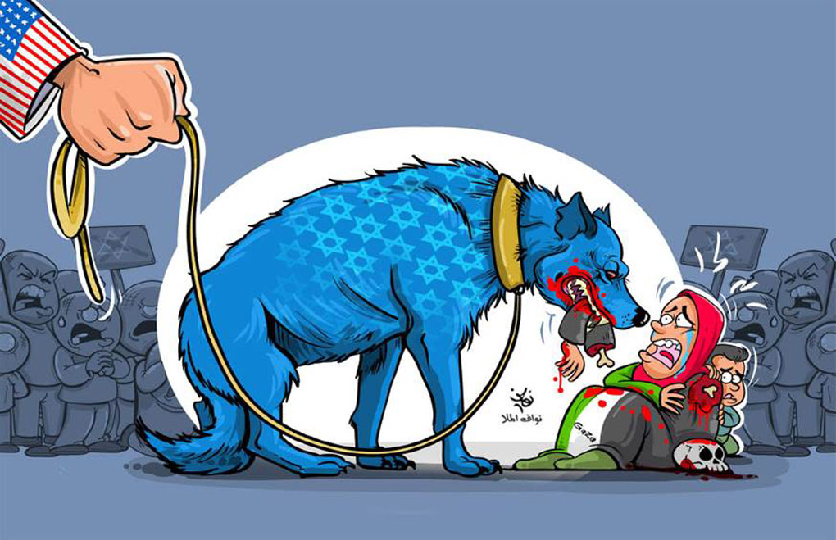
Slide Tite
LOOKING AT THE PRESENT
ANTISEMITIC CARTOONS
AN ONGOING GLOBAL POISON

Slide 19
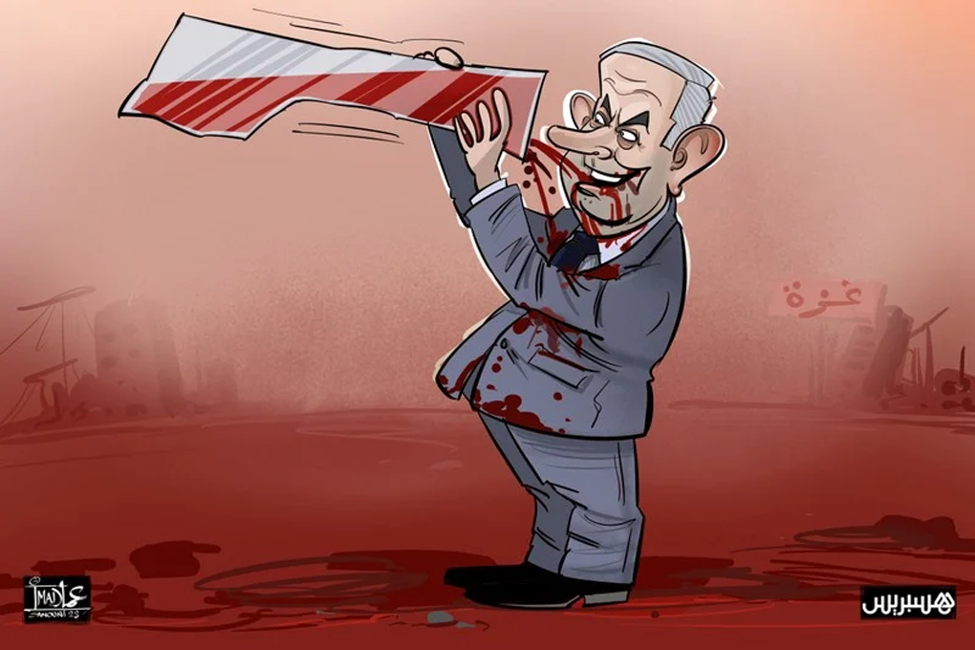
Slide Tite
LOOKING AT THE PRESENT
ANTISEMITIC CARTOONS
AN ONGOING GLOBAL POISON

Slide 20
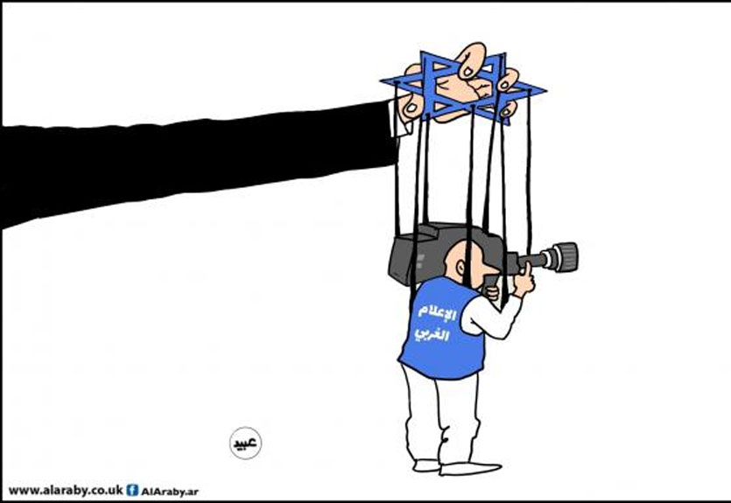
Slide Tite
LOOKING AT THE PRESENT
ANTISEMITIC CARTOONS
AN ONGOING GLOBAL POISON

Slide 21
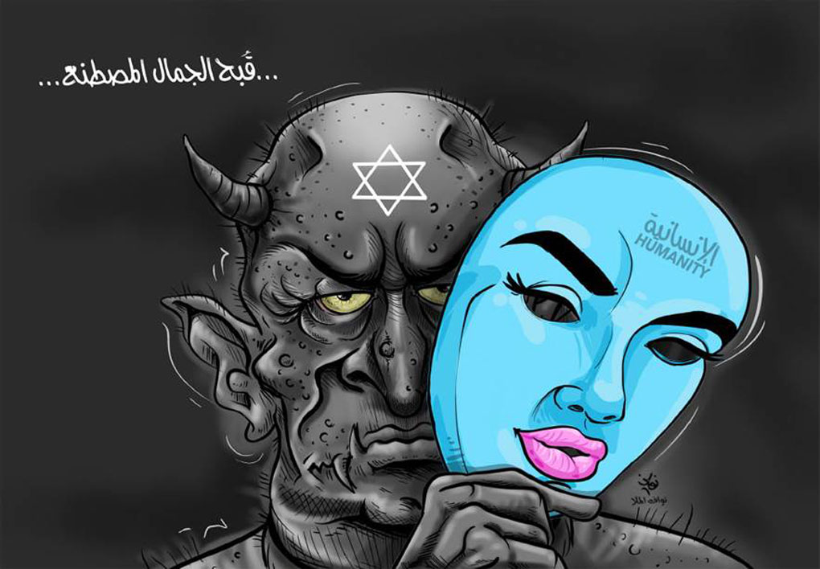
Slide Tite
LOOKING AT THE PRESENT
ANTISEMITIC CARTOONS
AN ONGOING GLOBAL POISON

Slide 22
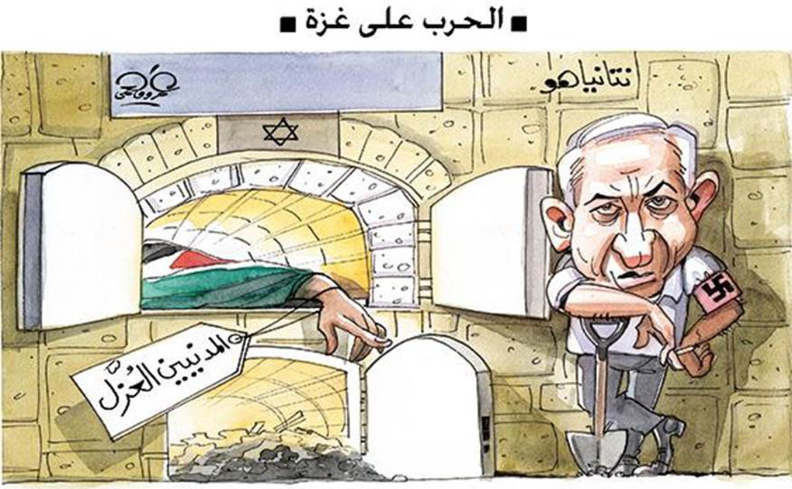
Slide Tite
LOOKING AT THE PRESENT
ANTISEMITIC CARTOONS
AN ONGOING GLOBAL POISON

Slide 23
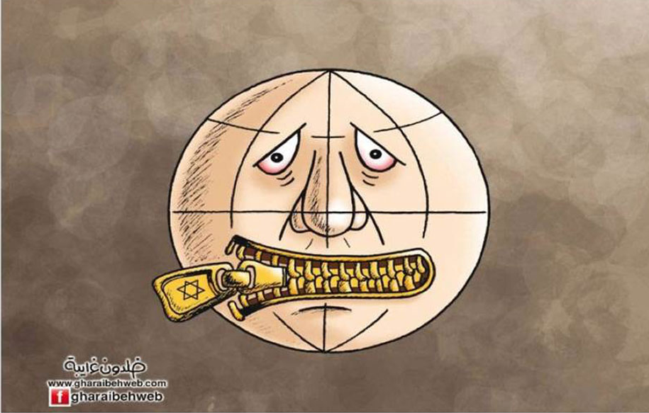
Slide Tite
LOOKING AT THE PRESENT
ANTISEMITIC CARTOONS
AN ONGOING GLOBAL POISON

Slide 24
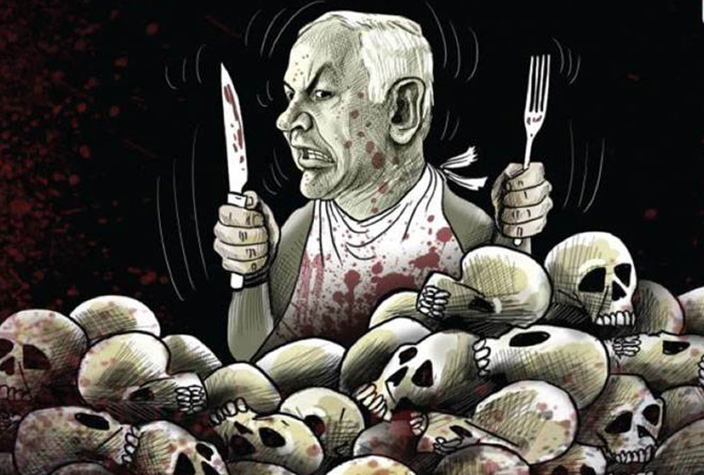
Slide Tite
LOOKING AT THE PRESENT
ANTISEMITIC CARTOONS
AN ONGOING GLOBAL POISON

Slide 25
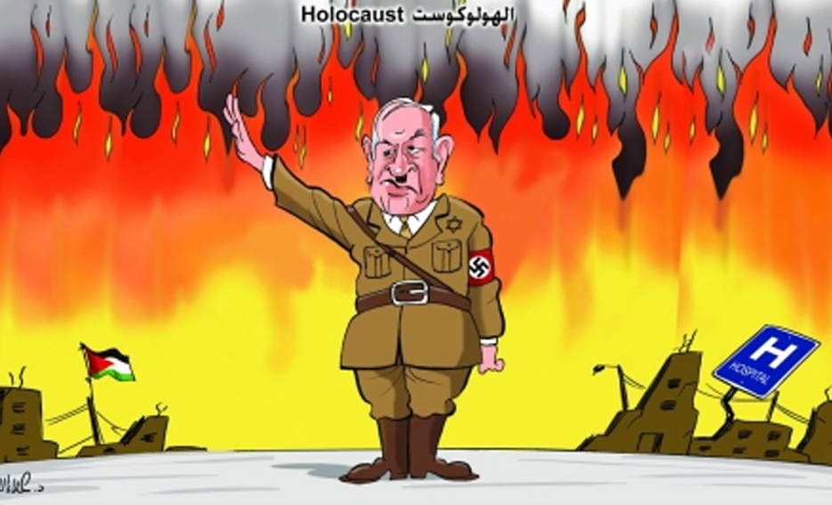
Slide Tite
LOOKING AT THE PRESENT
ANTISEMITIC CARTOONS
AN ONGOING GLOBAL POISON

Slide 26
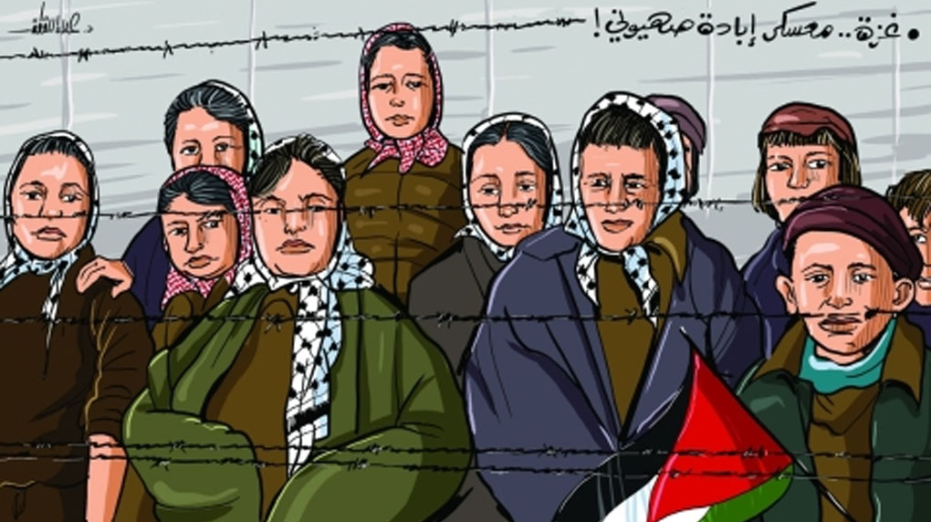
Slide Tite
LOOKING AT THE PRESENT
ANTISEMITIC CARTOONS
AN ONGOING GLOBAL POISON

Slide 27
Slide Tite
ACTING IN THE PRESENT
Prayer
PEACE: Absence of war
ULTIMATE PEACE: Yeshua’s Messianic reign in Jerusalem

Slide 28
Slide Tite
ACTING IN THE PRESENT
• Prayer for Peace Psalm 122:6 Pray for the peace of Jerusalem: “May they prosper who love you.

Slide 29
Slide Tite
ACTING IN THE PRESENT
• Prayer for Messianic Peace Isaiah 2:4 He shall judge between the nations and shall decide disputes for many peoples; and they shall beat their swords into plowshares, and their spears into pruning hooks; nation shall not lift up sword against nation, neither shall they learn war anymore.

Slide 30
Slide Tite
ACTING IN THE PRESENT
2. Speak Up
Isaiah 62:1 For Zion’s sake I will not keep silent, And for Jerusalem’s sake I will not keep quiet, Until her righteousness goes forth like brightness, And her salvation like a torch that is burning.

Slide 31
Slide Tite
ACTING IN THE PRESENT
2. Speak Up
Isaiah 62:6 On your walls, O Jerusalem, I have appointed
watchmen; All day and all night they will never keep silent. You who remind the Lord, take no rest for yourselves;

Slide 32
Slide Tite
ACTING IN THE PRESENT
3. Reach Out
Matthew 25:35-36 For I was hungry, and you gave Me something to eat; I was thirsty, and you gave Me
something to drink; I was a stranger,
and you invited Me in; naked, and you clothed Me; I was sick, and you
visited Me; I was in prison, and you came to Me.’

Slide 33
Slide Tite
ACTING IN THE PRESENT
3. Reach Out
Matthew 25:37-38 Then the righteous will answer Him, ‘Lord, when did we see You hungry, and feed You, or thirsty, and give You
something to drink? And when did we see You a stranger, and invite You in, or naked, and clothe You?

Slide 34
Slide Tite
ACTING IN THE PRESENT
3. Reach Out
Matthew 25:39-40 When did we see You sick, or in prison, and come to You?’ The King will answer and say to them, ‘Truly I say to you, to the extent that you did it to one of these brothers of Mine, even the least of them, you did it to Me.’

Slide 35
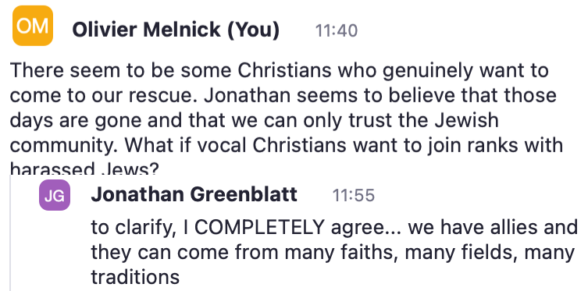
Slide Tite
ACTING IN THE PRESENT
ADL Webinar with CEO Jonathan Greenblatt, Nov. 13, 2023

Slide 36
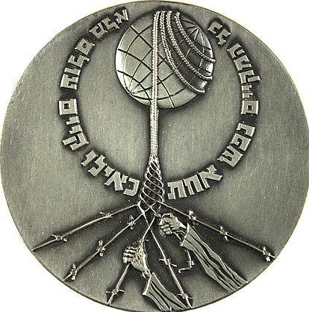
Slide Tite
ACTING IN THE PRESENT
A FINAL CHALLENGE TO BELIEVERS
THE RIGHTEOUS AMONG THE NATIONS
Gentiles were recognized for their rescuing of Jewish people during the Holocaust era.

Slide 37
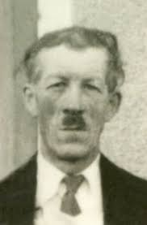
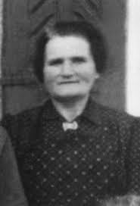
Slide Tite
ACTING IN THE PRESENT
A FINAL CHALLENGE TO BELIEVERS
Pierre & Ida Darricau
TWO “NOT SO FAMOUS” RIGHTEOUS AMONG THE NATIONS

Slide 38
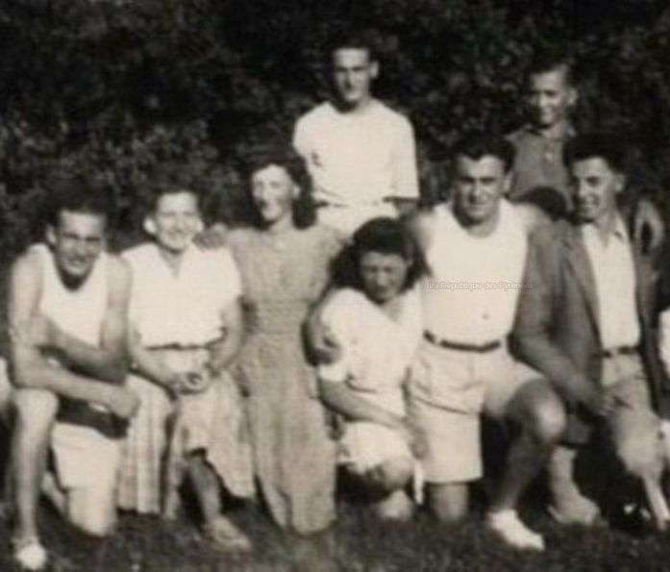
Slide Tite
ACTING IN THE PRESENT
A FINAL CHALLENGE TO BELIEVERS
Pierre & Ida Darricau rescued
Evelyn Weinzveig

Slide 39
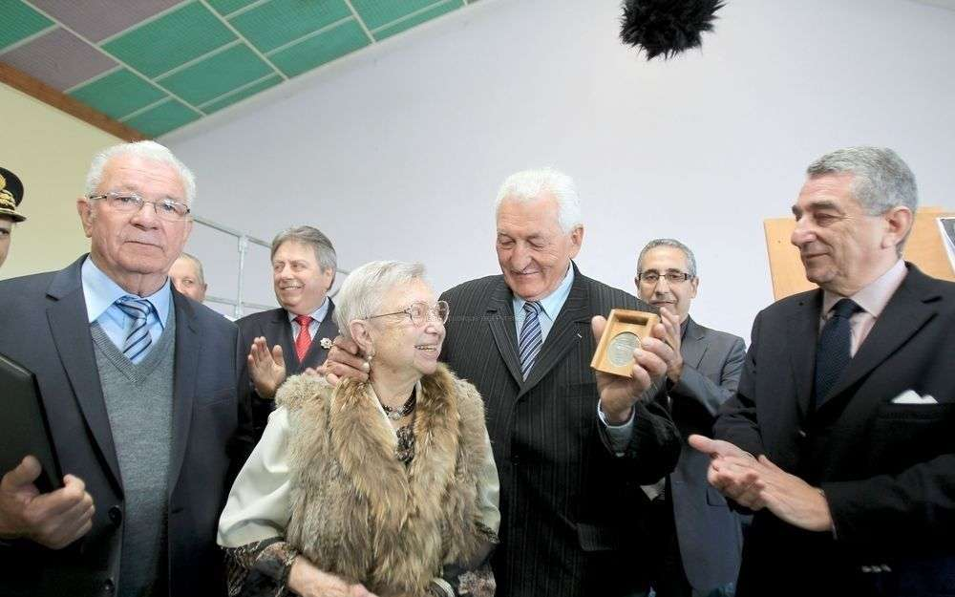
Slide Tite
ACTING IN THE PRESENT
A FINAL CHALLENGE TO BELIEVERS
In 2013,Evelyn Weinzveig reunited with the Darricau’s two sons as they received the Yad Vashem
medal on
behalf of
their deceased
parents.

Slide 40
Slide Tite
ACTING IN THE PRESENT
A FINAL CHALLENGE TO BELIEVERS
In 2013,Evelyn Weinzveig married Georges Melnick and they had two children.
I AM THEIR SON!

Slide 41
Slide Tite
ALTERING THE FUTURE
THE TIME OF JACOB’S TROUBLE
Zechariah 13:8-9 “It will come about in all the land,” Declares the Lord, “That two parts in it will be cut off and perish; But the third will be left in it. ⁹ “And I will bring the third part through the fire, Refine them as silver is refined, And test them as gold is tested. They will call on My name, And I will answer them; I will say, ‘They are My people,’ And they will say, ‘The Lord is my God.’”

Slide 42
Slide Tite
ALTERING THE FUTURE
THE TIME OF JACOB’S TROUBLE
• A percentage NOT an exact number!
• TODAY: 10,000.000/5,000.000
• FROM A PRE-MIL, PRE-TRIB PERSPECTIVE:
• ANY JEWISH PERSON SAVED BEFORE THE RAPTURE WILL REDUCE THE NUMBER WITHIN THE PERCENTAGE

Slide 43
Slide Tite
GET
THE
NOTES FROM OLIVIER

Slide 44
Olivier@ShalominMessiah.com
ShalominMessiah.com
YOUTUBE: Shalom in Messiah Ministries
INSTAGRAM:@OLIVIERMELNICK

