Slide 1
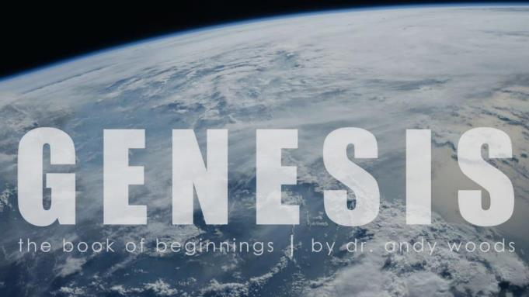
Genesis 12‒50
Israel’s Birth & Preservation

Slide 2
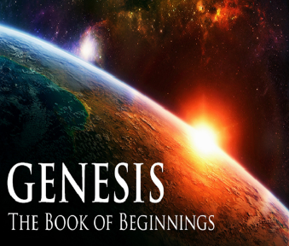
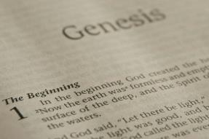
GENESIS STRUCTURE
Genesis 12-50 (four people)
Abraham (12:1–25:11)
Isaac (25:12–26:35)
Jacob (27–36)
Joseph (37–50)

Slide 3
Genesis 37:2-36 Joseph Sold unto Egypt
Joseph’s coat (37:2-4)
Joseph’s dreams (37:5-11)
Joseph’s pit (37:12-24)
Joseph’s enslavement (37:25-36)

Slide 4
IV. Genesis 37:25-36 Joseph’s Enslavement
Selling of Joseph (25-28)
Reuben’s discovery (29-30)
Brothers report to Jacob (31-32)
Jacob’s response (33-35)
Joseph sold again (36)

Slide 5
IV. Genesis 37:25-36 Joseph’s Enslavement
Selling of Joseph (25-28)
Reuben’s discovery (29-30)
Brothers report to Jacob (31-32)
Jacob’s response (33-35)
Joseph sold again (36)

Slide 6
Genesis 37:25-28 Selling of Joseph
Occasion (25)
Judah’s proposal (26-27a)
Agreement (27b)
Selling (28)

Slide 7
Genesis 37:25-28 Selling of Joseph
Occasion (25)
Judah’s proposal (26-27a)
Agreement (27b)
Selling (28)

Slide 8
Genesis 12‒25 Abraham’s Early Journeys
Unconditional promises (Gen. 12:1-3) From Haran to Canaan (Gen. 12:4-5) In Canaan (Gen. 12:6-9) In Egypt (Gen. 12:10-20) Abram and Lot Separate (Gen. 13:1-13) Reaffirmation of Abram’s promises (Gen. 13:14-18) Abram Rescues Lot (14:1-24) Abrahamic Covenant (15:1-21) Hagar & Ishmael (16:1-16) Circumcision (Gen. 17:1-27) | Sodom & Gomorrah (Gen. 18‒19) Abraham & Abimelech (Gen. 20) Isaac’s birth (Gen. 21:1-7) Ishmael’s expulsion (21:8-21) Abraham & Abimelech’s covenant (21:22-34) Abraham sacrifices Isaac (22) Sarah’s death (23) Isaac’s marriage (24) Abraham & Keturah (25:1-6) Abraham’s death (25:7-11)

Slide 9
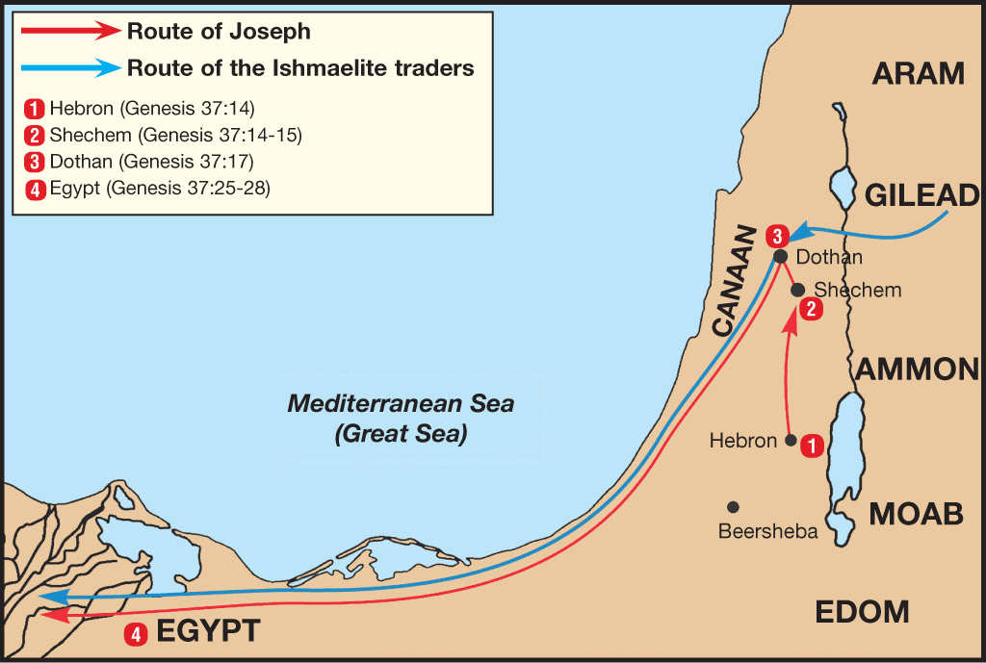

Slide 10
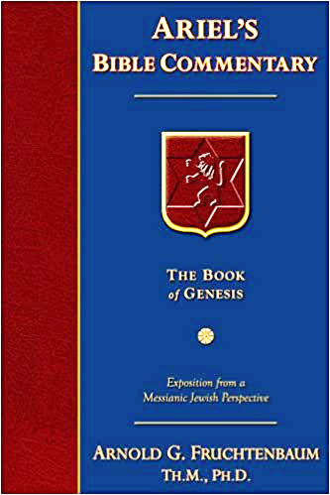
Dr. Arnold G. Fruchtenbaum
The Book of Genesis, 533
“So in verse 17b, Joseph journeys to Dothan: And Joseph went after his brethren and found them in Dothan. Dothan is north of Shechem, another day’s journey. The situation in Shechem may still have been somewhat tense, but for one reason or another they had chosen to go further north, and Dothan was the city located on the north-south trunk route. Dothan was also located on the east-west trade route between Gilead and the Coastal Plain where it connected with the Via Maris that in turn would go south into Egypt. All this set the stage for the selling of Joseph.”

Slide 11
Dr. Arnold G. Fruchtenbaum
The Book of Genesis, 536
“In verse 27b came the agreement: And his brethren hearkened unto him. Verse 28 records the selling: And there passed by Midianites, merchantmen. These are called merchantmen; for they were North Arabian caravaneers who branched off through Gilead to the main route to Egypt, the Via Maris, from the King’s Highway.”

Slide 12
Genesis 37:25-28 Selling of Joseph
Occasion (25)
Judah’s proposal (26-27a)
Agreement (27b)
Selling (28)

Slide 13
Genesis 37:26-27a Judah’s Proposal
Rhetorical question (26)
Proposal (27a)

Slide 14
Genesis 37:26-27a Judah’s Proposal
Rhetorical question (26)
Proposal (27a)

Slide 16
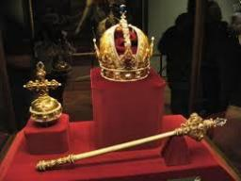
Genesis 49:10
“The scepter shall not depart from Judah, Nor the ruler’s staff from between his feet, Until Shiloh comes, And to him shall be the obedience of the peoples.”

Slide 17
Genesis 37:26-27a Judah’s Proposal
Rhetorical question (26)
Proposal (27a)

Slide 18
Genesis 37:25-28 Selling of Joseph
Occasion (25)
Judah’s proposal (26-27a)
Agreement (27b)
Selling (28)

Slide 20
Genesis 37:25-28 Selling of Joseph
Occasion (25)
Judah’s proposal (26-27a)
Agreement (27b)
Selling (28)

Slide 21
Genesis 12‒25 Abraham’s Early Journeys
Unconditional promises (Gen. 12:1-3) From Haran to Canaan (Gen. 12:4-5) In Canaan (Gen. 12:6-9) In Egypt (Gen. 12:10-20) Abram and Lot Separate (Gen. 13:1-13) Reaffirmation of Abram’s promises (Gen. 13:14-18) Abram Rescues Lot (14:1-24) Abrahamic Covenant (15:1-21) Hagar & Ishmael (16:1-16) Circumcision (Gen. 17:1-27) | Sodom & Gomorrah (Gen. 18‒19) Abraham & Abimelech (Gen. 20) Isaac’s birth (Gen. 21:1-7) Ishmael’s expulsion (21:8-21) Abraham & Abimelech’s covenant (21:22-34) Abraham sacrifices Isaac (22) Sarah’s death (23) Isaac’s marriage (24) Abraham & Keturah (25:1-6) Abraham’s death (25:7-11)

Slide 22
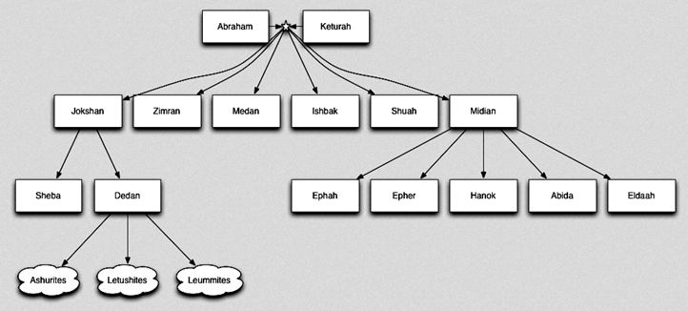

Slide 23
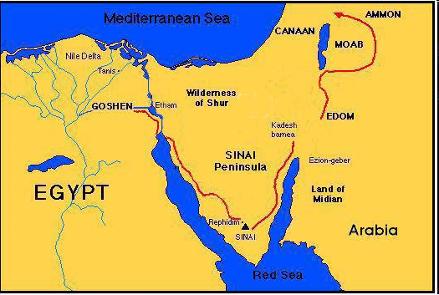

Slide 24
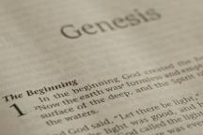
Beginning Themes
Universe Life Man Marriage Evil Clothing | Religion Salvation Language Government Nations Israel
Morris, Genesis Record, 18-20

Slide 25
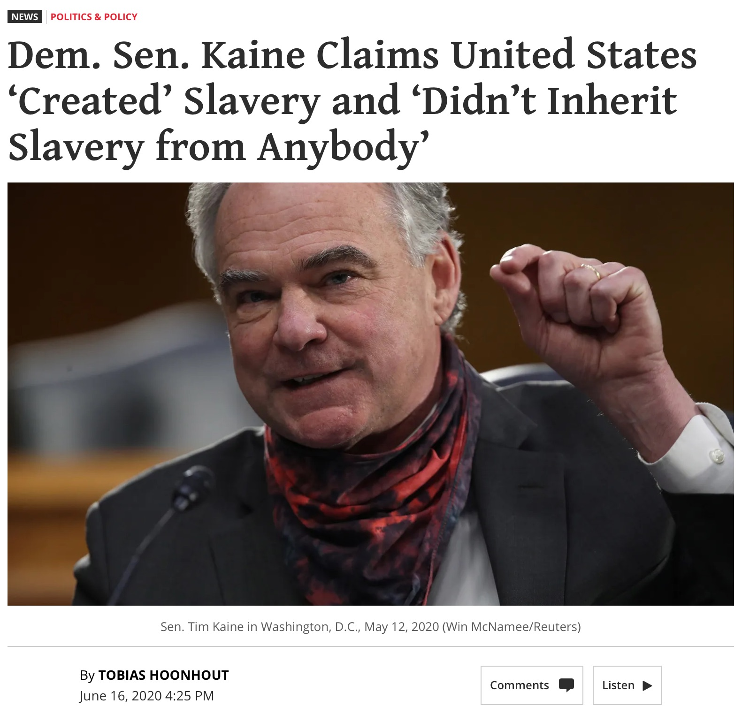

Slide 26
IV. Genesis 37:25-36 Joseph’s Enslavement
Selling of Joseph (25-28)
Reuben’s discovery (29-30)
Brothers report to Jacob (31-32)
Jacob’s response (33-35)
Joseph sold again (36)

Slide 27
Genesis 37:29-30 Reuben’s Discovery
Discovery (29)
Dilemma (30)

Slide 28
Genesis 37:29-30 Reuben’s Discovery
Discovery (29)
Dilemma (30)

Slide 30
Genesis 37:29-30 Reuben’s Discovery
Discovery (29)
Dilemma (30)

Slide 32
IV. Genesis 37:25-36 Joseph’s Enslavement
Selling of Joseph (25-28)
Reuben’s discovery (29-30)
Brothers report to Jacob (31-32)
Jacob’s response (33-35)
Joseph sold again (36)

Slide 33
Genesis 37:31-32 Brothers Report to Jacob
Cover up (31)
Brothers show Jacob Joseph’s coat (32)

Slide 34
Genesis 37:31-32 Brothers Report to Jacob
Cover up (31)
Brothers show Jacob Joseph’s coat (32)

Slide 35
Dr. Arnold G. Fruchtenbaum
The Book of Genesis, 537
“Here again, there is a form of retribution: Jacob deceived Isaac with goatskins (27:16), now Jacob was being deceived with goat’s blood. Furthermore, Jacob deceived Isaac with Esau’s clothes (27:15); now Jacob was deceived by the use of Joseph’s clothes.”

Slide 36
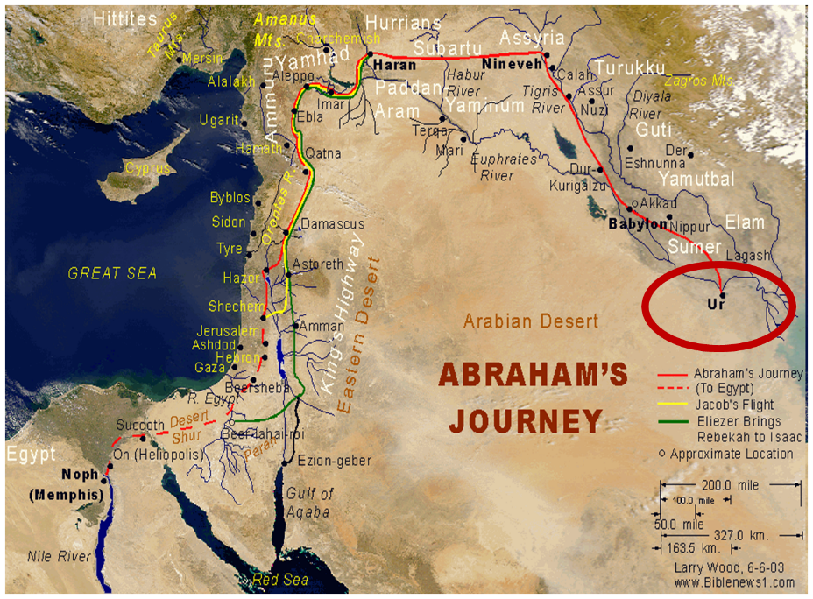

Slide 37
Dr. Arnold G. Fruchtenbaum
The Book of Genesis, 445
“Now the deceiver is deceived, although the motivations differ from good to bad. This is divine retribution in four ways. First, Isaac’s blindness equals the darkness of Jacob’s wedding night, and neither could see well as a result. Second, this Jacob is deceived by being presented the older for the younger, the reversal of Isaac’s presentation of Jacob for Esau. Third, Isaac thought Jacob was Esau and Jacob thought Leah was Rachel. Fourth, Jacob pretended to be his older brother, while Leah pretended to be her younger sister.”

Slide 38
Genesis 37:31-32 Brothers Report to Jacob
Cover up (31)
Brothers show Jacob Joseph’s coat (32)

Slide 39
IV. Genesis 37:25-36 Joseph’s Enslavement
Selling of Joseph (25-28)
Reuben’s discovery (29-30)
Brothers report to Jacob (31-32)
Jacob’s response (33-35)
Joseph sold again (36)

Slide 40
Genesis 37:33-35 Jacob’s Response
Conclusion (33)
Mourning (34)
Lack of comfort (35)

Slide 41
Genesis 37:33-35 Jacob’s Response
Conclusion (33)
Mourning (34)
Lack of comfort (35)

Slide 42
Genesis 37:33-35 Jacob’s Response
Conclusion (33)
Mourning (34)
Lack of comfort (35)

Slide 43
Zechariah 12:10
“I will pour out on the house of David and on the inhabitants of Jerusalem, the Spirit of grace and of supplication, so that they will look on Me whom they have pierced; and they will mourn for Him, as one mourns for an only son, and they will weep bitterly over Him like the bitter weeping over a firstborn.”

Slide 44
Genesis 37:33-35 Jacob’s Response
Conclusion (33)
Mourning (34)
Lack of comfort (35)

Slide 45
Dr. Arnold G. Fruchtenbaum
The Book of Genesis, 537
“Jacob’s refusal is stated: He refused to be comforted; and he said, For I will go down to Sheol to my son in mourning. And his father wept for him. Sheol is the center of the earth, and before the death of the Messiah, all souls descended there upon death; but the faithful and unfaithful entered into different compartments in Sheol.”

Slide 47
IV. Genesis 37:25-36 Joseph’s Enslavement
Selling of Joseph (25-28)
Reuben’s discovery (29-30)
Brothers report to Jacob (31-32)
Jacob’s response (33-35)
Joseph sold again (36)

Slide 48
Genesis 37:36 Joseph Sold Again
Place: Egypt (36a)
Person: Potiphar (36b)

Slide 49
Genesis 37:36 Joseph Sold Again
Place: Egypt (36a)
Person: Potiphar (36b)

Slide 53
Genesis 37:36 Joseph Sold Again
Place: Egypt (36a)
Person: Potiphar (36b)

Slide 54
Conclusion

Slide 55
Genesis 37:2-36 Joseph Sold unto Egypt
Joseph’s coat (37:2-4)
Joseph’s dreams (37:5-11)
Joseph’s pit (37:12-24)
Joseph’s enslavement (37:25-36)

Slide 56
²⁴ The Lord bless you, and keep you; ²⁵ The Lord make His face shine on you, And be gracious to you; ²⁶ The Lord lift up His countenance on you, And give you peace.
Numbers 6:24–26 (NASB95)

