Slide 1
Dr. Andy Woods
Senior Pastor – Sugar Land Bible Church
President – Chafer Theological Seminary

Slide 2
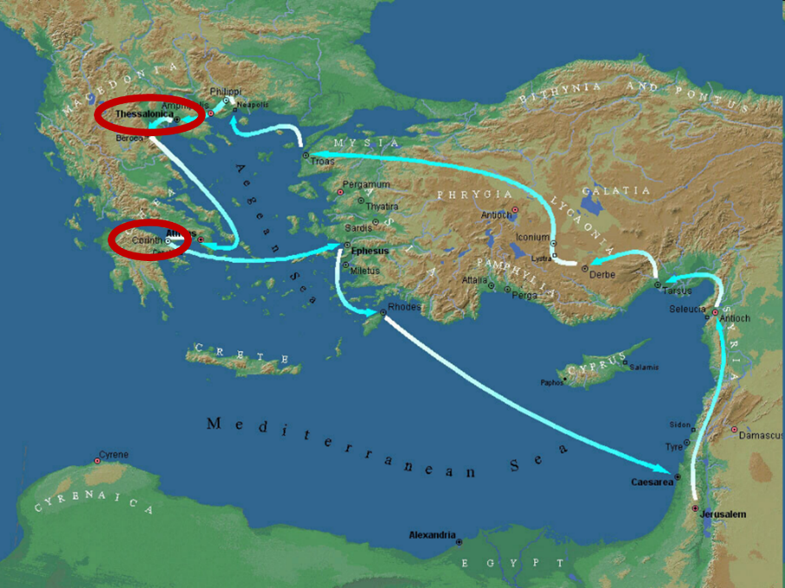

Slide 3
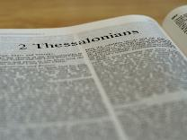
2 Thessalonians 2:1-12
Problem (2:1-2)
Prerequisites for the Day of the Lord (2:3-12)
The departure (2:3a)
Advent of the lawless one (2:3b-4)
Removal of the restrainer (2:5-7)
Destruction of the lawless one (2:8-9)
Destruction of lawless one’s followers (2:10-12)

Slide 4
2 Thessalonians 2:2
“that you not be quickly shaken from your composure or be disturbed either by a spirit or a message or a letter as if from us, to the effect that the day of the Lord [the Tribulation] has come.”

Slide 5
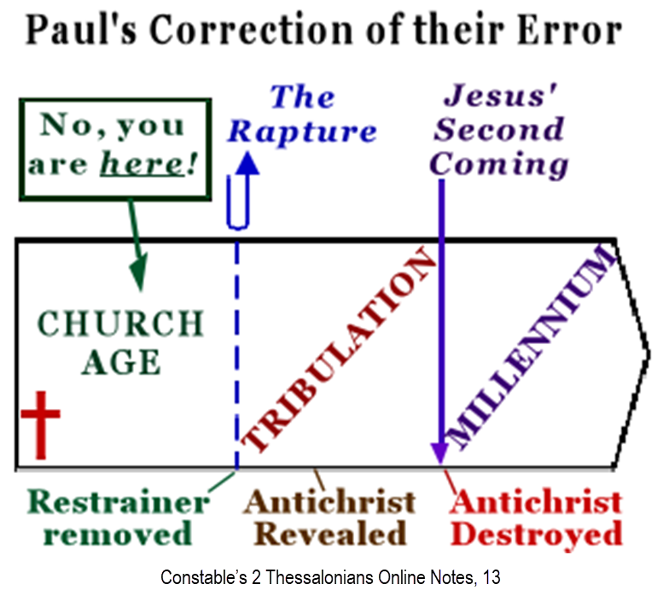

Slide 7
2 Thessalonians 2:1-12
Problem (2:1-2)
Prerequisites for the Day of the Lord (2:3-12)
The departure (2:3a)
Advent of the lawless one (2:3b-4)
Removal of the restrainer (2:5-7)
Destruction of the lawless one (2:8-9)
Destruction of lawless one’s followers (2:10-12)

Slide 8
2 Thessalonians 2:1-12
Problem (2:1-2)
Prerequisites for the Day of the Lord (2:3-12)
The departure (2:3a)
Advent of the lawless one (2:3b-4)
Removal of the restrainer (2:5-7)
Destruction of the lawless one (2:8-9)
Destruction of lawless one’s followers (2:10-12)

Slide 9
2 Thessalonians 2:1-12
Problem (2:1-2)
Prerequisites for the Day of the Lord (2:3-12)
The departure (2:3a)
Advent of the lawless one (2:3b-4)
Removal of the restrainer (2:5-7)
Destruction of the lawless one (2:8-9)
Destruction of lawless one’s followers (2:10-12)

Slide 10
2 Thessalonians 2:1-12
Problem (2:1-2)
Prerequisites for the Day of the Lord (2:3-12)
The departure (2:3a)
Advent of the lawless one (2:3b-4)
Removal of the restrainer (2:5-7)
Destruction of the lawless one (2:8-9)
Destruction of lawless one’s followers (2:10-12)

Slide 11
2 Thessalonians 2:6-7
⁶And you know what restrains [τὸ κατέχον; neuter] him now, so that in his time he will be revealed. ⁷For the mystery of lawlessness is already at work; only he who now restrains [ὁ κατέχων; masculine] will do so until he is taken out of the way.

Slide 12
Restrainer? (2:6-7)
Rome?
Satan?
Government?
Michael?
Spirit?

Slide 13
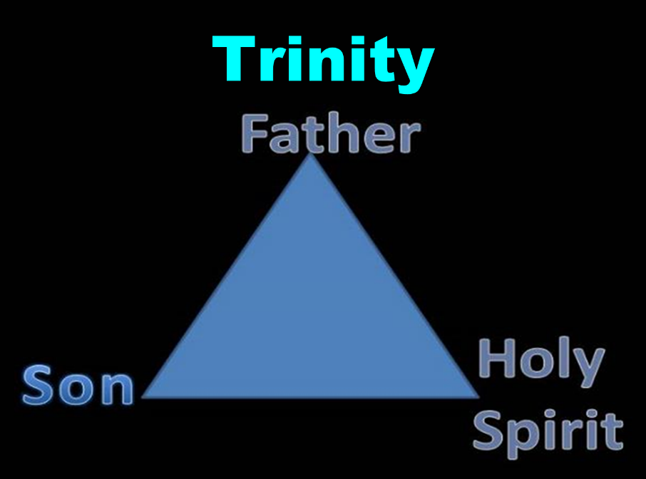

Slide 14
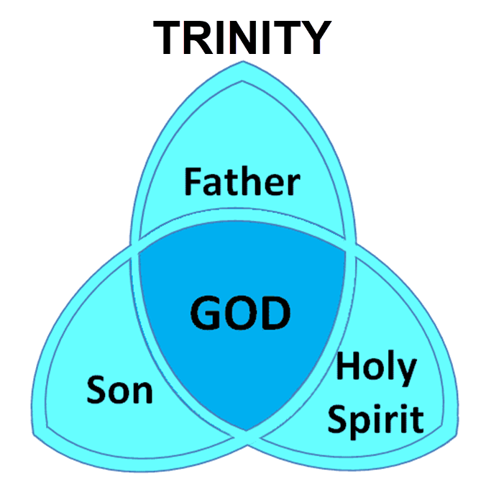

Slide 15
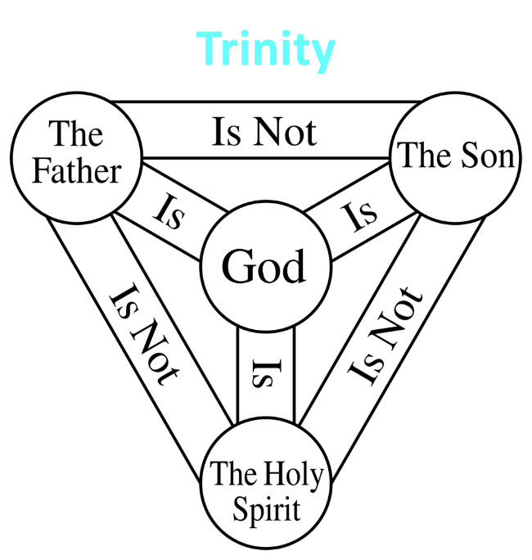

Slide 16
3 Reasons Why the Restrainer is the Holy Spirit (2 Thessalonians 2:6-7)
The Holy Spirit is omnipotent (2 Thess. 2:9)
The Holy Spirit is active in the world (Gen. 6:3; John 16:7-11)
The Holy Spirit view handles well the switch in gender from the neuter (vs. 6) to the masculine (vs. 7)

Slide 17
Romans 8:5-6
^{5 “}For those who are according to the flesh set their minds on the things of the flesh, but those who are according to the Spirit, the things of the Spirit. ⁶ For the mind set on the flesh is death, but the mind set on the Spirit is life and peace.”

Slide 18
2 Thessalonians 2:5
“Do you not remember that while I was still with you, I was telling you these things?”

Slide 19
Restrainer Must First be Removed
Restrainer holds back the Antichrist (2 Thess 2:6-7)
Restrainer = the omnipotent Holy Spirit (2 Thess 2:9)
Holy Spirit permanently indwells all Christians (John 14:16; Rom 8:9)
Sprit indwelt Christians must first be removed prior to the Antichrist's advent

Slide 20
Restrainer Must First be Removed
Restrainer holds back the Antichrist (2 Thess 2:6-7)
Restrainer = the omnipotent Holy Spirit (2 Thess 2:9)
Holy Spirit permanently indwells all Christians (John 14:16; Rom 8:9)
Sprit indwelt Christians must first be removed prior to the Antichrist's advent

Slide 21
Daniel 9:27
And he will make a firm covenant with the many for one week, but in the middle of the week he will put a stop to sacrifice and grain offering; and on the wing of abominations will come one who makes desolate, even until a complete destruction, one that is decreed, is poured out on the one who makes desolate.

Slide 23
Restrainer Must First be Removed
Restrainer holds back the Antichrist (2 Thess 2:6-7)
Restrainer = the omnipotent Holy Spirit (2 Thess 2:9)
Holy Spirit permanently indwells all Christians (John 14:16; Rom 8:9)
Sprit indwelt Christians must first be removed prior to the Antichrist's advent

Slide 24
Restrainer Must First be Removed
Restrainer holds back the Antichrist (2 Thess 2:6-7)
Restrainer = the omnipotent Holy Spirit (2 Thess 2:9)
Holy Spirit permanently indwells all Christians (John 14:16; Rom 8:9)
Sprit indwelt Christians must first be removed prior to the Antichrist's advent

Slide 25
WORK OF THE SPIRIT IN THE OT
 | OT/GOSPELS/ACTS 1 | ACTS 2/TODAY
External vs. Internal | Upon (1 Sam. 16:13) | Within (John 14:17)
Reception of all of the Spirit at the moment of salvation? | Subsequent to salvation (Exod 31:3) | At moment of salvation (Rom 8:9)
How long is the indwelling? | Temporary indwelling (1 Sam 16:14; Ps 51:11) | Permanent indwelling (John 14:16)
Who is indwelt? | Selective indwelling (Joel 2:28) | Universal indwelling (1 Cor 12:13)

Slide 26
1 Samuel 16:13-14
“¹³ Then Samuel took the horn of oil and anointed him in the midst of his brothers; and the Spirit of the Lord came mightily upon David from that day forward. And Samuel arose and went to Ramah. ¹⁴ Now the Spirit of the Lord departed from Saul, and an evil spirit from the Lord terrorized him.”

Slide 27
John 14:16-17
¹⁶ I will ask the Father, and He will give you another Helper, that He may be with you forever; ¹⁷ that is the Spirit of truth, whom the world cannot receive, because it does not see Him or know Him, but you know Him because He abides with you and will be in you.

Slide 28
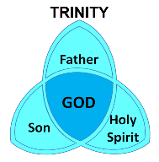
1 Corinthians 6:19
“Or do you not know that your body is a temple of the Holy Spirit who is in you, whom you have from God, and that you are not your own?”

Slide 29
Romans 8:9
“However, you are not in the flesh but in the Spirit, if indeed the Spirit of God dwells in you. But if anyone does not have the Spirit of Christ, he does not belong to Him.”

Slide 30
Ephesians 4:30
“Do not grieve the Holy Spirit of God, by whom you were sealed for the day of redemption.”

Slide 31
Restrainer Must First be Removed
Restrainer holds back the Antichrist (2 Thess 2:6-7)
Restrainer = the omnipotent Holy Spirit (2 Thess 2:9)
Holy Spirit permanently indwells all Christians (John 14:16; Rom 8:9)
Sprit indwelt Christians must first be removed prior to the Antichrist's advent

Slide 34
Remaining Questions
Will the Holy Spirit be active during the Tribulation period? NO
Should believers be politically active today? YES
Can we identify the Antichrist today? NO
Has Satan selected an Antichrist for every generation? YES
Will an Antichrist one day arise? YES

Slide 35
Remaining Questions
Will the Holy Spirit be active during the Tribulation period? NO
Should believers be politically active today? YES
Can we identify the Antichrist today? NO
Has Satan selected an Antichrist for every generation? YES
Will an Antichrist one day arise? YES

Slide 36
Psalm 139:7-8
“⁷ Where can I go from Your Spirit? Or where can I flee from Your presence? ⁸ If I ascend to heaven, You are there; If I make my bed in Sheol, behold, You are there..”

Slide 37
Mark 13:11
“¹¹ When they arrest you and hand you over, do not worry beforehand about what you are to say, but say whatever is given you in that hour; for it is not you who speak, but it is the Holy Spirit.”

Slide 38
Distinctions Between 144,000 & Multitude
144,000 | MULTITUDE
Revelation 7:1-8 | Revelation 7:9-17
Numbered | Innumerable
Jews | All nations
Sealed | Slain
Sealed before the Tribulation | Converted out of the Tribulation
Hitchcock and Ice, The Truth Behind Left Behind, 77

Slide 39
Remaining Questions
Will the Holy Spirit be active during the Tribulation period? NO
Should believers be politically active today? YES
Can we identify the Antichrist today? NO
Has Satan selected an Antichrist for every generation? YES
Will an Antichrist one day arise? YES

Slide 41
Remaining Questions
Will the Holy Spirit be active during the Tribulation period? NO
Should believers be politically active today? YES
Can we identify the Antichrist today? NO
Has Satan selected an Antichrist for every generation? YES
Will an Antichrist one day arise? YES

Slide 42
Guessing the Identity of the Antichrist?
Irenaeus Against Heresies 5.30.3
“We will not, however, incur the risk of pronouncing positively as to the name of Antichrist. But if it had been necessary to announce his name plainly at the present time, it would have been spoken by him who saw the apocalypse. For it was not seen long ago, but almost in our own time, at the end of the reign of Domitian (96 a.d.).”

Slide 43
Remaining Questions
Will the Holy Spirit be active during the Tribulation period? NO
Should believers be politically active today? YES
Can we identify the Antichrist today? NO
Has Satan selected an Antichrist for every generation? YES
Will an Antichrist one day arise? YES

Slide 44
Ezekiel 28:13–15
¹³ “You were in Eden, the garden of God; Every precious stone was your covering: The ruby, the topaz and the diamond; The beryl, the onyx and the jasper; The lapis lazuli, the turquoise and the emerald; And the gold, the workmanship of your settings and sockets, Was in you. On the day that you were created They were prepared….¹⁵ “You were blameless in your ways From the day you were created Until unrighteousness was found in you.

Slide 45
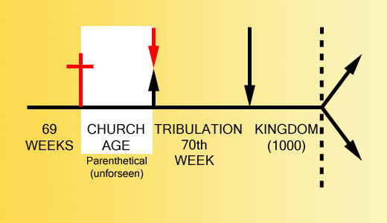

Slide 46
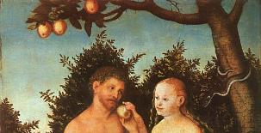
2 Thessalonians 2:3, 7
“…the man of lawlessness is revealed, the son of destruction…For the mystery of lawlessness is already at work; only he who now restrains will do so until he is taken out of the way.”

Slide 47
1 John 4:3
“and every spirit that does not confess Jesus is not from God; this is the spirit of the antichrist, of which you have heard that it is coming, and now it is already in the world.”

Slide 48
Remaining Questions
Will the Holy Spirit be active during the Tribulation period? NO
Should believers be politically active today? YES
Can we identify the Antichrist today? NO
Has Satan selected an Antichrist for every generation? YES
Will an Antichrist one day arise? YES

Slide 49
Revelation 13:16-18
¹⁶ And he causes all, the small and the great, and the rich and the poor, and the free men and the slaves, to be given a mark on their right hand or on their forehead, ¹⁷ and he provides that no one will be able to buy or to sell, except the one who has the mark, either the name of the beast or the number of his name. ¹⁸ Here is wisdom. Let him who has understanding calculate the number of the beast, for the number is that of a man; and his number is six hundred and sixty-six.

Slide 50
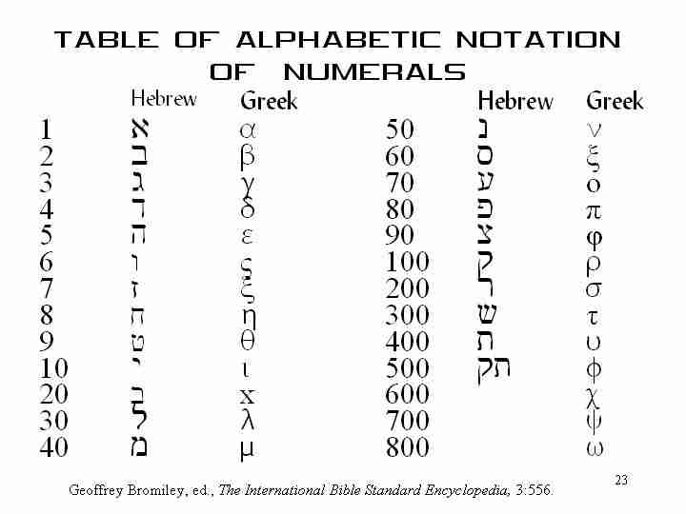

Slide 51
Conclusion

Slide 52
2 Thessalonians 2:1-12
Problem (2:1-2)
Prerequisites for the Day of the Lord (2:3-12)
The departure (2:3a)
Advent of the lawless one (2:3b-4)
Removal of the restrainer (2:5-7)
Destruction of the lawless one (2:8-9)
Destruction of lawless one’s followers (2:10-12)

