Slide 1
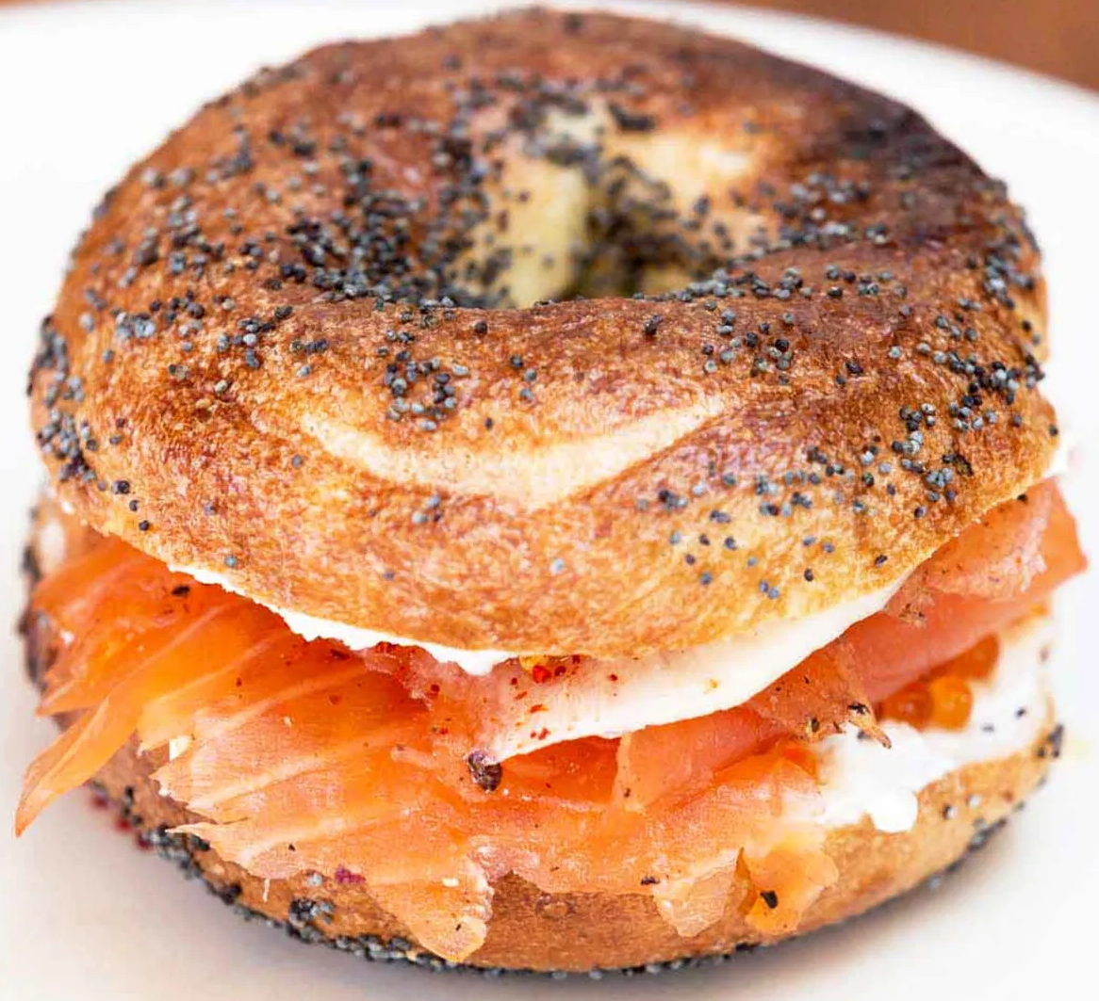
SO, YOU KNOW SOMEBODY JEWISH! NOW WHAT?
OLIVIER MELNICK
SHALOM IN MESSIAH MINISTRIES

Slide 2
JEWISH PEOPLE EXIST ON A VERY WIDE SPECTRUM

Slide 3
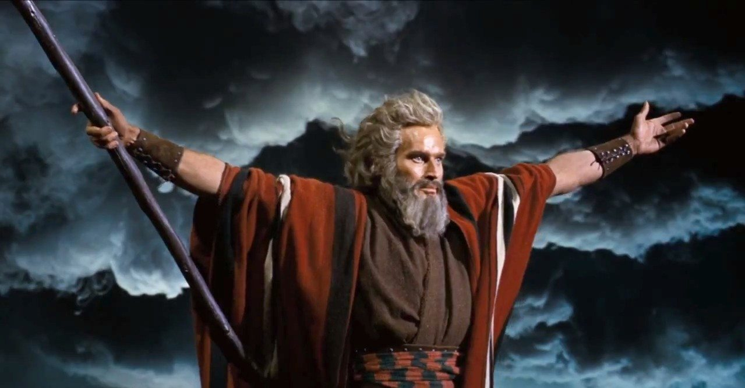
MOSES

Slide 4
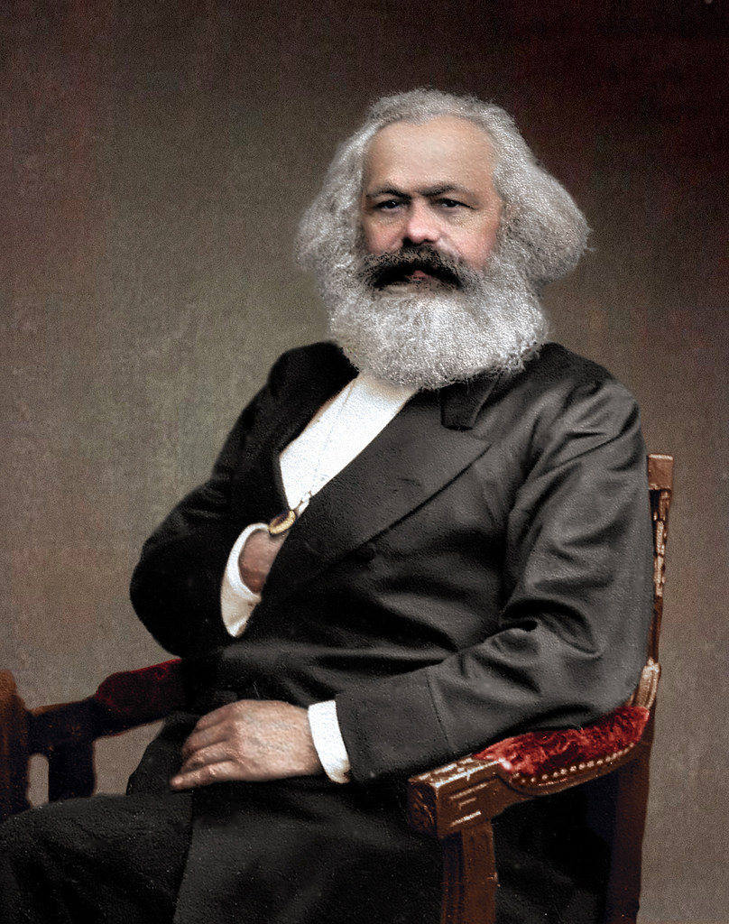
KARL MARX
MOSES

Slide 5
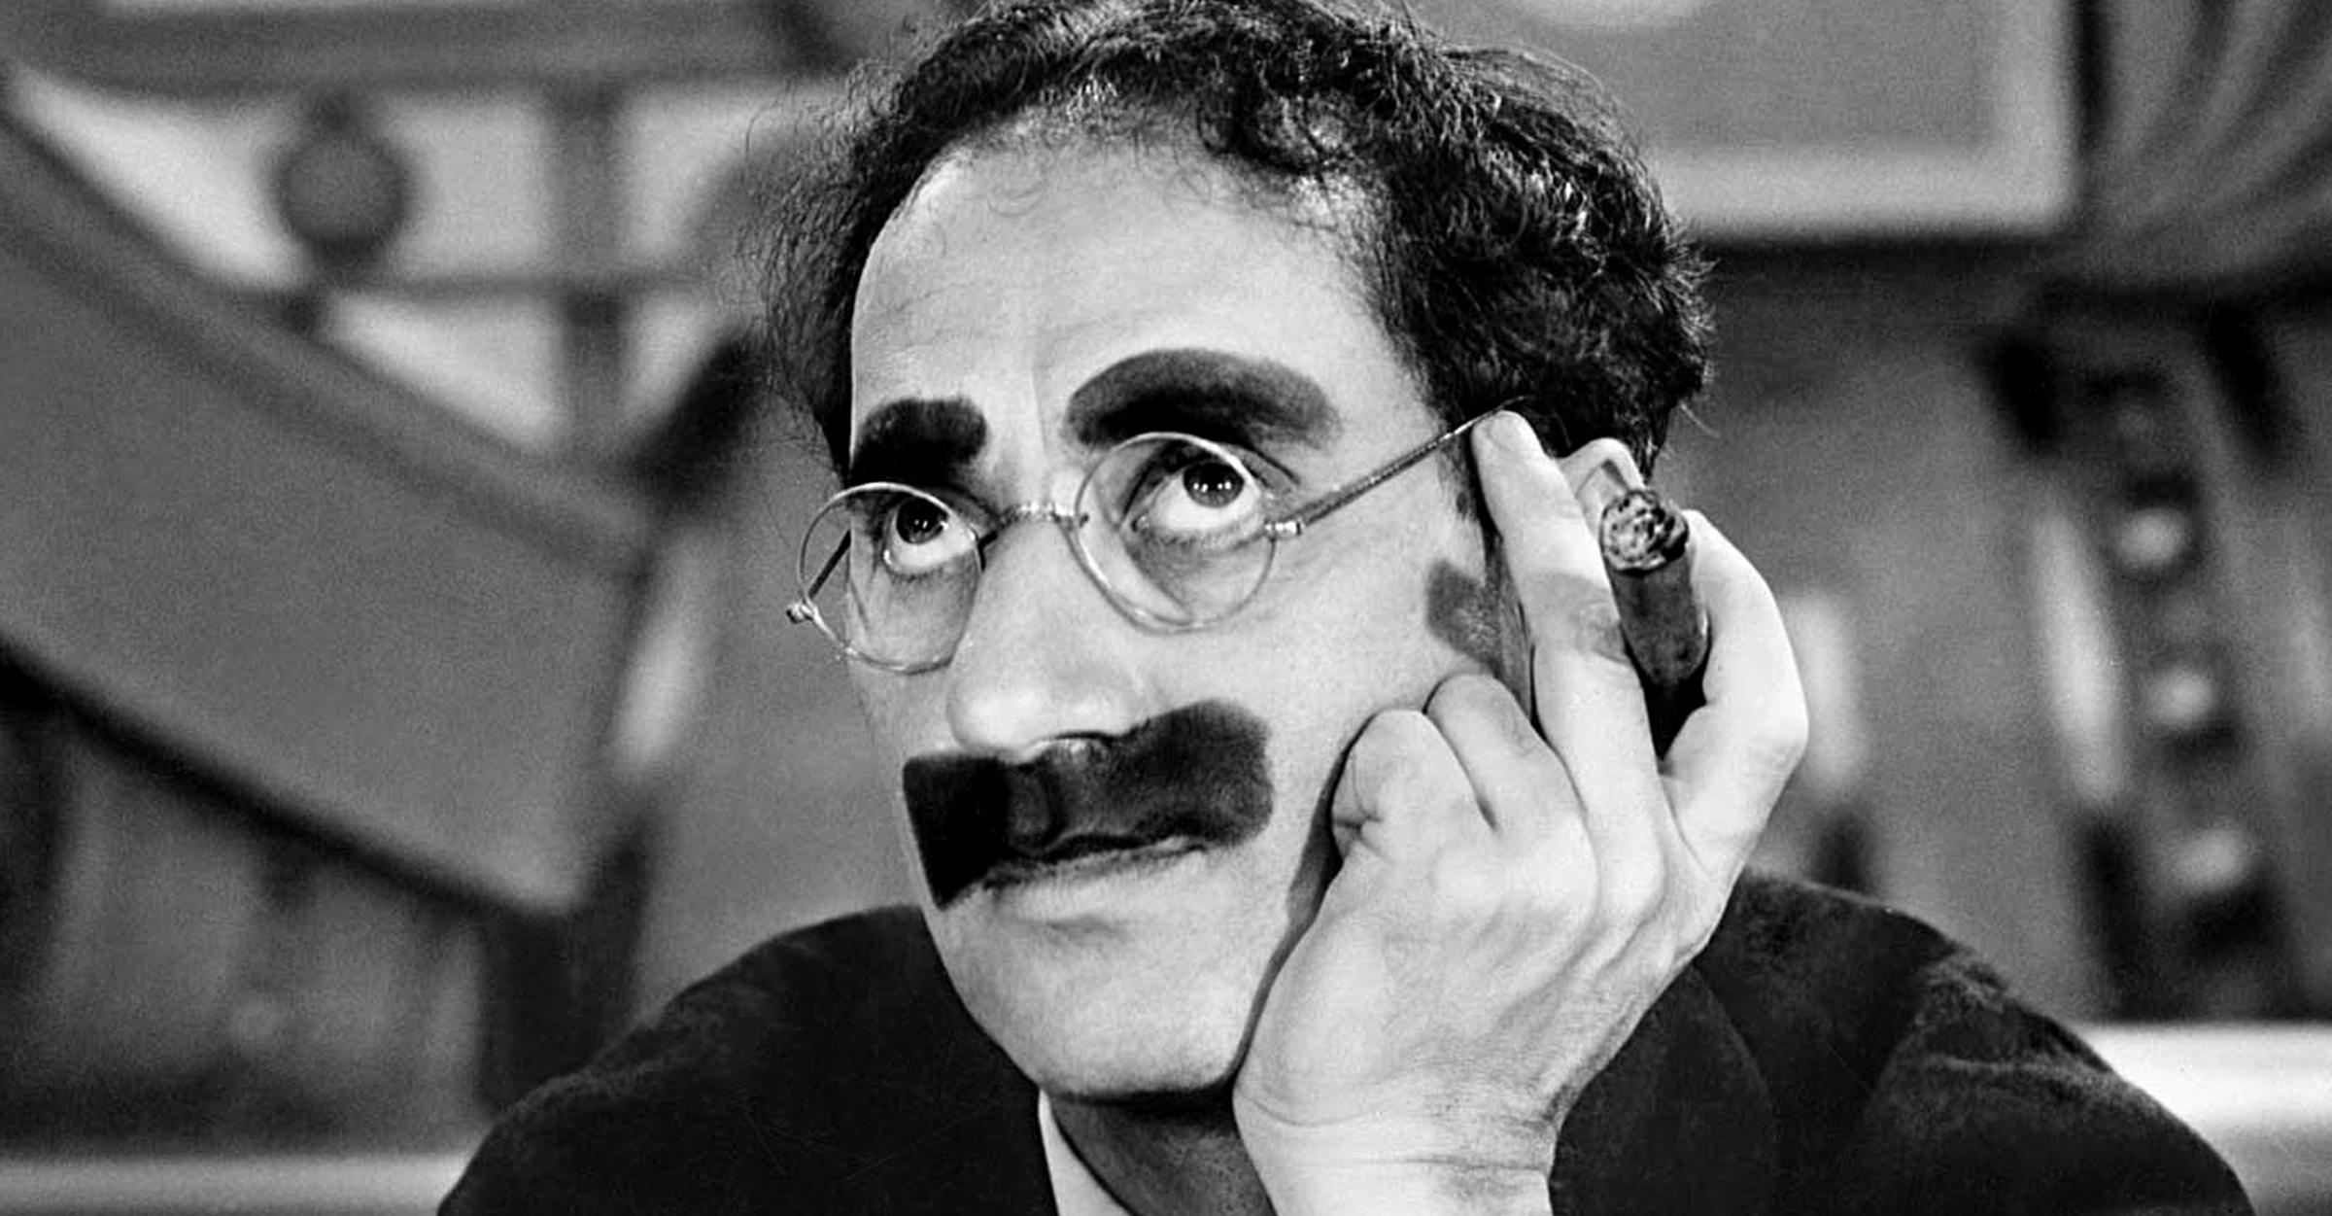
GROUCHO
MOSES
KARL MARX

Slide 6
RUTH BADER GINSBURG
MOSES
KARL MARX
GROUCHO

Slide 7
RUTH BADER GINSBURG
MOSES
KARL MARX
GOLDA MEIR
GROUCHO

Slide 8
THE MOST FAMOUS JEW OF ALL TIMES!

Slide 9
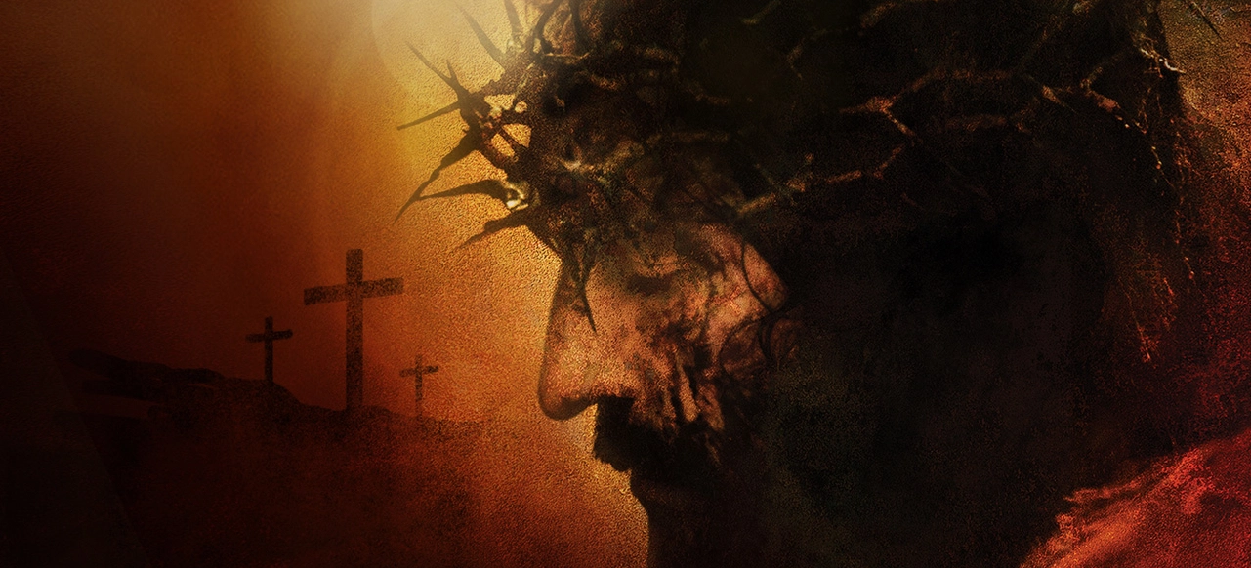
YESHUA OF NAZARETH
THE MOST FAMOUS JEW OF ALL TIMES!

Slide 10
TOP TEN BEST-KEPT SECRETS ABOUT THE JEWISH PEOPLE
1: THE JEWISH PEOPLE ARE THE CHOSEN PEOPLE.
Deuteronomy 7:6-8
6 For you are a holy people to the LORD your God; the LORD your God has chosen you to be a people for His own possession out of all the peoples who are on the face of the earth.

Slide 11
TOP TEN BEST-KEPT SECRETS ABOUT THE JEWISH PEOPLE
7 “The LORD did not set His love on you nor choose you because you were more in number than any of the peoples, for you were the fewest of all peoples, 8 but because the LORD loved you and kept the oath which He swore to your forefathers, the LORD brought you out by a mighty hand and redeemed you from the house of slavery, from the hand of Pharaoh king of Egypt.

Slide 12
TOP TEN BEST-KEPT SECRETS ABOUT THE JEWISH PEOPLE
Amos 3:1-2
Hear this word which the LORD has spoken against you, sons of Israel, against the entire family which He brought up from the land of Egypt:
“You only have I chosen among all the families of the earth; Therefore, I will punish you for all your iniquities.”

Slide 13
TOP TEN BEST-KEPT SECRETS ABOUT THE JEWISH PEOPLE
Romans 11:1-2
I say then, God has not rejected His people, has He? May it never be! For I too am an Israelite, a descendant of Abraham, of the tribe of Benjamin. God has not rejected His people whom He foreknew. Or do you not know what the Scripture says in the passage about Elijah, how he pleads with God against Israel?

Slide 14
TOP TEN BEST-KEPT SECRETS ABOUT THE JEWISH PEOPLE
2: THE JEWISH PEOPLE ARE A COVENANT PEOPLE.
Genesis 12:1-3
1 Now the LORD said to Abram, “Go forth from your country, And from your relatives
And from your father’s house, To the land which I will show you;

Slide 15
TOP TEN BEST-KEPT SECRETS ABOUT THE JEWISH PEOPLE
2: THE JEWISH PEOPLE ARE A COVENANT PEOPLE.
2 And I will make you a great nation, And I will bless you, And make your name great; And so you shall be a blessing; 3 And I will bless those who bless you, And the one who curses you I will curse. And in you all the families of the earth will be blessed.”

Slide 16
TOP TEN BEST-KEPT SECRETS ABOUT THE JEWISH PEOPLE
2: THE JEWISH PEOPLE ARE A COVENANT PEOPLE.
• The Abrahamic Covenant promises Abraham Land, Seed, Blessing
• The Land Covenant (Land) – Deut. 29:1-30:20
• The Davidic Covenant (Seed) – 2 Sam. 7:14
• The New Covenant (Blessing) – Jer. 31:31-34
ETERNAL AND UNCONDITIONAL COVENANTS

Slide 17
TOP TEN BEST-KEPT SECRETS ABOUT THE JEWISH PEOPLE
3: ISRAEL WILL NEVER BE DESTROYED
Jer. 31:35-37
Thus says the LORD, Who gives the sun for light by day And the fixed order of the moon and the stars for light by night, Who stirs up the sea so that its waves roar; The LORD of hosts is His name:

Slide 18
TOP TEN BEST-KEPT SECRETS ABOUT THE JEWISH PEOPLE
3: ISRAEL WILL NEVER BE DESTROYED
Jer. 31:35-37
If this fixed order departs From before Me,” declares the LORD, “Then the offspring of Israel also will cease From being a nation before Me forever.”

Slide 19
TOP TEN BEST-KEPT SECRETS ABOUT THE JEWISH PEOPLE
3: ISRAEL WILL NEVER BE DESTROYED
Jer. 31:35-37
Thus says the LORD, “If the heavens above can be measured And the foundations of the earth searched out below, Then I will also cast off all the offspring of Israel For all that they have done,” declares the LORD.

Slide 20
TOP TEN BEST-KEPT SECRETS ABOUT THE JEWISH PEOPLE
4: AT LEAST 85% OF JEWISH PEOPLE ARE NOT RELIGIOUS
• 15MM Jewish people in the world.
• 10 /15% are religious/observant.
• Outside of Israel, most Jewish people don’t know Hebrew.
• Many Jewish people don’t expect a Messiah.
• Many Jewish people don’t believe in sin.

Slide 21
TOP TEN BEST-KEPT SECRETS ABOUT THE JEWISH PEOPLE
5: JEWISH PEOPLE DON’T HOLD THE NT AS INSPIRED
• The Jewish Bible is the Old Testament in a different order.
• The Torah, the Nevi’im, the Ketuvim. TNK or Tanach.
• The Talmud (the Mishnah 200 CE and the Gemara 500 CE) constitutes the central text of Rabbinic Judaism.

Slide 22
TOP TEN BEST-KEPT SECRETS ABOUT THE JEWISH PEOPLE
5: JEWISH PEOPLE DON’T HOLD THE NT AS INSPIRED
• Yeshua, the Apostles, Paul and all early believers only used the Tanach to share the Good News.
Luke 24:25-27 And He said to them, “O foolish men and slow of heart to believe in all that the prophets have spoken! Was it not necessary for the Messiah to suffer these things and to enter into His glory?” Then beginning with Moses and with all the prophets, He explained to them the things concerning Himself in all the Scriptures.

Slide 23
TOP TEN BEST-KEPT SECRETS ABOUT THE JEWISH PEOPLE
5: JEWISH PEOPLE DON’T HOLD THE NT AS INSPIRED
• Yeshua, the Apostles, Paul and all early believers only used the Tanach to share the Good News.
Acts 26:22-23 So, having obtained help from God, I stand to this day testifying both to small and great, stating nothing but what the Prophets and Moses said was going to take place; that the Christ was to suffer, and that by reason of His resurrection from the dead He would be the first to proclaim light both to the Jewish people and to the Gentiles.”

Slide 24
TOP TEN BEST-KEPT SECRETS ABOUT THE JEWISH PEOPLE
6: JEWISH PEOPLE DON’T BELIEVE IN THE TRINITY
• Judaism is monotheistic.
• Jewish people believe that Christians worship three gods.
Deuteronomy 6:4
“Hear, O Israel! The Lord is our God, the Lord is one!

Slide 25
TOP TEN BEST-KEPT SECRETS ABOUT THE JEWISH PEOPLE
6: JEWISH PEOPLE DON’T BELIEVE IN THE TRINITY
• Judaism is monotheistic.
• Jewish people believe that Christians worship three gods.
Deuteronomy 6:4 (The Shema)
“Hear, O Israel! The Lord is our God, the Lord is one ! (echad)
ECHAD: COMPOUND UNITY
YACHID: SINGLE UNITY

Slide 26
TOP TEN BEST-KEPT SECRETS ABOUT THE JEWISH PEOPLE
Genesis 2:24
For this reason a man shall leave his father and his mother, and be joined to his wife; and they shall become one (echad) flesh.
ECHAD: COMPOUND UNITY
YACHID: SINGLE UNITY

Slide 27
TOP TEN BEST-KEPT SECRETS ABOUT THE JEWISH PEOPLE
Isaiah 48:12-16
“Listen to Me, O Jacob, even Israel whom I called; I am He, I am the first, I am also the last. 13 “Surely My hand founded the earth, And My right hand spread out the heavens; When I call to them, they stand together. 14 “Assemble, all of you, and listen! Who among them has declared these things?

Slide 28
TOP TEN BEST-KEPT SECRETS ABOUT THE JEWISH PEOPLE
The Lord loves him; he will carry out His good pleasure on Babylon, And His arm will be against the Chaldeans. 15 “I, even I, have spoken; indeed I have called him, I have brought him, and He will make his ways successful. 16 “Come near to Me, listen to this: From the first I have not spoken in secret, From the time it took place, I was there. And now the Lord God has sent Me, and His Spirit.”

Slide 29
TOP TEN BEST-KEPT SECRETS ABOUT THE JEWISH PEOPLE
7: JEWISH PEOPLE DON’T BELIEVE IN THE GOD/MAN
• Jewish people think that a man became a god, which in Judaism is blasphemous.
• Jewish people who believe in the coming of the Messiah, do not expect a divine Messiah but a human one anointed by God.

Slide 30
TOP TEN BEST-KEPT SECRETS ABOUT THE JEWISH PEOPLE
Isaiah 9:6-7 For a child will be born to us, a son will be given to us; And the government will rest on His shoulders; And His name will be called Wonderful Counselor, Mighty God, Eternal Father, Prince of Peace. There will be no end to the increase of His government or of peace, On the throne of David and over his kingdom, To establish it and to uphold it with justice and righteousness From then on and forever-more. The zeal of the Lord of hosts will accomplish this.

Slide 31
TOP TEN BEST-KEPT SECRETS ABOUT THE JEWISH PEOPLE
•Wonderful Counselor, Mighty God, Eternal Father, Prince of Peace.
PELE: Wonderful. ONLY USED OF GOD, NEVER OF MAN

Slide 32
TOP TEN BEST-KEPT SECRETS ABOUT THE JEWISH PEOPLE
8: JEWISH PEOPLE BELIEVE THAT ALL GENTILES ARE CHRISTIANS
• To a Jewish person, whoever is not Jewish is Christian. A Gentile and a Christian means the same thing.

Slide 33
TOP TEN BEST-KEPT SECRETS ABOUT THE JEWISH PEOPLE
FOLLOWING THAT LOGIC:

Slide 34
TOP TEN BEST-KEPT SECRETS ABOUT THE JEWISH PEOPLE
FOLLOWING THAT LOGIC:

Slide 35
TOP TEN BEST-KEPT SECRETS ABOUT THE JEWISH PEOPLE
FOLLOWING THAT LOGIC:

Slide 36
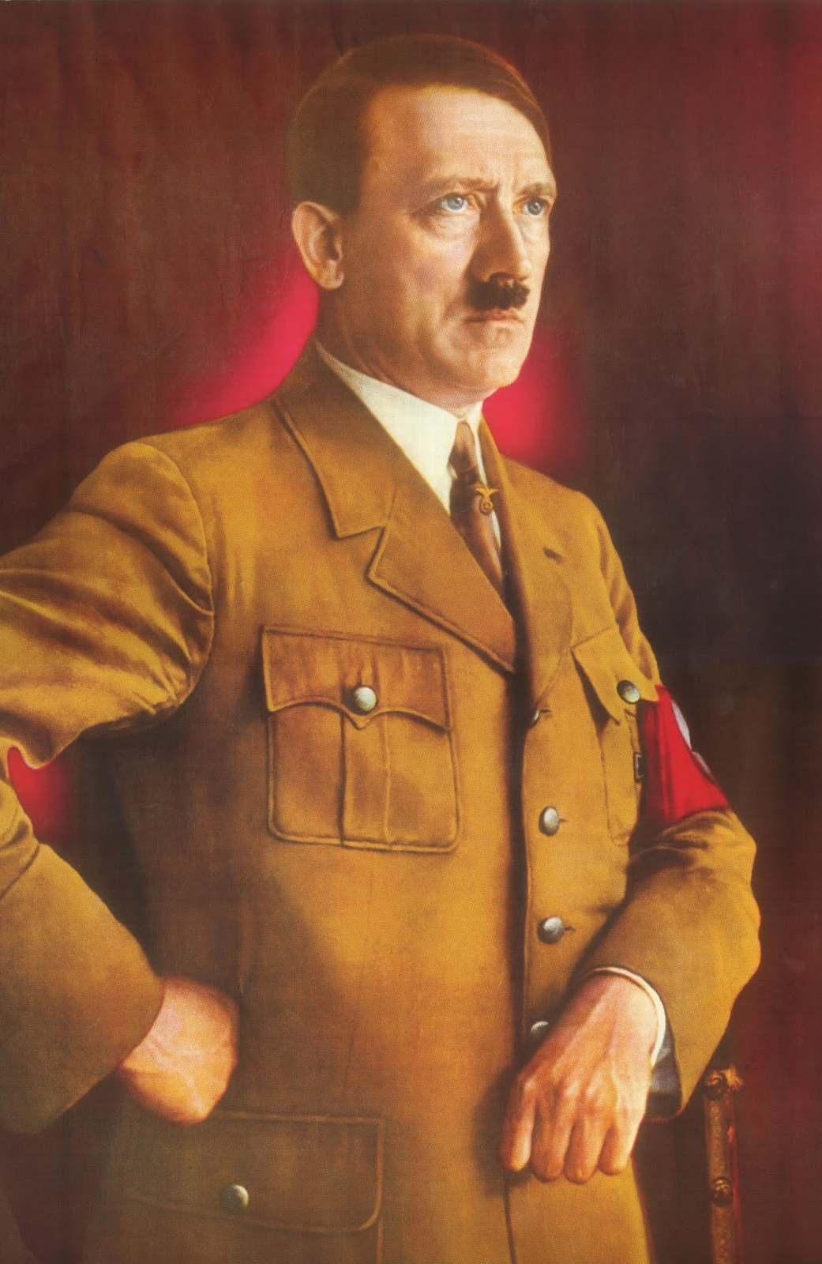
TOP TEN BEST-KEPT SECRETS ABOUT THE JEWISH PEOPLE
FOLLOWING THAT LOGIC:

Slide 37
TOP TEN BEST-KEPT SECRETS ABOUT THE JEWISH PEOPLE
FOLLOWING THAT LOGIC:
These
Three men
Are all
Christians.

Slide 38
TOP TEN BEST-KEPT SECRETS ABOUT THE JEWISH PEOPLE
9: JEWISH PEOPLE CONFUSE
JEWISHNESS AND JUDAISM
• JEWISHNESS: An ethnic condition received at birth that nothing can change. Nothing can be done to loose it or gain it.

Slide 39
TOP TEN BEST-KEPT SECRETS ABOUT THE JEWISH PEOPLE
9: JEWISH PEOPLE CONFUSE JEWISHNESS AND JUDAISM
• JUDAISM: Is a religion that can be practiced by anyone, regardless of their Jewish origins. It doesn’t really make one into a Jew, at least, not ethnically.

Slide 40
TOP TEN BEST-KEPT SECRETS ABOUT THE JEWISH PEOPLE
Ruth 1:4 They took for themselves
Moabite women as wives; the name of the one was Orpah and the name of the other Ruth.

Slide 41
TOP TEN BEST-KEPT SECRETS ABOUT THE JEWISH PEOPLE
Ruth 1:16-17 But Ruth said, “Do not urge me to leave you or turn back from following you; for where you go, I will go, and where you lodge, I will lodge. Your people shall be my people, and your God, my God. 17 Where you die, I will die, and there I will be buried. Thus may the Lord do to me, and worse, if anything but death parts you and me.”

Slide 42
TOP TEN BEST-KEPT SECRETS ABOUT THE JEWISH PEOPLE
Ruth 1:22 So Naomi returned, and with her Ruth the Moabitess, her daughter-in-law, who returned from the land of Moab. And they came to Bethlehem at the beginning of barley harvest.
Ruth 4:5 Then Boaz said, “On the day you buy the field from the hand of Naomi, you must also acquire Ruth the Moabitess, the widow of the deceased, in order to raise up the name of the deceased on his inheritance.”

Slide 43
TOP TEN BEST-KEPT SECRETS ABOUT THE JEWISH PEOPLE
10: MOST JEWISH PEOPLE BELIEVE THAT CHRISTIANS ARE ANTISEMITIC
• Christianity has a very bad reputation within the global Jewish community.
• Christians bring baggage when they engage in a dialogue with their Jewish friends

Slide 44
TOP TEN BEST-KEPT SECRETS ABOUT THE JEWISH PEOPLE
CHRISTIANS SHOULDN’T IGNORE THE “CHRISTIAN BAGGAGE”
WHEN THEY SPEAK TO JEWISH PEOPLE

Slide 45
SO, YOU KNOW SOMEBODY JEWISH! NOW WHAT?
• THE PLACE OF ISRAEL AND THE JEWISH PEOPLE IN THE BIBLE IS CENTRAL.
• THAT GOD WILL NEVER RENEGE ON ISRAEL.
• MOST JEWISH PEOPLE ARE NOT RELIGIOUS.
• JEWISH PEOPLE DON’T BELIEVE IN THE NEW TESTAMENT.
• JEWISH PEOPLE DON’T BELIEVE IN THE TRINITY.
• JEWISH PEOPLE DON’T BELIEVE IN THE GOD/MAN.
• MOST JEWISH PEOPLE THINK CHRISTIANS ARE ANTISEMITIC.
• JEWISH PEOPLE CONFUSE GENTILES AND CHRISTIANS.
• JEWISHNESS IS DIFFERENT FROM JUDAISM.

Slide 46
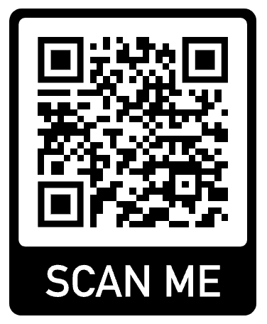
Olivier@SHALOMINMESSIAH.com
www. SHALOMINMESSIAH.com

