Slide 1
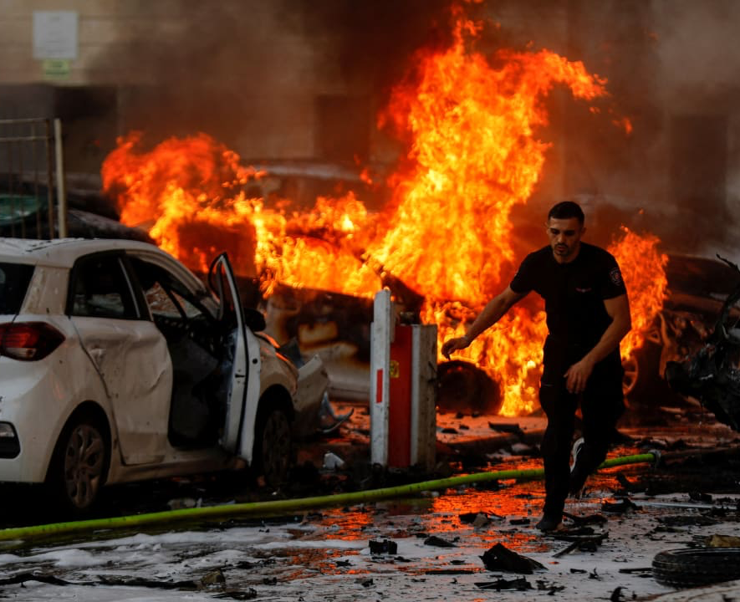
HAMAS/ISRAEL 2023 WAR
WHAT CHANGED AFTER
OCTOBER 7, 2023
OLIVIER MELNICK, SHALOM IN MESSIAH

Slide 2
On October 7, 2023, Hamas launched a major terrorist attack from the Gaza Strip into Israel. It turned out to be the heaviest Jewish death toll since the HOLOCAUST!

Slide 3
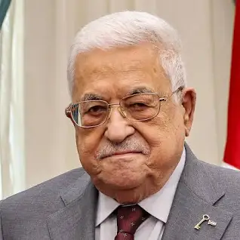
WHO IS HAMAS? Hamas took over Gaza Strip in 2006 Elections
Hamas: 44.45% (Ismail Haniyeh)
Fatah: 41.43% (Mahmoud Abbas)

Slide 4
WHO IS HAMAS? Islamic Resistance Movement (حركة المقاومة الإسلامية ) Ḥarakah al-Muqāwamah al-ʾIslāmiyyah. • Makes the Acronym HMS spelled HaMaS • It was created in 1988 as a chapter of the Muslim Brotherhood (Created in 1928). • The MB slogan: "Allah is our objective. The Prophet is our leader. Qur'an is our law. Jihad is our way. Dying in the way of Allah is our highest hope."

Slide 5
WHO IS HAMAS? • Article 8: The 1988 Hamas Charter reiterates the MB slogan. • Article 13: “There is no negotiated settlement possible. Jihad is the only answer.” • Article 21: Claims Jewish influence over the whole world. • Article 32: Promotes the 1904 hoax “The Protocols of the Elders of Zion.” • Article 33: Asks Muslims worldwide to unite for the liberation of Palestine.

Slide 6
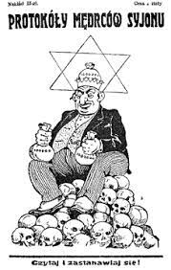
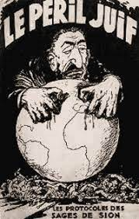
“ The Protocols of the Elders of Zion” claimed that a group of Jewish leaders got together to plot how to control the world, political parties and the banks.

Slide 7
Martin Griffiths serves as the Under-Secretary-General for Humanitarian Affairs and Emergency Relief Coordinator at the United Nations.
HE CLAIMS THAT HAMAS IS NOT A TERRORIST GROUP!
Interview with Australian Channel Sky News, Feb. 2024

Slide 8
HAMAS MEMBERS ARE NOT: POLITICAL ACTIVISTS MILITANTS RESISTANCE FIGHTERS FREEDOM FIGHTERS THEY ARE: TERRORISTS

Slide 9
TERRORISTS THRIVE ON FALSE NARRATIVES HISTORICAL REVISIONISM THEY COUNT ON PEOPLE’S IGNORANCE OF HISTORY

Slide 10
HAMAS CLAIMS: THAT ISRAEL IS PALESTINIAN LAND STOLEN AND OCCUPIED BY JEWS. THE TRUTH ABOUT PALESTINIAN IDENTITY!

Slide 11
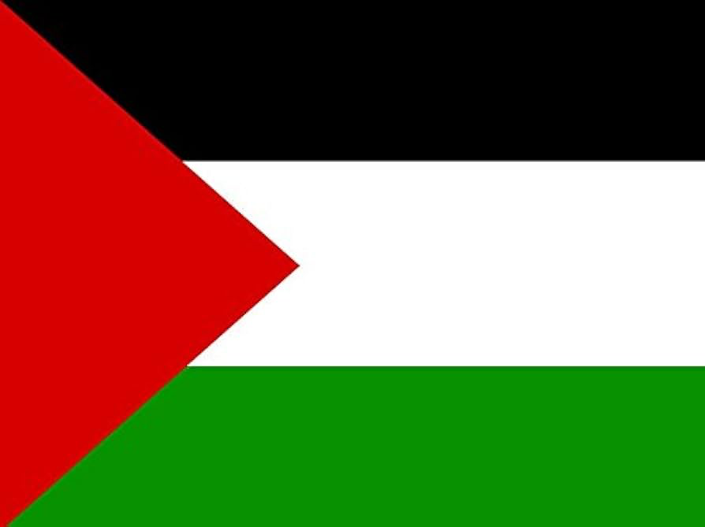
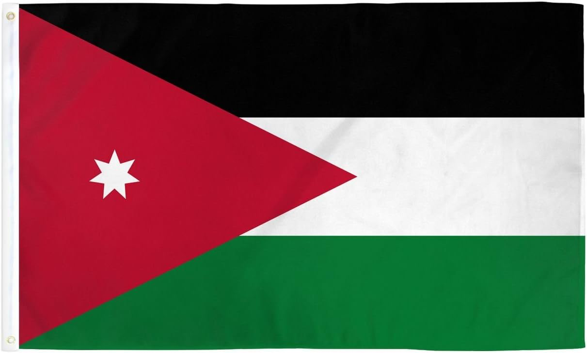
THE MODERN PALESTINIAN FLAG

Slide 12
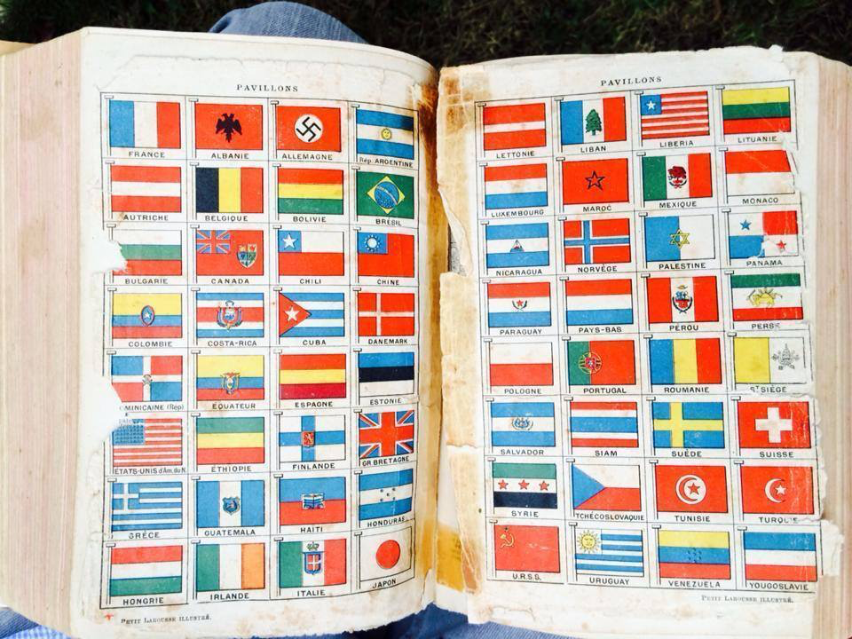
THE PREVIOUS PALESTINIAN FLAG
FRENCH LAROUSSE DICTIONARY 1939 Ed.

Slide 13
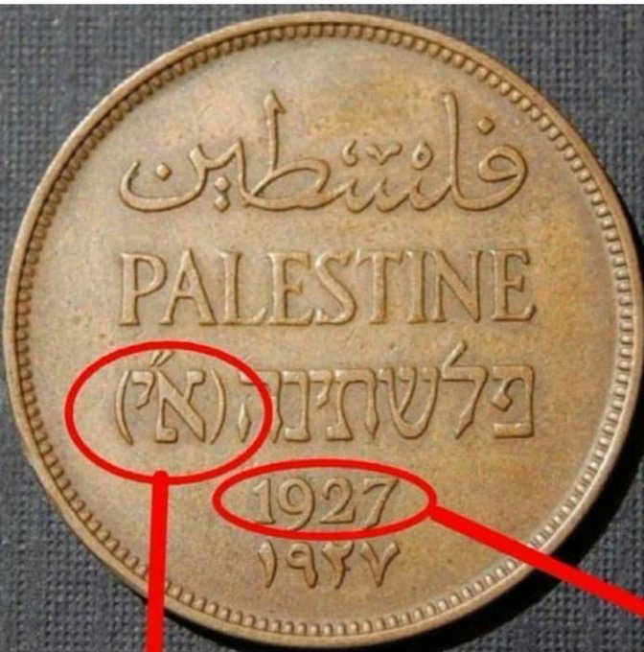
21 YEARS BEFORE ISRAEL BECAME A MODERN NATION
ERETZ YISRAEL

Slide 14
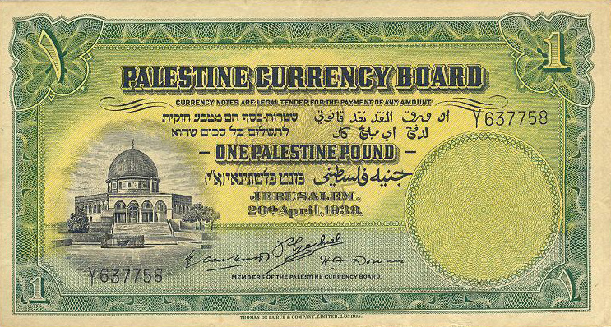
9 YEARS BEFORE ISRAEL BECAME A MODERN NATION
ERETZ YISRAEL

Slide 15
HAMAS/ISRAEL 2023 WHAT IT IS AND WHAT IT IS NOT!

Slide 16
HAMAS/ISRAEL 2023 IS IT THE START OF THE PSALM 83 WAR? Psalm 83:2-5 For behold, Your enemies make an uproar, And those who hate You have exalted themselves. ³ They make shrewd plans against Your people And conspire together against Your treasured ones. ⁴ They have said, “Come, and let us wipe them out as a nation, That the name of Israel be remembered no more.” ⁵ For they have conspired together with one mind; Against You they make a covenant.

Slide 17
HAMAS/ISRAEL 2023 IS IT THE START OF THE PSALM 83 WAR? Psalm 83:6-8 The tents of Edom and the Ishmaelites, Moab and the Hagrites; Gebal and Ammon and Amalek, Philistia with the inhabitants of Tyre; Assyria also has joined with them; They have become a help to the children of Lot.

Slide 18
HAMAS/ISRAEL 2023 IS IT THE START OF THE PSALM 83 WAR?
JORDAN: EDOM • MOAB •AMMON
SAUDI ARABIA: ISHMAELITES
EGYPT: HAGARENES • AMALEK
LEBANON: GEBAL • TYRE
THE GAZA STRIP: PHILISTIA
IRAQ, SYRIA: ASSYRIA

Slide 19
HAMAS/ISRAEL 2023 IS IT THE START OF THE PSALM 83 WAR? • Never all 10 countries before. • Egypt and Jordan are currently at peace with Israel. • A literary device by Asaph akin to saying, “The whole world is against us!”

Slide 20
HAMAS/ISRAEL 2023 IS NOT THE PSALM 83 WAR

Slide 21
HAMAS/ISRAEL 2023 IS IT THE START OF THE GOG AND MAGOG WAR? • 10 proper names (Ezekiel 38:1-7) Gog (a person), Magog (former Soviet Union), Rosh (Russia), Meshech and Tubal (Turkey), Persia (Iran), Ethiopia (Sudan), Put (Libya), Gomer (Central Turkey), Beth-Togarmah (Turkey).

Slide 22
HAMAS/ISRAEL 2023 IS IT THE START OF THE GOG AND MAGOG WAR? • In the context of Ezekiel, chapters 36 and 37 speak of the regathering of Israel in the Land, both physical and spiritual and chapters 40 through 48 speaks of the worship in the millennial Temple.

Slide 23
HAMAS/ISRAEL 2023 IS IT THE START OF THE GOG AND MAGOG WAR? Ezekiel 38:8 After many days you will be summoned; in the latter years you will come into the land that is restored from the sword, whose inhabitants have been gathered from many nations to the mountains of Israel which had been a continual waste; but its people were brought out from the nations, and they are living securely, all of them.

Slide 24
HAMAS/ISRAEL 2023 IS IT THE START OF THE GOG AND MAGOG WAR? Ezekiel 38:11 and you will say, ‘I will go up against the land of unwalled villages. I will go against those who are at rest, that live securely, all of them living without walls and having no bars or gates.

Slide 25
HAMAS/ISRAEL 2023 IS IT THE START OF THE GOG AND MAGOG WAR? Ezekiel 38:14 “Therefore prophesy, son of man, and say to Gog, ‘Thus says the Lord God, “On that day when My people Israel are living securely, will you not know it?

Slide 26
HAMAS/ISRAEL 2023 IS IT THE START OF THE GOG AND MAGOG WAR? The preferred timing is after the Rapture when Israel has signed a peace treaty with the Antichrist and the half point of the Tribulation before he desecrates the Temple in Jerusalem.

Slide 27
HAMAS/ISRAEL 2023 THE PURPOSE OF THE GOG AND MAGOG WAR? • Land grab (Ezekiel 38:8) • Wealth acquisition (Ezekiel 38:12) • Antisemitism (Ezekiel 38:10, 16) • God will be sanctified (Ezekiel 38:16)

Slide 28
HAMAS/ISRAEL 2023 IS NOT THE WAR OF GOG AND MAGOG

Slide 29
HAMAS/ISRAEL 2023 IS IT THE BEGINNING OF THE GREAT TRIBULATION? • The Rapture of the Saints (1 Thessalonians 4:13-17; 1 Corinthians 15:51-52) • The signing of a peace treaty between the Antichrist and Israel (Daniel 9:27)

Slide 30
HAMAS/ISRAEL 2023 IS NOT THE BEGINNING OF THE GREAT TRIBULATION

Slide 31
HAMAS/ISRAEL 2023 COULD IT BE THE SETTING OF THE STAGE FOR THE PROPHECIES OF ZECHARIAH 12?

Slide 32
Zechariah 12:1-3 The burden of the word of the Lord concerning Israel. Thus declares the Lord who stretches out the heavens, lays the foundation of the earth, and forms the spirit of man within him, ² “Behold, I am going to make Jerusalem a cup that causes reeling to all the peoples around; and when the siege is against Jerusalem, it will also be against Judah. ³ It will come about in that day that I will make Jerusalem a heavy stone for all the peoples; all who lift it will be severely injured. And all the nations of the earth will be gathered against it.

Slide 33
GOD IS NOT SURPRISED OR POWERLESS Zechariah 12:3 And all the nations of the earth will be gathered against it. Zechariah 12:9 And in that day I will set about to destroy all the nations that come against Jerusalem.

Slide 34
HAMAS/ISRAEL 2023 COULD BE THE SETTING OF THE STAGE FOR THE PROPHECIES OF ZECHARIAH 12

Slide 35
HAMAS/ISRAEL 2023 WHAT IT IS!

Slide 36
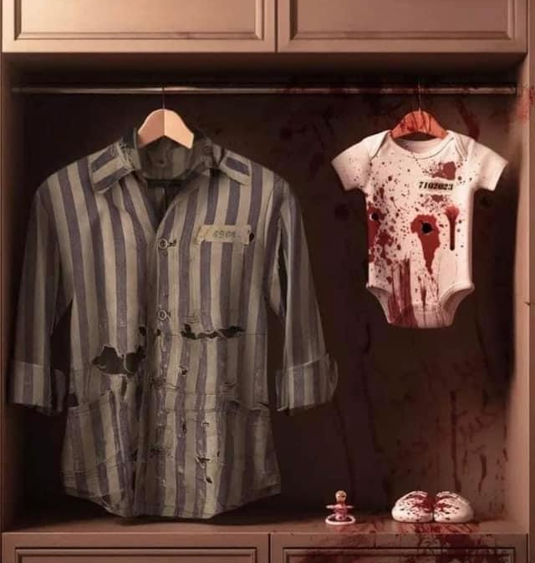
HAMAS/ ISRAEL 2023 HEAVIEST JEWISH DEATH TOLL SINCE THE HOLOCAUST!

Slide 37
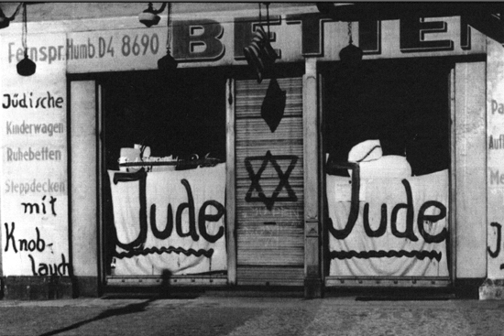
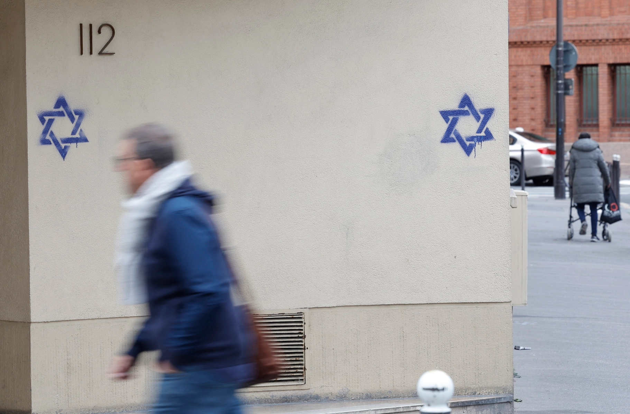
NOW!
1938
THEN
2023

Slide 38
CAUTION!!! NEXT TWO SLIDES ARE VERY GRAPHIC

Slide 39
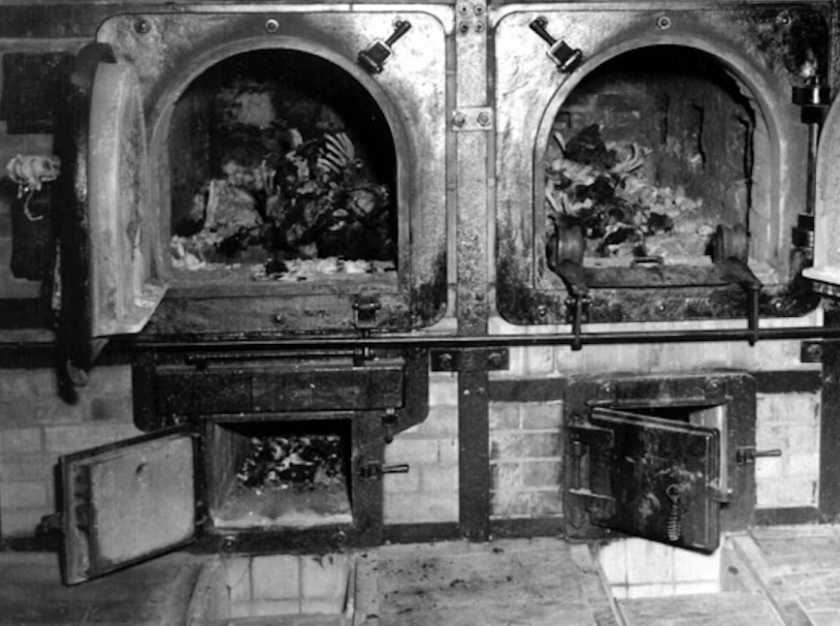
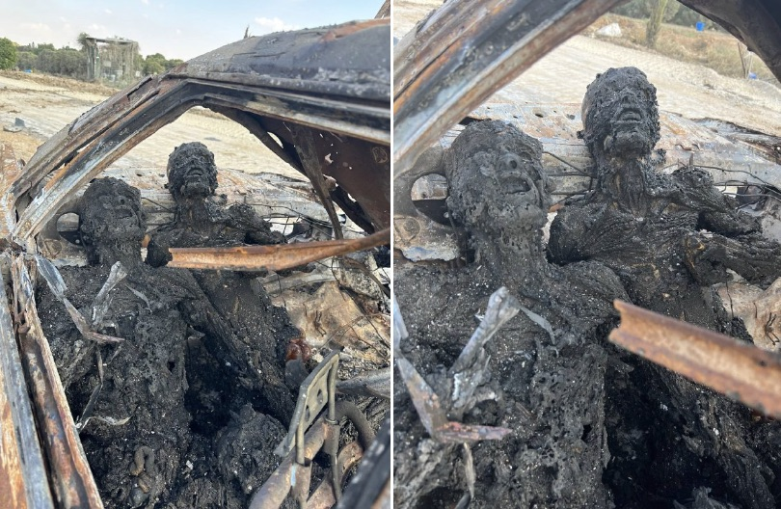
NOW!
1943
THEN
2023

Slide 40
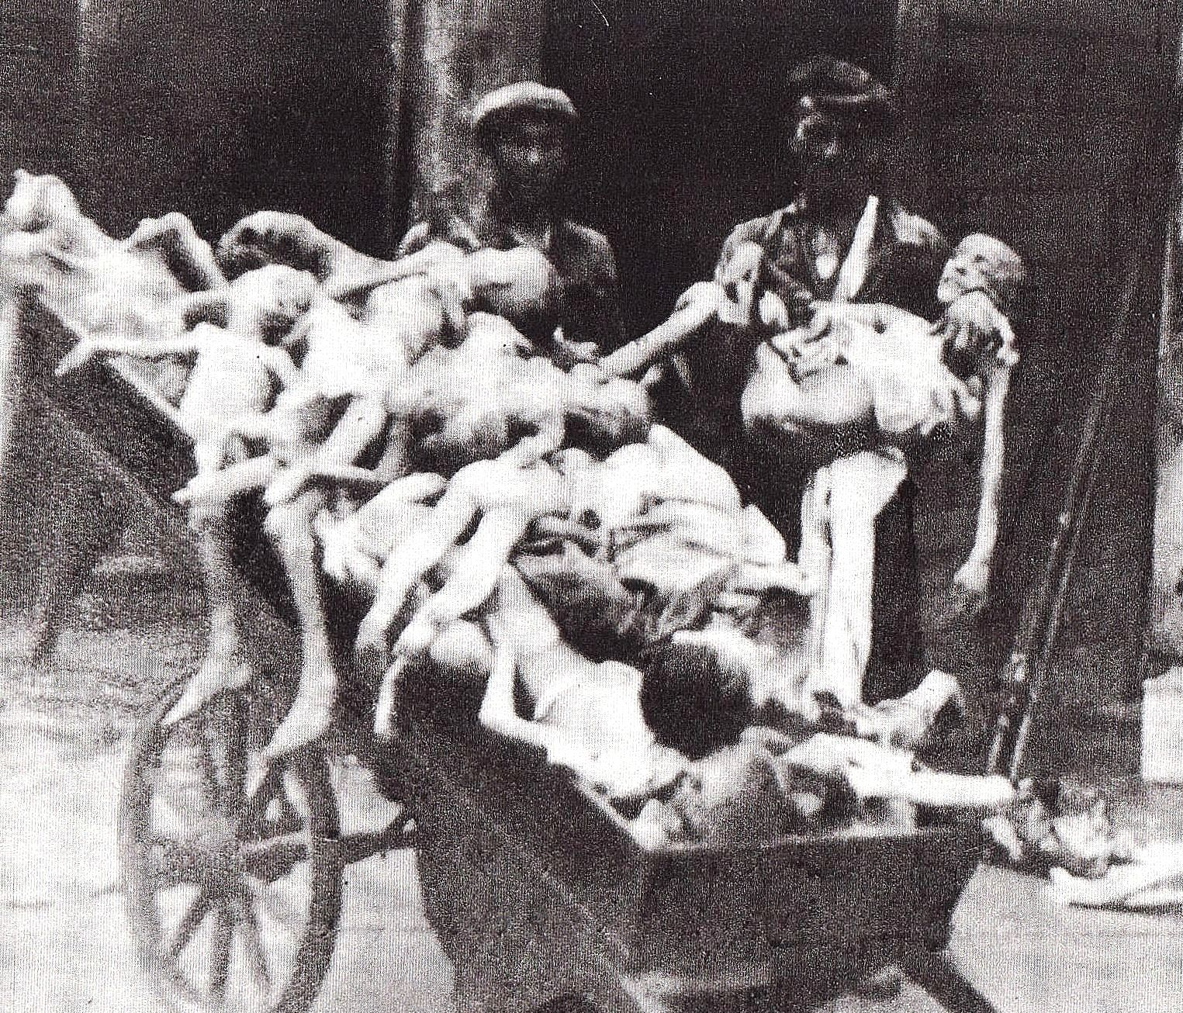
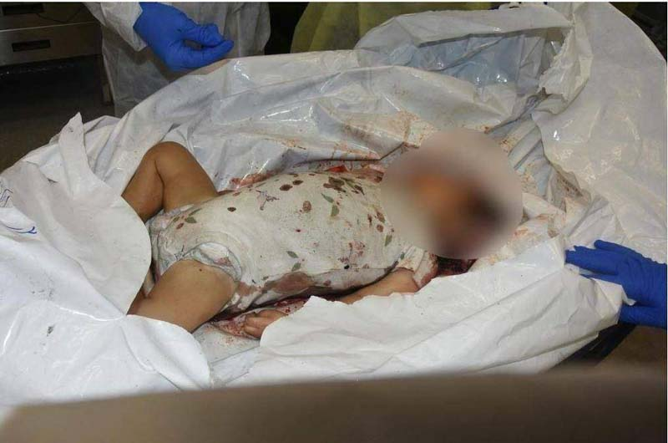
NOW!
1946
THEN
2023

Slide 41
HAMAS COMMITTED • GENOCIDE • ETHNIC CLEANSING • CRIMES AGAINST HUMANITY

Slide 42
HAMAS COMMITTED • A POGROM: “an organized massacre of a particular ethnic group.” This was exactly what took place on October 7, 2023.

Slide 43
GLOBAL ANTISEMITISM HAS BEEN UNLEASHED WITH AN UNPRECEDENTED DESTRUCTIVE AGENDA

Slide 44
Global Antisemitic Incidents ARE UP in the Wake of Hamas’ War on Israel
• USA: 500%
• UK: Up 1300%
• Austria: Up 300%
• Germany: Up 240%
ADL.org

Slide 45
“FROM THE RIVER TO THE SEA
PALESTINE SHALL BE FREE!”
• A EUPHEMISM
FOR THE
COMPLETE
ANNIHILATION
OF ALL JEWISH
PEOPLE

Slide 46
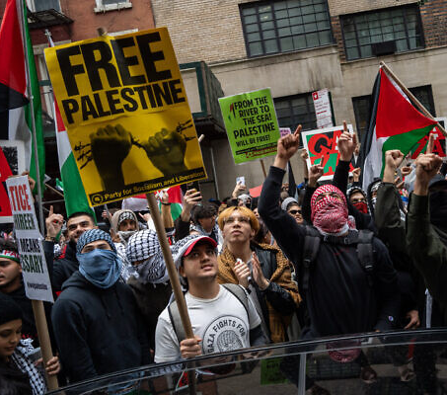
HAMAS’ POGROM UNLEASHED ANTISEMITISM ON A GLOBAL SCALE
NEW YORK

Slide 47
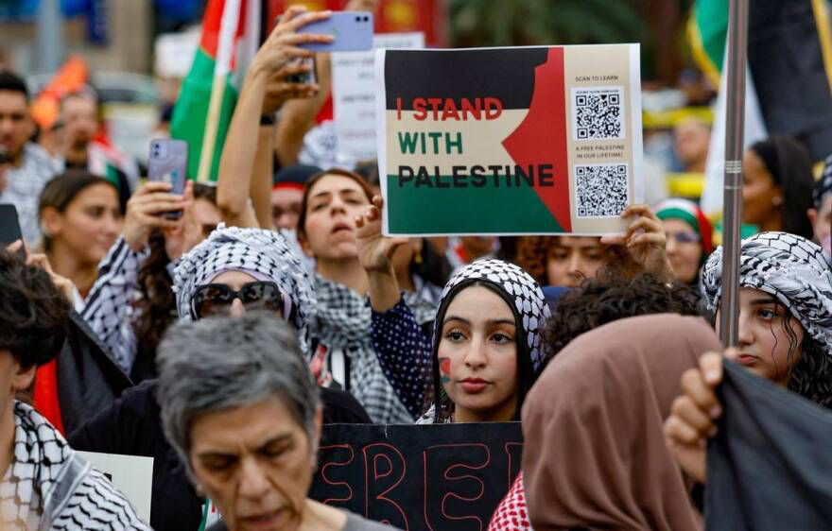
HAMAS’ POGROM UNLEASHED ANTISEMITISM ON A GLOBAL SCALE
SOUTH FLORIDA

Slide 48
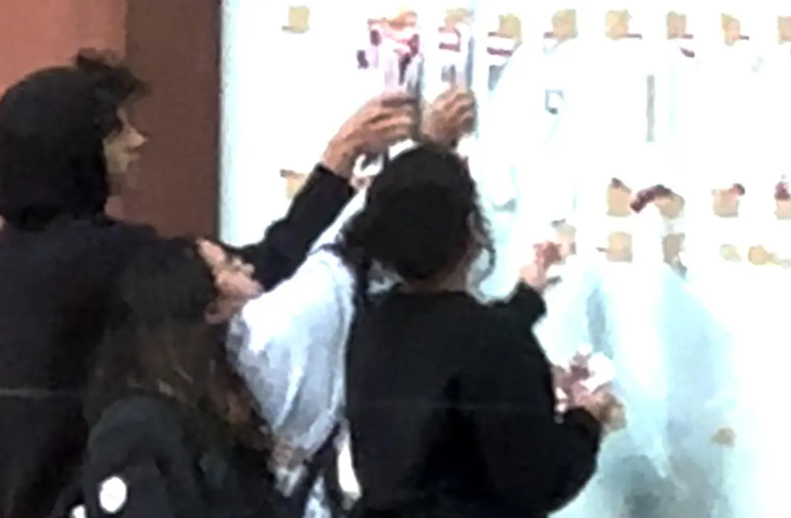
NYU STUDENTS TEARING DOWN FLYERS OF ISRAELI HOSTAGES

Slide 49
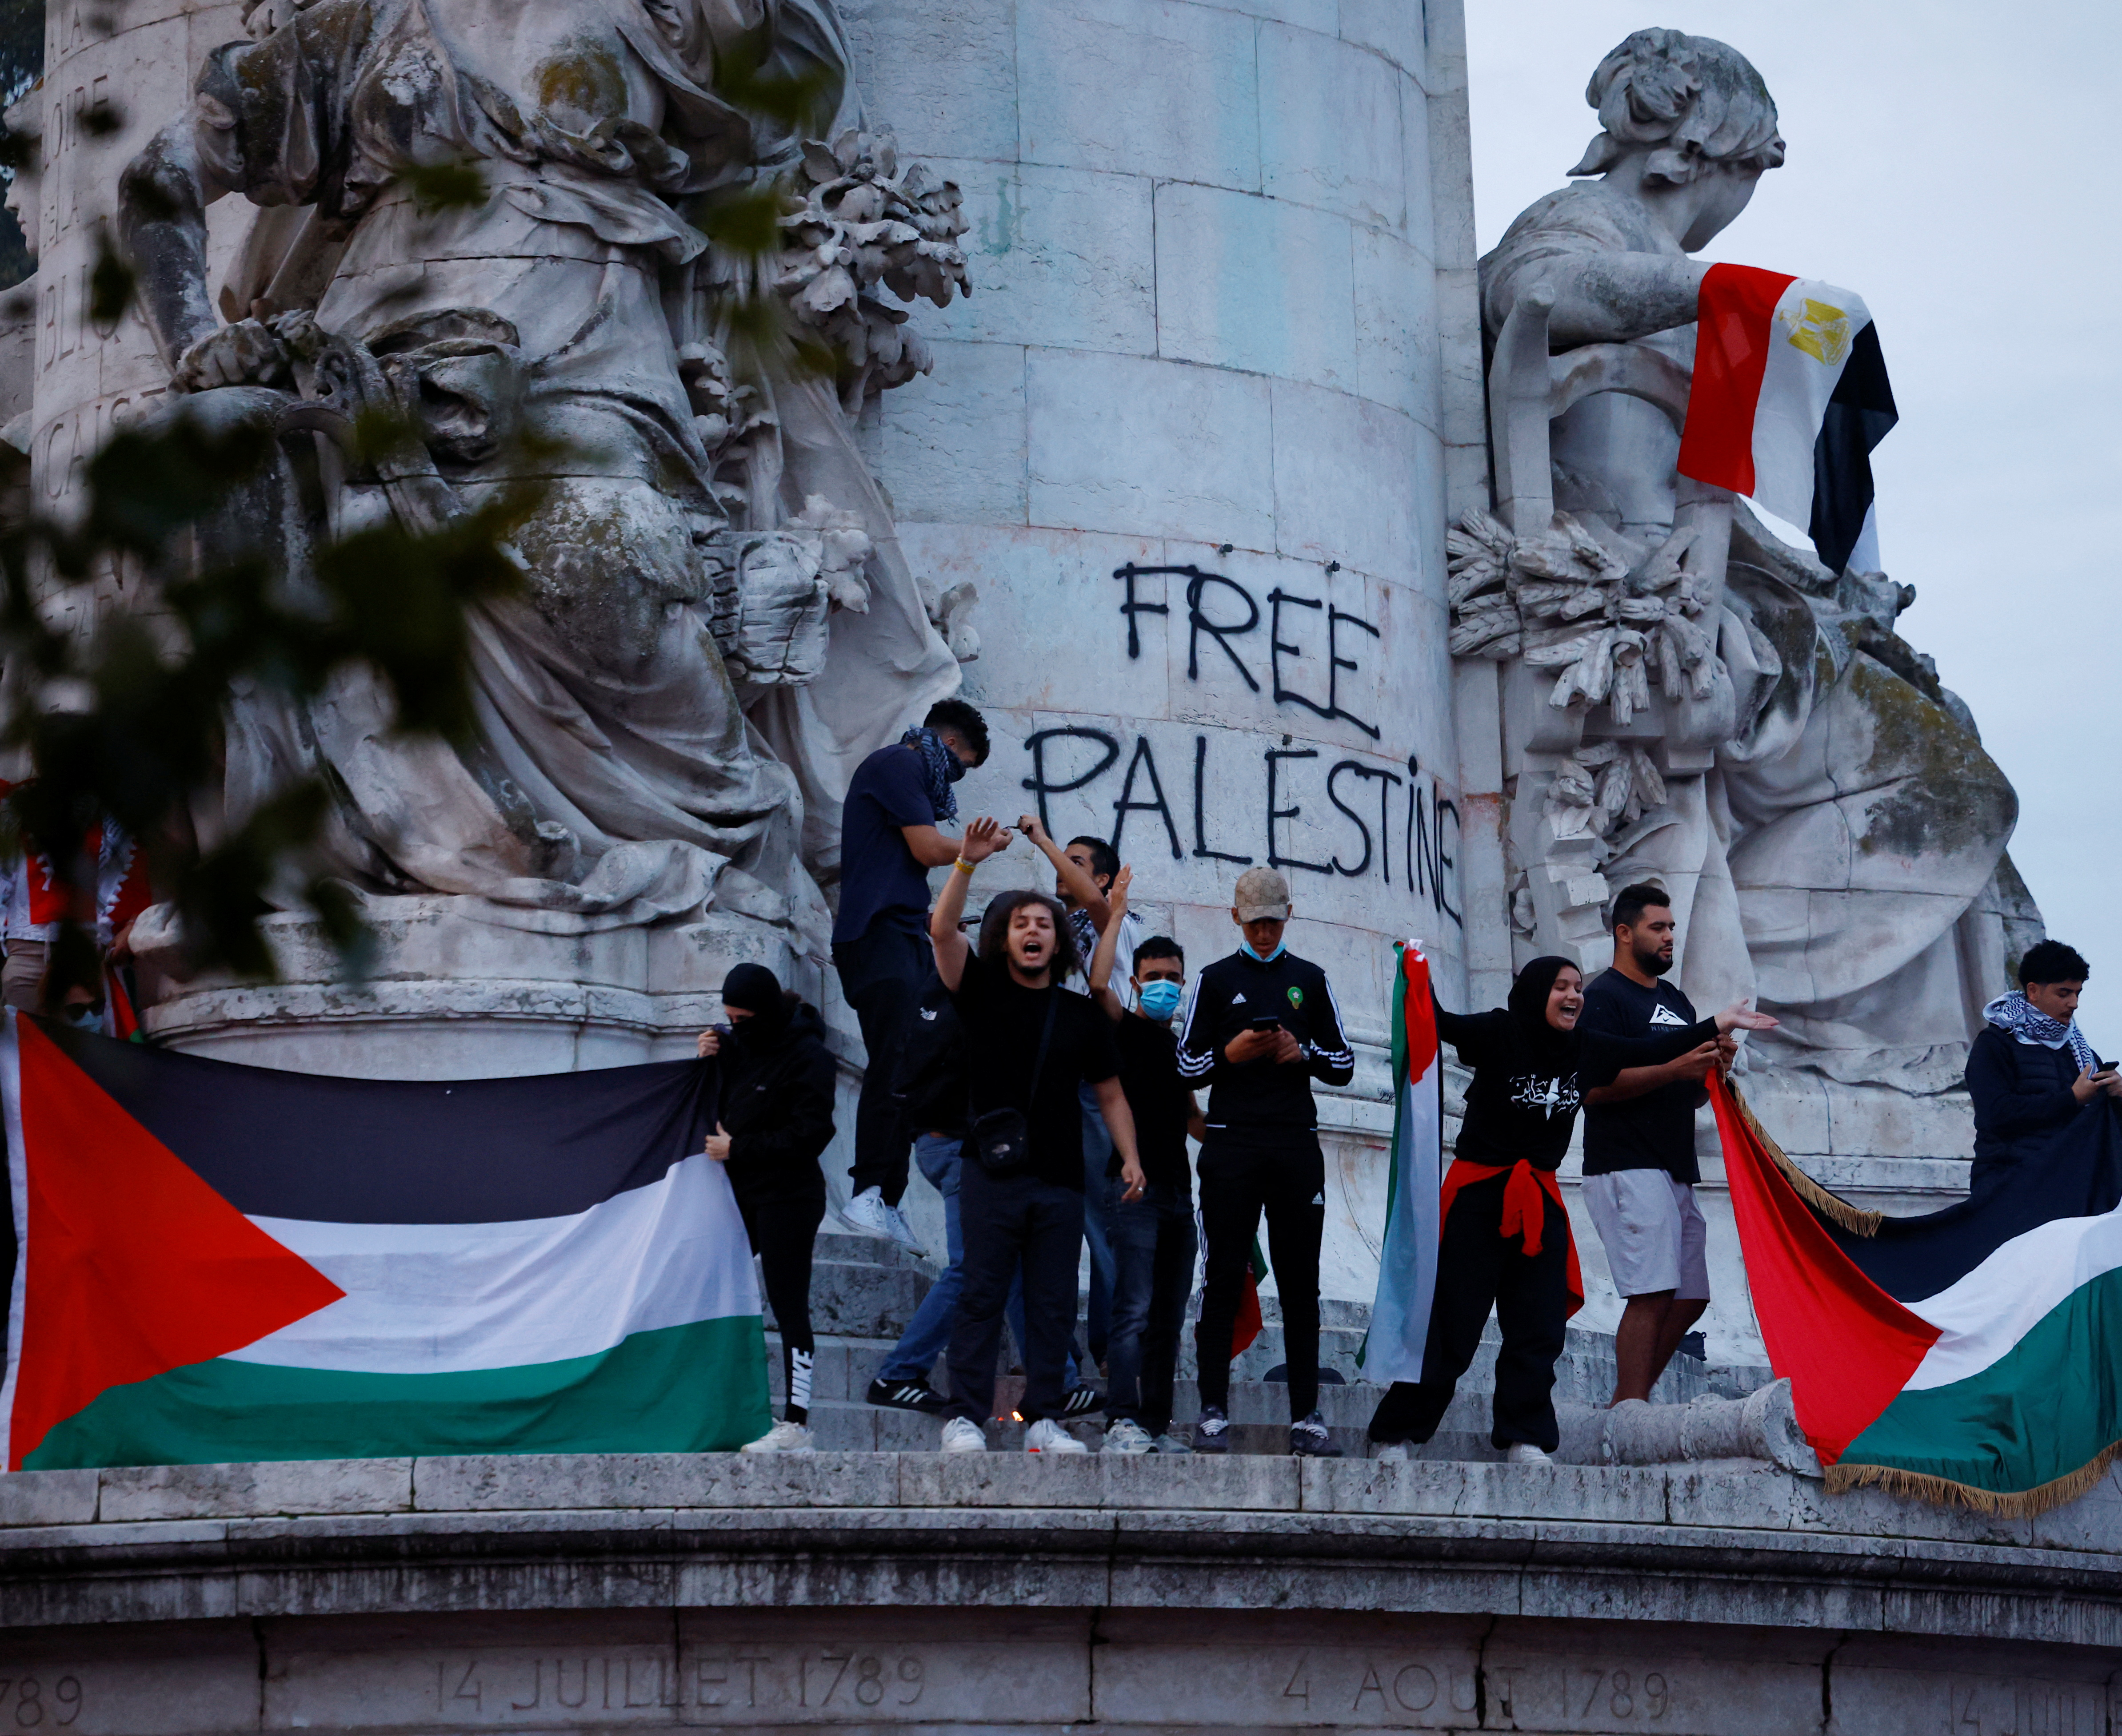
PARIS, FRANCE PRO-HAMAS PROTEST

Slide 50
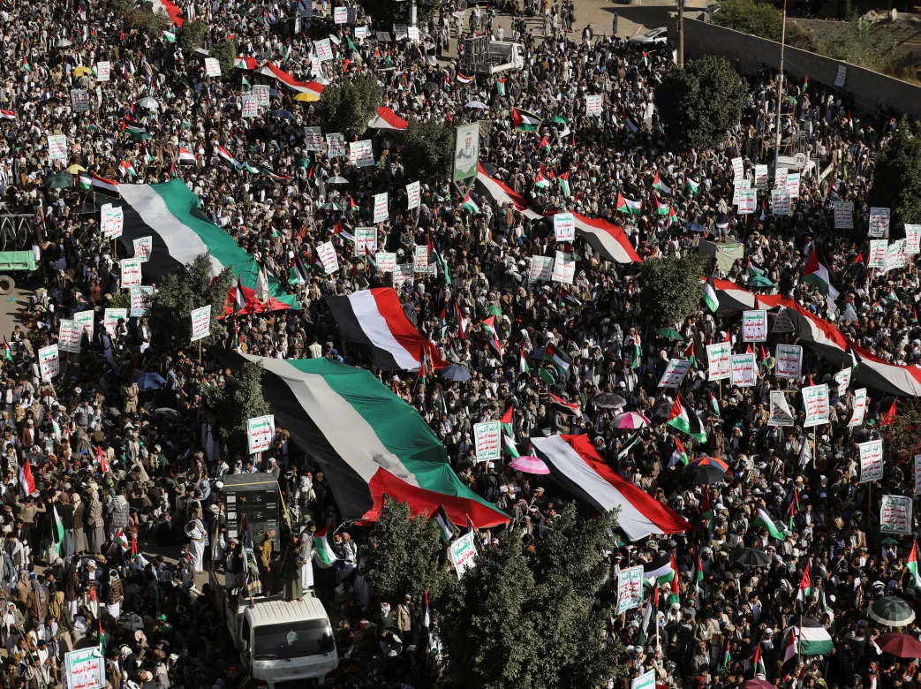
SANAA,
YEMEN PRO-
HAMAS PROTEST

Slide 51
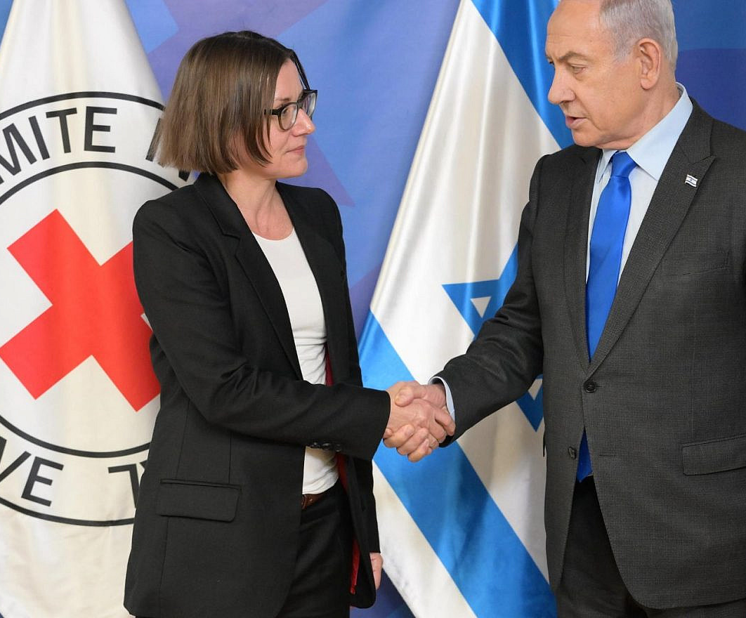
THE RED CROSS HAS DONE
ABSOLUTELY NOTHING IN GAZA FOR THE
HOSTAGES

Slide 52
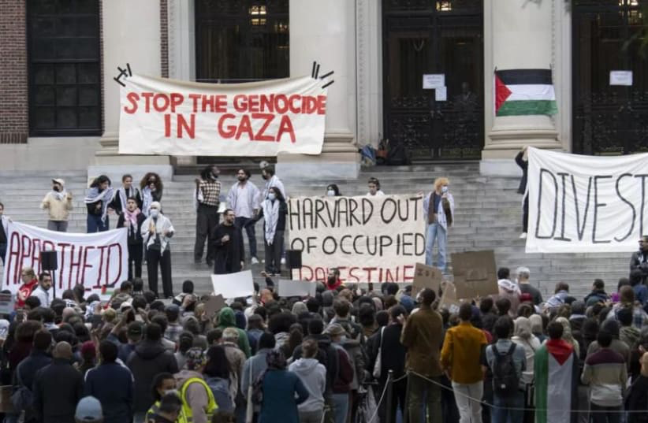
64% of Jewish teens consider antisemitism an important factor in their college search

Slide 53
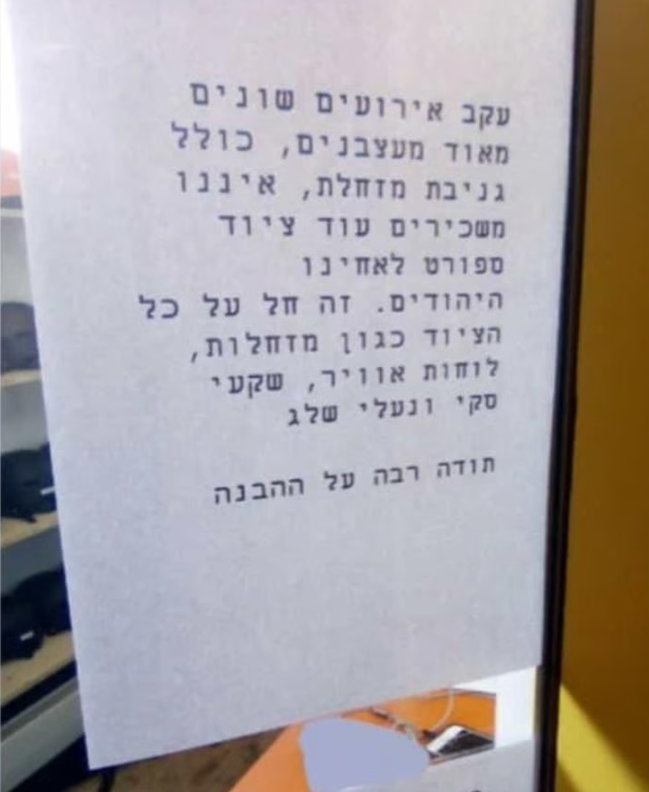
(Feb 2024) DAVOS, SWITZERLAND SKI SHOP
STOPS RENTING EQUIPEMENT TO JEWS
“After a series of annoying incidents, including the theft of a sled, we are no longer renting out sporting equipment to our Jewish brothers,”

Slide 54
HAMAS/ISRAEL 2023 WHAT CAN BELIEVERS DO?

Slide 55
“TO MY
FRIENDS
IN ISRAEL”
Sarah Huckabee Sanders

Slide 56
Support us at:
www.shalominmessiah.com
Olivier@ shalominmessiah.com
Twitter, Instagram, YouTube:
@OlivierMelnick

