Slide 2
From Peter to Paul
Reference | Center | Person | Place | Outreach
Acts 1–12 | Jerusalem | Peter | Jerusalem, Judea, Samaria | Jewish
Acts 13–28 | Antioch | Paul | Uttermost parts | Gentiles

Slide 3
From Peter to Paul
Peter | Paul
Heals a man lame from birth (3:1-11) | Heals a man lame from birth (14:8-18)
Heals by shadow (5:15-16) | Heals by handkerchief (19:11-12)
Success is a cause of jealousy (5:17) | Success is a cause of jealousy (13:45)
Confronts a sorcerer (8:9-24) | Confronts a sorcerer (13:6-11)
Raises Dorcas (9:36-41) | Raises Eutychus (20:9-12)
Jailed and miraculously freed (12:3-19) | Jailed and miraculously freed (16:25-34)

Slide 4
Acts 6:8‒8:4 Stephen
Stephen’s Arrest (6:8‒7:1)
Stephen’s Defense (Acts 7:2-53)
Stephen’s Stoning (7:54-60)
Third Persecution (Acts 8:1-4)

Slide 5
II. Stephen’s Arrest Acts 6:8-15
Description of Stephen (8)
Disputations against Stephen (9-10)
Conspiracy against Stephen (11)
Arrest of Stephen (12)
Charges against Stephen (13-14)
Face of Stephen (15)
Opportunity of Stephen (7:1)

Slide 6
Acts 6:8‒8:4 Stephen
Stephen’s Arrest (6:8‒7:1)
Stephen’s Defense (Acts 7:2-53)
Stephen’s Stoning (7:54-60)
Third Persecution (Acts 8:1-4)

Slide 7
Acts 7 – Stephen’s Speech
1. 7:2-5 | Abraham’s partial obedience
2. 7:6-38 | Israel’s initial rejections and later acceptances
3. 7:39-41 | Israel’s early rebellion against Moses
4. 7:42-45 | Israel reinterpreted Moses’ teachings though a polytheistic framework
5. 7:46-50 | Neither the Tabernacle nor Temple were intended as permanent habitations of God
6. 7:51-53 | Current generation imitating these same rebellions

Slide 8
Acts 7 – Stephen’s Speech
1. 7:2-5 | Abraham’s partial obedience
2. 7:6-38 | Israel’s initial rejections and later acceptances
3. 7:39-41 | Israel’s early rebellion against Moses
4. 7:42-45 | Israel reinterpreted Moses’ teachings though a polytheistic framework
5. 7:46-50 | Neither the Tabernacle nor Temple were intended as permanent habitations of God
6. 7:51-53 | Current generation imitating these same rebellions

Slide 9
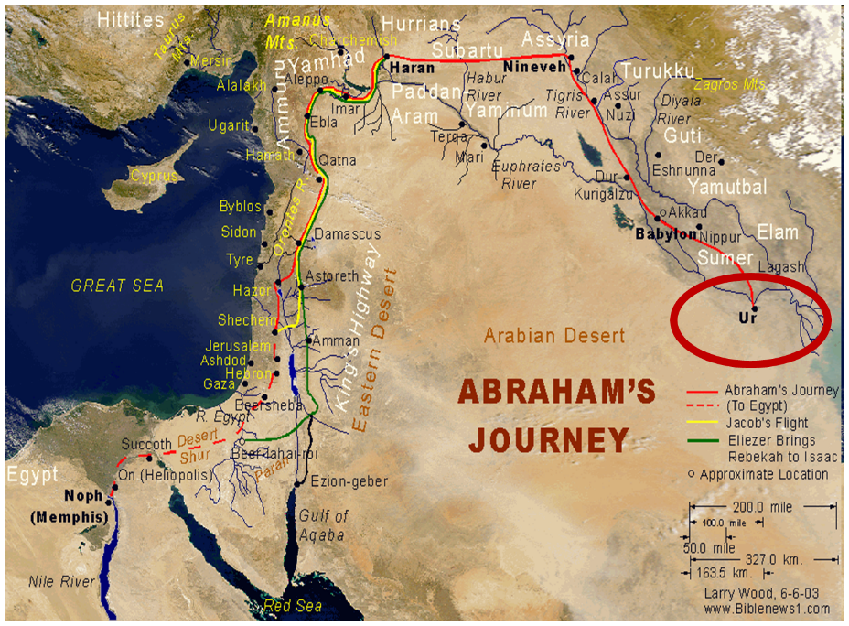

Slide 10
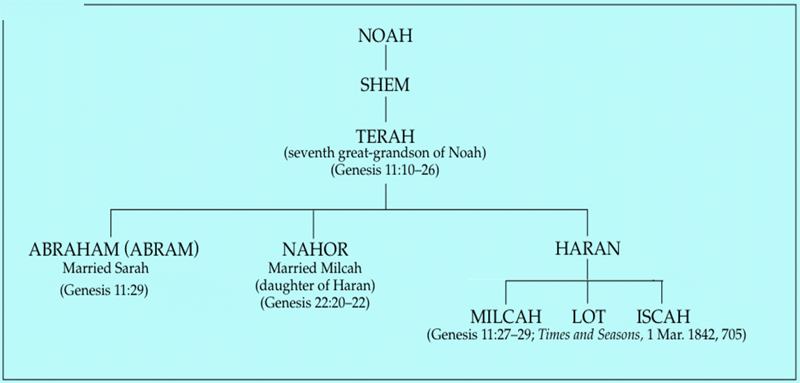

Slide 13
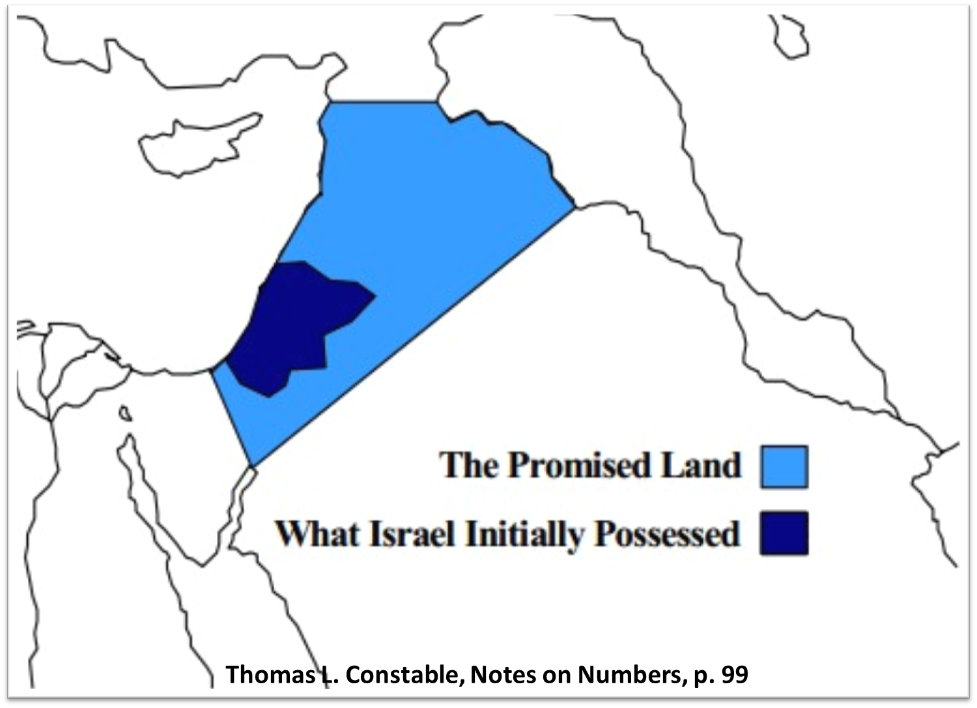

Slide 14
Genesis 12‒25 Abraham’s Early Journeys
Unconditional promises (Gen. 12:1-3) From Haran to Canaan (Gen. 12:4-5) In Canaan (Gen. 12:6-9) In Egypt (Gen. 12:10-20) Abram and Lot Separate (Gen. 13:1-13) Reaffirmation of Abram’s promises (Gen. 13:14-18) Abram Rescues Lot (14:1-24) Abrahamic Covenant (15:1-21) Hagar & Ishmael (16:1-16) Circumcision (Gen. 17:1-27) | Sodom & Gomorrah (Gen. 18‒19) Abraham & Abimelech (Gen. 20) Isaac’s birth (Gen. 21:1-7) Ishmael’s expulsion (21:8-21) Abraham & Abimelech’s covenant (21:22-34) Abraham sacrifices Isaac (22) Sarah’s death (23) Isaac’s marriage (24) Abraham & Keturah (25:1-6) Abraham’s death (25:7-11)

Slide 15
Acts 7 – Stephen’s Speech
1. 7:2-5 | Abraham’s partial obedience
2. 7:6-38 | Israel’s initial rejections and later acceptances
3. 7:39-41 | Israel’s early rebellion against Moses
4. 7:42-45 | Israel reinterpreted Moses’ teachings though a polytheistic framework
5. 7:46-50 | Neither the Tabernacle nor Temple were intended as permanent habitations of God
6. 7:51-53 | Current generation imitating these same rebellions

Slide 16
2. Israel’s Initial Rejections & Later Acceptances Acts 7:6-38
Example of Joseph (6-16)
Example of Moses (17-38)

Slide 17
2. Israel’s Initial Rejections & Later Acceptances Acts 7:6-38
Example of Joseph (6-16)
Example of Moses (17-38)

Slide 18
Genesis 15:16
“Then in the fourth generation they will return here, for the wrongdoing of the Amorite is not yet complete.”

Slide 19
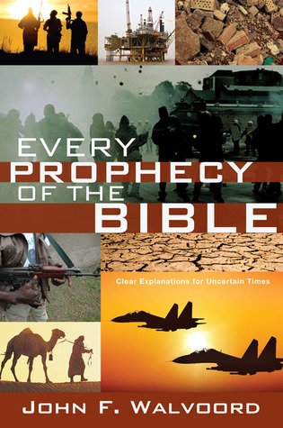

Slide 21
VI. 8 New Promises Genesis 12:1-3
Land (Gen. 12:1b)
Great nation (Gen. 12:2a)
Personal blessing (Gen. 12:2b)
Great name (Gen. 12:2c)
Blessing to others (Gen. 12:2d)
Blessing to blessers (Gen. 12:3a)
Cursing to cursers (Gen. 12:3b)
Blessing to the world (Gen. 12:3c)

Slide 22
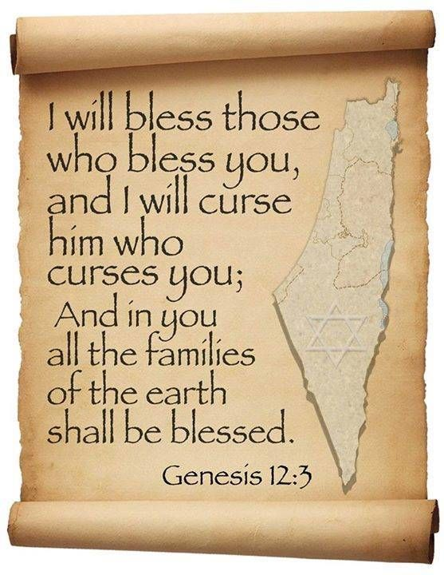
Genesis 12:3
“And I will bless those who bless you, And the one who curses you I will curse. And in you all the families of the earth will be blessed.”

Slide 23
Genesis 12‒25 Abraham’s Early Journeys
Unconditional promises (Gen. 12:1-3) From Haran to Canaan (Gen. 12:4-5) In Canaan (Gen. 12:6-9) In Egypt (Gen. 12:10-20) Abram and Lot Separate (Gen. 13:1-13) Reaffirmation of Abram’s promises (Gen. 13:14-18) Abram Rescues Lot (14:1-24) Abrahamic Covenant (15:1-21) Hagar & Ishmael (16:1-16) Circumcision (Gen. 17:1-27) | Sodom & Gomorrah (Gen. 18‒19) Abraham & Abimelech (Gen. 20) Isaac’s birth (Gen. 21:1-7) Ishmael’s expulsion (21:8-21) Abraham & Abimelech’s covenant (21:22-34) Abraham sacrifices Isaac (22) Sarah’s death (23) Isaac’s marriage (24) Abraham & Keturah (25:1-6) Abraham’s death (25:7-11)

Slide 27
Genesis 12‒25 Abraham’s Early Journeys
Unconditional promises (Gen. 12:1-3) From Haran to Canaan (Gen. 12:4-5) In Canaan (Gen. 12:6-9) In Egypt (Gen. 12:10-20) Abram and Lot Separate (Gen. 13:1-13) Reaffirmation of Abram’s promises (Gen. 13:14-18) Abram Rescues Lot (14:1-24) Abrahamic Covenant (15:1-21) Hagar & Ishmael (16:1-16) Circumcision (Gen. 17:1-27) | Sodom & Gomorrah (Gen. 18‒19) Abraham & Abimelech (Gen. 20) Isaac’s birth (Gen. 21:1-7) Ishmael’s expulsion (21:8-21) Abraham & Abimelech’s covenant (21:22-34) Abraham sacrifices Isaac (22) Sarah’s death (23) Isaac’s marriage (24) Abraham & Keturah (25:1-6) Abraham’s death (25:7-11)

Slide 28
2. Israel’s Initial Rejections & Later Acceptances Acts 7:6-38
Example of Joseph (6-16)
Example of Moses (17-38)

Slide 29
Genesis 15:16
“Then in the fourth generation they will return here, for the wrongdoing of the Amorite is not yet complete.”

Slide 30
THREE PHASES OF MOSES’ 120 YEAR LIFE
LIFE PHASE | SCRIPTURE | YEARS | AGE | ACTIVITY
Natural Training | Acts 7:23 | 1526–1486 B.C. | 1-40 | Egyptian Education
Spiritual Training | Exod. 7:7 | 1486–1446 B.C. | 40-80 | Midian Shepherding
Ministry | Deut. 31:2; 34:7; Acts 7:36 | 1446–1406 B.C. | 80-120 | Exodus, Law, Wilderness Preservation, Pentateuch Authorship

Slide 32
THREE PHASES OF MOSES’ 120 YEAR LIFE
LIFE PHASE | SCRIPTURE | YEARS | AGE | ACTIVITY
Natural Training | Acts 7:23 | 1526–1486 B.C. | 1-40 | Egyptian Education
Spiritual Training | Exod. 7:7 | 1486–1446 B.C. | 40-80 | Midian Shepherding
Ministry | Deut. 31:2; 34:7; Acts 7:36 | 1446–1406 B.C. | 80-120 | Exodus, Law, Wilderness Preservation, Pentateuch Authorship

Slide 34
THREE PHASES OF MOSES’ 120 YEAR LIFE
LIFE PHASE | SCRIPTURE | YEARS | AGE | ACTIVITY
Natural Training | Acts 7:23 | 1526–1486 B.C. | 1-40 | Egyptian Education
Spiritual Training | Exod. 7:7 | 1486–1446 B.C. | 40-80 | Midian Shepherding
Ministry | Deut. 31:2; 34:7; Acts 7:36 | 1446–1406 B.C. | 80-120 | Exodus, Law, Wilderness Preservation, Pentateuch Authorship

Slide 35
Matthew 16:18
“I also say to you that you are Peter, and upon this rock I WILL build [oikodomeō] My church; and the gates of Hades WILL NOT overpower it.”

Slide 36
Ephesians 2:14
For He Himself is our peace, who made both groups into one and broke down the barrier of the dividing wall.

Slide 37
Ephesians 3:3-6
“³ that by revelation there was made known to me the mystery, as I wrote before in brief. ⁴ By referring to this, when you read you can understand my insight into the mystery of Christ, ⁵ which in other generations was not made known to the sons of men, as it has now been revealed to His holy apostles and prophets in the Spirit; ⁶ to be specific, that the Gentiles are fellow heirs and fellow members of the body, and fellow partakers of the promise in Christ Jesus through the gospel”.

Slide 38
Ephesians 3:9
“and to bring to light what is the administration of the mystery which for ages has been hidden in God who created all things.”

Slide 40
Acts 7 – Stephen’s Speech
1. 7:2-5 | Abraham’s partial obedience
2. 7:6-38 | Israel’s initial rejections and later acceptances
3. 7:39-41 | Israel’s early rebellion against Moses
4. 7:42-45 | Israel reinterpreted Moses’ teachings though a polytheistic framework
5. 7:46-50 | Neither the Tabernacle nor Temple were intended as permanent habitations of God
6. 7:51-53 | Current generation imitating these same rebellions

Slide 42
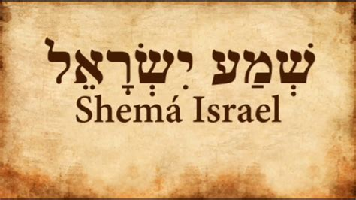
Deuteronomy 6:4-7
“⁴ Hear, Israel! The Lord is our God, the Lord is one!... ⁶ These words, which I am commanding you today, shall be on your heart. ⁷ You shall teach them diligently to your sons and shall talk of them when you sit in your house and when you walk by the way and when you lie down and when you rise up.”

Slide 43
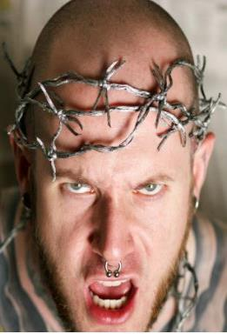
APOSTASY CAN HAPPEN QUICKLY
Galatians 1:6
“I marvel that you are turning away so soon from Him who called you in the grace of Christ, to a different gospel.” (Italics mine)
Exodus 32:8
“They have turned aside quickly out of the way which I have commanded them” (Italics mine; see also Exod 24:18).

Slide 44
Acts 7 – Stephen’s Speech
1. 7:2-5 | Abraham’s partial obedience
2. 7:6-38 | Israel’s initial rejections and later acceptances
3. 7:39-41 | Israel’s early rebellion against Moses
4. 7:42-45 | Israel reinterpreted Moses’ teachings though a polytheistic framework
5. 7:46-50 | Neither the Tabernacle nor Temple were intended as permanent habitations of God
6. 7:51-53 | Current generation imitating these same rebellions

Slide 45
Genesis 1:1-3
“¹ In the beginning God created the heavens and the earth. ² The earth was formless and void, and darkness was over the surface of the deep, and the Spirit of God was moving over the surface of the waters. ³ Then God said, ‘Let there be light’; and there was light.”

Slide 46
Genesis 1:14
Then God said, “Let there be lights in the expanse of the heavens to separate the day from the night, and let them be for signs and for seasons and for days and years.”

Slide 47
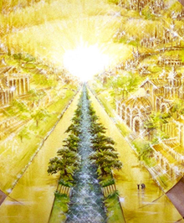
Eternal State is Future
No Satan (Rev 20:10)
No sea (Rev 21:1)
No death, crying, or pain (Rev 21:4)
No Sun (Rev 22:5)
No Moon (Rev 21:23)
No temple (Rev. 21:22)
No night (Rev 21:25)
No evil (Rev 21:27)
No curse (Rev 22:3)

Slide 48
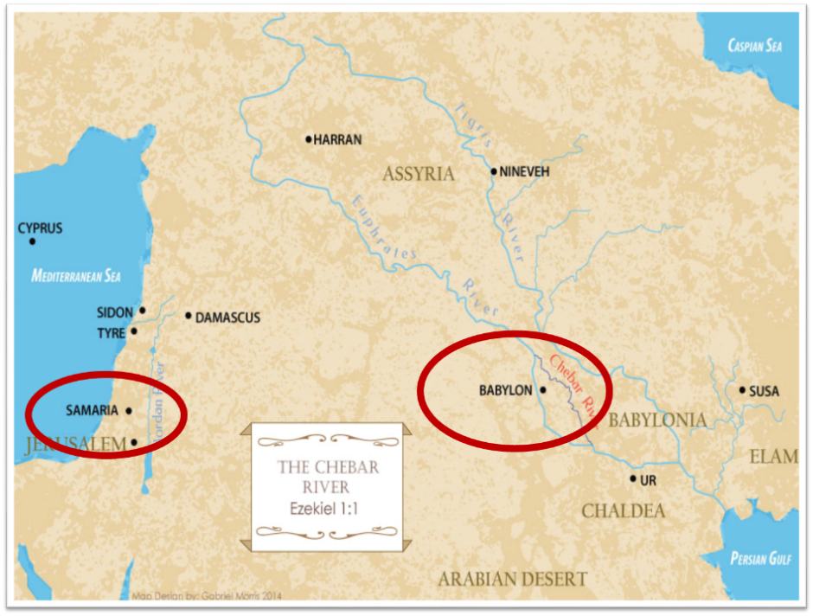

Slide 49
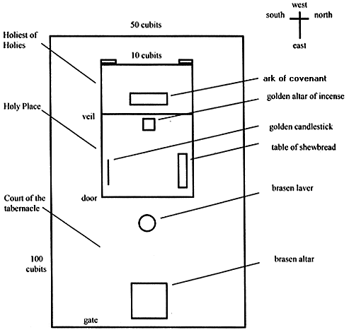
Tabernacle Diagram

Slide 50
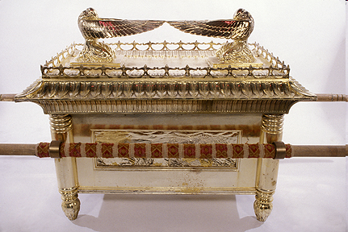
Ark of the Covenant

Slide 52
Matthew 5:21-22
“²¹ “You have heard that the ancients were told, ‘You shall not commit murder’ and ‘Whoever commits murder shall be liable to the court.’ ²² But I say to you that everyone who is angry with his brother shall be guilty before the court; and whoever says to his brother, ‘You good-for-nothing,’ shall be guilty before the supreme court; and whoever says, ‘You fool,’ shall be guilty enough to go into the fiery hell.””

Slide 53
Matthew 5:27-28
“²⁷ You have heard that it was said, ‘You shall not commit adultery’; ²⁸ but I say to you that everyone who looks at a woman with lust for her has already committed adultery with her in his heart.”

Slide 54
Acts 7 – Stephen’s Speech
1. 7:2-5 | Abraham’s partial obedience
2. 7:6-38 | Israel’s initial rejections and later acceptances
3. 7:39-41 | Israel’s early rebellion against Moses
4. 7:42-45 | Israel reinterpreted Moses’ teachings though a polytheistic framework
5. 7:46-50 | Neither the Tabernacle nor Temple were intended as permanent habitations of God
6. 7:51-53 | Current generation imitating these same rebellions

Slide 55
2 Samuel 7:12-16
¹² “When your days are complete and you lie down with your fathers, I will raise up your descendant after you, who will come forth from you, and I will establish his kingdom. ¹³ He shall build a house for My name, and I will establish the throne of his kingdom forever. ¹⁴ I will be a father to him and he will be a son to Me; when he commits iniquity, I will correct him with the rod of men and the strokes of the sons of men, ¹⁵ but My lovingkindness shall not depart . . .

Slide 56
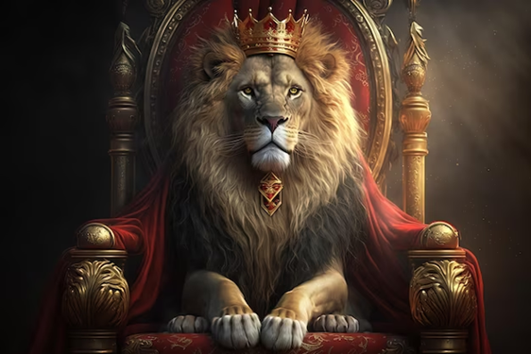
2 Samuel 7:12-16
. . .from him, as I took it away from Saul, whom I removed from before you. ¹⁶ Your house and your kingdom shall endure before Me forever; your throne shall be established forever.” ¹⁷ In accordance with all these words and all this vision, so Nathan spoke to David.”

Slide 57
ISRAEL’S FOUR TEMPLES
Solomon’s pre-exilic temple (Kings and Chronicles)
Zerubbabel’s post exilic temple (Ezra 1-6; John 2:20)
Antichrist's temple (Dan. 9:27; Matt. 24:15; 2 Thess. 2:4; Rev. 11:1-2)
Millennial temple (Ezek. 40-48)

Slide 62
Matthew 24:1-2
“¹ Jesus came out from the temple and was going away when His disciples came up to point out the temple buildings to Him. ² And He said to them, “Do you not see all these things? Truly I say to you, not one stone here will be left upon another, which will not be torn down.”

Slide 63
Luke 19:42-44
^{“42} saying, ‘If you had known in this day, even you, the things which make for peace! But now they have been hidden from your eyes. ⁴³ For the days will come upon you when your enemies will throw up a barricade against you, and surround you and hem you in on every side, ⁴⁴ and they will level you to the ground and your children within you, and they will not leave in you one stone upon another, because you did not recognize the time of your visitation.’”

Slide 64
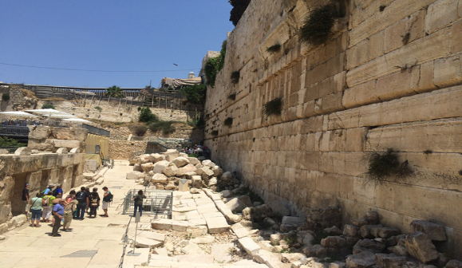

Slide 65
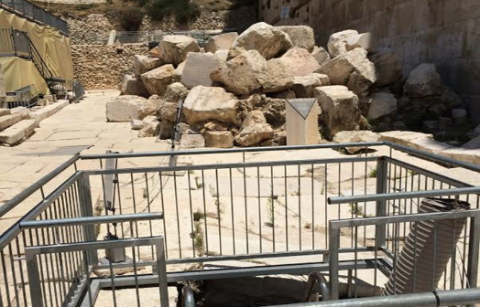

Slide 66
1 Samuel 16:13-14
“¹³ Then Samuel took the horn of oil and anointed him in the midst of his brothers; and the Spirit of the Lord came mightily upon David from that day forward. And Samuel arose and went to Ramah. ¹⁴ Now the Spirit of the Lord departed from Saul, and an evil spirit from the Lord terrorized him.”

Slide 67
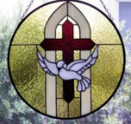
John 14:16-17
¹⁶ I will ask the Father, and He will give you another Helper, that He may be with you forever; ¹⁷ that is the Spirit of truth, whom the world cannot receive, because it does not see Him or know Him, but you know Him because He abides with you and will be in you.

Slide 68
WORK OF THE SPIRIT IN THE OT
 | OT/GOSPELS/ACTS 1 | ACTS 2/TODAY
External vs. Internal | Upon (1 Sam. 16:13) | Within (John 14:17)
Reception of all of the Spirit at the moment of salvation? | Subsequent to salvation (Exod 31:3) | At moment of salvation (Rom 8:9)
How long is the indwelling? | Temporary indwelling (1 Sam 16:14; Ps 51:11) | Permanent indwelling (John 14:16)
Who is indwelt? | Selective indwelling (Joel 2:28) | Universal indwelling (1 Cor 12:13)

Slide 69
Acts 7 – Stephen’s Speech
1. 7:2-5 | Abraham’s partial obedience
2. 7:6-38 | Israel’s initial rejections and later acceptances
3. 7:39-41 | Israel’s early rebellion against Moses
4. 7:42-45 | Israel reinterpreted Moses’ teachings though a polytheistic framework
5. 7:46-50 | Neither the Tabernacle nor Temple were intended as permanent habitations of God
6. 7:51-53 | Current generation imitating these same rebellions

Slide 70
6. Current Generation Imitating These Rebellions Acts 7:51-53
Resisting the Spirit (51)
Prophet Killers (52)
Law Breakers (53)

Slide 71
6. Current Generation Imitating These Rebellions Acts 7:51-53
Resisting the Spirit (51)
Prophet Killers (52)
Law Breakers (53)

Slide 72
Genesis 6:1-3
“¹ Now it came about, when men began to multiply on the face of the land, and daughters were born to them, ² that the sons of God saw that the daughters of men were beautiful; and they took wives for themselves, whomever they chose. ³ Then the Lord said, “My Spirit shall not strive with man forever, because he also is flesh; nevertheless his days shall be one hundred and twenty years.”

Slide 73
Zechariah 12:10
“I will pour out on the house of David and on the inhabitants of Jerusalem, the Spirit of grace and of supplication, so that they will look on Me whom they have pierced; and they will mourn for Him, as one mourns for an only son, and they will weep bitterly over Him like the bitter weeping over a firstborn.”

Slide 74
6. Current Generation Imitating These Rebellions Acts 7:51-53
Resisting the Spirit (51)
Prophet Killers (52)
Law Breakers (53)

Slide 75
Luke 24:27, 44
“²⁷ Then beginning with Moses and with all the prophets, He explained to them the things concerning Himself in all the Scriptures…⁴⁴ Now He said to them, ‘These are My words which I spoke to you while I was still with you, that all things which are written about Me in the Law of Moses and the Prophets and the Psalms must be fulfilled.’”

Slide 76
6. Current Generation Imitating These Rebellions Acts 7:51-53
Resisting the Spirit (51)
Prophet Killers (52)
Law Breakers (53)

Slide 77
John 5:39, 46
“³⁹ You search the Scriptures because you think that in them you have eternal life; it is these that testify about Me…⁴⁶ For if you believed Moses, you would believe Me, for he wrote about Me.”

Slide 78
Acts 6:8‒8:4 Stephen
Stephen’s Arrest (6:8‒7:1)
Stephen’s Defense (Acts 7:2-53)
Stephen’s Stoning (7:54-60)
Third Persecution (Acts 8:1-4)

Slide 79
III. Stephen’s Stoning Acts 7:54-60
Audience's reaction (54)
Stephen’s dying vision (55-56)
Stephen’s death (57-60)

Slide 80
III. Stephen’s Stoning Acts 7:54-60
Audience's reaction (54)
Stephen’s dying vision (55-56)
Stephen’s death (57-60)

Slide 81
John 16:7–11
⁷ “But I tell you the truth, it is to your advantage that I go away; for if I do not go away, the Helper will not come to you; but if I go, I will send Him to you. ⁸ “And He, when He comes, will convict the world concerning sin and righteousness and judgment; ⁹ concerning sin, because they do not believe in Me; ¹⁰ and concerning righteousness, because I go to the Father and you no longer see Me; ¹¹ and concerning judgment, because the ruler of this world has been judged.

Slide 82
III. Stephen’s Stoning Acts 7:54-60
Audience's reaction (54)
Stephen’s dying vision (55-56)
Stephen’s death (57-60)

Slide 83
Revelation 3:21
Promise to the Overcomers
“He who overcomes, I will grant to him to sit down with Me on My throne, as I also overcame and sat down with My Father on His throne.”

Slide 85
III. Stephen’s Stoning Acts 7:54-60
Audience's reaction (54)
Stephen’s dying vision (55-56)
Stephen’s death (57-60)

Slide 86
Acts 7:57-60 Stephen’s Death
Mob response (57)
Stephen’s stoning (58)
Stephen’s response (59)
Stephen’s death (60)

Slide 87
Acts 7:57-60 Stephen’s Death
Mob response (57)
Stephen’s stoning (58)
Stephen’s response (59)
Stephen’s death (60)

Slide 88
Acts 7:57-60 Stephen’s Death
Mob response (57)
Stephen’s stoning (58)
Stephen’s response (59)
Stephen’s death (60)

Slide 89
Dr. Arnold G. Fruchtenbaum
The Book of Acts, 176-77
“A second explanation is that this event may have occurred in A.D. 36. In that year, Vitellus became the new imperial legate of the Province of Syria, which included Judea. He deposed Pontius Pilate from his procuratorship in A.D. 36. Pilate’s successor, Marullus, did not arrive until A.D. 38. So there may have been a hiatus or a break between the deposing of Pilate and the arrival of the new procurator. It could very well be that the stoning of Stephen occurred during this time, which would have left the Sanhedrin without tight Roman oversight. A third explanation is that this was a mob scene, and mobs do not regard the rules of law.”

Slide 90
From Peter to Paul
Reference | Center | Person | Place | Outreach
Acts 1–12 | Jerusalem | Peter | Jerusalem, Judea, Samaria | Jewish
Acts 13–28 | Antioch | Paul | Uttermost parts | Gentiles

Slide 91
From Peter to Paul
Peter | Paul
Heals a man lame from birth (3:1-11) | Heals a man lame from birth (14:8-18)
Heals by shadow (5:15-16) | Heals by handkerchief (19:11-12)
Success is a cause of jealousy (5:17) | Success is a cause of jealousy (13:45)
Confronts a sorcerer (8:9-24) | Confronts a sorcerer (13:6-11)
Raises Dorcas (9:36-41) | Raises Eutychus (20:9-12)
Jailed and miraculously freed (12:3-19) | Jailed and miraculously freed (16:25-34)

Slide 92
Acts 7:57-60 Stephen’s Death
Mob response (57)
Stephen’s stoning (58)
Stephen’s response (59)
Stephen’s death (60)

Slide 93
Acts 7:57-60 Stephen’s Death
Mob response (57)
Stephen’s stoning (58)
Stephen’s response (59)
Stephen’s death (60)

Slide 94
Acts 7:60 Stephen’s Death
Kneeling (60a)
Cried out (60b)
Fell asleep (60c)

Slide 95
Acts 7:60 Stephen’s Death
Kneeling (60a)
Cried out (60b)
Fell asleep (60c)

Slide 96
Acts 7:60 Stephen’s Death
Kneeling (60a)
Cried out (60b)
Fell asleep (60c)

Slide 97
Acts 7:60 Stephen’s Death
Kneeling (60a)
Cried out (60b)
Fell asleep (60c)

Slide 98
1 Thessalonians 4:13-18
¹³ "But we do not want you to be uninformed, brethren, about those who are asleep, so that you will not grieve as do the rest who have no hope. ¹⁴ For if we believe that Jesus died and rose again, even so God will bring with Him those who have fallen asleep in Jesus. ¹⁵ For this we say to you by the word of the Lord, that we who are alive and remain until the coming of the Lord, will not precede . . .

Slide 99
1 Thessalonians 4:13-18
… those who have fallen asleep. ¹⁶ For the Lord Himself descend from heaven with a shout, with the voice of the archangel and with the trumpet of God, and the dead in Christ will rise first. ¹⁷ Then we who are alive and remain will be caught up together with them in the clouds to meet the Lord in the air, and so we shall always be with the Lord. ¹⁸ Therefore comfort one another with these words."

Slide 100
Conclusion

Slide 101
Acts 6:8‒8:4 Stephen
Stephen’s Arrest (6:8‒7:1)
Stephen’s Defense (Acts 7:2-53)
Stephen’s Stoning (7:54-60)
Third Persecution (Acts 8:1-4)

Slide 102
Acts 7 – Stephen’s Speech
1. 7:2-5 | Abraham’s partial obedience
2. 7:6-38 | Israel’s initial rejections and later acceptances
3. 7:39-41 | Israel’s early rebellion against Moses
4. 7:42-45 | Israel reinterpreted Moses’ teachings though a polytheistic framework
5. 7:46-50 | Neither the Tabernacle nor Temple were intended as permanent habitations of God
6. 7:51-53 | Current generation imitating these same rebellions

