Slide 2
An Appropriate Response to God:
Jonah 1:5, 10, 14, 16

Slide 3
JONAH: AN INTRODUCTION, PART 4
Who wrote it? Jonah
When was it written? 770-750 BC
Who was it written to? Israel
Historicity of the book? Fact!
Genre of the book? Historical Narrative
What is it all about? (Message) To showcase God’s universal love and plan of redemption which extends beyond Israel to include all nations

Slide 4
JONAH: AN INTRODUCTION, PART 4
Why was it written? (Purpose) Expose Israel’s ethnocentrism and encourage national repentance
What’s in it? (Survey) Defiance (1-2) Compliance (3-4)
Christ in Jonah? Yes, through Messianic typology
What makes this book unique?
Structure/outline of the book?

Slide 5
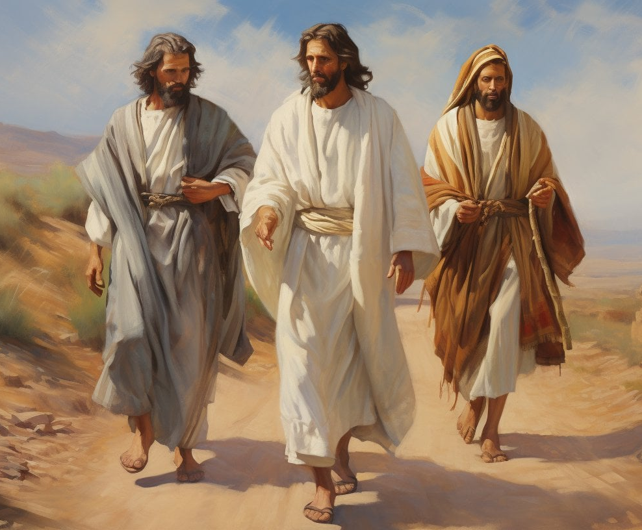
Luke 24:27
“Then beginning with Moses and with all the prophets, He explained to them the things concerning Himself in all the Scriptures.”

Slide 6
What makes this book unique?
Disobedience may bring turmoil in the believer’s life, but God will always pursue in faithfulness.
God’s relentless love, grace, and mercy towards man.
God’s sovereignty
God’s/Israel’s missionary purpose
Examples of appropriate responses to God

Slide 7
What makes this book unique?
Disobedience may bring turmoil in the believer’s life, but God will always pursue in faithfulness.
God’s relentless love, grace, and mercy towards man.
God’s sovereignty
God’s/Israel’s missionary purpose
Examples of appropriate responses to God

Slide 8
An Appropriate Response to God:
Jonah 1:5, 10, 14, 16

Slide 9
JONAH: AN INTRODUCTION, PART 4
Why was it written? (Purpose) Expose Israel’s ethnocentrism and encourage national repentance
What’s in it? (Survey) Defiance (1-2) Compliance (3-4)
Christ in Jonah? Yes, through Messianic typology
What makes this book unique?
Structure/outline of the book?

Slide 10
JONAH: AN INTRODUCTION, PART 4
Why was it written? (Purpose) Expose Israel’s ethnocentrism and encourage national repentance
What’s in it? (Survey) Defiance (1-2) Compliance (3-4)
Christ in Jonah? Yes, through Messianic typology
What makes this book unique?
Structure/outline of the book?

Slide 11
Examples of Appropriate Responses to God
The sailors’ response
Nineveh’s response
The king’s response

Slide 12
The Sailors’ Response
Fear (1:5)
Inquiry (1:7-8)
Humble evaluation (1:11)
A change of paradigm (1:14, 16)

Slide 13
The Sailors’ Response
Fear (1:5)
Inquiry (1:7-8)
Humble evaluation (1:11)
A change of paradigm (1:14, 16)

Slide 14
The Sailors’ Response
Fear (1:5)
Inquiry (1:7-8)
Humble evaluation (1:11)
A change of paradigm (1:14, 16)

Slide 16
The Sailors’ Response
Fear (1:5)
Inquiry (1:7-8)
Humble evaluation (1:11)
A change of paradigm (1:14, 16)

Slide 17
Nineveh’s Response
Heard (3:4)
Believed (3:5a)
Good works (3:5b)

Slide 18
Nineveh’s Response
Heard (3:4)
Believed (3:5a)
Good works (3:5b)

Slide 19
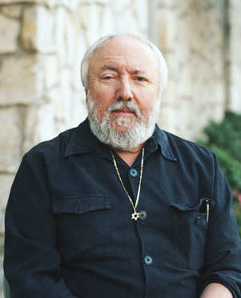
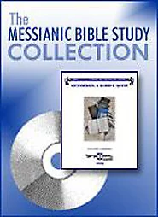
The Book of Jonah
“Yet forty days, and Nineveh shall be overthrown.” The Hebrew word translated overthrown became a technical term that means “the overthrow of Sodom and Gomorrah.” The point of Jonah’s message was that within forty days God would overthrow Nineveh in the same way He overthrew Sodom and Gomorrah. He was threatening Nineveh with the same type of destruction that Sodom and Gomorrah received; it would be a total overthrow so that no inhabitant will be left.

Slide 20
The King’s Response
Humility (3:6)
Monarchial responsibility and accountability (3:7-9)
Trust (3:9)

Slide 21
The King’s Response
Humility (3:6)
Monarchial responsibility and accountability (3:7-9)
Trust (3:9)

Slide 22
The King’s Response
Humility (3:6)
Monarchial responsibility and accountability (3:7-9)
Trust (3:9)

Slide 23
The King’s Response
Humility (3:6)
Monarchial responsibility and accountability (3:7-8)
Trust (3:9)

Slide 24
What makes this book unique?
Disobedience may bring turmoil in the believer’s life, but God will always pursue in faithfulness.
God’s relentless love, grace, and mercy towards man.
God’s sovereignty
God’s/Israel’s missionary purpose
Examples of appropriate responses to God

Slide 25
The Sailors’ Response
Fear (1:5)
Inquiry (1:7-8)
Humble evaluation (1:11)
A change of paradigm (1:14, 16)

Slide 26
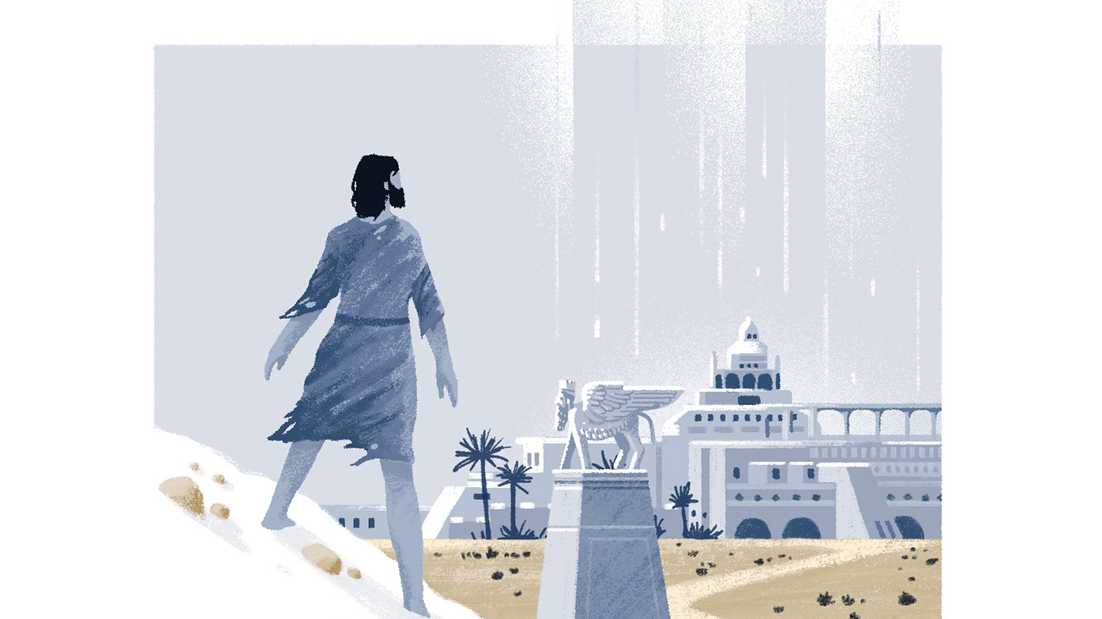
Nineveh’s Response
Heard (3:4)
Believed (3:5a)
Good works (3:5b)

Slide 27
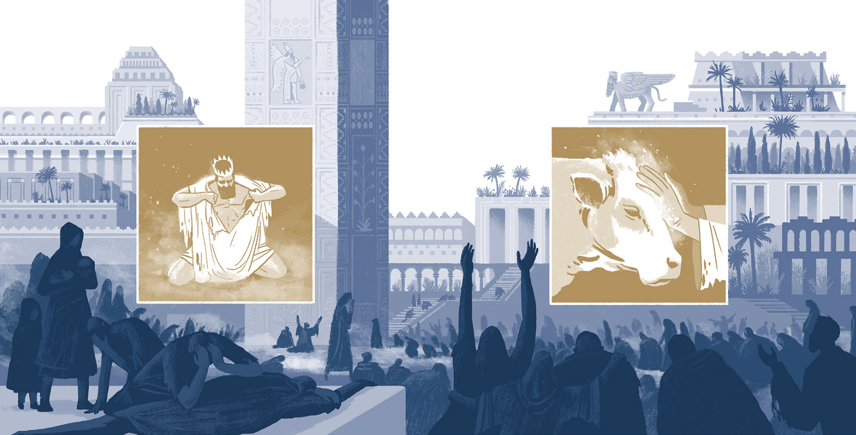
The King’s Response
Humility (3:6)
Monarchial responsibility and accountability (3:7-8)
Trust (3:9)

Slide 28
Outline of Jonah
Defiance (1-2)
The running prophet (1)
The praying prophet (2)
Compliance (3-4)
The preaching prophet (3)
The pouting prophet (4)

Slide 29
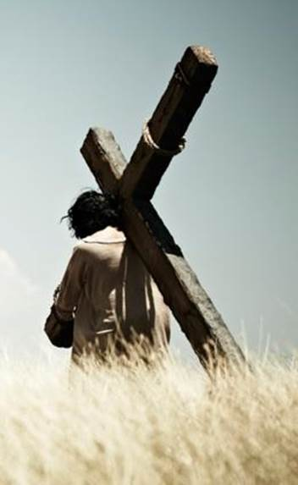
Romans 3:23-24
“…for all have sinned and fall short of the glory of God, being justified as a gift by His grace through the redemption which is in Christ Jesus.”

Slide 30
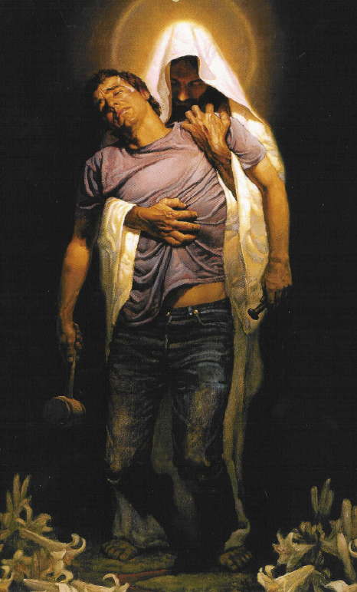
Romans 6:23
“For the wages of sin is death, but the free gift of God is eternal life in Christ Jesus our Lord.”

