Slide 1
Law and Grace: An Overview Jim McGowan, Th.D. Sugar Land Bible Church 01-28-2024
…but grace and truth were realized through Jesus Christ - John 1:17
For the Law was given through Moses…
Special thanks to Dr. Vern Peterman for access to his insights and resources.

Slide 2
Session 41 Outline
Review
Purpose, Aim, and Objective
Session 40
The Gospel of Substitution & the Gospel of the Kingdom – Part 1
Contrasts and Comparisons
Concluding Observations

Slide 3
OUR PURPOSE, AIM AND OBJECTIVE
Law and Grace
…is to Compare and Contrast Law and Grace so as to properly understand these two important themes and how they are related to the life of the New Testament Believer.

Slide 4
C. I. Scofield, D. D.
The Grace of God, The Fundamentals Vol. 3, Chapter VII, p. 98
We have, most of us, been reared and now live under the influence of Galatianism. Protestant theology, alas, is for the most part, thoroughly Galatianized, in that neither law nor grace are given their distinct and separated places, as in the counsels of God, but are mingled together in one incoherent system.
The law is no longer, as in the Divine intent, a ministration of death (2 Cor. 3:7), of cursing (Gal. 3:10), of conviction (Rom. 3:19), because we are taught that we must try to keep it, and that by Divine help we may.
Nor, on the other hand, does grace bring us blessed deliverance from the dominion of sin, for we are kept under the law as a rule of life despite the plain declaration, “Sin shall not have dominion over you: for ye are not under the law, but under grace” (Rom. 6:14). (emphasis mine)

Slide 5
William R. Newell
Romans Verse-by-Verse (p. 274).
Grand Rapids, MI: Christian Classics Ethereal Library.
It is because Reformed theology has kept us Gentiles under the Law,—if not as a means of righteousness, then as “a rule of life,” that all the trouble has arisen. The Law is no more a rule of life than it is a means of righteousness. Walking in the Spirit has now taken the place of walking by ordinances. God has another principle under which He has put his saints: “Ye are not under law, but, under grace! (Rom. 6:14)” (italics mine)
PDF Download Here: https://archive.org/details/Romans_Verse_By_Verse-NewellWR

Slide 6
Henry Ironside
The Continual Burnt Offering: Daily Meditations on the Word of God (p. 265). Neptune, NJ: Loizeaux Brothers.
In Romans 7 we have a man renewed by the Spirit of God, but struggling under law, hoping thereby to subdue or find deliverance from the power of the old Adamic nature. In chapter 8 we have God’s way of deliverance through the death and resurrection of Christ with which the believer is identified before God. The chapter begins with “no condemnation” and ends with “no separation.” All who are in Christ Jesus are accepted in the Beloved and as free from every charge of guilt as He is Himself. He paid our penalty on the cross. Now we are linked up with Him in resurrection, not under law but under grace.

Slide 7
Matthew’s 3-Fold Purpose
Law and Grace: Review The SOM – Matthew 5:1–8:1 (Luke 6:17–49)
To explain:
that Jesus in whom they had believed was the long-awaited Jewish Messiah
why the kingdom had been postponed despite the fact that the king had arrived
the interim program of God during the kingdom’s absence

Slide 8
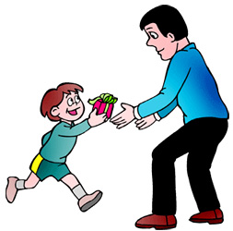
Matthew and the Kingdom
Law and Grace: Review The SOM – Matthew 5:1–8:1 (Luke 6:17–49)
 | offered
 | rejected
 | postponed Interim program
 | ultimately accepted

Slide 9
Matthew’s Message
Law and Grace: Review The SOM – Matthew 5:1–8:1 (Luke 6:17–49)
Jesus is the predicted Jewish king who ushered in an interim program by building the sons of the kingdom into the Church in between Israel’s past rejection and future acceptance of her king.

Slide 10
Session 41 Outline
Review
Purpose, Aim, and Objective
Session 40
The Gospel of Substitution & the Gospel of the Kingdom – Part 1
Contrasts and Comparisons
Concluding Observations

Slide 11
Law and Grace: Grace Review - Universal kingdom vs earthly kingdom
THE UNIVERSAL KINGDOM OF GOD
God’s rule over, management of, and building of, His creation as King, Administrator, Builder
Psalm 47; 57:11; Jeremiah 23:24; Ephesians 1:10; Hebrews 3:4
Alpha
Omega
Seal Opener
Seated in the heavenlies, and our life on earth
The Messiah, King of Israel, King of kings and Lord of lords over the Gentiles
Creator
The Angel of the Lord
Lamb, Word made flesh
7 year Tribulation
Abraham
Moses
David
Adam
Millennial Kingdom
Noah
Church: Grace
Israel: Mosaic Law
Kingdom Law
Gentiles
World, Flesh, Devil
Flesh

Slide 12
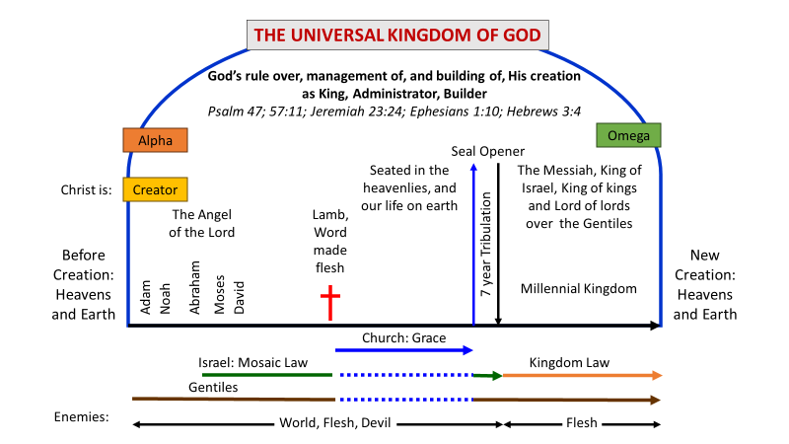
THE UNIVERSAL KINGDOM OF GOD
Law and Grace: Review - Universal kingdom vs earthly kingdom
The term ‘Universal Kingdom of God’ is God’s rule, building and management of the present heavens and earth (this world).

Slide 13
THE UNIVERSAL KINGDOM OF GOD
Law and Grace: Review - Universal kingdom vs earthly kingdom
The Kingdom of God on earth (aka kingdom of heaven, or millennial 1000 year kingdom) is the final phase of this present heavens and earth.
1

Slide 14
Law and Grace: Review - Universal kingdom vs earthly kingdom
1

Slide 15
Law and Grace: Review - Universal kingdom vs earthly kingdom

Slide 16
Law and Grace: Review - Universal kingdom vs earthly kingdom

Slide 17
Session 41 Outline
Review
Purpose, Aim, and Objective
Session 40
The Gospel of Substitution and & Gospel of the Kingdom – Part 1
Contrasts and Comparisons
Concluding Observations

Slide 18
THE GOSPEL
Law and Grace: The Gospel of Substitution & The Gospel of the Kingdom – Part 1
The word that is translated ‘gospel’ in the New Testament is a compound word that literally means ‘good message’ but is most often translated ‘good news’ in our English Bibles.
We find the word ‘gospel’ only in the New Testament, but the word pair ‘good news’ is found in both the Old and the New Testaments, often in telling about a spiritual truth.

Slide 19
GOOD NEW ABOUT WHAT?
Law and Grace: The Gospel of Substitution & The Gospel of the Kingdom – Part 1
“Our English word gospel means “good story” or “good news.” But the word gospel must be further defined by answering one more question: good news about what? Even the New Testament uses the word gospel to mean various types of good news, so one has to describe what good news is in view.”
Ryrie, C. C. (1997). So Great Salvation: What It Means to Believe in Jesus Christ (p. 36). Moody Press.

Slide 20
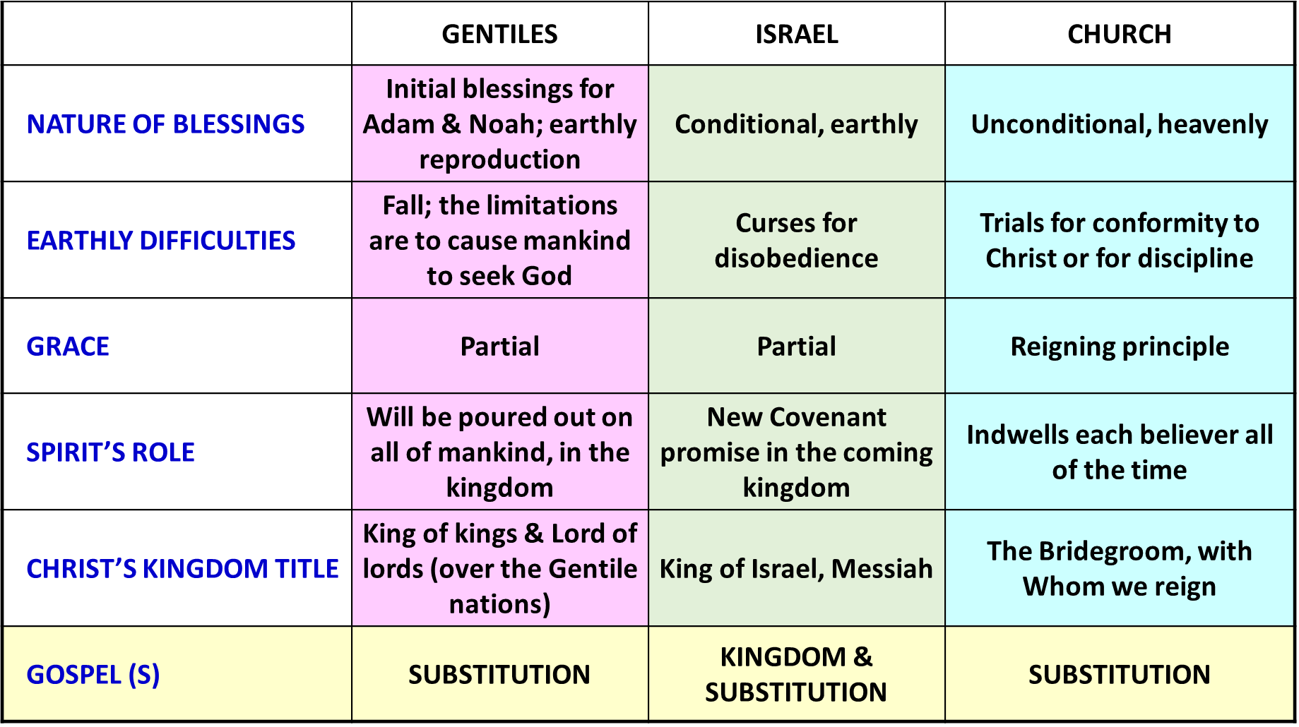
THE GOSPEL
Law and Grace: The Gospel of Substitution & The Gospel of the Kingdom – Part 1

Slide 21
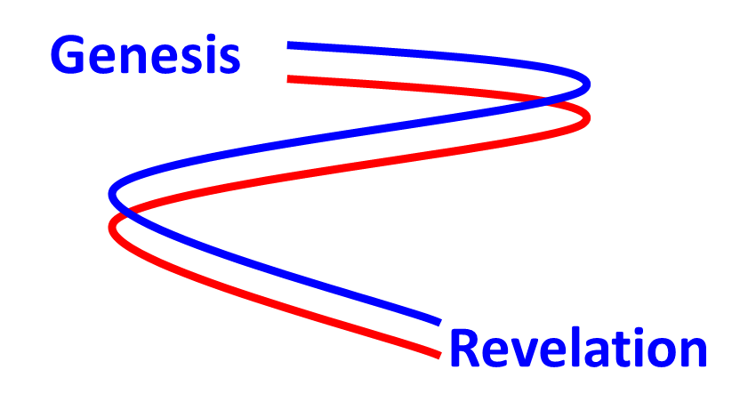
TWO GOSPELS THAT SPAN FROM GENESIS TO REVELATION
Law and Grace: The Gospel of Substitution & The Gospel of the Kingdom – Part 1
The two gospels that begin in the book of Genesis continue as two threads on into the book of Revelation.
1

Slide 22
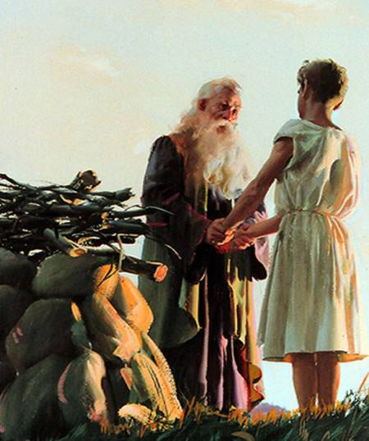
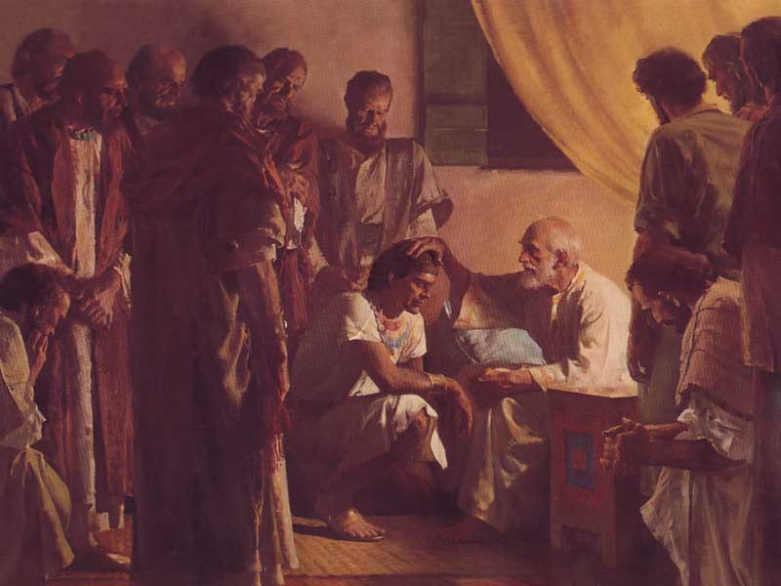
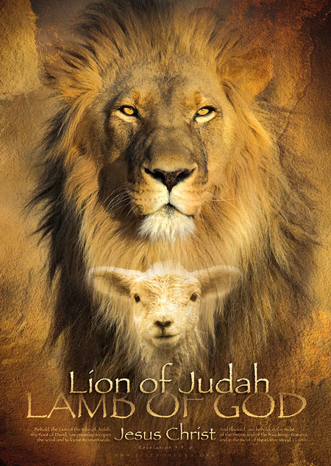
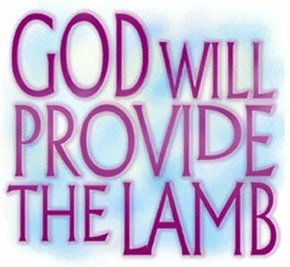
Law and Grace: The Gospel of Substitution & The Gospel of the Kingdom – Part 1
"Judah… your father's sons shall bow down to you… "

Slide 23
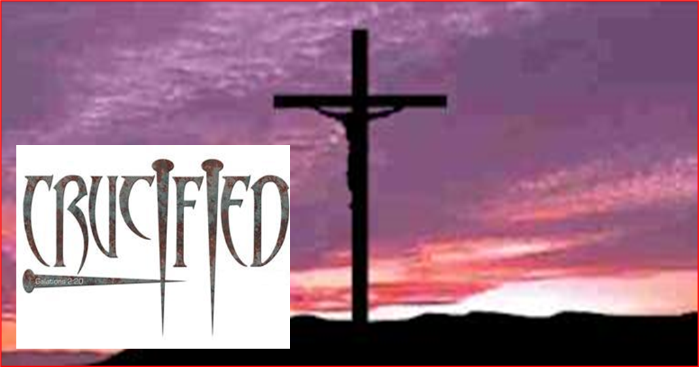
Law and Grace: The Gospel of Substitution & The Gospel of the Kingdom – Part 1
TWO GOSPELS THAT SPAN FROM GENESIS TO REVELATION
The Gospel of Substitution is that Christ died in the place of every single human being for all of time.

Slide 24
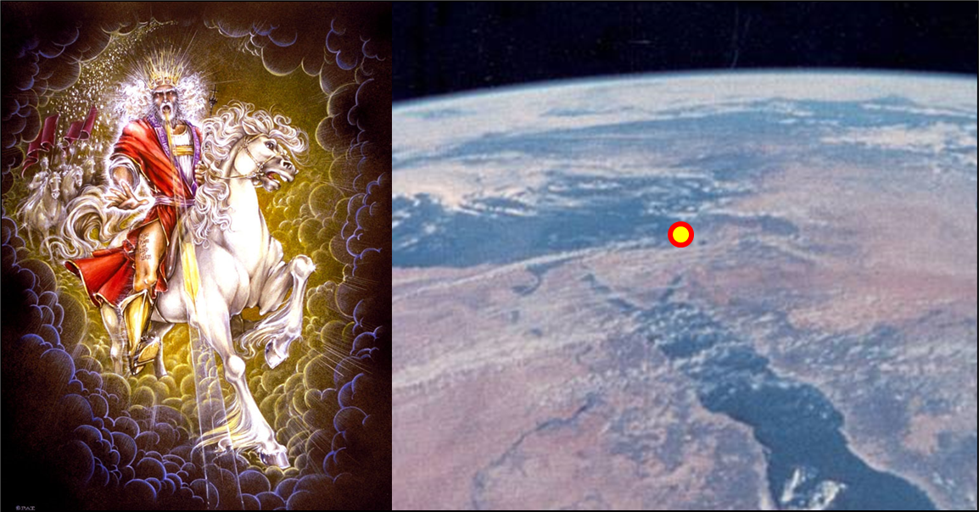
Law and Grace: The Gospel of Substitution & The Gospel of the Kingdom – Part 1
TWO GOSPELS THAT SPAN FROM GENESIS TO REVELATION
The Gospel of the Kingdom is that Christ will reign over Israel and the entire earth for 1000 years.

Slide 25
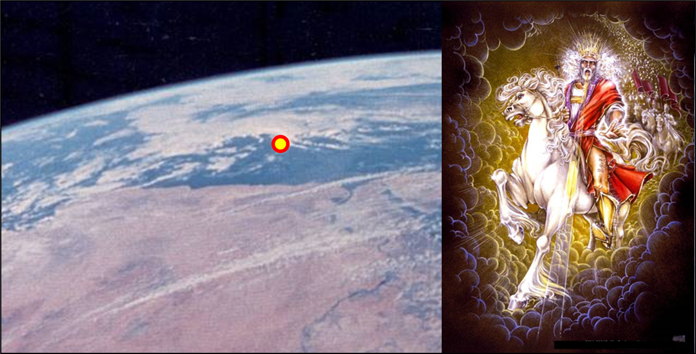
Law and Grace: The Gospel of Substitution & The Gospel of the Kingdom – Part 1
THE GOSPEL OF THE KINGDOM
The Gospel of the Kingdom is that Christ will reign on earth as the last of all earthly times on this present earth.

Slide 26
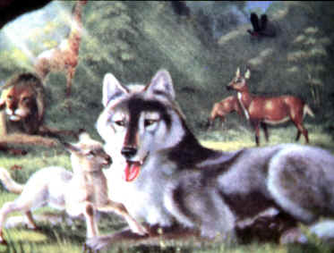
Law and Grace: The Gospel of Substitution & The Gospel of the Kingdom – Part 1
THE GOSPEL OF THE KINGDOM
The earth will be in many ways restored to its original fertile and productive state, and Israel will be the way to the Messiah.
The Gospel of the Kingdom is primarily what the people of Israel need to know to enter and do well in that coming kingdom.

Slide 27
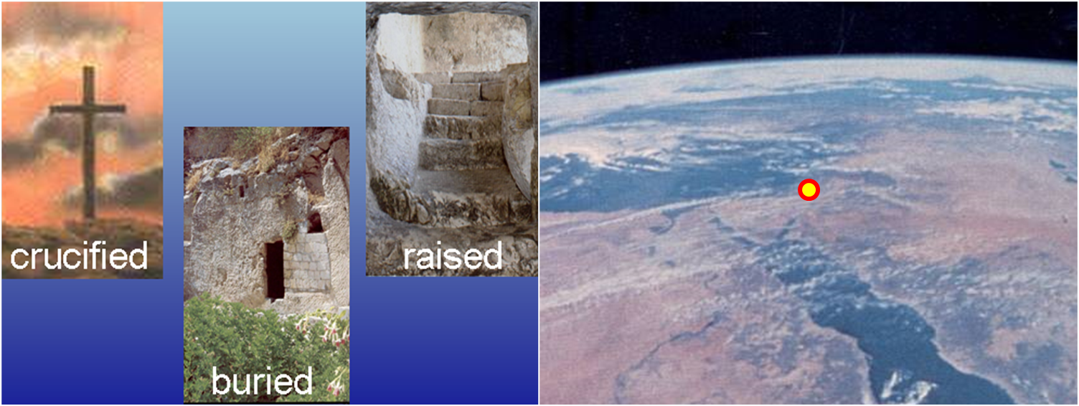
Law and Grace: The Gospel of Substitution & The Gospel of the Kingdom – Part 1
WHAT DO YOU THINK OF CHRIST?

Slide 28
Law and Grace: The Gospel of Substitution & The Gospel of the Kingdom – Part 1
WHAT DO YOU THINK OF CHRIST?
The key question of the ‘Gospel of Substitution’ is, “Do you believe God regarding Jesus Christ’s death for your sins, His burial, and His resurrection?”

Slide 29
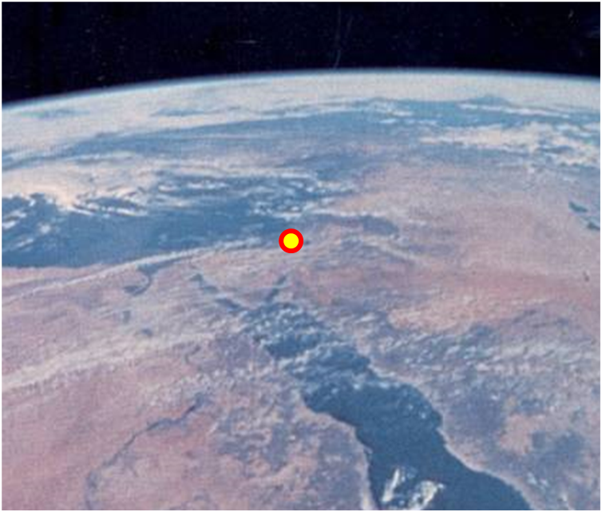
Law and Grace: The Gospel of Substitution & The Gospel of the Kingdom – Part 1
WHAT DO YOU THINK OF CHRIST?
The key question of the ‘Gospel of the Kingdom’ is, “Do you believe that Jesus is the Christ, that is, Israel’s promised Messiah?”, and that question is of first priority for Israel.
The questions about Christ are different.

Slide 30
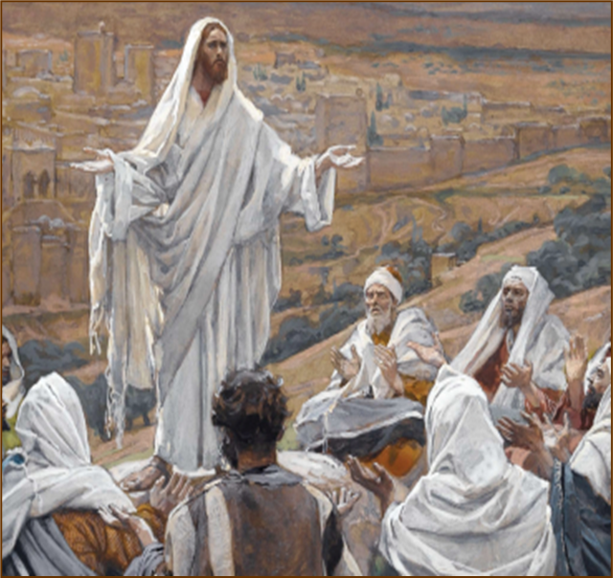
Law and Grace: The Gospel of Substitution & The Gospel of the Kingdom – Part 1
WHO IS CHRIST AND WHEN?

Slide 31
Law and Grace: The Gospel of Substitution & The Gospel of the Kingdom – Part 1
WHO IS CHRIST AND WHEN?
The gospel of Jesus Christ dying as our substitute, in our place, is centered in His first coming, when He died for the sins of the whole world, was buried, and rose again.

Slide 32
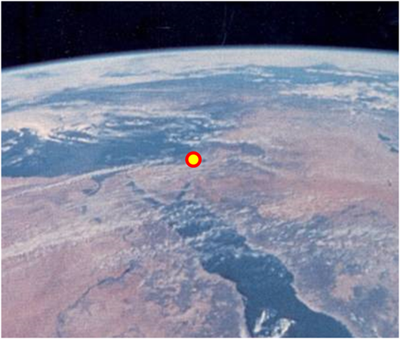
Law and Grace: The Gospel of Substitution & The Gospel of the Kingdom – Part 1
WHO IS CHRIST AND WHEN?
The Gospel of the Kingdom on earth, is about Jesus the Christ (Messiah), in His Second Coming, Who will reign as King of Israel and over the earth.

Slide 33
Law and Grace: The Gospel of Substitution & The Gospel of the Kingdom – Part 1
THE SILVER BOWL OF ARTAXERXES I
“This silver bowl dates to the 5th century BC and comes from ancient Persia. It was used as a wine-drinking vessel, and it comes from the royal house of the Persian ruler Artaxerxes I. It is inscribed with the name of Artaxerxes himself, as well as his father Xerxes and his grandfather Darius. Of interest is the fact that the biblical figure Nehemiah is listed as a cup-bearer to Artaxerxes in Nehemiah 2:1. Found before 1935,* it is nearly 12 inches in diameter and is one of four such bowls discovered so far. The inscription is in the Old Persian language using cuneiform script, and the bowl is on display in The Metropolitan Museum of Art, New York.”
https://bibleandarchaeology.blogspot.com/2011/02/silver-bowl-of-artaxerxes-i.html

Slide 34
Law and Grace: The Gospel of Substitution & The Gospel of the Kingdom – Part 1
“KING OF KINGS”
"Artaxerxes, the great king, king of kings, king of countries, son of Xerxes the king, of Xerxes who was son of Darius the king, the Achaemenian, in whose house this silver drinking cup was made.“ (cf. Ezra 7:12, titling Artaxerxes as “king of kings”)

Slide 35
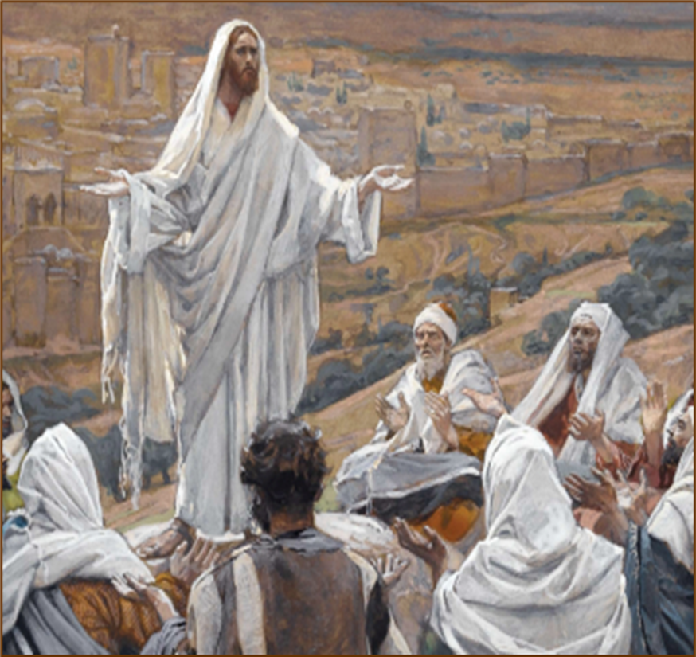
Law and Grace: The Gospel of Substitution & The Gospel of the Kingdom – Part 1
WHO IS CHRIST AND WHEN?
“BUT WHO DO YOU SAY THAT I AM?”

Slide 36
Matthew 16:15
“[Jesus] said to them, “But who do you say that I am?””
Mark 8:29
“And [Jesus] continued by questioning them, “But who do you say that I am?”...”
Luke 9:20
“And [Jesus] said to them, “But who do you say that I am?”...”

Slide 37
Matthew 4:23
~2½ years before the crucifixion
Jesus was going throughout all Galilee, teaching in their synagogues and proclaiming the gospel of the kingdom, and healing every kind of disease and every kind of sickness among the people. (cf. Matthew 9:35)

Slide 38
Law and Grace: The Gospel of Substitution & The Gospel of the Kingdom – Part 1
WHO IS CHRIST AND WHEN?
The purpose of Christ’s healing ministry was 1) to demonstrate His qualification as Israel’s Messiah, 2) to announce the gospel of the Coming Kingdom for Israel, and 3) looked ahead to His Second Coming (cf. Isa. 35). The same could be said of His preaching the gospel to the poor (cf. Isa. 61:1).

Slide 39
Law and Grace: The Gospel of Substitution & The Gospel of the Kingdom – Part 1
Dr. Arnold Fruchtenbaum
The Messianic Bible Study Collection (Vol. 3, pp. 3–4). Ariel Ministries. (1983).
The purpose of all His miracles between [Matthew] chapters 4 and 12 is to authenticate His Person and His message. They are signs to force the nation of Israel to come to a decision regarding two things: first, His Person, that He is the Messiah; and secondly, His message, the gospel of the Kingdom.

Slide 40
Matthew 16:15-17
~ 1 year before crucifixion
¹⁵ He [Christ, speaking to his disciples] said to them, "But who do you say that I am?" ¹⁶ Simon Peter answered, “You are the Christ [Messiah], the Son of the living God.” ¹⁷ And Jesus said to him, “Blessed are you, Simon Barjona, because flesh and blood did not reveal this to you, but My Father who is in heaven.”

Slide 41
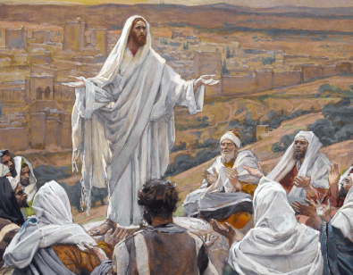
Law and Grace: The Gospel of Substitution & The Gospel of the Kingdom – Part 1
WHO IS CHRIST AND WHEN?
So, it is clear that at this point in time (~1 year before crucifixion), Peter understood and believed Christ’s Gospel of the Kingdom, (that Jesus was and is the Messiah - God’s Anointed One!).

Slide 42
Matthew 16:21-23
(right after verses 15-17)
²¹ “From that time Jesus began to show His disciples that He must go to Jerusalem, and suffer many things from the elders and chief priests and scribes, and be killed, and be raised up on the third day…”

Slide 43
Matthew 16:21-23
(right after verses 15-17)
“…²² Peter took Him aside and began to rebuke Him, saying, “God forbid it, Lord! This shall never happen to You.”…

Slide 44
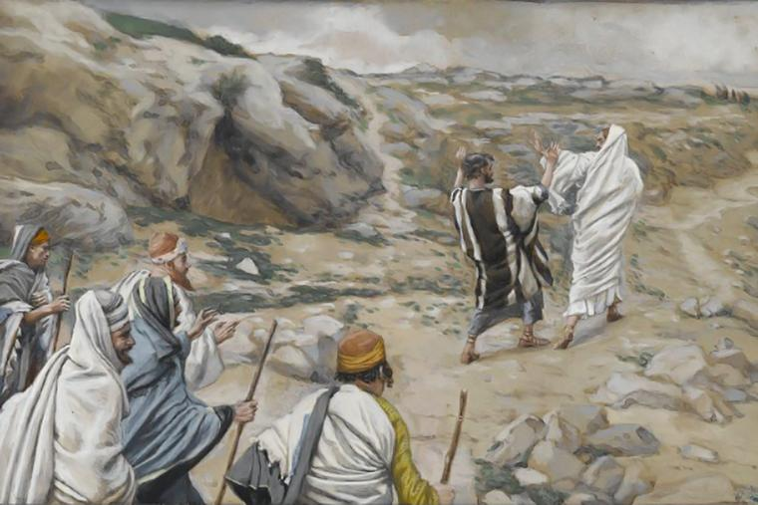
Matthew 16:21-23
(right after verses 15-17)
“…²³ But He turned and said to Peter, “Get behind Me, Satan! You are a stumbling block to Me; for you are not setting your mind on God's interests, but man’s.””

Slide 45
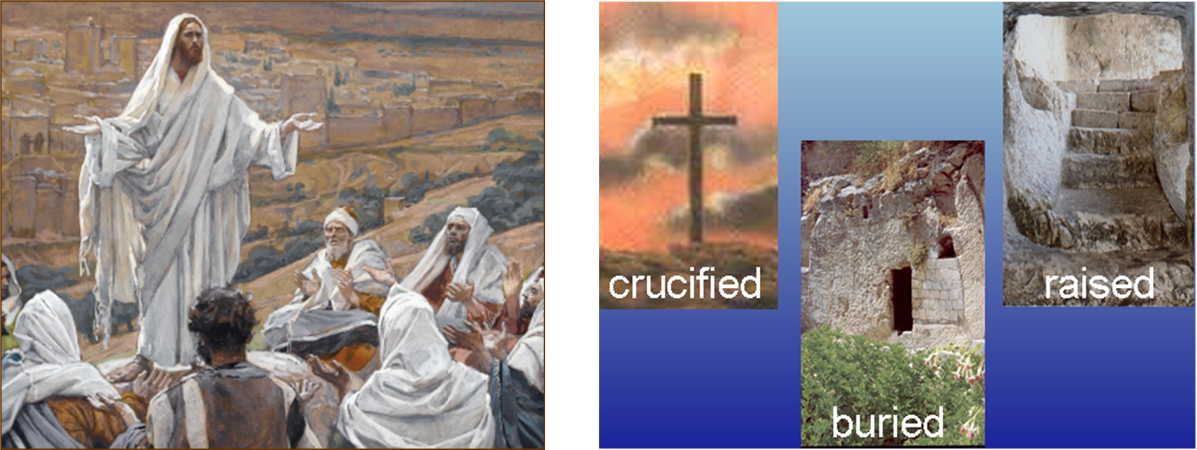
WHO IS CHRIST, WHEN?
Law and Grace: The Gospel of Substitution & The Gospel of the Kingdom – Part 1
So, it is clear that at this point in time Peter did not understand the Gospel of Substitution.

Slide 46
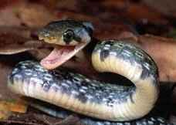
Genesis 3:15
“And I will put enmity Between you and the woman, And between your seed and her seed; He shall bruise you on the head [a fatal wound], And you shall bruise him on the heel [a wound that would not ultimately be fatal, since Christ was resurrected from the dead].”

Slide 47
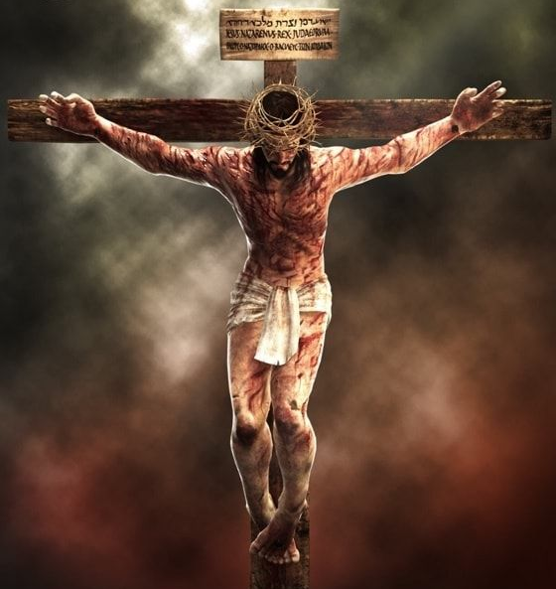
THE GOSPEL OF SUBSTITUTION
Law and Grace: The Gospel of Substitution & The Gospel of the Kingdom – Part 1
Though Satan, acting through the serpent, would be given a wound that would put a final end to his strategies against us, God’s own strategy was to send the Savior, Jesus Christ, who would be wounded for us.

Slide 48
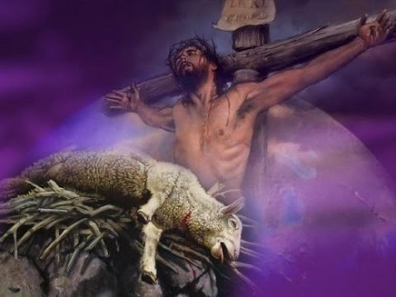
THE GOSPEL OF SUBSTITUTION
Law and Grace: The Gospel of Substitution & The Gospel of the Kingdom – Part 1
From the earliest times to Israel’s sacrifices, a sacrifice was made in anticipation of Christ giving His life as our substitute.

Slide 49
Genesis 4:3–5
³ So it came about in the course of time that Cain brought an offering to the Lord of the fruit of the ground. ⁴ Abel, on his part also brought of the firstlings of his flock and of their fat portions. And the Lord had regard for Abel and for his offering; ⁵ but for Cain and for his offering He had no regard. So Cain became very angry and his countenance fell. (cf. Noah in Gen. 8:20; Abram in Gen. 22:7-14)

Slide 50
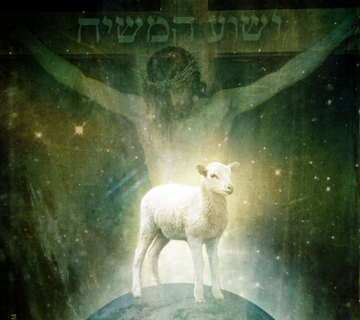
Genesis 22:7-14
⁷ Isaac spoke to Abraham his father and said,…“Behold, the fire and the wood, but where is the lamb for the burnt offering?” ⁸ Abraham said, “God will provide for Himself the lamb for the burnt offering, my son.” … ⁹ Then they came to the place of which God had told him; and Abraham built the altar there…and bound his son Isaac and laid him on the altar,... ¹⁰ Abraham stretched out his hand and took the knife to slay his son….

Slide 51
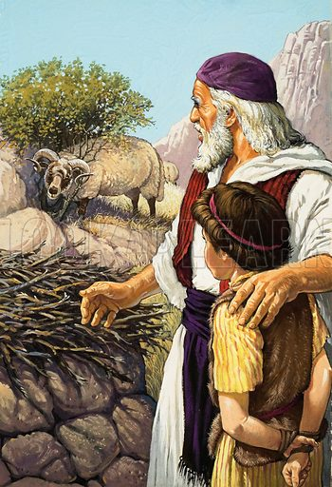
Genesis 22:7-14 (cont’d)
…¹¹ But the angel of the Lord called to him from heaven and said, …"Do not stretch out your hand against the lad,… ¹³ Then Abraham raised his eyes and looked, and behold, behind him a ram caught in the thicket by his horns; and Abraham went and took the ram and offered him up for a burnt offering in the place of his son. ¹⁴ Abraham called the name of that place The Lord Will Provide, as it is said to this day, "In the mount of the Lord it will be provided."

Slide 52
Law and Grace: The Gospel of Substitution & The Gospel of the Kingdom – Part 1
Dr. Arnold Fruchtenbaum
Fruchtenbaum, A. G. (2008). Ariel’s Bible commentary: the Book of Genesis (1st ed., p. 354). Ariel Ministries.
In Hebrew, [in v.8] it reads yireh-lo, which allows for two options. The first option is that God will provide for Himself or, second, that God will provide Himself as an offering. –

Slide 53
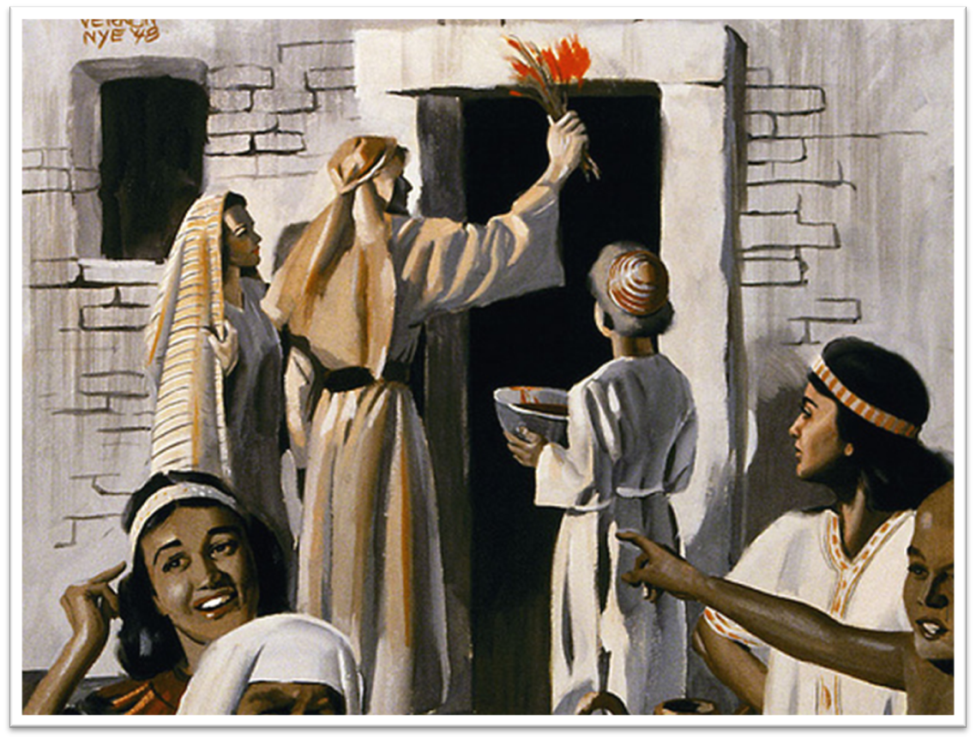
EXODUS 12:27
THE GOSPEL OF SUBSTITUTION
“you shall say, ‘It is a Passover sacrifice to the LORD who passed over the houses of the sons of Israel in Egypt when He smote the Egyptians, but spared our homes.’” And the people bowed low and worshiped.

Slide 54
THE GREAT ISAIAH SCROLL Isa. 52:13-53:12
Law and Grace: The Gospel of Substitution & The Gospel of the Kingdom – Part 1

Slide 55
The gospel in 1 Corinthians 15:3-4
³ For I delivered to you as of first importance what I also received, that Christ died for our sins* according to the Scriptures, ⁴ and that He was buried**, and that He was raised*** on the third day according to the Scriptures… (Isaiah 53:4-6, 8,10-12; Isaiah 53:9; Isaiah 53:10-12)
The 3 fundamental facts that must be believed about Christ, in order for a person to be saved, were prophesied in Isaiah 53 ~700 BC!!!

Slide 56
Law and Grace: The Gospel of Substitution & The Gospel of the Kingdom – Part 1
THE GOSPEL OF THE KINGDOM IN GENESIS
The Bible indicates that during the Millennial (1000 year) reign of Christ, Israel’s land will expand well beyond its present small size.

Slide 57
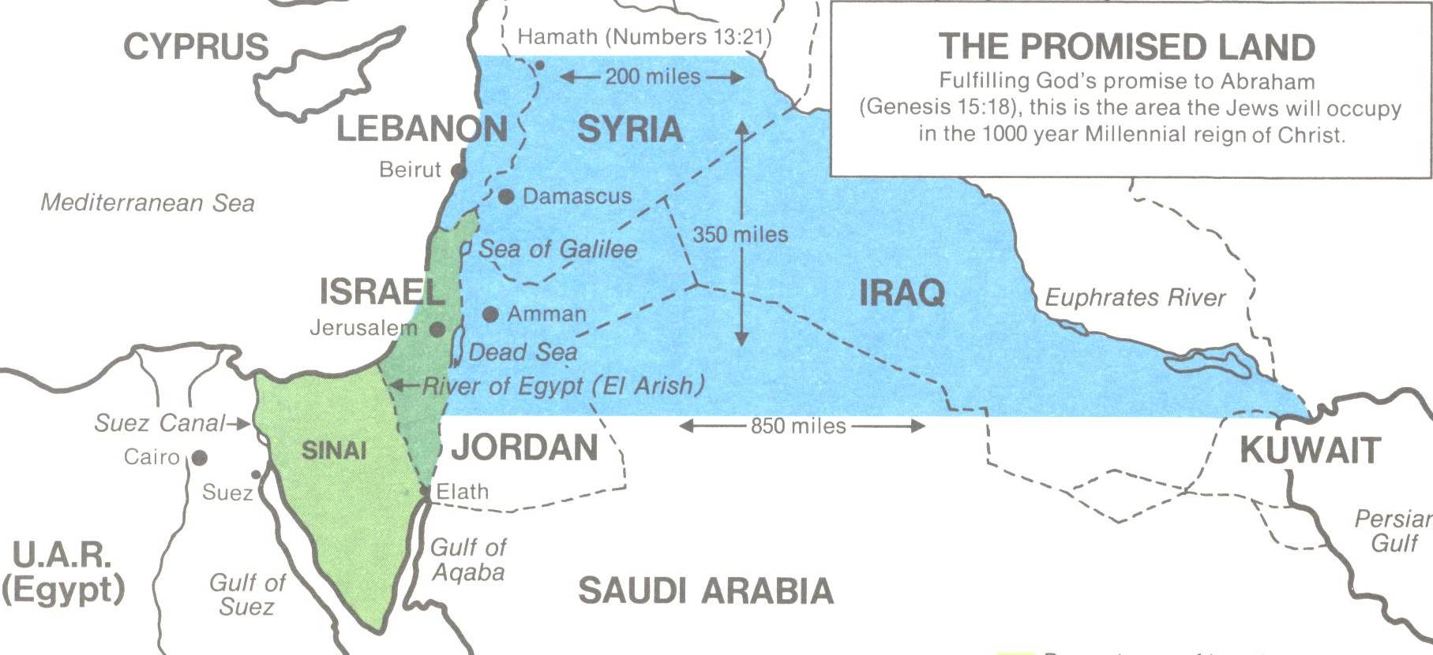
Law and Grace: The Gospel of Substitution & The Gospel of the Kingdom – Part 1
THE GOSPEL OF THE KINGDOM IN GENESIS

Slide 58
Genesis 49:8-10
Jacob prophesies re: Judah
“⁸ Judah, your brothers shall praise you; your hand shall be on the neck of your enemies; your father's sons shall bow down to you [you’ll be the one in power and authority in Israel]….”

Slide 59
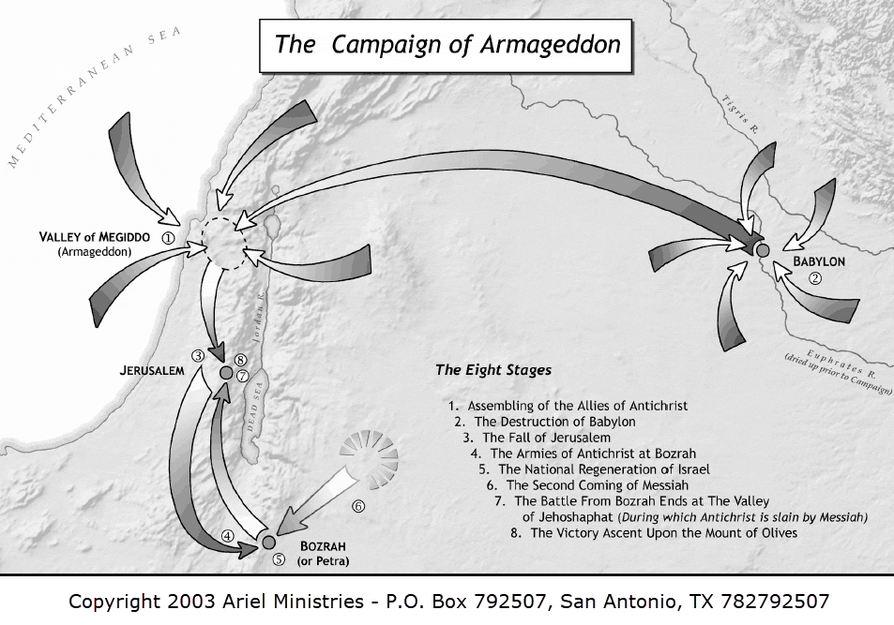
Law and Grace: The Gospel of Substitution & The Gospel of the Kingdom – Part 1
“YOUR HAND SHALL BE ON THE NECK OF YOUR ENEMIES”

Slide 60
Genesis 49:8-10
jacob prophesies re: judah
“…⁹ Judah is a lion's whelp [a symbol of power]; from the prey, my son, you have gone up. He couches, he lies down as a lion, and as a lion [“the Lion that is from the tribe of Judah”, Rev. 5:5], who dares rouse him up?...”

Slide 61
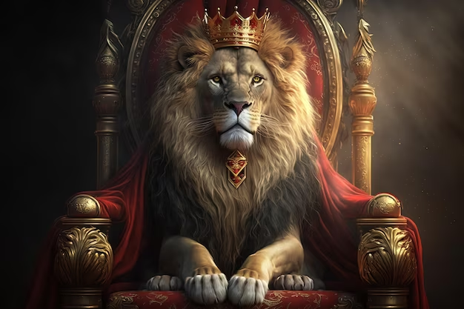
Genesis 49:8-10
jacob prophesies re: judah
“…¹⁰ The scepter [as a symbol of kingship] shall not depart from Judah, nor the ruler's staff [also a symbol of kingship] from between his feet, until Shiloh [the one to Whom it belongs] comes, and to him shall be the obedience of the peoples [= Gentiles].”

Slide 62
Law and Grace: The Gospel of Substitution & The Gospel of the Kingdom – Part 1
THE KING AND KINGDOM PROPHECY TIMELINE
❑
2000 BC 1500 BC 1000 BC 500 BC BC 0 AD
Following the prophecy about Judah…

Slide 63
Law and Grace: The Gospel of Substitution & The Gospel of the Kingdom – Part 1
THE KING AND KINGDOM PROPHECY TIMELINE
❑
❑
2000 BC 1500 BC 1000 BC 500 BC BC 0 AD
…King David (about 1000 BC) was promised that one of His descendants would reign on his throne and over his kingdom forever (2 Samuel 7:8-17 and 1 Chronicles 22:6-16)….

Slide 64
Law and Grace: The Gospel of Substitution & The Gospel of the Kingdom – Part 1
THE KING AND KINGDOM PROPHECY TIMELINE
❑
❑
❑
2000 BC 1500 BC 1000 BC 500 BC BC 0 AD
…Following that, Psalms and most of the prophets foretold conditions and particulars about the coming kingdom reign of the Messiah.

Slide 65
Matthew 1:20-21
the gospel of substitution
²⁰ But when he had considered this, behold, an angel of the Lord appeared to him in a dream, saying, "Joseph, son of David, do not be afraid to take Mary as your wife; for the Child who has been conceived in her is of the Holy Spirit. ²¹ She will bear a Son; and you shall call His name Jesus, for He will save His people from their sins."
Bible Trivia: Though lesser-known, the ancient rabbis called the Messiah who would suffer as a substitute for us all, “Messiah ben Joseph”, after the suffering of Joseph, son of Jacob.

Slide 66
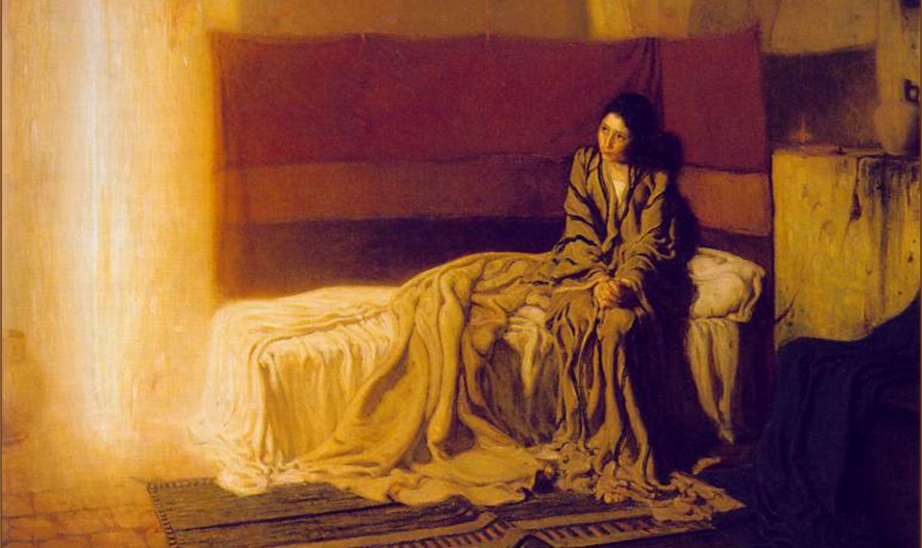
Luke 1:30-33
the gospel of the kingdom
³⁰ The angel said to her, "Do not be afraid, Mary; for you have found favor with God. ³¹ And behold, you will conceive in your womb and bear a son, and you shall name Him Jesus. ³² He will be great and will be called the Son of the Most High; and the Lord God will give Him the throne of His father David; ³³ and He will reign over the house of Jacob forever, and His kingdom will have no end."

Slide 67
Session 41 Outline
Review
Purpose, Aim, and Objective
Session 40
The Gospel of Substitution & the Gospel of the Kingdom – Part 1
Contrasts and Comparisons
Concluding Observations

Slide 68
Law and Grace: The Gospel of Substitution & The Gospel of the Kingdom – Part 1
WHAT DO YOU THINK OF CHRIST?
The key question of the ‘Gospel of Substitution’ is, “Do you believe God regarding Jesus Christ’s death for your sins, His burial, and His resurrection?”

Slide 69
Law and Grace: The Gospel of Substitution & The Gospel of the Kingdom – Part 1
WHAT DO YOU THINK OF CHRIST?
The key question of the ‘Gospel of the Kingdom’ is, “Do you believe that Jesus is the Christ, that is, Israel’s promised Messiah?”, and that question is of first priority for Israel.

Slide 70
Law and Grace: An Overview Jim McGowan, Th.D. Sugar Land Bible Church 01-28-2024
…but grace and truth were realized through Jesus Christ - John 1:17
For the Law was given through Moses…
Special thanks to Dr. Vern Peterman for access to his insights and resources.

