Slide 2
Acts 6:1‒15 First Deacons & Stephen’s Arrest
Appointment of the First Deacons (6:1-7)
Stephen’s Arrest (6:8-15)

Slide 3
From Peter to Paul
Reference | Center | Person | Place | Outreach
Acts 1–12 | Jerusalem | Peter | Jerusalem, Judea, Samaria | Jewish
Acts 13–28 | Antioch | Paul | Uttermost parts | Gentiles

Slide 4
From Peter to Paul
Peter | Paul
Heals a man lame from birth (3:1-11) | Heals a man lame from birth (14:8-18)
Heals by shadow (5:15-16) | Heals by handkerchief (19:11-12)
Success is a cause of jealousy (5:17) | Success is a cause of jealousy (13:45)
Confronts a sorcerer (8:9-24) | Confronts a sorcerer (13:6-11)
Raises Dorcas (9:36-41) | Raises Eutychus (20:9-12)
Jailed and miraculously freed (12:3-19) | Jailed and miraculously freed (16:25-34)

Slide 5
II. Stephen’s Arrest Acts 6:8-15
Description of Stephen (8)
Disputations against Stephen (9-10)
Conspiracy against Stephen (11)
Arrest of Stephen (12)
Charges against Stephen (13-14)
Face of Stephen (15)
Opportunity of Stephen (7:1)

Slide 6
II. Stephen’s Arrest Acts 6:8-15
Description of Stephen (8)
Disputations against Stephen (9-10)
Conspiracy against Stephen (11)
Arrest of Stephen (12)
Charges against Stephen (13-14)
Face of Stephen (15)
Opportunity of Stephen (7:1)

Slide 7
Acts 6:8 Description of Stephen
Grace (8a)
Power (8b)
Miracles (8c)

Slide 8
Acts 6:8 Description of Stephen
Grace (8a)
Power (8b)
Miracles (8c)

Slide 9
Acts 6:8 Description of Stephen
Grace (8a)
Power (8b)
Miracles (8c)

Slide 10
Acts 6:8 Description of Stephen
Grace (8a)
Power (8b)
Miracles (8c)

Slide 11
Stephen’s Miracles (Acts 6:8)
MIRACLE | GREEK | STEPHEN’S MINISTRY
Powers | Dynamis | Acts 6:8
Signs | Semēion | Acts 6:8
Wonders | Teras | Acts 6:8

Slide 12
Dr. Arnold G. Fruchtenbaum
The Book of Acts, 129
“Verse 12 provides evidence of apostolic authority. The account of the second persecution of the church begins by describing the apostolic signs (v. 12a). Again it is important to note that in the book of Acts, only the apostles and the apostolic [de]legates, who were appointed by the apostles by the laying on of hands, were able to perform miracles, signs, and wonders (e.g. Acts 6:8).[113] This fact has come out four times before (Acts 2:43; 3:6-7; 4:22, 33), and now it is repeated once again in this verse.”

Slide 13
II. Stephen’s Arrest Acts 6:8-15
Description of Stephen (8)
Disputations against Stephen (9-10)
Conspiracy against Stephen (11)
Arrest of Stephen (12)
Charges against Stephen (13-14)
Face of Stephen (15)
Opportunity of Stephen (7:1)

Slide 14
Acts 6:9-10 Disputations Against Stephen
Sources of the attack (9)
Failure of the attack (10)

Slide 15
Acts 6:9-10 Disputations Against Stephen
Sources of the attack (9)
Failure of the attack (10)

Slide 17
Acts 6:9 Sources of the Attack
Libertine (9a)
Cyrene (9b)
Alexandria (9c)
Cilicia (9d)
Asia (9e)

Slide 18
Acts 6:9 Sources of the Attack
Libertine (9a)
Cyrene (9b)
Alexandria (9c)
Cilicia (9d)
Asia (9e)

Slide 20
Acts 6:9 Sources of the Attack
Libertine (9a)
Cyrene (9b)
Alexandria (9c)
Cilicia (9d)
Asia (9e)

Slide 22
Acts 6:9 Sources of the Attack
Libertine (9a)
Cyrene (9b)
Alexandria (9c)
Cilicia (9d)
Asia (9e)

Slide 23
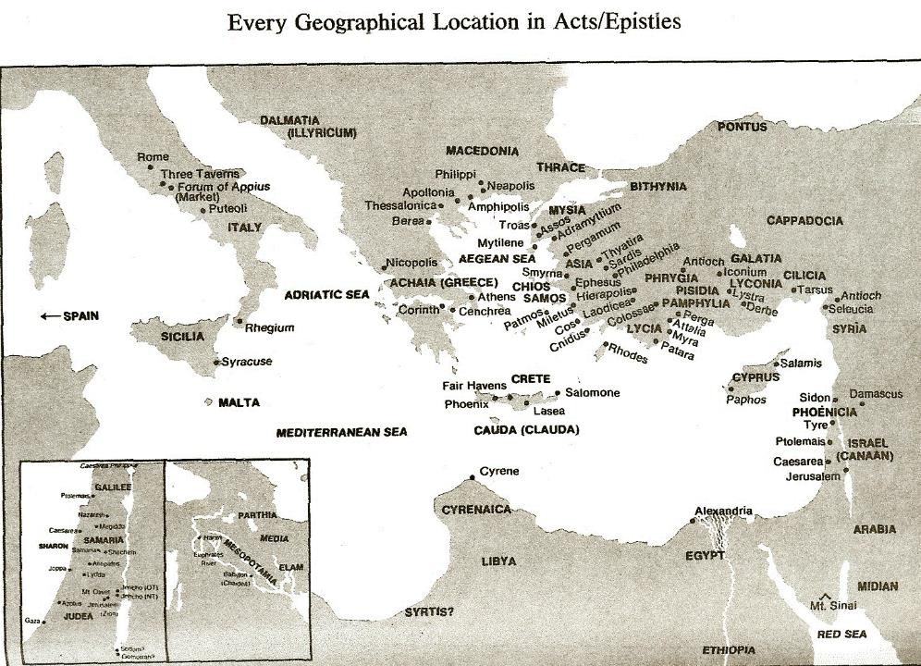

Slide 24
Acts 6:9 Sources of the Attack
Libertine (9a)
Cyrene (9b)
Alexandria (9c)
Cilicia (9d)
Asia (9e)

Slide 26
Acts 6:9 Sources of the Attack
Libertine (9a)
Cyrene (9b)
Alexandria (9c)
Cilicia (9d)
Asia (9e)

Slide 29
Acts 6:9-10 Disputations Against Stephen
Sources of the attack (9)
Failure of the attack (10)

Slide 30
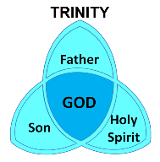
Mark 13:11
“¹¹ When they arrest you and hand you over, do not worry beforehand about what you are to say, but say whatever is given you in that hour; for it is not you who speak, but it is the Holy Spirit.”

Slide 31
II. Stephen’s Arrest Acts 6:8-15
Description of Stephen (8)
Disputations against Stephen (9-10)
Conspiracy against Stephen (11)
Arrest of Stephen (12)
Charges against Stephen (13-14)
Face of Stephen (15)
Opportunity of Stephen (7:1)

Slide 32
Acts 6:11 Conspiracy Against Stephen
Bribery (11a)
Charges (11b-c)

Slide 33
Acts 6:11 Conspiracy Against Stephen
Bribery (11a)
Charges (11b-c)

Slide 34
Acts 6:11 Conspiracy Against Stephen
Bribery (11a)
Charges (11b-c)

Slide 35
Acts 6:11b-c Charges
Speaking against Moses (11b)
Speaking against God (11c)

Slide 36
Acts 6:11b-c Charges
Speaking against Moses (11b)
Speaking against God (11c)

Slide 38
Acts 6:11b-c Charges
Speaking against Moses (11b)
Speaking against God (11c)

Slide 39
II. Stephen’s Arrest Acts 6:8-15
Description of Stephen (8)
Disputations against Stephen (9-10)
Conspiracy against Stephen (11)
Arrest of Stephen (12)
Charges against Stephen (13-14)
Face of Stephen (15)
Opportunity of Stephen (7:1)

Slide 40
II. Stephen’s Arrest Acts 6:8-15
Description of Stephen (8)
Disputations against Stephen (9-10)
Conspiracy against Stephen (11)
Arrest of Stephen (12)
Charges against Stephen (13-14)
Face of Stephen (15)
Opportunity of Stephen (7:1)

Slide 41
Acts 6:13-14 Charges Against Stephen
Charge (13)
Substantiation of charges (14)

Slide 42
Acts 6:13-14 Charges Against Stephen
Charge (13)
Substantiation of charges (14)

Slide 43
Acts 6:13 Charges
Speaking Against the Temple (13a)
Speaking Against the Law (13b)

Slide 44
Acts 6:13 Charges
Speaking Against the Temple (13a)
Speaking Against the Law (13b)

Slide 45
Acts 6:13 Charges
Speaking Against the Temple (13a)
Speaking Against the Law (13b)

Slide 47
Acts 6:13-14 Charges Against Stephen
Charge (13)
Substantiation of charges (14)

Slide 48
Acts 6:14 Substantiation of the Charges
Against the Temple (14a)
Against the Law (14b)

Slide 49
Acts 6:14 Substantiation of the Charges
Against the Temple (14a)
Against the Law (14b)

Slide 50
Matthew 24:1-2
“¹ Jesus came out from the temple and was going away when His disciples came up to point out the temple buildings to Him. ² And He said to them, “Do you not see all these things? Truly I say to you, not one stone here will be left upon another, which will not be torn down.”

Slide 51
Luke 19:41-44
^{41 “}When He approached Jerusalem, He saw the city and wept over it, ⁴² saying, “If you had known in this day, even you, the things which make for peace! But now they have been hidden from your eyes. ⁴³ For the days will come upon you when your enemies will throw up a barricade against you, and surround you and hem you in on . . .

Slide 52
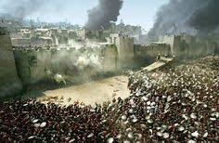
Luke 19:41-44
. . . every side, ⁴⁴ and they will level you to the ground and your children within you, and they will not leave in you one stone upon another, because you did not recognize the time of your visitation.”

Slide 53
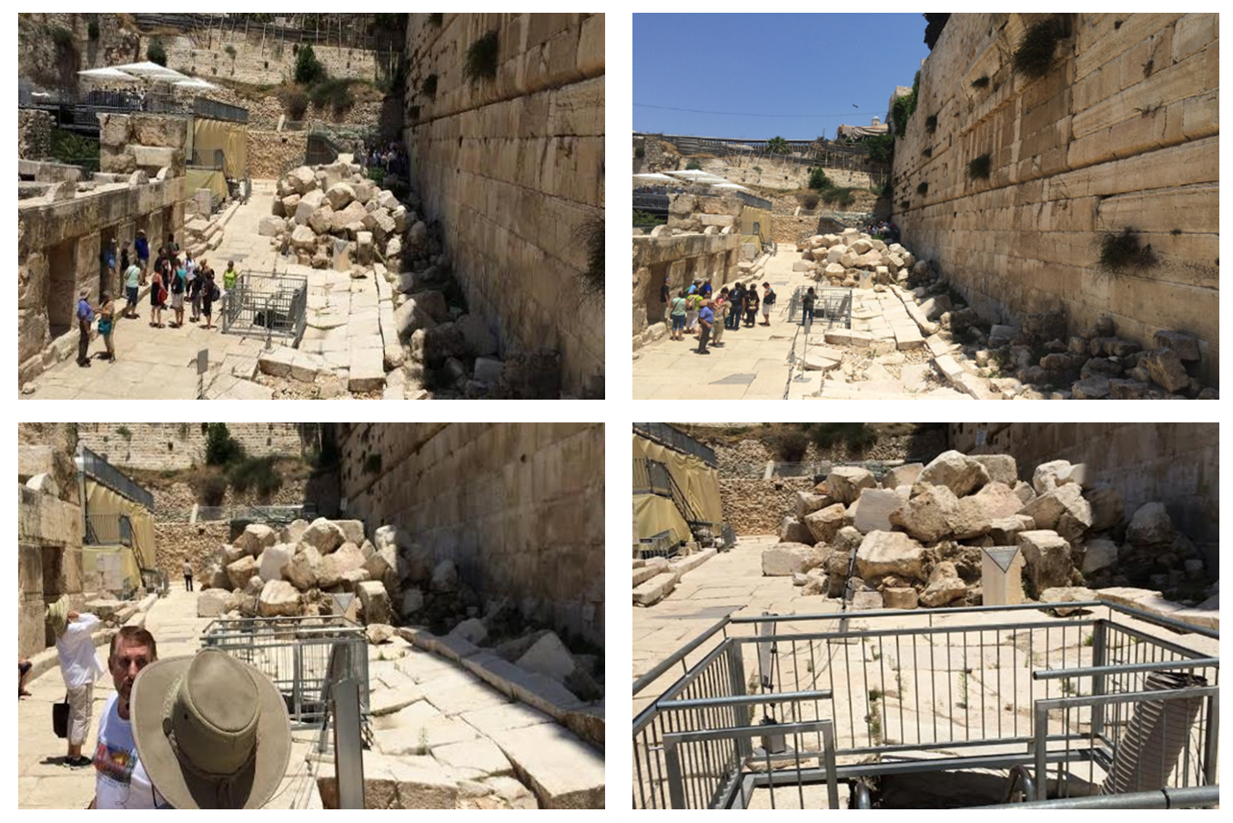

Slide 54
Acts 6:14 Substantiation of the Charges
Against the Temple (14a)
Against the Law (14b)

Slide 55
II. Stephen’s Arrest Acts 6:8-15
Description of Stephen (8)
Disputations against Stephen (9-10)
Conspiracy against Stephen (11)
Arrest of Stephen (12)
Charges against Stephen (13-14)
Face of Stephen (15)
Opportunity of Stephen (7:1)

Slide 56
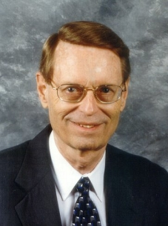
Charles Ryrie Dispensationalism (Chicago: Moody Press, 1965), 86.
Literal interpretation “…might also be called plain interpretation so that no one receives the mistaken notion that the literal principle rules out figures of speech.”

Slide 58
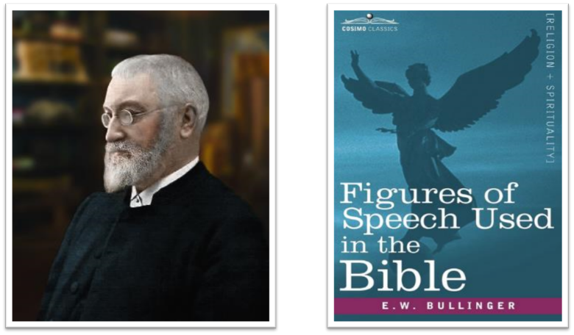
E.W. Bullinger (1837‒1913)

Slide 59
II. Stephen’s Arrest Acts 6:8-15
Description of Stephen (8)
Disputations against Stephen (9-10)
Conspiracy against Stephen (11)
Arrest of Stephen (12)
Charges against Stephen (13-14)
Face of Stephen (15)
Opportunity of Stephen (7:1)

Slide 60
Conclusion

Slide 61
Acts 6:1‒15 First Deacons & Stephen’s Arrest
Appointment of the First Deacons (6:1-7)
Stephen’s Arrest (6:8-15)

Slide 62
Acts 6:8‒8:4 Stephen
Stephen’s Arrest (6:8‒7:1)
Stephen’s Defense (Acts 7:2-53)
Stephen’s Stoning (7:54-60)
Third Persecution (Acts 8:1-4)

Slide 63
Acts 7 – Stephen’s Speech
1. 7:2-5 | Abraham’s partial obedience
2. 7:6-38 | Israel’s initial rejections and later acceptances
3. 7:39-41 | Israel’s early rebellion against Moses
4. 7:42-45 | Israel reinterpreted Moses’ teachings though a polytheistic framework
5. 7:46-50 | Neither the Tabernacle nor Temple were intended as permanent habitations of God
6. 7:51-53 | Current generation imitating these same rebellions

