Slide 1
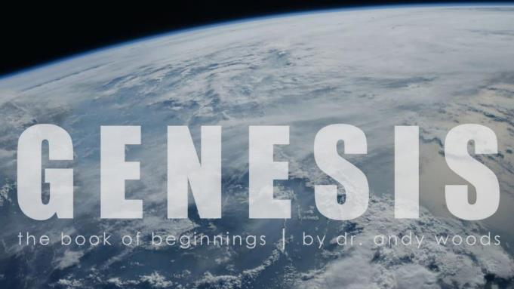
Genesis 12‒50
Israel’s Birth & Preservation

Slide 2
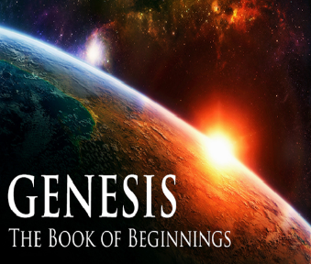
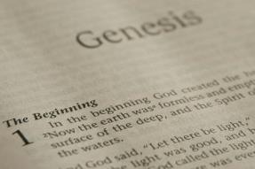
GENESIS STRUCTURE
Genesis 12-50 (four people)
Abraham (12:1–25:11)
Isaac (25:12–26:35)
Jacob (27–36)
Joseph (37–50)

Slide 3
Genesis 37:2-36 Joseph Sold unto Egypt
Joseph’s coat (37:2-4)
Joseph’s dreams (37:5-11)
Joseph’s pit (37:12-24)
Joseph’s enslavement (37:25-36)

Slide 4
Genesis 37:2-36 Joseph Sold unto Egypt
Joseph’s coat (37:2-4)
Joseph’s dreams (37:5-11)
Joseph’s pit (37:12-24)
Joseph’s enslavement (37:25-36)

Slide 5
Genesis 37:2-36 Joseph Sold unto Egypt
Joseph’s coat (37:2-4)
Joseph’s dreams (37:5-11)
Joseph’s pit (37:12-24)
Joseph’s enslavement (37:25-36)

Slide 6
Genesis 37:2-36 Joseph Sold unto Egypt
Joseph’s coat (37:2-4)
Joseph’s dreams (37:5-11)
Joseph’s pit (37:12-24)
Joseph’s enslavement (37:25-36)

Slide 7
III. Genesis 37:12-24 Joseph’s Pit
Joseph’s search for his brothers (12-17)
Brothers’ conspiracy to kill Joseph (18-24)

Slide 8
III. Genesis 37:12-24 Joseph’s Pit
Joseph’s search for his brothers (12-17)
Brothers’ conspiracy to kill Joseph (18-24)

Slide 9
Genesis 37:12-17 Joseph’s Search for his Brothers
Location: Shechem (12)
Jacob sends Joseph (13-14)
Joseph’s search in Shechem (15-17a)
Joseph’s journey (17b)

Slide 10
Genesis 37:12-17 Joseph’s Search for his Brothers
Location: Shechem (12)
Jacob sends Joseph (13-14)
Joseph’s search in Shechem (15-17a)
Joseph’s journey (17b)

Slide 11
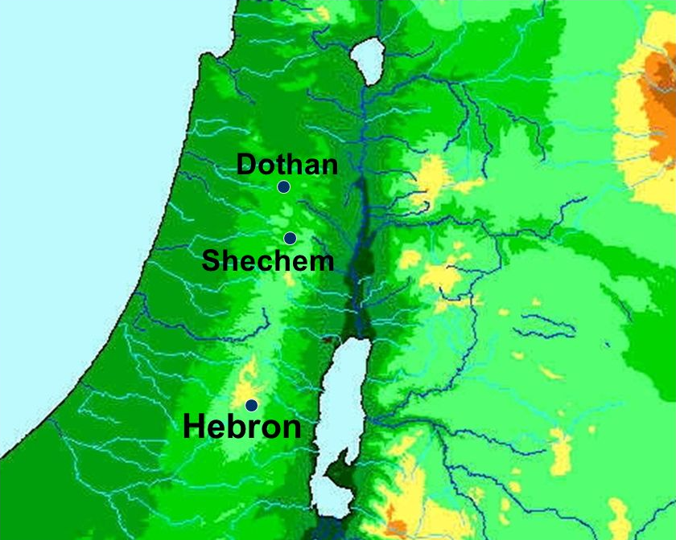

Slide 12
Genesis 37:12-17 Joseph’s Search for his Brothers
Location: Shechem (12)
Jacob sends Joseph (13-14)
Joseph’s search in Shechem (15-17a)
Joseph’s journey (17b)

Slide 13
Genesis 37:13-14 Jacob Sends Joseph
Jacob’s initiation (13a)
Joseph’s response (13b)
Jacob’s instructions (14a)
Joseph’s journey (14b)

Slide 14
Genesis 37:13-14 Jacob Sends Joseph
Jacob’s initiation (13a)
Joseph’s response (13b)
Jacob’s instructions (14a)
Joseph’s journey (14b)

Slide 15
Genesis 37:13-14 Jacob Sends Joseph
Jacob’s initiation (13a)
Joseph’s response (13b)
Jacob’s instructions (14a)
Joseph’s journey (14b)

Slide 16
Genesis 37:13-14 Jacob Sends Joseph
Jacob’s initiation (13a)
Joseph’s response (13b)
Jacob’s instructions (14a)
Joseph’s journey (14b)

Slide 17
Genesis 37:13-14 Jacob Sends Joseph
Jacob’s initiation (13a)
Joseph’s response (13b)
Jacob’s instructions (14a)
Joseph’s journey (14b)

Slide 19
Genesis 37:12-17 Joseph’s Search for his Brothers
Location: Shechem (12)
Jacob sends Joseph (13-14)
Joseph’s search in Shechem (15-17a)
Joseph’s journey (17b)

Slide 20
Genesis 37:15-17a Jospeh’s Search in Shechem
Circumstances (15a)
Conversation (15b-17a)

Slide 21
Genesis 37:15-17a Jospeh’s Search in Shechem
Circumstances (15a)
Conversation (15b-17a)

Slide 22
Genesis 37:15-17a Jospeh’s Search in Shechem
Circumstances (15a)
Conversation (15b-17a)

Slide 23
Genesis 37:1b-17a Conversation
Inquiry (15b)
Joseph’s response (16)
Answer (17a)

Slide 24
Genesis 37:1b-17a Conversation
Inquiry (15b)
Joseph’s response (16)
Answer (17a)

Slide 25
Genesis 37:1b-17a Conversation
Inquiry (15b)
Joseph’s response (16)
Answer (17a)

Slide 26
Genesis 37:1b-17a Conversation
Inquiry (15b)
Joseph’s response (16)
Answer (17a)

Slide 28
Genesis 37:12-17 Joseph’s Search for his Brothers
Location: Shechem (12)
Jacob sends Joseph (13-14)
Joseph’s search in Shechem (15-17a)
Joseph’s journey (17b)

Slide 29
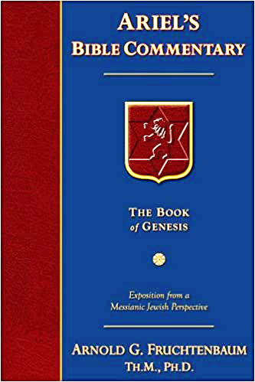
Dr. Arnold G. Fruchtenbaum
The Book of Genesis, 533
“So in verse 17b, Joseph journeys to Dothan: And Joseph went after his brethren and found them in Dothan. Dothan is north of Shechem, another day’s journey. The situation in Shechem may still have been somewhat tense, but for one reason or another they had chosen to go further north, and Dothan was the city located on the north-south trunk route. Dothan was also located on the east-west trade route between Gilead and the Coastal Plain where it connected with the Via Maris that in turn would go south into Egypt. All this set the stage for the selling of Joseph.”

Slide 30
III. Genesis 37:12-24 Joseph’s Pit
Joseph’s search for his brothers (12-17)
Brothers’ conspiracy to kill Joseph (18-24)

Slide 31
Genesis 37:18-24 Brothers’ Conspiracy to Kill Joseph
Plot to kill Joseph (18-20)
Reuben’s intercession (21-22)
Plan executed (23-24)

Slide 32
Genesis 37:18-24 Brothers’ Conspiracy to Kill Joseph
Plot to kill Joseph (18-20)
Reuben’s intercession (21-22)
Plan executed (23-24)

Slide 33
Genesis 37:18-20 Plot to Kill Joseph
Timing (18)
Plot (19-20)

Slide 34
Genesis 37:18-20 Plot to Kill Joseph
Timing (18)
Plot (19-20)

Slide 35
Genesis 37:18-20 Plot to Kill Joseph
Timing (18)
Plot (19-20)

Slide 36
Genesis 37:19-20 Plot
Victim (19)
Content (20)

Slide 37
Genesis 37:19-20 Plot
Victim (19)
Content (20)

Slide 38
Dr. Arnold G. Fruchtenbaum
The Book of Genesis, 536
“Then came the merchant’s journey: They brought Joseph into Egypt. While this was not the brothers’ intent, by selling him in place of killing him, they rendered the fulfillment of the dream certain. Although they thought they were rendering the dreams null and void by what they were doing, they were actually creating a situation that would cause the fulfillment of them, proving the principle of Scripture: Even the wrath of men will end up praising God.”

Slide 39
Genesis 37:19-20 Plot
Victim (19)
Content (20)

Slide 40
Genesis 37:18-24 Brothers’ Conspiracy to Kill Joseph
Plot to kill Joseph (18-20)
Reuben’s intercession (21-22)
Plan executed (23-24)

Slide 41
Genesis 37:21-22 Reuben’s Intercession
Intervention (21)
Plan (22)

Slide 42
Genesis 37:21-22 Reuben’s Intercession
Intervention (21)
Plan (22)

Slide 44
Genesis 37:21-22 Reuben’s Intercession
Intervention (21)
Plan (22)

Slide 45
Genesis 37:22 Plan
Do not murder (22a)
Pit (22b)
Rescue later (22c)

Slide 46
Genesis 37:22 Plan
Do not murder (22a)
Pit (22b)
Rescue later (22c)

Slide 47
Genesis 37:22 Plan
Do not murder (22a)
Pit (22b)
Rescue later (22c)

Slide 48
Genesis 37:22 Plan
Do not murder (22a)
Pit (22b)
Rescue later (22c)

Slide 49
Genesis 37:18-24 Brothers’ Conspiracy to Kill Joseph
Plot to kill Joseph (18-20)
Reuben’s intercession (21-22)
Plan executed (23-24)

Slide 50
Genesis 37:23-24 Plan Executed
Removal of the coat (23)
Cast into the pit (24)

Slide 51
Genesis 37:23-24 Plan Executed
Removal of the coat (23)
Cast into the pit (24)

Slide 52
Genesis 37:23-24 Plan Executed
Removal of the coat (23)
Cast into the pit (24)

Slide 53
Genesis 37:2-36 Joseph Sold unto Egypt
Joseph’s coat (37:2-4)
Joseph’s dreams (37:5-11)
Joseph’s pit (37:12-24)
Joseph’s enslavement (37:25-36)

Slide 54
IV. Genesis 37:25-36 Joseph’s Enslavement
Selling of Joseph (25-28)
Reuben’s discovery (29-30)
Brothers report to Jacob (31-32)
Jacob’s response (33-35)
Joseph sold again (36)

Slide 55
IV. Genesis 37:25-36 Joseph’s Enslavement
Selling of Joseph (25-28)
Reuben’s discovery (29-30)
Brothers report to Jacob (31-32)
Jacob’s response (33-35)
Joseph sold again (36)

Slide 56
Genesis 37:25-28 Selling of Joseph
Occasion (25)
Judah’s proposal (26-27a)
Agreement (27b)
Selling (28)

Slide 57
Genesis 37:25-28 Selling of Joseph
Occasion (25)
Judah’s proposal (26-27a)
Agreement (27b)
Selling (28)

Slide 58
Genesis 12‒25 Abraham’s Early Journeys
Unconditional promises (Gen. 12:1-3) From Haran to Canaan (Gen. 12:4-5) In Canaan (Gen. 12:6-9) In Egypt (Gen. 12:10-20) Abram and Lot Separate (Gen. 13:1-13) Reaffirmation of Abram’s promises (Gen. 13:14-18) Abram Rescues Lot (14:1-24) Abrahamic Covenant (15:1-21) Hagar & Ishmael (16:1-16) Circumcision (Gen. 17:1-27) | Sodom & Gomorrah (Gen. 18‒19) Abraham & Abimelech (Gen. 20) Isaac’s birth (Gen. 21:1-7) Ishmael’s expulsion (21:8-21) Abraham & Abimelech’s covenant (21:22-34) Abraham sacrifices Isaac (22) Sarah’s death (23) Isaac’s marriage (24) Abraham & Keturah (25:1-6) Abraham’s death (25:7-11)

Slide 59
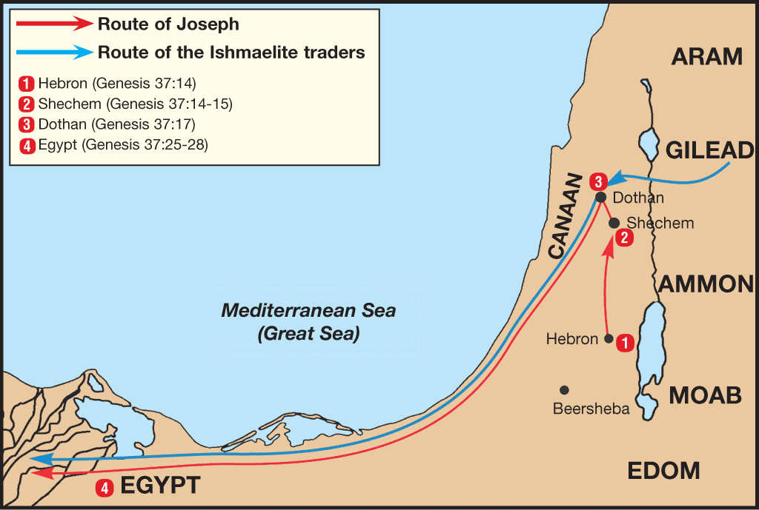

Slide 60
Dr. Arnold G. Fruchtenbaum
The Book of Genesis, 536
“In verse 27b came the agreement: And his brethren hearkened unto him. Verse 28 records the selling: And there passed by Midianites, merchantmen. These are called merchantmen; for they were North Arabian caravaneers who branched off through Gilead to the main route to Egypt, the Via Maris, from the King’s Highway.”

Slide 61
Genesis 37:25-28 Selling of Joseph
Occasion (25)
Judah’s proposal (26-27a)
Agreement (27b)
Selling (28)

Slide 62
Genesis 37:26-27a Judah’s Proposal
Rhetorical question (26)
Proposal (27a)

Slide 63
Genesis 37:26-27a Judah’s Proposal
Rhetorical question (26)
Proposal (27a)

Slide 65
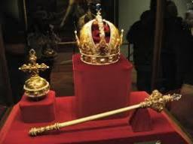
Genesis 49:10
“The scepter shall not depart from Judah, Nor the ruler’s staff from between his feet, Until Shiloh comes, And to him shall be the obedience of the peoples.”

Slide 66
Genesis 37:26-27a Judah’s Proposal
Rhetorical question (26)
Proposal (27a)

Slide 67
Genesis 37:25-28 Selling of Joseph
Occasion (25)
Judah’s proposal (26-27a)
Agreement (27b)
Selling (28)

Slide 69
Genesis 37:25-28 Selling of Joseph
Occasion (25)
Judah’s proposal (26-27a)
Agreement (27b)
Selling (28)

Slide 70
Genesis 12‒25 Abraham’s Early Journeys
Unconditional promises (Gen. 12:1-3) From Haran to Canaan (Gen. 12:4-5) In Canaan (Gen. 12:6-9) In Egypt (Gen. 12:10-20) Abram and Lot Separate (Gen. 13:1-13) Reaffirmation of Abram’s promises (Gen. 13:14-18) Abram Rescues Lot (14:1-24) Abrahamic Covenant (15:1-21) Hagar & Ishmael (16:1-16) Circumcision (Gen. 17:1-27) | Sodom & Gomorrah (Gen. 18‒19) Abraham & Abimelech (Gen. 20) Isaac’s birth (Gen. 21:1-7) Ishmael’s expulsion (21:8-21) Abraham & Abimelech’s covenant (21:22-34) Abraham sacrifices Isaac (22) Sarah’s death (23) Isaac’s marriage (24) Abraham & Keturah (25:1-6) Abraham’s death (25:7-11)

Slide 71
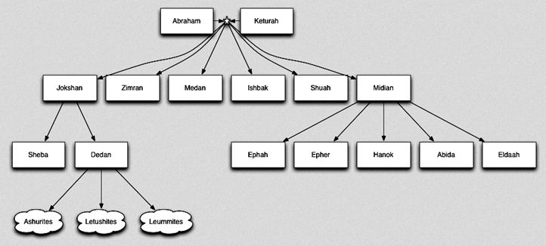

Slide 72
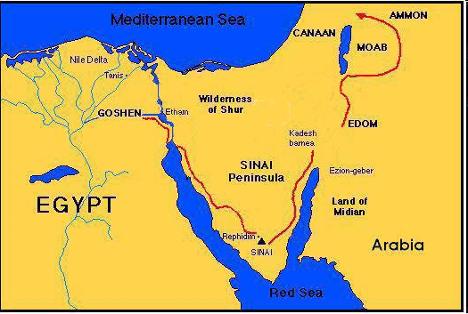

Slide 73
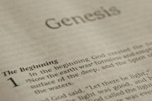
Beginning Themes
Universe Life Man Marriage Evil Clothing | Religion Salvation Language Government Nations Israel
Morris, Genesis Record, 18-20

Slide 74
IV. Genesis 37:25-36 Joseph’s Enslavement
Selling of Joseph (25-28)
Reuben’s discovery (29-30)
Brothers report to Jacob (31-32)
Jacob’s response (33-35)
Joseph sold again (36)

Slide 75
Genesis 37:29-30 Reuben’s Discovery
Discovery (29)
Dilemma (30)

Slide 76
Genesis 37:29-30 Reuben’s Discovery
Discovery (29)
Dilemma (30)

Slide 77
Genesis 37:29-30 Reuben’s Discovery
Discovery (29)
Dilemma (30)

Slide 79
IV. Genesis 37:25-36 Joseph’s Enslavement
Selling of Joseph (25-28)
Reuben’s discovery (29-30)
Brothers report to Jacob (31-32)
Jacob’s response (33-35)
Joseph sold again (36)

Slide 80
Genesis 37:31-32 Brothers Report to Jacob
Cover up (31)
Brothers show Jacob Joseph’s coat (32)

Slide 81
Genesis 37:31-32 Brothers Report to Jacob
Cover up (31)
Brothers show Jacob Joseph’s coat (32)

Slide 82
Dr. Arnold G. Fruchtenbaum
The Book of Genesis, 537
“Here again, there is a form of retribution: Jacob deceived Isaac with goatskins (27:16), now Jacob was being deceived with goat’s blood. Furthermore, Jacob deceived Isaac with Esau’s clothes (27:15); now Jacob was deceived by the use of Joseph’s clothes.”

Slide 83
Dr. Arnold G. Fruchtenbaum
The Book of Genesis, 445
“Now the deceiver is deceived, although the motivations differ from good to bad. This is divine retribution in four ways. First, Isaac’s blindness equals the darkness of Jacob’s wedding night, and neither could see well as a result. Second, this Jacob is deceived by being presented the older for the younger, the reversal of Isaac’s presentation of Jacob for Esau. Third, Isaac thought Jacob was Esau and Jacob thought Leah was Rachel. Fourth, Jacob pretended to be his older brother, while Leah pretended to be her younger sister.”

Slide 84
Genesis 37:31-32 Brothers Report to Jacob
Cover up (31)
Brothers show Jacob Joseph’s coat (32)

Slide 85
IV. Genesis 37:25-36 Joseph’s Enslavement
Selling of Joseph (25-28)
Reuben’s discovery (29-30)
Brothers report to Jacob (31-32)
Jacob’s response (33-35)
Joseph sold again (36)

Slide 86
Genesis 37:33-35 Jacob’s Response
Conclusion (33)
Mourning (34)
Lack of comfort (35)

Slide 87
Genesis 37:33-35 Jacob’s Response
Conclusion (33)
Mourning (34)
Lack of comfort (35)

Slide 88
Genesis 37:33-35 Jacob’s Response
Conclusion (33)
Mourning (34)
Lack of comfort (35)

Slide 89
Genesis 37:33-35 Jacob’s Response
Conclusion (33)
Mourning (34)
Lack of comfort (35)

Slide 90
Dr. Arnold G. Fruchtenbaum
The Book of Genesis, 537
“Jacob’s refusal is stated: He refused to be comforted; and he said, For I will go down to Sheol to my son in mourning. And his father wept for him. Sheol is the center of the earth, and before the death of the Messiah, all souls descended there upon death; but the faithful and unfaithful entered into different compartments in Sheol.”

Slide 91
IV. Genesis 37:25-36 Joseph’s Enslavement
Selling of Joseph (25-28)
Reuben’s discovery (29-30)
Brothers report to Jacob (31-32)
Jacob’s response (33-35)
Joseph sold again (36)

Slide 92
Genesis 37:36 Joseph Sold Again
Place: Egypt (36a)
Person: Potiphar (36b)

Slide 93
Genesis 37:36 Joseph Sold Again
Place: Egypt (36a)
Person: Potiphar (36b)

Slide 97
Genesis 37:36 Joseph Sold Again
Place: Egypt (36a)
Person: Potiphar (36b)

Slide 98
Conclusion

Slide 99
Genesis 37:2-36 Joseph Sold unto Egypt
Joseph’s coat (37:2-4)
Joseph’s dreams (37:5-11)
Joseph’s pit (37:12-24)
Joseph’s enslavement (37:25-36)

Slide 100
²⁴ The Lord bless you, and keep you; ²⁵ The Lord make His face shine on you, And be gracious to you; ²⁶ The Lord lift up His countenance on you, And give you peace.
Numbers 6:24–26 (NASB95)

