Slide 1
Dr. Andy Woods
Senior Pastor – Sugar Land Bible Church
President – Chafer Theological Seminary

Slide 2
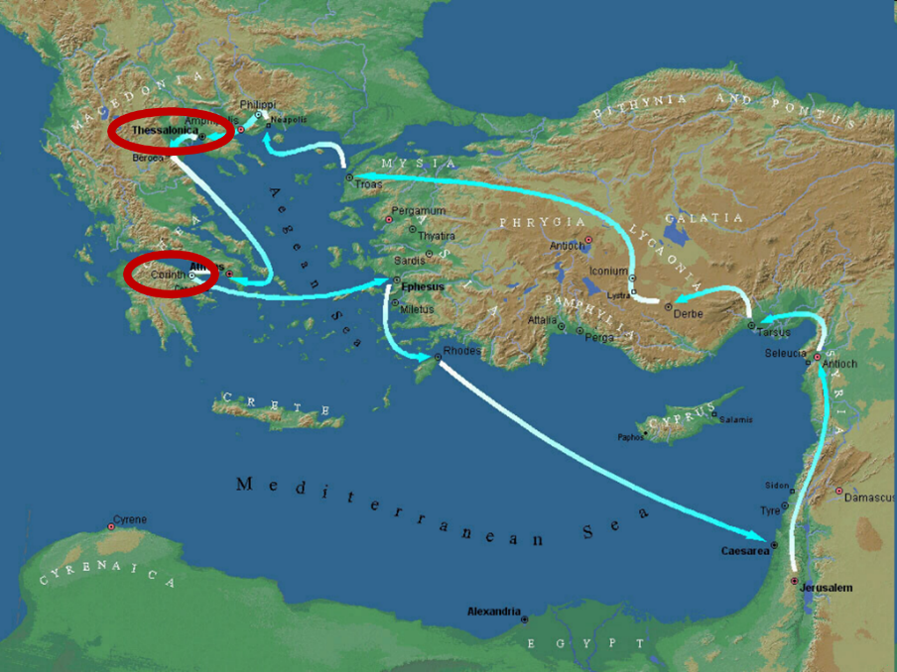

Slide 3
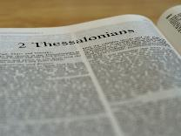
2 Thessalonians 2:1-12
Problem (2:1-2)
Prerequisites for the Day of the Lord (2:3-12)
The departure (2:3a)
Advent of the lawless one (2:3b-4)
Removal of the restrainer (2:5-7)
Destruction of the lawless one (2:8-9)
Destruction of lawless one’s followers (2:10-12)

Slide 4
2 Thessalonians 2:2
“that you not be quickly shaken from your composure or be disturbed either by a spirit or a message or a letter as if from us, to the effect that the day of the Lord [the Tribulation] has come.”

Slide 5
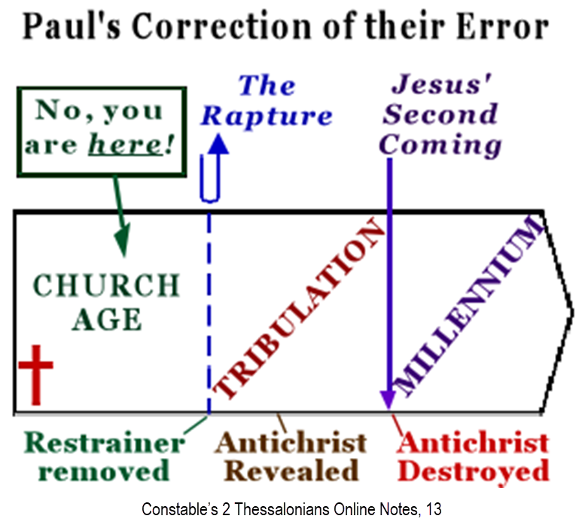

Slide 7
2 Thessalonians 2:1-12
Problem (2:1-2)
Prerequisites for the Day of the Lord (2:3-12)
The departure (2:3a)
Advent of the lawless one (2:3b-4)
Removal of the restrainer (2:5-7)
Destruction of the lawless one (2:8-9)
Destruction of lawless one’s followers (2:10-12)

Slide 8
2 Thessalonians 2:1-12
Problem (2:1-2)
Prerequisites for the Day of the Lord (2:3-12)
The departure (2:3a)
Advent of the lawless one (2:3b-4)
Removal of the restrainer (2:5-7)
Destruction of the lawless one (2:8-9)
Destruction of lawless one’s followers (2:10-12)

Slide 9
2 Thessalonians 2:1-12
Problem (2:1-2)
Prerequisites for the Day of the Lord (2:3-12)
The departure (2:3a)
Advent of the lawless one (2:3b-4)
Removal of the restrainer (2:5-7)
Destruction of the lawless one (2:8-9)
Destruction of lawless one’s followers (2:10-12)

Slide 10
2 Thessalonians 2:1-12
Problem (2:1-2)
Prerequisites for the Day of the Lord (2:3-12)
The departure (2:3a)
Advent of the lawless one (2:3b-4)
Removal of the restrainer (2:5-7)
Destruction of the lawless one (2:8-9)
Destruction of lawless one’s followers (2:10-12)

Slide 11
2 Thessalonians 2:5
“Do you not remember that while I was still with you, I was telling you these things?”

Slide 12
2 Thessalonians 2:6-7
⁶And you know what restrains [katechon; neuter] him now, so that in his time he will be revealed. ⁷For the mystery of lawlessness is already at work; only he who now restrains [katechōn; masculine] will do so until he is taken out of the way.

Slide 13
Restrainer? (2:6-7)
Rome?
Satan?
Government?
Michael?
Spirit?

Slide 14
Restrainer? (2:6-7)
Rome?
Satan?
Government?
Michael?
Spirit?

Slide 15
Restrainer? (2:6-7)
Rome?
Satan?
Government?
Michael?
Spirit?

Slide 16
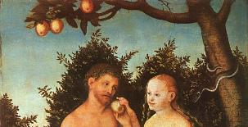
2 Thessalonians 2:9
“that is, the one whose coming is in accord with the activity of Satan, with all power and signs and false wonders.”

Slide 17
Matthew 12:24-26
“²⁴ But when the Pharisees heard this, they said, ‘This man casts out demons only by Beelzebul the ruler of the demons.’ ²⁵ And knowing their thoughts Jesus said to them, ‘Any kingdom divided against itself is laid waste; and any city or house divided against itself will not stand. ²⁶ If Satan casts out Satan, he is divided against himself; how then will his kingdom stand?”

Slide 18
Restrainer? (2:6-7)
Rome?
Satan?
Government?
Michael?
Spirit?

Slide 19
Genesis 9:6
“Whoever sheds man’s blood, By man his blood shall be shed, For in the image of God He made man.”

Slide 20
Romans 13:1-7
¹ Every person is to be in subjection to the governing authorities. For there is no authority except from God, and those which exist are established by God. ² Therefore whoever resists authority has opposed the ordinance of God; and they who have opposed will receive condemnation upon themselves. ³ For rulers are not a cause of fear for good behavior, but for evil. Do you want to have no fear of authority? Do what is good and you will have praise from the same; ⁴ for it is a minister of God to you for good. . . .

Slide 21
Romans 13:1-7
... But if you do what is evil, be afraid; for it does not bear the sword for nothing; for it is a minister of God, an avenger who brings wrath on the one who practices evil. ⁵ Therefore it is necessary to be in subjection, not only because of wrath, but also for conscience’ sake. ⁶ For because of this you also pay taxes, for rulers are servants of God, devoting themselves to this very thing. ⁷ Render to all what is due them: tax to whom tax is due; custom to whom custom; fear to whom fear; honor to whom honor.

Slide 22
Daniel 7:19, 23, 25
“Then I desired to know the exact meaning of the fourth beast, which was different from all the others, exceedingly dreadful, with its teeth of iron and its claws of bronze, and which devoured, crushed and trampled down the remainder with its feet…Thus he said: ‘The fourth beast will be a fourth kingdom on the earth, which will be different from all the other kingdoms and will devour the whole . . .

Slide 23
Daniel 7:19, 23, 25
. . . earth and tread it down and crush it…He will speak out against the Most High and wear down the saints of the Highest One, and he will intend to make alterations in times and in law; and they will be given into his hand for a time, times, and half a time.”

Slide 24
Restrainer? (2:6-7)
Rome?
Satan?
Government?
Michael?
Spirit?

Slide 25
Marvin Rosenthal
“…of paramount importance is the identification of the one who restraints or hinders the Antichrist until ‘he [the restrainer] be taken out of the way.’ The restrainer is neither the Holy Spirit nor human government. Evidence is strained to support either of those contentions. There is, however, substantial evidence to identify the restrainer. He who restraints until ‘he be taken out of the way’ is the Archangel Michael.”
Marvin J. Rosenthal, The Pre-Wrath Rapture of the Church: A New Understanding of the Tribulation, and the Second Coming (Nashville, TN: Thomas Nelson, 1990), 112.

Slide 26
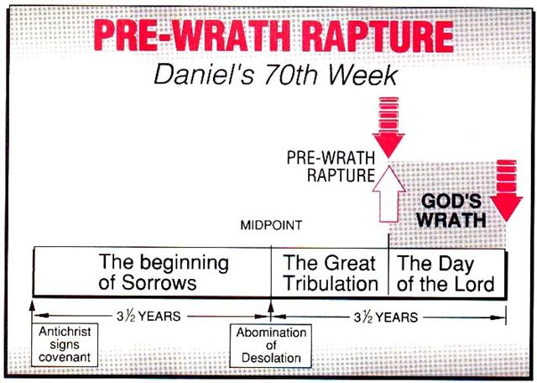
Marvin J. Rosenthal, The Pre-Wrath Rapture of the Church: A New Understanding of the Tribulation, and the Second Coming (Nashville, TN: Thomas Nelson, 1990), 112.

Slide 28
2 Thessalonians 2:6-7
⁶And you know what restrains [katechon; neuter] him now, so that in his time he will be revealed. ⁷For the mystery of lawlessness is already at work; only he who now restrains [katechōn; masculine] will do so until he is taken out of the way.

Slide 29
2 Thessalonians 2:6-7
⁶And you know what restrains [τὸ κατέχον; neuter] him now, so that in his time he will be revealed. ⁷For the mystery of lawlessness is already at work; only he who now restrains [ὁ κατέχων; masculine] will do so until he is taken out of the way.

Slide 30
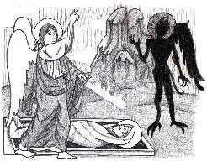
Jude 9
“But Michael the archangel, when he disputed with the devil and argued about the body of Moses, did not dare pronounce against him a railing judgment, but said, ‘The Lord rebuke you!’”

Slide 31
2 Thessalonians 2:9
“that is, the one whose coming is in accord with the activity of Satan, with all power and signs and false wonders.”

Slide 32
Daniel 12:1
“Now at that time Michael, the great prince who stands guard over the sons of your people [Israel], will arise. And there will be a time of distress such as never occurred since there was a nation until that time; and at that time your people, everyone who is found written in the book, will be rescued.”

Slide 33
Tony Kessinger
“The pre-wrath view holds to the rather inventive idea that Michael the archangel is the restrainer. This concept fails to take into consideration Michael's special protective ministry toward Israel.”
Tony Kessinger, "Pre-Wrath Rapture," in The Popular Encyclopedia of Bible Prophecy: Over 140 Topics from the World's Foremost Prophecy Experts, ed. Tim LaHaye and Ed Hindson (Eugene, OR: Harvest, 2004), 294.

Slide 34
Daniel 12:1
“Now at that time Michael, the great prince who stands guard over the sons of your people [Israel], will arise. And there will be a time of distress such as never occurred since there was a nation until that time; and at that time your people, everyone who is found written in the book, will be rescued.”

Slide 35
Restrainer? (2:6-7)
Rome?
Satan?
Government?
Michael?
Spirit?

Slide 36
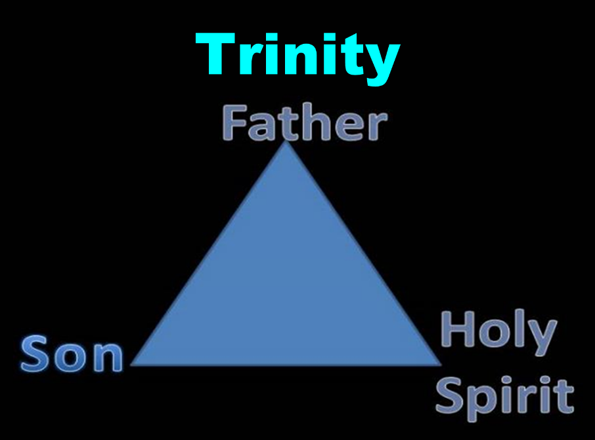

Slide 37
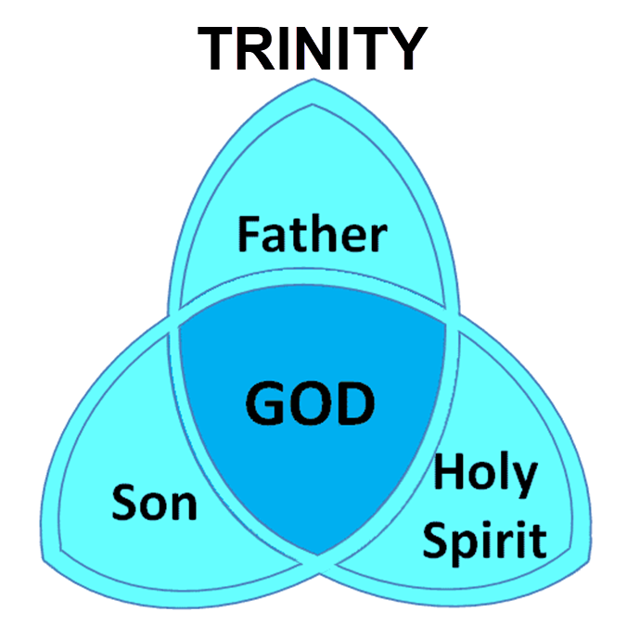

Slide 38
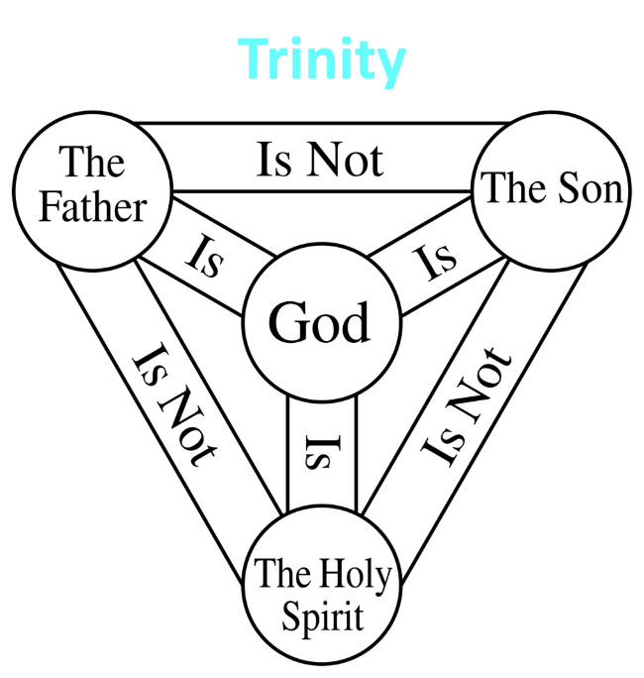

Slide 39
3 Reasons Why the Restrainer is the Holy Spirit (2 Thessalonians 2:6-7)
The Holy Spirit is omnipotent (2 Thess. 2:9)
The Holy Spirit is active in the world (Gen. 6:3; John 16:7-11)
The Holy Spirit view handles well the switch in gender from the neuter (vs. 6) to the masculine (vs. 7)

Slide 40
3 Reasons Why the Restrainer is the Holy Spirit (2 Thessalonians 2:6-7)
The Holy Spirit is omnipotent (2 Thess. 2:9)
The Holy Spirit is active in the world (Gen. 6:3; John 16:7-11)
The Holy Spirit view handles well the switch in gender from the neuter (vs. 6) to the masculine (vs. 7)

Slide 41
2 Thessalonians 2:9
“that is, the one whose coming is in accord with the activity of Satan, with all power and signs and false wonders.”

Slide 42
3 Reasons Why the Restrainer is the Holy Spirit (2 Thessalonians 2:6-7)
The Holy Spirit is omnipotent (2 Thess. 2:9)
The Holy Spirit is active in the world (Gen. 6:3; John 16:7-11)
The Holy Spirit view handles well the switch in gender from the neuter (vs. 6) to the masculine (vs. 7)

Slide 43
Genesis 6:1-3
“¹ Now it came about, when men began to multiply on the face of the land, and daughters were born to them, ² that the sons of God saw that the daughters of men were beautiful; and they took wives for themselves, whomever they chose. ³ Then the Lord said, “My Spirit shall not strive with man forever, because he also is flesh; nevertheless his days shall be one hundred and twenty years.”

Slide 44
John 16:7-11
“⁷ But I tell you the truth, it is to your advantage that I go away; for if I do not go away, the Helper will not come to you; but if I go, I will send Him to you. ⁸ And He, when He comes, will convict the world concerning sin and righteousness and judgment; ⁹ concerning sin, because they do not believe in Me; ¹⁰ and concerning righteousness, because I go to the Father and you no longer see Me; ¹¹ and concerning judgment, because the ruler of this world has been judged.”

Slide 45
3 Reasons Why the Restrainer is the Holy Spirit (2 Thessalonians 2:6-7)
The Holy Spirit is omnipotent (2 Thess. 2:9)
The Holy Spirit is active in the world (Gen. 6:3; John 16:7-11)
The Holy Spirit view handles well the switch in gender from the neuter (vs. 6) to the masculine (vs. 7)

Slide 46
2 Thessalonians 2:6-7
⁶And you know what restrains [katechō; neuter] him now, so that in his time he will be revealed. ⁷For the mystery of lawlessness is already at work; only he who now restrains [katechō; masculine] will do so until he is taken out of the way.

Slide 47
2 Thessalonians 2:6-7
⁶And you know what restrains [τὸ κατέχον; neuter] him now, so that in his time he will be revealed. ⁷For the mystery of lawlessness is already at work; only he who now restrains [ὁ κατέχων; masculine] will do so until he is taken out of the way.

Slide 48
John 14:16-17
¹⁶ I will ask the Father, and He will give you another Helper, that He may be with you forever; ¹⁷ that is the Spirit of truth, whom the world cannot receive, because it does not see Him or know Him, but you know Him because He abides with you and will be in you.

Slide 49
John 16:7-11
“⁷ But I tell you the truth, it is to your advantage that I go away; for if I do not go away, the Helper will not come to you; but if I go, I will send Him to you. ⁸ And He, when He comes, will convict the world concerning sin and righteousness and judgment; ⁹ concerning sin, because they do not believe in Me; ¹⁰ and concerning righteousness, because I go to the Father and you no longer see Me; ¹¹ and concerning judgment, because the ruler of this world has been judged.”

Slide 50
Romans 8:5-6
^{5 “}For those who are according to the flesh set their minds on the things of the flesh, but those who are according to the Spirit, the things of the Spirit. ⁶ For the mind set on the flesh is death, but the mind set on the Spirit is life and peace.”

Slide 51
2 Thessalonians 2:5
“Do you not remember that while I was still with you, I was telling you these things?”

Slide 52
Restrainer Must First be Removed
Restrainer holds back the Antichrist (2 Thess 2:6-7)
Restrainer = the omnipotent Holy Spirit (2 Thess 2:9)
Holy Spirit permanently indwells all Christians (John 14:16; Rom 8:9)
Sprit indwelt Christians must first be removed prior to the Antichrist's advent

Slide 53
Restrainer Must First be Removed
Restrainer holds back the Antichrist (2 Thess 2:6-7)
Restrainer = the omnipotent Holy Spirit (2 Thess 2:9)
Holy Spirit permanently indwells all Christians (John 14:16; Rom 8:9)
Sprit indwelt Christians must first be removed prior to the Antichrist's advent

Slide 54
Restrainer Must First be Removed
Restrainer holds back the Antichrist (2 Thess 2:6-7)
Restrainer = the omnipotent Holy Spirit (2 Thess 2:9)
Holy Spirit permanently indwells all Christians (John 14:16; Rom 8:9)
Sprit indwelt Christians must first be removed prior to the Antichrist's advent

Slide 55
Restrainer Must First be Removed
Restrainer holds back the Antichrist (2 Thess 2:6-7)
Restrainer = the omnipotent Holy Spirit (2 Thess 2:9)
Holy Spirit permanently indwells all Christians (John 14:16; Rom 8:9)
Sprit indwelt Christians must first be removed prior to the Antichrist's advent

Slide 56
WORK OF THE SPIRIT IN THE OT
 | OT/GOSPELS/ACTS 1 | ACTS 2/TODAY
External vs. Internal | Upon (1 Sam. 16:13) | Within (John 14:17)
Reception of all of the Spirit at the moment of salvation? | Subsequent to salvation (Exod 31:3) | At moment of salvation (Rom 8:9)
How long is the indwelling? | Temporary indwelling (1 Sam 16:14; Ps 51:11) | Permanent indwelling (John 14:16)
Who is indwelt? | Selective indwelling (Joel 2:28) | Universal indwelling (1 Cor 12:13)

Slide 57
1 Samuel 16:13-14
“¹³ Then Samuel took the horn of oil and anointed him in the midst of his brothers; and the Spirit of the Lord came mightily upon David from that day forward. And Samuel arose and went to Ramah. ¹⁴ Now the Spirit of the Lord departed from Saul, and an evil spirit from the Lord terrorized him.”

Slide 58
John 14:16-17
¹⁶ I will ask the Father, and He will give you another Helper, that He may be with you forever; ¹⁷ that is the Spirit of truth, whom the world cannot receive, because it does not see Him or know Him, but you know Him because He abides with you and will be in you.

Slide 59
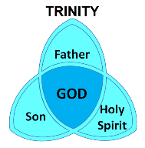
1 Corinthians 6:19
“Or do you not know that your body is a temple of the Holy Spirit who is in you, whom you have from God, and that you are not your own?”

Slide 60
Romans 8:9
“However, you are not in the flesh but in the Spirit, if indeed the Spirit of God dwells in you. But if anyone does not have the Spirit of Christ, he does not belong to Him.”

Slide 61
Ephesians 4:30
“Do not grieve the Holy Spirit of God, by whom you were sealed for the day of redemption.”

Slide 62
Restrainer Must First be Removed
Restrainer holds back the Antichrist (2 Thess 2:6-7)
Restrainer = the omnipotent Holy Spirit (2 Thess 2:9)
Holy Spirit permanently indwells all Christians (John 14:16; Rom 8:9)
Sprit indwelt Christians must first be removed prior to the Antichrist's advent

Slide 65
Guessing the Identity of the Antichrist?
Irenaeus Against Heresies 5.30.3
“We will not, however, incur the risk of pronouncing positively as to the name of Antichrist. But if it had been necessary to announce his name plainly at the present time, it would have been spoken by him who saw the apocalypse. For it was not seen long ago, but almost in our own time, at the end of the reign of Domitian (96 a.d.).”

Slide 66
Psalm 139:7-8
“⁷ Where can I go from Your Spirit? Or where can I flee from Your presence? ⁸ If I ascend to heaven, You are there; If I make my bed in Sheol, behold, You are there..”

Slide 67
Mark 13:11
“¹¹ When they arrest you and hand you over, do not worry beforehand about what you are to say, but say whatever is given you in that hour; for it is not you who speak, but it is the Holy Spirit.”

Slide 68
Distinctions Between 144,000 & Multitude
144,000 | MULTITUDE
Revelation 7:1-8 | Revelation 7:9-17
Numbered | Innumerable
Jews | All nations
Sealed | Slain
Sealed before the Tribulation | Converted out of the Tribulation
Hitchcock and Ice, The Truth Behind Left Behind, 77

Slide 69
Ezekiel 28:13–15
¹³ “You were in Eden, the garden of God; Every precious stone was your covering: The ruby, the topaz and the diamond; The beryl, the onyx and the jasper; The lapis lazuli, the turquoise and the emerald; And the gold, the workmanship of your settings and sockets, Was in you. On the day that you were created They were prepared….¹⁵ “You were blameless in your ways From the day you were created Until unrighteousness was found in you.

Slide 70
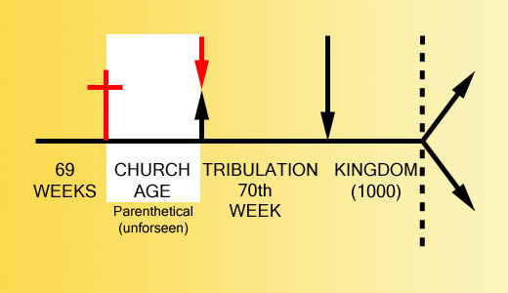

Slide 71
2 Thessalonians 2:3, 7
“…the man of lawlessness is revealed, the son of destruction…For the mystery of lawlessness is already at work; only he who now restrains will do so until he is taken out of the way.”

Slide 72
1 John 4:3
“and every spirit that does not confess Jesus is not from God; this is the spirit of the antichrist, of which you have heard that it is coming, and now it is already in the world.”

Slide 73
Revelation 13:16-18
¹⁶ And he causes all, the small and the great, and the rich and the poor, and the free men and the slaves, to be given a mark on their right hand or on their forehead, ¹⁷ and he provides that no one will be able to buy or to sell, except the one who has the mark, either the name of the beast or the number of his name. ¹⁸ Here is wisdom. Let him who has understanding calculate the number of the beast, for the number is that of a man; and his number is six hundred and sixty-six.

Slide 74
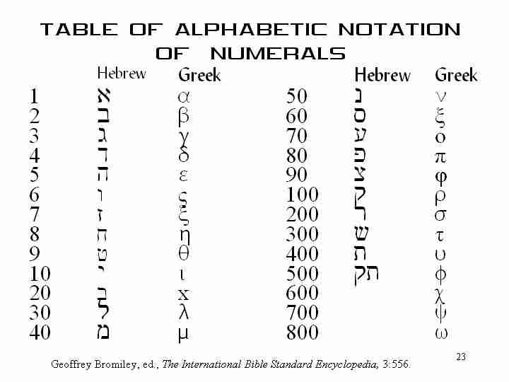

Slide 75
Conclusion

Slide 76
2 Thessalonians 2:1-12
Problem (2:1-2)
Prerequisites for the Day of the Lord (2:3-12)
The departure (2:3a)
Advent of the lawless one (2:3b-4)
Removal of the restrainer (2:5-7)
Destruction of the lawless one (2:8-9)
Destruction of lawless one’s followers (2:10-12)

