Slide 2
Acts 6:1‒15 First Deacons & Stephen’s Arrest
Appointment of the First Deacons (6:1-7)
Stephen’s Arrest (6:8-15)

Slide 3
Acts 6:1‒15 First Deacons & Stephen’s Arrest
Appointment of the First Deacons (6:1-7)
Stephen’s Arrest (6:8-15)

Slide 4
I. Appointment of the First Deacons Acts 6:1-7
Occasion (1)
Apostles’ advice (2-4)
Appointment (5-6)
Results (7)

Slide 5
Acts 6:2-4 Apostolic Advice
Advice (2)
Qualifications (3)
Apostolic responsibility (4)

Slide 7
I. Appointment of the First Deacons Acts 6:1-7
Occasion (1)
Apostles’ advice (2-4)
Appointment (5-6)
Results (7)

Slide 8
Acts 6:5-6 Appointment
Approval (5a)
Enumeration (5b)
Appointment (6)

Slide 9
Acts 6:5-6 Appointment
Approval (5a)
Enumeration (5b)
Appointment (6)

Slide 10
Acts 6:5-6 Appointment
Approval (5a)
Enumeration (5b)
Appointment (6)

Slide 12
1 Corinthians 3:1-3 (NKJV)
¹ And I, brethren, could not speak to you as to spiritual people but as to carnal, as to babes in Christ. ² I fed you with milk and not with solid food; for until now you were not able to receive it, and even now you are still not able; ³ for you are still carnal. For where there are envy, strife, and divisions among you, are you not carnal and behaving like mere men?

Slide 13
Notes:
Ray Steadman – “1st Californians”
Unbelievers vs Categories of Believers
Unbelievers – ψυχικός psuchikós; Natural, pertaining to the natural as distinguished from the spiritual
Spiritual Believers – πνευματικός pneumatikós; of persons who are spiritual, enlightened by the Holy Spirit
Infant Believers – σάρκινος sárkinos; with propensities of the flesh unto sin; νήπιος nḗpios; an infant, child, baby without any definite limitation of age. (This relates to immaturity and lack of instruction)
Carnal Believers – σαρκικός sarkikós; tendency to satisfy the flesh, implying sinfulness, sinful propensity, carnal (This relates to disobedience and open rebellion)

Slide 15
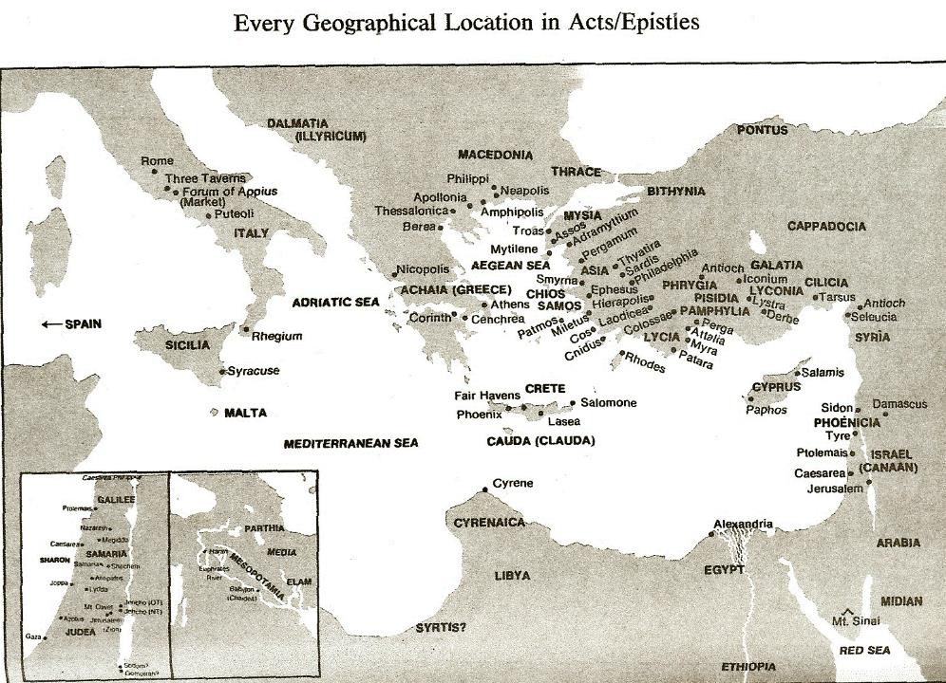

Slide 17
Acts 6:5-6 Appointment
Approval (5a)
Enumeration (5b)
Appointment (6)

Slide 18
I. Appointment of the First Deacons Acts 6:1-7
Occasion (1)
Apostles’ advice (2-4)
Appointment (5-6)
Results (7)

Slide 19
Acts 6:7 Results
Word increased (7a)
Disciples increased (7b)
Priestly converts increased (7c)

Slide 20
Acts 6:7 Results
Word increased (7a)
Disciples increased (7b)
Priestly converts increased (7c)

Slide 21
Acts 6:7 Results
Word increased (7a)
Disciples increased (7b)
Priestly converts increased (7c)

Slide 22
Purpose
To present Theophilus with an orderly account of the birth and growth of the church so as to affirm him in what he has believed.

Slide 23
Message
Birth and growth of the church numerically, geographically, ethnically.
Components
Numerically (progress reports)
Geographically (From Jerusalem to Rome)
Ethnically (From Judaism to Gentile domination)

Slide 24
Progress Reports
Clearest:
Acts 2:47; 4:4; 6:7; 9:31; 12:24; 16:5; 19:20; 28:30-31
Less clear:
Acts 1:13, 15; 2:41; 4:4:31; 5:14, 42; 8:25, 40; 11:21; 13:49; 17:6

Slide 25
Matthew 16:18
“I also say to you that you are Peter, and upon this rock I WILL build [oikodomeō] My church; and the gates of Hades WILL NOT overpower it.”

Slide 26
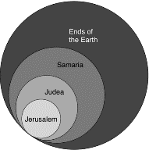
Acts 1:8
“but you will receive power when the Holy Spirit has come upon you; and you shall be My witnesses both in Jerusalem, and in all Judea and Samaria, and even to the remotest part of the earth.”

Slide 27
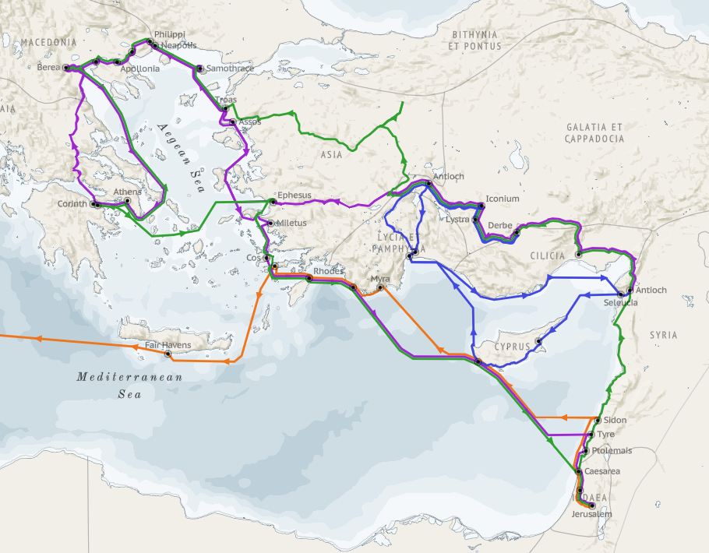
Structure (Acts 1:8)
Jerusalem (Acts 1–7)
Judea and Samaria (Acts 8–12)
Remotest part of the earth (Acts 13–28)
1st missionary journey (Acts 13–14)
Jerusalem council (Acts 15:1-35)
2nd missionary journey (Acts 15:36 –18:22)
3rd missionary journey (Acts 18:23–21:17)
Trip to Rome (Acts 21:18–28:31)

Slide 28
Structure (Acts 1:8)
Jerusalem (Acts 1–7)
Judea and Samaria (Acts 8–12)
Remotest part of the earth (Acts 13–28)
1st missionary journey (Acts 13–14)
Jerusalem council (Acts 15:1-35)
2nd missionary journey (Acts 15:36 –18:22)
3rd missionary journey (Acts 18:23–21:17)
Trip to Rome (Acts 21:18–28:31)

Slide 29
Acts 6:7 Results
Word increased (7a)
Disciples increased (7b)
Priestly convets increased (7c)

Slide 30
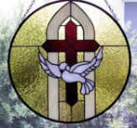
John 3:36
“The one who believes in the Son has eternal life; but the one who does not obey the Son will not see life, but the wrath of God remains on him.”

Slide 31
Acts 6:1‒15 First Deacons & Stephen’s Arrest
Appointment of the First Deacons (6:1-7)
Stephen’s Arrest (6:8-15)

Slide 32
From Peter to Paul
Reference | Center | Person | Place | Outreach
Acts 1–12 | Jerusalem | Peter | Jerusalem, Judea, Samaria | Jewish
Acts 13–28 | Antioch | Paul | Uttermost parts | Gentiles

Slide 33
From Peter to Paul
Peter | Paul
Heals a man lame from birth (3:1-11) | Heals a man lame from birth (14:8-18)
Heals by shadow (5:15-16) | Heals by handkerchief (19:11-12)
Success is a cause of jealousy (5:17) | Success is a cause of jealousy (13:45)
Confronts a sorcerer (8:9-24) | Confronts a sorcerer (13:6-11)
Raises Dorcas (9:36-41) | Raises Eutychus (20:9-12)
Jailed and miraculously freed (12:3-19) | Jailed and miraculously freed (16:25-34)

Slide 34
II. Stephen’s Arrest Acts 6:8-15
Description of Stephen (8)
Disputations against Stephen (9-10)
Conspiracy against Stephen (11)
Arrest of Stephen (12)
Charges against Stephen (13-14)
Face of Stephen (15)
Opportunity of Stephen (7:1)

Slide 35
II. Stephen’s Arrest Acts 6:8-15
Description of Stephen (8)
Disputations against Stephen (9-10)
Conspiracy against Stephen (11)
Arrest of Stephen (12)
Charges against Stephen (13-14)
Face of Stephen (15)
Opportunity of Stephen (7:1)

Slide 36
Acts 6:8 Description of Stephen
Grace (8a)
Power (8b)
Miracles (8c)

Slide 37
Acts 6:8 Description of Stephen
Grace (8a)
Power (8b)
Miracles (8c)

Slide 38
Acts 6:8 Description of Stephen
Grace (8a)
Power (8b)
Miracles (8c)

Slide 39
Acts 6:8 Description of Stephen
Grace (8a)
Power (8b)
Miracles (8c)

Slide 40
Dr. Arnold G. Fruchtenbaum
The Book of Acts, 129
“Verse 12 provides evidence of apostolic authority. The account of the second persecution of the church begins by describing the apostolic signs (v. 12a). Again it is important to note that in the book of Acts, only the apostles and the apostolic [de]legates, who were appointed by the apostles by the laying on of hands, were able to perform miracles, signs, and wonders (e.g. Acts 6:8).[113] This fact has come out four times before (Acts 2:43; 3:6-7; 4:22, 33), and now it is repeated once again in this verse.”

Slide 41
II. Stephen’s Arrest Acts 6:8-15
Description of Stephen (8)
Disputations against Stephen (9-10)
Conspiracy against Stephen (11)
Arrest of Stephen (12)
Charges against Stephen (13-14)
Face of Stephen (15)
Opportunity of Stephen (7:1)

Slide 42
Acts 6:9-10 Disputations Against Stephen
Sources of the attack (9)
Failure of the attack (10)

Slide 43
Acts 6:9-10 Disputations Against Stephen
Sources of the attack (9)
Failure of the attack (10)

Slide 45
Acts 6:9 Sources of the Attack
Libertine (9a)
Cyrene (9b)
Alexandria (9c)
Cilicia (9d)
Asia (9e)

Slide 46
Acts 6:9 Sources of the Attack
Libertine (9a)
Cyrene (9b)
Alexandria (9c)
Cilicia (9d)
Asia (9e)

Slide 48
Acts 6:9 Sources of the Attack
Libertine (9a)
Cyrene (9b)
Alexandria (9c)
Cilicia (9d)
Asia (9e)

Slide 50
Acts 6:9 Sources of the Attack
Libertine (9a)
Cyrene (9b)
Alexandria (9c)
Cilicia (9d)
Asia (9e)

Slide 52
Acts 6:9 Sources of the Attack
Libertine (9a)
Cyrene (9b)
Alexandria (9c)
Cilicia (9d)
Asia (9e)

Slide 54
Acts 6:9 Sources of the Attack
Libertine (9a)
Cyrene (9b)
Alexandria (9c)
Cilicia (9d)
Asia (9e)

Slide 57
Acts 6:9-10 Disputations Against Stephen
Sources of the attack (9)
Failure of the attack (10)

Slide 58
II. Stephen’s Arrest Acts 6:8-15
Description of Stephen (8)
Disputations against Stephen (9-10)
Conspiracy against Stephen (11)
Arrest of Stephen (12)
Charges against Stephen (13-14)
Face of Stephen (15)
Opportunity of Stephen (7:1)

Slide 59
Acts 6:11 Conspiracy Against Stephen
Bribery (11a)
Charges (11b-c)

Slide 60
Acts 6:11 Conspiracy Against Stephen
Bribery (11a)
Charges (11b-c)

Slide 61
Acts 6:11 Conspiracy Against Stephen
Bribery (11a)
Charges (11b-c)

Slide 62
Acts 6:11b-c Charges
Speaking against Moses (11b)
Speaking against God (11c)

Slide 63
Acts 6:11b-c Charges
Speaking against Moses (11b)
Speaking against God (11c)

Slide 64
Acts 6:11b-c Charges
Speaking against Moses (11b)
Speaking against God (11c)

Slide 65
II. Stephen’s Arrest Acts 6:8-15
Description of Stephen (8)
Disputations against Stephen (9-10)
Conspiracy against Stephen (11)
Arrest of Stephen (12)
Charges against Stephen (13-14)
Face of Stephen (15)
Opportunity of Stephen (7:1)

Slide 66
II. Stephen’s Arrest Acts 6:8-15
Description of Stephen (8)
Disputations against Stephen (9-10)
Conspiracy against Stephen (11)
Arrest of Stephen (12)
Charges against Stephen (13-14)
Face of Stephen (15)
Opportunity of Stephen (7:1)

Slide 67
Acts 6:13-14 Charges Against Stephen
Charge (13)
Substantiation of charges (14)

Slide 68
Acts 6:13-14 Charges Against Stephen
Charge (13)
Substantiation of charges (14)

Slide 69
Acts 6:13 Charges
Speaking Against the Temple (13a)
Speaking Against the Law (13b)

Slide 70
Acts 6:13 Charges
Speaking Against the Temple (13a)
Speaking Against the Law (13b)

Slide 71
Acts 6:13 Charges
Speaking Against the Temple (13a)
Speaking Against the Law (13b)

Slide 72
Acts 6:13-14 Charges Against Stephen
Charge (13)
Substantiation of charges (14)

Slide 73
Acts 6:14 Substantiation of the Charges
Against the Temple (14a)
Against the Law (14b)

Slide 74
Acts 6:14 Substantiation of the Charges
Against the Temple (14a)
Against the Law (14b)

Slide 75
Matthew 24:1-2
“¹ Jesus came out from the temple and was going away when His disciples came up to point out the temple buildings to Him. ² And He said to them, “Do you not see all these things? Truly I say to you, not one stone here will be left upon another, which will not be torn down.”

Slide 76
Luke 19:41-44
^{41 “}When He approached Jerusalem, He saw the city and wept over it, ⁴² saying, “If you had known in this day, even you, the things which make for peace! But now they have been hidden from your eyes. ⁴³ For the days will come upon you when your enemies will throw up a barricade against you, and surround you and hem you in on . . .

Slide 77
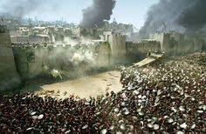
Luke 19:41-44
. . . every side, ⁴⁴ and they will level you to the ground and your children within you, and they will not leave in you one stone upon another, because you did not recognize the time of your visitation.”

Slide 78
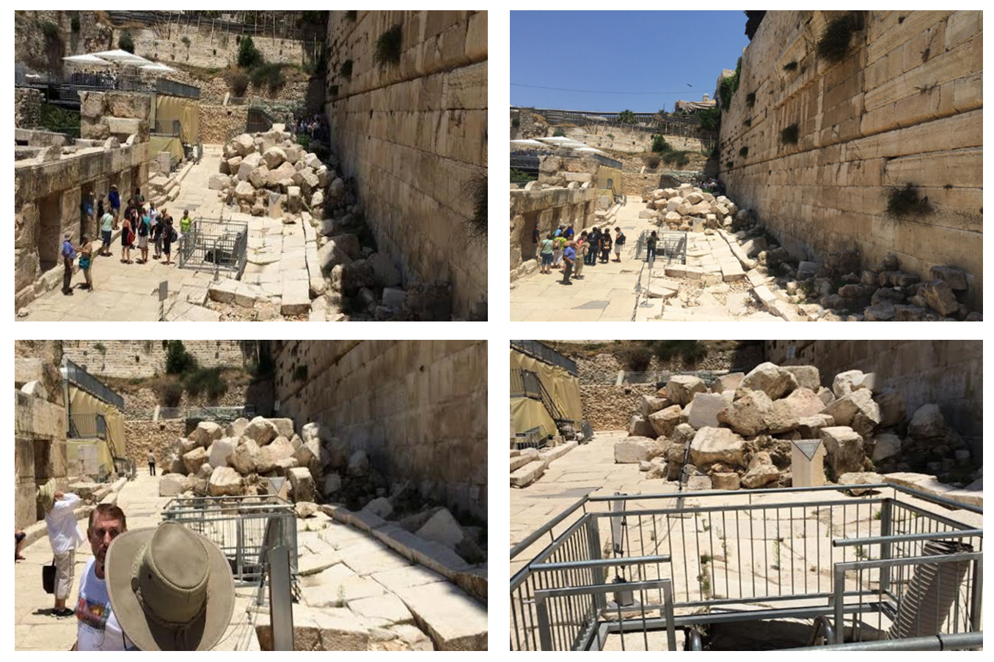

Slide 79
Acts 6:14 Substantiation of the Charges
Against the Temple (14a)
Against the Law (14b)

Slide 80
II. Stephen’s Arrest Acts 6:8-15
Description of Stephen (8)
Disputations against Stephen (9-10)
Conspiracy against Stephen (11)
Arrest of Stephen (12)
Charges against Stephen (13-14)
Face of Stephen (15)
Opportunity of Stephen (7:1)

Slide 81
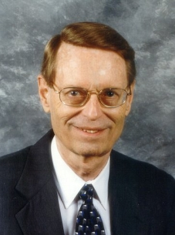
Charles Ryrie Dispensationalism (Chicago: Moody Press, 1965), 86.
Literal interpretation “…might also be called plain interpretation so that no one receives the mistaken notion that the literal principle rules out figures of speech.”

Slide 83
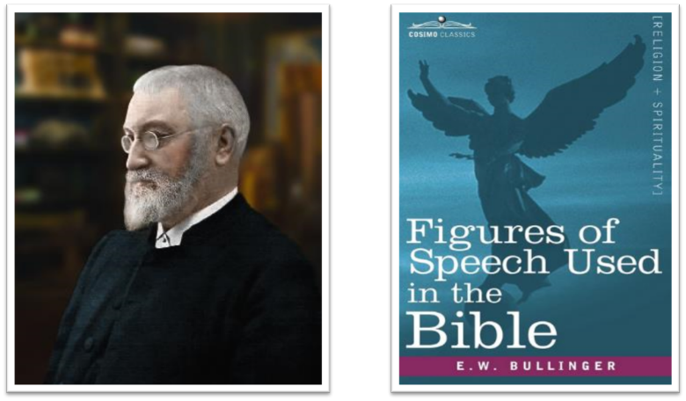
E.W. Bullinger (1837‒1913)

Slide 84
II. Stephen’s Arrest Acts 6:8-15
Description of Stephen (8)
Disputations against Stephen (9-10)
Conspiracy against Stephen (11)
Arrest of Stephen (12)
Charges against Stephen (13-14)
Face of Stephen (15)
Opportunity of Stephen (7:1)

Slide 85
Conclusion

Slide 86
Acts 6:1‒15 First Deacons & Stephen’s Arrest
Appointment of the First Deacons (6:1-7)
Stephen’s Arrest (6:8-15)

