Slide 1
Genesis 12‒50
Israel’s Birth & Preservation

Slide 2
GENESIS STRUCTURE
Genesis 12-50 (four people)
Abraham (12:1–25:11)
Isaac (25:12–26:35)
Jacob (27–36)
Joseph (37–50)

Slide 3
Genesis 37:2-36 Joseph Sold unto Egypt
Joseph’s coat (37:2-4)
Joseph’s dreams (37:5-11)
Joseph’s pit (37:12-24)
Joseph’s enslavement (37:25-36)

Slide 4
Genesis 37:2-36 Joseph Sold unto Egypt
Joseph’s coat (37:2-4)
Joseph’s dreams (37:5-11)
Joseph’s pit (37:12-24)
Joseph’s enslavement (37:25-36)

Slide 5
Genesis 37:2-36 Joseph Sold unto Egypt
Joseph’s coat (37:2-4)
Joseph’s dreams (37:5-11)
Joseph’s pit (37:12-24)
Joseph’s enslavement (37:25-36)

Slide 6
II. Genesis 37:5-11 Joseph’s Dreams
Another reason for brothers’ hatred (5)
First dream (6-8)
Second dream (9-11)

Slide 7
II. Genesis 37:5-11 Joseph’s Dreams
Another reason for brothers’ hatred (5)
First dream (6-8)
Second dream (9-11)

Slide 8
Genesis 37:5 Another Reason for Brother’s Hatred
Dreams (5a)
Naivete (5b)
Reaction (5c)

Slide 9
Genesis 37:5 Another Reason for Brother’s Hatred
Dreams (5a)
Naivete (5b)
Reaction (5c)

Slide 11
Genesis 37:5 Another Reason for Brother’s Hatred
Dreams (5a)
Naivete (5b)
Reaction (5c)

Slide 12
Genesis 37:5 Another Reason for Brother’s Hatred
Dreams (5a)
Naivete (5b)
Reaction (5c)

Slide 13
II. Genesis 37:5-11 Joseph’s Dreams
Another reason for brothers’ hatred (5)
First dream (6-8)
Second dream (9-11)

Slide 14
Genesis 37:6-8 First Dream
Introduction (6)
Content (7)
Reaction (8)

Slide 15
Genesis 37:6-8 First Dream
Introduction (6)
Content (7)
Reaction (8)

Slide 16
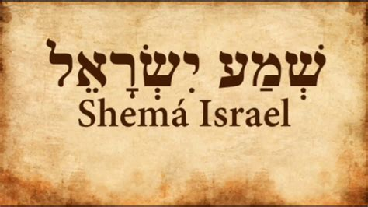
Deuteronomy 6:4-7
“⁴ Hear, Israel! The Lord is our God, the Lord is one!... ⁶ These words, which I am commanding you today, shall be on your heart. ⁷ You shall teach them diligently to your sons and shall talk of them when you sit in your house and when you walk by the way and when you lie down and when you rise up.”

Slide 17
Genesis 37:6-8 First Dream
Introduction (6)
Content (7)
Reaction (8)

Slide 18
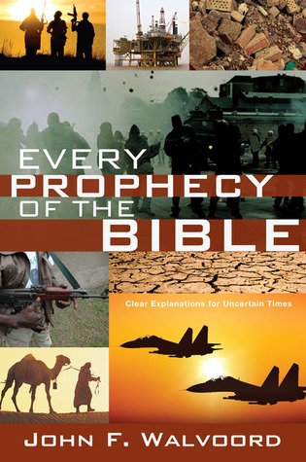

Slide 19
Charles Ryrie Charles C. Ryrie, The Basis of the Premillennial Faith (Dubuque, IA: ECS Ministries, 2005), iBooks edition.
“…in the interpretation of unfulfilled prophecy, fulfilled prophecy forms the pattern…the logical way to discover how God will fulfill prophecy in the future is to discover how He fulfilled it in the past. If the hundreds of prophecies concerning Christ’s first coming were fulfilled literally, how can anyone reject the literal fulfillment of the numerous prophecies concerning His second coming and reign on the earth?”

Slide 20
Dispensational Theology a System of Theology
Traditional-normative dispensational theology is a system that embodies three essential, fundamental concepts called the sine qua non (lit. “without which is not”):
The consistent use of a plain, normal, literal, grammatical-historical method of interpretation;
Which reveals that the Church is distinct from Israel;
God’s overall purpose is to bring glory to Himself (Eph. 1:6, 12, 14).
Dr. Charles Ryrie, Dispensationalism, pp. 38-41

Slide 22
Genesis 37:6-8 First Dream
Introduction (6)
Content (7)
Reaction (8)

Slide 23
Genesis 37:8 Reaction
Dreams (8a)
Word (8b)

Slide 24
Genesis 37:8 Reaction
Dreams (8a)
Word (8b)

Slide 25
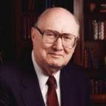
Two Rules of Interpretation
Search the immediate context
Walvoord: 26X
Search the remote context
Old Testament
Thomas: 278 / 404 verses

Slide 26
Genesis 37:8 Reaction
Dreams (8a)
Word (8b)

Slide 27
II. Genesis 37:5-11 Joseph’s Dreams
Another reason for brothers’ hatred (5)
First dream (6-8)
Second dream (9-11)

Slide 28
Genesis 37:9-11 Second Dream
Dream (9)
Jacob’s response (10)
Responses (11)

Slide 29
Genesis 37:9-11 Second Dream
Dream (9)
Jacob’s response (10)
Responses (11)

Slide 30
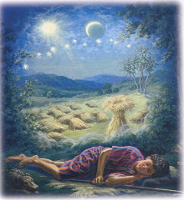
Genesis 37:9
Now he had still another dream, and related it to his brothers, and said, “Lo, I have had still another dream; and behold, the sun and the moon and eleven stars were bowing down to me.”

Slide 31
Genesis 37:9-11 Second Dream
Dream (9)
Jacob’s response (10)
Responses (11)

Slide 32
Genesis 37:10
He related it to his father and to his brothers; and his father rebuked him and said to him, “What is this dream that you have had? Shall I and your mother and your brothers actually come to bow ourselves down before you to the ground?”

Slide 34
Sun = Jacob
Moon = Leah
11 Stars = Joseph’s brothers
12th Star = Joseph
12 Stars = Israel’s twelve tribes

Slide 35
Revelation 12:1-5
¹And a great sign appeared in heaven: a woman clothed in the sun, and the moon under her feet, and upon her head a crown of twelve stars; ²and she was with child; and she cried out, being in labor pain to give birth. ³And another sign was seen in heaven: and behold, a great red dragon, having seven heads and ten horns, and upon his heads seven diadems ⁴And his tail swept a third part of . . .

Slide 36
Revelation 12:1-5 (cont’d)
. . . the stars of heaven, and did cast them to the earth: and the dragon stood before the woman that is about to give birth, so that when she gave birth he may devour her child. ⁵And she gave birth to a son, a man child, who is to rule all the nations with a rod of iron: and her child was caught up unto God, and to his throne.

Slide 37
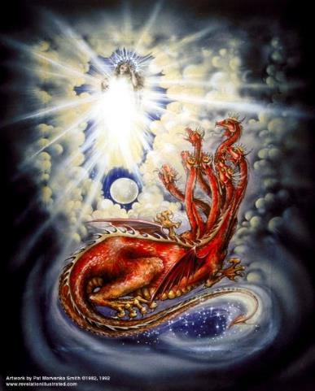
CAST OF 3 CHARACTERS Revelation 12:1-5
SON (v.5)
DRAGON (v. 3)
WOMAN (v.1)

Slide 39
Revelation 12:1-5
¹And a great sign (sēmeion) appeared in heaven: a woman clothed in the sun, and the moon under her feet, and upon her head a crown of twelve stars; ²and she was with child; and she cried out, being in labor pain to give birth. ³And another sign (sēmeion) was seen in heaven: and behold, a great red dragon, having seven heads and ten horns, and upon his heads seven diadems . . .

Slide 40
Two Rules of Interpretation
Search the immediate context
Walvoord: 26X
Search the remote context
Old Testament
Thomas: 278 / 404 verses

Slide 41
CAST OF 3 CHARACTERS Revelation 12:1-5
SON = MESSIAH
Ps. 2:9; Acts 1:9
DRAGON = SATAN
Rev. 12:9; 20:2
WOMAN = ISRAEL
Gen. 37:9-10

Slide 42
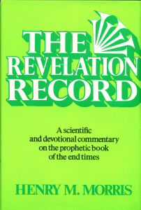
Morris
The Revelation Record, 323
“At the very least, it would be confusing to John’s first century readers, as well as to later generations, for him to write so much about Babylon when he really meant Rome (Paul was not afraid to speak directly against Rome in his writings, so why should John be?) or ‘the false church’ (all the apostles , including John, wrote plainly and scathingly about false teachers and false doctrines in the church and would not hide their teachings by symbols). It must be stressed that Revelation means ‘unveiling,’ not ‘veiling.’ In the absence of any statement in the text to the contrary, therefore, we must assume that the term Babylon applies to the real city of Babylon…”

Slide 43
Matthew 16:18
“I also say to you that you are Peter, and upon this rock I WILL build [oikodomeō] My church; and the gates of Hades WILL NOT overpower it.”

Slide 44
Genesis 37:9-11 Second Dream
Dream (9)
Jacob’s response (10)
Responses (11)

Slide 45
Genesis 37:11 Responses
Brothers (11a)
Jacob (11b)

Slide 46
Genesis 37:11 Responses
Brothers (11a)
Jacob (11b)

Slide 47
Genesis 37:11 Responses
Brothers (11a)
Jacob (11b)

Slide 48
1 Corinthians 4:5
“ Therefore do not go on passing judgment before the time, but wait until the Lord comes who will both bring to light the things hidden in the darkness and disclose the motives of men’s hearts; and then each man’s praise will come to him from God.”

Slide 49
Genesis 37:2-36 Joseph Sold unto Egypt
Joseph’s coat (37:2-4)
Joseph’s dreams (37:5-11)
Joseph’s pit (37:12-24)
Joseph’s enslavement (37:25-36)

Slide 50
III. Genesis 37:12-24 Joseph’s Pit
Joseph’s search for his brothers (12-17)
Brothers’ conspiracy to kill Joseph (18-24)

Slide 51
III. Genesis 37:12-24 Joseph’s Pit
Joseph’s search for his brothers (12-17)
Brothers’ conspiracy to kill Joseph (18-24)

Slide 52
Genesis 37:12-17 Joseph’s Search for his Brothers
Location: Shechem (12)
Jacob sends Joseph (13-14)
Joseph’s search in Shechem (15-17a)
Joseph’s journey (17b)

Slide 53
Genesis 37:12-17 Joseph’s Search for his Brothers
Location: Shechem (12)
Jacob sends Joseph (13-14)
Joseph’s search in Shechem (15-17a)
Joseph’s journey (17b)

Slide 54
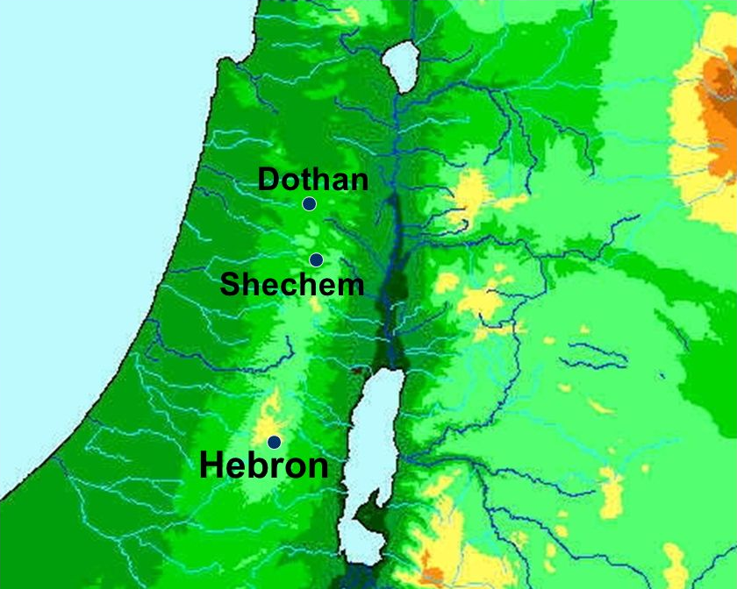

Slide 55
Genesis 37:12-17 Joseph’s Search for his Brothers
Location: Shechem (12)
Jacob sends Joseph (13-14)
Joseph’s search in Shechem (15-17a)
Joseph’s journey (17b)

Slide 56
Genesis 37:13-14 Jacob Sends Joseph
Jacob’s initiation (13a)
Joseph’s response (13b)
Jacob’s instructions (14a)
Joseph’s journey (14b)

Slide 57
Genesis 37:13-14 Jacob Sends Joseph
Jacob’s initiation (13a)
Joseph’s response (13b)
Jacob’s instructions (14a)
Joseph’s journey (14b)

Slide 58
Genesis 37:13-14 Jacob Sends Joseph
Jacob’s initiation (13a)
Joseph’s response (13b)
Jacob’s instructions (14a)
Joseph’s journey (14b)

Slide 59
Genesis 37:13-14 Jacob Sends Joseph
Jacob’s initiation (13a)
Joseph’s response (13b)
Jacob’s instructions (14a)
Joseph’s journey (14b)

Slide 60
Genesis 37:13-14 Jacob Sends Joseph
Jacob’s initiation (13a)
Joseph’s response (13b)
Jacob’s instructions (14a)
Joseph’s journey (14b)

Slide 62
Genesis 37:12-17 Joseph’s Search for his Brothers
Location: Shechem (12)
Jacob sends Joseph (13-14)
Joseph’s search in Shechem (15-17a)
Joseph’s journey (17b)

Slide 63
Genesis 37:15-17a Jospeh’s Search in Shechem
Circumstances (15a)
Conversation (15b-17a)

Slide 64
Genesis 37:15-17a Jospeh’s Search in Shechem
Circumstances (15a)
Conversation (15b-17a)

Slide 65
Genesis 37:15-17a Jospeh’s Search in Shechem
Circumstances (15a)
Conversation (15b-17a)

Slide 66
Genesis 37:1b-17a Conversation
Inquiry (15b)
Joseph’s response (16)
Answer (17a)

Slide 67
Genesis 37:1b-17a Conversation
Inquiry (15b)
Joseph’s response (16)
Answer (17a)

Slide 68
Genesis 37:1b-17a Conversation
Inquiry (15b)
Joseph’s response (16)
Answer (17a)

Slide 69
Genesis 37:1b-17a Conversation
Inquiry (15b)
Joseph’s response (16)
Answer (17a)

Slide 71
Genesis 37:12-17 Joseph’s Search for his Brothers
Location: Shechem (12)
Jacob sends Joseph (13-14)
Joseph’s search in Shechem (15-17a)
Joseph’s journey (17b)

Slide 72
Dr. Arnold G. Fruchtenbaum
The Book of Genesis, 533
“So in verse 17b, Joseph journeys to Dothan: And Joseph went after his brethren and found them in Dothan. Dothan is north of Shechem, another day’s journey. The situation in Shechem may still have been somewhat tense, but for one reason or another they had chosen to go further north, and Dothan was the city located on the north-south trunk route. Dothan was also located on the east-west trade route between Gilead and the Coastal Plain where it connected with the Via Maris that in turn would go south into Egypt. All this set the stage for the selling of Joseph.”

Slide 73
III. Genesis 37:12-24 Joseph’s Pit
Joseph’s search for his brothers (12-17)
Brothers’ conspiracy to kill Joseph (18-24)

Slide 74
Genesis 37:18-24 Brothers’ Conspiracy to Kill Joseph
Plot to kill Joseph (18-20)
Reuben’s intercession (21-22)
Plan executed (23-24)

Slide 75
Genesis 37:18-24 Brothers’ Conspiracy to Kill Joseph
Plot to kill Joseph (18-20)
Reuben’s intercession (21-22)
Plan executed (23-24)

Slide 76
Genesis 37:18-20 Plot to Kill Joseph
Timing (18)
Plot (19-20)

Slide 77
Genesis 37:18-20 Plot to Kill Joseph
Timing (18)
Plot (19-20)

Slide 78
Genesis 37:18-20 Plot to Kill Joseph
Timing (18)
Plot (19-20)

Slide 79
Genesis 37:19-20 Plot
Victim (19)
Content (20)

Slide 80
Genesis 37:19-20 Plot
Victim (19)
Content (20)

Slide 81
Dr. Arnold G. Fruchtenbaum
The Book of Genesis, 536
“Then came the merchant’s journey: They brought Joseph into Egypt. While this was not the brothers’ intent, by selling him in place of killing him, they rendered the fulfillment of the dream certain. Although they thought they were rendering the dreams null and void by what they were doing, they were actually creating a situation that would cause the fulfillment of them, proving the principle of Scripture: Even the wrath of men will end up praising God.”

Slide 82
Genesis 37:19-20 Plot
Victim (19)
Content (20)

Slide 83
Genesis 37:18-24 Brothers’ Conspiracy to Kill Joseph
Plot to kill Joseph (18-20)
Reuben’s intercession (21-22)
Plan executed (23-24)

Slide 84
Genesis 37:21-22 Reuben’s Intercession
Intervention (21)
Plan (22)

Slide 85
Genesis 37:21-22 Reuben’s Intercession
Intervention (21)
Plan (22)

Slide 87
Genesis 37:21-22 Reuben’s Intercession
Intervention (21)
Plan (22)

Slide 88
Genesis 37:22 Plan
Do not murder (22a)
Pit (22b)
Rescue later (22c)

Slide 89
Genesis 37:22 Plan
Do not murder (22a)
Pit (22b)
Rescue later (22c)

Slide 90
Genesis 37:22 Plan
Do not murder (22a)
Pit (22b)
Rescue later (22c)

Slide 91
Genesis 37:22 Plan
Do not murder (22a)
Pit (22b)
Rescue later (22c)

Slide 92
Genesis 37:18-24 Brothers’ Conspiracy to Kill Joseph
Plot to kill Joseph (18-20)
Reuben’s intercession (21-22)
Plan executed (23-24)

Slide 93
Genesis 37:23-24 Plan Executed
Removal of the coat (23)
Cast into the pit (24)

Slide 94
Genesis 37:23-24 Plan Executed
Removal of the coat (23)
Cast into the pit (24)

Slide 95
Genesis 37:23-24 Plan Executed
Removal of the coat (23)
Cast into the pit (24)

Slide 96
Genesis 37:2-36 Joseph Sold unto Egypt
Joseph’s coat (37:2-4)
Joseph’s dreams (37:5-11)
Joseph’s pit (37:12-24)
Joseph’s enslavement (37:25-36)

Slide 97
IV. Genesis 37:25-36 Joseph’s Enslavement
Selling of Joseph (25-28)
Reuben’s discovery (29-30)
Brothers report to Jacob (31-32)
Jacob’s response (33-35)
Joseph sold again (36)

Slide 98
IV. Genesis 37:25-36 Joseph’s Enslavement
Selling of Joseph (25-28)
Reuben’s discovery (29-30)
Brothers report to Jacob (31-32)
Jacob’s response (33-35)
Joseph sold again (36)

Slide 99
Genesis 37:25-28 Selling of Joseph
Occasion (25)
Judah’s proposal (26-27a)
Agreement (27b)
Selling (28)

Slide 100
Genesis 37:25-28 Selling of Joseph
Occasion (25)
Judah’s proposal (26-27a)
Agreement (27b)
Selling (28)

Slide 101
Genesis 12‒25 Abraham’s Early Journeys
Unconditional promises (Gen. 12:1-3) From Haran to Canaan (Gen. 12:4-5) In Canaan (Gen. 12:6-9) In Egypt (Gen. 12:10-20) Abram and Lot Separate (Gen. 13:1-13) Reaffirmation of Abram’s promises (Gen. 13:14-18) Abram Rescues Lot (14:1-24) Abrahamic Covenant (15:1-21) Hagar & Ishmael (16:1-16) Circumcision (Gen. 17:1-27) | Sodom & Gomorrah (Gen. 18‒19) Abraham & Abimelech (Gen. 20) Isaac’s birth (Gen. 21:1-7) Ishmael’s expulsion (21:8-21) Abraham & Abimelech’s covenant (21:22-34) Abraham sacrifices Isaac (22) Sarah’s death (23) Isaac’s marriage (24) Abraham & Keturah (25:1-6) Abraham’s death (25:7-11)

Slide 102
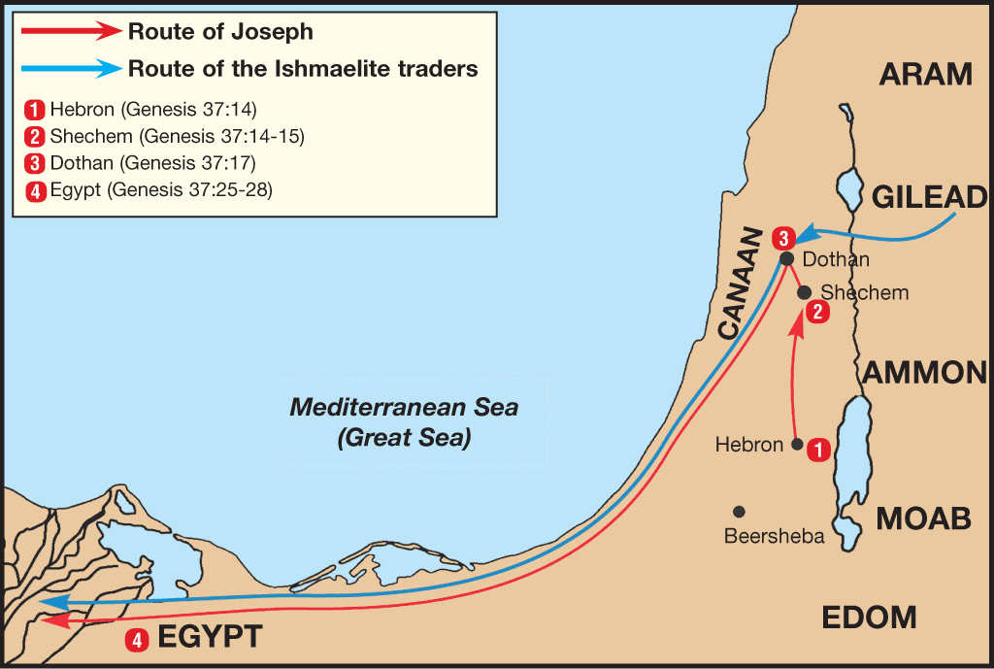

Slide 103
Dr. Arnold G. Fruchtenbaum
The Book of Genesis, 536
“In verse 27b came the agreement: And his brethren hearkened unto him. Verse 28 records the selling: And there passed by Midianites, merchantmen. These are called merchantmen; for they were North Arabian caravaneers who branched off through Gilead to the main route to Egypt, the Via Maris, from the King’s Highway.”

Slide 104
Genesis 37:25-28 Selling of Joseph
Occasion (25)
Judah’s proposal (26-27a)
Agreement (27b)
Selling (28)

Slide 105
Genesis 37:26-27a Judah’s Proposal
Rhetorical question (26)
Proposal (27a)

Slide 106
Genesis 37:26-27a Judah’s Proposal
Rhetorical question (26)
Proposal (27a)

Slide 108
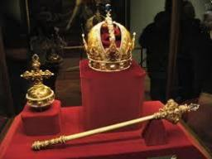
Genesis 49:10
“The scepter shall not depart from Judah, Nor the ruler’s staff from between his feet, Until Shiloh comes, And to him shall be the obedience of the peoples.”

Slide 109
Genesis 37:26-27a Judah’s Proposal
Rhetorical question (26)
Proposal (27a)

Slide 110
Genesis 37:25-28 Selling of Joseph
Occasion (25)
Judah’s proposal (26-27a)
Agreement (27b)
Selling (28)

Slide 112
Genesis 37:25-28 Selling of Joseph
Occasion (25)
Judah’s proposal (26-27a)
Agreement (27b)
Selling (28)

Slide 113
Genesis 12‒25 Abraham’s Early Journeys
Unconditional promises (Gen. 12:1-3) From Haran to Canaan (Gen. 12:4-5) In Canaan (Gen. 12:6-9) In Egypt (Gen. 12:10-20) Abram and Lot Separate (Gen. 13:1-13) Reaffirmation of Abram’s promises (Gen. 13:14-18) Abram Rescues Lot (14:1-24) Abrahamic Covenant (15:1-21) Hagar & Ishmael (16:1-16) Circumcision (Gen. 17:1-27) | Sodom & Gomorrah (Gen. 18‒19) Abraham & Abimelech (Gen. 20) Isaac’s birth (Gen. 21:1-7) Ishmael’s expulsion (21:8-21) Abraham & Abimelech’s covenant (21:22-34) Abraham sacrifices Isaac (22) Sarah’s death (23) Isaac’s marriage (24) Abraham & Keturah (25:1-6) Abraham’s death (25:7-11)

Slide 114
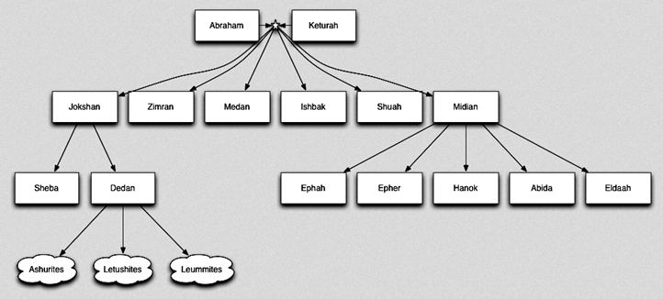

Slide 116
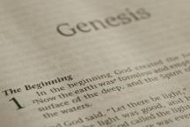
Beginning Themes
Universe Life Man Marriage Evil Clothing | Religion Salvation Language Government Nations Israel
Morris, Genesis Record, 18-20

Slide 117
IV. Genesis 37:25-36 Joseph’s Enslavement
Selling of Joseph (25-28)
Reuben’s discovery (29-30)
Brothers report to Jacob (31-32)
Jacob’s response (33-35)
Joseph sold again (36)

Slide 118
Genesis 37:29-30 Reuben’s Discovery
Discovery (29)
Dilemma (30)

Slide 119
Genesis 37:29-30 Reuben’s Discovery
Discovery (29)
Dilemma (30)

Slide 120
Genesis 37:29-30 Reuben’s Discovery
Discovery (29)
Dilemma (30)

Slide 122
IV. Genesis 37:25-36 Joseph’s Enslavement
Selling of Joseph (25-28)
Reuben’s discovery (29-30)
Brothers report to Jacob (31-32)
Jacob’s response (33-35)
Joseph sold again (36)

Slide 123
Genesis 37:31-32 Brothers Report to Jacob
Cover up (31)
Brothers show Jacob Joseph’s coat (32)

Slide 124
Genesis 37:31-32 Brothers Report to Jacob
Cover up (31)
Brothers show Jacob Joseph’s coat (32)

Slide 125
Dr. Arnold G. Fruchtenbaum
The Book of Genesis, 537
“Here again, there is a form of retribution: Jacob deceived Isaac with goatskins (27:16), now Jacob was being deceived with goat’s blood. Furthermore, Jacob deceived Isaac with Esau’s clothes (27:15); now Jacob was deceived by the use of Joseph’s clothes.”

Slide 126
Dr. Arnold G. Fruchtenbaum
The Book of Genesis, 445
“Now the deceiver is deceived, although the motivations differ from good to bad. This is divine retribution in four ways. First, Isaac’s blindness equals the darkness of Jacob’s wedding night, and neither could see well as a result. Second, this Jacob is deceived by being presented the older for the younger, the reversal of Isaac’s presentation of Jacob for Esau. Third, Isaac thought Jacob was Esau and Jacob thought Leah was Rachel. Fourth, Jacob pretended to be his older brother, while Leah pretended to be her younger sister.”

Slide 127
Genesis 37:31-32 Brothers Report to Jacob
Cover up (31)
Brothers show Jacob Joseph’s coat (32)

Slide 128
IV. Genesis 37:25-36 Joseph’s Enslavement
Selling of Joseph (25-28)
Reuben’s discovery (29-30)
Brothers report to Jacob (31-32)
Jacob’s response (33-35)
Joseph sold again (36)

Slide 129
Genesis 37:33-35 Jacob’s Response
Conclusion (33)
Mourning (34)
Lack of comfort (35)

Slide 130
Genesis 37:33-35 Jacob’s Response
Conclusion (33)
Mourning (34)
Lack of comfort (35)

Slide 131
Genesis 37:33-35 Jacob’s Response
Conclusion (33)
Mourning (34)
Lack of comfort (35)

Slide 132
Genesis 37:33-35 Jacob’s Response
Conclusion (33)
Mourning (34)
Lack of comfort (35)

Slide 133
Dr. Arnold G. Fruchtenbaum
The Book of Genesis, 537
“Jacob’s refusal is stated: He refused to be comforted; and he said, For I will go down to Sheol to my son in mourning. And his father wept for him. Sheol is the center of the earth, and before the death of the Messiah, all souls descended there upon death; but the faithful and unfaithful entered into different compartments in Sheol.”

Slide 134
IV. Genesis 37:25-36 Joseph’s Enslavement
Selling of Joseph (25-28)
Reuben’s discovery (29-30)
Brothers report to Jacob (31-32)
Jacob’s response (33-35)
Joseph sold again (36)

Slide 135
Genesis 37:36 Joseph Sold Again
Place: Egypt (36a)
Person: Potiphar (36b)

Slide 136
Genesis 37:36 Joseph Sold Again
Place: Egypt (36a)
Person: Potiphar (36b)

Slide 140
Genesis 37:36 Joseph Sold Again
Place: Egypt (36a)
Person: Potiphar (36b)

Slide 141
Conclusion

Slide 142
Genesis 37:2-36 Joseph Sold unto Egypt
Joseph’s coat (37:2-4)
Joseph’s dreams (37:5-11)
Joseph’s pit (37:12-24)
Joseph’s enslavement (37:25-36)

Slide 143
²⁴ The Lord bless you, and keep you; ²⁵ The Lord make His face shine on you, And be gracious to you; ²⁶ The Lord lift up His countenance on you, And give you peace.
Numbers 6:24–26 (NASB95)

