Slide 1
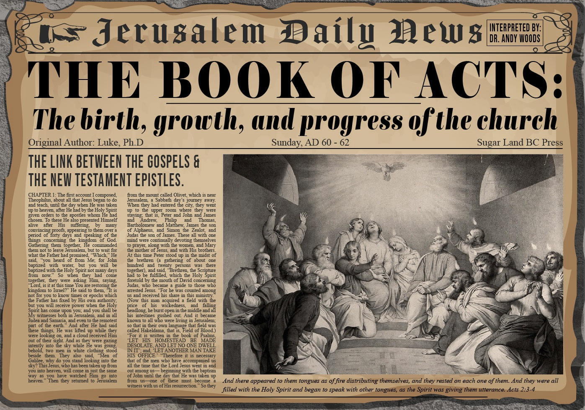


Slide 2
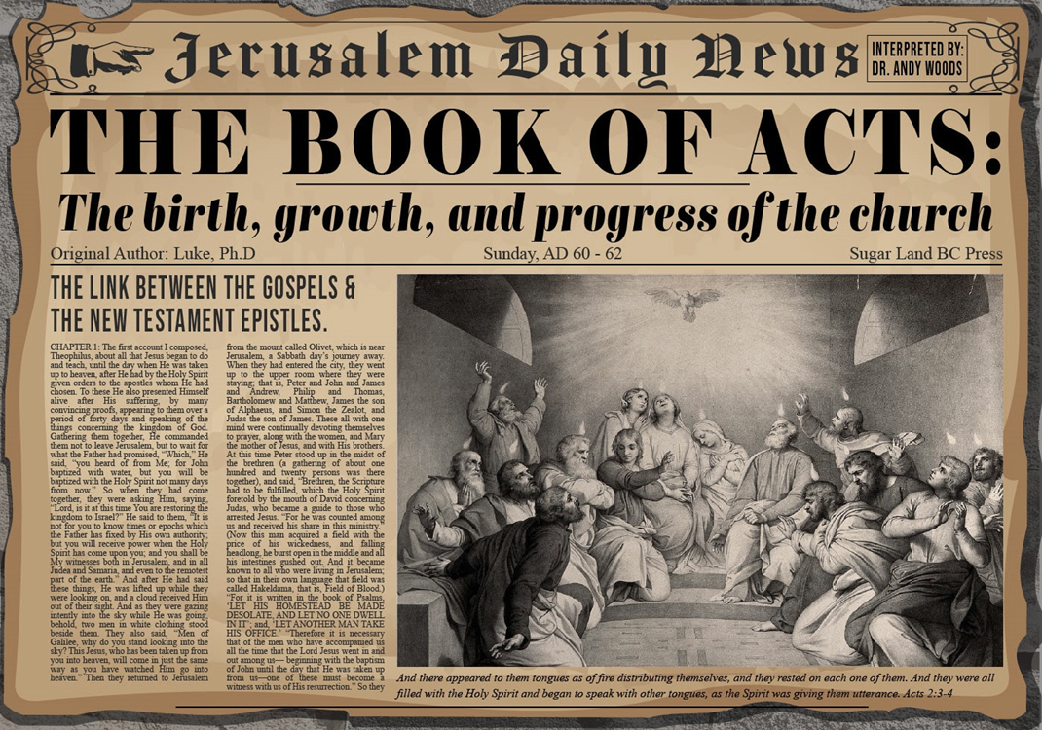
Acts 6:1‒15
First Deacons & Stephen’s Arrest
  Appointment of the First Deacons (6:1-7)
  Stephen’s Arrest (6:8-15)

Slide 3
Acts 6:1‒15
First Deacons & Stephen’s Arrest
  Appointment of the First Deacons (6:1-7)
  Stephen’s Arrest (6:8-15)

Slide 4
I. Appointment of the First Deacons
Acts 6:1-7
  Occasion (1)
  Apostles’ advice (2-4)
  Appointment (5-6)
  Results (7)

Slide 5
I. Appointment of the First Deacons
Acts 6:1-7
  Occasion (1)
  Apostles’ advice (2-4)
  Appointment (5-6)
  Results (7)

Slide 6
Acts 6:1
Occasion
      Timing (1a)
      Circumstances (1b)

Slide 7
Acts 6:1
Occasion
      Timing (1a)
      Circumstances (1b)

Slide 8
Acts 6:1
Occasion
      Timing (1a)
      Circumstances (1b)

Slide 9
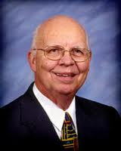
Purposes of the Local Church
Glorify God (Eph 3:21)
Edify the saints (Eph 4:11-16)
Fulfill the Great Commission (Matt 28:18-20)

Slide 10
Three Tenses of Salvation
Phase | Justification | Sanctification | Glorification
Tense | Past | Present | Future
Saved from sin’s: | Penalty | Power | Presence
Scripture | Eph 2:8-9; Titus 3:5 | Philip 2:12 | Rom 5:10

Slide 11
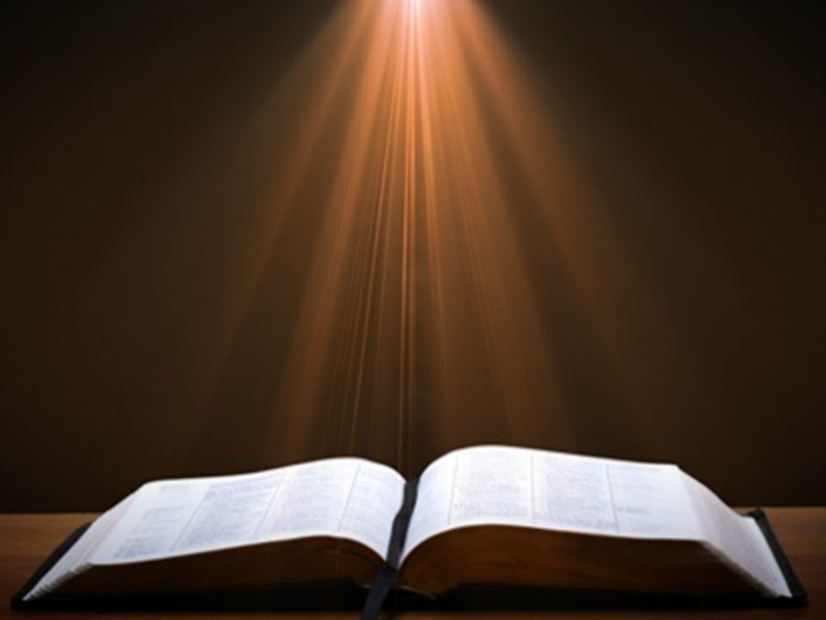

Matthew 16:18
“I also say to you that you are Peter, and upon this rock I WILL build [oikodomeō] My church; and the gates of Hades WILL NOT overpower it.”

Slide 12
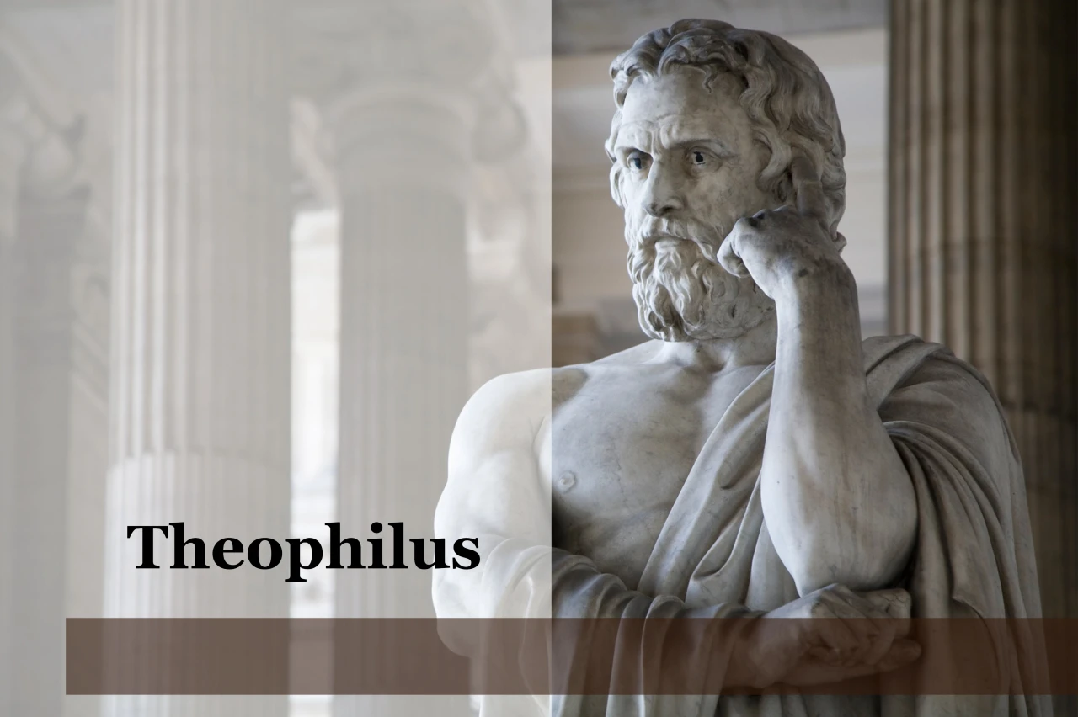
Purpose
  To present Theophilus with an orderly account of the birth and growth of the church so as to affirm him in what he has believed.

Slide 13

Message
  Birth and growth of the church numerically, geographically, ethnically.
  Components
  Numerically (progress reports)
  Geographically (From Jerusalem to Rome)
  Ethnically (From Judaism to Gentile domination)

Slide 14
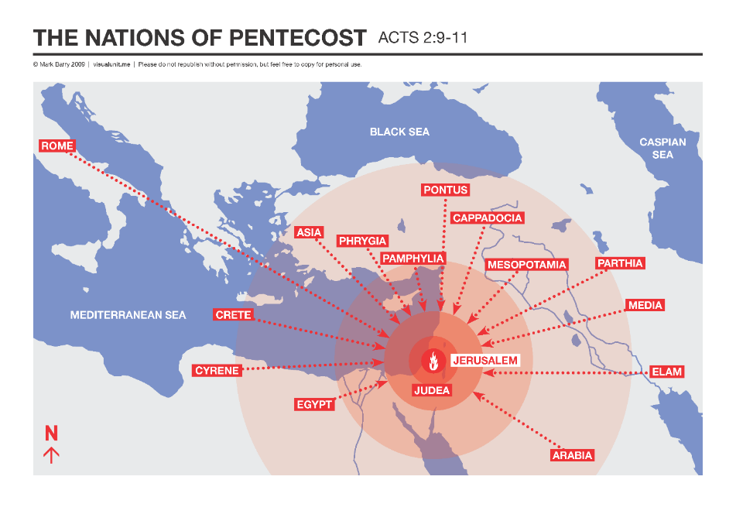

Slide 15
I. Appointment of the First Deacons
Acts 6:1-7
  Occasion (1)
  Apostles’ advice (2-4)
  Appointment (5-6)
  Results (7)

Slide 16
Acts 6:2-4
Apostolic Advice
      Advice (2)
      Qualifications (3)
      Apostolic responsibility (4)

Slide 17
Acts 6:2-4
Apostolic Advice
      Advice (2)
      Qualifications (3)
      Apostolic responsibility (4)

Slide 18
Local Church Government
Episcopalian/bishop rule – Acts 15:2, 6
Congregational rule – Acts 6:1-7
Presbyterian/elder rule – Acts 20:28; 1 Tim 5:17; 4:14

Slide 19
Acts 6:2-4
Apostolic Advice
      Advice (2)
      Qualifications (3)
      Apostolic responsibility (4)

Slide 20
Acts 6:3a
Deacon Qualifications
      Believers
      Males
      Reputable
      Spiritual
      Wise

Slide 21
Acts 6:3a
Deacon Qualifications
      Believers
      Males
      Reputable
      Spiritual
      Wise

Slide 22

1 Corinthians 3:1-3 (NKJV)
¹ And I, brethren, could not speak to you as to spiritual people but as to carnal, as to babes in Christ. ² I fed you with milk and not with solid food; for until now you were not able to receive it, and even now you are still not able; ³ for you are still carnal. For where there are envy, strife, and divisions among you, are you not carnal and behaving like mere men?

Slide 23
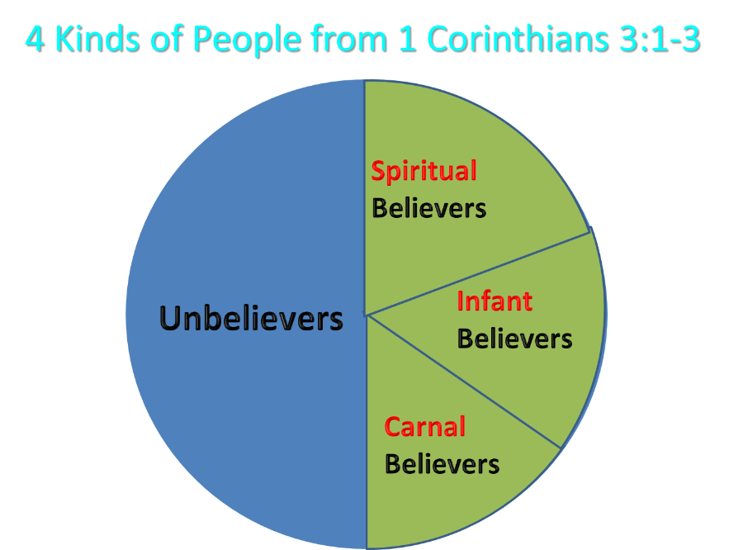
Notes:
Ray Steadman – “1st Californians”
Unbelievers vs Categories of Believers
Unbelievers – ψυχικός psuchikós; Natural, pertaining to the natural as distinguished from the spiritual
Spiritual Believers – πνευματικός pneumatikós; of persons who are spiritual, enlightened by the Holy Spirit
Infant Believers – σάρκινος sárkinos; with propensities of the flesh unto sin; νήπιος nḗpios; an infant, child, baby without any definite limitation of age. (This relates to immaturity and lack of instruction)
Carnal Believers – σαρκικός sarkikós; tendency to satisfy the flesh, implying sinfulness, sinful propensity, carnal (This relates to disobedience and open rebellion)

Slide 24
Acts 6:3a
Deacon Qualifications
      Believers
      Males
      Reputable
      Spiritual
      Wise

Slide 25
Ephesians 4:1
Therefore…
1-3
4-6

Slide 26
EPHESIANS: WHAT IS INSIDE?
1–3 | 4–6
Relationship | Responsibility
Doctrine | Deed
Orthodoxy | Orthopraxy
Knowledge | Wisdom
Belief | Behavior
Position | Practice
Privileges | Responsibility

Slide 27
Acts 6:2-4
Apostolic Advice
      Advice (2)
      Qualifications (3)
      Apostolic responsibility (4)

Slide 28
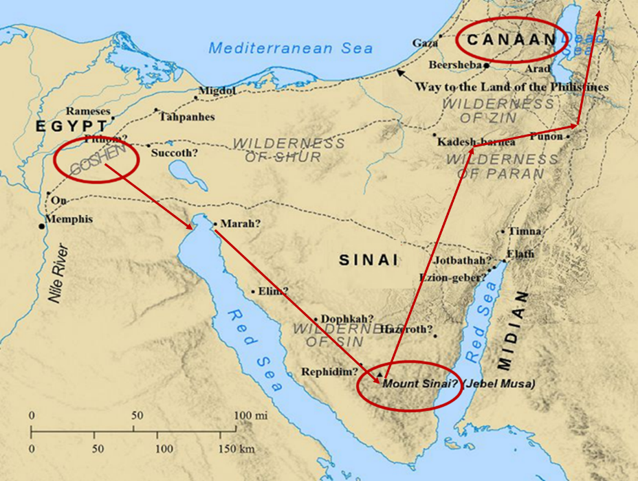

Slide 29
I. Appointment of the First Deacons
Acts 6:1-7
  Occasion (1)
  Apostles’ advice (2-4)
  Appointment (5-6)
  Results (7)

Slide 30
Acts 6:5-6
Appointment
      Approval (5a)
      Enumeration (5b)
      Appointment (6)

Slide 31
Acts 6:5-6
Appointment
      Approval (5a)
      Enumeration (5b)
      Appointment (6)

Slide 32
Acts 6:5-6
Appointment
      Approval (5a)
      Enumeration (5b)
      Appointment (6)

Slide 34
1 Corinthians 3:1-3 (NKJV)
¹ And I, brethren, could not speak to you as to spiritual people but as to carnal, as to babes in Christ. ² I fed you with milk and not with solid food; for until now you were not able to receive it, and even now you are still not able; ³ for you are still carnal. For where there are envy, strife, and divisions among you, are you not carnal and behaving like mere men?

Slide 35
Notes:
Ray Steadman – “1st Californians”
Unbelievers vs Categories of Believers
Unbelievers – ψυχικός psuchikós; Natural, pertaining to the natural as distinguished from the spiritual
Spiritual Believers – πνευματικός pneumatikós; of persons who are spiritual, enlightened by the Holy Spirit
Infant Believers – σάρκινος sárkinos; with propensities of the flesh unto sin; νήπιος nḗpios; an infant, child, baby without any definite limitation of age. (This relates to immaturity and lack of instruction)
Carnal Believers – σαρκικός sarkikós; tendency to satisfy the flesh, implying sinfulness, sinful propensity, carnal (This relates to disobedience and open rebellion)

Slide 36
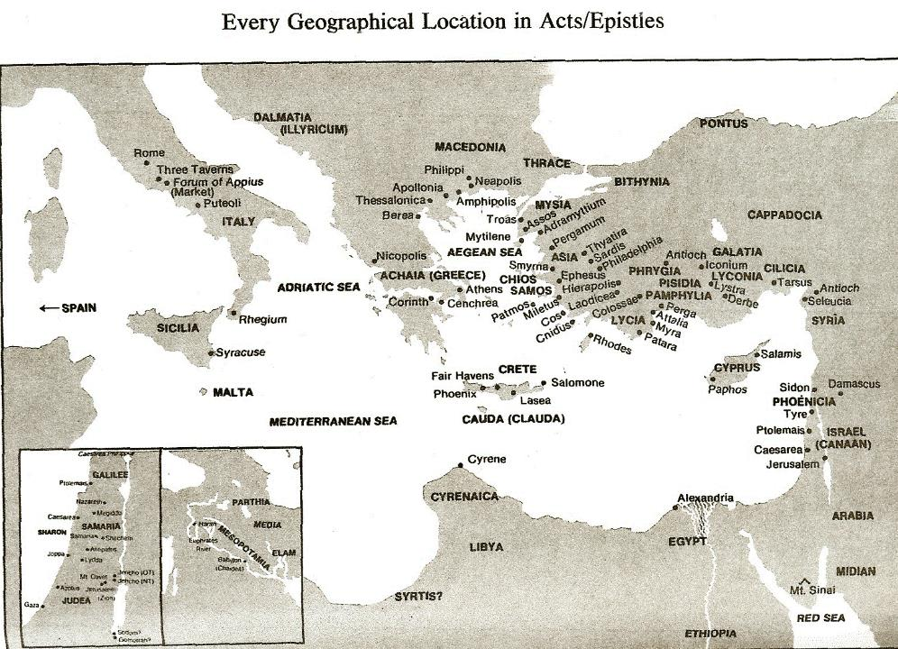

Slide 37
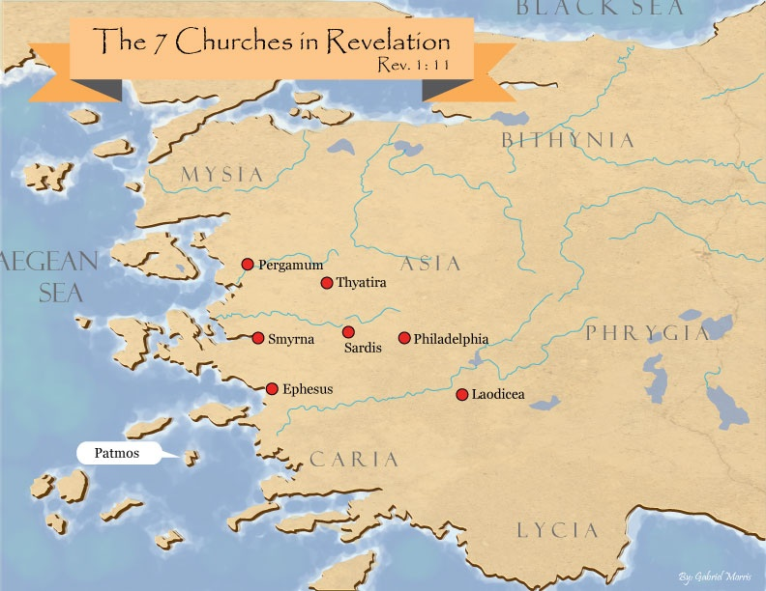
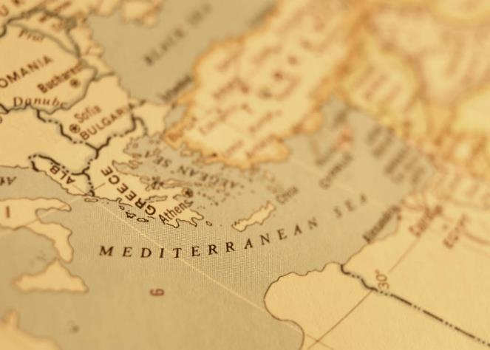

Slide 38
Acts 6:5-6
Appointment
      Approval (5a)
      Enumeration (5b)
      Appointment (6)

Slide 39
I. Appointment of the First Deacons
Acts 6:1-7
  Occasion (1)
  Apostles’ advice (2-4)
  Appointment (5-6)
  Results (7)

Slide 40
Acts 6:7
Results
      Word increased (7a)
      Disciples increased (7b)
      Priestly converts increased (7c)

Slide 41
Acts 6:7
Results
      Word increased (7a)
      Disciples increased (7b)
      Priestly converts increased (7c)

Slide 42
Acts 6:7
Results
      Word increased (7a)
      Disciples increased (7b)
      Priestly converts increased (7c)

Slide 43
Purpose
  To present Theophilus with an orderly account of the birth and growth of the church so as to affirm him in what he has believed.

Slide 44
Message
  Birth and growth of the church numerically, geographically, ethnically.
  Components
  Numerically (progress reports)
  Geographically (From Jerusalem to Rome)
  Ethnically (From Judaism to Gentile domination)

Slide 45
Matthew 16:18
“I also say to you that you are Peter, and upon this rock I WILL build [oikodomeō] My church; and the gates of Hades WILL NOT overpower it.”

Slide 46

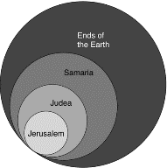
Acts 1:8
“but you will receive power when the Holy Spirit has come upon you; and you shall be My witnesses both in Jerusalem, and in all Judea and Samaria, and even to the remotest part of the earth.”

Slide 47
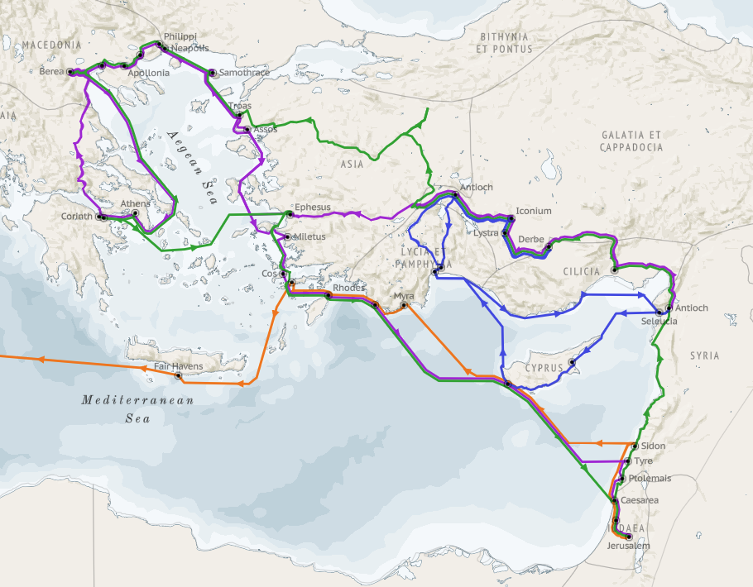
Structure (Acts 1:8)
  Jerusalem (Acts 1–7)
  Judea and Samaria (Acts 8–12)
  Remotest part of the earth (Acts 13–28)
  1st missionary journey (Acts 13–14)
  Jerusalem council (Acts 15:1-35)
  2nd missionary journey (Acts 15:36 –18:22)
  3rd missionary journey (Acts 18:23–21:17)
  Trip to Rome (Acts 21:18–28:31)

Slide 48
Acts 6:7
Results
      Word increased (7a)
      Disciples increased (7b)
      Priestly convets increased (7c)

Slide 49


John 3:36
“The one who believes in the Son has eternal life; but the one who does not obey the Son will not see life, but the wrath of God remains on him.”

Slide 50
Acts 6:1‒15
First Deacons & Stephen’s Arrest
  Appointment of the First Deacons (6:1-7)
  Stephen’s Arrest (6:8-15)

Slide 51
From Peter to Paul
Reference | Center | Person | Place | Outreach
Acts 1–12 | Jerusalem | Peter | Jerusalem, Judea, Samaria | Jewish
Acts 13–28 | Antioch | Paul | Uttermost parts | Gentiles

Slide 52
From Peter to Paul
Peter | Paul
Heals a man lame from birth (3:1-11) | Heals a man lame from birth (14:8-18)
Heals by shadow (5:15-16) | Heals by handkerchief (19:11-12)
Success is a cause of jealousy (5:17) | Success is a cause of jealousy (13:45)
Confronts a sorcerer (8:9-24) | Confronts a sorcerer (13:6-11)
Raises Dorcas (9:36-41) | Raises Eutychus (20:9-12)
Jailed and miraculously freed (12:3-19) | Jailed and miraculously freed (16:25-34)

Slide 53
II. Stephen’s Arrest
Acts 6:8-15
  Description of Stephen (8)
  Disputations against Stephen (9-10)
  Conspiracy against Stephen (11)
  Arrest of Stephen (12)
  Charges against Stephen (13-14)
  Face of Stephen (15)
  Opportunity of Stephen (7:1)

Slide 54
II. Stephen’s Arrest
Acts 6:8-15
  Description of Stephen (8)
  Disputations against Stephen (9-10)
  Conspiracy against Stephen (11)
  Arrest of Stephen (12)
  Charges against Stephen (13-14)
  Face of Stephen (15)
  Opportunity of Stephen (7:1)

Slide 55
Acts 6:8
Description of Stephen
      Grace (8a)
      Power (8b)
      Miracles (8c)

Slide 56
Acts 6:8
Description of Stephen
      Grace (8a)
      Power (8b)
      Miracles (8c)

Slide 57
Acts 6:8
Description of Stephen
      Grace (8a)
      Power (8b)
      Miracles (8c)

Slide 58
Acts 6:8
Description of Stephen
      Grace (8a)
      Power (8b)
      Miracles (8c)

Slide 59

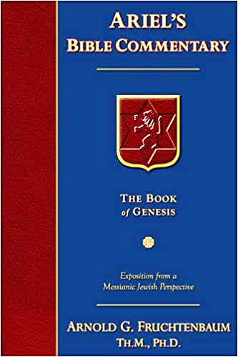
Dr. Arnold G. Fruchtenbaum
The Book of Acts, 129
“Verse 12 provides evidence of apostolic authority. The account of the second persecution of the church begins by describing the apostolic signs (v. 12a). Again it is important to note that in the book of Acts, only the apostles and the apostolic [de]legates, who were appointed by the apostles by the laying on of hands, were able to perform miracles, signs, and wonders (e.g. Acts 6:8).[113] This fact has come out four times before (Acts 2:43; 3:6-7; 4:22, 33), and now it is repeated once again in this verse.”

Slide 60
II. Stephen’s Arrest
Acts 6:8-15
  Description of Stephen (8)
  Disputations against Stephen (9-10)
  Conspiracy against Stephen (11)
  Arrest of Stephen (12)
  Charges against Stephen (13-14)
  Face of Stephen (15)
  Opportunity of Stephen (7:1)

Slide 61
Acts 6:9-10
Disputations Against Stephen
      Sources of the attack (9)
      Failure of the attack (10)

Slide 62
Acts 6:9-10
Disputations Against Stephen
      Sources of the attack (9)
      Failure of the attack (10)

Slide 64
Acts 6:9
Sources of the Attack
      Libertine (9a)
      Cyrene (9b)
      Alexandria (9c)
      Cilicia (9d)
      Asia (9e)

Slide 65
Acts 6:9
Sources of the Attack
      Libertine (9a)
      Cyrene (9b)
      Alexandria (9c)
      Cilicia (9d)
      Asia (9e)

Slide 67
Acts 6:9
Sources of the Attack
      Libertine (9a)
      Cyrene (9b)
      Alexandria (9c)
      Cilicia (9d)
      Asia (9e)

Slide 69
Acts 6:9
Sources of the Attack
      Libertine (9a)
      Cyrene (9b)
      Alexandria (9c)
      Cilicia (9d)
      Asia (9e)

Slide 71
Acts 6:9
Sources of the Attack
      Libertine (9a)
      Cyrene (9b)
      Alexandria (9c)
      Cilicia (9d)
      Asia (9e)

Slide 73
Acts 6:9
Sources of the Attack
      Libertine (9a)
      Cyrene (9b)
      Alexandria (9c)
      Cilicia (9d)
      Asia (9e)

Slide 76
Acts 6:9-10
Disputations Against Stephen
      Sources of the attack (9)
      Failure of the attack (10)

Slide 77
II. Stephen’s Arrest
Acts 6:8-15
  Description of Stephen (8)
  Disputations against Stephen (9-10)
  Conspiracy against Stephen (11)
  Arrest of Stephen (12)
  Charges against Stephen (13-14)
  Face of Stephen (15)
  Opportunity of Stephen (7:1)

Slide 78
Acts 6:11
Conspiracy Against Stephen
      Bribery (11a)
      Charges (11b-c)

Slide 79
Acts 6:11
Conspiracy Against Stephen
      Bribery (11a)
      Charges (11b-c)

Slide 80
Acts 6:11
Conspiracy Against Stephen
      Bribery (11a)
      Charges (11b-c)

Slide 81
Acts 6:11b-c
Charges
      Speaking against Moses (11b)
      Speaking against God (11c)

Slide 82
Acts 6:11b-c
Charges
      Speaking against Moses (11b)
      Speaking against God (11c)

Slide 83
Acts 6:11b-c
Charges
      Speaking against Moses (11b)
      Speaking against God (11c)

Slide 84
II. Stephen’s Arrest
Acts 6:8-15
  Description of Stephen (8)
  Disputations against Stephen (9-10)
  Conspiracy against Stephen (11)
  Arrest of Stephen (12)
  Charges against Stephen (13-14)
  Face of Stephen (15)
  Opportunity of Stephen (7:1)

Slide 85
II. Stephen’s Arrest
Acts 6:8-15
  Description of Stephen (8)
  Disputations against Stephen (9-10)
  Conspiracy against Stephen (11)
  Arrest of Stephen (12)
  Charges against Stephen (13-14)
  Face of Stephen (15)
  Opportunity of Stephen (7:1)

Slide 86
Acts 6:13-14
Charges Against Stephen
      Charge (13)
      Substantiation of charges (14)

Slide 87
Acts 6:13-14
Charges Against Stephen
      Charge (13)
      Substantiation of charges (14)

Slide 88
Acts 6:13
Charges
      Speaking Against the Temple (13a)
      Speaking Against the Law (13b)

Slide 89
Acts 6:13
Charges
      Speaking Against the Temple (13a)
      Speaking Against the Law (13b)

Slide 90
Acts 6:13
Charges
      Speaking Against the Temple (13a)
      Speaking Against the Law (13b)

Slide 91
Acts 6:13-14
Charges Against Stephen
      Charge (13)
      Substantiation of charges (14)

Slide 92
Acts 6:14
Substantiation of the Charges
      Against the Temple (14a)
      Against the Law (14b)

Slide 93
Acts 6:14
Substantiation of the Charges
      Against the Temple (14a)
      Against the Law (14b)

Slide 94
Matthew 24:1-2
“¹ Jesus came out from the temple and was going away when His disciples came up to point out the temple buildings to Him. ² And He said to them, “Do you not see all these things? Truly I say to you, not one stone here will be left upon another, which will not be torn down.”

Slide 95

Luke 19:41-44
^{41 “}When He approached Jerusalem, He saw the city and wept over it, ⁴² saying, “If you had known in this day, even you, the things which make for peace! But now they have been hidden from your eyes. ⁴³ For the days will come upon you when your enemies will throw up a barricade against you, and surround you and hem you in on . . .

Slide 96
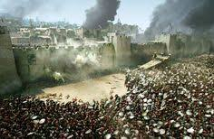
Luke 19:41-44
. . . every side, ⁴⁴ and they will level you to the ground and your children within you, and they will not leave in you one stone upon another, because you did not recognize the time of your visitation.”

Slide 97
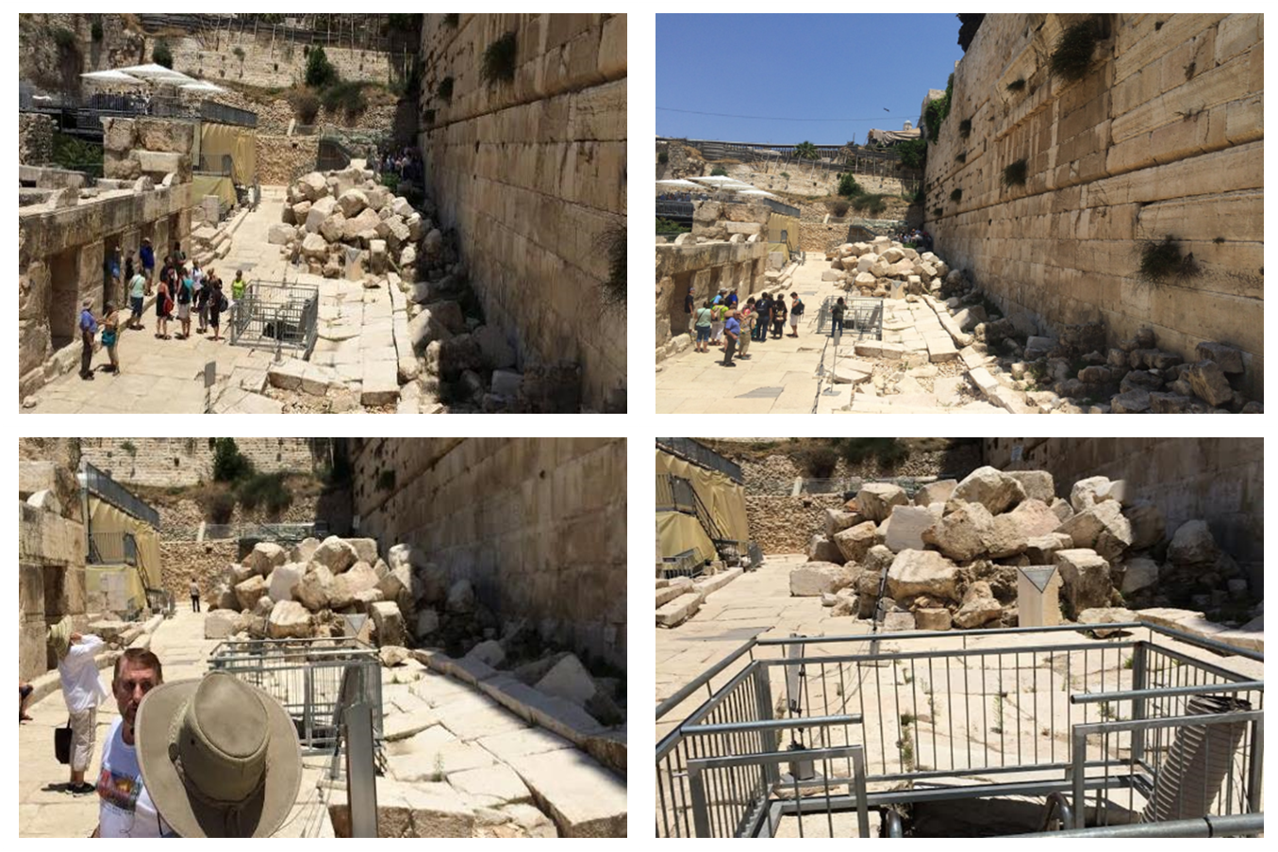

Slide 98
Acts 6:14
Substantiation of the Charges
      Against the Temple (14a)
      Against the Law (14b)

Slide 99
II. Stephen’s Arrest
Acts 6:8-15
  Description of Stephen (8)
  Disputations against Stephen (9-10)
  Conspiracy against Stephen (11)
  Arrest of Stephen (12)
  Charges against Stephen (13-14)
  Face of Stephen (15)
  Opportunity of Stephen (7:1)

Slide 100
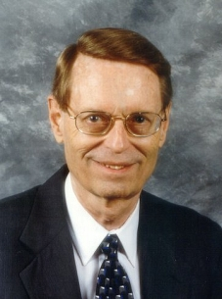
Charles Ryrie
Dispensationalism (Chicago: Moody Press, 1965), 86.
Literal interpretation “…might also be called plain interpretation so that no one receives the mistaken notion that the literal principle rules out figures of speech.”

Slide 101
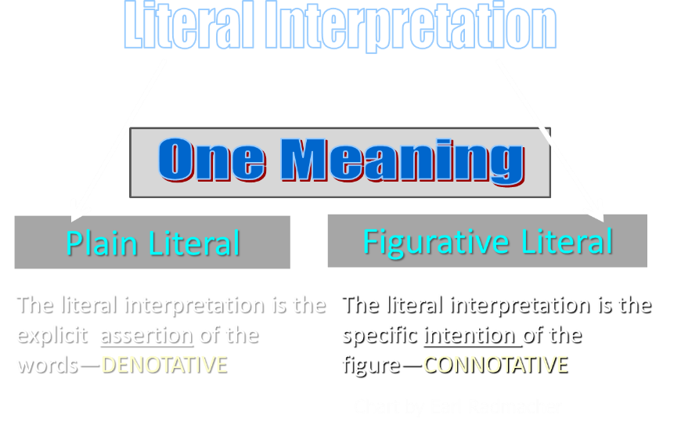

Slide 102
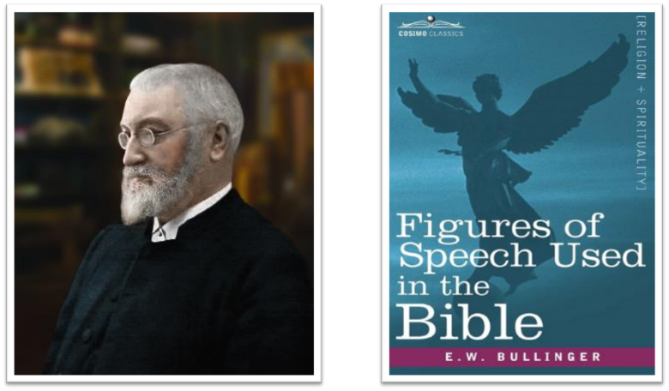
E.W. Bullinger (1837‒1913)

Slide 103
II. Stephen’s Arrest
Acts 6:8-15
  Description of Stephen (8)
  Disputations against Stephen (9-10)
  Conspiracy against Stephen (11)
  Arrest of Stephen (12)
  Charges against Stephen (13-14)
  Face of Stephen (15)
  Opportunity of Stephen (7:1)

Slide 104
Conclusion

Slide 105
Acts 6:1‒15
First Deacons & Stephen’s Arrest
  Appointment of the First Deacons (6:1-7)
  Stephen’s Arrest (6:8-15)

