Slide 1


Dr. Andy Woods
Senior Pastor – Sugar Land Bible Church
President – Chafer Theological Seminary

Slide 2
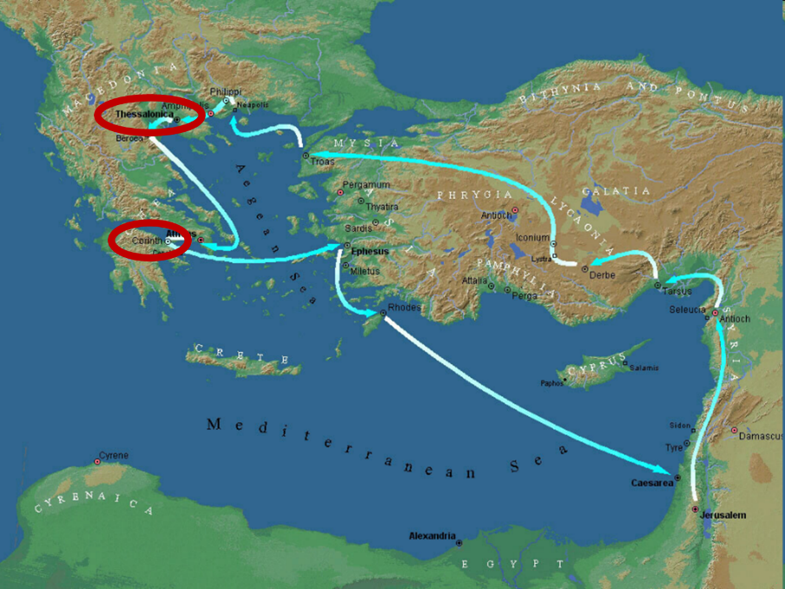

Slide 3
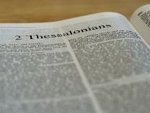
2 Thessalonians 2:1-12
Problem (2:1-2)
Prerequisites for the Day of the Lord (2:3-12)
  The departure (2:3a)
  Advent of the lawless one (2:3b-4)
  Removal of the restrainer (2:5-7)
  Destruction of the lawless one (2:8-9)
  Destruction of lawless one’s followers (2:10-12)

Slide 4
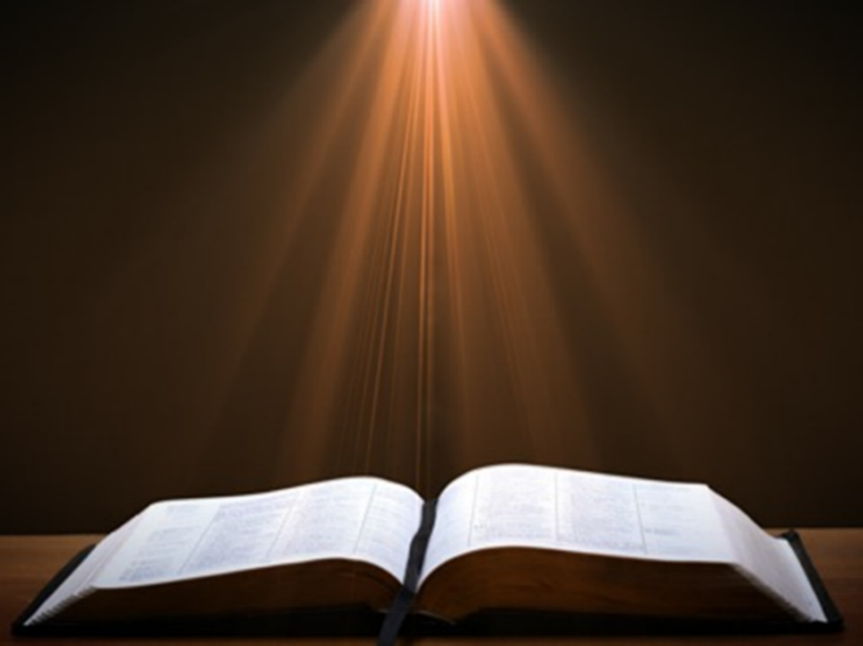

2 Thessalonians 2:2
“that you not be quickly shaken from your composure or be disturbed either by a spirit or a message or a letter as if from us, to the effect that the day of the Lord [the Tribulation] has come.”

Slide 5
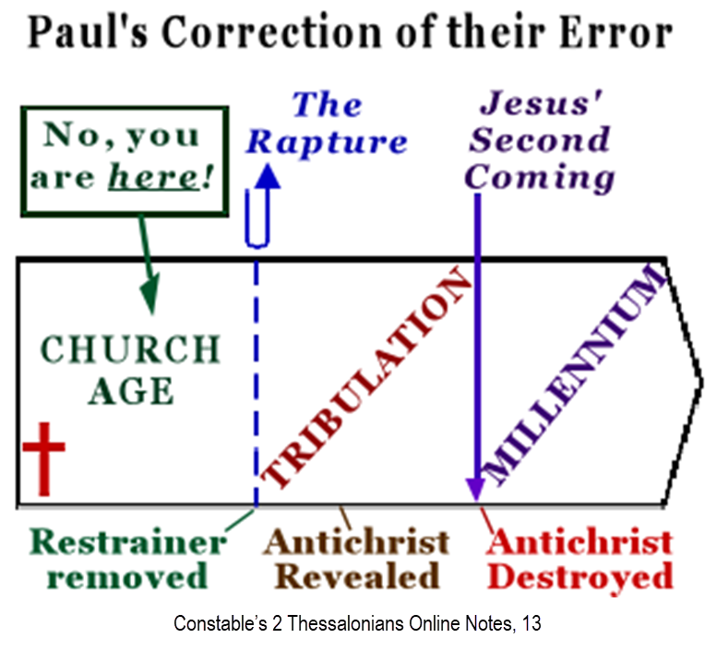

Slide 6
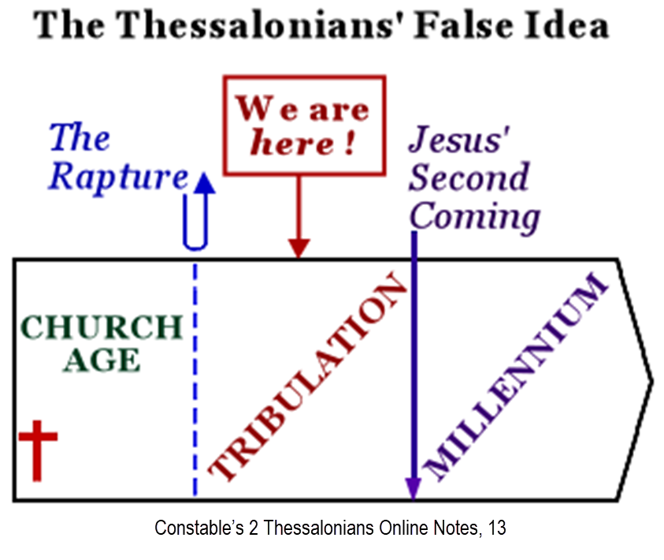

Slide 7
2 Thessalonians 2:1-12
Problem (2:1-2)
Prerequisites for the Day of the Lord (2:3-12)
  The departure (2:3a)
  Advent of the lawless one (2:3b-4)
  Removal of the restrainer (2:5-7)
  Destruction of the lawless one (2:8-9)
  Destruction of lawless one’s followers (2:10-12)

Slide 8
2 Thessalonians 2:1-12
Problem (2:1-2)
Prerequisites for the Day of the Lord (2:3-12)
  The departure (2:3a)
  Advent of the lawless one (2:3b-4)
  Removal of the restrainer (2:5-7)
  Destruction of the lawless one (2:8-9)
  Destruction of lawless one’s followers (2:10-12)

Slide 9
2 Thessalonians 2:1-12
Problem (2:1-2)
Prerequisites for the Day of the Lord (2:3-12)
  The departure (2:3a)
  Advent of the lawless one (2:3b-4)
  Removal of the restrainer (2:5-7)
  Destruction of the lawless one (2:8-9)
  Destruction of lawless one’s followers (2:10-12)

Slide 10

Daniel 9:27
“And he will make a firm covenant with the many for one week, but in the middle of the week he will put a stop to sacrifice and grain offering; and on the wing of abominations will come one who makes desolate, even until a complete destruction, one that is decreed, is poured out on the one who makes desolate.”

Slide 11
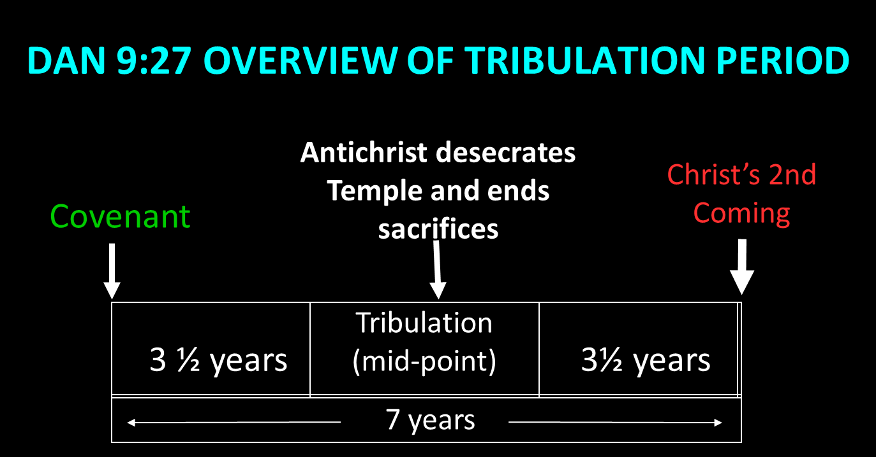

Slide 12
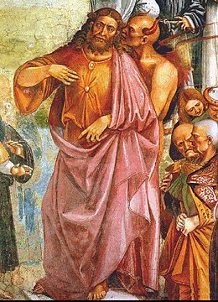
Daniel 11:31
“Forces from him will arise, desecrate the sanctuary fortress, and do away with the regular sacrifice. And they will set up the abomination of desolation.”

Slide 13


Slide 14

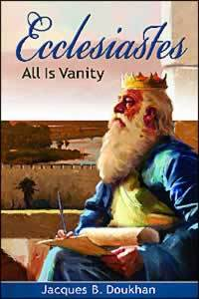
Ecclesiastes 1:9
“That which has been is that which will be, And that which has been done is that which will be done. So there is nothing new under the sun.”

Slide 15

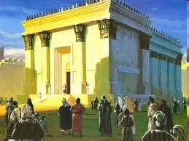
Israel’s Four Temples
Solomon’s pre-exilic temple (Kings and Chronicles)
Zerubbabel’s post exilic temple (Ezra 1-6; John 2:20)
Antichrist's temple (Dan 9:27; Matt 24:15; 2 Thess 2:4; Rev 11:1-2)
Millennial temple (Ezek 40-48)

Slide 16
The Stage Is Being Set
Rebirth of Israel in 1948
Israel’s desire for peace
Desire among some Jews to Rebuild 3rd Jewish temple and Restore the sacrificial system
  Source: Randall Price “Ready to Rebuild”

Slide 17
The Stage Is Being Set
Rebirth of Israel in 1948
Israel’s desire for peace
Desire among some Jews to Rebuild 3rd Jewish temple and Restore the sacrificial system
  Source: Randall Price “Ready to Rebuild”

Slide 18
The Stage Is Being Set
Rebirth of Israel in 1948
Israel’s desire for peace
Desire among some Jews to Rebuild 3rd Jewish temple and Restore the sacrificial system
  Source: Randall Price “Ready to Rebuild”

Slide 19
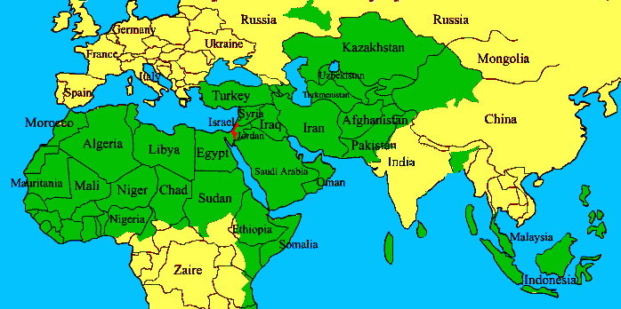
ISRAEL

Slide 20
The Stage Is Being Set
Rebirth of Israel in 1948
Israel’s desire for peace
Desire among some Jews to Rebuild 3rd Jewish temple and Restore the sacrificial system
  Source: Randall Price “Ready to Rebuild”

Slide 21


Slide 22
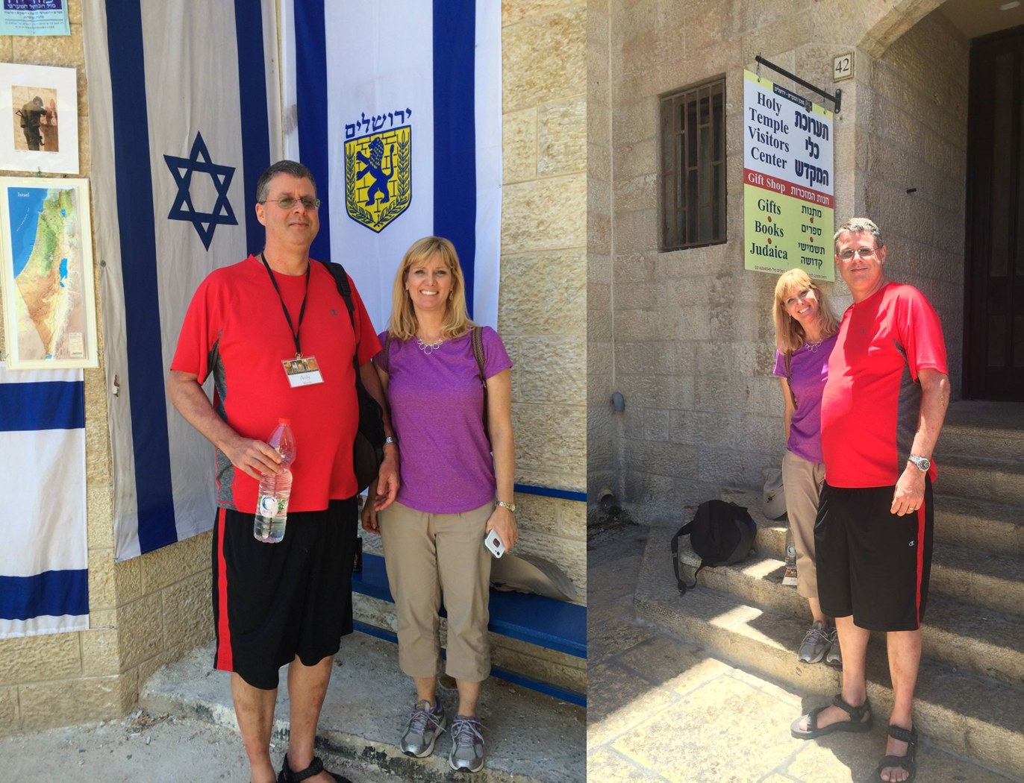

Slide 23
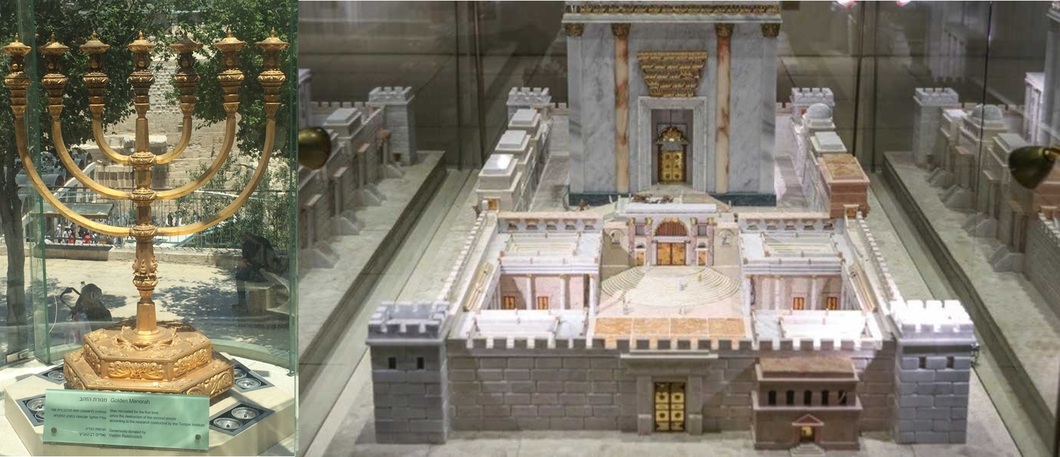

Slide 24
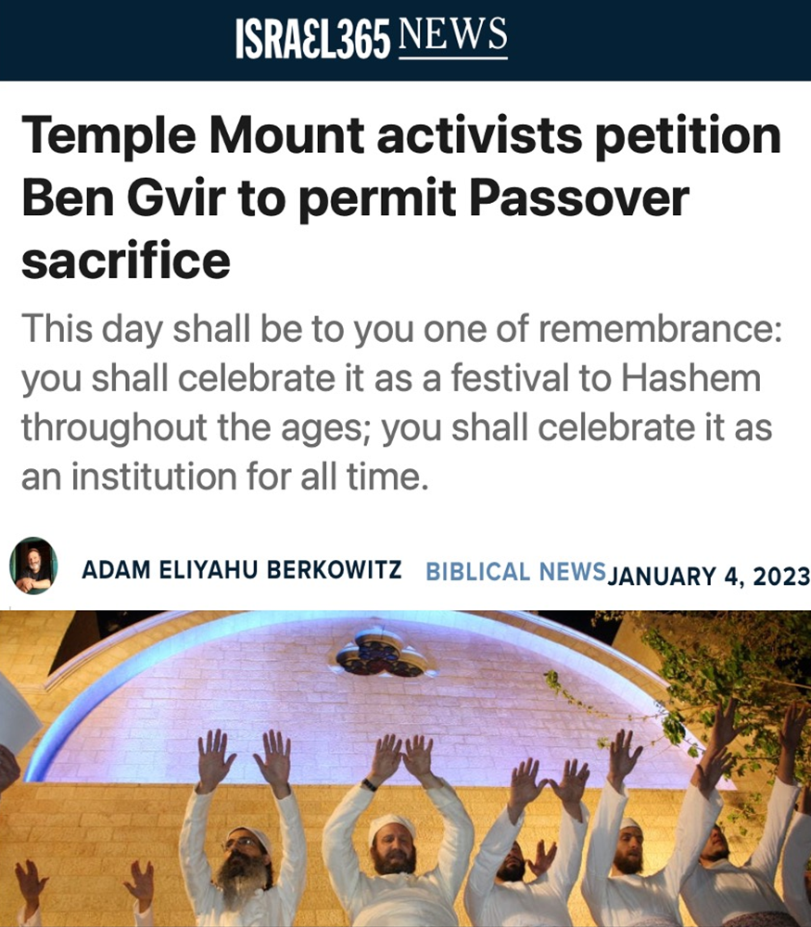

Slide 25
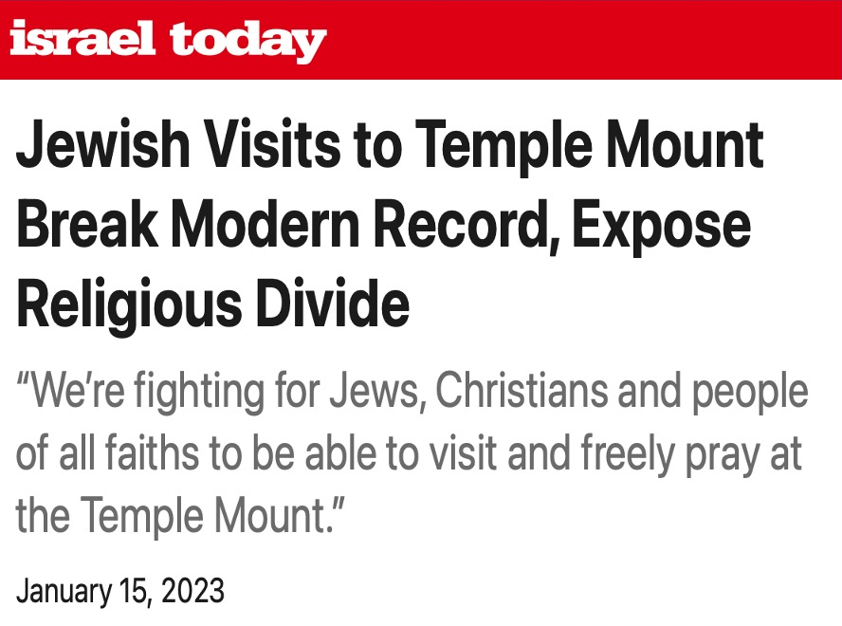

Slide 26
Daniel 11:31
“Forces from him will arise, desecrate the sanctuary fortress, and do away with the regular sacrifice. And they will set up the abomination of desolation.”

Slide 28
Daniel 9:27
“And he will make a firm covenant with the many for one week, but in the middle of the week he will put a stop to sacrifice and grain offering; and on the wing of abominations will come one who makes desolate, even until a complete destruction, one that is decreed, is poured out on the one who makes desolate.”

Slide 29
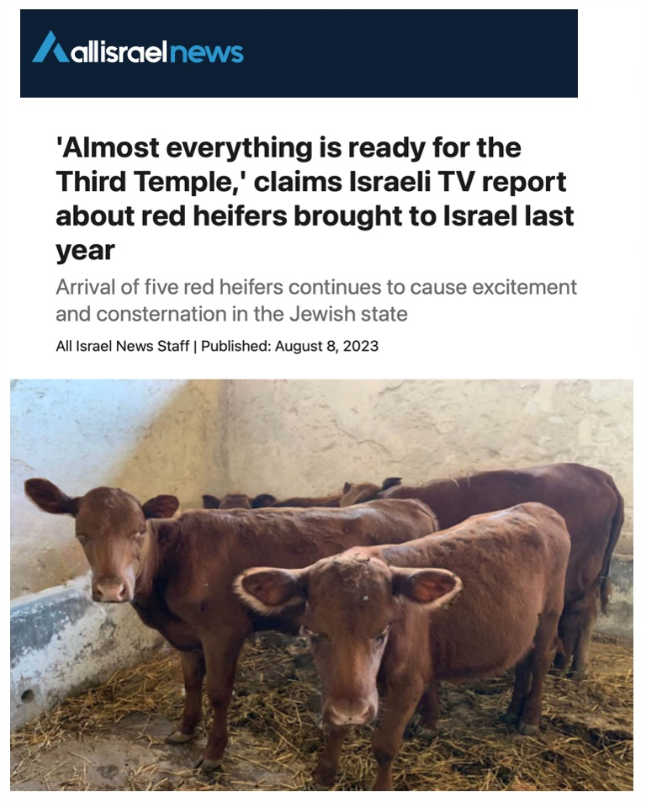

Slide 30
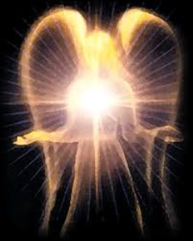
Original State and First Sin
ISAIAH 14:12-15 – 5 “I WILL” STATEMENTS
    Ascend to heaven (13)
    Raise my throne above the stars of God (13)
    Sit enthroned on the Mt. of the Assembly (13)
    Ascend above the tops of the clouds (14)
    Make myself like the Most High (14)

Slide 31
Original State and First Sin
ISAIAH 14:12-15 – 5 “I WILL” STATEMENTS
    Ascend to heaven (13)
    Raise my throne above the stars of God (13)
    Sit enthroned on the Mt. of the Assembly (13)
    Ascend above the tops of the clouds (14)
    Make myself like the Most High (14)

Slide 32
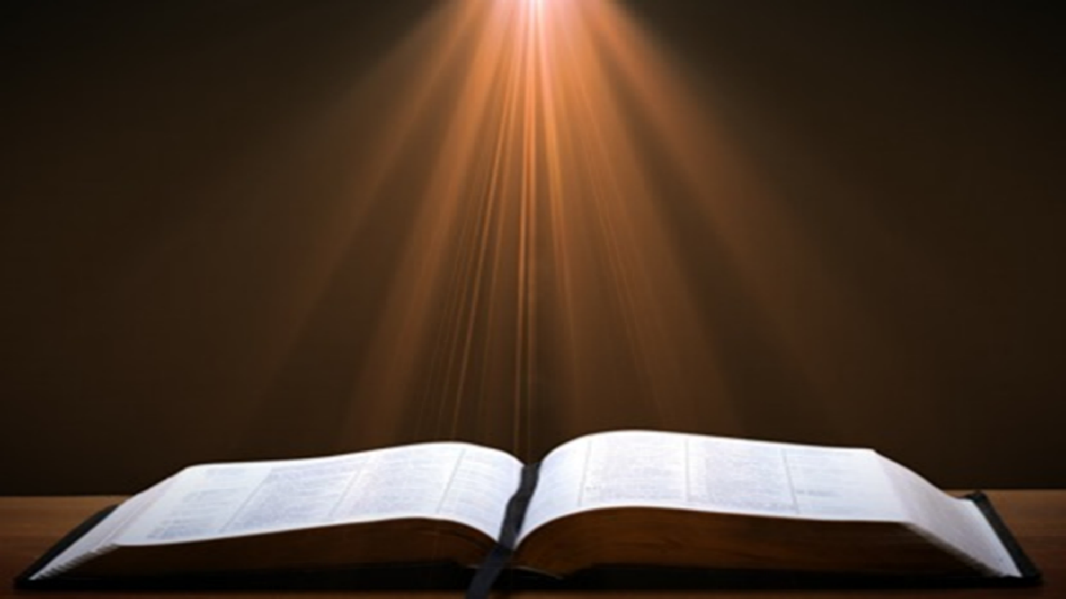

Isaiah 14:14
“I will ascend above the heights of the clouds; I will make myself like the Most High.”

Slide 33
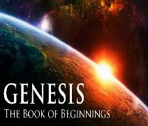
Satan’s Tactics (2 Cor 2:11)
  Adds to God’s Word (3:1; 2:16-17)
  Challenges God’s goodness (3:1; 2:16-17)
  Subtracts from God’s Word (3:4; 2:17)
  Offers wisdom without submission to God (3:5; Prov 1:7)

Slide 34

Genesis 3:5
“For God knows that in the day you eat from it your eyes will be opened, and you will be like God, knowing good and evil.”

Slide 35

Humanist Beliefs
The non-existence or irrelevancy of god
Man as the center of all things
The reality of evolution
Man as an evolved animal rather than a special creature made in the image of his creator
The absence of any absolute morals or values
Confidence in the scientific method to solve the world’s problems
Eidsmoe, The Christian Legal Advisor, 180-87.

Slide 36

Genesis 1:1–3
¹ In the beginning God created the heavens and the earth. ² The earth was formless and void, and darkness was over the surface of the deep, and the Spirit of God was moving over the surface of the waters. ³ Then God said, “Let there be light”; and there was light.

Slide 37
Refutation of Man’s Philosophies
(Gen 1:1)
Atheism – God created (Ps. 14:1)
Pantheism – God is transcendent over creation
Polytheism – One God created (Deut. 6:4; Isa 43:11; 44:6; 45:5)
Materialism – Matter began
Dualism – God alone created (Ezek. 28:13, 15)
Humanism – God rather than man created
Naturalism – God created
Morris, Genesis Record, 38

Slide 38
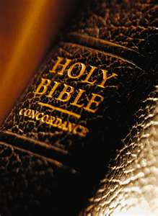
Fundamental Questions – Christian Answers
“Who am I?” – a special creation of God
“Where did I come from?” – from God’s design
“Why am I here?” – to know and glorify God
“Where am I going?” – to heaven
“How can I get there?” – only through Jesus Christ

Slide 39
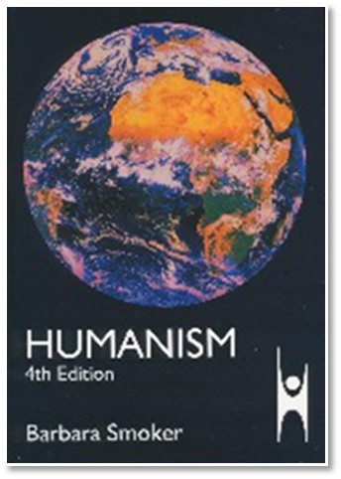
Fundamental Questions - Humanistic Answers
“Who am I?” – a biological accident
“Where did I come from?” – from the primordial soup
“Why am I here?” – to fulfill self
“Where am I going?” – toward a planetary new world order
“How can I get there?” – the scientific method

Slide 40
Humanists Call Themselves Religious
Advancement of a religion
“Religious humanists”
“Religious humanism.”
Kurtz, ed., Humanist Manifestos I and II, 8, 10.

Slide 41
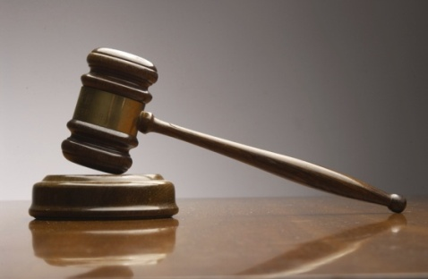
Torcaso v. Watkins (1961)
“Among the religions in this country which do not teach what would generally be considered a belief in the existence of God are Buddhism, Taoism, Ethical Culture, Secular Humanism and others” (italics added).
Torcaso v. Watkins, 367 U.S. 488, 495, n. 11 (1961).

Slide 42
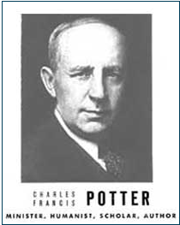
Humanist Proselytizing
“Education is thus a most powerful ally of Humanism, and every public school is a school of Humanism. What can the theistic Sunday-schools, meeting for an hour once a week, and teaching only a fraction of the children, do to stem the tide of a five-day program of humanistic teaching?”
Charles Francis Potter, Humanism: A New Religion (New York: Simon and Schuster, 1930), 128

Slide 43


New Age Proselytizing
“I am convinced that the battle for humankind’s future must be waged and won in the public school classrooms by teachers who correctly perceive their role as proselytizers of a new faith: a religion of humanity that recognizes and respects the spark of what theologians call the Divinity in every human being. These teachers must embody the same selfless dedication as the most rabid fundamentalist preachers.”
John Dunphy, “A Religion for the New Age,” The Humanist (January/February 1983): 26

Slide 44
2 Thessalonians 2:1-12
Problem (2:1-2)
Prerequisites for the Day of the Lord (2:3-12)
  The departure (2:3a)
  Advent of the lawless one (2:3b-4)
  Removal of the restrainer (2:5-7)
  Destruction of the lawless one (2:8-9)
  Destruction of lawless one’s followers (2:10-12)

Slide 45


2 Thessalonians 2:5
“Do you not remember that while I was still with you, I was telling you these things?”

Slide 46

Paul’s Various Rapture Terms
parousia | 2 Thess. 2:1
episynagōgē | 2 Thess. 2:1
apokalypsis | 1 Cor. 1:7
epiphaneia | Titus 2:13
rhyomai | 1 Thess. 1:10
harpazō | 1 Thess. 4:17
apostasia | 2 Thess. 2:3a

Slide 47
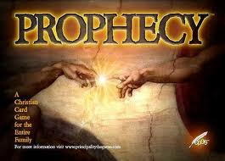
Biblical Prophecy: Importance
27% of Scripture was prophetic at the time it was written
2 Pet 1:19

Slide 48

2 Peter 1:19
“So we have the prophetic word made more sure, to which you do well to pay attention as to a lamp shining in a dark place, until the day dawns and the morning star arises in your hearts.”

Slide 49
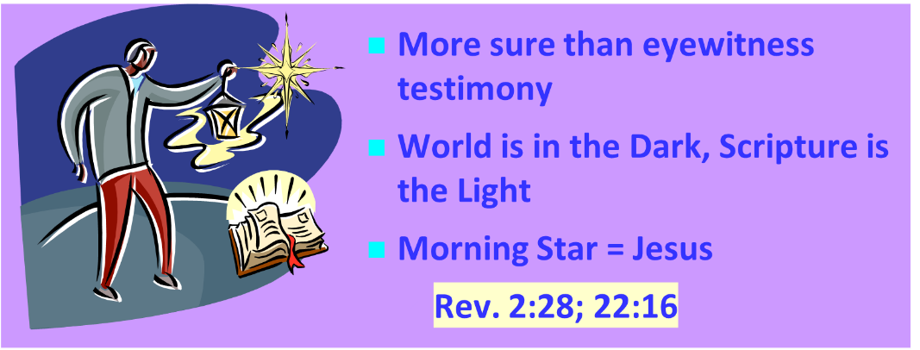
AUTHORITY OF SCRIPTURE V. 19

Slide 50


2 Thessalonians 2:6-7
⁶And you know what restrains [katechon; neuter] him now, so that in his time he will be revealed. ⁷For the mystery of lawlessness is already at work; only he who now restrains [katechōn; masculine] will do so until he is taken out of the way.

Slide 51

Restrainer? (2:6-7)
Rome?
Satan?
Government?
Michael?
Spirit?

Slide 52
Restrainer? (2:6-7)
Rome?
Satan?
Government?
Michael?
Spirit?

Slide 53
Restrainer? (2:6-7)
Rome?
Satan?
Government?
Michael?
Spirit?

Slide 54
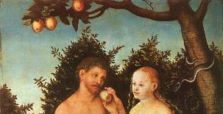
2 Thessalonians 2:9
“that is, the one whose coming is in accord with the activity of Satan, with all power and signs and false wonders.”

Slide 55
Matthew 12:24-26
“²⁴ But when the Pharisees heard this, they said, ‘This man casts out demons only by Beelzebul the ruler of the demons.’ ²⁵ And knowing their thoughts Jesus said to them, ‘Any kingdom divided against itself is laid waste; and any city or house divided against itself will not stand. ²⁶ If Satan casts out Satan, he is divided against himself; how then will his kingdom stand?”

Slide 56
Restrainer? (2:6-7)
Rome?
Satan?
Government?
Michael?
Spirit?

Slide 57

Genesis 9:6
“Whoever sheds man’s blood, By man his blood shall be shed, For in the image of God He made man.”

Slide 58
Romans 13:1-7
¹ Every person is to be in subjection to the governing authorities. For there is no authority except from God, and those which exist are established by God. ² Therefore whoever resists authority has opposed the ordinance of God; and they who have opposed will receive condemnation upon themselves. ³ For rulers are not a cause of fear for good behavior, but for evil. Do you want to have no fear of authority? Do what is good and you will have praise from the same; ⁴ for it is a minister of God to you for good. . . .

Slide 59
Romans 13:1-7
... But if you do what is evil, be afraid; for it does not bear the sword for nothing; for it is a minister of God, an avenger who brings wrath on the one who practices evil. ⁵ Therefore it is necessary to be in subjection, not only because of wrath, but also for conscience’ sake. ⁶ For because of this you also pay taxes, for rulers are servants of God, devoting themselves to this very thing. ⁷ Render to all what is due them: tax to whom tax is due; custom to whom custom; fear to whom fear; honor to whom honor.

Slide 60

Daniel 7:19, 23, 25
“Then I desired to know the exact meaning of the fourth beast, which was different from all the others, exceedingly dreadful, with its teeth of iron and its claws of bronze, and which devoured, crushed and trampled down the remainder with its feet…Thus he said: ‘The fourth beast will be a fourth kingdom on the earth, which will be different from all the other kingdoms and will devour the whole . . .

Slide 61
Daniel 7:19, 23, 25
. . . earth and tread it down and crush it…He will speak out against the Most High and wear down the saints of the Highest One, and he will intend to make alterations in times and in law; and they will be given into his hand for a time, times, and half a time.”

Slide 62
Restrainer? (2:6-7)
Rome?
Satan?
Government?
Michael?
Spirit?

Slide 63

Marvin Rosenthal
“…of paramount importance is the identification of the one who restraints or hinders the Antichrist until ‘he [the restrainer] be taken out of the way.’ The restrainer is neither the Holy Spirit nor human government. Evidence is strained to support either of those contentions. There is, however, substantial evidence to identify the restrainer. He who restraints until ‘he be taken out of the way’ is the Archangel Michael.”
Marvin J. Rosenthal, The Pre-Wrath Rapture of the Church: A New Understanding of the Tribulation, and the Second Coming (Nashville, TN: Thomas Nelson, 1990), 112.

Slide 64
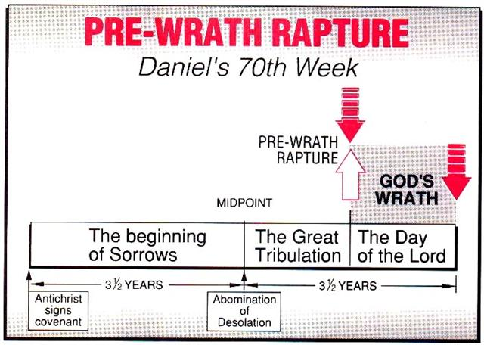
Marvin J. Rosenthal, The Pre-Wrath Rapture of the Church: A New Understanding of the Tribulation, and the Second Coming (Nashville, TN: Thomas Nelson, 1990), 112.

Slide 65
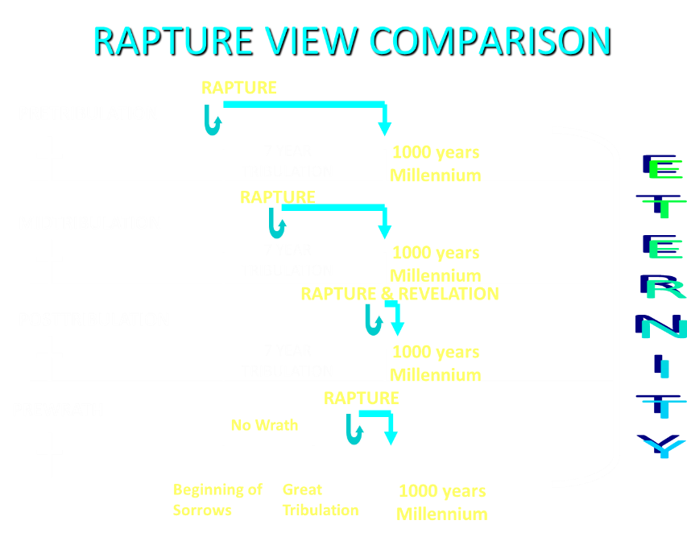

Slide 66
2 Thessalonians 2:6-7
⁶And you know what restrains [katechon; neuter] him now, so that in his time he will be revealed. ⁷For the mystery of lawlessness is already at work; only he who now restrains [katechōn; masculine] will do so until he is taken out of the way.

Slide 67
2 Thessalonians 2:6-7
⁶And you know what restrains [τὸ κατέχον; neuter] him now, so that in his time he will be revealed. ⁷For the mystery of lawlessness is already at work; only he who now restrains [ὁ κατέχων; masculine] will do so until he is taken out of the way.

Slide 68
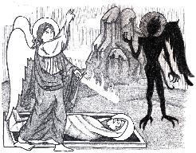
Jude 9
“But Michael the archangel, when he disputed with the devil and argued about the body of Moses, did not dare pronounce against him a railing judgment, but said, ‘The Lord rebuke you!’”

Slide 69
2 Thessalonians 2:9
“that is, the one whose coming is in accord with the activity of Satan, with all power and signs and false wonders.”

Slide 70
Daniel 12:1
“Now at that time Michael, the great prince who stands guard over the sons of your people [Israel], will arise. And there will be a time of distress such as never occurred since there was a nation until that time; and at that time your people, everyone who is found written in the book, will be rescued.”

Slide 71
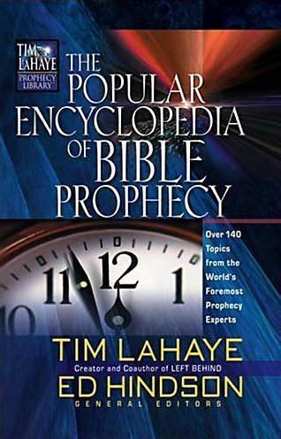
Tony Kessinger
“The pre-wrath view holds to the rather inventive idea that Michael the archangel is the restrainer. This concept fails to take into consideration Michael's special protective ministry toward Israel.”
Tony Kessinger, "Pre-Wrath Rapture," in The Popular Encyclopedia of Bible Prophecy: Over 140 Topics from the World's Foremost Prophecy Experts, ed. Tim LaHaye and Ed Hindson (Eugene, OR: Harvest, 2004), 294.

Slide 72
Daniel 12:1
“Now at that time Michael, the great prince who stands guard over the sons of your people [Israel], will arise. And there will be a time of distress such as never occurred since there was a nation until that time; and at that time your people, everyone who is found written in the book, will be rescued.”

Slide 73
Restrainer? (2:6-7)
Rome?
Satan?
Government?
Michael?
Spirit?

Slide 74
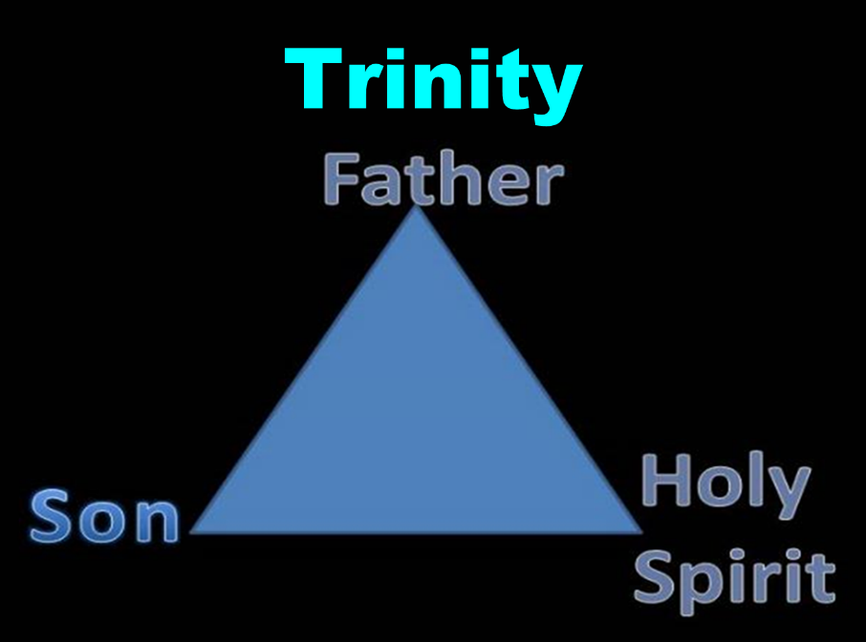

Slide 75
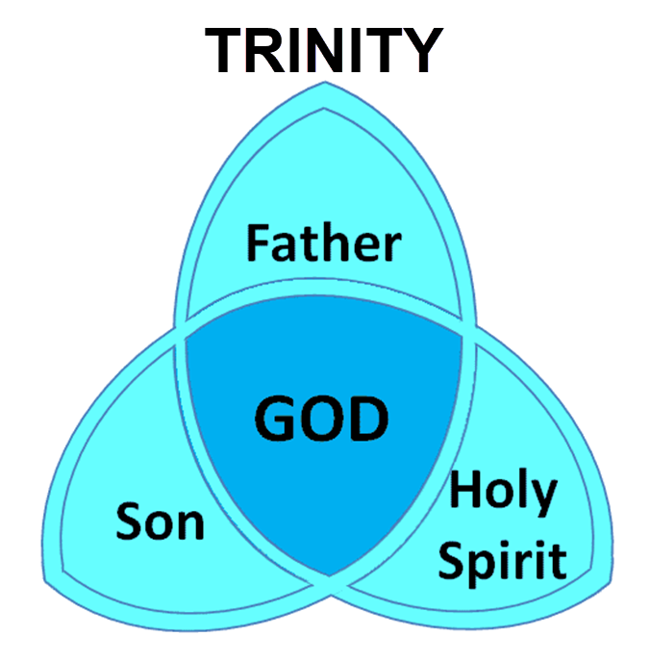

Slide 76
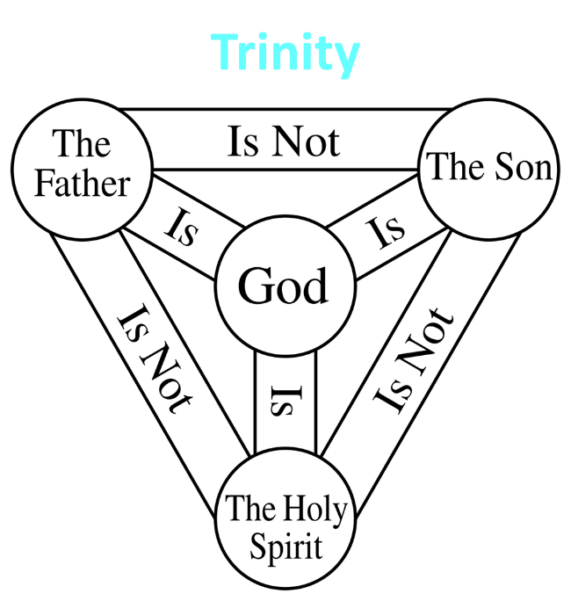

Slide 77

3 Reasons Why the Restrainer is the Holy Spirit
(2 Thessalonians 2:6-7)
The Holy Spirit is omnipotent (2 Thess. 2:9)
The Holy Spirit is active in the world (Gen. 6:3; John 16:7-11)
The Holy Spirit view handles well the switch in gender from the neuter (vs. 6) to the masculine (vs. 7)

Slide 78
3 Reasons Why the Restrainer is the Holy Spirit
(2 Thessalonians 2:6-7)
The Holy Spirit is omnipotent (2 Thess. 2:9)
The Holy Spirit is active in the world (Gen. 6:3; John 16:7-11)
The Holy Spirit view handles well the switch in gender from the neuter (vs. 6) to the masculine (vs. 7)

Slide 79
2 Thessalonians 2:9
“that is, the one whose coming is in accord with the activity of Satan, with all power and signs and false wonders.”

Slide 80
3 Reasons Why the Restrainer is the Holy Spirit
(2 Thessalonians 2:6-7)
The Holy Spirit is omnipotent (2 Thess. 2:9)
The Holy Spirit is active in the world (Gen. 6:3; John 16:7-11)
The Holy Spirit view handles well the switch in gender from the neuter (vs. 6) to the masculine (vs. 7)

Slide 81
Genesis 6:1-3
“¹ Now it came about, when men began to multiply on the face of the land, and daughters were born to them, ² that the sons of God saw that the daughters of men were beautiful; and they took wives for themselves, whomever they chose. ³ Then the Lord said, “My Spirit shall not strive with man forever, because he also is flesh; nevertheless his days shall be one hundred and twenty years.”

Slide 82
John 16:7-11
“⁷ But I tell you the truth, it is to your advantage that I go away; for if I do not go away, the Helper will not come to you; but if I go, I will send Him to you. ⁸ And He, when He comes, will convict the world concerning sin and righteousness and judgment; ⁹ concerning sin, because they do not believe in Me; ¹⁰ and concerning righteousness, because I go to the Father and you no longer see Me; ¹¹ and concerning judgment, because the ruler of this world has been judged.”

Slide 83
3 Reasons Why the Restrainer is the Holy Spirit
(2 Thessalonians 2:6-7)
The Holy Spirit is omnipotent (2 Thess. 2:9)
The Holy Spirit is active in the world (Gen. 6:3; John 16:7-11)
The Holy Spirit view handles well the switch in gender from the neuter (vs. 6) to the masculine (vs. 7)

Slide 84

2 Thessalonians 2:6-7
⁶And you know what restrains [katechō; neuter] him now, so that in his time he will be revealed. ⁷For the mystery of lawlessness is already at work; only he who now restrains [katechō; masculine] will do so until he is taken out of the way.

Slide 85
2 Thessalonians 2:6-7
⁶And you know what restrains [τὸ κατέχον; neuter] him now, so that in his time he will be revealed. ⁷For the mystery of lawlessness is already at work; only he who now restrains [ὁ κατέχων; masculine] will do so until he is taken out of the way.

Slide 86
John 14:16-17
¹⁶ I will ask the Father, and He will give you another Helper, that He may be with you forever; ¹⁷ that is the Spirit of truth, whom the world cannot receive, because it does not see Him or know Him, but you know Him because He abides with you and will be in you.

Slide 87
John 16:7-11
“⁷ But I tell you the truth, it is to your advantage that I go away; for if I do not go away, the Helper will not come to you; but if I go, I will send Him to you. ⁸ And He, when He comes, will convict the world concerning sin and righteousness and judgment; ⁹ concerning sin, because they do not believe in Me; ¹⁰ and concerning righteousness, because I go to the Father and you no longer see Me; ¹¹ and concerning judgment, because the ruler of this world has been judged.”

Slide 88
Romans 8:5-6
^{5 “}For those who are according to the flesh set their minds on the things of the flesh, but those who are according to the Spirit, the things of the Spirit. ⁶ For the mind set on the flesh is death, but the mind set on the Spirit is life and peace.”

Slide 89
2 Thessalonians 2:5
“Do you not remember that while I was still with you, I was telling you these things?”

Slide 90
Restrainer Must First be Removed
Restrainer holds back the Antichrist (2 Thess 2:6-7)
Restrainer = the omnipotent Holy Spirit (2 Thess 2:9)
Holy Spirit permanently indwells all Christians (John 14:16; Rom 8:9)
Sprit indwelt Christians must first be removed prior to the Antichrist's advent

Slide 91
Restrainer Must First be Removed
Restrainer holds back the Antichrist (2 Thess 2:6-7)
Restrainer = the omnipotent Holy Spirit (2 Thess 2:9)
Holy Spirit permanently indwells all Christians (John 14:16; Rom 8:9)
Sprit indwelt Christians must first be removed prior to the Antichrist's advent

Slide 92
Restrainer Must First be Removed
Restrainer holds back the Antichrist (2 Thess 2:6-7)
Restrainer = the omnipotent Holy Spirit (2 Thess 2:9)
Holy Spirit permanently indwells all Christians (John 14:16; Rom 8:9)
Sprit indwelt Christians must first be removed prior to the Antichrist's advent

Slide 93
Restrainer Must First be Removed
Restrainer holds back the Antichrist (2 Thess 2:6-7)
Restrainer = the omnipotent Holy Spirit (2 Thess 2:9)
Holy Spirit permanently indwells all Christians (John 14:16; Rom 8:9)
Sprit indwelt Christians must first be removed prior to the Antichrist's advent

Slide 94
WORK OF THE SPIRIT IN THE OT
 | OT/GOSPELS/ACTS 1 | ACTS 2/TODAY
External vs. Internal | Upon (1 Sam. 16:13) | Within (John 14:17)
Reception of all of the Spirit at the moment of salvation? | Subsequent to salvation (Exod 31:3) | At moment of salvation (Rom 8:9)
How long is the indwelling? | Temporary indwelling (1 Sam 16:14; Ps 51:11) | Permanent indwelling (John 14:16)
Who is indwelt? | Selective indwelling (Joel 2:28) | Universal indwelling (1 Cor 12:13)

Slide 95
1 Samuel 16:13-14
“¹³ Then Samuel took the horn of oil and anointed him in the midst of his brothers; and the Spirit of the Lord came mightily upon David from that day forward. And Samuel arose and went to Ramah. ¹⁴ Now the Spirit of the Lord departed from Saul, and an evil spirit from the Lord terrorized him.”

Slide 96
John 14:16-17
¹⁶ I will ask the Father, and He will give you another Helper, that He may be with you forever; ¹⁷ that is the Spirit of truth, whom the world cannot receive, because it does not see Him or know Him, but you know Him because He abides with you and will be in you.

Slide 97
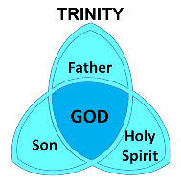
1 Corinthians 6:19
“Or do you not know that your body is a temple of the Holy Spirit who is in you, whom you have from God, and that you are not your own?”

Slide 98
Romans 8:9
“However, you are not in the flesh but in the Spirit, if indeed the Spirit of God dwells in you. But if anyone does not have the Spirit of Christ, he does not belong to Him.”

Slide 99
Ephesians 4:30
“Do not grieve the Holy Spirit of God, by whom you were sealed for the day of redemption.”

Slide 100
Restrainer Must First be Removed
Restrainer holds back the Antichrist (2 Thess 2:6-7)
Restrainer = the omnipotent Holy Spirit (2 Thess 2:9)
Holy Spirit permanently indwells all Christians (John 14:16; Rom 8:9)
Sprit indwelt Christians must first be removed prior to the Antichrist's advent

Slide 102

Guessing the Identity of the Antichrist?
Irenaeus Against Heresies 5.30.3
“We will not, however, incur the risk of pronouncing positively as to the name of Antichrist. But if it had been necessary to announce his name plainly at the present time, it would have been spoken by him who saw the apocalypse. For it was not seen long ago, but almost in our own time, at the end of the reign of Domitian (96 a.d.).”

Slide 103
Psalm 139:7-8
“⁷ Where can I go from Your Spirit? Or where can I flee from Your presence? ⁸ If I ascend to heaven, You are there; If I make my bed in Sheol, behold, You are there..”

Slide 104
Mark 13:11
“¹¹ When they arrest you and hand you over, do not worry beforehand about what you are to say, but say whatever is given you in that hour; for it is not you who speak, but it is the Holy Spirit.”

Slide 105
Distinctions Between 144,000 & Multitude
144,000 | MULTITUDE
Revelation 7:1-8 | Revelation 7:9-17
Numbered | Innumerable
Jews | All nations
Sealed | Slain
Sealed before the Tribulation | Converted out of the Tribulation
Hitchcock and Ice, The Truth Behind Left Behind, 77

Slide 106

Ezekiel 28:13–15
¹³ “You were in Eden, the garden of God; Every precious stone was your covering: The ruby, the topaz and the diamond; The beryl, the onyx and the jasper; The lapis lazuli, the turquoise and the emerald; And the gold, the workmanship of your settings and sockets, Was in you. On the day that you were created They were prepared….¹⁵ “You were blameless in your ways From the day you were created Until unrighteousness was found in you.

Slide 107
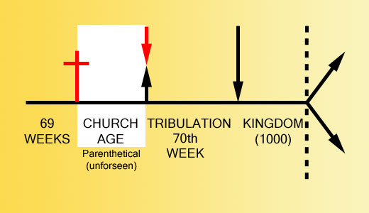

Slide 108
2 Thessalonians 2:3, 7
“…the man of lawlessness is revealed, the son of destruction…For the mystery of lawlessness is already at work; only he who now restrains will do so until he is taken out of the way.”

Slide 109
1 John 4:3
“and every spirit that does not confess Jesus is not from God; this is the spirit of the antichrist, of which you have heard that it is coming, and now it is already in the world.”

Slide 110
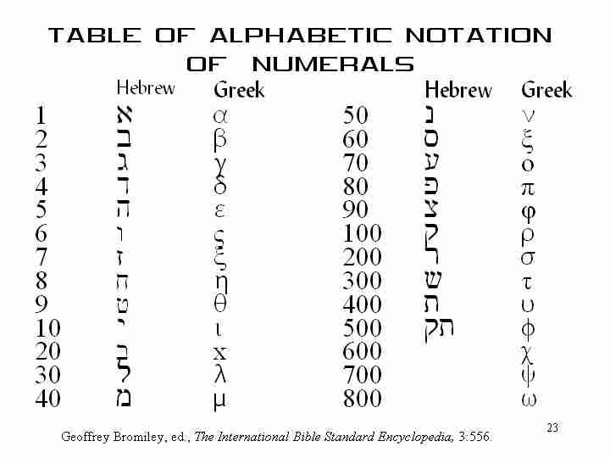

Slide 111
Conclusion

Slide 112
2 Thessalonians 2:1-12
Problem (2:1-2)
Prerequisites for the Day of the Lord (2:3-12)
  The departure (2:3a)
  Advent of the lawless one (2:3b-4)
  Removal of the restrainer (2:5-7)
  Destruction of the lawless one (2:8-9)
  Destruction of lawless one’s followers (2:10-12)

