Slide 1
Genesis 12‒50
Israel’s Birth & Preservation

Slide 2
GENESIS STRUCTURE
Genesis 12-50 (four people)
Abraham (12:1–25:11)
Isaac (25:12–26:35)
Jacob (27–36)
Joseph (37–50)

Slide 3
Genesis 37:2-36 Joseph Sold unto Egypt
Joseph’s coat (37:2-4)
Joseph’s dreams (37:5-11)
Joseph’s pit (37:12-24)
Joseph’s enslavement (37:25-36)

Slide 4
Genesis 37:2-36 Joseph Sold unto Egypt
Joseph’s coat (37:2-4)
Joseph’s dreams (37:5-11)
Joseph’s pit (37:12-24)
Joseph’s enslavement (37:25-36)

Slide 5
I. Genesis 37:2-4 Joseph’s Coat
Joseph’s tablet (2a)
Joseph’s relationship with his brothers (2b-e)
Jacob’s elevation of Joseph (3)
Reactions of his brothers (4)

Slide 6
I. Genesis 37:2-4 Joseph’s Coat
Joseph’s tablet (2a)
Joseph’s relationship with his brothers (2b-e)
Jacob’s elevation of Joseph (3)
Reactions of his brothers (4)

Slide 7
Toledoth “And These Are the Generations of…”
Introduction to the generations (1:1–2:3)
Generations of the heaven and earth (2:4–4:26)
Generations of Adam (5:1–6:8)
Generations of Noah (6:9–9:29)
Generations of the sons of Noah (10:1–11:9)
Generations of Shem (11:10–26)
Generations of Terah (11:27–25:11)
Generations of Ishmael (25:12-18)
Generations of Isaac (25:19–35:29)
Generations of Esau (36:1–37:1)
Generations of Jacob (37:2–50:26)

Slide 9
Luke 1:1–4
¹ Inasmuch as many have undertaken to compile an account of the things accomplished among us, ² just as they were handed down to us by those who from the beginning were eyewitnesses and servants of the word, ³ it seemed fitting for me as well, having investigated everything carefully from the beginning, to write it out for you in consecutive order, most excellent Theophilus; ⁴ so that you may know the exact truth about the things you have been taught.

Slide 11
I. Genesis 37:2-4 Joseph’s Coat
Joseph’s tablet (2a)
Joseph’s relationship with his brothers (2b-e)
Jacob’s elevation of Joseph (3)
Reactions of his brothers (4)

Slide 12
Genesis 37:2b-e Joseph’s Relationship with his Brothers
Age (2b)
Work (2c)
Associations (2d)
Actions (2e)

Slide 13
Genesis 37:2b-e Joseph’s Relationship with his Brothers
Age (2b)
Work (2c)
Associations (2d)
Actions (2e)

Slide 14
Genesis 37:2b-e Joseph’s Relationship with his Brothers
Age (2b)
Work (2c)
Associations (2d)
Actions (2e)

Slide 15
Genesis 37:2b-e Joseph’s Relationship with his Brothers
Age (2b)
Work (2c)
Associations (2d)
Actions (2e)

Slide 17
Genesis 37:2b-e Joseph’s Relationship with his Brothers
Age (2b)
Work (2c)
Associations (2d)
Actions (2e)

Slide 18
I. Genesis 37:2-4 Joseph’s Coat
Joseph’s tablet (2a)
Joseph’s relationship with his brothers (2b-e)
Jacob’s elevation of Joseph (3)
Reactions of his brothers (4)

Slide 19
Genesis 37:3 Jacob’s Elevation of Joseph
First-born of Rachel (3a)
Coat (3b)

Slide 20
Genesis 37:3 Jacob’s Elevation of Joseph
First-born of Rachel (3a)
Coat (3b)

Slide 22
Genesis 37:3 Jacob’s Elevation of Joseph
First-born of Rachel (3a)
Coat (3b)

Slide 23
Dr. Arnold G. Fruchtenbaum
The Book of Genesis, 529
“…a coat of royalty (II Sam. 13:18–19). The tradition of many colors is based on the Septuagint, which reads ‘a multicolored frock,’ a reading followed by the Latin Vulgate…The Tombs of Bene Hassein in Egypt dating back to the patriarchal age have pictorials that show Semitic chiefs (and the family of Jacob was Semitic) wore coats of…many colors as an insignia of rulership. Therefore, this was a sign that Jacob appointed Joseph the leader of the clan.”

Slide 25
I. Genesis 37:2-4 Joseph’s Coat
Joseph’s tablet (2a)
Joseph’s relationship with his brothers (2b-e)
Jacob’s elevation of Joseph (3)
Reactions of his brothers (4)

Slide 26
Genesis 37:4 Reaction of Brothers
Hatred (4a)
Lack of civility (4b)

Slide 27
Genesis 37:4 Reaction of Brothers
Hatred (4a)
Lack of civility (4b)

Slide 28
Matthew 5:21-22
“²¹ “You have heard that the ancients were told, ‘You shall not commit murder’ and ‘Whoever commits murder shall be liable to the court.’ ²² But I say to you that everyone who is angry with his brother shall be guilty before the court; and whoever says to his brother, ‘You good-for-nothing,’ shall be guilty before the supreme court; and whoever says, ‘You fool,’ shall be guilty enough to go into the fiery hell.”

Slide 29
Matthew 5:27-28
“²⁷ You have heard that it was said, ‘You shall not commit adultery’; ²⁸ but I say to you that everyone who looks at a woman with lust for her has already committed adultery with her in his heart.”

Slide 30
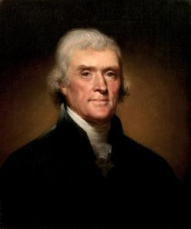
Thomas Jefferson
"My views ... are the result of a life of inquiry and reflection, and very different from the anti-Christian system imputed to me by those who know nothing of my opinions. To the corruptions of Christianity, I am, indeed, opposed; but not to the genuine precepts of Jesus Himself. I am a Christian in the only sense in which He wished any one to be; sincerely attached to his doctrines in preference to all others...His system of morals...if filled up in the style and spirit of the rich fragments He left us, would be the most perfect and sublime that has ever been taught by man...His moral doctrines...were more pure and . . .
On April 21, 1803, Jefferson wrote to Dr. Benjamin Rush, also a signer of the Declaration

Slide 31
Thomas Jefferson
...perfect than those of the most correct of the philosophers...gathering all into one family under the bonds of love, charity, peace, common wants and common aids. A development of this head will evince the peculiar superiority of the system of Jesus over all others. The precepts of philosophy, and of the Hebrew code, laid hold of actions only. He pushed his scrutinies into the heart of man; erected his tribunal in the region of his thoughts, and purified the waters at the fountain head.”
On April 21, 1803, Jefferson wrote to Dr. Benjamin Rush, also a signer of the Declaration

Slide 32
Genesis 37:4 Reaction of Brothers
Hatred (4a)
Lack of civility (4b)

Slide 33
Genesis 37:2-36 Joseph Sold unto Egypt
Joseph’s coat (37:2-4)
Joseph’s dreams (37:5-11)
Joseph’s pit (37:12-24)
Joseph’s enslavement (37:25-36)

Slide 34
II. Genesis 37:5-11 Joseph’s Dreams
Another reason for brothers’ hatred (5)
First dream (6-8)
Second dream (9-11)

Slide 35
II. Genesis 37:5-11 Joseph’s Dreams
Another reason for brothers’ hatred (5)
First dream (6-8)
Second dream (9-11)

Slide 36
Genesis 37:5 Another Reason for Brother’s Hatred
Dreams (5a)
Naivete (5b)
Reaction (5c)

Slide 37
Genesis 37:5 Another Reason for Brother’s Hatred
Dreams (5a)
Naivete (5b)
Reaction (5c)

Slide 39
Genesis 37:5 Another Reason for Brother’s Hatred
Dreams (5a)
Naivete (5b)
Reaction (5c)

Slide 40
Genesis 37:5 Another Reason for Brother’s Hatred
Dreams (5a)
Naivete (5b)
Reaction (5c)

Slide 41
II. Genesis 37:5-11 Joseph’s Dreams
Another reason for brothers’ hatred (5)
First dream (6-8)
Second dream (9-11)

Slide 42
Genesis 37:6-8 First Dream
Introduction (6)
Content (7)
Reaction (8)

Slide 43
Genesis 37:6-8 First Dream
Introduction (6)
Content (7)
Reaction (8)

Slide 44
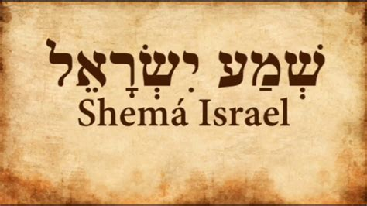
Deuteronomy 6:4-7
“⁴ Hear, Israel! The Lord is our God, the Lord is one!... ⁶ These words, which I am commanding you today, shall be on your heart. ⁷ You shall teach them diligently to your sons and shall talk of them when you sit in your house and when you walk by the way and when you lie down and when you rise up.”

Slide 45
Genesis 37:6-8 First Dream
Introduction (6)
Content (7)
Reaction (8)

Slide 47
Charles Ryrie Charles C. Ryrie, The Basis of the Premillennial Faith (Dubuque, IA: ECS Ministries, 2005), iBooks edition.
“…in the interpretation of unfulfilled prophecy, fulfilled prophecy forms the pattern…the logical way to discover how God will fulfill prophecy in the future is to discover how He fulfilled it in the past. If the hundreds of prophecies concerning Christ’s first coming were fulfilled literally, how can anyone reject the literal fulfillment of the numerous prophecies concerning His second coming and reign on the earth?”

Slide 48
Genesis 37:6-8 First Dream
Introduction (6)
Content (7)
Reaction (8)

Slide 49
Genesis 37:8 Reaction
Dreams (8a)
Word (8b)

Slide 50
Genesis 37:8 Reaction
Dreams (8a)
Word (8b)

Slide 51
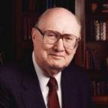
Two Rules of Interpretation
Search the immediate context
Walvoord: 26X
Search the remote context
Old Testament
Thomas: 278 / 404 verses

Slide 52
Genesis 37:8 Reaction
Dreams (8a)
Word (8b)

Slide 53
II. Genesis 37:5-11 Joseph’s Dreams
Another reason for brothers’ hatred (5)
First dream (6-8)
Second dream (9-11)

Slide 54
Genesis 37:9-11 Second Dream
Dream (9)
Jacob’s response (10)
Responses (11)

Slide 55
Genesis 37:9-11 Second Dream
Dream (9)
Jacob’s response (10)
Responses (11)

Slide 56
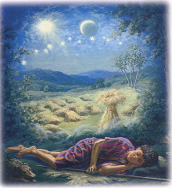
Genesis 37:9
Now he had still another dream, and related it to his brothers, and said, “Lo, I have had still another dream; and behold, the sun and the moon and eleven stars were bowing down to me.”

Slide 57
Genesis 37:9-11 Second Dream
Dream (9)
Jacob’s response (10)
Responses (11)

Slide 58
Genesis 37:10
He related it to his father and to his brothers; and his father rebuked him and said to him, “What is this dream that you have had? Shall I and your mother and your brothers actually come to bow ourselves down before you to the ground?”

Slide 60
Sun = Jacob
Moon = Leah
11 Stars = Joseph’s brothers
12th Star = Joseph
12 Stars = Israel’s twelve tribes

Slide 61
Revelation 12:1-5
¹And a great sign appeared in heaven: a woman clothed in the sun, and the moon under her feet, and upon her head a crown of twelve stars; ²and she was with child; and she cried out, being in labor pain to give birth. ³And another sign was seen in heaven: and behold, a great red dragon, having seven heads and ten horns, and upon his heads seven diadems ⁴And his tail swept a third part of . . .

Slide 62
Revelation 12:1-5 (cont’d)
. . . the stars of heaven, and did cast them to the earth: and the dragon stood before the woman that is about to give birth, so that when she gave birth he may devour her child. ⁵And she gave birth to a son, a man child, who is to rule all the nations with a rod of iron: and her child was caught up unto God, and to his throne.

Slide 63
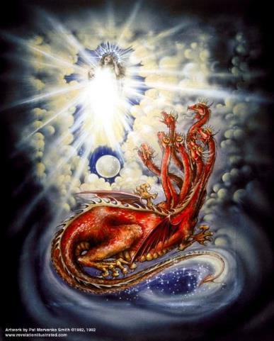
CAST OF 3 CHARACTERS Revelation 12:1-5
SON (v.5)
DRAGON (v. 3)
WOMAN (v.1)

Slide 65
Revelation 12:1-5
¹And a great sign (sēmeion) appeared in heaven: a woman clothed in the sun, and the moon under her feet, and upon her head a crown of twelve stars; ²and she was with child; and she cried out, being in labor pain to give birth. ³And another sign (sēmeion) was seen in heaven: and behold, a great red dragon, having seven heads and ten horns, and upon his heads seven diadems . . .

Slide 66
Two Rules of Interpretation
Search the immediate context
Walvoord: 26X
Search the remote context
Old Testament
Thomas: 278 / 404 verses

Slide 67
CAST OF 3 CHARACTERS Revelation 12:1-5
SON = MESSIAH
Ps. 2:9; Acts 1:9
DRAGON = SATAN
Rev. 12:9; 20:2
WOMAN = ISRAEL
Gen. 37:9-10

Slide 68
Genesis 37:9-11 Second Dream
Dream (9)
Jacob’s response (10)
Responses (11)

Slide 69
Genesis 37:11 Responses
Brothers (11a)
Jacob (11b)

Slide 70
Genesis 37:11 Responses
Brothers (11a)
Jacob (11b)

Slide 71
Genesis 37:11 Responses
Brothers (11a)
Jacob (11b)

Slide 72
Genesis 37:2-36 Joseph Sold unto Egypt
Joseph’s coat (37:2-4)
Joseph’s dreams (37:5-11)
Joseph’s pit (37:12-24)
Joseph’s enslavement (37:25-36)

Slide 73
III. Genesis 37:12-24 Joseph’s Pit
Joseph’s search for his brothers (12-17)
Brothers’ conspiracy to kill Joseph (18-24)

Slide 74
III. Genesis 37:12-24 Joseph’s Pit
Joseph’s search for his brothers (12-17)
Brothers’ conspiracy to kill Joseph (18-24)

Slide 75
Genesis 37:12-17 Joseph’s Search for his Brothers
Location: Shechem (12)
Jacob sends Joseph (13-14)
Joseph’s search in Shechem (15-17a)
Joseph’s journey (17b)

Slide 76
Genesis 37:12-17 Joseph’s Search for his Brothers
Location: Shechem (12)
Jacob sends Joseph (13-14)
Joseph’s search in Shechem (15-17a)
Joseph’s journey (17b)

Slide 77
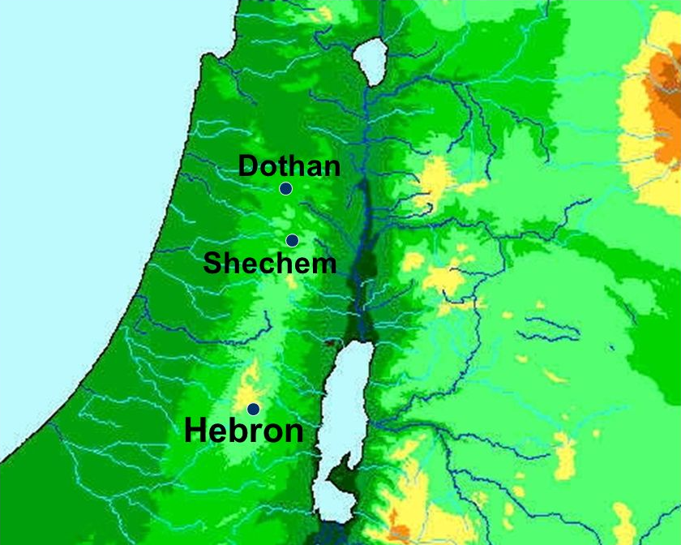

Slide 78
Genesis 37:12-17 Joseph’s Search for his Brothers
Location: Shechem (12)
Jacob sends Joseph (13-14)
Joseph’s search in Shechem (15-17a)
Joseph’s journey (17b)

Slide 79
Genesis 37:13-14 Jacob Sends Joseph
Jacob’s initiation (13a)
Joseph’s response (13b)
Jacob’s instructions (14a)
Joseph’s journey (14b)

Slide 80
Genesis 37:13-14 Jacob Sends Joseph
Jacob’s initiation (13a)
Joseph’s response (13b)
Jacob’s instructions (14a)
Joseph’s journey (14b)

Slide 81
Genesis 37:13-14 Jacob Sends Joseph
Jacob’s initiation (13a)
Joseph’s response (13b)
Jacob’s instructions (14a)
Joseph’s journey (14b)

Slide 82
Genesis 37:13-14 Jacob Sends Joseph
Jacob’s initiation (13a)
Joseph’s response (13b)
Jacob’s instructions (14a)
Joseph’s journey (14b)

Slide 83
Genesis 37:13-14 Jacob Sends Joseph
Jacob’s initiation (13a)
Joseph’s response (13b)
Jacob’s instructions (14a)
Joseph’s journey (14b)

Slide 85
Genesis 37:12-17 Joseph’s Search for his Brothers
Location: Shechem (12)
Jacob sends Joseph (13-14)
Joseph’s search in Shechem (15-17a)
Joseph’s journey (17b)

Slide 86
Genesis 37:15-17a Jospeh’s Search in Shechem
Circumstances (15a)
Conversation (15b-17a)

Slide 87
Genesis 37:15-17a Jospeh’s Search in Shechem
Circumstances (15a)
Conversation (15b-17a)

Slide 88
Genesis 37:15-17a Jospeh’s Search in Shechem
Circumstances (15a)
Conversation (15b-17a)

Slide 89
Genesis 37:1b-17a Conversation
Inquiry (15b)
Joseph’s response (16)
Answer (17a)

Slide 90
Genesis 37:1b-17a Conversation
Inquiry (15b)
Joseph’s response (16)
Answer (17a)

Slide 91
Genesis 37:1b-17a Conversation
Inquiry (15b)
Joseph’s response (16)
Answer (17a)

Slide 92
Genesis 37:1b-17a Conversation
Inquiry (15b)
Joseph’s response (16)
Answer (17a)

Slide 94
Genesis 37:12-17 Joseph’s Search for his Brothers
Location: Shechem (12)
Jacob sends Joseph (13-14)
Joseph’s search in Shechem (15-17a)
Joseph’s journey (17b)

Slide 95
Dr. Arnold G. Fruchtenbaum
The Book of Genesis, 533
“So in verse 17b, Joseph journeys to Dothan: And Joseph went after his brethren and found them in Dothan. Dothan is north of Shechem, another day’s journey. The situation in Shechem may still have been somewhat tense, but for one reason or another they had chosen to go further north, and Dothan was the city located on the north-south trunk route. Dothan was also located on the east-west trade route between Gilead and the Coastal Plain where it connected with the Via Maris that in turn would go south into Egypt. All this set the stage for the selling of Joseph.”

Slide 96
III. Genesis 37:12-24 Joseph’s Pit
Joseph’s search for his brothers (12-17)
Brothers’ conspiracy to kill Joseph (18-24)

Slide 97
Genesis 37:18-24 Brothers’ Conspiracy to Kill Joseph
Plot to kill Joseph (18-20)
Reuben’s intercession (21-22)
Plan executed (23-24)

Slide 98
Genesis 37:18-24 Brothers’ Conspiracy to Kill Joseph
Plot to kill Joseph (18-20)
Reuben’s intercession (21-22)
Plan executed (23-24)

Slide 99
Genesis 37:18-20 Plot to Kill Joseph
Timing (18)
Plot (19-20)

Slide 100
Genesis 37:18-20 Plot to Kill Joseph
Timing (18)
Plot (19-20)

Slide 101
Genesis 37:18-20 Plot to Kill Joseph
Timing (18)
Plot (19-20)

Slide 102
Genesis 37:19-20 Plot
Victim (19)
Content (20)

Slide 103
Genesis 37:19-20 Plot
Victim (19)
Content (20)

Slide 104
Dr. Arnold G. Fruchtenbaum
The Book of Genesis, 536
“Then came the merchant’s journey: They brought Joseph into Egypt. While this was not the brothers’ intent, by selling him in place of killing him, they rendered the fulfillment of the dream certain. Although they thought they were rendering the dreams null and void by what they were doing, they were actually creating a situation that would cause the fulfillment of them, proving the principle of Scripture: Even the wrath of men will end up praising God.”

Slide 105
Genesis 37:19-20 Plot
Victim (19)
Content (20)

Slide 106
Genesis 37:18-24 Brothers’ Conspiracy to Kill Joseph
Plot to kill Joseph (18-20)
Reuben’s intercession (21-22)
Plan executed (23-24)

Slide 107
Genesis 37:21-22 Reuben’s Intercession
Intervention (21)
Plan (22)

Slide 108
Genesis 37:21-22 Reuben’s Intercession
Intervention (21)
Plan (22)

Slide 110
Genesis 37:21-22 Reuben’s Intercession
Intervention (21)
Plan (22)

Slide 111
Genesis 37:22 Plan
Do not murder (22a)
Pit (22b)
Rescue later (22c)

Slide 112
Genesis 37:22 Plan
Do not murder (22a)
Pit (22b)
Rescue later (22c)

Slide 113
Genesis 37:22 Plan
Do not murder (22a)
Pit (22b)
Rescue later (22c)

Slide 114
Genesis 37:22 Plan
Do not murder (22a)
Pit (22b)
Rescue later (22c)

Slide 115
Genesis 37:18-24 Brothers’ Conspiracy to Kill Joseph
Plot to kill Joseph (18-20)
Reuben’s intercession (21-22)
Plan executed (23-24)

Slide 116
Genesis 37:23-24 Plan Executed
Removal of the coat (23)
Cast into the pit (24)

Slide 117
Genesis 37:23-24 Plan Executed
Removal of the coat (23)
Cast into the pit (24)

Slide 118
Genesis 37:23-24 Plan Executed
Removal of the coat (23)
Cast into the pit (24)

Slide 119
Genesis 37:2-36 Joseph Sold unto Egypt
Joseph’s coat (37:2-4)
Joseph’s dreams (37:5-11)
Joseph’s pit (37:12-24)
Joseph’s enslavement (37:25-36)

Slide 120
IV. Genesis 37:25-36 Joseph’s Enslavement
Selling of Joseph (25-28)
Reuben’s discovery (29-30)
Brothers report to Jacob (31-32)
Jacob’s response (33-35)
Joseph sold again (36)

Slide 121
IV. Genesis 37:25-36 Joseph’s Enslavement
Selling of Joseph (25-28)
Reuben’s discovery (29-30)
Brothers report to Jacob (31-32)
Jacob’s response (33-35)
Joseph sold again (36)

Slide 122
Genesis 37:25-28 Selling of Joseph
Occasion (25)
Judah’s proposal (26-27a)
Agreement (27b)
Selling (28)

Slide 123
Genesis 37:25-28 Selling of Joseph
Occasion (25)
Judah’s proposal (26-27a)
Agreement (27b)
Selling (28)

Slide 124
Genesis 12‒25 Abraham’s Early Journeys
Unconditional promises (Gen. 12:1-3) From Haran to Canaan (Gen. 12:4-5) In Canaan (Gen. 12:6-9) In Egypt (Gen. 12:10-20) Abram and Lot Separate (Gen. 13:1-13) Reaffirmation of Abram’s promises (Gen. 13:14-18) Abram Rescues Lot (14:1-24) Abrahamic Covenant (15:1-21) Hagar & Ishmael (16:1-16) Circumcision (Gen. 17:1-27) | Sodom & Gomorrah (Gen. 18‒19) Abraham & Abimelech (Gen. 20) Isaac’s birth (Gen. 21:1-7) Ishmael’s expulsion (21:8-21) Abraham & Abimelech’s covenant (21:22-34) Abraham sacrifices Isaac (22) Sarah’s death (23) Isaac’s marriage (24) Abraham & Keturah (25:1-6) Abraham’s death (25:7-11)

Slide 125
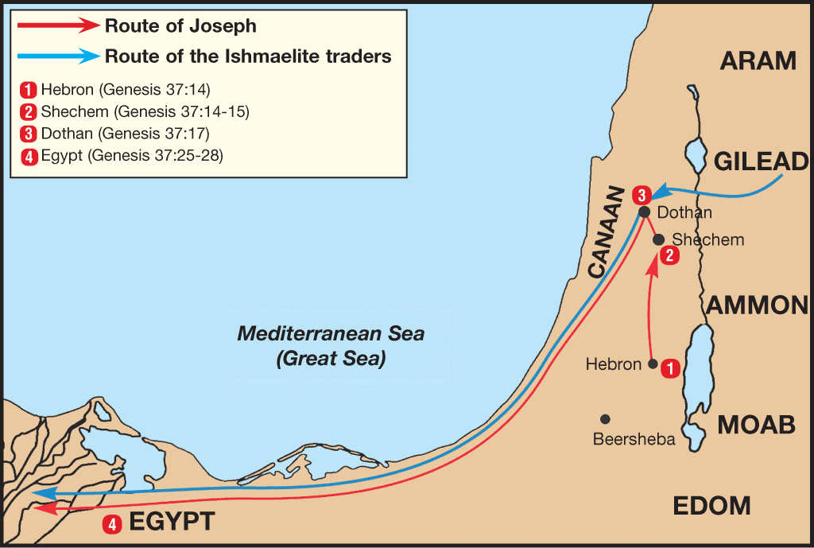

Slide 126
Dr. Arnold G. Fruchtenbaum
The Book of Genesis, 536
“In verse 27b came the agreement: And his brethren hearkened unto him. Verse 28 records the selling: And there passed by Midianites, merchantmen. These are called merchantmen; for they were North Arabian caravaneers who branched off through Gilead to the main route to Egypt, the Via Maris, from the King’s Highway.”

Slide 127
Genesis 37:25-28 Selling of Joseph
Occasion (25)
Judah’s proposal (26-27a)
Agreement (27b)
Selling (28)

Slide 128
Genesis 37:26-27a Judah’s Proposal
Rhetorical question (26)
Proposal (27a)

Slide 129
Genesis 37:26-27a Judah’s Proposal
Rhetorical question (26)
Proposal (27a)

Slide 131
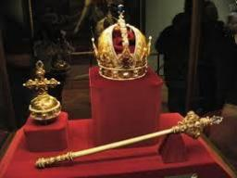
Genesis 49:10
“The scepter shall not depart from Judah, Nor the ruler’s staff from between his feet, Until Shiloh comes, And to him shall be the obedience of the peoples.”

Slide 132
Genesis 37:26-27a Judah’s Proposal
Rhetorical question (26)
Proposal (27a)

Slide 133
Genesis 37:25-28 Selling of Joseph
Occasion (25)
Judah’s proposal (26-27a)
Agreement (27b)
Selling (28)

Slide 135
Genesis 37:25-28 Selling of Joseph
Occasion (25)
Judah’s proposal (26-27a)
Agreement (27b)
Selling (28)

Slide 136
Genesis 12‒25 Abraham’s Early Journeys
Unconditional promises (Gen. 12:1-3) From Haran to Canaan (Gen. 12:4-5) In Canaan (Gen. 12:6-9) In Egypt (Gen. 12:10-20) Abram and Lot Separate (Gen. 13:1-13) Reaffirmation of Abram’s promises (Gen. 13:14-18) Abram Rescues Lot (14:1-24) Abrahamic Covenant (15:1-21) Hagar & Ishmael (16:1-16) Circumcision (Gen. 17:1-27) | Sodom & Gomorrah (Gen. 18‒19) Abraham & Abimelech (Gen. 20) Isaac’s birth (Gen. 21:1-7) Ishmael’s expulsion (21:8-21) Abraham & Abimelech’s covenant (21:22-34) Abraham sacrifices Isaac (22) Sarah’s death (23) Isaac’s marriage (24) Abraham & Keturah (25:1-6) Abraham’s death (25:7-11)

Slide 137
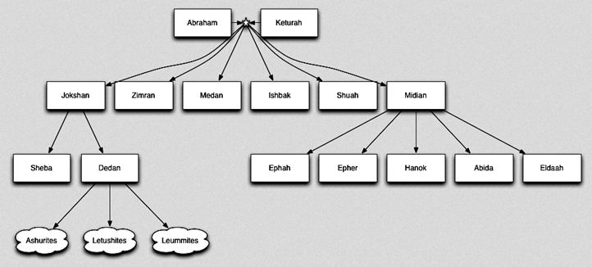

Slide 139
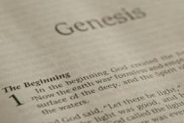
Beginning Themes
Universe Life Man Marriage Evil Clothing | Religion Salvation Language Government Nations Israel
Morris, Genesis Record, 18-20

Slide 140
IV. Genesis 37:25-36 Joseph’s Enslavement
Selling of Joseph (25-28)
Reuben’s discovery (29-30)
Brothers report to Jacob (31-32)
Jacob’s response (33-35)
Joseph sold again (36)

Slide 141
Genesis 37:29-30 Reuben’s Discovery
Discovery (29)
Dilemma (30)

Slide 142
Genesis 37:29-30 Reuben’s Discovery
Discovery (29)
Dilemma (30)

Slide 143
Genesis 37:29-30 Reuben’s Discovery
Discovery (29)
Dilemma (30)

Slide 145
IV. Genesis 37:25-36 Joseph’s Enslavement
Selling of Joseph (25-28)
Reuben’s discovery (29-30)
Brothers report to Jacob (31-32)
Jacob’s response (33-35)
Joseph sold again (36)

Slide 146
Genesis 37:31-32 Brothers Report to Jacob
Cover up (31)
Brothers show Jacob Joseph’s coat (32)

Slide 147
Genesis 37:31-32 Brothers Report to Jacob
Cover up (31)
Brothers show Jacob Joseph’s coat (32)

Slide 148
Dr. Arnold G. Fruchtenbaum
The Book of Genesis, 537
“Here again, there is a form of retribution: Jacob deceived Isaac with goatskins (27:16), now Jacob was being deceived with goat’s blood. Furthermore, Jacob deceived Isaac with Esau’s clothes (27:15); now Jacob was deceived by the use of Joseph’s clothes.”

Slide 149
Dr. Arnold G. Fruchtenbaum
The Book of Genesis, 445
“Now the deceiver is deceived, although the motivations differ from good to bad. This is divine retribution in four ways. First, Isaac’s blindness equals the darkness of Jacob’s wedding night, and neither could see well as a result. Second, this Jacob is deceived by being presented the older for the younger, the reversal of Isaac’s presentation of Jacob for Esau. Third, Isaac thought Jacob was Esau and Jacob thought Leah was Rachel. Fourth, Jacob pretended to be his older brother, while Leah pretended to be her younger sister.”

Slide 150
Genesis 37:31-32 Brothers Report to Jacob
Cover up (31)
Brothers show Jacob Joseph’s coat (32)

Slide 151
IV. Genesis 37:25-36 Joseph’s Enslavement
Selling of Joseph (25-28)
Reuben’s discovery (29-30)
Brothers report to Jacob (31-32)
Jacob’s response (33-35)
Joseph sold again (36)

Slide 152
Genesis 37:33-35 Jacob’s Response
Conclusion (33)
Mourning (34)
Lack of comfort (35)

Slide 153
Genesis 37:33-35 Jacob’s Response
Conclusion (33)
Mourning (34)
Lack of comfort (35)

Slide 154
Genesis 37:33-35 Jacob’s Response
Conclusion (33)
Mourning (34)
Lack of comfort (35)

Slide 155
Genesis 37:33-35 Jacob’s Response
Conclusion (33)
Mourning (34)
Lack of comfort (35)

Slide 156
Dr. Arnold G. Fruchtenbaum
The Book of Genesis, 537
“Jacob’s refusal is stated: He refused to be comforted; and he said, For I will go down to Sheol to my son in mourning. And his father wept for him. Sheol is the center of the earth, and before the death of the Messiah, all souls descended there upon death; but the faithful and unfaithful entered into different compartments in Sheol.”

Slide 157
IV. Genesis 37:25-36 Joseph’s Enslavement
Selling of Joseph (25-28)
Reuben’s discovery (29-30)
Brothers report to Jacob (31-32)
Jacob’s response (33-35)
Joseph sold again (36)

Slide 158
Genesis 37:36 Joseph Sold Again
Place: Egypt (36a)
Person: Potiphar (36b)

Slide 159
Genesis 37:36 Joseph Sold Again
Place: Egypt (36a)
Person: Potiphar (36b)

Slide 163
Genesis 37:36 Joseph Sold Again
Place: Egypt (36a)
Person: Potiphar (36b)

Slide 164
Conclusion

Slide 165
Genesis 37:2-36 Joseph Sold unto Egypt
Joseph’s coat (37:2-4)
Joseph’s dreams (37:5-11)
Joseph’s pit (37:12-24)
Joseph’s enslavement (37:25-36)

Slide 166
²⁴ The Lord bless you, and keep you; ²⁵ The Lord make His face shine on you, And be gracious to you; ²⁶ The Lord lift up His countenance on you, And give you peace.
Numbers 6:24–26 (NASB95)

