Slide 1
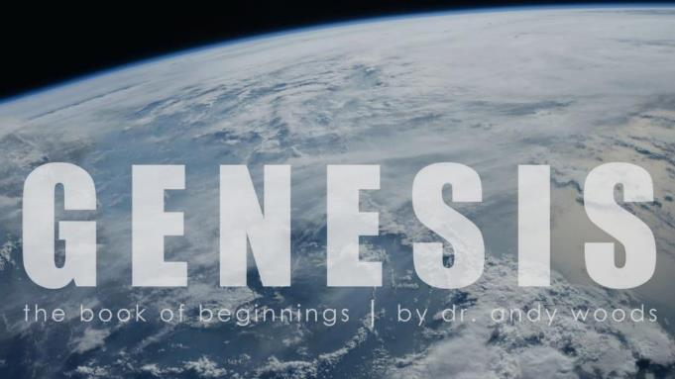
Genesis 12‒50
Israel’s Birth & Preservation

Slide 2
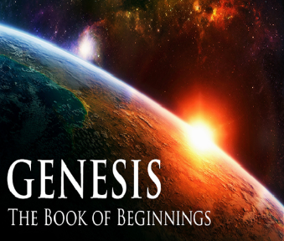
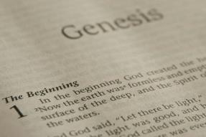
GENESIS STRUCTURE
Genesis 12-50 (four people)
Abraham (12:1–25:11)
Isaac (25:12–26:35)
Jacob (27–36)
Joseph (37–50)

Slide 3
Genesis 36:1-43 The Edomites
Esau’s sons: born in Canaan (36:1-8)
Esau’s sons: born in Seir (36:9-14)
Esau’s descendants as chiefs (36:15-19)
Descendants of Seir the Horite (36:20-30)
Edom’s kings (36:31-39)
Edom’s chiefs (36:40-43a)
Jacob & Esau’s division (36:43b‒37:1)

Slide 4
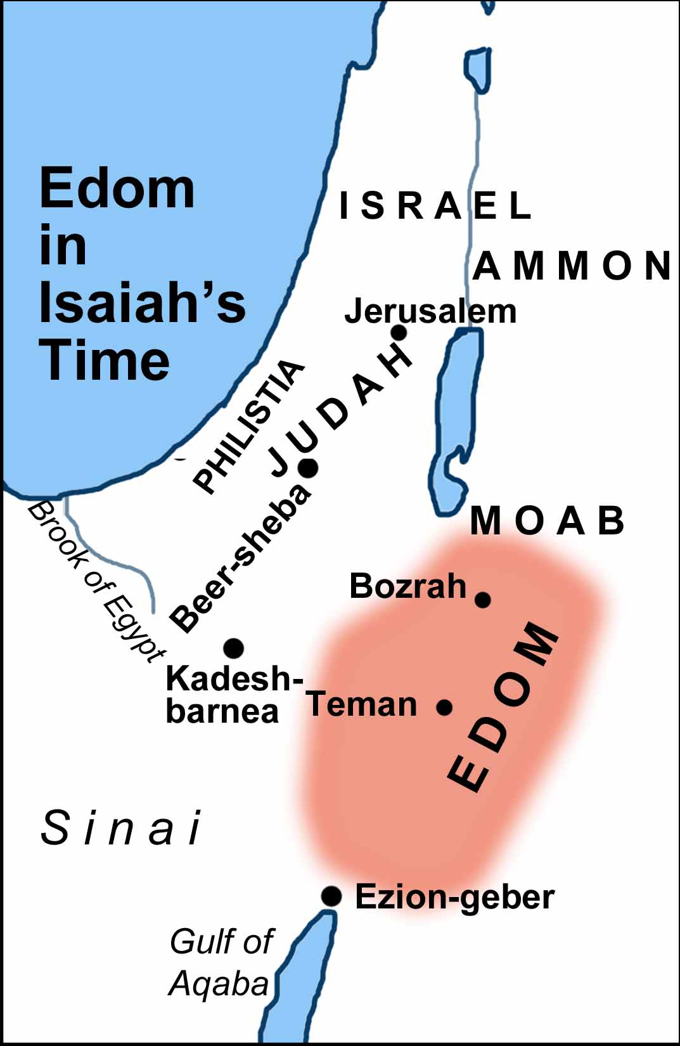

Slide 5
Genesis 36:1-43 The Edomites
Esau’s sons: born in Canaan (36:1-8)
Esau’s sons: born in Seir (36:9-14)
Esau’s descendants as chiefs (36:15-19)
Descendants of Seir the Horite (36:20-30)
Edom’s kings (36:31-39)
Edom’s chiefs (36:40-43a)
Jacob & Esau’s division (36:43b‒37:1)

Slide 6
III. Genesis 36:15-19 Esau’s Sons & Grandsons as Chiefs
Introduction (15a)
Sons of Eliphaz as Chiefs (15b-16d)
Sons of Ruel as Chiefs (17)
Sons of Oholibamah as Chiefs (18)
Conclusion (19)

Slide 7
III. Genesis 36:15-19 Esau’s Sons & Grandsons as Chiefs
Introduction (15a)
Sons of Eliphaz as Chiefs (15b-16d)
Sons of Ruel as Chiefs (17)
Sons of Oholibamah as Chiefs (18)
Conclusion (19)

Slide 8
III. Genesis 36:15-19 Esau’s Sons & Grandsons as Chiefs
Introduction (15a)
Sons of Eliphaz as Chiefs (15b-16d)
Sons of Ruel as Chiefs (17)
Sons of Oholibamah as Chiefs (18)
Conclusion (19)

Slide 9
Genesis 36:15b-16d Sons of Eliphaz as Chiefs
Sons (15b-16c)
Conclusion (16d)

Slide 10
Genesis 36:15b-16d Sons of Eliphaz as Chiefs
Sons (15b-16c)
Conclusion (16d)

Slide 11
Genesis 36:15b-16 Sons
Teman (15b)
Omar (15c)
Zepho (15d)
Kenaz (15e)
Korah (16a)
Gatam (16b)
Amalek (16c)

Slide 12
Genesis 36:15b-16d Sons of Eliphaz as Chiefs
Sons (15b-16c)
Conclusion (16d)

Slide 13
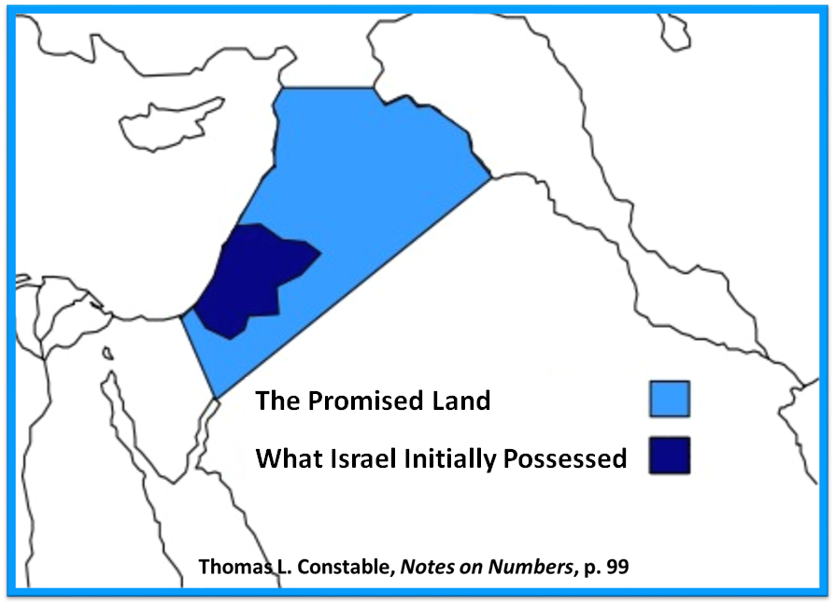

Slide 15
III. Genesis 36:15-19 Esau’s Sons & Grandsons as Chiefs
Introduction (15a)
Sons of Eliphaz as Chiefs (15b-16d)
Sons of Ruel as Chiefs (17)
Sons of Oholibamah as Chiefs (18)
Conclusion (19)

Slide 16
Genesis 36:17 Sons of Ruel as Chiefs
Sons (17a-d)
Conclusion (17e)

Slide 17
Genesis 36:17 Sons of Ruel as Chiefs
Sons (17a-d)
Conclusion (17e)

Slide 18
Genesis 36:17a-d Sons
Nabath (17a)
Nerah (17b)
Shammah (17c)
Mizzah (17d)

Slide 19
Genesis 36:17 Sons of Ruel as Chiefs
Sons (17a-d)
Conclusion (17e)

Slide 22
III. Genesis 36:15-19 Esau’s Sons & Grandsons as Chiefs
Introduction (15a)
Sons of Eliphaz as Chiefs (15b-16d)
Sons of Ruel as Chiefs (17)
Sons of Oholibamah as Chiefs (18)
Conclusion (19)

Slide 23
Genesis 36:18 Sons of Oholibamah as Chiefs
Sons (18a-c)
Conclusion (18d)

Slide 24
Genesis 36:18 Sons of Oholibamah as Chiefs
Sons (18a-c)
Conclusion (18d)

Slide 25
Genesis 36:18a-c Sons
Jeush (18a)
Jalaam (18b)
Korah (18c)

Slide 26
Genesis 36:18 Sons of Oholibamah as Chiefs
Sons (18a-c)
Conclusion (18d)

Slide 27
III. Genesis 36:15-19 Esau’s Sons & Grandsons as Chiefs
Introduction (15a)
Sons of Eliphaz as Chiefs (15b-16d)
Sons of Ruel as Chiefs (17)
Sons of Oholibamah as Chiefs (18)
Conclusion (19)

Slide 28
Genesis 36:1-43 The Edomites
Esau’s sons: born in Canaan (36:1-8)
Esau’s sons: born in Seir (36:9-14)
Esau’s descendants as chiefs (36:15-19)
Descendants of Seir the Horite (36:20-30)
Edom’s kings (36:31-39)
Edom’s chiefs (36:40-43a)
Jacob & Esau’s division (36:43b‒37:1)

Slide 29
IV. Genesis 36:20-30 Descendants of Seir the Horite
Sons of Seir (20-21)
Grandsons of Seir (22-28)
Horite Chiefs (29-30)

Slide 30
IV. Genesis 36:20-30 Esau’s Sons & Grandsons as Chiefs
Sons of Seir (20-21)
Grandsons of Seir (22-28)
Horite Chiefs (29-30)

Slide 31
Genesis 36:20-21 Sons of Seir
Introduction (20a)
Sons (20b-21c)
Conclusion (21d)

Slide 32
Genesis 36:20-21 Sons of Seir
Introduction (20a)
Sons (20b-21c)
Conclusion (21d)

Slide 33
Genesis 36:20-21 Sons of Seir
Introduction (20a)
Sons (20b-21c)
Conclusion (21d)

Slide 34
Genesis 36:20b-21c Sons
Lotan (20b)
Shobal (20c)
Zibeon (20d)
Anah (20e)
Dishon (21a)
Ezer (21b)
Dishan (21c)

Slide 35
Genesis 36:20-21 Sons of Seir
Introduction (20a)
Sons (20b-21c)
Conclusion (21d)

Slide 36
IV. Genesis 36:20-30 Esau’s Sons & Grandsons as Chiefs
Sons of Seir (20-21)
Grandsons of Seir (22-28)
Horite Chiefs (29-30)

Slide 37
Genesis 36:22-28 Grandsons of Seir
Sons of Lotan (22)
Sons of Shobal (23)
Sons of Zibeon (24)
Sons of Anah (25)
Sons of Dishon (26)
Sons of Ezer (27)
Sons of Dishan (28)

Slide 38
Genesis 36:22-28 Grandsons of Seir
Sons of Lotan (22)
Sons of Shobal (23)
Sons of Zibeon (24)
Sons of Anah (25)
Sons of Dishon (26)
Sons of Ezer (27)
Sons of Dishan (28)

Slide 39
Genesis 36:22-28 Grandsons of Seir
Sons of Lotan (22)
Sons of Shobal (23)
Sons of Zibeon (24)
Sons of Anah (25)
Sons of Dishon (26)
Sons of Ezer (27)
Sons of Dishan (28)

Slide 40
IV. Genesis 36:20-30 Esau’s Sons & Grandsons as Chiefs
Sons of Seir (20-21)
Grandsons of Seir (22-28)
Horite Chiefs (29-30)

Slide 41
Genesis 36:29-30 Sons of Seir
Introduction (29a)
Chiefs (29b-30c)
Conclusion (30d)

Slide 42
Genesis 36:29-30 Sons of Seir
Introduction (29a)
Chiefs (29b-30c)
Conclusion (30d)

Slide 43
Genesis 36:29-30 Sons of Seir
Introduction (29a)
Chiefs (29b-30c)
Conclusion (30d)

Slide 44
Genesis 36:29b-c Sons
Lotan (29b)
Shobal (29c)
Zibeon (29d)
Anah (29e)
Dishon (30a)
Ezer (30b)
Dishan (30c)

Slide 45
Genesis 36:29-30 Sons of Seir
Introduction (29a)
Chiefs (29b-30c)
Conclusion (30d)

Slide 46
Genesis 36:1-43 The Edomites
Esau’s sons: born in Canaan (36:1-8)
Esau’s sons: born in Seir (36:9-14)
Esau’s descendants as chiefs (36:15-19)
Descendants of Seir the Horite (36:20-30)
Edom’s kings (36:31-39)
Edom’s chiefs (36:40-43a)
Jacob & Esau’s division (36:43b‒37:1)

Slide 47
V. Genesis 36:31-39 Kings of Edom
Introduction (31a)
Timing (31b)
Edom’s kings (32-39)

Slide 48
V. Genesis 36:31-39 Kings of Edom
Introduction (31a)
Timing (31b)
Edom’s kings (32-39)

Slide 49
V. Genesis 36:31-39 Kings of Edom
Introduction (31a)
Timing (31b)
Edom’s kings (32-39)

Slide 51
Good and Bad Kings
North – 19 kings (all bad)
South – 20 kings (8 good; significance of Gen 49:10)

Slide 52
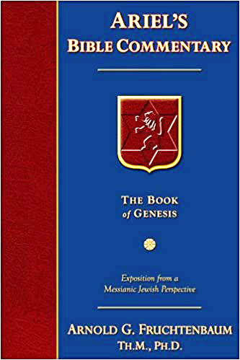
Dr. Arnold G. Fruchtenbaum
The Book of Genesis, 522
“There is a future history of Israel in which Israel will have kings. Here again is an example where those outside the Covenant initially seemed to do better than those within the Abrahamic Covenant. Esau seemed initially to do better than Jacob did. Edom seemed initially to do better than Israel. Lot initially seemed to do better than Abraham, etc.”

Slide 53
V. Genesis 36:31-39 Kings of Edom
Introduction (31a)
Timing (31b)
Edom’s kings (32-39)

Slide 54
Genesis 36:32-39 Edom’s Kings
First king (32)
Second king (33)
Third king (34)
Fourth king (35)
Fifth king (36)
Sixth king (37)
Seventh king (38)
Eighth king (39)

Slide 55
Genesis 36:32-39 Edom’s Kings
First king (32)
Second king (33)
Third king (34)
Fourth king (35)
Fifth king (36)
Sixth king (37)
Seventh king (38)
Eighth king (39)

Slide 56
Genesis 36:32-39 Edom’s Kings
First king (32)
Second king (33)
Third king (34)
Fourth king (35)
Fifth king (36)
Sixth king (37)
Seventh king (38)
Eighth king (39)

Slide 57
Genesis 36:32-39 Edom’s Kings
First king (32)
Second king (33)
Third king (34)
Fourth king (35)
Fifth king (36)
Sixth king (37)
Seventh king (38)
Eighth king (39)

Slide 58
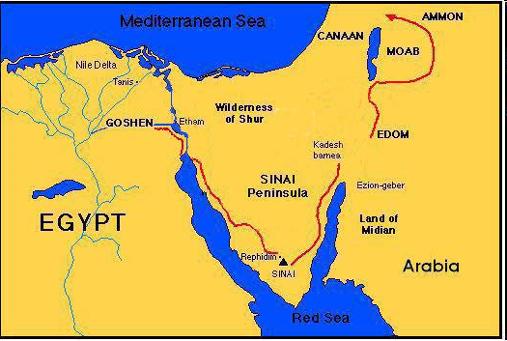

Slide 59
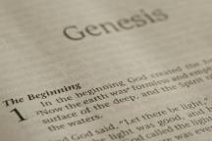
Beginning Themes
Universe Life Man Marriage Evil Clothing | Religion Salvation Language Government Nations Israel
Morris, Genesis Record, 18-20

Slide 60
Genesis 36:1-43 The Edomites
Esau’s sons: born in Canaan (36:1-8)
Esau’s sons: born in Seir (36:9-14)
Esau’s descendants as chiefs (36:15-19)
Descendants of Seir the Horite (36:20-30)
Edom’s kings (36:31-39)
Edom’s chiefs (36:40-43a)
Jacob & Esau’s division (36:43b‒37:1)

Slide 61
VI. Genesis 36:40-43c Edom’s Chiefs
Introduction (40a)
Chiefs (40b-43b)
Conclusion (43c)

Slide 62
VI. Genesis 36:40-43c Edom’s Chiefs
Introduction (40a)
Chiefs (40b-43b)
Conclusion (43c)

Slide 63
VI. Genesis 36:40-43c Edom’s Chiefs
Introduction (40a)
Chiefs (40b-43b)
Conclusion (43c)

Slide 64
Genesis 36:40b-43b Edom’s Chiefs
Timnah (40b)
Alvah (40c)
Jeheth (40d)
Ohalibamah (41a)
Elah (41b)
Pinion (41c)
Kenaz (42a)
Teman (42b)
Mizbar (42c)
Magdiel (43a)
Imam (43b)

Slide 65
VI. Genesis 36:40-43c Edom’s Chiefs
Introduction (40a)
Chiefs (40b-43b)
Conclusion (43c)

Slide 66
Genesis 36:1-43 The Edomites
Esau’s sons: born in Canaan (36:1-8)
Esau’s sons: born in Seir (36:9-14)
Esau’s descendants as chiefs (36:15-19)
Descendants of Seir the Horite (36:20-30)
Edom’s kings (36:31-39)
Edom’s chiefs (36:40-43a)
Jacob & Esau’s division (36:43b‒37:1)

Slide 67
VII. Genesis 36:43b‒37:1 Division of Jacob & Esau
Concerning Esau (36:43b)
Concerning Jacob (37:1)

Slide 68
VII. Genesis 36:43b‒37:1 Division of Jacob & Esau
Concerning Esau (36:43b)
Concerning Jacob (37:1)

Slide 70
VII. Genesis 36:43b‒37:1 Division of Jacob & Esau
Concerning Esau (36:43b)
Concerning Jacob (37:1)

Slide 72
Conclusion

Slide 73
Genesis 36:1-43 The Edomites
Esau’s sons: born in Canaan (36:1-8)
Esau’s sons: born in Seir (36:9-14)
Esau’s descendants as chiefs (36:15-19)
Descendants of Seir the Horite (36:20-30)
Edom’s kings (36:31-39)
Edom’s chiefs (36:40-43a)
Jacob & Esau’s division (36:43b‒37:1)

Slide 74
²⁴ The Lord bless you, and keep you; ²⁵ The Lord make His face shine on you, And be gracious to you; ²⁶ The Lord lift up His countenance on you, And give you peace.
Numbers 6:24–26 (NASB95)

