Slide 1


Dr. Andy Woods
Senior Pastor – Sugar Land Bible Church
President – Chafer Theological Seminary

Slide 2
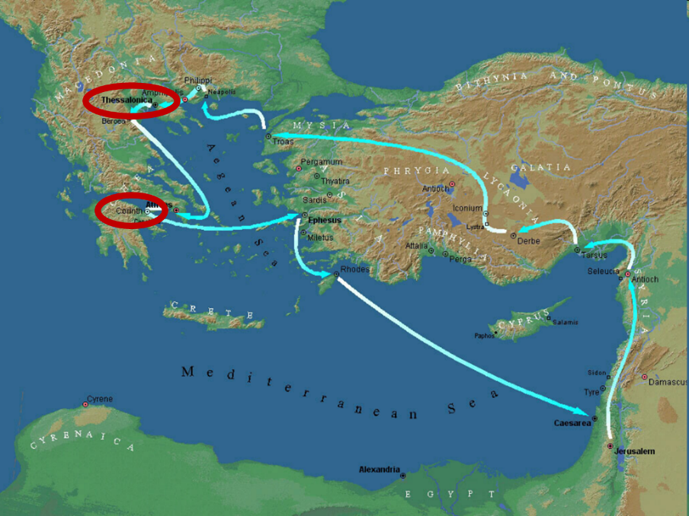

Slide 3
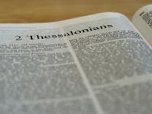
2 Thessalonians 2:1-12
Problem (2:1-2)
Prerequisites for the Day of the Lord (2:3-12)
  The departure (2:3a)
  Advent of the lawless one (2:3b-4)
  Removal of the restrainer (2:5-7)
  Destruction of the lawless one (2:8-9)
  Destruction of lawless one’s followers (2:10-12)

Slide 4


2 Thessalonians 2:2
“that you not be quickly shaken from your composure or be disturbed either by a spirit or a message or a letter as if from us, to the effect that the day of the Lord [the Tribulation] has come.”

Slide 5
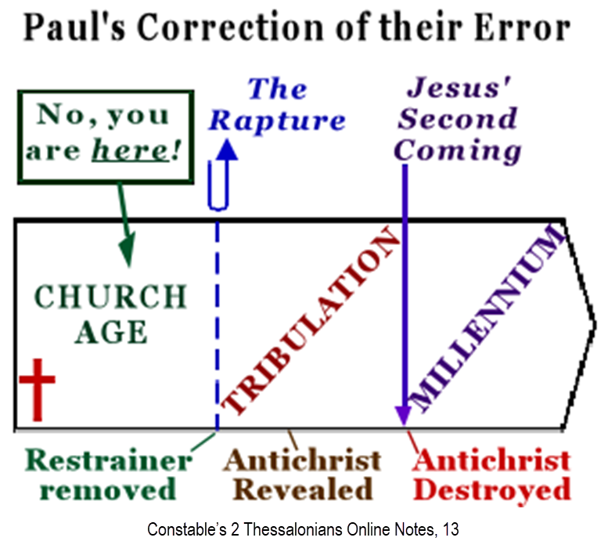

Slide 6
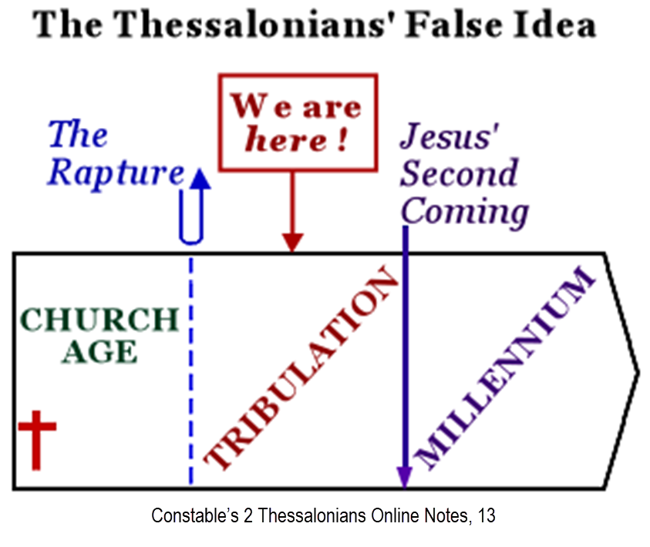

Slide 7
2 Thessalonians 2:1-12
Problem (2:1-2)
Prerequisites for the Day of the Lord (2:3-12)
  The departure (2:3a)
  Advent of the lawless one (2:3b-4)
  Removal of the restrainer (2:5-7)
  Destruction of the lawless one (2:8-9)
  Destruction of lawless one’s followers (2:10-12)

Slide 8
2 Thessalonians 2:1-12
Problem (2:1-2)
Prerequisites for the Day of the Lord (2:3-12)
  The departure (2:3a)
  Advent of the lawless one (2:3b-4)
  Removal of the restrainer (2:5-7)
  Destruction of the lawless one (2:8-9)
  Destruction of lawless one’s followers (2:10-12)

Slide 9
2 Thessalonians 2:1-12
Problem (2:1-2)
Prerequisites for the Day of the Lord (2:3-12)
  The departure (2:3a)
  Advent of the lawless one (2:3b-4)
  Removal of the restrainer (2:5-7)
  Destruction of the lawless one (2:8-9)
  Destruction of lawless one’s followers (2:10-12)

Slide 10

Daniel 9:27
“And he will make a firm covenant with the many for one week, but in the middle of the week he will put a stop to sacrifice and grain offering; and on the wing of abominations will come one who makes desolate, even until a complete destruction, one that is decreed, is poured out on the one who makes desolate.”

Slide 11


Slide 12


Slide 13
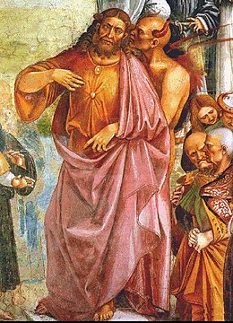
Daniel 11:31
“Forces from him will arise, desecrate the sanctuary fortress, and do away with the regular sacrifice. And they will set up the abomination of desolation.”

Slide 14
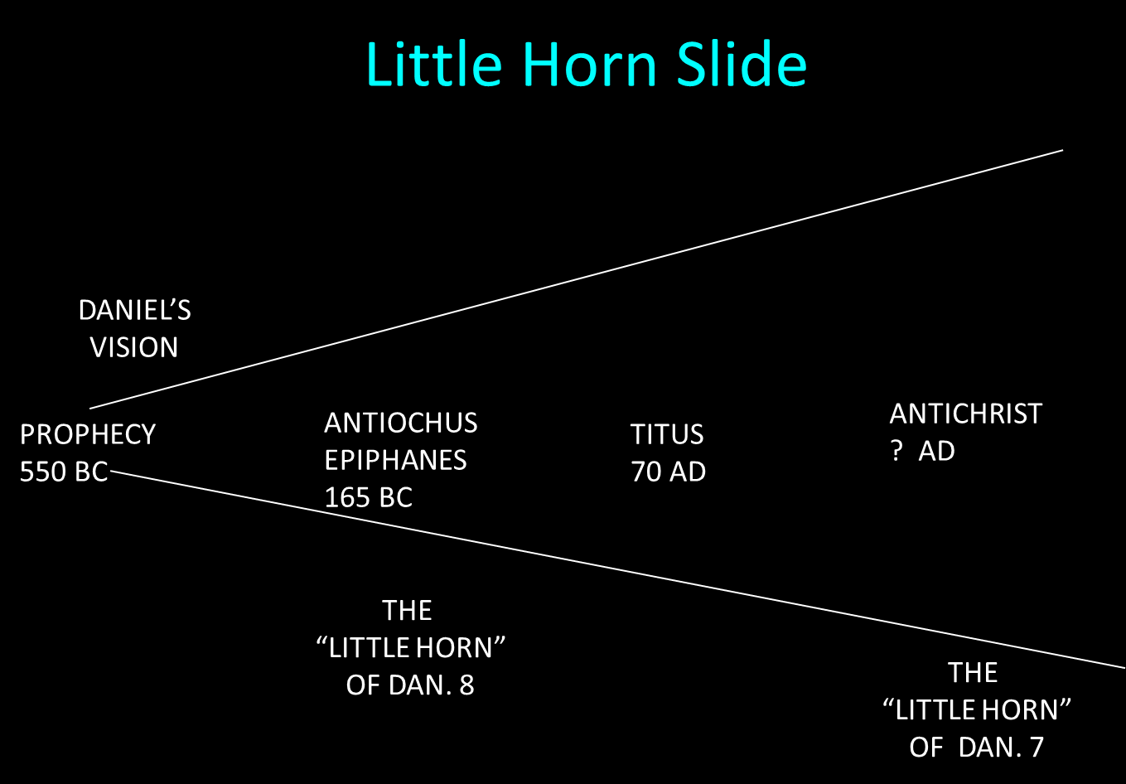

Slide 15

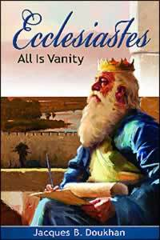
Ecclesiastes 1:9
“That which has been is that which will be, And that which has been done is that which will be done. So there is nothing new under the sun.”

Slide 16

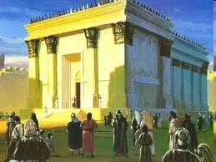
Israel’s Four Temples
Solomon’s pre-exilic temple (Kings and Chronicles)
Zerubbabel’s post exilic temple (Ezra 1-6; John 2:20)
Antichrist's temple (Dan 9:27; Matt 24:15; 2 Thess 2:4; Rev 11:1-2)
Millennial temple (Ezek 40-48)

Slide 17
Israel’s Four Temples
Solomon’s pre-exilic temple (Kings and Chronicles)
Zerubbabel’s post exilic temple (Ezra 1-6; John 2:20)
Antichrist's temple (Dan 9:27; Matt 24:15; 2 Thess 2:4; Rev 11:1-2)
Millennial temple (Ezek 40-48)

Slide 18


Slide 19
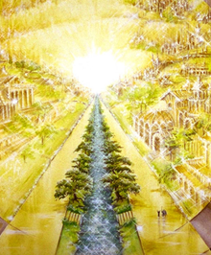
Eternal State is Future
No Satan (Rev 20:10)
No sea (Rev 21:1)
No death, crying, or pain (Rev 21:4)
No Sun (Rev 22:5)
No Moon (Rev 21:23)
No temple (Rev. 21:22)
No night (Rev 21:25)
No evil (Rev 21:27)
No curse (Rev 22:3)

Slide 20
Eternal State is Future
No Satan (Rev 20:10)
No sea (Rev 21:1)
No death, crying, or pain (Rev 21:4)
No Sun (Rev 22:5)
No Moon (Rev 21:23)
No temple (Rev. 21:22)
No night (Rev 21:25)
No evil (Rev 21:27)
No curse (Rev 22:3)

Slide 21
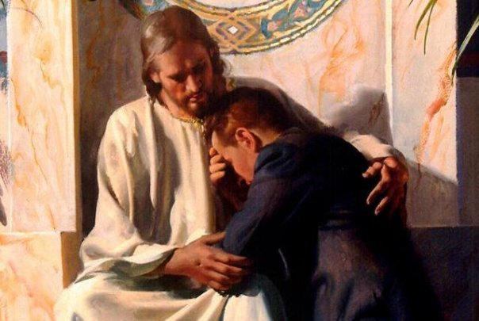
Revelation 21:4
“and He will wipe away every tear from their eyes; and there will no longer be any death; there will no longer be any mourning, or crying, or pain; the first things have passed away.”

Slide 22
Eternal State is Future
No Satan (Rev 20:10)
No sea (Rev 21:1)
No death, crying, or pain (Rev 21:4)
No Sun (Rev 22:5)
No Moon (Rev 21:23)
No temple (Rev. 21:22)
No night (Rev 21:25)
No evil (Rev 21:27)
No curse (Rev 22:3)

Slide 23
Millennium Rev.20 | Eternal State Rev.21-22
Sin restrained | Sin removed
Curse restrained | Curse removed
Death | No death
Mortals / resurrected | Resurrected only
Destinies undecided | Destinies sealed
Renovation | Recreation
Temporary | Eternal
Transitional | Non-transitional

Slide 24
Millennium and Eternal State
 | REV 20:1-10 | REV 21–22
Time | 20:4 | 22:5
Luminaries | Isa 30:26 | 21:23; 22:5
Temple | Ezek 40–48 | 21:22
Death | Isa 65:20 | 21:4
Satanic activity | 20:7 | 20:10
Rebellion | 20:8-9 | 21:27

Slide 25
Israel’s Four Temples
Solomon’s pre-exilic temple (Kings and Chronicles)
Zerubbabel’s post exilic temple (Ezra 1-6; John 2:20)
Antichrist's temple (Dan 9:27; Matt 24:15; 2 Thess 2:4; Rev 11:1-2)
Millennial temple (Ezek 40-48)

Slide 26

Matthew 24:15-16, 20
“¹⁵ Therefore when you see the abomination of desolation which was spoken of through Daniel the prophet, standing in the holy place (let the reader understand) ¹⁶ then those who are in Judea must flee to the mountains…²⁰ But pray that your flight will not be in the winter, or on a Sabbath.”

Slide 27
Daniel 11:31
“Forces from him will arise, desecrate the sanctuary fortress, and do away with the regular sacrifice. And they will set up the abomination of desolation.”

Slide 28
The Stage Is Being Set
Rebirth of Israel in 1948
Israel’s desire for peace
Desire among some Jews to Rebuild 3rd Jewish temple and Restore the sacrificial system
  Source: Randall Price “Ready to Rebuild”

Slide 29
The Stage Is Being Set
Rebirth of Israel in 1948
Israel’s desire for peace
Desire among some Jews to Rebuild 3rd Jewish temple and Restore the sacrificial system
  Source: Randall Price “Ready to Rebuild”

Slide 30
The Stage Is Being Set
Rebirth of Israel in 1948
Israel’s desire for peace
Desire among some Jews to Rebuild 3rd Jewish temple and Restore the sacrificial system
  Source: Randall Price “Ready to Rebuild”

Slide 31
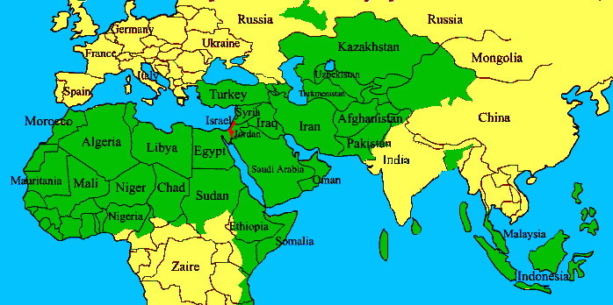
ISRAEL

Slide 32
The Stage Is Being Set
Rebirth of Israel in 1948
Israel’s desire for peace
Desire among some Jews to Rebuild 3rd Jewish temple and Restore the sacrificial system
  Source: Randall Price “Ready to Rebuild”

Slide 33


Slide 34
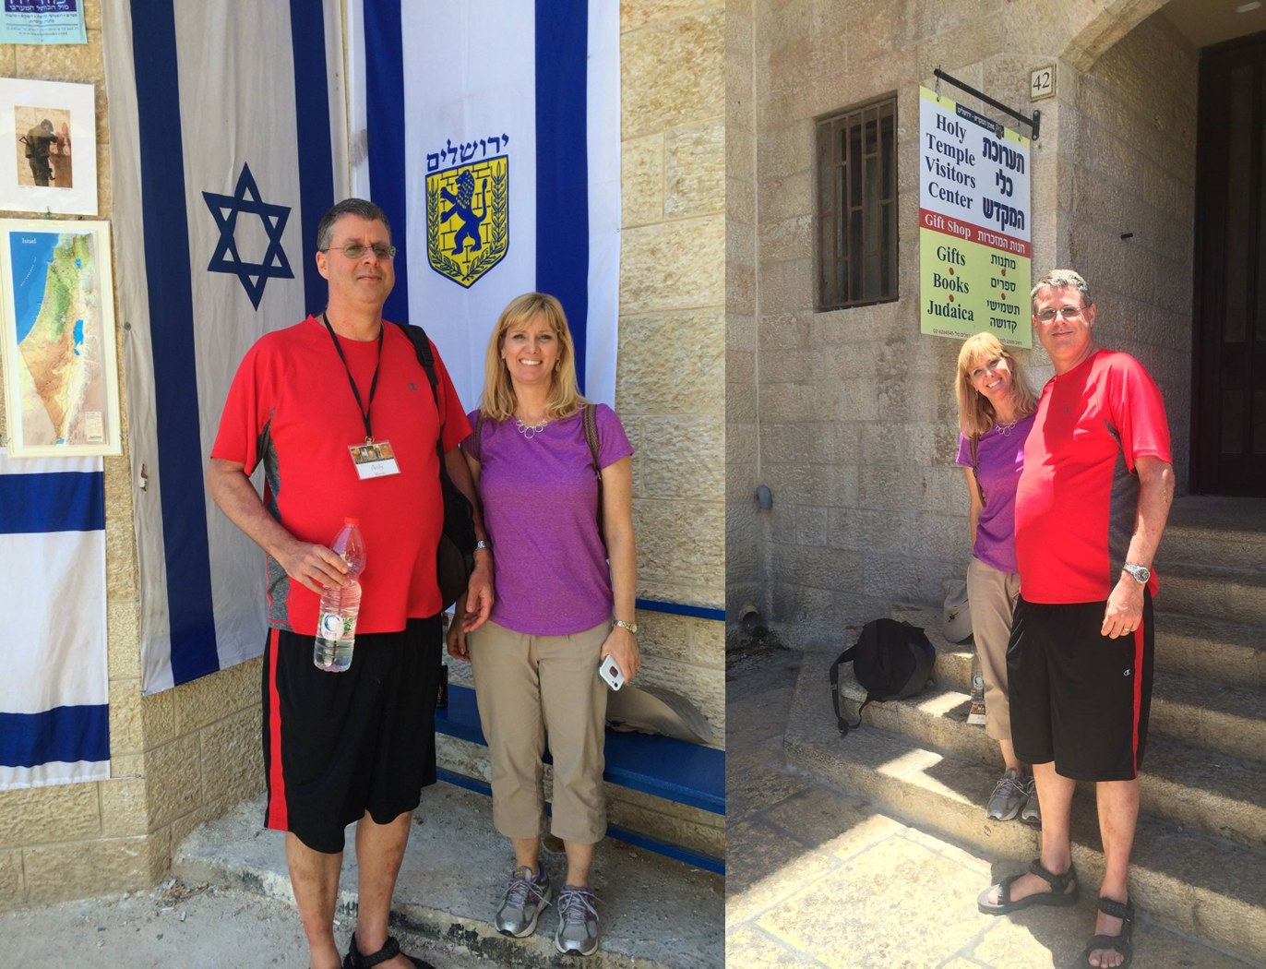

Slide 35
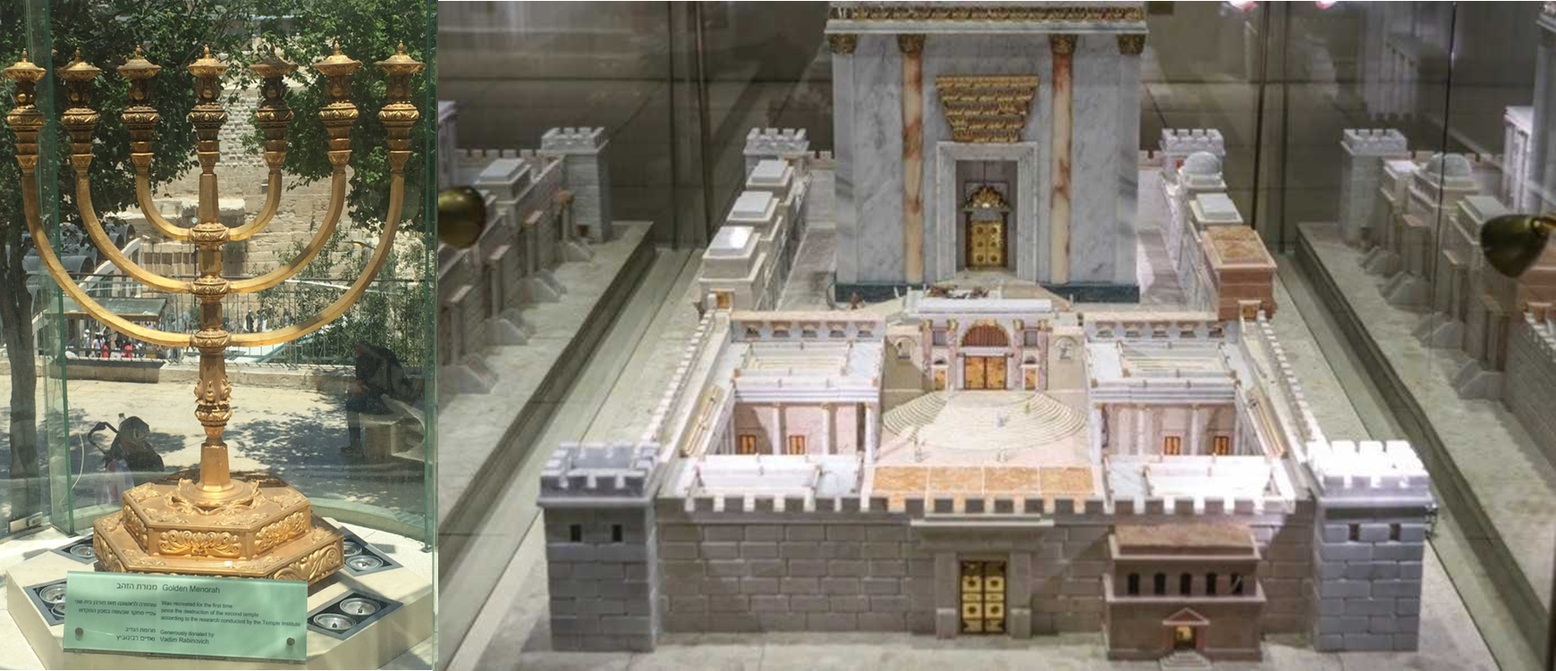

Slide 36
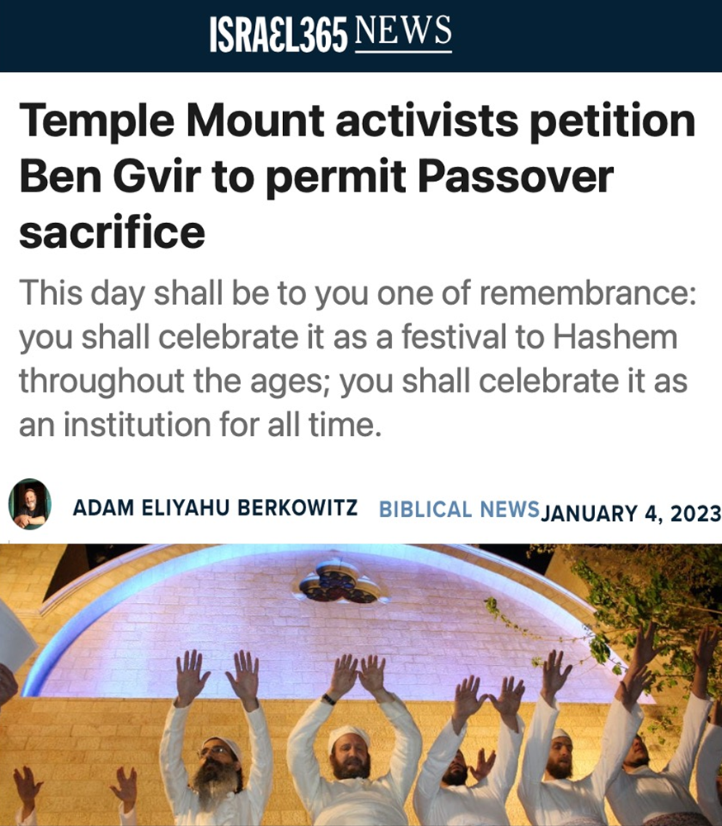

Slide 37
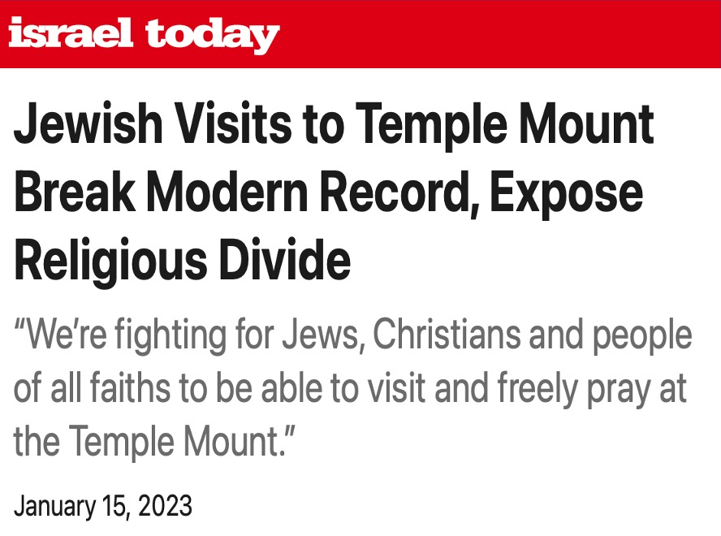

Slide 38
Daniel 11:31
“Forces from him will arise, desecrate the sanctuary fortress, and do away with the regular sacrifice. And they will set up the abomination of desolation.”

Slide 40
Daniel 9:27
“And he will make a firm covenant with the many for one week, but in the middle of the week he will put a stop to sacrifice and grain offering; and on the wing of abominations will come one who makes desolate, even until a complete destruction, one that is decreed, is poured out on the one who makes desolate.”

Slide 41
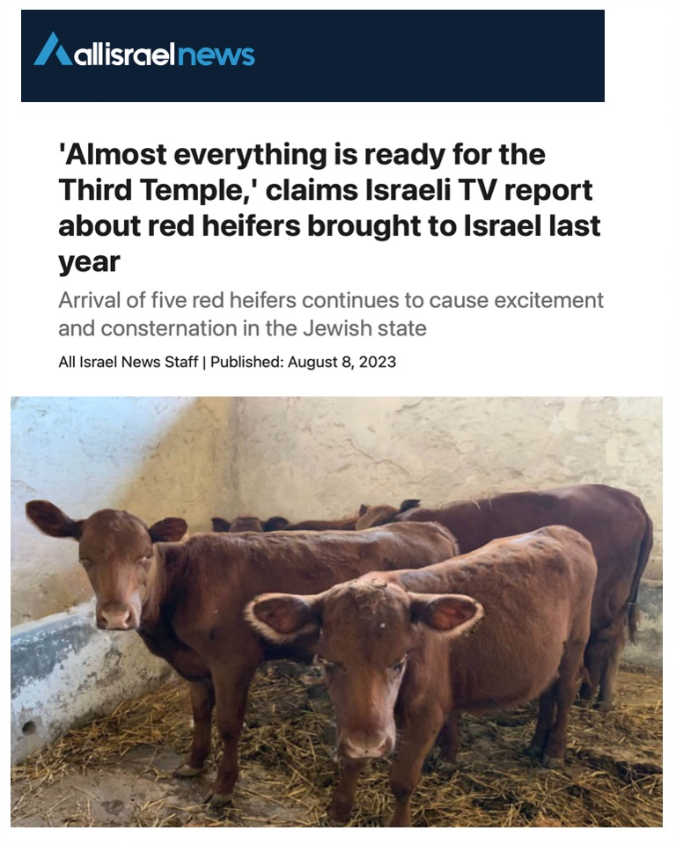

Slide 42
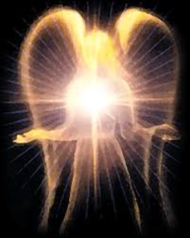
Original State and First Sin
ISAIAH 14:12-15 – 5 “I WILL” STATEMENTS
    Ascend to heaven (13)
    Raise my throne above the stars of God (13)
    Sit enthroned on the Mt. of the Assembly (13)
    Ascend above the tops of the clouds (14)
    Make myself like the Most High (14)

Slide 43
Original State and First Sin
ISAIAH 14:12-15 – 5 “I WILL” STATEMENTS
    Ascend to heaven (13)
    Raise my throne above the stars of God (13)
    Sit enthroned on the Mt. of the Assembly (13)
    Ascend above the tops of the clouds (14)
    Make myself like the Most High (14)

Slide 44


Isaiah 14:14
“I will ascend above the heights of the clouds; I will make myself like the Most High.”

Slide 45

Satan’s Tactics (2 Cor 2:11)
  Adds to God’s Word (3:1; 2:16-17)
  Challenges God’s goodness (3:1; 2:16-17)
  Subtracts from God’s Word (3:4; 2:17)
  Offers wisdom without submission to God (3:5; Prov 1:7)

Slide 46

Genesis 3:5
“For God knows that in the day you eat from it your eyes will be opened, and you will be like God, knowing good and evil.”

Slide 47

Humanist Beliefs
The non-existence or irrelevancy of god
Man as the center of all things
The reality of evolution
Man as an evolved animal rather than a special creature made in the image of his creator
The absence of any absolute morals or values
Confidence in the scientific method to solve the world’s problems.
Eidsmoe, The Christian Legal Advisor, 180-87.

Slide 48

Genesis 1:1–3
¹ In the beginning God created the heavens and the earth. ² The earth was formless and void, and darkness was over the surface of the deep, and the Spirit of God was moving over the surface of the waters. ³ Then God said, “Let there be light”; and there was light.

Slide 49
Refutation of Man’s Philosophies
(Gen 1:1)
Atheism – God created (Ps. 14:1)
Pantheism – God is transcendent over creation
Polytheism – One God created (Deut. 6:4; Isa 43:11; 44:6; 45:5)
Materialism – Matter began
Dualism – God alone created (Ezek. 28:13, 15)
Humanism – God rather than man created
Naturalism – God created
Morris, Genesis Record, 38

Slide 50
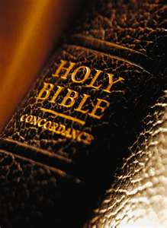
Fundamental Questions – Christian Answers
“Who am I?” – a special creation of God
“Where did I come from?” – from God’s design
“Why am I here?” – to know and glorify God
“Where am I going?” – to heaven
“How can I get there?” – only through Jesus Christ

Slide 51

Fundamental Questions - Humanistic Answers
“Who am I?” – a biological accident
“Where did I come from?” – from the primordial soup
“Why am I here?” – to fulfill self
“Where am I going?” – toward a planetary new world order
“How can I get there?” – the scientific method

Slide 52
Humanists Call Themselves Religious
Advancement of a religion
“Religious humanists”
“Religious humanism.”
Kurtz, ed., Humanist Manifestos I and II, 8, 10.

Slide 53

Torcaso v. Watkins (1961)
“Among the religions in this country which do not teach what would generally be considered a belief in the existence of God are Buddhism, Taoism, Ethical Culture, Secular Humanism and others” (italics added).
Torcaso v. Watkins, 367 U.S. 488, 495, n. 11 (1961).

Slide 54
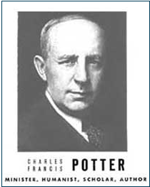
Humanist Proselytizing
“Education is thus a most powerful ally of Humanism, and every public school is a school of Humanism. What can the theistic Sunday-schools, meeting for an hour once a week, and teaching only a fraction of the children, do to stem the tide of a five-day program of humanistic teaching?”
Charles Francis Potter, Humanism: A New Religion (New York: Simon and Schuster, 1930), 128

Slide 55


New Age Proselytizing
“I am convinced that the battle for humankind’s future must be waged and won in the public school classrooms by teachers who correctly perceive their role as proselytizers of a new faith: a religion of humanity that recognizes and respects the spark of what theologians call the Divinity in every human being. These teachers must embody the same selfless dedication as the most rabid fundamentalist preachers.”
John Dunphy, “A Religion for the New Age,” The Humanist (January/February 1983): 26

Slide 56
2 Thessalonians 2:1-12
Problem (2:1-2)
Prerequisites for the Day of the Lord (2:3-12)
  The departure (2:3a)
  Advent of the lawless one (2:3b-4)
  Removal of the restrainer (2:5-7)
  Destruction of the lawless one (2:8-9)
  Destruction of lawless one’s followers (2:10-12)

Slide 57

Paul’s Various Rapture Terms
parousia | 2 Thess. 2:1
episynagōgē | 2 Thess. 2:1
apokalypsis | 1 Cor. 1:7
epiphaneia | Titus 2:13
rhyomai | 1 Thess. 1:10
harpazō | 1 Thess. 4:17
apostasia | 2 Thess. 2:3a

Slide 58
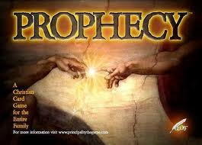
Biblical Prophecy: Importance
27% of Scripture was prophetic at the time it was written
2 Pet 1:19

Slide 59

2 Peter 1:19
“So we have the prophetic word made more sure, to which you do well to pay attention as to a lamp shining in a dark place, until the day dawns and the morning star arises in your hearts.”

Slide 60
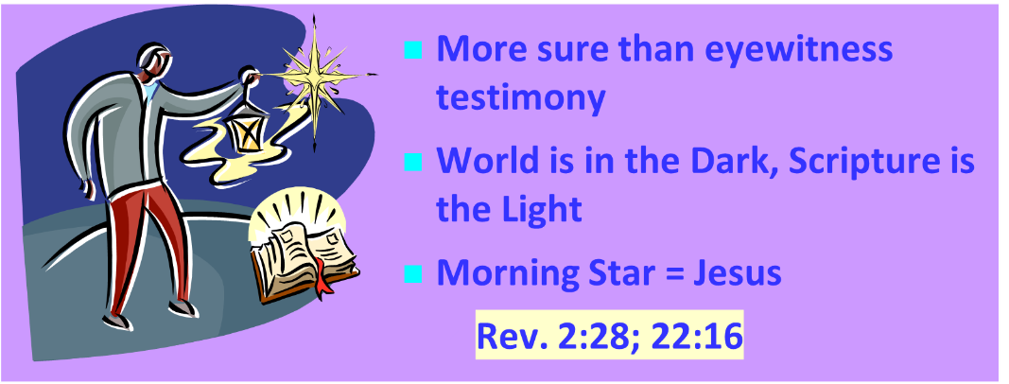
AUTHORITY OF SCRIPTURE V. 19

Slide 61
Conclusion

Slide 62
2 Thessalonians 2:1-12
Problem (2:1-2)
Prerequisites for the Day of the Lord (2:3-12)
  The departure (2:3a)
  Advent of the lawless one (2:3b-4)
  Removal of the restrainer (2:5-7)
  Destruction of the lawless one (2:8-9)
  Destruction of lawless one’s followers (2:10-12)

