Slide 1
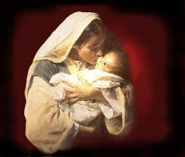

Christmas Eve
Micah 5:2
Andrew Marshall Woods, Th.M., JD., PhD.
Sr. Pastor, Sugar Land Bible Church

Slide 2

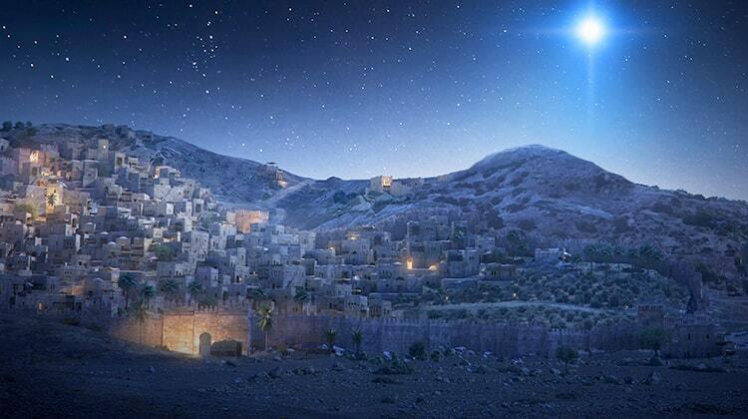
Micah 5:2
“But as for you, Bethlehem Ephrathah, Too little to be among the clans of Judah, From you One will go forth for Me to be ruler in Israel. His goings forth are from long ago, From the days of eternity.”

Slide 3
Seven Words from Micah 5:2
Eternity
Ruler
Israel
Judah
Bethlehem
Ephrathah
Little

Slide 4
Seven Words from Micah 5:2
Eternity
Ruler
Israel
Judah
Bethlehem
Ephrathah
Little

Slide 5
Micah 5:2
“But as for you, Bethlehem Ephrathah, Too little to be among the clans of Judah, From you One will go forth for Me to be ruler in Israel. His goings forth are from long ago, From the days of eternity (olam).”

Slide 6

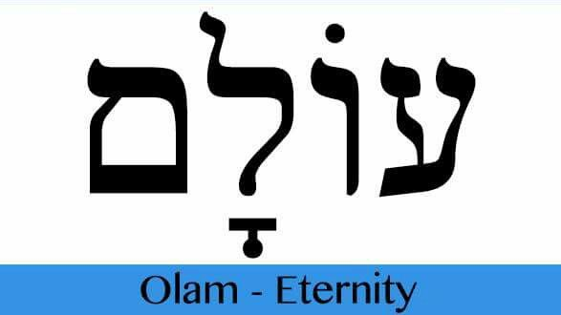
Psalm 90:2
“Before the mountains were born Or You gave birth to the earth and the world, Even from everlasting (olam) to everlasting (olam), You are God.”

Slide 7

Virgin Birth Emphasizes Christ’s Eternality

Slide 8
Seven Words from Micah 5:2
Eternity
Ruler
Israel
Judah
Bethlehem
Ephrathah
Little

Slide 9
Micah 5:2
“But as for you, Bethlehem Ephrathah, Too little to be among the clans of Judah, From you One will go forth for Me to be ruler in Israel. His goings forth are from long ago, From the days of eternity.”

Slide 10

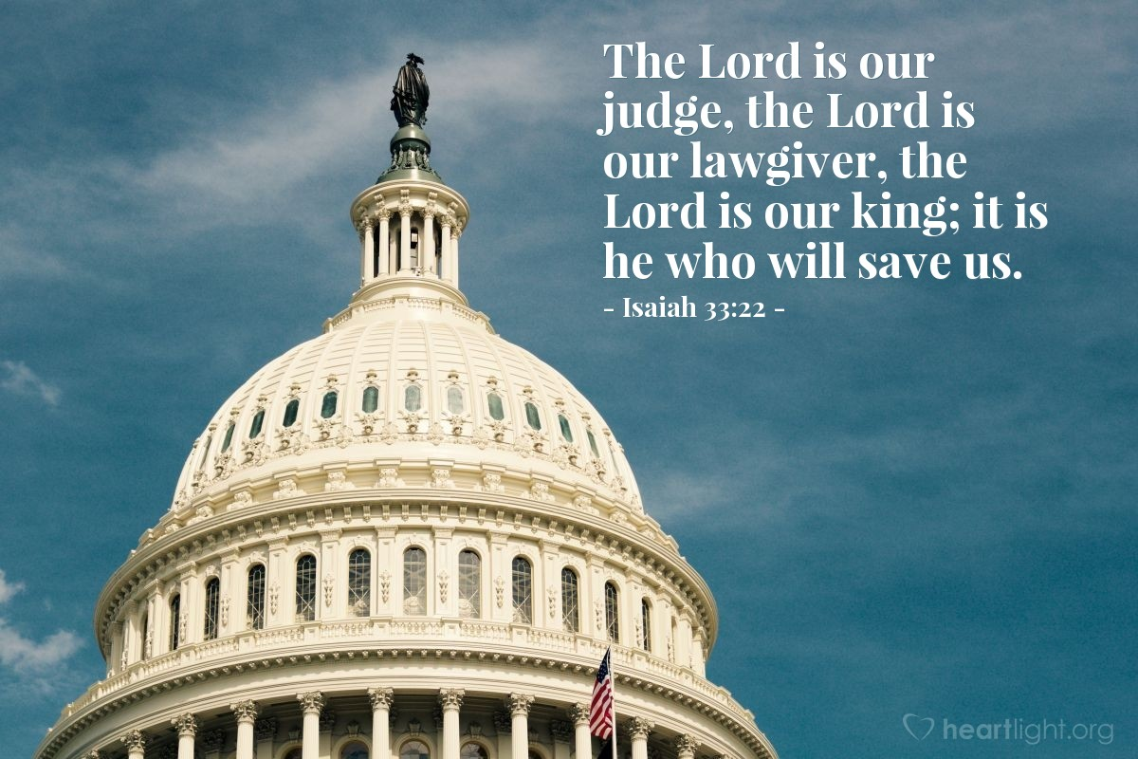
Isaiah 33:22
“For the LORD is our judge, The LORD is our lawgiver, The LORD is our king.”

Slide 11
Seven Words from Micah 5:2
Eternity
Ruler
Israel
Judah
Bethlehem
Ephrathah
Little

Slide 12
Micah 5:2
“But as for you, Bethlehem Ephrathah, Too little to be among the clans of Judah, From you One will go forth for Me to be ruler in Israel. His goings forth are from long ago, From the days of eternity.”

Slide 13

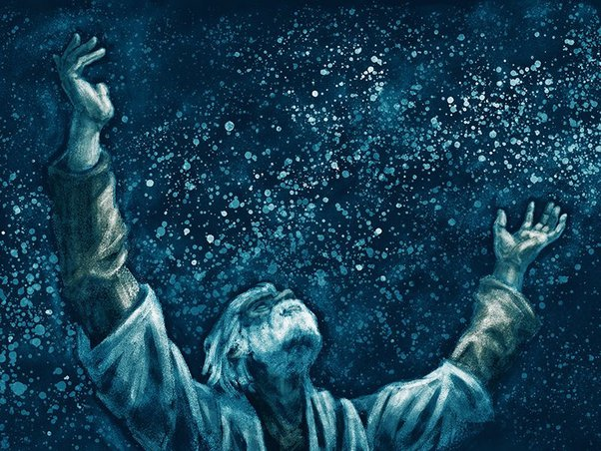
Genesis 12:3
“And I will bless those who bless you, And the one who curses you I will curse. And in you all the families of the earth will be blessed.”

Slide 14
Numbers 24:17
“I see him, but not now; I behold him, but not near; A star shall come forth from Jacob, A scepter shall rise from Israel, And shall crush through the forehead of Moab, And tear down all the sons of Sheth.”

Slide 15
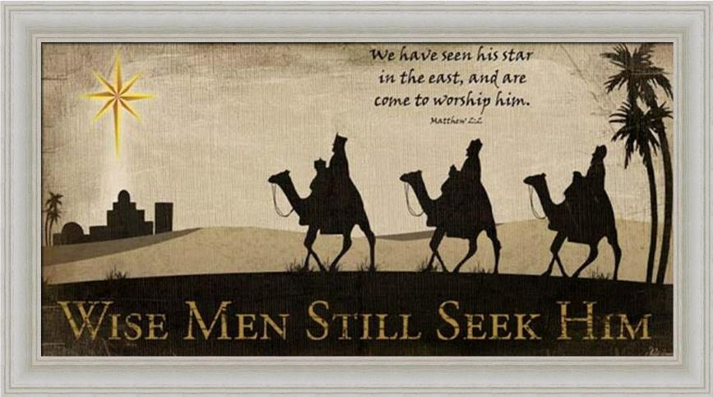

Slide 16
Messiah Must Be:
  A man (Gen 3:15)
  Semitic (Gen 9:26)
  From Abraham’s line (Gen 12:3)
  From Isaac’s line (Gen 17:18-19)
  From Jacob’s line (Num 24:17)

Slide 17
Seven Words from Micah 5:2
Eternity
Ruler
Israel
Judah
Bethlehem
Ephrathah
Little

Slide 18
Micah 5:2
“But as for you, Bethlehem Ephrathah, Too little to be among the clans of Judah, From you One will go forth for Me to be ruler in Israel. His goings forth are from long ago, From the days of eternity.”

Slide 19
Messiah Must Be:
  A man (Gen 3:15)
  Semitic (Gen 9:26)
  From Abraham’s line (Gen 12:3)
  From Isaac’s line (Gen 17:18-19)
  From Jacob’s line (Num 24:17)
  From the Tribe of Judah (Gen. 49:10)

Slide 20
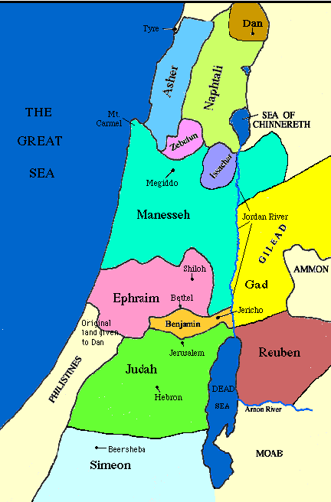

Slide 22
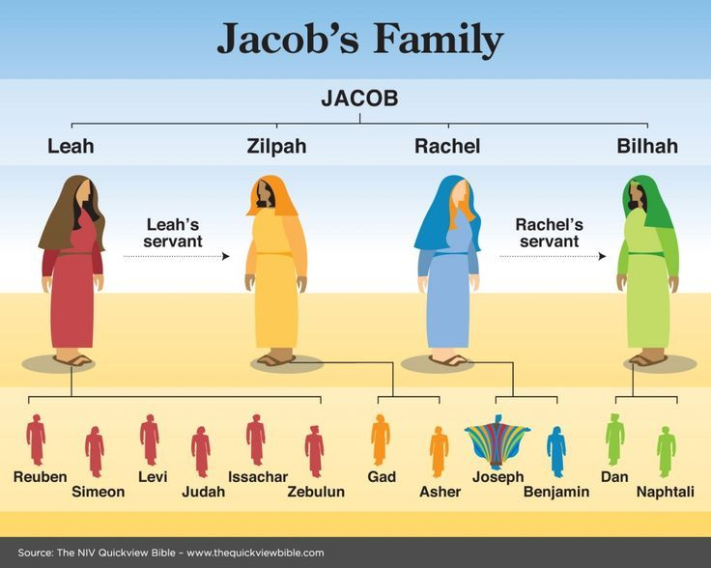

Slide 23
Messiah must be from the tribe of Judah
Genesis 49:10
Revelation 5:5

Slide 24

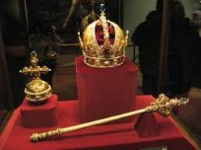
Genesis 49:10
“The scepter shall not depart from Judah, Nor the ruler’s staff from between his feet, Until Shiloh comes, And to him shall be the obedience of the peoples.”

Slide 25

Revelation 5:5
“and one of the elders said to me, ‘Stop weeping; behold, the Lion that is from the tribe of Judah, the Root of David, has overcome so as to open the book and its seven seals.’”

Slide 26
Seven Words from Micah 5:2
Eternity
Ruler
Israel
Judah
Bethlehem
Ephrathah
Little

Slide 27
Micah 5:2
“But as for you, Bethlehem Ephrathah, Too little to be among the clans of Judah, From you One will go forth for Me to be ruler in Israel. His goings forth are from long ago, From the days of eternity.”

Slide 28
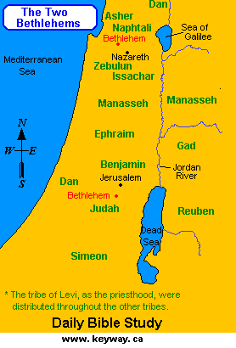

Slide 29
Seven Words from Micah 5:2
Eternity
Ruler
Israel
Judah
Bethlehem
Ephrathah
Little

Slide 30
Micah 5:2
“But as for you, Bethlehem Ephrathah, Too little to be among the clans of Judah, From you One will go forth for Me to be ruler in Israel. His goings forth are from long ago, From the days of eternity.”

Slide 31
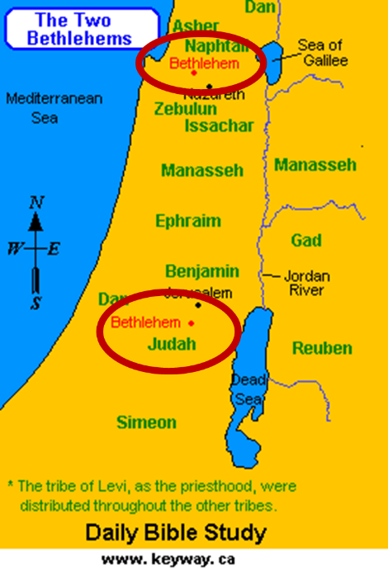

Slide 32
Seven Words from Micah 5:2
Eternity
Ruler
Israel
Judah
Bethlehem
Ephrathah
Little

Slide 33
Micah 5:2
“But as for you, Bethlehem Ephrathah, Too little to be among the clans of Judah, From you One will go forth for Me to be ruler in Israel. His goings forth are from long ago, From the days of eternity.”

Slide 34
Conclusion

Slide 35
Seven Words from Micah 5:2
Eternity
Ruler
Israel
Judah
Bethlehem
Ephrathah
Little

