Slide 1
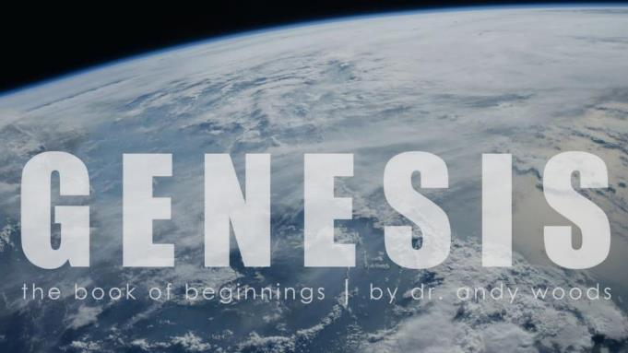
Genesis 12‒50
Israel’s Birth & Preservation

Slide 2
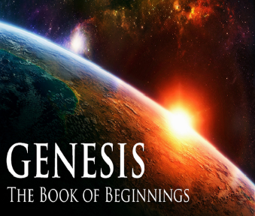
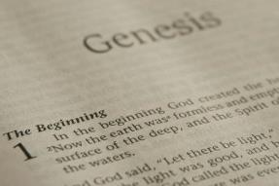
GENESIS STRUCTURE
Genesis 12-50 (four people)
Abraham (12:1–25:11)
Isaac (25:12–26:35)
Jacob (27–36)
Joseph (37–50)

Slide 3
Genesis 36:1-43 The Edomites
Esau’s sons: born in Canaan (36:1-8)
Esau’s sons: born in Seir (36:9-14)
Esau’s descendants as chiefs (36:15-19)
Descendants of Seir the Horite (36:20-30)
Edom’s kings (36:31-39)
Edom’s chiefs (36:40-43a)
Jacob & Esau’s division (36:43b‒37:1)

Slide 4
Genesis 36:1-43 The Edomites
Esau’s sons: born in Canaan (36:1-8)
Esau’s sons: born in Seir (36:9-14)
Esau’s descendants as chiefs (36:15-19)
Descendants of Seir the Horite (36:20-30)
Edom’s kings (36:31-39)
Edom’s chiefs (36:40-43a)
Jacob & Esau’s division (36:43b‒37:1)

Slide 5
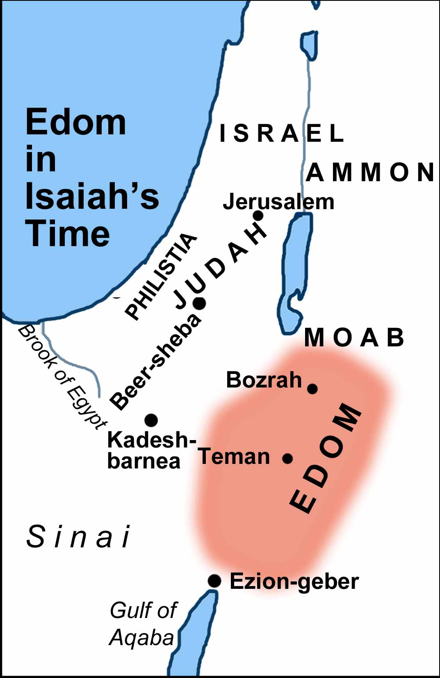

Slide 6
Genesis 36:1-43 The Edomites
Esau’s sons: born in Canaan (36:1-8)
Esau’s sons: born in Seir (36:9-14)
Esau’s descendants as chiefs (36:15-19)
Descendants of Seir the Horite (36:20-30)
Edom’s kings (36:31-39)
Edom’s chiefs (36:40-43a)
Jacob & Esau’s division (36:43b‒37:1)

Slide 7
II. Genesis 36:9-14 Esau’s Sons: born in Seir
Esau’s tablet (9)
Esau’s sons from Canaanite wives (10)
Sons of Eliphaz (11-12)
Sons of Ruel (13)
Sons of Oholibamah (14)

Slide 8
II. Genesis 36:9-14 Esau’s Sons: born in Seir
Esau’s tablet (9)
Esau’s sons from Canaanite wives (10)
Sons of Eliphaz (11-12)
Sons of Ruel (13)
Sons of Oholibamah (14)

Slide 9
Toledoth “And These Are the Generations of…”
Introduction to the generations (1:1–2:3)
Generations of the heaven and earth (2:4–4:26)
Generations of Adam (5:1–6:8)
Generations of Noah (6:9–9:29)
Generations of the sons of Noah (10:1–11:9)
Generations of Shem (11:10–26)
Generations of Terah (11:27–25:11)
Generations of Ishmael (25:12-18)
Generations of Isaac (25:19–35:29)
Generations of Esau (36:1–37:1)
Generations of Jacob (37:2–50:26)

Slide 11
Luke 1:1–4
¹ Inasmuch as many have undertaken to compile an account of the things accomplished among us, ² just as they were handed down to us by those who from the beginning were eyewitnesses and servants of the word, ³ it seemed fitting for me as well, having investigated everything carefully from the beginning, to write it out for you in consecutive order, most excellent Theophilus; ⁴ so that you may know the exact truth about the things you have been taught.

Slide 13
II. Genesis 36:9-14 Esau’s Sons: born in Seir
Esau’s tablet (9)
Esau’s sons from Canaanite wives (10)
Sons of Eliphaz (11-12)
Sons of Ruel (13)
Sons of Oholibamah (14)

Slide 14
Genesis 36:10 Esau’s Sons from Canaanite Wives
Eliphaz through Adah (10a)
Reul through Basemath (10b)

Slide 15
II. Genesis 36:9-14 Esau’s Sons: born in Seir
Esau’s tablet (9)
Esau’s sons from Canaanite wives (10)
Sons of Eliphaz (11-12)
Sons of Ruel (13)
Sons of Oholibamah (14)

Slide 16
Genesis 36:11-12 Sons of Eliphaz
Sons (11)
Through Timnah: Amalek (12a)
Conclusion (12b)

Slide 17
Genesis 36:11-12 Sons of Eliphaz
Sons (11)
Through Timnah: Amalek (12a)
Conclusion (12b)

Slide 18
Genesis 36:11 Sons
Teman (11a)
Omar (11b)
Zepho (11c)
Gatam (11d)
Kenaz (11e)

Slide 19
Genesis 36:11-12 Sons of Eliphaz
Sons (11)
Through Timnah: Amalek (12a)
Conclusion (12b)

Slide 20
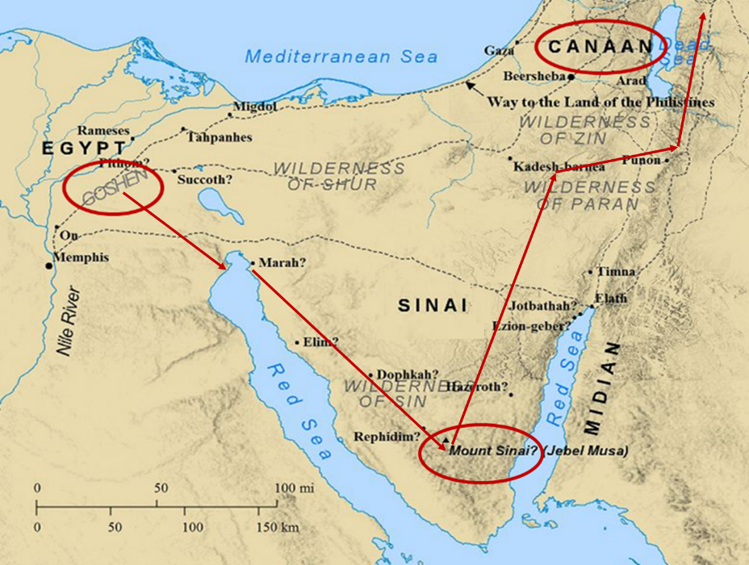

Slide 21
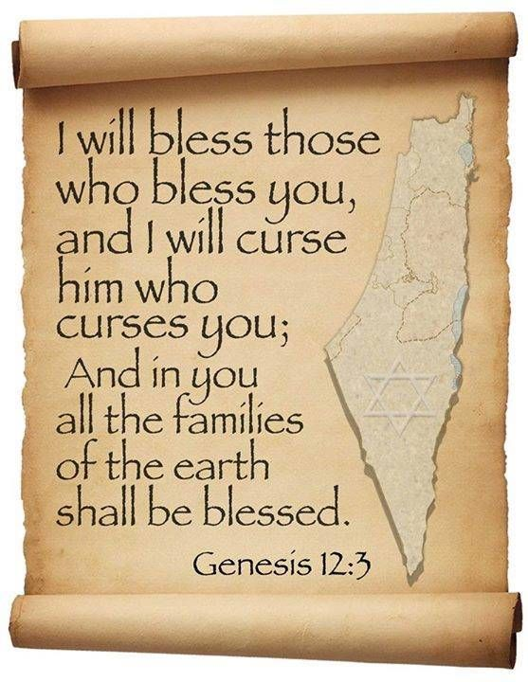
Genesis 12:3
“And I will bless those who bless you, And the one who curses you I will curse. And in you all the families of the earth will be blessed.”

Slide 22
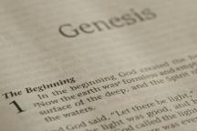
Beginning Themes
Universe Life Man Marriage Evil Clothing | Religion Salvation Language Government Nations Israel
Morris, Genesis Record, 18-20

Slide 23
Genesis 36:11-12 Sons of Eliphaz
Sons (11)
Through Timnah: Amalek (12a)
Conclusion (12b)

Slide 24
II. Genesis 36:9-14 Esau’s Sons: born in Seir
Esau’s tablet (9)
Esau’s sons from Canaanite wives (10)
Sons of Eliphaz (11-12)
Sons of Ruel (13)
Sons of Oholibamah (14)

Slide 25
Genesis 36:13 Sons
Sons (13a-d)
Conclusion (13e)

Slide 26
Genesis 36:13 Sons
Sons (13a-d)
Conclusion (13e)

Slide 27
Genesis 36:13a-d Sons
Nabath (13a)
Nerah (13b)
Shammah (13c)
Mizzah (13d)

Slide 28
Genesis 36:13 Sons
Sons (13a-d)
Conclusion (13e)

Slide 29
II. Genesis 36:9-14 Esau’s Sons: born in Seir
Esau’s tablet (9)
Esau’s sons from Canaanite wives (10)
Sons of Eliphaz (11-12)
Sons of Ruel (13)
Sons of Oholibamah (14)

Slide 30
Genesis 36:14 Sons of Oholibamah
Jeush (14a)
Jalaam (14b)
Korah (14c)

Slide 31
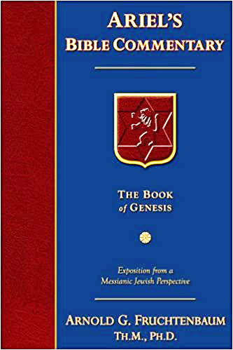
Dr. Arnold G. Fruchtenbaum
The Book of Genesis, 514
“…observations can be made about Esau’s House…there are a total of eighty-one names, but only two contain the Name of God. One is Reuel, which means the ‘friend of God,’ and the other is Jeush, which means ‘Jehovah help.’”

Slide 32
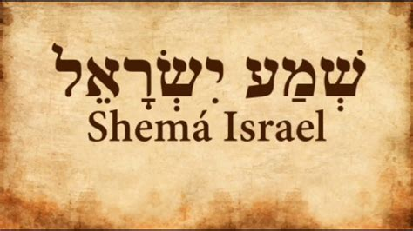
Deuteronomy 6:4-7
“⁴ Hear, Israel! The Lord is our God, the Lord is one!... ⁶ These words, which I am commanding you today, shall be on your heart. ⁷ You shall teach them diligently to your sons and shall talk of them when you sit in your house and when you walk by the way and when you lie down and when you rise up.”
32

Slide 33
Genesis 36:1-43 The Edomites
Esau’s sons: born in Canaan (36:1-8)
Esau’s sons: born in Seir (36:9-14)
Esau’s descendants as chiefs (36:15-19)
Descendants of Seir the Horite (36:20-30)
Edom’s kings (36:31-39)
Edom’s chiefs (36:40-43a)
Jacob & Esau’s division (36:43b‒37:1)

Slide 34
III. Genesis 36:15-19 Esau’s Sons & Grandsons as Chiefs
Introduction (15a)
Sons of Eliphaz as Chiefs (15b-16d)
Sons of Ruel as Chiefs (17)
Sons of Oholibamah as Chiefs (18)
Conclusion (19)

Slide 35
III. Genesis 36:15-19 Esau’s Sons & Grandsons as Chiefs
Introduction (15a)
Sons of Eliphaz as Chiefs (15b-16d)
Sons of Ruel as Chiefs (17)
Sons of Oholibamah as Chiefs (18)
Conclusion (19)

Slide 36
III. Genesis 36:15-19 Esau’s Sons & Grandsons as Chiefs
Introduction (15a)
Sons of Eliphaz as Chiefs (15b-16d)
Sons of Ruel as Chiefs (17)
Sons of Oholibamah as Chiefs (18)
Conclusion (19)

Slide 37
Genesis 36:15b-16d Sons of Eliphaz as Chiefs
Sons (15b-16c)
Conclusion (16d)

Slide 38
Genesis 36:15b-16d Sons of Eliphaz as Chiefs
Sons (15b-16c)
Conclusion (16d)

Slide 39
Genesis 36:15b-16 Sons
Teman (15b)
Omar (15c)
Zepho (15d)
Kenaz (15e)
Korah (16a)
Gatam (16b)
Amalek (16c)

Slide 40
Genesis 36:15b-16d Sons of Eliphaz as Chiefs
Sons (15b-16c)
Conclusion (16d)

Slide 41
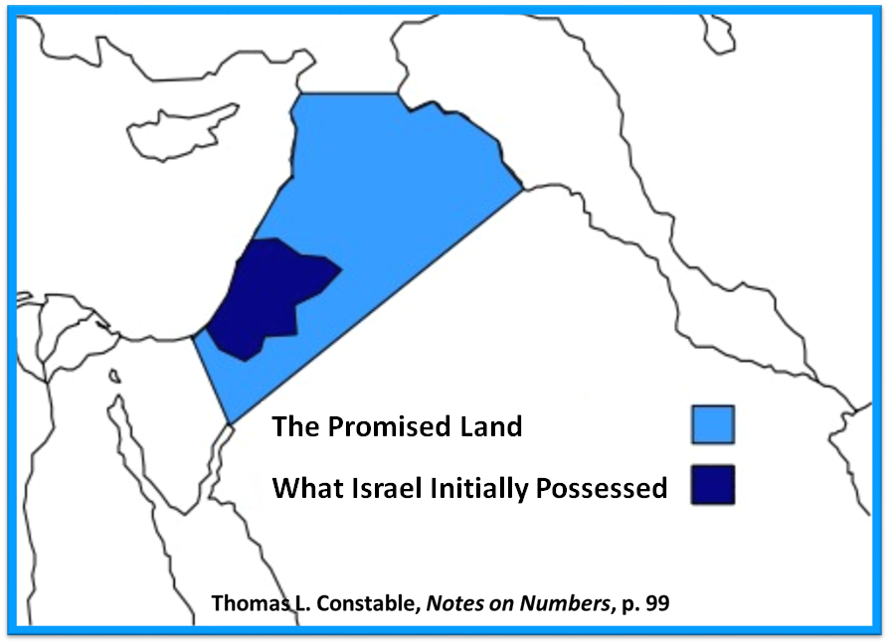

Slide 43
III. Genesis 36:15-19 Esau’s Sons & Grandsons as Chiefs
Introduction (15a)
Sons of Eliphaz as Chiefs (15b-16d)
Sons of Ruel as Chiefs (17)
Sons of Oholibamah as Chiefs (18)
Conclusion (19)

Slide 44
Genesis 36:17 Sons of Ruel as Chiefs
Sons (17a-d)
Conclusion (17e)

Slide 45
Genesis 36:17 Sons of Ruel as Chiefs
Sons (17a-d)
Conclusion (17e)

Slide 46
Genesis 36:17a-d Sons
Nabath (17a)
Nerah (17b)
Shammah (17c)
Mizzah (17d)

Slide 47
Genesis 36:17 Sons of Ruel as Chiefs
Sons (17a-d)
Conclusion (17e)

Slide 50
III. Genesis 36:15-19 Esau’s Sons & Grandsons as Chiefs
Introduction (15a)
Sons of Eliphaz as Chiefs (15b-16d)
Sons of Ruel as Chiefs (17)
Sons of Oholibamah as Chiefs (18)
Conclusion (19)

Slide 51
Genesis 36:18 Sons of Oholibamah as Chiefs
Sons (18a-c)
Conclusion (18d)

Slide 52
Genesis 36:18 Sons of Oholibamah as Chiefs
Sons (18a-c)
Conclusion (18d)

Slide 53
Genesis 36:18a-c Sons
Jeush (18a)
Jalaam (18b)
Korah (18c)

Slide 54
Genesis 36:18 Sons of Oholibamah as Chiefs
Sons (18a-c)
Conclusion (18d)

Slide 55
III. Genesis 36:15-19 Esau’s Sons & Grandsons as Chiefs
Introduction (15a)
Sons of Eliphaz as Chiefs (15b-16d)
Sons of Ruel as Chiefs (17)
Sons of Oholibamah as Chiefs (18)
Conclusion (19)

Slide 56
Genesis 36:1-43 The Edomites
Esau’s sons: born in Canaan (36:1-8)
Esau’s sons: born in Seir (36:9-14)
Esau’s descendants as chiefs (36:15-19)
Descendants of Seir the Horite (36:20-30)
Edom’s kings (36:31-39)
Edom’s chiefs (36:40-43a)
Jacob & Esau’s division (36:43b‒37:1)

Slide 57
IV. Genesis 36:20-30 Descendants of Seir the Horite
Sons of Seir (20-21)
Grandsons of Seir (22-28)
Horite Chiefs (29-30)

Slide 58
IV. Genesis 36:20-30 Esau’s Sons & Grandsons as Chiefs
Sons of Seir (20-21)
Grandsons of Seir (22-28)
Horite Chiefs (29-30)

Slide 59
Genesis 36:20-21 Sons of Seir
Introduction (20a)
Sons (20b-21c)
Conclusion (21d)

Slide 60
Genesis 36:20-21 Sons of Seir
Introduction (20a)
Sons (20b-21c)
Conclusion (21d)

Slide 61
Genesis 36:20-21 Sons of Seir
Introduction (20a)
Sons (20b-21c)
Conclusion (21d)

Slide 62
Genesis 36:20b-21c Sons
Lotan (20b)
Shobal (20c)
Zibeon (20d)
Anah (20e)
Dishon (21a)
Ezer (21b)
Dishan (21c)

Slide 63
Genesis 36:20-21 Sons of Seir
Introduction (20a)
Sons (20b-21c)
Conclusion (21d)

Slide 64
IV. Genesis 36:20-30 Esau’s Sons & Grandsons as Chiefs
Sons of Seir (20-21)
Grandsons of Seir (22-28)
Horite Chiefs (29-30)

Slide 65
Genesis 36:22-28 Grandsons of Seir
Sons of Lotan (22)
Sons of Shobal (23)
Sons of Zibeon (24)
Sons of Anah (25)
Sons of Dishon (26)
Sons of Ezer (27)
Sons of Dishan (28)

Slide 66
Genesis 36:22-28 Grandsons of Seir
Sons of Lotan (22)
Sons of Shobal (23)
Sons of Zibeon (24)
Sons of Anah (25)
Sons of Dishon (26)
Sons of Ezer (27)
Sons of Dishan (28)

Slide 67
Genesis 36:22-28 Grandsons of Seir
Sons of Lotan (22)
Sons of Shobal (23)
Sons of Zibeon (24)
Sons of Anah (25)
Sons of Dishon (26)
Sons of Ezer (27)
Sons of Dishan (28)

Slide 68
IV. Genesis 36:20-30 Esau’s Sons & Grandsons as Chiefs
Sons of Seir (20-21)
Grandsons of Seir (22-28)
Horite Chiefs (29-30)

Slide 69
Genesis 36:29-30 Sons of Seir
Introduction (29a)
Chiefs (29b-30c)
Conclusion (30d)

Slide 70
Genesis 36:29-30 Sons of Seir
Introduction (29a)
Chiefs (29b-30c)
Conclusion (30d)

Slide 71
Genesis 36:29-30 Sons of Seir
Introduction (29a)
Chiefs (29b-30c)
Conclusion (30d)

Slide 72
Genesis 36:29b-c Sons
Lotan (29b)
Shobal (29c)
Zibeon (29d)
Anah (29e)
Dishon (30a)
Ezer (30b)
Dishan (30c)

Slide 73
Genesis 36:29-30 Sons of Seir
Introduction (29a)
Chiefs (29b-30c)
Conclusion (30d)

Slide 74
Genesis 36:1-43 The Edomites
Esau’s sons: born in Canaan (36:1-8)
Esau’s sons: born in Seir (36:9-14)
Esau’s descendants as chiefs (36:15-19)
Descendants of Seir the Horite (36:20-30)
Edom’s kings (36:31-39)
Edom’s chiefs (36:40-43a)
Jacob & Esau’s division (36:43b‒37:1)

Slide 75
V. Genesis 36:31-39 Kings of Edom
Introduction (31a)
Timing (31b)
Edom’s kings (32-39)

Slide 76
V. Genesis 36:31-39 Kings of Edom
Introduction (31a)
Timing (31b)
Edom’s kings (32-39)

Slide 77
V. Genesis 36:31-39 Kings of Edom
Introduction (31a)
Timing (31b)
Edom’s kings (32-39)

Slide 79
Good and Bad Kings
North – 19 kings (all bad)
South – 20 kings (8 good; significance of Gen 49:10)

Slide 80
Dr. Arnold G. Fruchtenbaum
The Book of Genesis, 522
“There is a future history of Israel in which Israel will have kings. Here again is an example where those outside the Covenant initially seemed to do better than those within the Abrahamic Covenant. Esau seemed initially to do better than Jacob did. Edom seemed initially to do better than Israel. Lot initially seemed to do better than Abraham, etc.”

Slide 81
V. Genesis 36:31-39 Kings of Edom
Introduction (31a)
Timing (31b)
Edom’s kings (32-39)

Slide 82
Genesis 36:32-39 Edom’s Kings
First king (32)
Second king (33)
Third king (34)
Fourth king (35)
Fifth king (36)
Sixth king (37)
Seventh king (38)
Eighth king (39)

Slide 83
Genesis 36:32-39 Edom’s Kings
First king (32)
Second king (33)
Third king (34)
Fourth king (35)
Fifth king (36)
Sixth king (37)
Seventh king (38)
Eighth king (39)

Slide 84
Genesis 36:32-39 Edom’s Kings
First king (32)
Second king (33)
Third king (34)
Fourth king (35)
Fifth king (36)
Sixth king (37)
Seventh king (38)
Eighth king (39)

Slide 85
Genesis 36:32-39 Edom’s Kings
First king (32)
Second king (33)
Third king (34)
Fourth king (35)
Fifth king (36)
Sixth king (37)
Seventh king (38)
Eighth king (39)

Slide 86
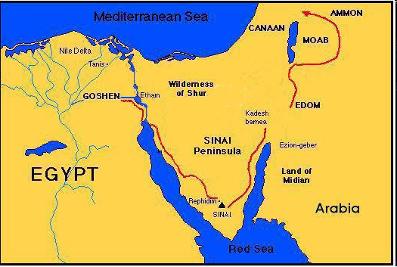

Slide 87
Beginning Themes
Universe Life Man Marriage Evil Clothing | Religion Salvation Language Government Nations Israel
Morris, Genesis Record, 18-20

Slide 88
Genesis 36:1-43 The Edomites
Esau’s sons: born in Canaan (36:1-8)
Esau’s sons: born in Seir (36:9-14)
Esau’s descendants as chiefs (36:15-19)
Descendants of Seir the Horite (36:20-30)
Edom’s kings (36:31-39)
Edom’s chiefs (36:40-43a)
Jacob & Esau’s division (36:43b‒37:1)

Slide 89
VI. Genesis 36:40-43c Edom’s Chiefs
Introduction (40a)
Chiefs (40b-43b)
Conclusion (43c)

Slide 90
VI. Genesis 36:40-43c Edom’s Chiefs
Introduction (40a)
Chiefs (40b-43b)
Conclusion (43c)

Slide 91
VI. Genesis 36:40-43c Edom’s Chiefs
Introduction (40a)
Chiefs (40b-43b)
Conclusion (43c)

Slide 92
Genesis 36:40b-43b Edom’s Chiefs
Timnah (40b)
Alvah (40c)
Jeheth (40d)
Ohalibamah (41a)
Elah (41b)
Pinion (41c)
Kenaz (42a)
Teman (42b)
Mizbar (42c)
Magdiel (43a)
Imam (43b)

Slide 93
VI. Genesis 36:40-43c Edom’s Chiefs
Introduction (40a)
Chiefs (40b-43b)
Conclusion (43c)

Slide 94
Genesis 36:1-43 The Edomites
Esau’s sons: born in Canaan (36:1-8)
Esau’s sons: born in Seir (36:9-14)
Esau’s descendants as chiefs (36:15-19)
Descendants of Seir the Horite (36:20-30)
Edom’s kings (36:31-39)
Edom’s chiefs (36:40-43a)
Jacob & Esau’s division (36:43b‒37:1)

Slide 95
VII. Genesis 36:43b‒37:1 Division of Jacob & Esau
Concerning Esau (36:43b)
Concerning Jacob (37:1)

Slide 96
VII. Genesis 36:43b‒37:1 Division of Jacob & Esau
Concerning Esau (36:43b)
Concerning Jacob (37:1)

Slide 98
VII. Genesis 36:43b‒37:1 Division of Jacob & Esau
Concerning Esau (36:43b)
Concerning Jacob (37:1)

Slide 100
Conclusion

Slide 101
Genesis 36:1-43 The Edomites
Esau’s sons: born in Canaan (36:1-8)
Esau’s sons: born in Seir (36:9-14)
Esau’s descendants as chiefs (36:15-19)
Descendants of Seir the Horite (36:20-30)
Edom’s kings (36:31-39)
Edom’s chiefs (36:40-43a)
Jacob & Esau’s division (36:43b‒37:1)

Slide 102
²⁴ The Lord bless you, and keep you; ²⁵ The Lord make His face shine on you, And be gracious to you; ²⁶ The Lord lift up His countenance on you, And give you peace.
Numbers 6:24–26 (NASB95)

