Slide 1


Dr. Andy Woods
Senior Pastor – Sugar Land Bible Church
President – Chafer Theological Seminary

Slide 2
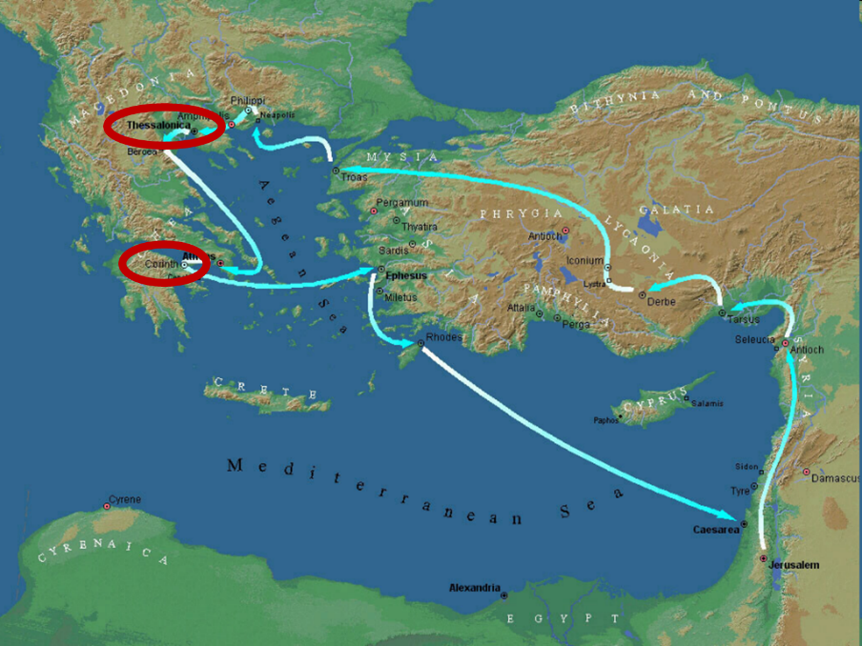

Slide 3
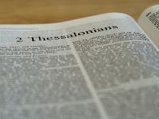
2 Thessalonians 2:1-12
Problem (2:1-2)
Prerequisites for the Day of the Lord (2:3-12)
  The departure (2:3a)
  Advent of the lawless one (2:3b-4)
  Removal of the restrainer (2:5-7)
  Destruction of the lawless one (2:8-9)
  Destruction of lawless one’s followers (2:10-12)

Slide 4
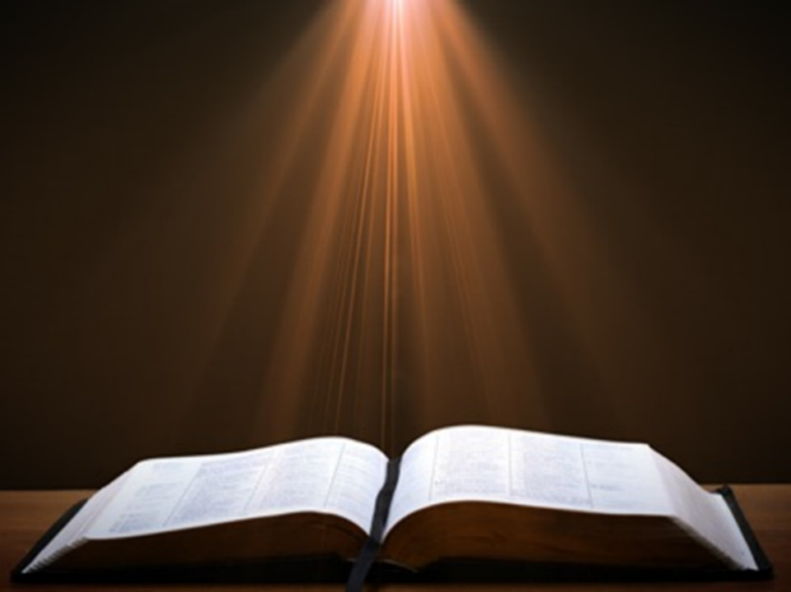

2 Thessalonians 2:2
“that you not be quickly shaken from your composure or be disturbed either by a spirit or a message or a letter as if from us, to the effect that the day of the Lord [the Tribulation] has come.”

Slide 5
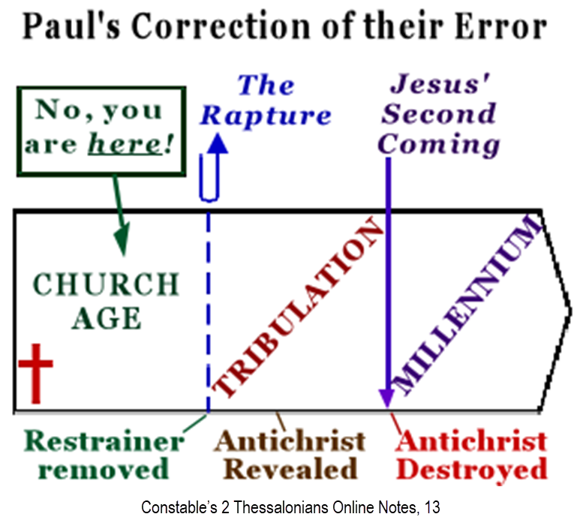

Slide 6
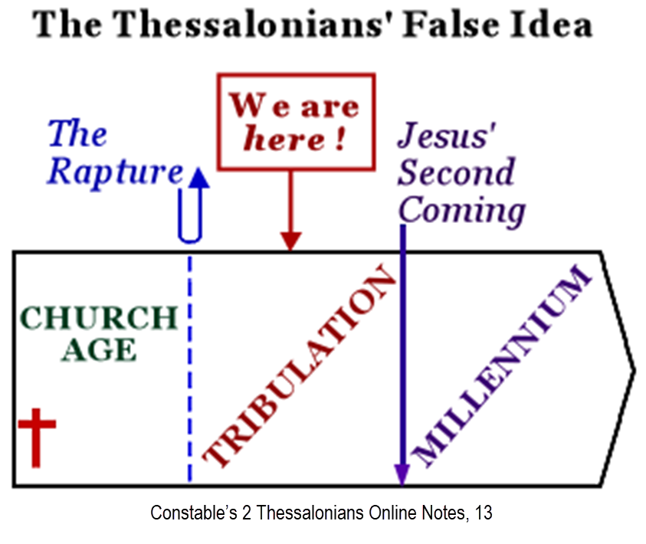

Slide 7
2 Thessalonians 2:1-12
Problem (2:1-2)
Prerequisites for the Day of the Lord (2:3-12)
  The departure (2:3a)
  Advent of the lawless one (2:3b-4)
  Removal of the restrainer (2:5-7)
  Destruction of the lawless one (2:8-9)
  Destruction of lawless one’s followers (2:10-12)

Slide 8
2 Thessalonians 2:1-12
Problem (2:1-2)
Prerequisites for the Day of the Lord (2:3-12)
  The departure (2:3a)
  Advent of the lawless one (2:3b-4)
  Removal of the restrainer (2:5-7)
  Destruction of the lawless one (2:8-9)
  Destruction of lawless one’s followers (2:10-12)

Slide 9
2 Thessalonians 2:1-12
Problem (2:1-2)
Prerequisites for the Day of the Lord (2:3-12)
  The departure (2:3a)
  Advent of the lawless one (2:3b-4)
  Removal of the restrainer (2:5-7)
  Destruction of the lawless one (2:8-9)
  Destruction of lawless one’s followers (2:10-12)

Slide 10

Daniel 9:27
“And he will make a firm covenant with the many for one week, but in the middle of the week he will put a stop to sacrifice and grain offering; and on the wing of abominations will come one who makes desolate, even until a complete destruction, one that is decreed, is poured out on the one who makes desolate.”

Slide 11
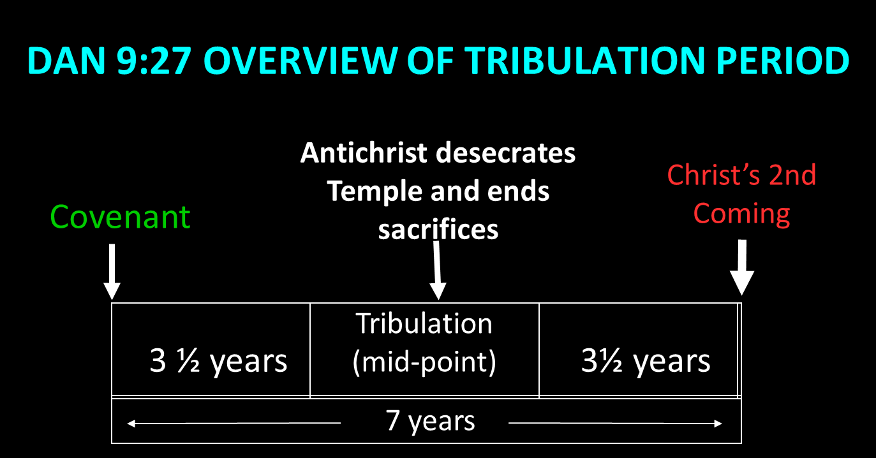

Slide 12
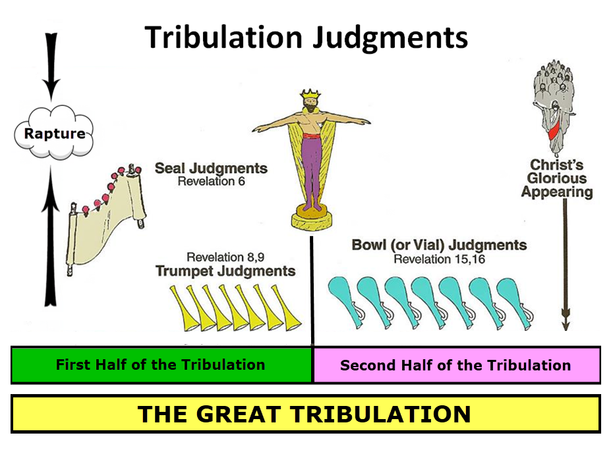

Slide 13
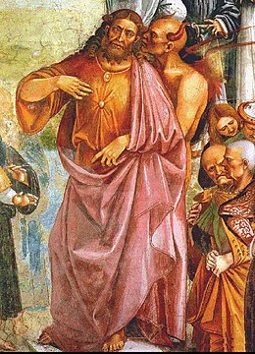
Daniel 11:31
“Forces from him will arise, desecrate the sanctuary fortress, and do away with the regular sacrifice. And they will set up the abomination of desolation.”

Slide 14
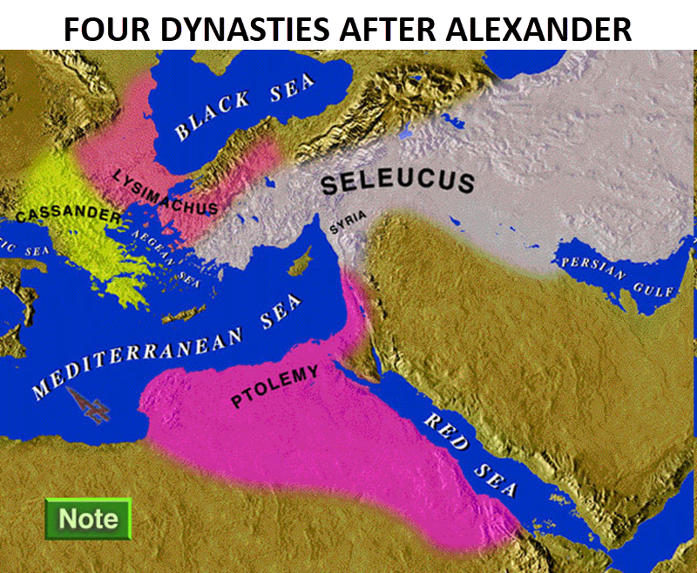

Slide 15
Intertestamental Chronology (Dates BC)
SELEUCIDS
Seleucus I 312-281
Antiochus I 281-261
Antiochus II 261-246
Seleucus II 246-226
Seleucus III 226-223
Antiochus III 223-187
Seleucus IV Philapator 187-175
Antiochus IV Epiphanes 175-163

Slide 16

HANUKKAH
Persecution under Antiochus IV
The Maccabean revolt
December 25th 164 BC : the temple is liberated and rededicated
1 & 2 Maccabees
The miracle of the lamp oil
Hanukkah “Feast of Dedication” (festival of lights).
Christmas / Jewish Holiday
John 10:22-24

Slide 17
Levitical Feasts (Lev. 23)
Feast | Season | Purpose | Type
Passover | Spring | Redemption | 1 Cor. 5:7
Unleavened Bread | Spring | Separation | John 6:35
1st fruits | Spring | Praise | 1 Cor. 15:20
Pentecost | Spring | Praise | Acts 2:1-4
Trumpets | Fall | New Year | Matt. 24:31
Atonement | Fall | Lev 16 | Zech. 12:10
Booths | Fall | Wilderness provision | Zech. 14:16-18

Slide 18
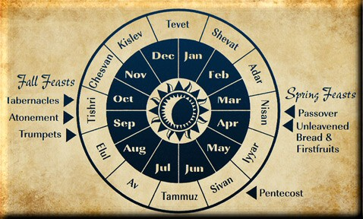

Slide 19
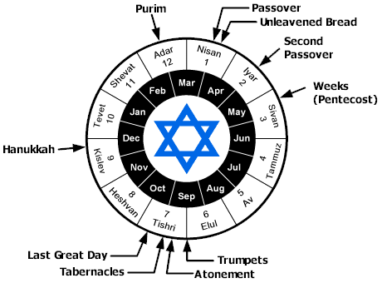

Slide 20
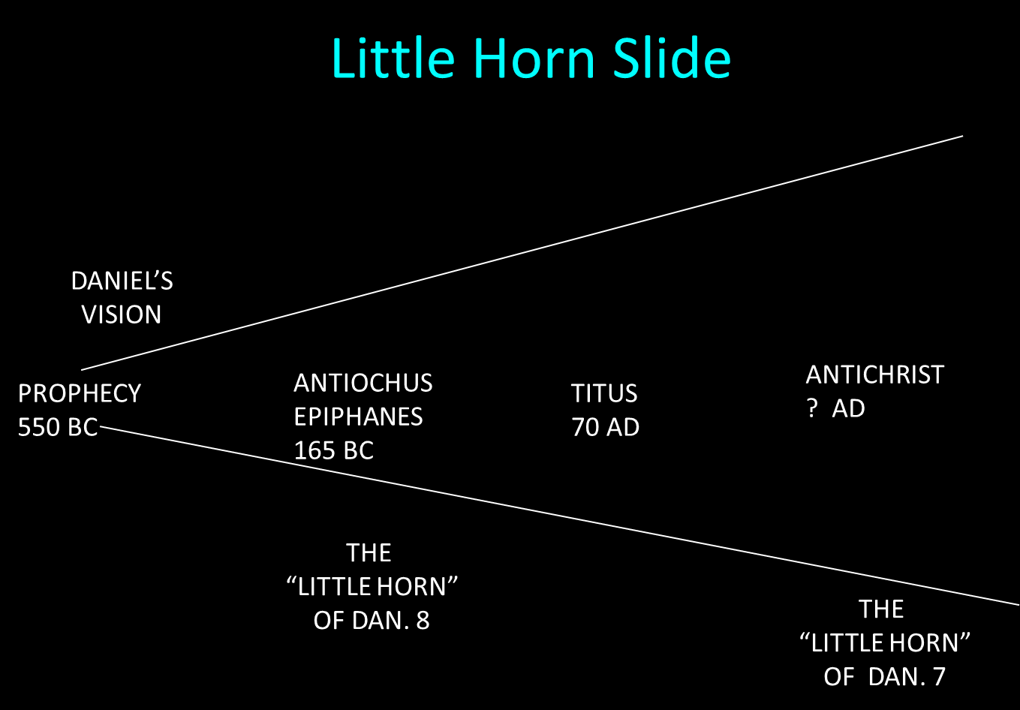

Slide 21

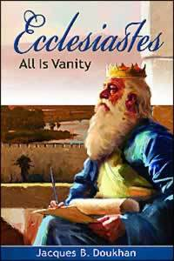
Ecclesiastes 1:9
“That which has been is that which will be, And that which has been done is that which will be done. So there is nothing new under the sun.”

Slide 22
Daniel 9:27
“And he will make a firm covenant with the many for one week, but in the middle of the week he will put a stop to sacrifice and grain offering; and on the wing of abominations will come one who makes desolate, even until a complete destruction, one that is decreed, is poured out on the one who makes desolate.”

Slide 25

Daniel 12:7
“I heard the man dressed in linen, who was above the waters of the river, as he raised his right hand and his left toward heaven, and swore by Him who lives forever that it would be for a time, times, and half a time; and as soon as they finish shattering the power of the holy people, all these events will be completed.”

Slide 26


Matthew 16:18
“I also say to you that you are Peter, and upon this rock I WILL build [oikodomeō] My church; and the gates of Hades WILL NOT overpower it.”

Slide 27
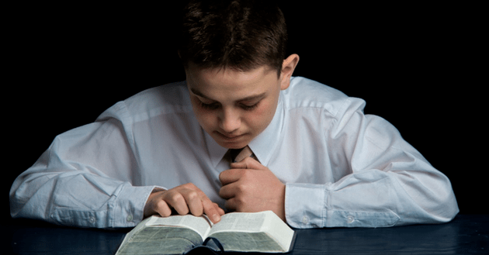
Psalm 50:5 (NKJV)
“Gather My saints together to Me, Those who have made a covenant with Me by sacrifice.”

Slide 28
Psalm 149:1 (NKJV)
“Praise the Lord! Sing to the Lord a new song, And His praise in the assembly of saints.”

Slide 29

Zechariah 13:8-9
⁸“It will come about in all the land,” Declares the Lord, “That two parts in it will be cut off and perish; But the third will be left in it. ⁹“And I will bring the third part through the fire, Refine them as silver is refined, And test them as gold is tested. They will call on My name, And I will answer them; I will say, ‘They are My people,’ And they will say, ‘The Lord is my God.’ ”

Slide 30
Zechariah 12:10
“I will pour out on the house of David and on the inhabitants of Jerusalem, the Spirit of grace and of supplication, so that they will look on Me whom they have pierced; and they will mourn for Him, as one mourns for an only son, and they will weep bitterly over Him like the bitter weeping over a firstborn.”

Slide 31
Romans 11:25-26
“²⁵ For I do not want you, brethren, to be uninformed of this mystery—so that you will not be wise in your own estimation—that a partial hardening has happened to Israel until the fullness of the Gentiles has come in; ²⁶ and so all Israel will be saved; just as it is written, ‘The Deliverer will come from Zion, He will remove ungodliness from Jacob.’”

Slide 32

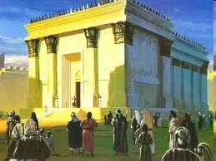
Israel’s Four Temples
Solomon’s pre exilic temple (Kings and Chronicles)
Zerubbabel’s post exilic temple (Ezra 1-6; John 2:20)
Antichrist's temple (Dan 9:27; Matt 24:15; 2 Thess 2:4; Rev 11:1-2)
Millennial temple (Ezek 40-48)

Slide 33
Israel’s Four Temples
Solomon’s pre exilic temple (Kings and Chronicles)
Zerubbabel’s post exilic temple (Ezra 1-6; John 2:20)
Antichrist's temple (Dan 9:27; Matt 24:15; 2 Thess 2:4; Rev 11:1-2)
Millennial temple (Ezek 40-48)

Slide 34
Matthew 24:15-16, 20
“¹⁵ Therefore when you see the abomination of desolation which was spoken of through Daniel the prophet, standing in the holy place (let the reader understand) ¹⁶ then those who are in Judea must flee to the mountains…²⁰ But pray that your flight will not be in the winter, or on a Sabbath.”

Slide 35
The Stage Is Being Set
Rebirth of Israel in 1948
Israel’s desire for peace
Desire among some Jews to Rebuild 3rd Jewish temple and Restore the sacrificial system
  Source: Randall Price “Ready to Rebuild”

Slide 36
The Stage Is Being Set
Rebirth of Israel in 1948
Israel’s desire for peace
Desire among some Jews to Rebuild 3rd Jewish temple and Restore the sacrificial system
  Source: Randall Price “Ready to Rebuild”

Slide 37
The Stage Is Being Set
Rebirth of Israel in 1948
Israel’s desire for peace
Desire among some Jews to Rebuild 3rd Jewish temple and Restore the sacrificial system
  Source: Randall Price “Ready to Rebuild”

Slide 38
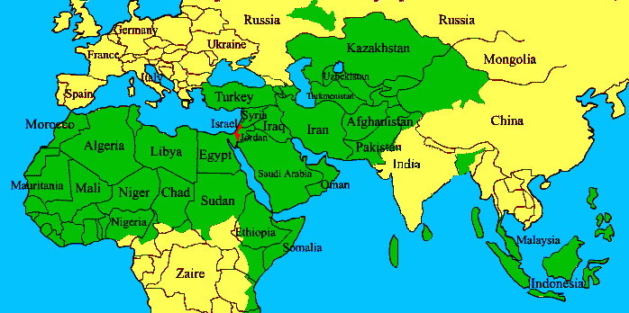
ISRAEL

Slide 39
The Stage Is Being Set
Rebirth of Israel in 1948
Israel’s desire for peace
Desire among some Jews to Rebuild 3rd Jewish temple and Restore the sacrificial system
  Source: Randall Price “Ready to Rebuild”

Slide 40


Slide 41
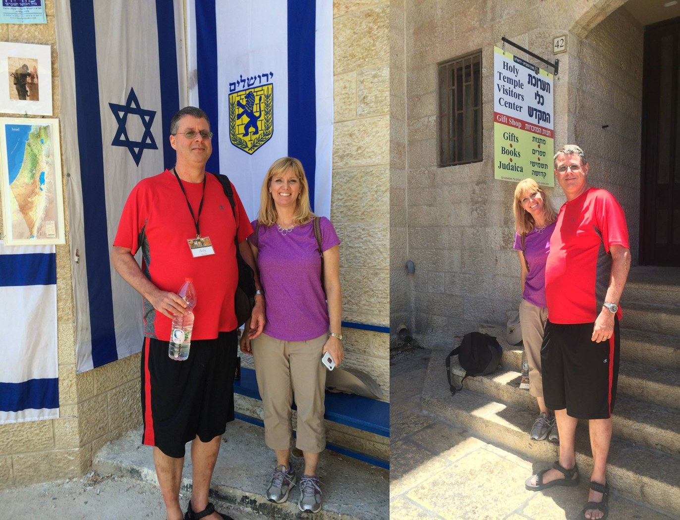

Slide 42
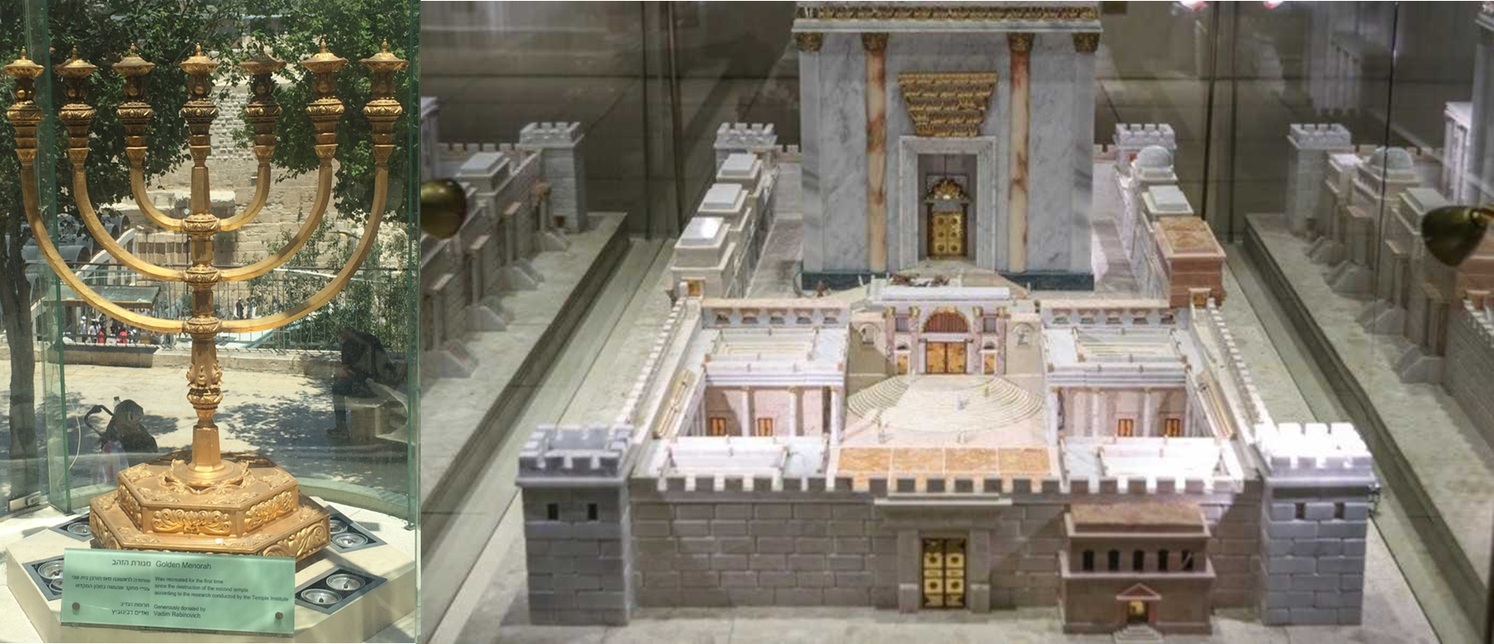

Slide 43
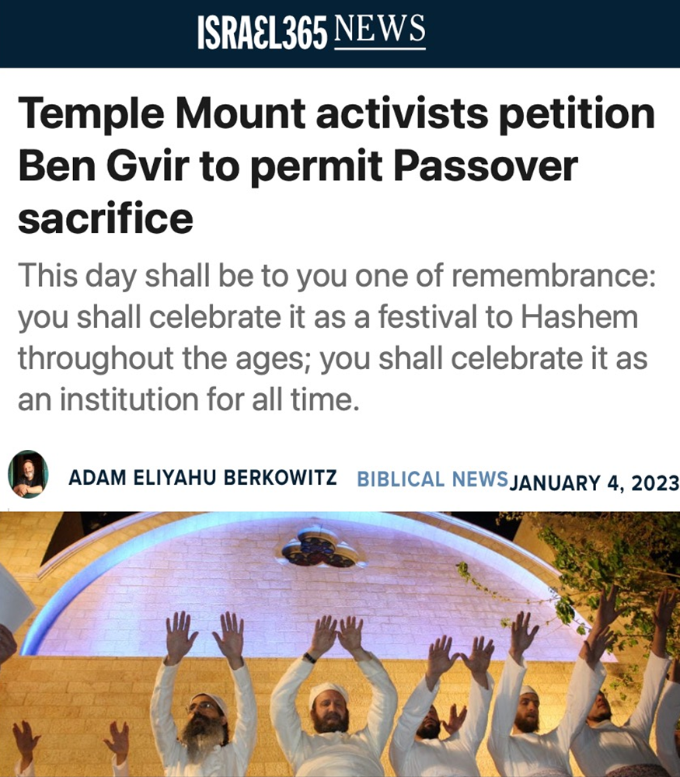

Slide 44
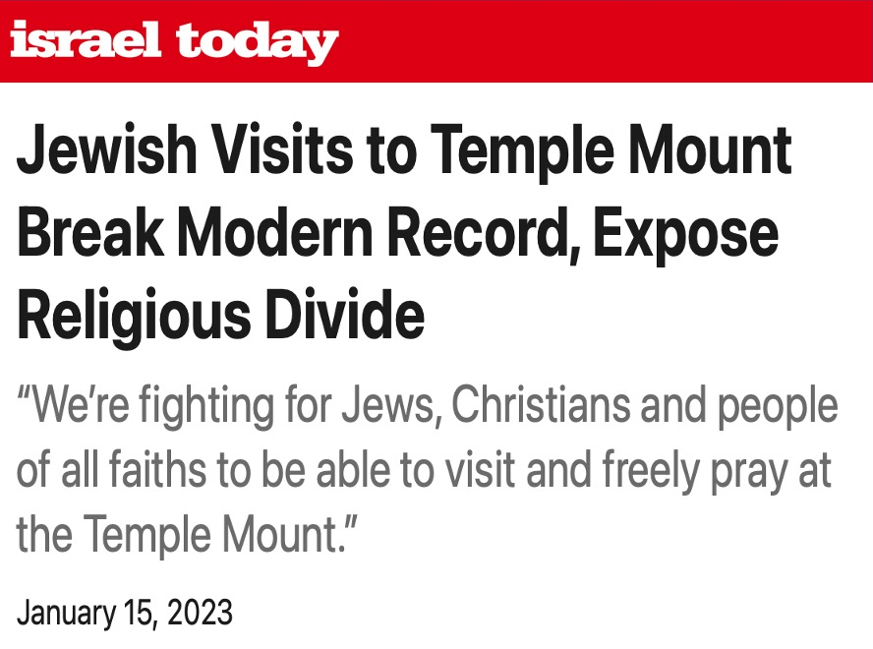

Slide 45
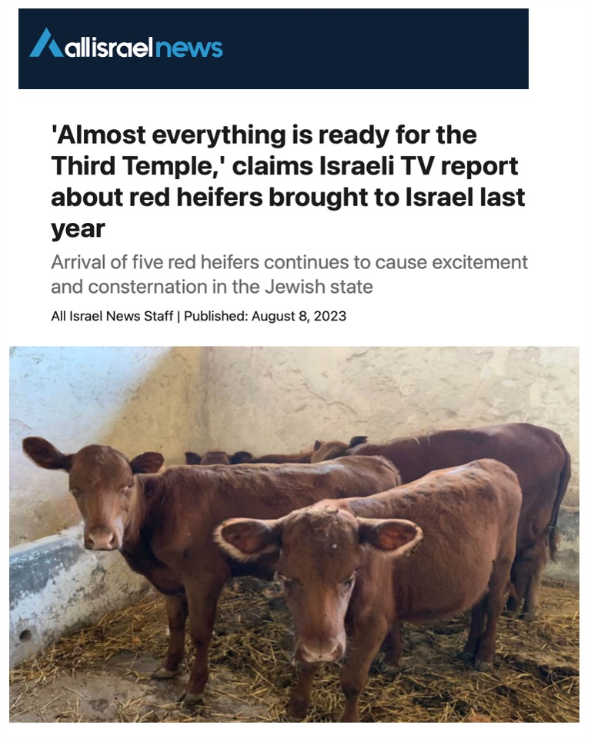

Slide 46
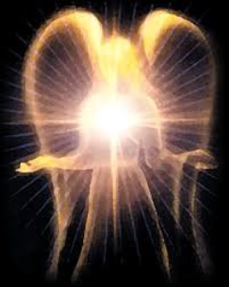
Original State and First Sin (cont’d)
Isaiah 14:12-15
    5 “I will” statements
    Ascend to heaven (13)
    Raise my throne above the stars of God (13)
    Sit enthroned on the Mt. of the Assembly (13)
    Ascend above the tops of the clouds (14)
    Make myself like the Most High (14)

Slide 47
Original State and First Sin (cont’d)
Isaiah 14:12-15
    5 “I will” statements
    Ascend to heaven (13)
    Raise my throne above the stars of God (13)
    Sit enthroned on the Mt. of the Assembly (13)
    Ascend above the tops of the clouds (14)
    Make myself like the Most High (14)

Slide 48
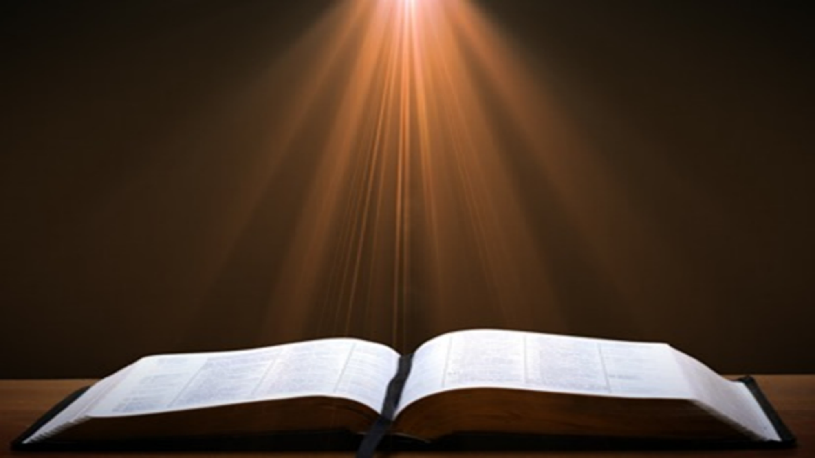
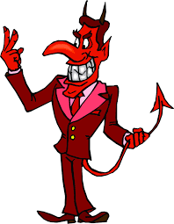
Isaiah 14:14
“I will ascend above the heights of the clouds; I will make myself like the Most High.”

Slide 49
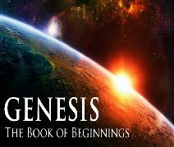
Satan’s Tactics (2 Cor 2:11)
  Adds to God’s Word (3:1; 2:16-17)
  Challenges God’s goodness (3:1; 2:16-17)
  Subtracts from God’s Word (3:4; 2:17)
  Offers wisdom without submission to God (3:5; Prov 1:7)

Slide 50
2 Thessalonians 2:1-12
Problem (2:1-2)
Prerequisites for the Day of the Lord (2:3-12)
  The departure (2:3a)
  Advent of the lawless one (2:3b-4)
  Removal of the restrainer (2:5-7)
  Destruction of the lawless one (2:8-9)
  Destruction of lawless one’s followers (2:10-12)

Slide 51

Paul’s Various Rapture Terms
parousia | 2 Thess. 2:1
episynagōgē | 2 Thess. 2:1
apokalypsis | 1 Cor. 1:7
epiphaneia | Titus 2:13
rhyomai | 1 Thess. 1:10
harpazō | 1 Thess. 4:17
apostasia | 2 Thess. 2:3a

Slide 52
Conclusion

Slide 53
2 Thessalonians 2:1-12
Problem (2:1-2)
Prerequisites for the Day of the Lord (2:3-12)
  The departure (2:3a)
  Advent of the lawless one (2:3b-4)
  Removal of the restrainer (2:5-7)
  Destruction of the lawless one (2:8-9)
  Destruction of lawless one’s followers (2:10-12)

