Slide 1


Dr. Andy Woods
Senior Pastor – Sugar Land Bible Church
President – Chafer Theological Seminary

Slide 2
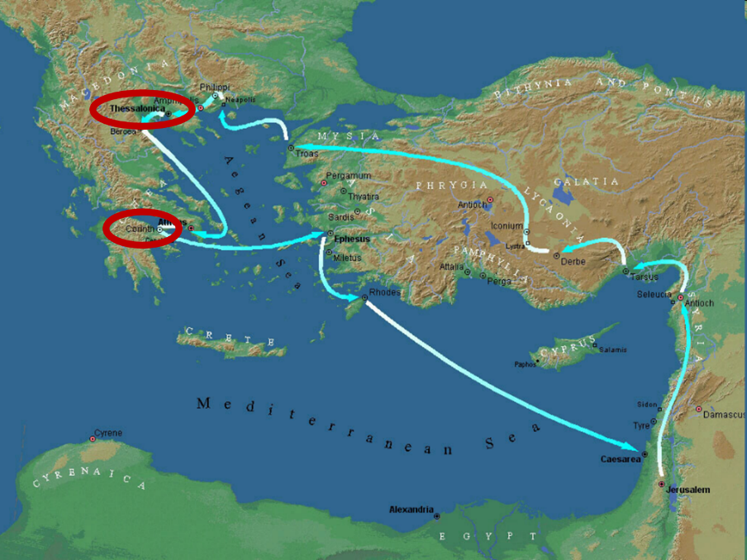

Slide 3
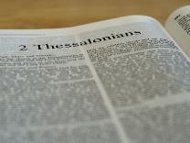
2 Thessalonians 2:1-12
Problem (2:1-2)
Prerequisites for the Day of the Lord (2:3-12)
  The departure (2:3a)
  Advent of the lawless one (2:3b-4)
  Removal of the restrainer (2:5-7)
  Destruction of the lawless one (2:8-9)
  Destruction of lawless one’s followers (2:10-12)

Slide 4


2 Thessalonians 2:2
“that you not be quickly shaken from your composure or be disturbed either by a spirit or a message or a letter as if from us, to the effect that the day of the Lord [the Tribulation] has come.”

Slide 5
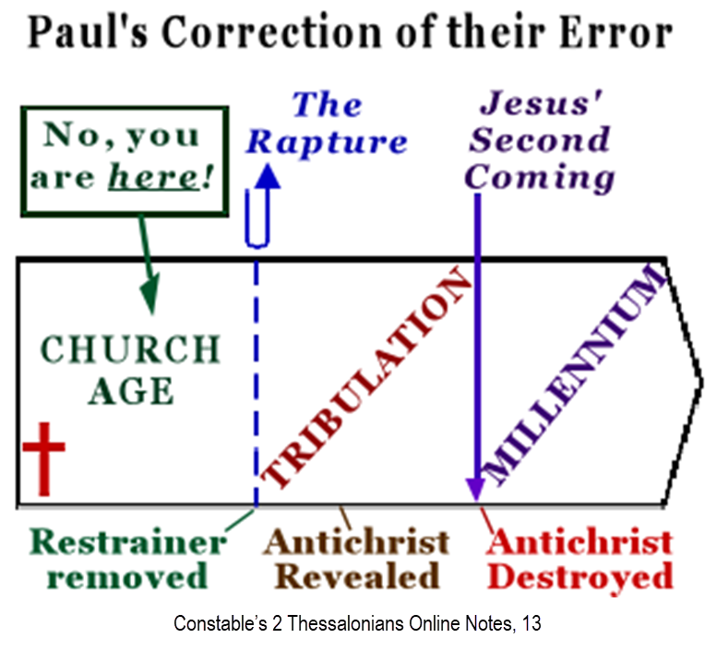

Slide 6
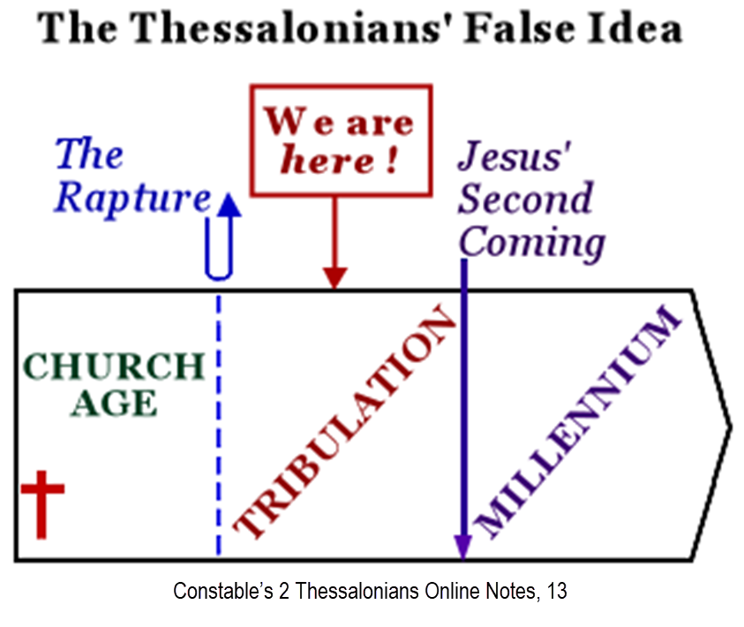

Slide 7
2 Thessalonians 2:1-12
Problem (2:1-2)
Prerequisites for the Day of the Lord (2:3-12)
  The departure (2:3a)
  Advent of the lawless one (2:3b-4)
  Removal of the restrainer (2:5-7)
  Destruction of the lawless one (2:8-9)
  Destruction of lawless one’s followers (2:10-12)

Slide 8
2 Thessalonians 2:1-12
Problem (2:1-2)
Prerequisites for the Day of the Lord (2:3-12)
  The departure (2:3a)
  Advent of the lawless one (2:3b-4)
  Removal of the restrainer (2:5-7)
  Destruction of the lawless one (2:8-9)
  Destruction of lawless one’s followers (2:10-12)

Slide 9

Apostasy? (2:3a)
Spiritual departure (Acts 21:21) – Unbelieving world embracing the antichrist
Physical departure (Acts 12:10; 2 Cor. 12:8) – Rapture

Slide 10

10 Reasons Favoring Physical Departure
There have always been doctrinal departures
2 Thess. was an early letter
The definite article before apostasia
Noun apostasia can refer to physical departure
Verb aphistēmi can refer to physical departure

Slide 11
10 Reasons Favoring Physical Departure
Extended context favors physical departure
Immediate context favors physical departure
2 Thess. 2:2 is a review course
Early Bible translations favor physical departure
Physical departure is held by credible scholars

Slide 12

Answering Objections to the Physical Departure View
Greek from the Koine period?
Subtraction from the Last Days will be characterized by continual apostasy?
Rapture is passive and apostasy is active?
Incongruence with verse 1?
Paul is re-assuring the Thessalonians that they had not already missed the rapture; therefore, it would be incomprehensible to read, “the rapture cannot have happened unless the rapture happens first.”

Slide 13
2 Thessalonians 2:2-3 (NKJV)
“² not to be soon shaken in mind or troubled, either by spirit or by word or by letter, as if from us, as though the day of Christ [rapture] had come. ³ Let no man deceive you by any means: for that day [rapture] shall not come, except there come a falling away [rapture] first, and that man of sin be revealed, the son of perdition”

Slide 14
2 Thessalonians 2:3 (NASB)
“² that you not be quickly shaken from your composure or be disturbed either by a spirit or a message or a letter as if from us, to the effect that the day of the Lord [the tribulation period] has come. ³ Let no one in any way deceive you, for it [the tribulation period] will not come unless the apostasy [apostasia] comes first, and the man of lawlessness is revealed, the son of destruction.”

Slide 15
2 Thessalonians 2:1-12
Problem (2:1-2)
Prerequisites for the Day of the Lord (2:3-12)
  The departure (2:3a)
  Advent of the lawless one (2:3b-4)
  Removal of the restrainer (2:5-7)
  Destruction of the lawless one (2:8-9)
  Destruction of lawless one’s followers (2:10-12)

Slide 16

2 Thessalonians 2:3
“Let no one in any way deceive you, for it will not come unless the apostasy [apostasia] comes first [prōton], and the man [anthrōpos] of lawlessness [anomia] is revealed, the son of destruction.”

Slide 17

Daniel 9:27
“And he will make a firm covenant with the many for one week, but in the middle of the week he will put a stop to sacrifice and grain offering; and on the wing of abominations will come one who makes desolate, even until a complete destruction, one that is decreed, is poured out on the one who makes desolate.”

Slide 18


2 Thessalonians 2:9
“that is, the one whose coming is in accord with the activity of Satan, with all power and signs and false wonders.”

Slide 19
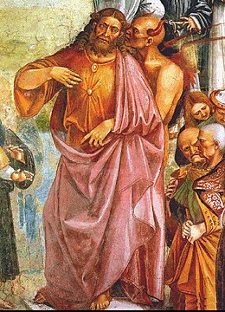
Daniel 11:36
³⁶ “Then the king will do as he pleases, and he will exalt and magnify himself above every god and will speak monstrous things against the God of gods; and he will prosper until the indignation is finished, for that which is decreed will be done.”

Slide 20
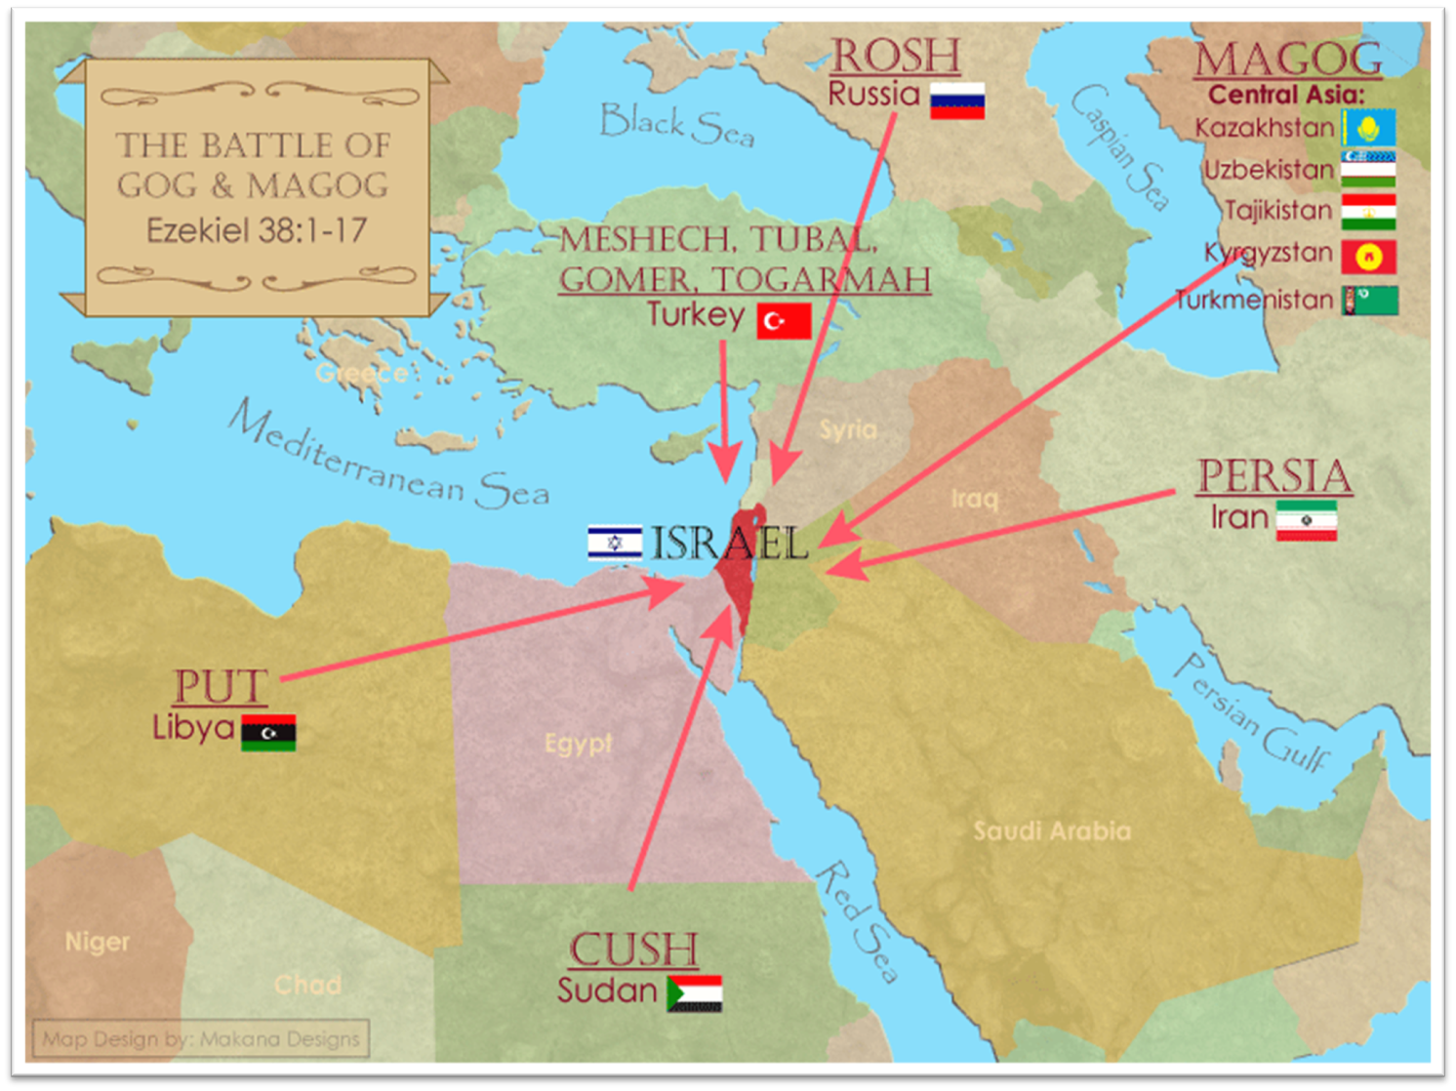
Saudi Arabia

Slide 21
Daniel 9:27
“And he will make a firm covenant with the many for one week, but in the middle of the week he will put a stop to sacrifice and grain offering; and on the wing of abominations will come one who makes desolate, even until a complete destruction, one that is decreed, is poured out on the one who makes desolate.”

Slide 22
Daniel 9:26
“Then after the sixty-two weeks the Messiah will be cut off and have nothing, and the people of the prince who is to come will destroy the city and the sanctuary. And its end will come with a flood; even to the end there will be war; desolations are determined.”

Slide 23
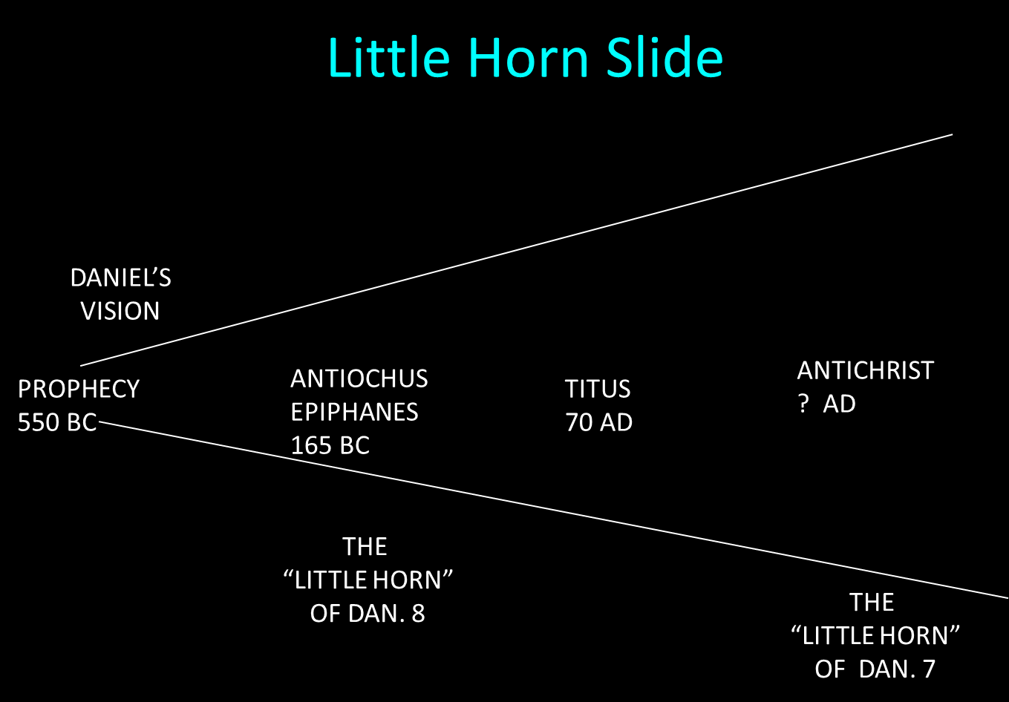

Slide 24
Daniel 9:27
“And he will make a firm covenant with the many for one week, but in the middle of the week he will put a stop to sacrifice and grain offering; and on the wing of abominations will come one who makes desolate, even until a complete destruction, one that is decreed, is poured out on the one who makes desolate.”

Slide 25


Slide 26


Slide 27
Daniel 11:31
“Forces from him will arise, desecrate the sanctuary fortress, and do away with the regular sacrifice. And they will set up the abomination of desolation.”

Slide 28
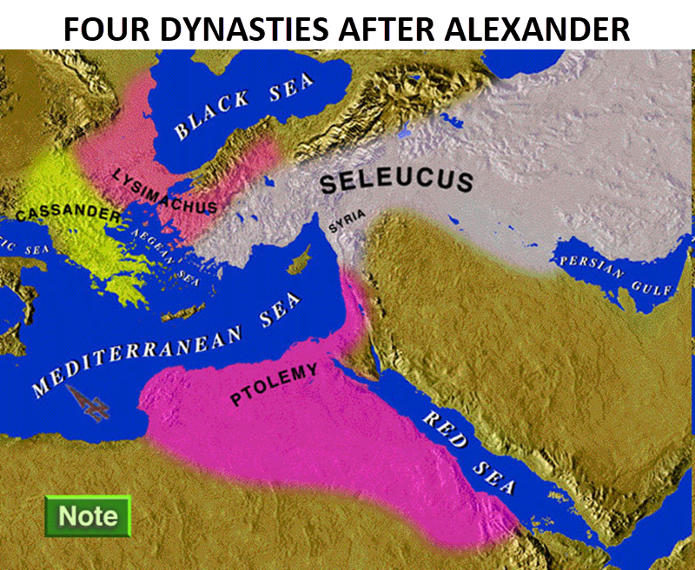

Slide 29
Intertestamental Chronology (Dates BC)
SELEUCIDS
Seleucus I 312-281
Antiochus I 281-261
Antiochus II 261-246
Seleucus II 246-226
Seleucus III 226-223
Antiochus III 223-187
Seleucus IV Philapator 187-175
Antiochus IV Epiphanes 175-163

Slide 30

HANUKKAH
The Maccabean revolt
December 25th 164 BC : the temple is liberated and rededicated
1 & 2 Maccabees
The miracle of the lamp oil
Hanukkah “Feast of Dedication” (festival of lights).
Christmas / Jewish Holiday
John 10:22-24

Slide 31
Levitical Feasts (Lev. 23)
Feast | Season | Purpose | Type
Passover | Spring | Redemption | 1 Cor. 5:7
Unleavened Bread | Spring | Separation | John 6:35
1st fruits | Spring | Praise | 1 Cor. 15:20
Pentecost | Spring | Praise | Acts 2:1-4
Trumpets | Fall | New Year | Matt. 24:31
Atonement | Fall | Lev 16 | Zech. 12:10
Booths | Fall | Wilderness provision | Zech. 14:16-18

Slide 32


Slide 33
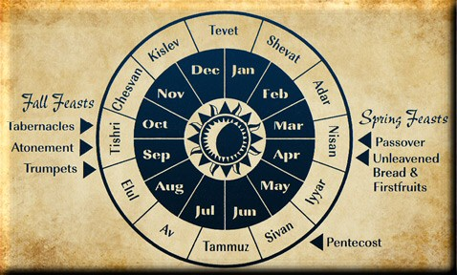

Slide 35

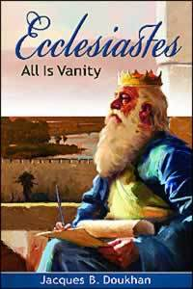
Ecclesiastes 1:9
“That which has been is that which will be, And that which has been done is that which will be done. So there is nothing new under the sun.”

Slide 36
Daniel 9:27
“And he will make a firm covenant with the many for one week, but in the middle of the week he will put a stop to sacrifice and grain offering; and on the wing of abominations will come one who makes desolate, even until a complete destruction, one that is decreed, is poured out on the one who makes desolate.”

Slide 39

Daniel 12:7
“I heard the man dressed in linen, who was above the waters of the river, as he raised his right hand and his left toward heaven, and swore by Him who lives forever that it would be for a time, times, and half a time; and as soon as they finish shattering the power of the holy people, all these events will be completed.”

Slide 40


Matthew 16:18
“I also say to you that you are Peter, and upon this rock I WILL build [oikodomeō] My church; and the gates of Hades WILL NOT overpower it.”

Slide 41

Psalm 50:5 (NKJV)
“Gather My saints together to Me, Those who have made a covenant with Me by sacrifice.”

Slide 42
Psalm 149:1 (NKJV)
“Praise the Lord! Sing to the Lord a new song, And His praise in the assembly of saints.”

Slide 43

Zechariah 13:8-9
⁸“It will come about in all the land,” Declares the Lord, “That two parts in it will be cut off and perish; But the third will be left in it. ⁹“And I will bring the third part through the fire, Refine them as silver is refined, And test them as gold is tested. They will call on My name, And I will answer them; I will say, ‘They are My people,’ And they will say, ‘The Lord is my God.’ ”

Slide 44
Zechariah 12:10
“I will pour out on the house of David and on the inhabitants of Jerusalem, the Spirit of grace and of supplication, so that they will look on Me whom they have pierced; and they will mourn for Him, as one mourns for an only son, and they will weep bitterly over Him like the bitter weeping over a firstborn.”

Slide 45
Romans 11:25-26
“²⁵ For I do not want you, brethren, to be uninformed of this mystery—so that you will not be wise in your own estimation—that a partial hardening has happened to Israel until the fullness of the Gentiles has come in; ²⁶ and so all Israel will be saved; just as it is written, ‘The Deliverer will come from Zion, He will remove ungodliness from Jacob.’”

Slide 46

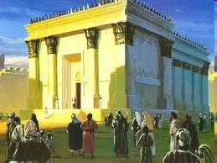
Israel’s Four Temples
Solomon’s pre exilic temple (Kings and Chronicles)
Zerubbabel’s post exilic temple (Ezra 1-6; John 2:20)
Antichrist's temple (Dan 9:27; Matt 24:15; 2 Thess 2:4; Rev 11:1-2)
Millennial temple (Ezek 40-48)

Slide 47
Israel’s Four Temples
Solomon’s pre exilic temple (Kings and Chronicles)
Zerubbabel’s post exilic temple (Ezra 1-6; John 2:20)
Antichrist's temple (Dan 9:27; Matt 24:15; 2 Thess 2:4; Rev 11:1-2)
Millennial temple (Ezek 40-48)

Slide 48
Matthew 24:15-16, 20
“¹⁵ Therefore when you see the abomination of desolation which was spoken of through Daniel the prophet, standing in the holy place (let the reader understand) ¹⁶ then those who are in Judea must flee to the mountains…²⁰ But pray that your flight will not be in the winter, or on a Sabbath.”

Slide 49
The Stage Is Being Set
Rebirth of Israel in 1948
Israel’s desire for peace
Desire among some Jews to Rebuild 3rd Jewish temple and Restore the sacrificial system
  Source: Randall Price “Ready to Rebuild”

Slide 50
The Stage Is Being Set
Rebirth of Israel in 1948
Israel’s desire for peace
Desire among some Jews to Rebuild 3rd Jewish temple and Restore the sacrificial system
  Source: Randall Price “Ready to Rebuild”

Slide 51
The Stage Is Being Set
Rebirth of Israel in 1948
Israel’s desire for peace
Desire among some Jews to Rebuild 3rd Jewish temple and Restore the sacrificial system
  Source: Randall Price “Ready to Rebuild”

Slide 52
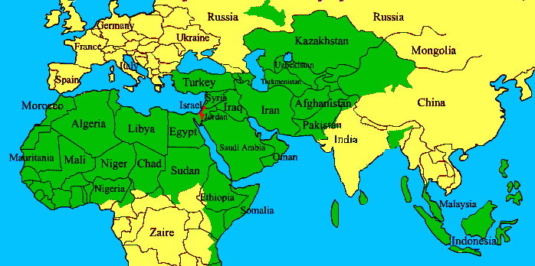
ISRAEL

Slide 53
The Stage Is Being Set
Rebirth of Israel in 1948
Israel’s desire for peace
Desire among some Jews to Rebuild 3rd Jewish temple and Restore the sacrificial system
  Source: Randall Price “Ready to Rebuild”

Slide 54


Slide 55
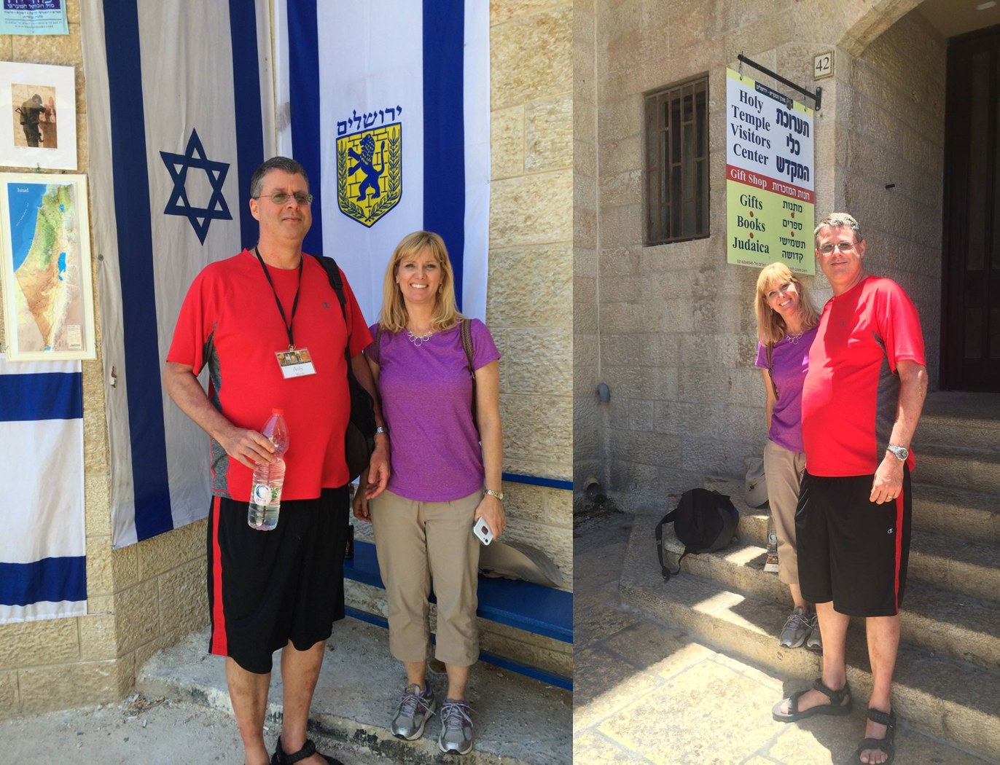

Slide 56
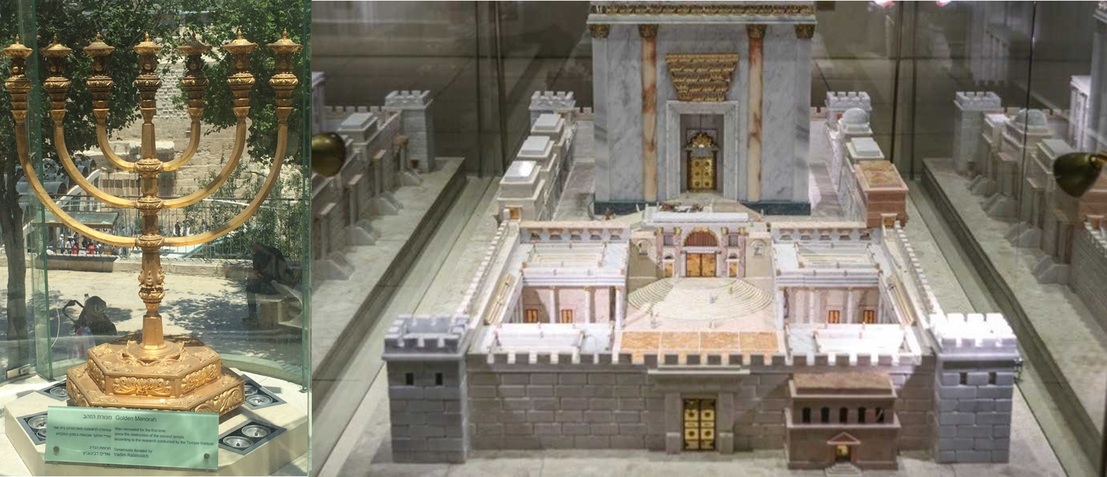

Slide 57
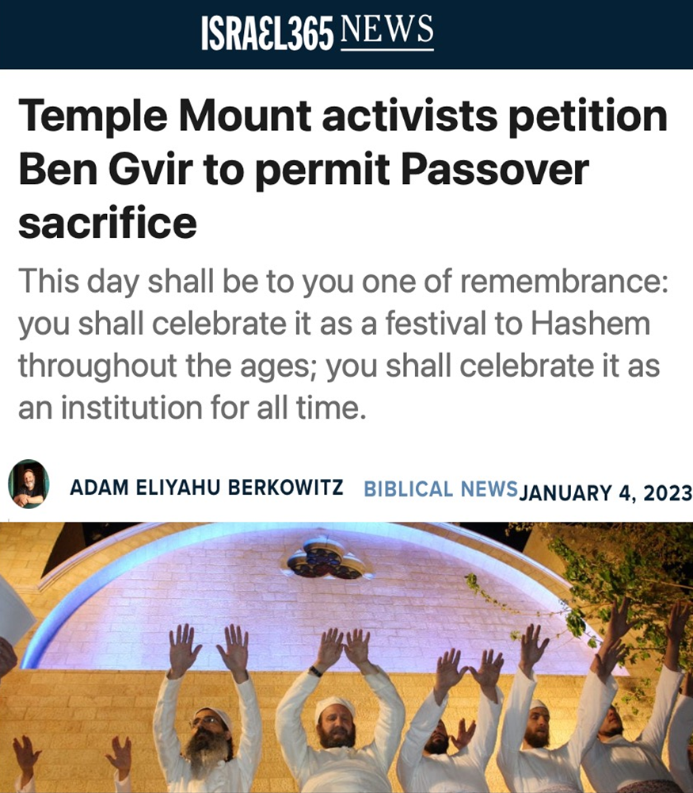

Slide 58
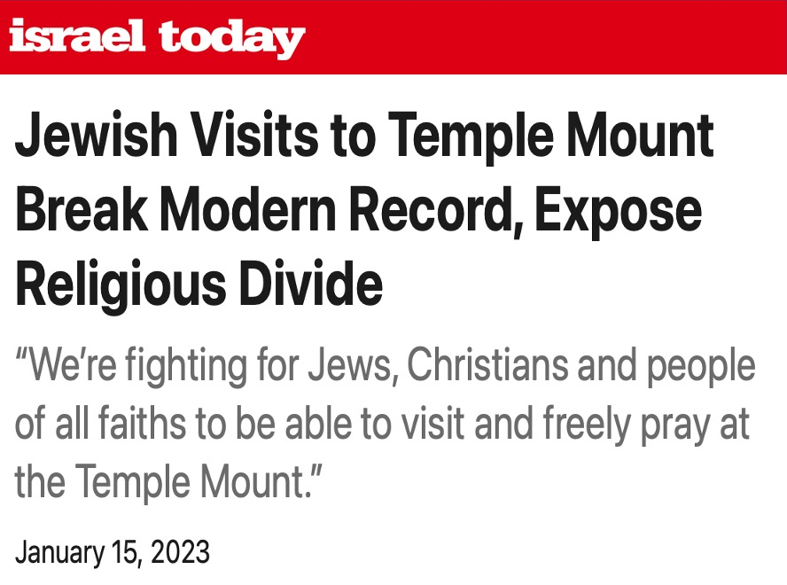

Slide 59
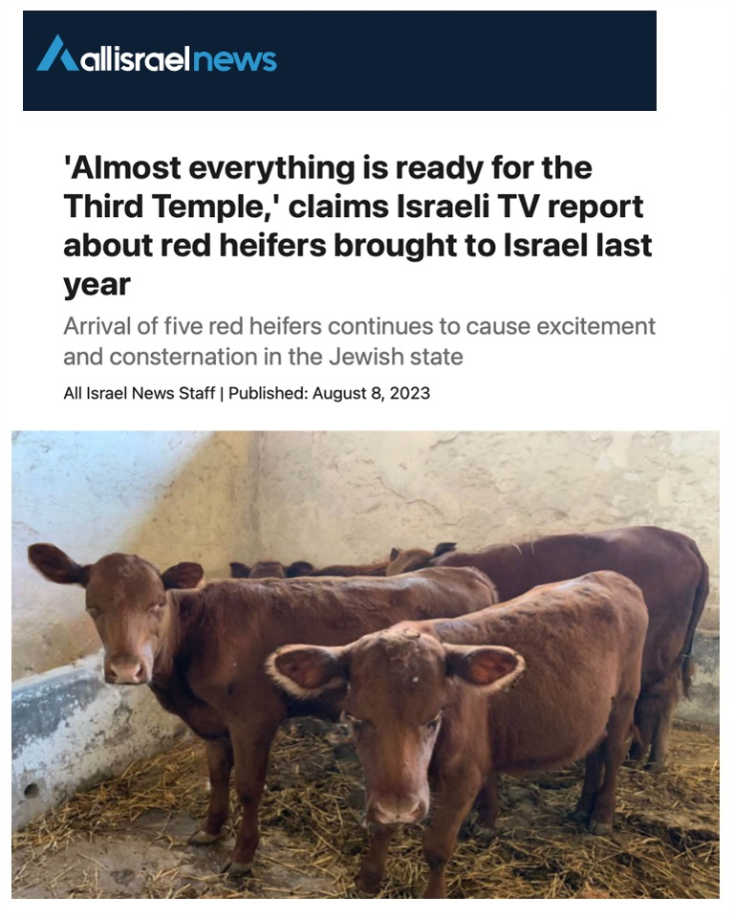

Slide 60
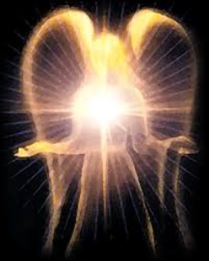
Original State and First Sin (cont’d)
Isaiah 14:12-15
    5 “I will” statements
    Ascend to heaven (13)
    Raise my throne above the stars of God (13)
    Sit enthroned on the Mt. of the Assembly (13)
    Ascend above the tops of the clouds (14)
    Make myself like the Most High (14)

Slide 61
Original State and First Sin (cont’d)
Isaiah 14:12-15
    5 “I will” statements
    Ascend to heaven (13)
    Raise my throne above the stars of God (13)
    Sit enthroned on the Mt. of the Assembly (13)
    Ascend above the tops of the clouds (14)
    Make myself like the Most High (14)

Slide 62


Isaiah 14:14
“I will ascend above the heights of the clouds; I will make myself like the Most High.”

Slide 63

Satan’s Tactics (2 Cor 2:11)
  Adds to God’s Word (3:1; 2:16-17)
  Challenges God’s goodness (3:1; 2:16-17)
  Subtracts from God’s Word (3:4; 2:17)
  Offers wisdom without submission to God (3:5; Prov 1:7)

Slide 64
2 Thessalonians 2:1-12
Problem (2:1-2)
Prerequisites for the Day of the Lord (2:3-12)
  The departure (2:3a)
  Advent of the lawless one (2:3b-4)
  Removal of the restrainer (2:5-7)
  Destruction of the lawless one (2:8-9)
  Destruction of lawless one’s followers (2:10-12)

Slide 65

Paul’s Various Rapture Terms
parousia | 2 Thess. 2:1
episynagōgē | 2 Thess. 2:1
apokalypsis | 1 Cor. 1:7
epiphaneia | Titus 2:13
rhyomai | 1 Thess. 1:10
harpazō | 1 Thess. 4:17
apostasia | 2 Thess. 2:3a

Slide 66
Conclusion

Slide 67
2 Thessalonians 2:1-12
Problem (2:1-2)
Prerequisites for the Day of the Lord (2:3-12)
  The departure (2:3a)
  Advent of the lawless one (2:3b-4)
  Removal of the restrainer (2:5-7)
  Destruction of the lawless one (2:8-9)
  Destruction of lawless one’s followers (2:10-12)

