Slide 1
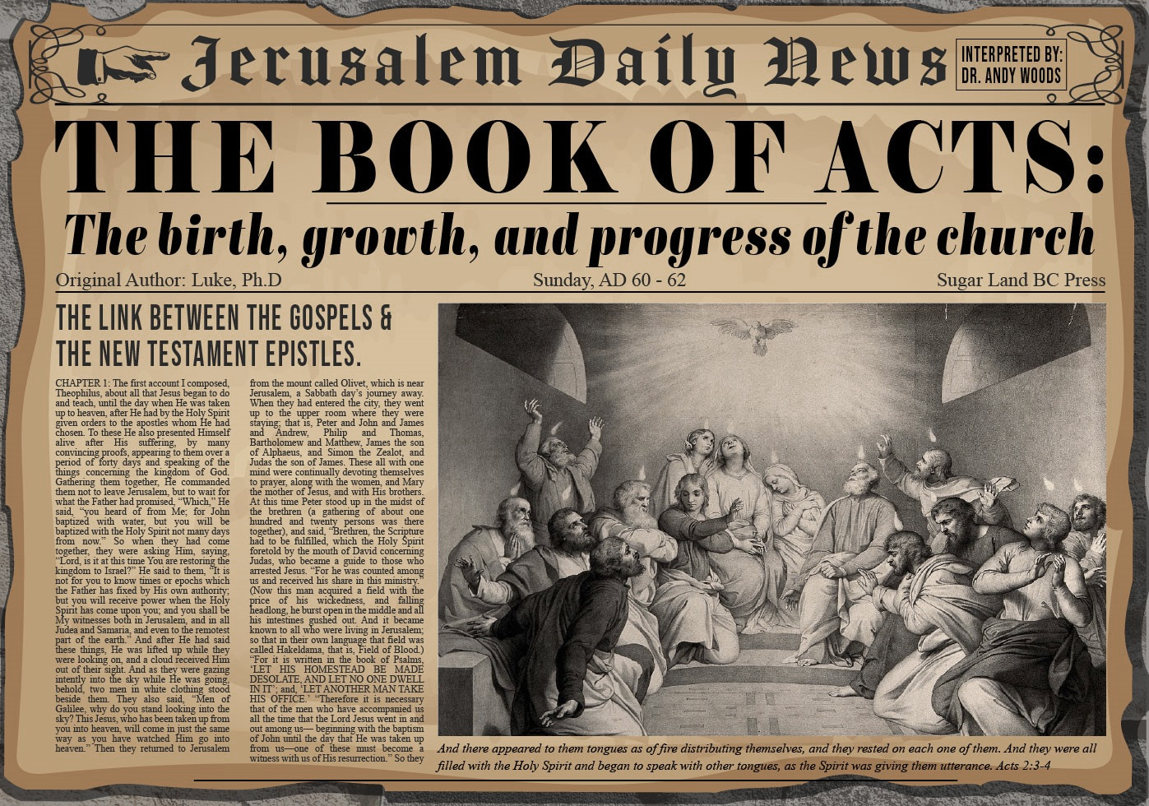

Slide 2
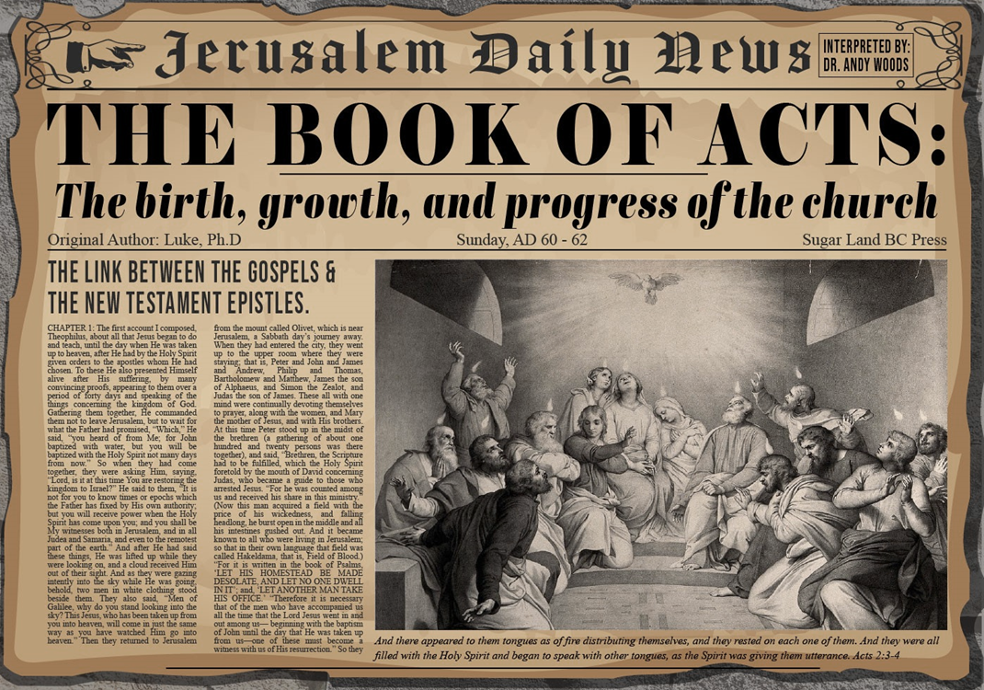
Acts 5:12‒42 Church’s Second Persecution
Apostles’ Power (5:12-16)
Apostles' Persecution (5:17-42)

Slide 3
II. Apostles’ Persecution Acts 5:17-42
Apostles’ arrest (17-26)
Apostles’ examination (27-33)
Gamaliel’s interruption & advice (34-39)
Results (40-42)

Slide 4
Acts 5:34-39 Gamaliel’s Interruption & Advice
Gamaliel’s background (34)
Gamaliel’s address (35-39)

Slide 5
Acts 5:34-39 Gamaliel’s Interruption & Advice
Gamaliel’s background (34)
Gamaliel’s address (35-39)

Slide 6
Acts 5:34 Gamaliel’s Background
Introduction (34a)
Command (34b)

Slide 7
Acts 5:34 Gamaliel’s Background
Introduction (34a)
Command (34b)

Slide 8
Acts 5:34 Gamaliel’s Background
Introduction (34a)
Command (34b)

Slide 9
Acts 5:34-39 Gamaliel’s Interruption & Advice
Gamaliel’s background (34)
Gamaliel’s address (35-39)

Slide 10
Acts 5:35-39 Gamaliel’s Address
Need for caution (35)
Two parallel illustrations (36-37)
Application (38-39)

Slide 11
Acts 5:35-39 Gamaliel’s Address
Need for caution (35)
Two parallel illustrations (36-37)
Application (38-39)

Slide 12
Acts 5:35-39 Gamaliel’s Address
Need for caution (35)
Two parallel illustrations (36-37)
Application (38-39)

Slide 13
Acts 5:36-37 Two Parallel Illustrations
Theudas (36)
Judas of Galilee (37)

Slide 14
Acts 5:36-37 Two Parallel Illustrations
Theudas (36)
Judas of Galilee (37)

Slide 15
Acts 5:36-37 Two Parallel Illustrations
Theudas (36)
Judas of Galilee (37)

Slide 16
Acts 5:35-39 Gamaliel’s Address
Need for caution (35)
Two parallel illustrations (36-37)
Application (38-39)

Slide 17
Acts 5:38-39 Application
Command (38a)
Reason (38b-39)

Slide 18
Acts 5:38-39 Application
Command (38a)
Reason (38b-39)

Slide 19
Acts 5:38-39 Application
Command (38a)
Reason (38b-39)

Slide 20
Purpose
To present Theophilus with an orderly account of the birth and growth of the church so as to affirm him in what he has believed.

Slide 21
Message
Birth and growth of the church numerically, geographically, ethnically.
Components
Numerically (progress reports)
Geographically (From Jerusalem to Rome)
Ethnically (From Judaism to Gentile domination)

Slide 22
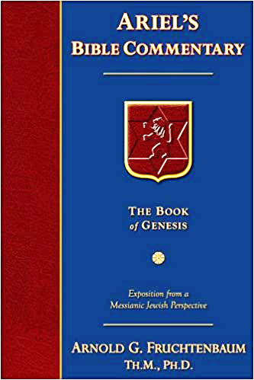
Dr. Arnold G. Fruchtenbaum
The Book of Acts, 143
“Some have taken Gamaliel’s words and turned them into divine truth. However, Luke simply recorded what Gamaliel said without confirming the validity of the words. This was Gamaliel’s personal opinion; it was not a biblical truth. Many things that are not of God (such as false religions and cults) have prospered. One must be careful not to use someone’s opinion as biblical truth.”

Slide 23
II. Apostles’ Persecution Acts 5:17-42
Apostles’ arrest (17-26)
Apostles’ examination (27-33)
Gamaliel’s interruption & advice (34-39)
Results (40-42)

Slide 24
Acts 5:40-42 Results
Sanhedrin (40)
Results (41-42)

Slide 25
Acts 5:40-42 Results
Sanhedrin (40)
Results (41-42)

Slide 26
Acts 5:40 Sanhedrin
Agreement with Gamaliel (40a)
Summoned the Apostles (40b)
Punished the Apostles (40c)
Charged the Apostles (40d)
Released the Apostles (40e)

Slide 27
Acts 5:40 Sanhedrin
Agreement with Gamaliel (40a)
Summoned the Apostles (40b)
Punished the Apostles (40c)
Charged the Apostles (40d)
Released the Apostles (40e)

Slide 28
Acts 5:40 Sanhedrin
Agreement with Gamaliel (40a)
Summoned the Apostles (40b)
Punished the Apostles (40c)
Charged the Apostles (40d)
Released the Apostles (40e)

Slide 29
Acts 5:40 Sanhedrin
Agreement with Gamaliel (40a)
Summoned the Apostles (40b)
Punished the Apostles (40c)
Charged the Apostles (40d)
Released the Apostles (40e)

Slide 30
Acts 5:40 Sanhedrin
Agreement with Gamaliel (40a)
Summoned the Apostles (40b)
Punished the Apostles (40c)
Charged the Apostles (40d)
Released the Apostles (40e)

Slide 31
Acts 5:40 Sanhedrin
Agreement with Gamaliel (40a)
Summoned the Apostles (40b)
Punished the Apostles (40c)
Charged the Apostles (40d)
Released the Apostles (40e)

Slide 32
Acts 5:40-42 Results
Sanhedrin (40)
Results (41-42)

Slide 33
Acts 5:41-42 Apostles
Joy (41)
Zeal (42)

Slide 34
Acts 5:41-42 Apostles
Joy (41)
Zeal (42)

Slide 35
Acts 5:41-42 Apostles
Joy (41)
Zeal (42)

Slide 36
Conclusion

Slide 37
Acts 5:12‒42 Church’s Second Persecution
Apostles’ Power (5:12-16)
Apostles' Persecution (5:17-42)

